Slide 1

Milliampere beam studies using high polarization photocathodes at the CEBAF Photoinjector
J. Grames
JLAAC Review September 13-15, 2017

Slide 2
Outline
Ion bombardment, the dominant lifetime limiting mechanism of polarized photocathode
PEPPo – an application requiring a milliampere polarized electron beams
To operate at mA current without interruption, require kC charge lifetime
R&D to extend the charge lifetime of polarized electron sources

Slide 3

Ion Bombardment

Slide 4


Polarized Electrons for Polarized Positrons
electron beam polarization
85.2 ± 0.6 ± 0.7 %
Bremsstrahlung of polarized electrons results in efficient production of polarized positrons
PEPPo’s success suggests nanoAmps of polarized positrons for CEBAF using milliamperes of polarized electrons
D. Abbott et al, "Production of Highly Polarized Positrons Using Polarized Electrons at MeV Energies", Phys. Rev. Lett, 116, 214801 (2016)
(PEPPo Collaboration) D. Abbott et al., Phys. Rev. Lett. 116 (2016) 214801

Slide 5
High Polarization Photocathodes
Bulk GaAs
Strained GaAs
Strained Superlattice GaAs/GaAsP
With DBR
100 nm
100 nm
14 Layers
30 mA/W
1 mA/W
6 mA/W
30 mA/W
P_{e-} 35% 35% 75% 75% 85% 89%
I_{e-} 30μA 100μA 50μA 100μA 150μA 200μA
1995 1998 1999 2000 2004 2017
Photocathode capability (polarization and QE) has grown significantly.

Slide 6


Improving Lifetime with Larger Laser Size
J. Grames, et al, Phys. Rev. ST Accel. Beams 14 043501 (2011)
GaAs @ 532nm

Slide 7

Improving charge lifetime with GaAs/GaAsP
Indeed, we enhanced the Charge Lifetime for Qweak by a factor of four when doubling the laser spot size from 0.5mm to 1.0 mm (diameter)
milliampere applications require killoCoulomb charge lifetime to provide uninterrupted operation of reasonable duration

Slide 8


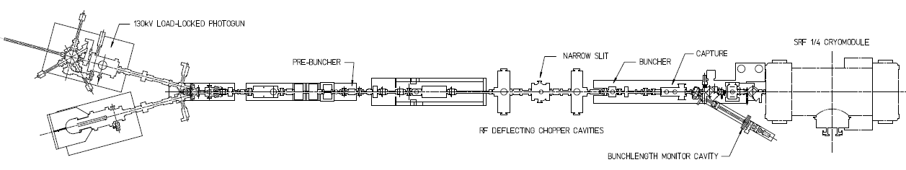
Lifetime Studies at mA Beam Current
CEBAF 130kV polarized “inverted gun” with load lock
Note:
1 mA 86 C/day
5 mA 432 C/day
10 mA 860 C/day
50 mA 4320 C/day
Polarized positrons for CEBAF, and on-going discussions with BNL related to high current eRHIC EIC, prompted experiments at CEBAF to characterize lifetime vs. laser spot size using high-polarization photocathodes
Required laser power, slope proportional to QE decay
Make beam here
Increasing laser size reduces QE decay proportionally
Deliver it here
Monitor vacuum and radiation
1mA
Vary the laser beam size

Slide 9

First Results: GaAs/GaAsP at milliampere Current
  CEBAF charge lifetime improves with spot size, as expected, but eventually beam size becomes “too large”
  Laser diameters greater than ~ XX mm (4 sigma) will require properly designed cathode/anode electrodes, to ensure 100% transmission, to maintain excellent vacuum, to minimize ion bombardment

Slide 10

Polarization Studies at mA Beam Current
First measurement of polarization from superlattice photocathode at milliampere current
CEBAF 5 MeV Mott polarimeter: on-going effort to ascribe sub-percent accuracy (collaborators D. Moser, X. Roca-Maza, Charles Sinclair, M.J. McHugh, A.K. Opper, and Tim Gay)
CEBAF 5 MeV Mott Polarimeter

Slide 11
Summary
Extending the charge lifetime of today’s spin polarized GaAs photoguns from tens to thousands of Coulombs is a requirement for extended uninterrupted operation at milliampere beam current
These new experimental results demonstrate improved charge lifetime with larger laser spot sizes using GaAs/GaAsP photocathodes at mA current but…
Managing ALL of the beam remains essential. These results suggest CEBAF gun requires larger electrodes for sustainable milliampere operation
New DBR photocathode is an excellent candidate for high current (mA) polarized electron beam initiatives. Lifetime tests at CEBAF to happen soon, during this shutdown

Slide 12
Thanks to: P. Adderley, B. Bullard, J. Hansknecht, M. Stutzman, S. Zhang

Slide 14
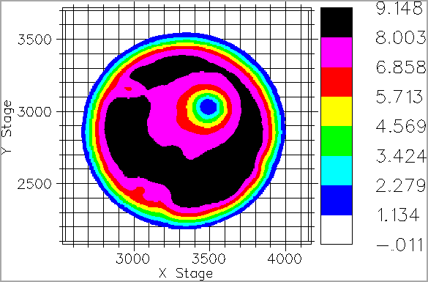
Ions Bombarding the Electrostatic Center
Ionized gas focused to electrostatic center
electrons OUT
laser IN
anode
cathode

Slide 15
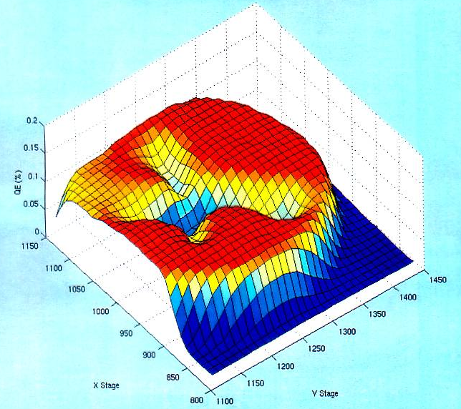
Pragmatically Avoiding the “EC”
We don’t run beam from electrostatic center
Laser spot size is ~0.5 mm and can be moved to different locations on the photocathode.
electron beam
OUT
laser light IN
Ions create QE trough to electrostatic center

