Slide 1
Study of bialkali antimonide photocathode on NB substrate at Jlab
Abdullah Mamun
P3 Workshop : Photocathode Physics for Photoinjectors, October 17-19, 2016
Thomas Jefferson National Accelerator Facility, Newport News, Virginia, USA

Slide 2
Estimation of Spectral Response at 2 K for Bialkali Antimonide on Nb Substrate

Slide 3
Motivation
The future Jefferson Lab Electron Ion Collider would require to implement electron cooling of the proton beam.
A superconducting radio frequency (SRF) photogun is an ideal candidate electron source for this application, provided that the photocathode can give good yield or quantum efficiency (QE) at cryogenic temperature.
The focus of this project is to make bialkali antimonide photocathode on a niobium substrate that can be used in an SRF photogun.
The goal of this work is to estimate the spectral response at liquid helium temperature (2 K) by investigating the photocathode QE at different temperatures:
Room temperature (295 K) → Water ice(273 K) → Dry ice (195 K) → Liquid nitrogen (77 K) temperatures.

Slide 4
Deposition chamber
Photograph of the bialkali-antimonide photocathode deposition chamber with effusion-type alkali dispenser (shown in the inset),
Schematic of the substrate holder assembly with substrate heater that acted as a cryostat,
Photograph of the QE scanner system with the mirrors attached to the stepper-motor-controlled translation stages,
Photograph of the GaAs substrate secured to the sample holder using an annular Ta cup, and
Schematic of the effusion-type alkali dispenser used for coevaporation of K and Cs species (with permission from Lawrence S. Cardman).
M.A. Mamun, C. Hernandez-Garcia, M. Poelker, and A.A. Elmustafa, “Effect of Sb thickness on the performance of bialkali-antimonide photocathodes,” Journal of Vacuum Science & Technology A 34 , 021509 (2016).

Slide 5
Bialkali Antimonide Photocathode by Codeposition
Sources:
Sb pellets (99.9999% purity, from Alfa Aesar)
K ampoules (99.95% purity, 1 gram in argon) from Espi-metals
Cs ampoules (99.9þ% purity, 1 gram in argon) from Strem Chemicals
For the baked system, the evacuated chamber was baked at 180 °C for 60 h
Post bake vacuum reached ~1.4×10⁻⁹ Pa
Sb evaporation via resistive heating by 32.7 A supply to the Tungsten heater
Sb was deposited for ~30 min on Nb substrate at 200 °C
Alkali coevaporation was controlled by adjusting heater power and gas flow through the effusion source., in the following ranges:
Inlet tube: 381-462 °C
Dispensing tube: 232-294 °C
Reservoir tube: 153-281 °C
Used a residual gas analyzer (RGA) to monitor the chemical’s vapor pressure during deposition. Representative partial pressures observed and maintained as:
Sb PP: 7.3(±0.6)×10⁻⁹ Pa; Cs PP: 1.8(±0.1)×10⁻⁸ Pa K PP: 4.2(±0.5)×10⁻⁹ Pa
Alkali was deposited at substrate temperatures falling from 120 °C to 80 °C
Alkali deposition continued as long as the photocurrent showed increasing trend
QE was monitored using a 532 nm green laser with cathode biased at V_{b}= - 284 V
M.A. Mamun, C. Hernandez-Garcia, M. Poelker, and A.A. Elmustafa, “Effect of Sb thickness on the performance of bialkali-antimonide photocathodes,” Journal of Vacuum Science & Technology A 34 , 021509 (2016).

Slide 6
Photocathode QE at Cryogenic Condition
Photocathode QE is expected to decrease at lower temperature due to the change in the emission threshold (i.e., E_{g}+E_{A}) of the semiconductor.
The QE is also expected to decrease if chemicals adsorb onto the cold photocathode surface. These chemicals serve as contaminants that increase the surface work function.
We investigated QE change as a function of temperature for two vacuum conditions of the deposition chamber (pre-bake and post-bake) and observed that:
QE reduction due to contamination of the photocathode surface via adsorption can be minimized by reducing the amount of water vapor and oxygen within the gun chamber.

Slide 7
Vacuum Conditions
We investigated QE change as a function of temperature for two vacuum conditions of the deposition chamber (pre-bake and post-bake)
H₂O

Slide 8
Distinguishing QE Drop due to Contamination
Pre bake vacuum ~1.8×10⁻⁸ Pa
Brief heating 170 - 200 °C,
H₂O 34%
Brief heating 170 - 200 °C,
H₂O 26%
Brief heating 170 - 200 °C,
H₂O 37%
QE Recovery
QE Recovery
QE Recovery
RT
LN₂
RT (Post Heating)
Systematic decrease in QE at RT in repeated cooling events
Considerable increase in water partial pressure during brief heating was observed
Rejuvenation of QE by brief heating at 170-200 °C was consistently observed in the non-baked system which can be considered as a signature of water adsorption

Slide 9
Distinguishing QE Drop due to Contamination
Post bake vacuum ~1.4×10⁻⁹ Pa
Heating 170 - 200 °C,
H₂O 7.1%
RT
LN₂
RT (Post Heating)
NO QE Recovery
NO Systematic decrease in QE at RT in repeated cooling events
NO QE Rejuvenation from brief heating at 170-200 °C in the baked system
minimal water adsorption
QE degradation due to photocathode lifetime in chamber

Slide 10
Reproducible QE in Cryocooled Photocathode
RT
LN₂
RT (Post Heating)
The QE at RT did not show any decrease between repeated cooling events
QE at Liquid N₂ temperature (77 K)showed similar QE every time it was cooled
Initial QE rise due to stoichiometric optimization
We did our spectral response and temperature analysis from this phocathode.

Slide 11
A shift in spectral response when cooled
A shift equivalent to 35.6 nm in wavelength
A change in emission threshold equivalent to a horizontal
wavelength shift in spectral response when the photocathode
is cooled to liquid N₂ temperature (77 K)

Slide 12
Analysis Approach
The experimental spectral response data were fitted according to R. H. Fowler, Phys. Rev. 38, 45 (1931):
Correlate V_{o} and B with temperature and obtain temperature dependent functions V_{o}(T) and B(T)
Evaluate V_{o}(2 K) and B(2 K), and use the values to simulate spectral response for photocathode at 2 K

Slide 13
Applying Fowler’s Model to the Experimental Data Allows to Estimate QE at 2 K
Ice Water
V_{o} | 1.66
B | -19.69
V_{o} | 1.70
B | -19.80
V_{o} | 1.76
B | -20.09
1.804 eV
-21.246

Slide 14
Estimated QE Spectral Response at 2K
λ | Hν | QE (%)
nm | eV | 276.95 K | 194.65 K | 77 K | 2 K (sim)
440 | 2.82 | 23.38 | 20.75 | 15.16 | 4.10
530 | 2.34 | 10.78 | 8.88 | 4.86 | 1.14
600 | 2.07 | 2.76 | 1.92 | 1.15 | 0.27
650 | 1.91 | 1.07 | 0.68 | 0.33 | 0.04
670 | 1.85 | 0.71 | 0.44 | 0.10 | 0.01

Slide 15
Conclusions
A bialkali-antimonide photocathode (Cs and K)was grown on a niobium substrate.
QE at LN₂ temperature decreased as expected due to the change in the bandgap energy and electron affinity of the semiconductor.
We used Fowler’s model to fit the experimental data and determined the temperature dependent V_{o} (T) and B (T)
Fowler’s model and our experimental results extrapolate to an estimated QE for this cathode of ~1% at 2K and 530 nm, compatible with an SRF gun versus 10.8% QE at 277K.

Slide 16
Thank you
Q&A

Slide 17
Backup Slides

Slide 18
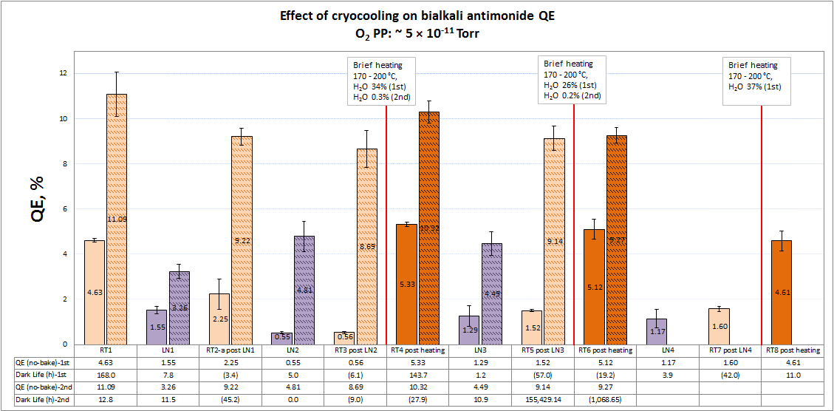
Pre-bake

Slide 19
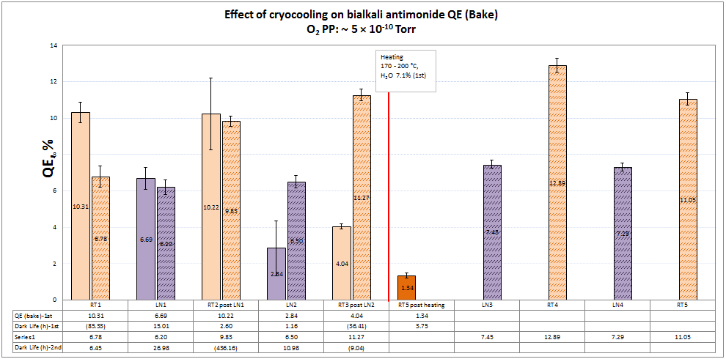
Post-bake

Slide 21
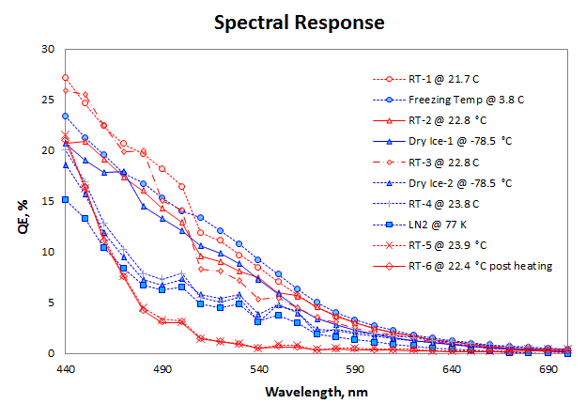
After ~70 days of activation of K₂CsSb photocathode
- QE did not recover with temperature reversal or rejuvenation effort by brief heating.

