Slide 1

Production of Highly Polarized Positrons Using Polarized Electrons at MeV Energies
(…or why PEPPo is like the Red-Billed Oxpecker)
Joe Grames
Jefferson Laboratory

Slide 2
Acknowledgments

Slide 3
Outline
Motivation
PEPPo Experiment
Polarized Positron R&D Efforts
Summary
Jefferson Lab Positron Working Group

Slide 4
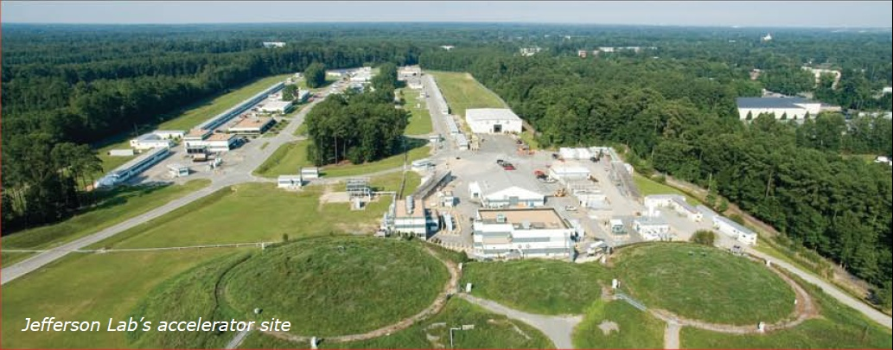

Polarized Positron Beam Applications
Jefferson Lab’s CEBAF Accelerator
CW electron beam to 3 halls
Electron Polarization 85-90%
Max Energy: 11 GeV(ABC) / 12GeV(D)
Max Current: 200 uA
Jefferson Lab physics that would benefit a polarized positron beam:
  Interference (Two Photon, GPD’s)
  Standard Model Test (Dark Matter, C_{3q})
Proposed physics that may benefit investigation:
  Electron Ion Collider (spin EMC, Strange/Charm GPD)
  Materials Science (spintronic devices, ferromagnetics)
The charge and polarization of the probe beam provide degrees of freedom which constrain physical observables.
4

Slide 5
Electromagnetic Form Factors
M.P. Rekalo, E. Tomasi Gustafsson, NPA 742 (2004) 322 C. Carlson, M. Vanderhaeghen, ARNPS 57 (2007) 171
Unpolarized e± elastic scattering and polarization transfer observables from the nucleon involve up to 5 unknown quantities.
Cross Section
Polarization
Transfer
5 unknown contributions for 6 independent observables
Combining Polarized electrons and positrons allows a model independent separation of the electromagnetic form factors of the nucleon.

Slide 6
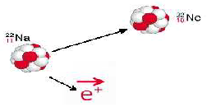



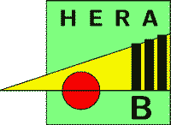
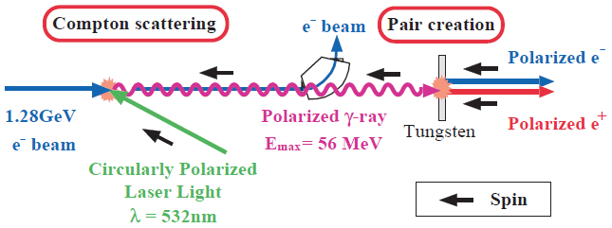
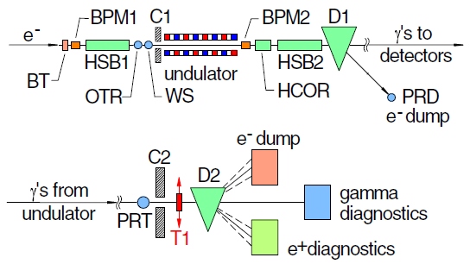
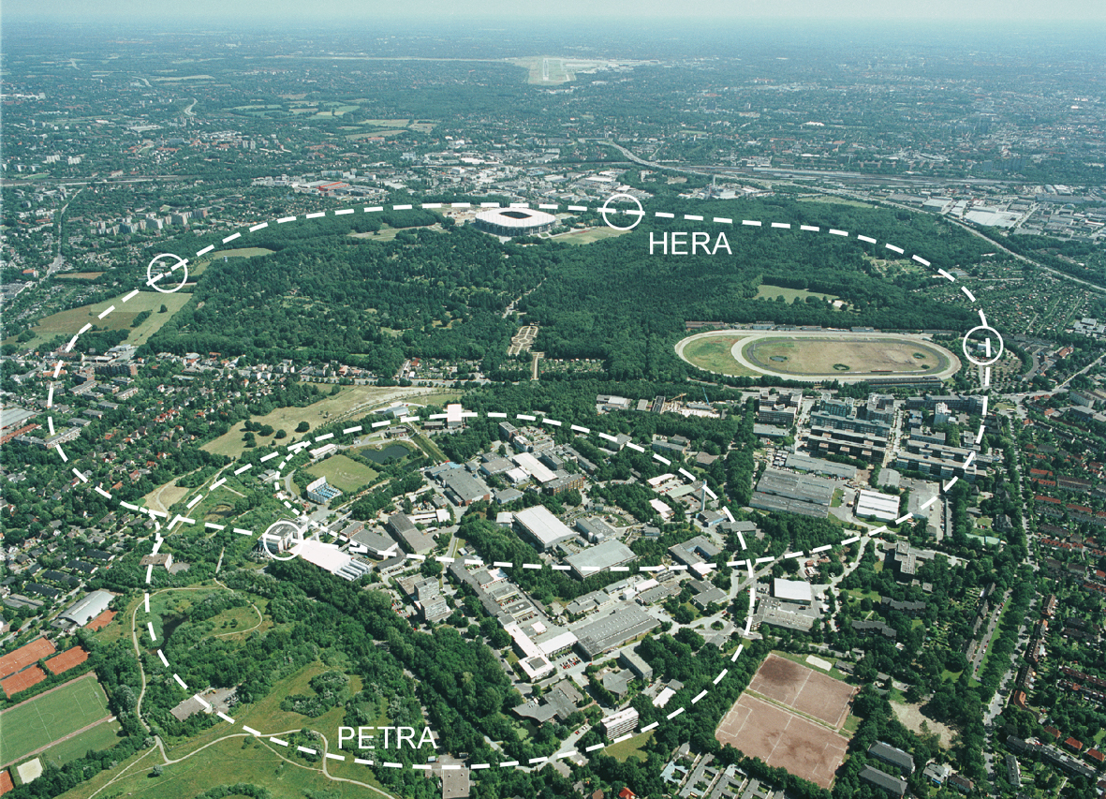
Polarized Positron Options
Polarized β⁺ Decay
L.A. Page & M. Heinberg. Phys. Rev.
106(6):1220-1224 (1957)
Sokolov-Ternov Effect
D. Barber , AIP Conf. Proc. 588, 338 (2001)
HERA 27.5 GeV e+/e-
Polarized due to parity non-conservation in the weak interaction
P(e⁺) ~ 40 %
P(e⁺) ~ 70 %
Compton Backscattering (KEK)
T. Omori et al, PRL 96 (2006) 114801
Helical Undulator (SLAC E166)
G. Alexander et al, PRL 100 (2008) 210801
47.7GeV
P(e⁺) = 73 ± 15_{(stat)} ± 19_{(syst)} %
P(e⁺) = 80 ± 7_{(stat)} ± 9_{(syst)} %

Slide 7



Polarized Bremmstrahlung
E.G. Bessonov, A.A. Mikhailichenko, EPAC (1996) A.P. Potylitsin, NIM A398 (1997) 395
Bremsstrahlung
Pair Creation
P_{circ}(g) / P_{z} (e⁻)
P_{z} (e⁺) / P_{circ} (g)
E_{g} / T_{e-}
T_{e+} / (E_{g} – 2m_{e+})
E.A. Kuraev, Y.M. Bystritskiy, M. Shatnev, E.Tomasi-Gustafsson, PRC 81 (2010) 055208
7

Slide 8
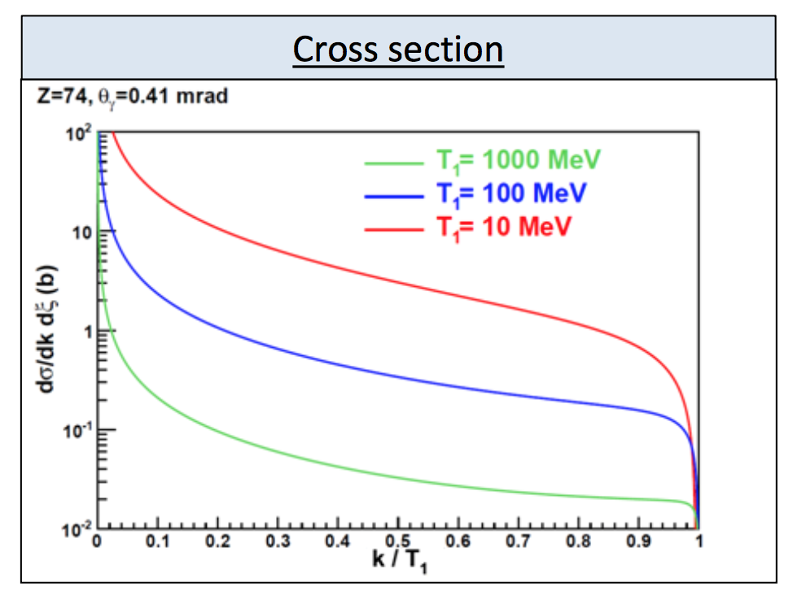
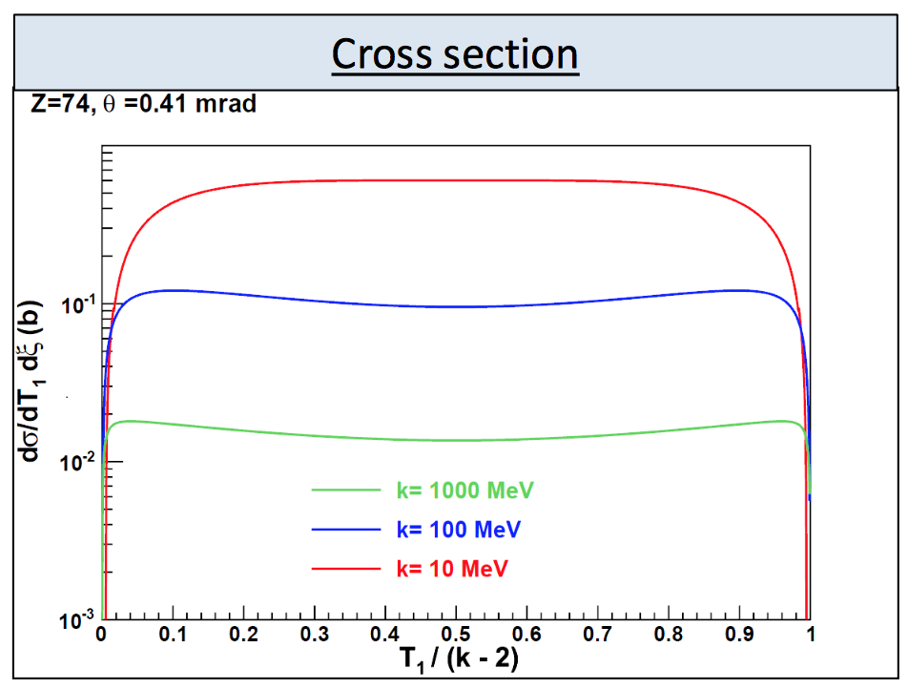
Positron Yield
Bremsstrahlung
Pair Production
Photon energy k up to electron energy T1
Cross section decreases as 1/k
Positron energy T1 to photon energy k-2mc²
Cross section essentially energy independent
100nA – 1μA useful for CEBAF NP

Slide 9
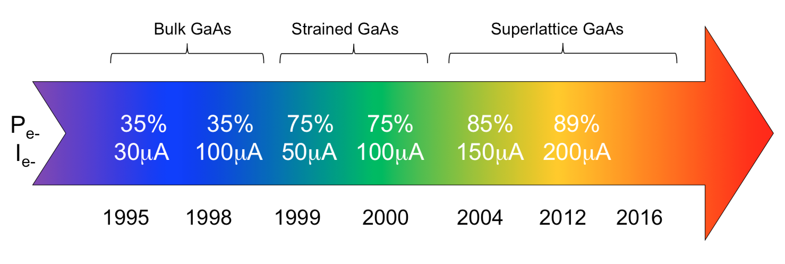
GaAs Photocathode Evolution
Bulk GaAs
Strained GaAs:
GaAs on GaAsP
Superlattice GaAs:
Layers of GaAs on GaAsP
100 nm
100 nm
2 μm
14 Layers
625 μm
350 μm
QE ~ 5%, 30 μA/mW
Pol ~ 35% @ 780 nm
QE ~ 0.2%, 1 μA/mW
Pol ~ 75% @ 850 nm
QE ~ 1%, 6 μA/mW
Pol ~ 85% @ 780 nm
Timeline of Polarized Source at CEBAF
Spin Polarized program at JLab (particularly our PV Users) have
driven the need for improved performance over last 20+ years

Slide 10
Polarized Electron Source Intensity
Parameter | Value | Value
Laser Rep Rate | 499 MHz | 1500 MHz
Laser Pulse Length | 30 ps | 50 ps
Laser Wavelength | 780 nm | 780 nm
Laser Spot Size | 0.45 mm | 0.35 mm
Photocathode | GaAs/GaAsP | GaAs/GaAsP
Gun Voltage | 100 kV | 200 kV
Beam Current | 1 mA | 4 mA
Run Duration | 8.25 hr | 1.4 hr
Extracted Charge | 30.3 C | 20 C
Charge Lifetime | 210 C | 80 C
Fluence Lifetime | 132 kC/cm² | 83 kC/cm²
Bunch Charge | 2.0 pC | 2.7 pC
Peak Current | 67 mA | 53 mA
Peak Current Density | 42 A/cm² | 55 A/cm²
First GaAs photogun
Low-P Bulk GaAs
High-P GaAs/GaAsP
Intensity (mA)
Year
J. Grames et al., PAC07, THPMS064
R. Suleiman et al., PAC11, WEODS3

Slide 11
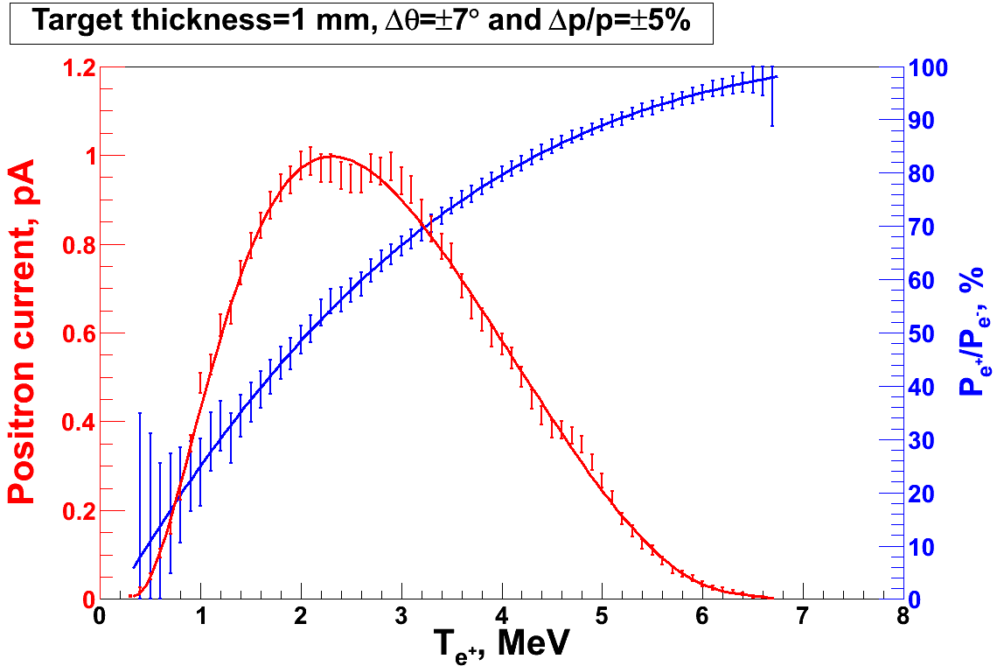
PEPPo - Principle of Operation
Polarized Electrons
(< 10 MeV/c) strike production target
Positron Transverse and Momentum Phase Space Selection
Geant4
E_{e} = 6.3 MeV
I_{e} = 1 µA
T₁ = 1 mm W
S₁
P_{e-}
e⁻
D
T₁
PEPPo
COMPTON TRANSMISSION
Polarized e⁺ convert into polarized γ (P_{γ}) whose transmission through a polarized iron target (P_{T}) depends on P_{γ}.P_{T}
BREMSSTRAHLUNG
Longitudinal e⁻ (P_{e-}) produce elliptical γ whose circular (P_{γ}) component is proportional to P_{e-}
PAIR PRODUCTION
In the same target, γ produce e⁺e⁻ pairs and transfer Pγ into longitudinal (P_{e+}) and transverse polarization averages to zero
J. Dumas, PhD Thesis (2011)
S₂
P_{e+}
P_{T}
D
Calorimeter
e⁺
T₂
Compton Transmission Polarimeter
PEPPo measured the longitudinal polarization transfer from 8.25 MeV/c e⁻ to e⁺ in the 3.07-6.25 MeV/c momentum range.

Slide 12
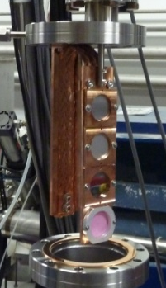

PEPPo @ CEBAF Injector
Compton
Polarimeter
(DESY/Cornell)
Pair
Creation
Target
Mott
Polarimeter
Positron Collection
Magnets
(Princeton/SLAC)

Slide 13
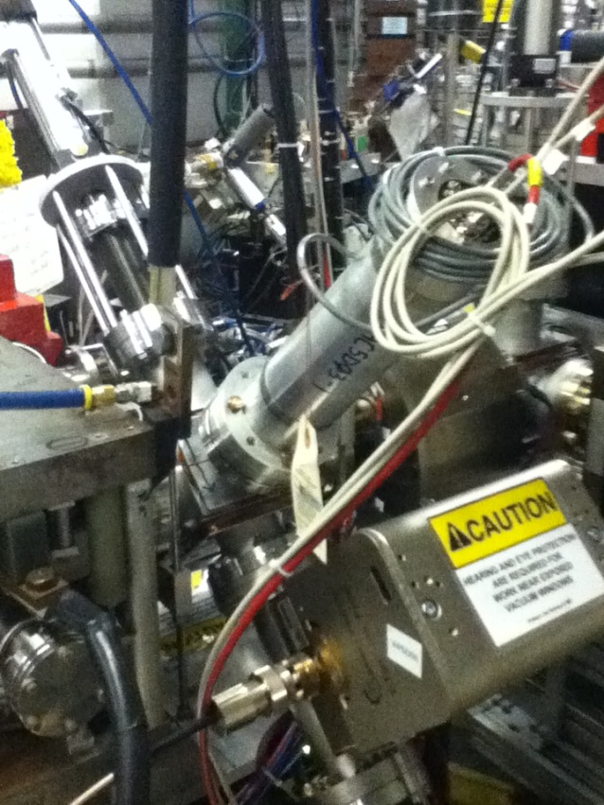
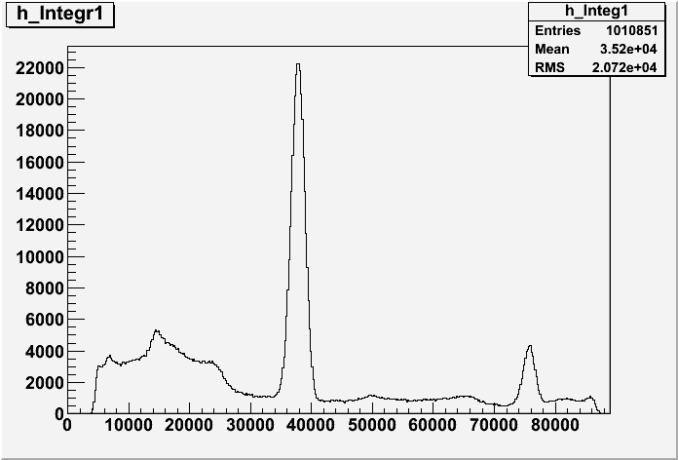
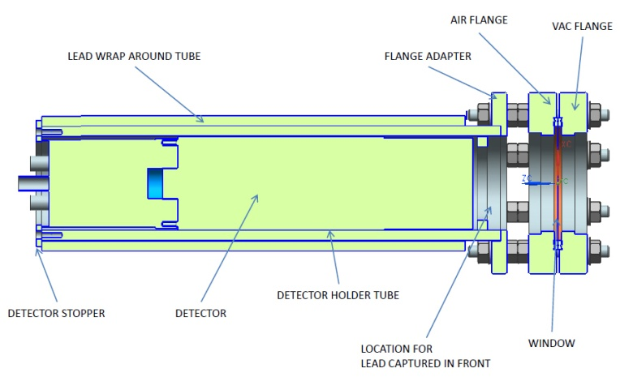
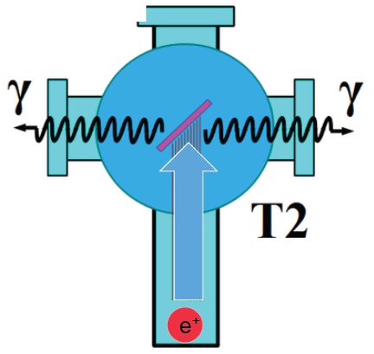
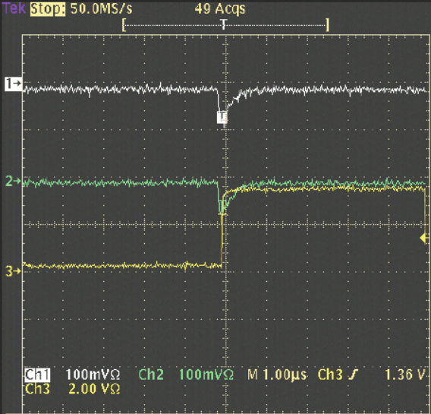
Positron Detection
Positron Collection
Two NaI detectors measured coincidence of back-to-back photons emitted by annihilation of positrons in a viewscreen.
S₁
e⁻
p_{e-}= 8.2 MeV/c
D
T₁
Na²²
S₂
D
e⁺
T₂
Viewscreen 0.011 thick @ 45 deg to beam line
99.5% aluminum oxide Al₂O₃
0.5% chromium doped Al₂O₃/Al₂O₃Cr₂O₃
4 MeV/c e+
13

Slide 14
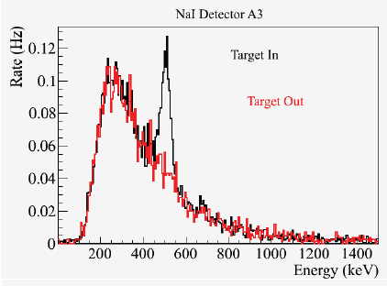
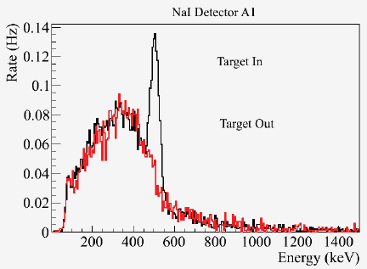
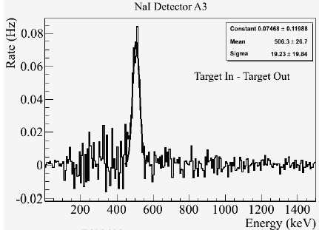
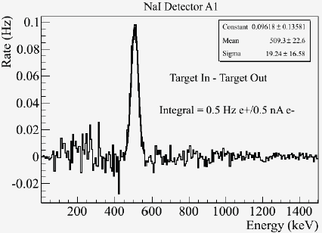
Positron Yield
Detected e+ rate (1 e⁺ per 10⁹ e⁻)
Solid Angle (0.1 sr)
GEANT annihilation probability (1/400)
Coincidence detector efficiency (0.49 @ 511keV)
1 e⁺ per 10⁵ e⁻
14

Slide 15
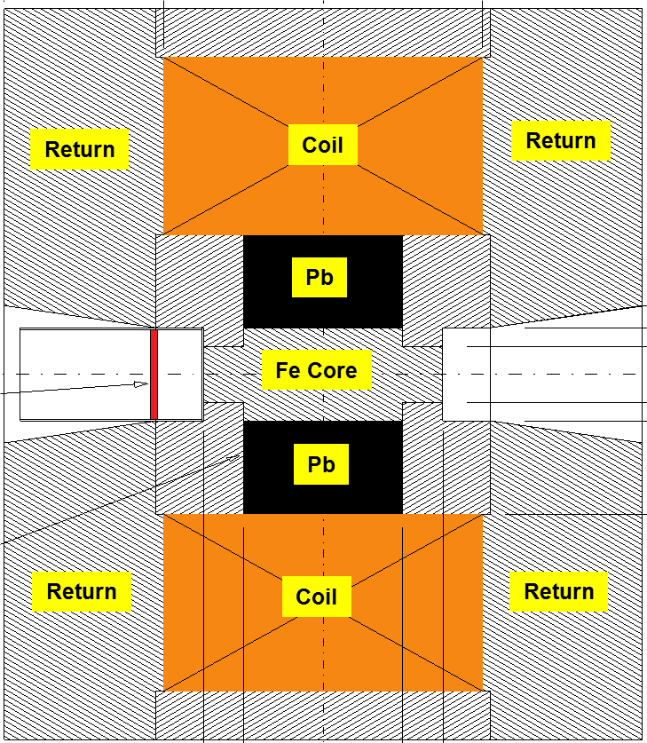
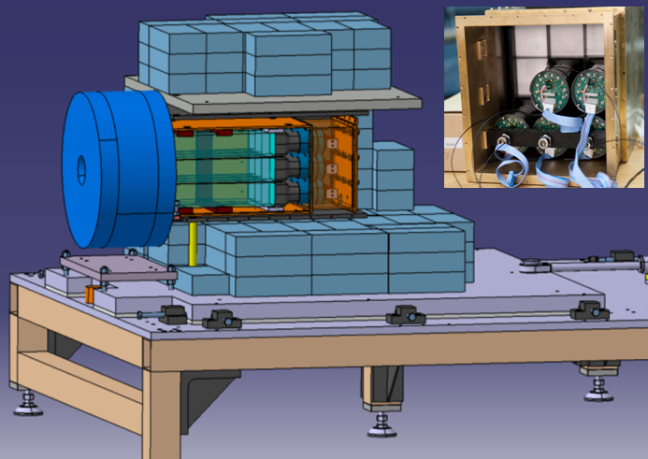
Compton Transmission Polarimetry
Electrons or Positrons radiate polarized photons by Bremmstrahlung in reconversion target. Energy dependent Compton scattering of photons transmitted through polarized target correspond to polarization of incoming Electrons or Positrons (aligned or anti-aligned).
P_{e-}
e⁻
γ
P_{e+}
e⁺
Target (Densimet D17K)
90.5% W, 7%, 2.5% Cu
μ1 - Compton absorption coefficient
L - target length
P₃ - photon polarization (long.)
P_{e} - electron/positron polarization
P_{T} - target polarization
A_{e} - analyzing power

Slide 16
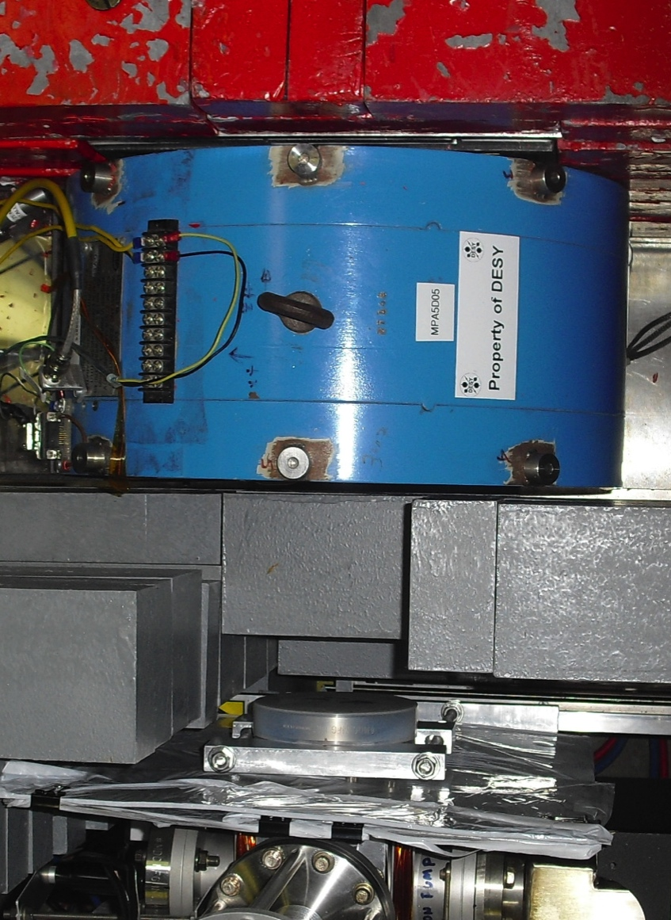
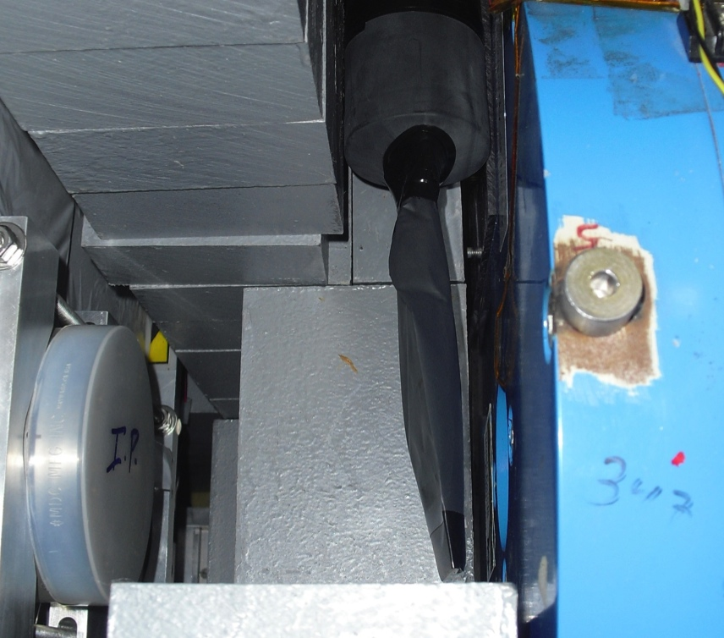
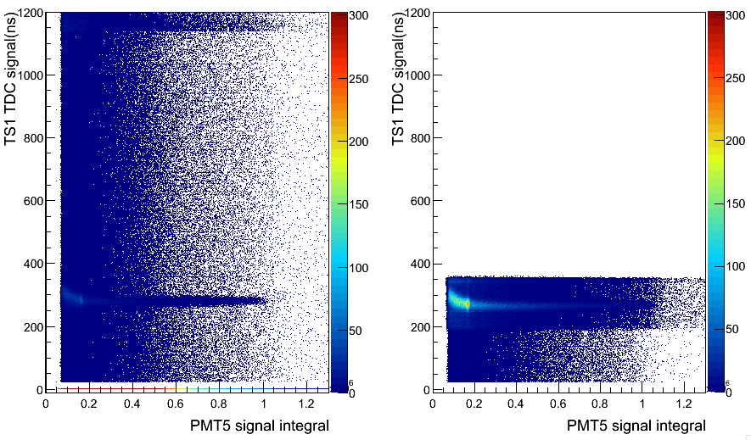
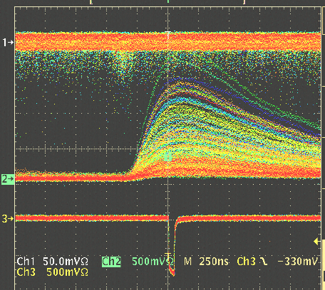
Energy Integrated Asymmetry
Positrons are detected in coincidence between a thin trigger scintillator placed prior to the reconversion target and the central crystal (PMT5) and tagged by e- helicity.
C
A
L
O
R
I
M
E
T
E
R
e+
γ
WITHOUT
Coincidence
Reconversion
Target
10mil Al window
Trigger Scintillator
Trigger Scintillator
Calorimeter
WITH
Coincidence
Coincidence

Slide 17
Energy Integrated Asymmetry
511 keV from e+ annihilation at rest
Bremsstrahlung
end-point
Energy (FADC units)

Slide 18
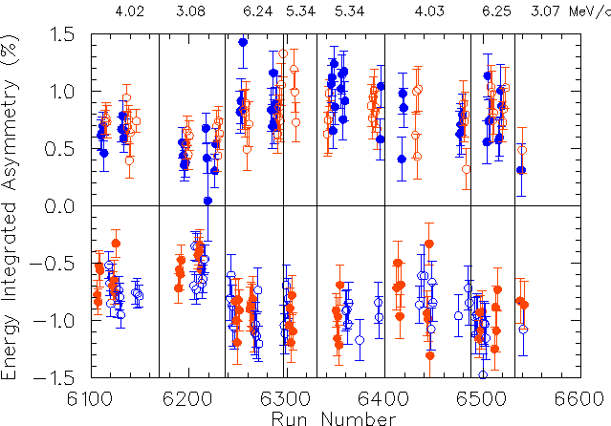
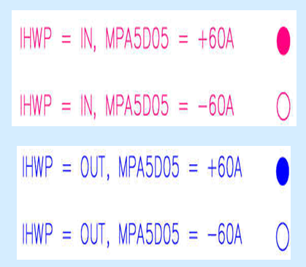
Summary of Positron Asymmetries

Slide 19
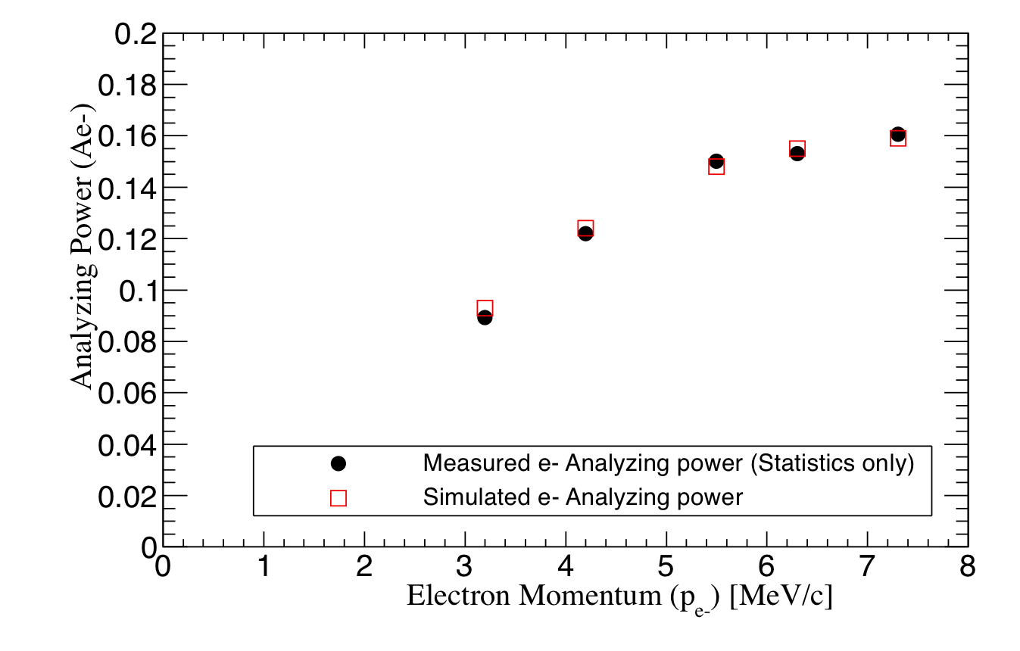
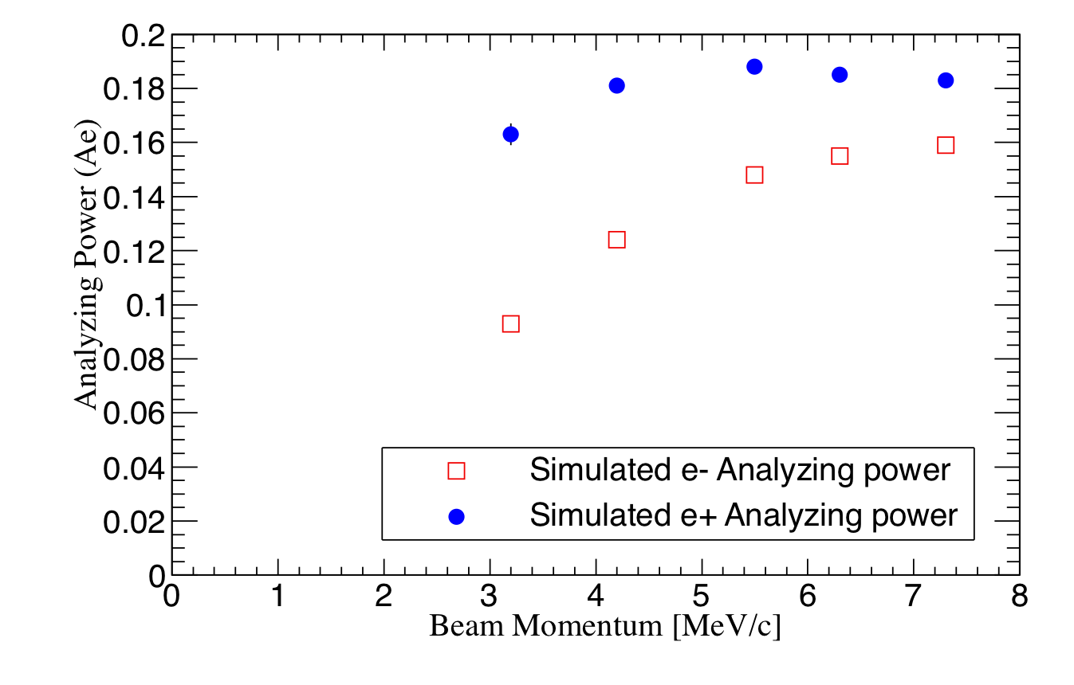
Positron Analyzing Power
GEANT4 simulations allow to link the measured electron analyzing power to the expected positron analyzing power of the PEPPo Compton transmission polarimeter.
See A. Adeyemi talk

Slide 20

Positron Polarization Results
Demonstrated efficient polarization transfer from 8.2 MeV/c electrons to positrons, expanding polarized positron capabilities from GeV to MeV accelerators.
e⁻ beam polarization
85.2 ± 0.6 ± 0.7 %
Whenever producing e⁺ from e⁻, polarization is coming for free
if initial electrons are polarized.
(PEPPo Collaboration) D. Abbott et al., Phys. Rev. Lett. 116 (2016) 214801

Slide 21
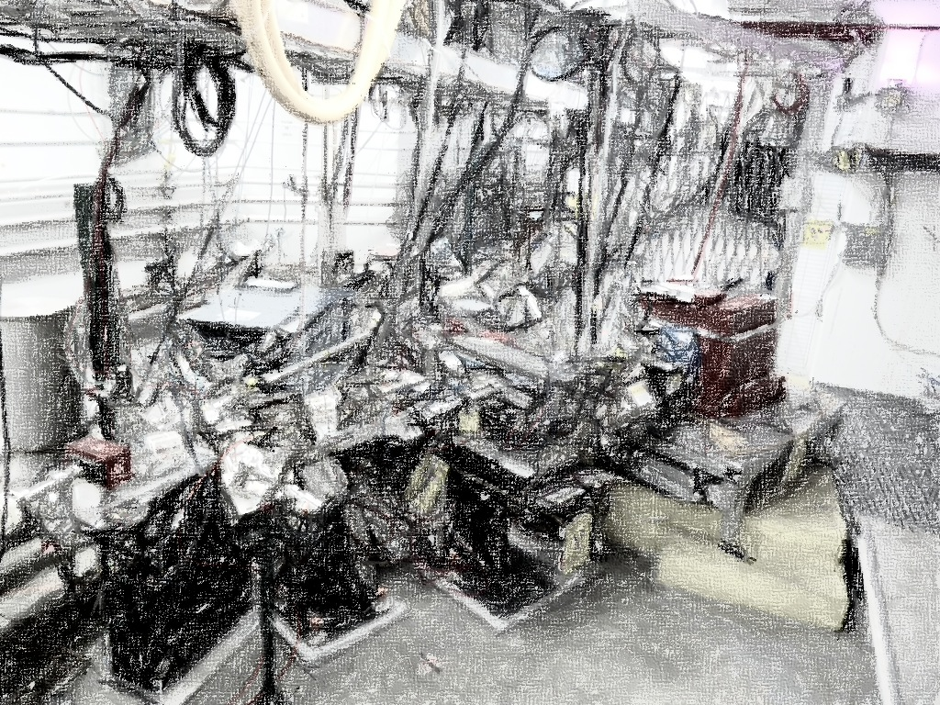
PEPPo Collaboration
P. Aderley¹, A. Adeyemi⁴, P. Aguilera¹, M. Ali¹, H. Areti¹, M. Baylac², J. Benesch¹,
G. Bosson², B. Cade¹, A. Camsonne¹, L. Cardman¹, J. Clark¹, P. Cole⁵, S. Covert¹,
C. Cuevas¹, O. Dadoun³, D. Dale⁵, J. Dumas^{1,2}, E. Fanchini², T. Forest⁵, E. Forman¹,
Freyberger¹, E. Froidefond², S. Golge⁶, J. Grames¹, P. Guèye⁴, J. Hansknecht¹,
P. Harrell¹, J. Hoskins⁸, C. Hyde⁷, R. Kazimi¹, Y. Kim^{1,5}, D. Machie¹, K. Mahoney¹,
R. Mammei¹, M. Marton², J. McCarter⁹, M. McCaughan¹, M. McHugh¹⁰, D. McNulty⁵, T. Michaelides¹, R. Michaels¹, C. Muñoz Camacho¹¹, J.-F. Muraz², K. Myers¹²,
Opper¹⁰, M. Poelker¹, J.-S. Réal², L. Richardson¹, S. Setiniyazi⁵, M. Stutzman¹,
R. Suleiman¹, C. Tennant¹, C.-Y. Tsai¹³, D. Turner¹, A. Variola³, E. Voutier^{2,11},
Y. Wang¹, Y. Zhang¹²
¹ Jefferson Lab, Newport News, VA, US ² LPSC, Grenoble, France ³ LAL, Orsay, France
⁴ Hampton University, Hampton, VA, USA ⁵ Idaho State University & IAC, Pocatello, ID, USA
⁶ North Carolina University, Durham, NC, USA ⁷ Old Dominion University, Norfolk, VA, US
⁸ The College of William & Mary, Williamsburg, VA, USA ⁹ University of Virginia, Charlottesville, VA, USA ¹⁰ George Washington University, Washington, DC, USA ¹¹ IPN, Orsay, France
¹² Rutgers University, Piscataway, NJ, USA ¹³ Virginia Tech, Blacksburg, VA, USA
Many thanks for advice, equipment loan, GEANT4 modeling support, and funding to
SLAC E-166 Collaboration
International Linear Collider Project
Jefferson Science Association Initiatives Award
Orsay, September 14-16, 2016
13/19

Slide 22

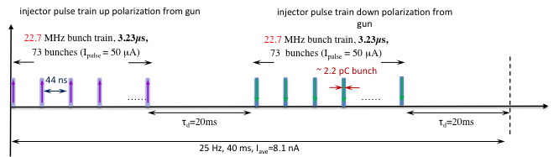
Positrons at JLEIC
A group (J. Grames, J. Guo, F. Lin, V. Morozov, E. Voutier) is exploring a polarized positron injector suitable for JLEIC.
L ≥10³³cm⁻²s⁻¹ P_{e+}≥40%
20 times CEBAF
A pulsed beam with low average current (~10 nA) but significant bunch charge (~2pC) and high macro-pulse peak current (~50µA) is required for injection into JLEIC.

Slide 23
JLEIC Positron Production Scheme
22 m accumulator ring
with 500 turn
phase-space painting
22 m
extraction ring
bunch focusing
and compression
if needed
e⁺ collection
system
x 10⁻²
1 mm W
target
x 10⁻³
to CEBAF
10 MeV polarized e⁻
1.33 pC @ 1500 MHz
= 2 mA
5-7 MeV Polarized e⁺
6.7 fC @ 68.1 MHz
= 460 nA
10 MeV pol e⁻
0.67 nC bunches
@ 1500 MHz
= 1 A
10 MeV polarized e⁻
0.67 nC @ 68.1 MHz
= 46 mA
0-9.5 MeV polarized e⁺
0.67 pC @ 68.1 MHz
= 46 uA
Machine | Electron Source | Storage Ring | Extractor Ring | Positron Source
JLEIC | Ave = 2 mA 1500 MHz DF = 0.8% | Ave = 1 A 1500 MHz DF = 0.8% | Ave = 46 mA 68.1 MHz DF = 0.8% | Ave = 460 nA 68.1 MHz DF = 0.8%
CEBAF (cw) | Ave = 1-10 mA 499 or 250 Mhz DF = 100% | n/a | n/a | Ave = 0.01 - 0.1 uA 499 or 250 Mhz DF = 100%
Accelerator R&D
High-P photocathodes
High bunch charge gun
Electron accumulator
Electron extractor
High power 10kW target

Slide 24
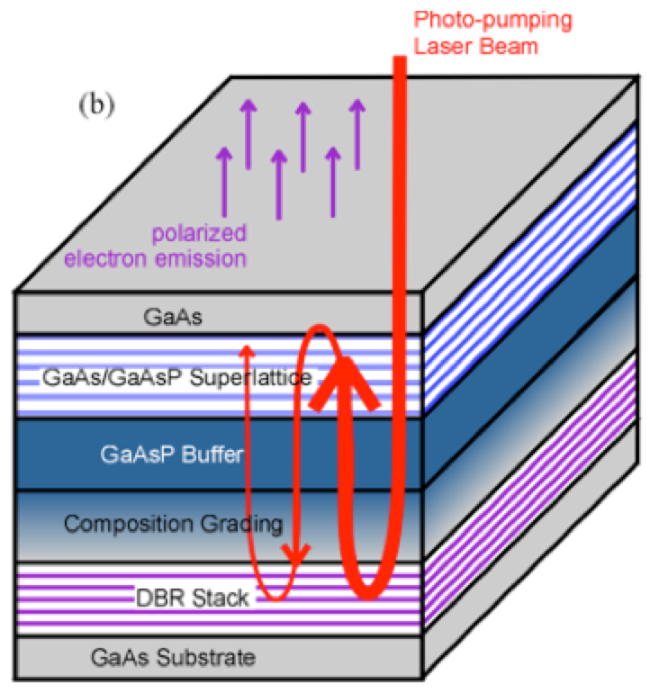
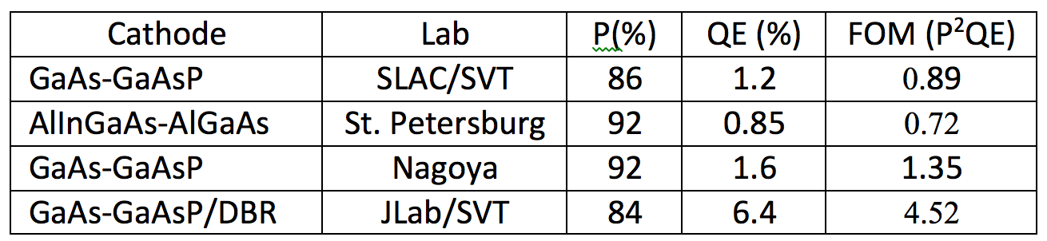
High Polarization Photocathode R&D
6.4% QE & 84% polarization at 776 nm from strained GaAs/GaAsP superlattice photocathode with GaAsP/AlAsP Distributed Bragg Reflector (DBR)
The highest QE & FOM of any reported high polarization photocathode
Possible to improve both QE & Pol
SBIR partnership
See W. Liu talk
Photo-cathode
DBR
Substrate
Paper ready for SPIN and APL submission: W. Liu, S. Zhang, M. Stutzman, M. Poelker, Y. Chen, W. Lu, and A. Moy

Slide 25
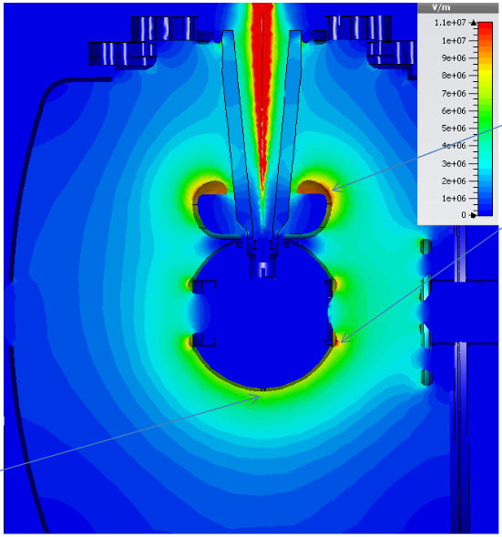
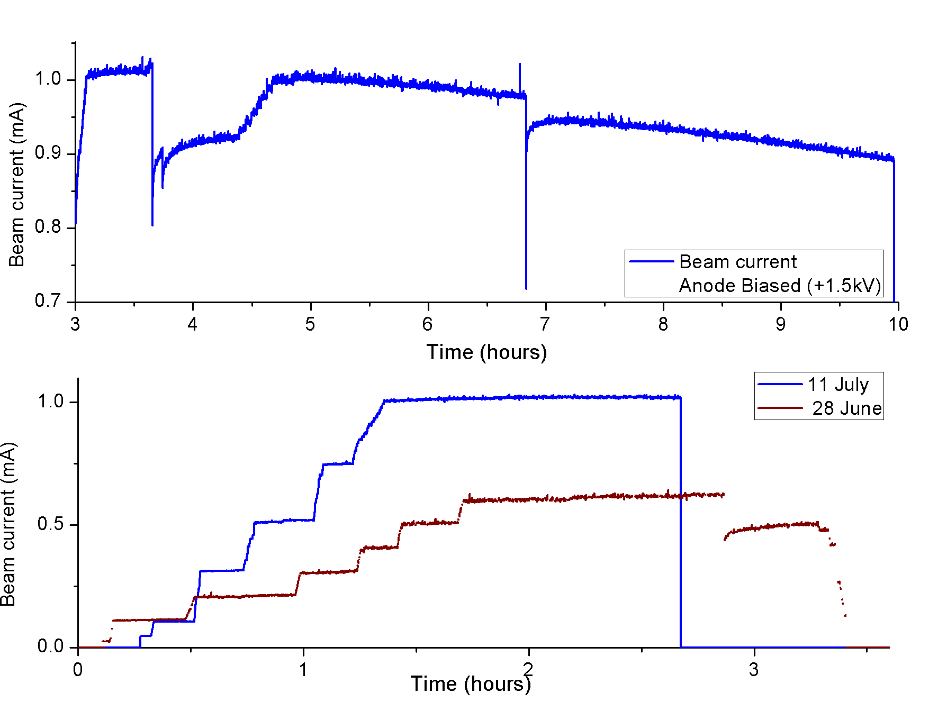
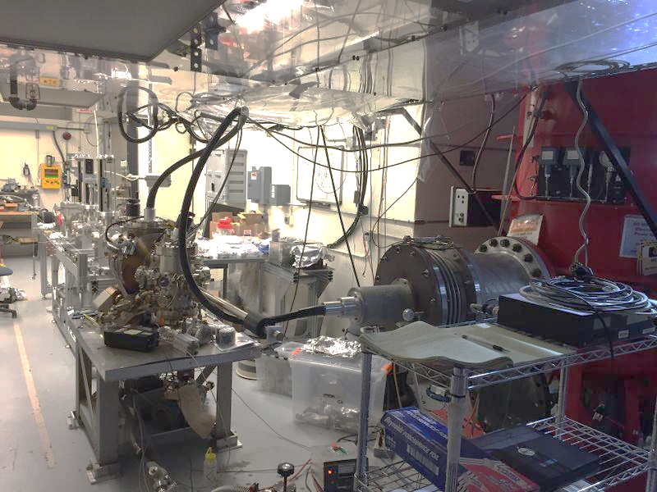
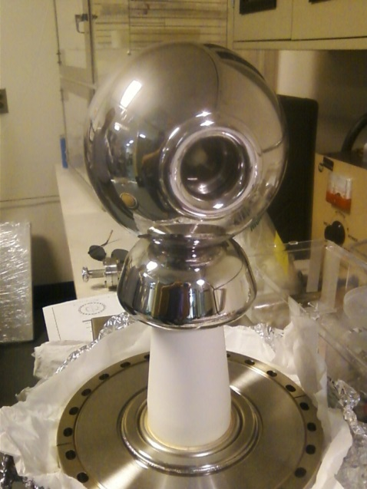
Higher Voltage (300 kV) Inverted Photo Gun
11 MV/m
CsK₂Sb 1mA
8 MV/m
First insulator commissioned to 325 kV
New insulator, getting installed now, supports higher voltage operation

Slide 26
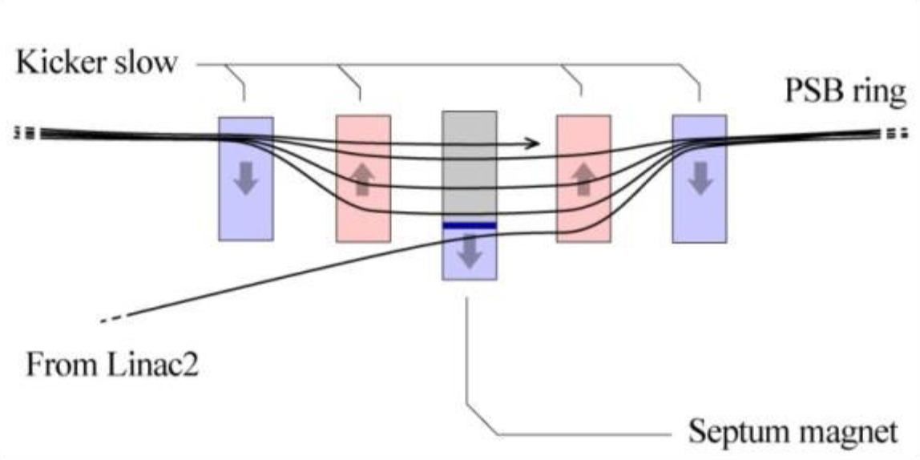
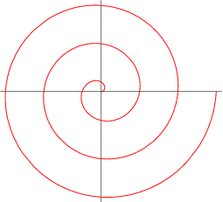
Multi-Turn Injection
Concept: an orbit bump created near a septum and then slowly reduced as beam being injected (phase-space painting)
A number of painting schemes has been developed
Process can also be simultaneously occurring
in vertical and longitudinal dimensions
CERN’s LEIR has a design for 75-turn injection of Pb⁵⁴⁺,
we plan to push this number to a few hundred to
a thousand using low electron emittance
Main injection system components
  Magnetic or electrostatic septum
  Four bumper magnets with ~1 μs rise time, reasonably
  fast fall-off time and ~10 mrad maximum deflection
x′
> Septum thickness +
bunch width
Accumulator ring
x
Injected beam

Slide 27
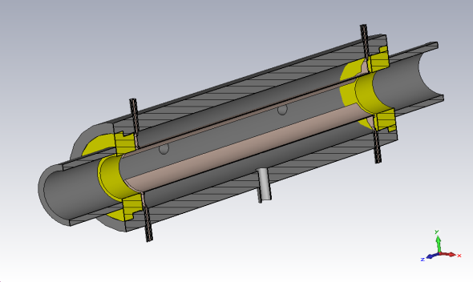
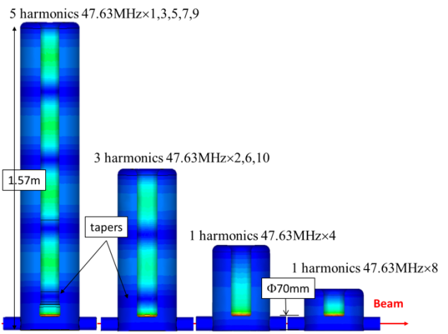
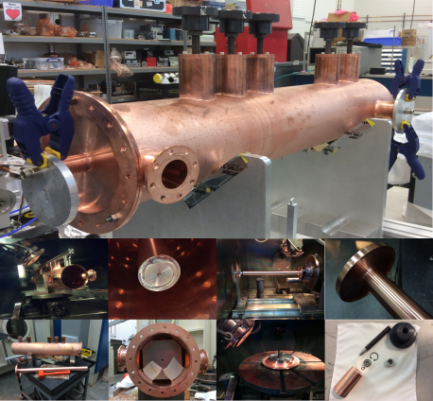
Harmonic Kicker Extraction
Empty ring buckets already kicked out to linac
Two technology options for the kicker
Ring buckets still occupied by bunches
Port 1/2
Empty linac buckets
Linac buckets occupied by extracted bunches
Port3/4, to matched load
Harmonic kicker that kicks every 3rd bunch
A ring using harmonic kickers to extract bunch train 3 times longer
Stripline kicker, faster rise time, can synthesize 10s of modes with single device. Consumes more RF power, but power level might be acceptable for low energy 10MeV beam
J. Guo et al. COOL15 TUPF10
JLEIC e⁺/e⁻ injection requires CEBAF to operate at a reduced bunch reprate of 68MHz (1/22 of 1.497GHz in CEBAF) or its subharmonics to match the 476MHz RF system in JLEIC.
An example is that we use a ring with Nh=89 at 1.497GHz (~18.9m circumference), and kicks out 1 in every 88 bunches with the harmonic kicker, generating a bunch train with ~60 bunches and ~1050m long, leaving a ~19ns gap in the ring to accommodate the rise time for the kickers..
Harmonic cavity kicker designed to kick 1 in every 10 bunches using 4 cavities (Y. Huang et al, accepted by PRSTAB). The 5 harmonics prototype was built as shown.
More efficient than stripline, but needs 5 cavities to kick 1 in every 22 bunches, or 7 cavities to kick every 66 /88bunches
Slow rise time, need a 2nd ring., so the kicker can be turned on before bunch train arrives

Slide 28
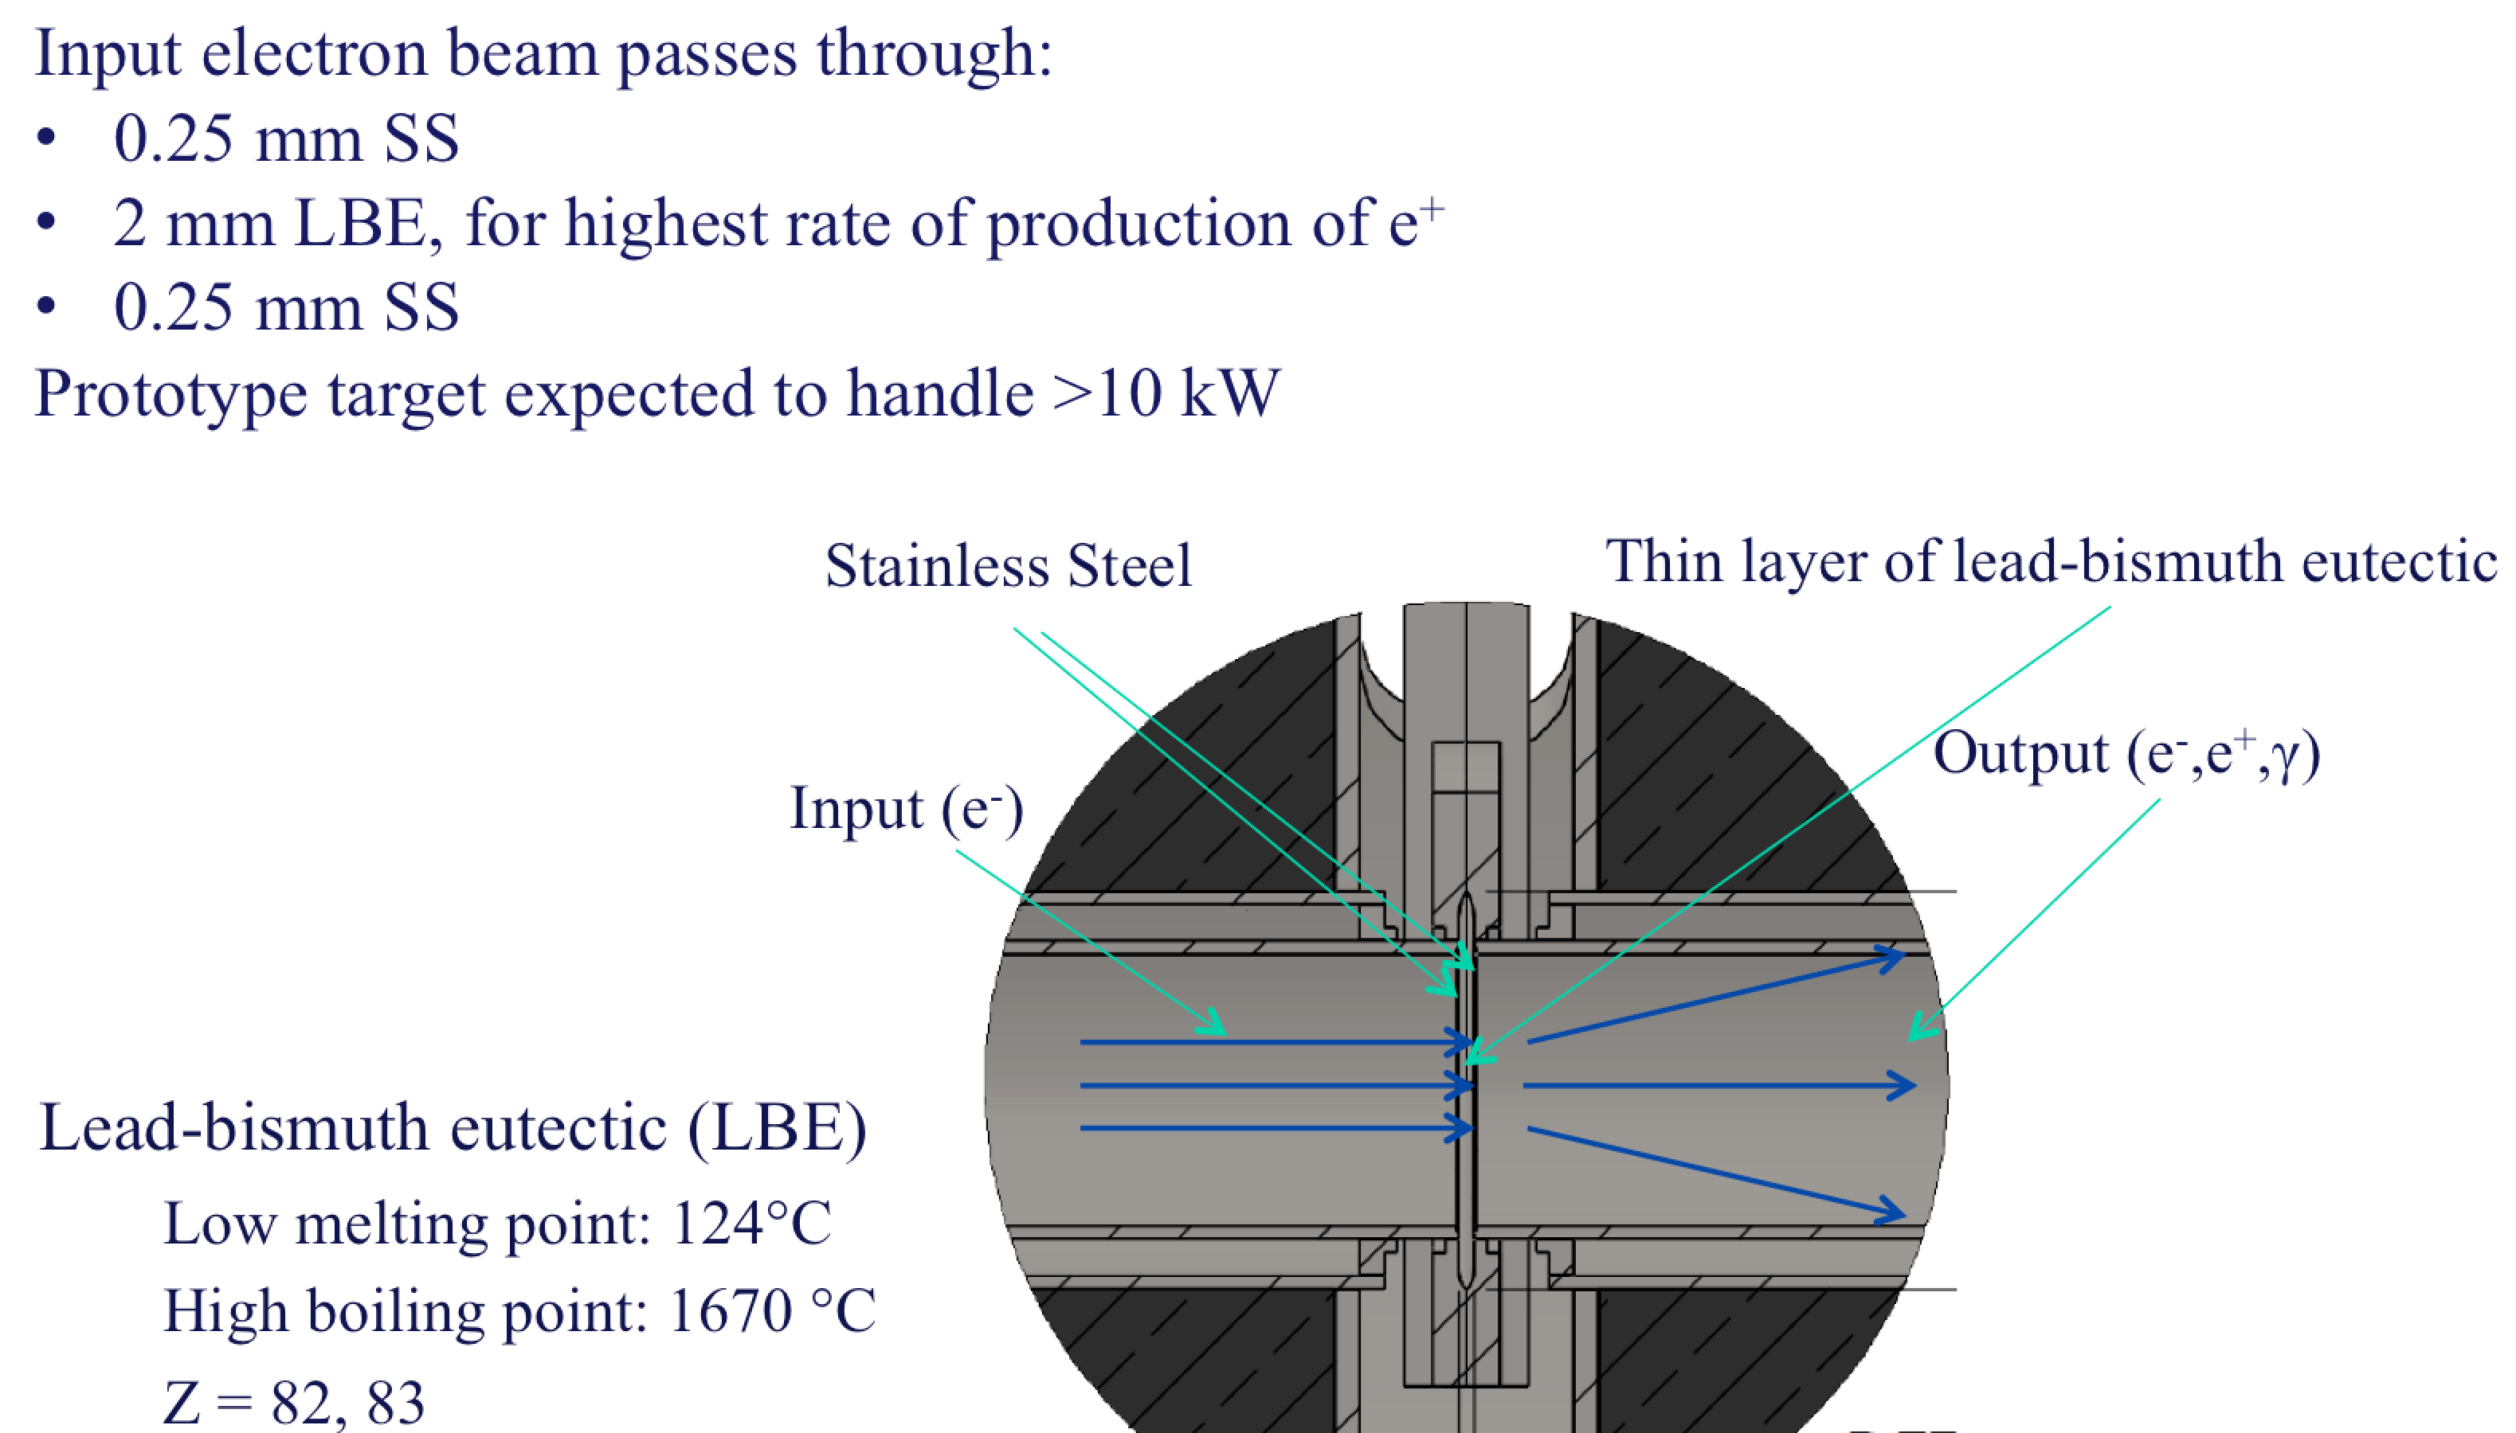

High Power Target R&D

Slide 29
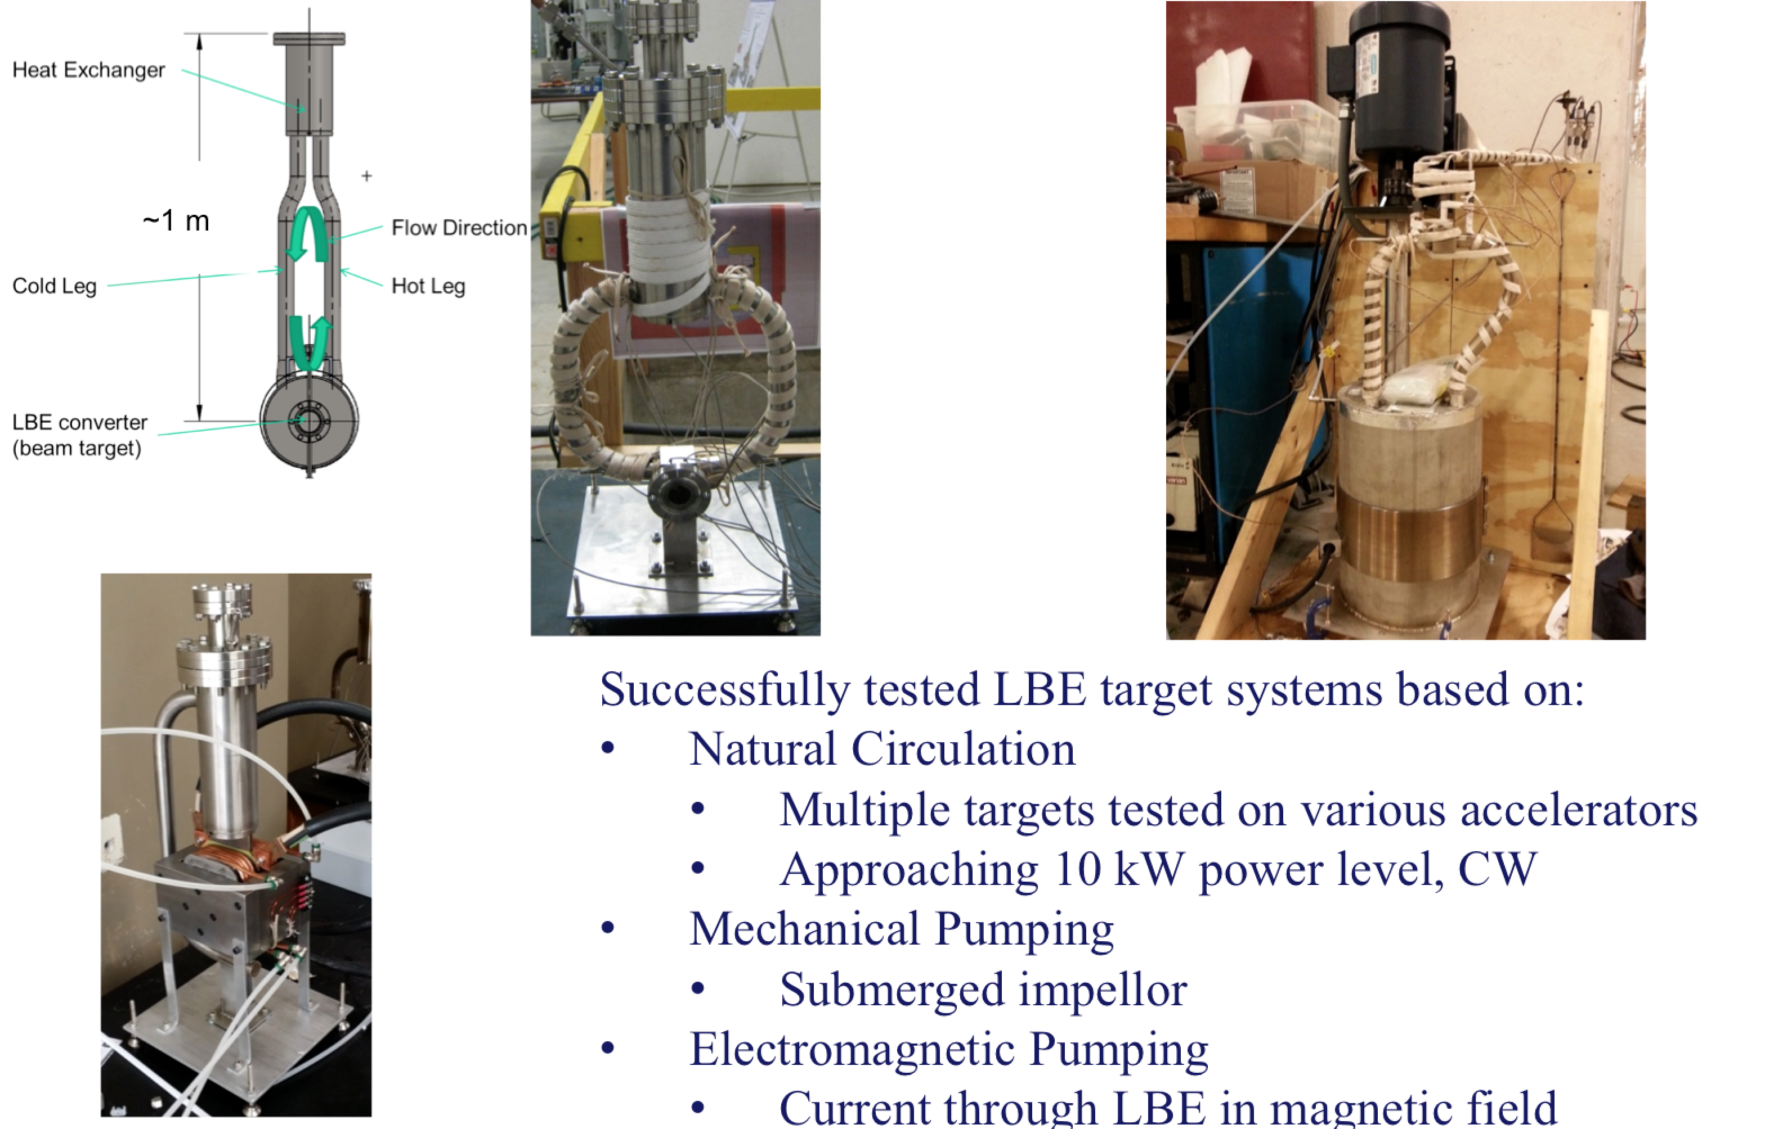
High Power Target R&D

Slide 30
Summary
The PEPPo technique provides an efficient, reliable, radioactive-less, and low cost method opening access to polarized positron beam to a wide community.
Next steps in low energy scheme of e+ source R&D is optimizing for beam intensity and beam quality.
An experimental program in context of CEBAF 12 GeV, JLEIC and LERF is being explored. If you would like to participate in the newly formed Jefferson Lab Positron Working Group please visit: wiki.jlab.org/pwg

Slide 31

Synergy
The Hippopotamus and Red-Billed Oxpecker share a positive and synergistic relationship.

