Slide 1
DAQ of UITF 200 keV Mott Polarimeter
New 200 keV Mott DAQ
Riad Suleiman

Slide 2
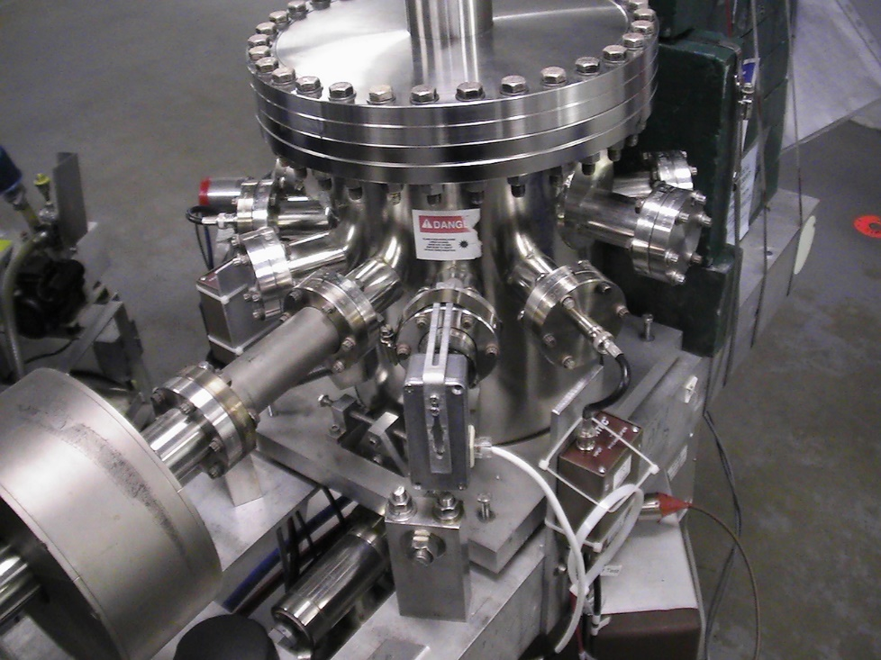
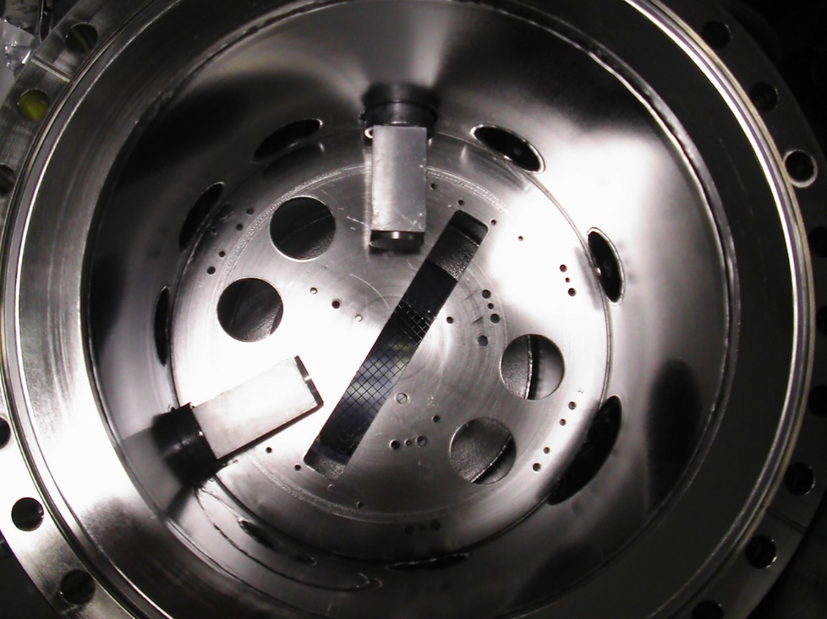
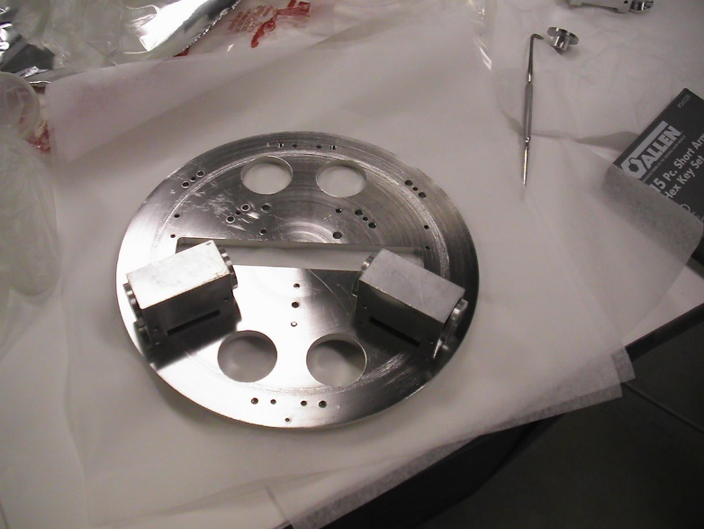
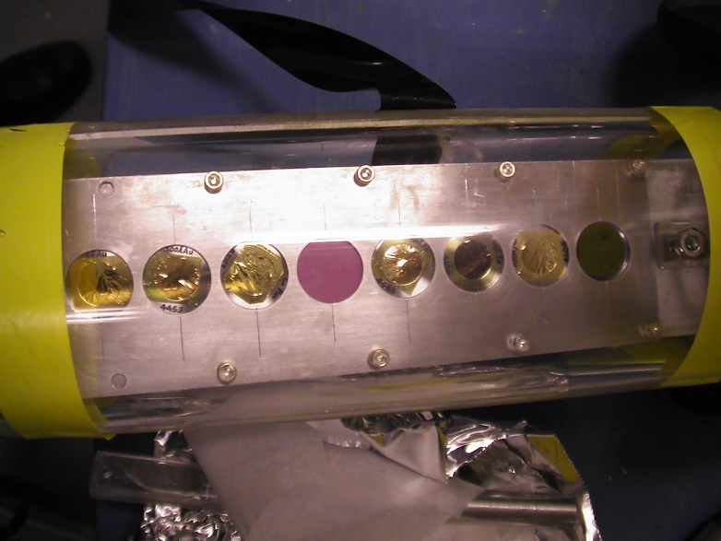
Vacuum Chamber

Slide 3
Measuring Mott Asymmetry
How to measure the Mott Asymmetry A?
For one helicity state, measure the left and right detector counting rate, and
Flip the electron polarization, measure the counting rate again, and
Calculate the cross-ratio (r),
Then, the Mott Asymmetry (A),
This cancels false asymmetries from detector efficiency, beam current, target thickness, and solid angle
$$N_{L}^{↑}$$
$$N_{R}^{↑}$$
$$N_{L}^{↓}$$
$$N_{R}^{↓}$$
$$r=\sqrt{\frac{N_{L}^{↑}N_{R}^{↓}}{N_{L}^{↓}N_{R}^{↑}}}$$
$$A=\frac{1−r}{1+r}$$

Slide 4
Measuring Instr. Asymmetry
How to measure the Instrumental Asymmetry A₁?
For one helicity state, measure the left and right detector counting rate, and
Flip the electron polarization, measure the counting rate again, and
Calculate the cross-ratio (x1),
Then, the Instrumental Asymmetry (A1),
This measures asymmetries from detector efficiency and solid angle but cancels beam current and target thickness
$$N_{L}^{↑}$$
$$N_{R}^{↑}$$
$$N_{L}^{↓}$$
$$N_{R}^{↓}$$
$$x_{1}=\sqrt{\frac{N_{L}^{↑}N_{L}^{↓}}{N_{R}^{↓}N_{R}^{↑}}}$$
$$A_{1}=\frac{1−x_{1}}{1+x_{1}}$$

Slide 5
Measuring Instr. Asymmetry
How to measure the Instrumental Asymmetry A₂?
For one helicity state, measure the left and right detector counting rate, and
Flip the electron polarization, measure the counting rate again, and
Calculate the cross-ratio (x2),
Then, the Instrumental Asymmetry (A2),
This measures asymmetries from beam current and target thickness but cancels detector efficiency and solid angle
$$N_{L}^{↑}$$
$$N_{R}^{↑}$$
$$N_{L}^{↓}$$
$$N_{R}^{↓}$$
$$x_{2}=\sqrt{\frac{N_{L}^{↑}N_{R}^{↑}}{N_{L}^{↓}N_{R}^{↓}}}$$
$$A_{2}=\frac{1−x_{2}}{1+x_{2}}$$

Slide 6
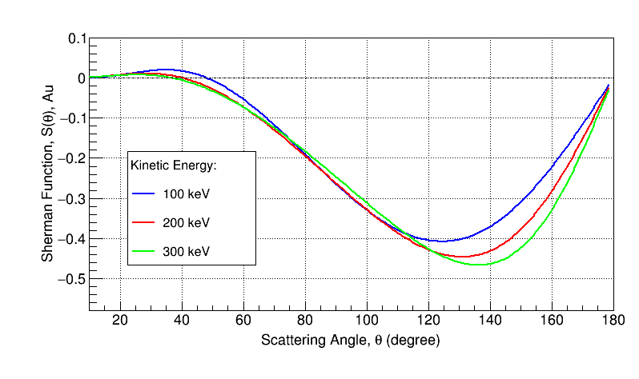
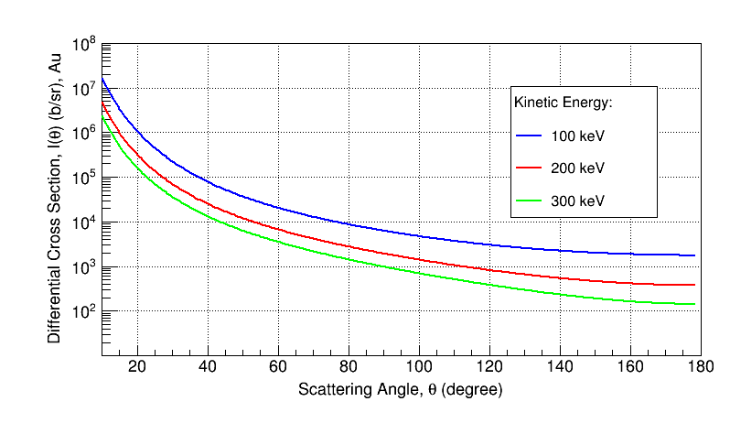
Sherman Function and Differential Cross Section, Au

Slide 7
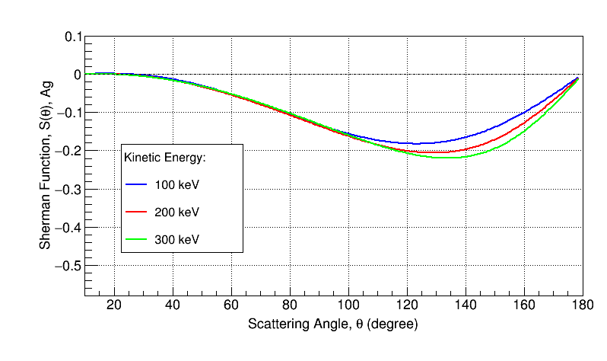
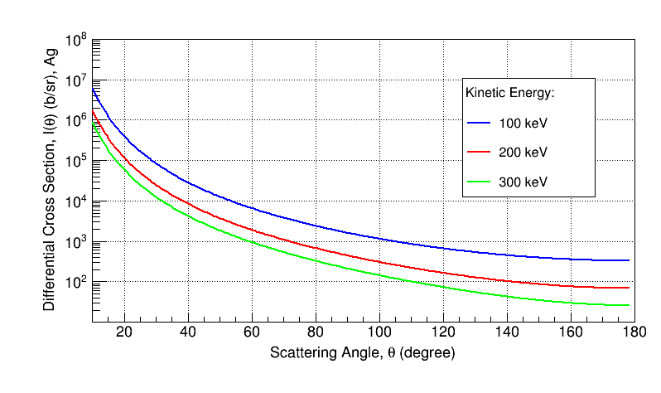
Sherman Function and Differential Cross Section, Ag
200 keV | S(130˚) | DCS (b/sr)
Au | -0.446 | 659
Ag | -0.206 | 128

Slide 8
ORTEC Electronics
Have these modules:
(1) ORTEC 710 Quad High Voltage Bias Supply (1 - 1000 V)
(2) ORTEC 142A Preamplifier for detector input capacitance 0 to 100 pF (conversion gain 45 mV/MeV)
(2) ORTEC 142B Preamplifier for detector input capacitance 100 to 400 pF (conversion gain 20 mV/MeV)
(2) ORTEC Model 590A Amplifier and Timing Single-Channel Analyzer (SCA)
(2) ORTEC Model 570 Amplifier

Slide 9
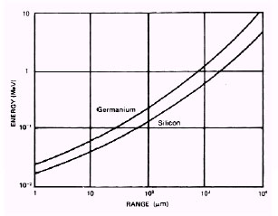
ORTEC Detectors
(2) ORTEC ULTRA Detectors (BU-013-050-1000-S):
Ion-Implanted Silicon Charged Particles Detectors
Ultra-thin entrance window (500 Å) for optimum energy
resolution (FWHM, $α=$13 keV, $β=$ 7 keV)
B Mount
Detector size of 50 mm²
Depletion Depth (Range) of 1000 um for energies $≤$ 500 keV
Bias Voltage: +115 V
(2) ORTEC ULTRA Detectors (BU-012-050-100):
Ion-Implanted Silicon Charged Particles Detectors
Ultra-thin entrance window (500 Å) for optimum energy
resolution (FWHM, $α=$12 keV , $β=$ 6 keV)
B Mount
Detector size of 50 mm²
Depletion Depth (Range) of 100 um for energies $<$ 200 keV
Bias Voltage: +50 V
Zero Transmission Rage vs. Energy for Electrons in Silicon

Slide 10
Single-Channel Analyzer (SCA)
SCA Out:
Standard NIM of +5 V, 500 ns wide if the amplified signal passes the threshold of the Lower Level discriminator
Connect to Scaler
Amp Out:
Energy output (Amplified: x5 to x1250)
Connect to fADC

Slide 11
Summer 2008 Test at CEBAF Injector
100 / 500 keV

Slide 12
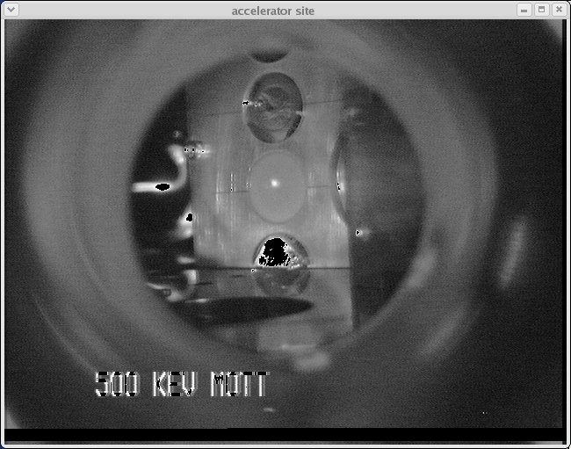
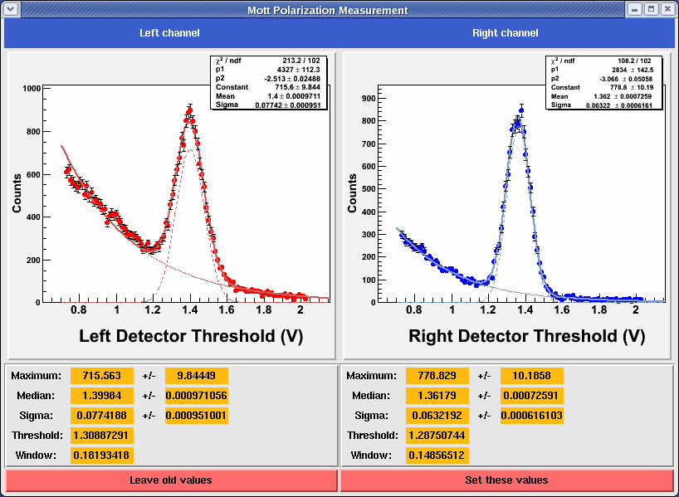

Slide 13
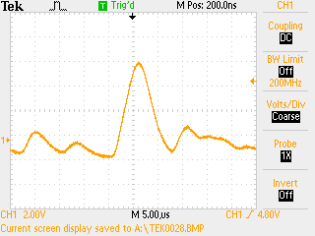
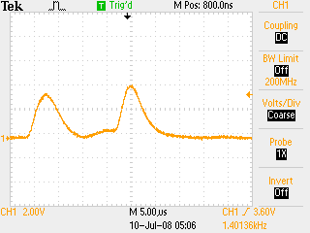
Left Detector
Right Detector
Note: the timing output is 50 ns wide signals with 5 ns rise time (picture pending)
Left Preamp T Output
Right Preamp T Output

Slide 14
The old 100 keV DAQ

Slide 15
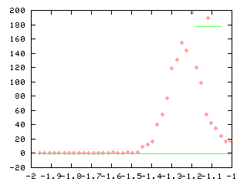
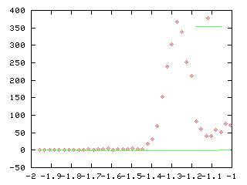
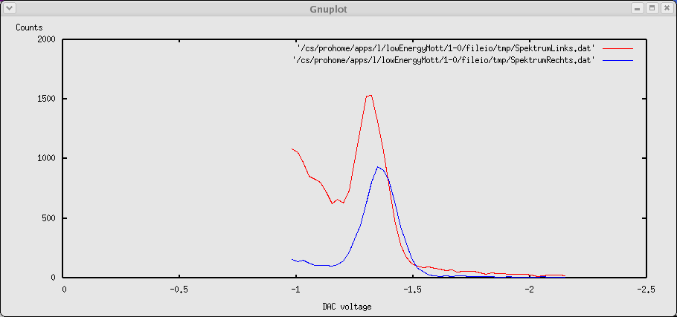
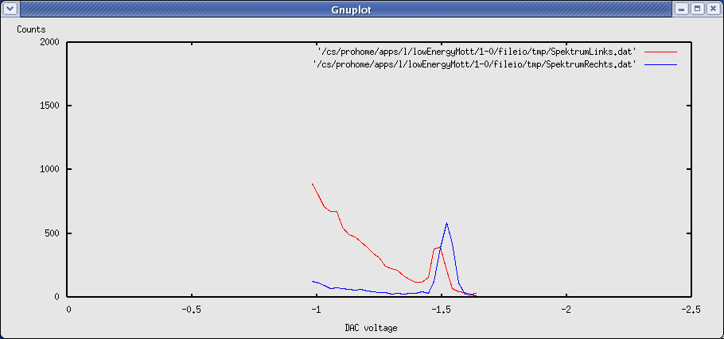
100 keV, ITS Cave
100 keV, CEBAF Tunnel
500 keV, CEBAF Tunnel

Slide 16
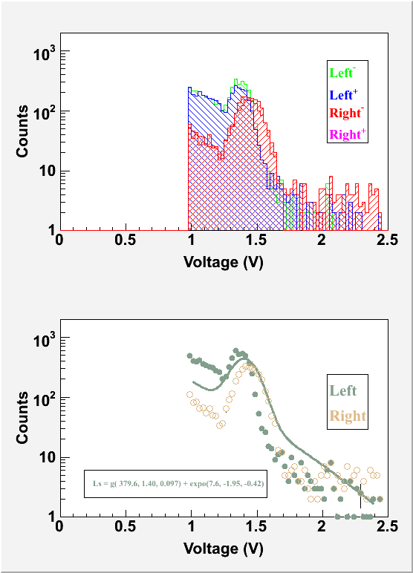
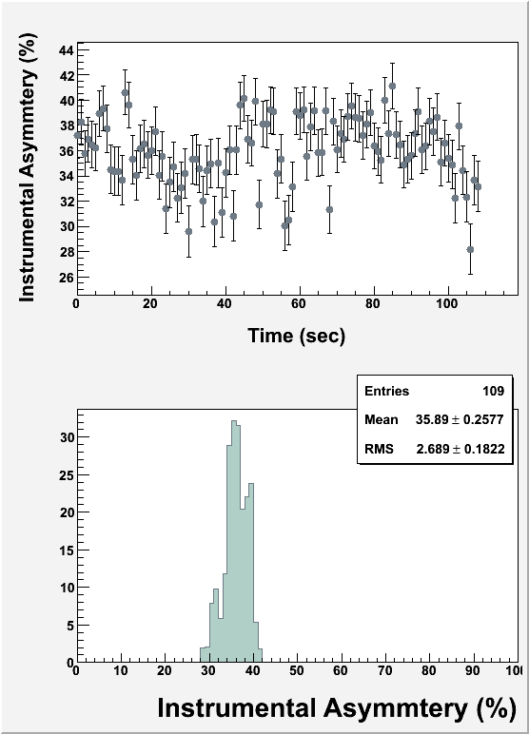
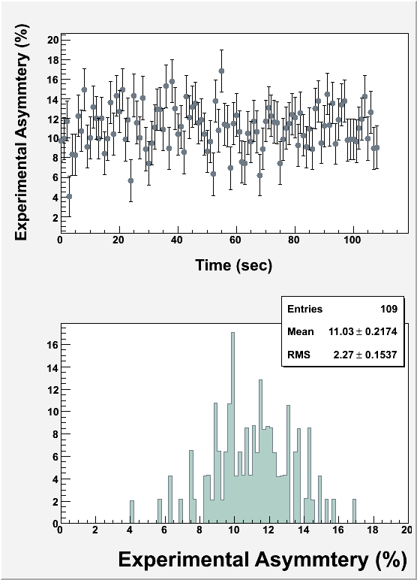
Asymmetry Data (100 keV, 300n A)
Detectors HV +115 V
Coarse Gain = 500, Fine Gain = 1.5
Lower Level threshold = 1.25 V
Window Width = 0.1 V for spectra data, = 0.5 for asymmetry data
HWien = 90 degrees, MFB0D01A = -964 G-cm, MFB0D01B = 1013 G-cm
P = 31.3 % (Bulk GaAs)

Slide 17
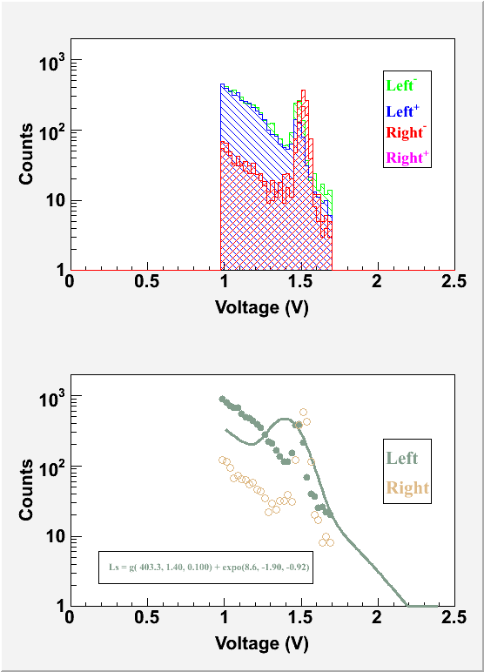
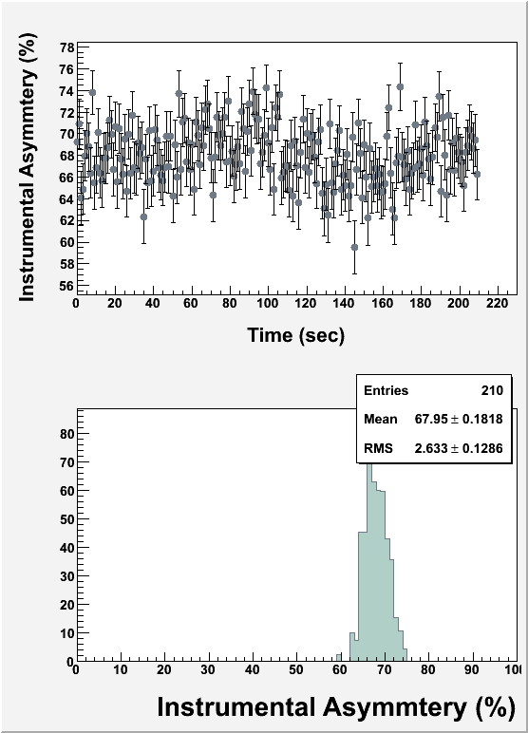
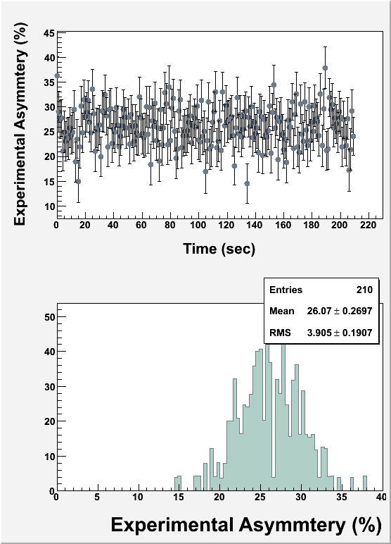
Asymmetry Data (500 keV, 300n A)
Detectors HV +115 V
Coarse Gain = 100, Fine Gain = 1.5
Lower Level threshold = 1.4 V
Window Width = 0.1 V for spectra data, = 0.3 for asymmetry data
HWien = 90 degrees, MFB0D01A = -2369 G-cm, MFB0D01B = 2369 G-cm
P = 67.7 % (Super Lattice GaAs)

Slide 18
Target Thickness Extrapolation
Single-Atom Sherman Function must be corrected for plural scattering (a few large angle scattering) in the target:
alpha = 0.0005/A for 100 keV electrons and 0.0001/A for 500 keV electrons
If possible, run with the thinnest target
$$S_{eff}(130^{∘},d)=\frac{S_{SA}(130^{∘})}{1+α(130^{∘})⋅d}$$

Slide 19
Target Thickness Scan at 100 keV

Slide 20
Design of
UITF 200 keV Mott Polarimeter

Slide 21
DAQ Schematic Diagram
4 Helicity Signals,
1 FC, 2 BPMs (X±, Y±)
VXS crate
Integ.
fADC
Counting
fADC
SBC
TI
4 Helicity Signals
Helicity
Trigger
SCA
Out
Amp
Out
590A
Amp/Disc
OR
Fanout
Mott Trigger
E Out
570 Amp
142A
Preamp
E Out
142B
Preamp
T Out
Left (50˚)
Detector
Right (50˚)
Detector
Left (120˚)
Detector
Right (120˚)
Detector
BU-012-050-100
BU-013-050-1000-S

Slide 22
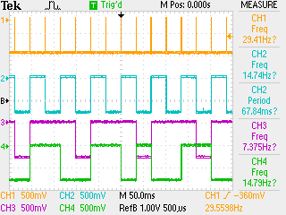
Helicity Signals
T_Settle
Pair Sync
Helicity Pattern
Reported or Delayed Helicity

Slide 23
New DAQ for Mott Polarimeter
Measure Mott asymmetry (event counting)
Measure Charge asymmetry (per helicity)
Measure position differences (per helicity)
DAQ Triggers:
Mott Detector
Helicity
DAQ Hardware:
VXS crate (Ordered)
XVR-16 from Abaco Single Board Computer (SBC) (Ordered)
Jefferson Lab Flash Analog-to-Digital Convertor (fADC250) (quantity = 2) (On-site)
Trigger Interface (TI) (On-site)
Front Panel Signal Distribution module (On-site)
Desktop (Ready to Order)

Slide 24
Installation Timeline
DAQ design and procurement: October – December
CODA and Firmware: January
Data decoding and analysis: January - February
DAQ tests: January – February
Ready for beam: March 1, 2021

Slide 25
DAQ Readouts
Mott Trigger:
Counting fADC
Integration fADC
Helicity Trigger:
Integration fADC

Slide 26
Signals to DAQ
Signals to Counting fADC:
(2) Amp Out
(2) Timing output from preamplifier
(4) Helicity Signals
Signals to Integration fADC (helicity-gated):
(2) SCA Out
(4) Helicity Signals
(1) FC
(8) 2 BPMs (X±, Y±)

Slide 27
Target and Rates
Wien Vertical at 90˚
Gold Targets (Z=79): 100, 300, 500 Å
Silver Targets (Z=47): 300, 500, 2000 Å
Solid angle of 0.11 msr (hole with diameter of 0.02” at 1.6875”)
Backward scattering angle of 130 degrees:
Viewer and a thru hole
 | 200 keV
Au Target (A) | 100
Current (nA) | 50
Rate per detector(Hz) | 1200
Time (s) | 300

Slide 28
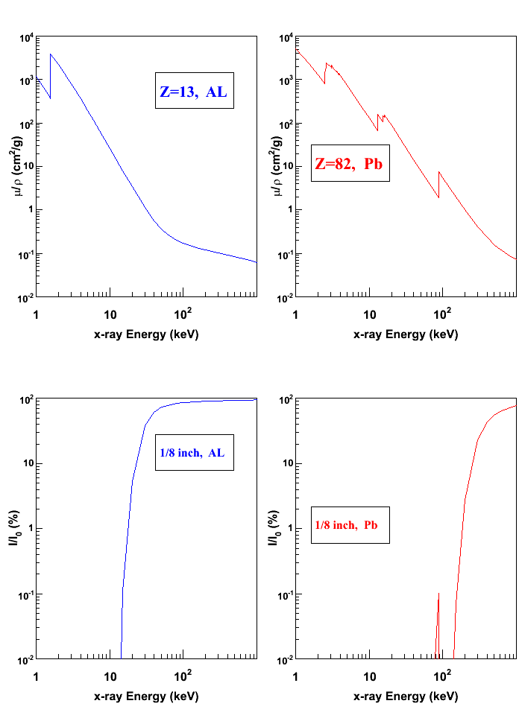
Collimators
Electron Energy | Al Range (g/cm²) | Al Range (mm)
100 keV | 0.0075 | 0.03
500 keV | 0.095 | 0.35
Electron Shielding: The front collimator is 1 mm thick Al. Do not change the Al Collimator.
x-ray Shielding: Add 1/8 inch lead jacket around the Al Collimator.

Slide 29
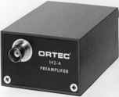
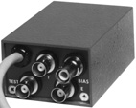
Cables, …
(4) Bias cable, SHV connector, 0 - 1000 V, male connectors
(2) E 142A preamp 93-ohm cable, RG62A/U BNC, male connectors
(2) T 142A preamp 50-ohm cable, RG58A/U BNC, male connectors
(2) Test 142A preamp 50-ohm cable, RG58A/U BNC, male connectors
(2) 142A preamp power cable, 9-pin D connectors (amphenol 17-10090), female in cave, male in service rack
(2) E 142B preamp 93-ohm cable, RG62A/U BNC, male connectors
(2) T 142B preamp 50-ohm cable, RG58A/U BNC, male connectors
(2) Test 142B preamp 50-ohm cable, RG58A/U BNC, male connectors
(2) 142B preamp power cable, 9-pin D connectors (amphenol 17-10090), female cave, male in service rack

