Slide 1
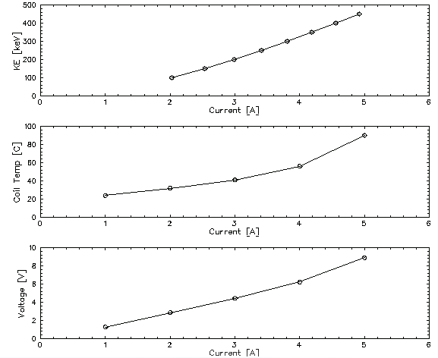
Comment on 15 deg bend magnet

Slide 2
Comment on 15 deg bend magnet
Existing ITCU DS should run fine (4.2A, 7V) at 350kV OK, although warm at about 60C.
Next upgrade: wind new coils on existing fixture w/ AWG16 (~40% improvement).
Next upgrade: fab longer fixture+coil. Fractional length of straight > total length of wire.
Next upgrade: iron magnet

Slide 3
Comment on Chopping Setup
A1
A2
C1
C2
S1
S2
S3
S4
A1 and A2 define largest transverse emittance.
S1 images A1 on chopping plane
C1-S2-S3-C2:
0
M11
M12
0
M12 = 0
M22 = -1
=
-x’
M21
M22
x
Focal length of S2 is the C1-S2 distance
Choose C1 kick for displacement at chopper plane.
Make S2-S3 distance as small as mechanically reasonable

Slide 4
Comment on 1497 MHz chopper cavities
TN-90-214, C. Yao – Comparison of measurement and MAFIA (agrees 50%)
TN-90-234, G. Krafft – Includes relativistic correction, deflection equation, cavity parameters
Typical parameters:
(R/Q) ~ 12 ohms
(Q0) ~ 14000
(Power @ 100eV) ~ 21 W
Required Voltage ~ (Total Energy) * (Beta) * (deflection angle)
Required Power ~ (Required Voltage)^2 / [ (R/Q) * (Q0) ]
Calculate voltage, power for 350kV operation.
Re-measure both cavities

