Slide 1
High Polarization Photocathodes: Operational Experience at Jefferson Lab Marcy L. Stutzman, P. Adderley, J. Clark, S. Covert, C.Hernandez-Garcia, J. Grames, J. Hansknecht, M. Poelker R. Suleiman
Notes:
Title Page Design 3

Slide 2
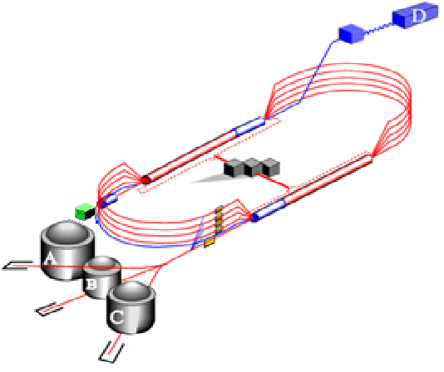
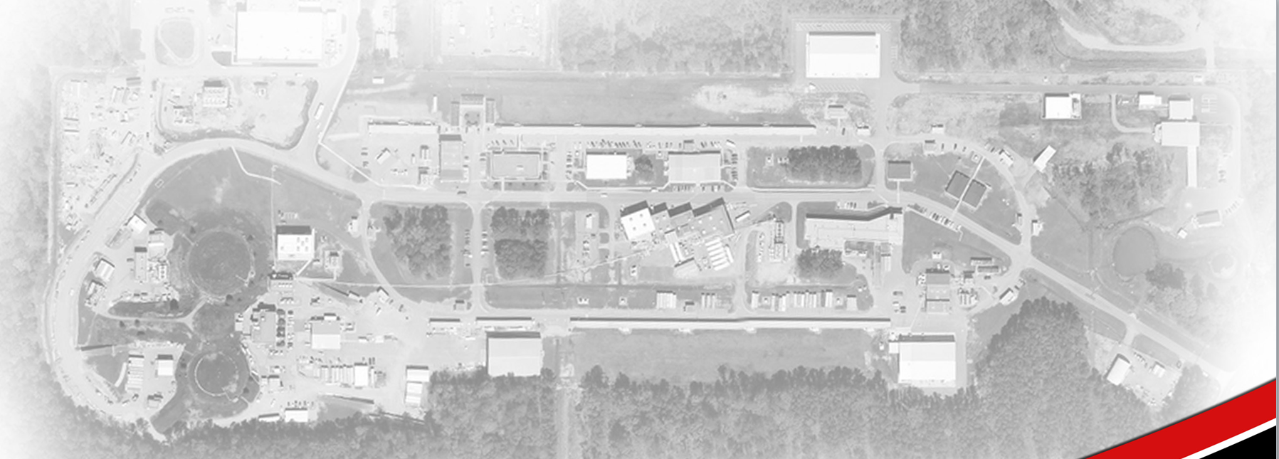
Thomas Jefferson National Accelerator Facility
12 GeV electron accelerator for Nuclear Physics (DOE)
Mission: To understand the transition from hadronic (protons and neutrons) to partonic (quarks and gluons) physics.
Polarized source
Electron beam, with polarization nearly 90% and current to 200 μA
Investigate spin dependent nuclear processes
7/8 mile racetrack design accelerator
4 experimental halls
Source
Hall D
Hall A
Hall B
Hall C

Slide 3
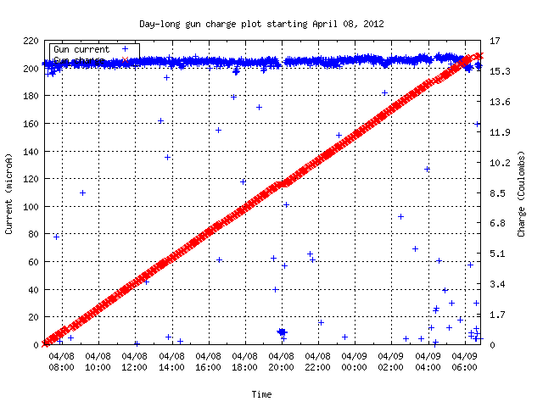
Beam required at Jefferson Lab
Outline
Polarized source
Strained superlattice photocathode
Ion bombardment
Polarization issues
Surface charge limit
Lifetime enhancement
Laser position, size
Activation area
High voltage
Future directions, ongoing research
24 Hours
High polarization for 3 (4) experimental halls simultaneously
24/7 beam operation
Beam Current: 200 µA
Charge Delivered: 16 Coulombs polarized electrons

Slide 4
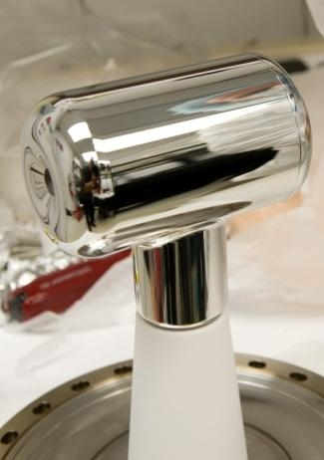
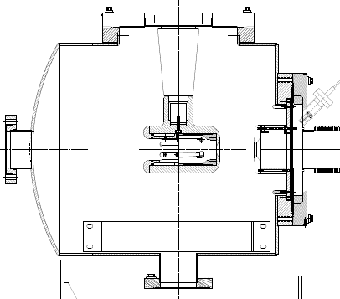
Photoemission Source
-130 kV DC (vs. RF) electrode bias
x-ray standard “inverted” insulator
Pumps with NEG modules and SEM style ion pump
Base pressure approaching XHV ≡ P < 1x10⁻¹⁰ Pa
400°C heat treatment to reduce outgassing rate
Commercial XHV gauge characterization to validate pressure measurement
Field emission reduced through polishing, electrode design
“synchronous photoinjection” = illuminate only when beam is needed
High polarization strained superlattice GaAs/GaAsP photocathode
-130kV
light in
electrons out
photocathode

Slide 5
Photoemission from GaAs
Bare GaAs surface
Large Work Function
Positive Electron Affinity (PEA)
NEA Surface Activation
Dipole layers of Cs + NF₃ or Oxygen
Reduces Work Function
Negative Electron Affinity (NEA)
PEA=4.07 eV
-
Conduction
Band
-
χ^{NEA} ~ 0.2 eV
E_{gap}=1.4 eV
Valence
Band
+
Light
GaAs
Vacuum
GaAs
Vacuum
GaAs Spin Polarized Electron Source, D.T. Pierce, R.J. Celotta, G.-C. Wang, W.N. Unertl, A. Galejs, C.E. Kuyatt, and S.R. Mielczarek, Review of Scientific Instruments 51(4), 478 (1980).

Slide 6
Polarized electrons using circularly polarized light
Crystalline (bulk) GaAs
Circularly polarized light
780 nm ~ band gap
Helicity reversal: 1kHz
Maximum theoretical polarization: 50%
GaAs Spin Polarized Electron Source, D.T. Pierce, R.J. Celotta, G.-C. Wang, W.N. Unertl, A. Galejs, C.E. Kuyatt, and S.R. Mielczarek, Review of Scientific Instruments 51(4), 478 (1980).

Slide 7
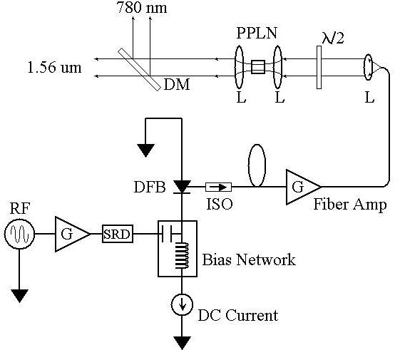
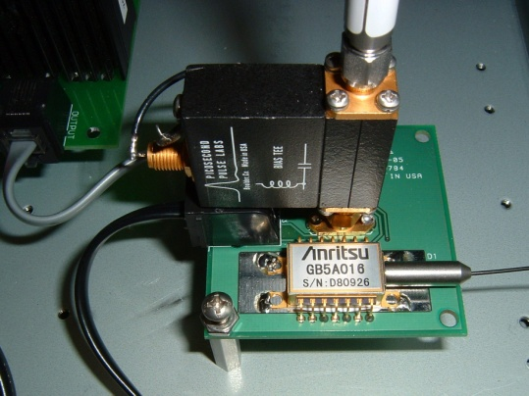
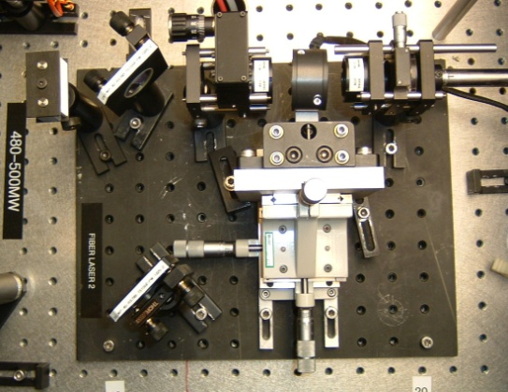
Fiber-Based Drive Laser: telecom
780nm
Gain-switched seed
Frequency-doubler
1560nm
ErYb-doped fiber amplifier
Flip helicity of circularly polarized laser light
and electron polarization at 1 kHz

Slide 8
High P: Breaking GaAs Degeneracy
Split degeneracy of P_{3/2} : Introduce strain on GaAs crystal by growing it on substrate (GaAsP) with different lattice constant
High polarization by circularly polarized laser excitation from
P_{3/2} to S_{1/2} : E_{gap} < E_{γ} < E_{gap}+δ
m_{j} = -1/2
+1/2
S_{1/2}
σ+
σ-
E_{gap}
P_{3/2}
m_{j} = -3/2
+3/2
δ=20–50
meV
-1/2
+1/2
Bulk GaAs
Higher QE: Alternating layers of GaAs and GaAsP
Strained Superlattice GaAs
Max 100% theoretical polarization

Slide 9
Strained Superlattice QE and Polarization
m_{j} = -1/2
+1/2
S_{1/2}
σ+
σ-
E_{gap}
P_{3/2}
m_{j} = -3/2
+3/2
δ=20–50
meV
-1/2
+1/2
Highest polarization at wavelength just over the band gap
Higher QE with shorter wavelengths
J.L. McCarter, … M.L. Stutzman et al., NIMA 618 (2010) 30.

Slide 10
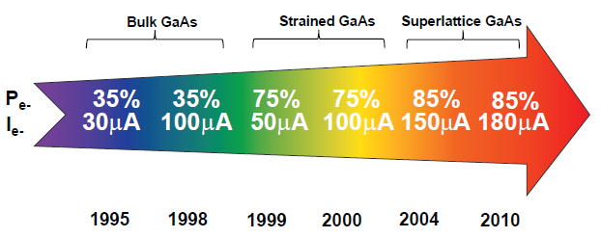
GaAs Photocathode Evolution
Bulk GaAs
Strained GaAs:
GaAs on GaAsP
Superlattice GaAs:
Layers of GaAs on GaAsP
GaAs
GaAs
100 nm
GaAsP
100 nm
14 Layers
0.36
GaAsP
0.36
2 μm
625 μm
GaAs
350 μm
GaAs
350 μm
QE ~ 20%, 120 μA/mW
Unpolarized @ 532 nm
QE ~ 5%, 30 μA/mW
Pol ~ 35% @ 780 nm
QE ~ 0.2%, 1 μA/mW
Pol ~ 75% @ 850 nm
No strain relaxation
QE ~ 1%, 6 μA/mW
Pol ~ 85% @ 780 nm (1.59 eV)
Timeline of Polarized Source at CEBAF

Slide 11
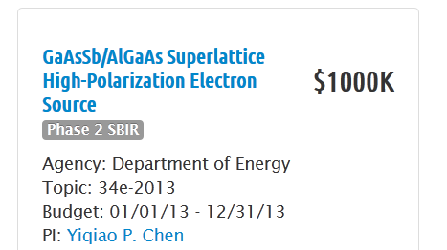
High Polarization Photocathode
DOE Small Business Innovation Research (SBIR) partner (SLAC, JLab)
Grows high polarization photocathodes
GaAs/GaAsP, boron doped, gas phase MBE
Ongoing research for higher polarization or more robust photocathode materials

Slide 12
Operational Lifetime Limitations
Any gas in chamber can be ionized by electron beam, accelerated back toward the photocathode and
limit photocathode operational lifetime
Static vacuum approaching 1x10⁻¹⁰ Pa
Baked, leak free, all metal vacuum systems
Residual water vapor destroys surface chemistry
Hydrogen outgassing reduction
Extended 400°C heat treatment of chamber
Elimination of thick flanges
Pump with NEG (non-evaporable getter) and ion pumps
Dynamic vacuum issues
Eliminate field emission from electrodes
Eliminate beam halo, scraping

Slide 13
Ion Bombardment

Slide 14
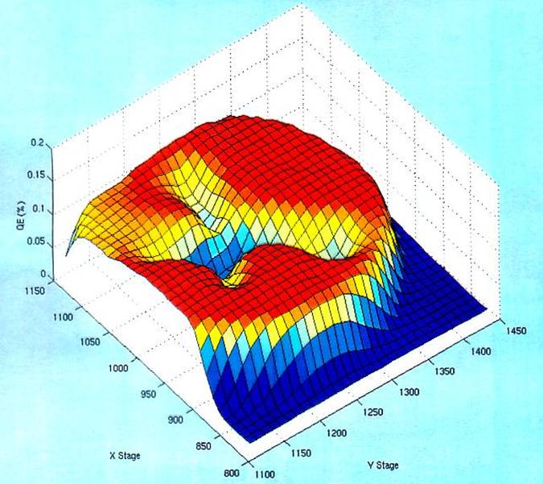
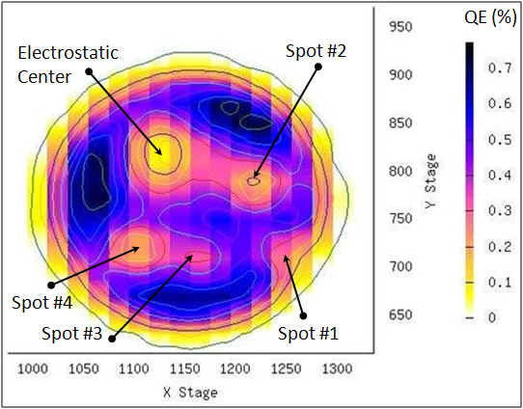
Photocathode Lifetime
Ion bombardment – with characteristic QE “trench” from laser spot to electrostatic center of photocathode – damages NEA of GaAs
High energy ions are focused to electrostatic center: create QE “hole”
Don’t run beam from electrostatic center.
QE can be restored, but takes about 8 hours to heat and reactivate
Photocathode “QE scan”
Active area = 5 mm
Laser size = 0.35 mm
What causes photocathode damage?

Slide 15
Off-axis implantation: SIMS analysis
Unused sample
Used sample
,

Slide 16
Electrostatic center implantation: SIMS
V. Shutthanandan, …, M.L. Stutzman, et al., Surface science analysis of GaAs photocathodes following sustained electron beam delivery, PRSTAB 15 063501 (2012)

Slide 17
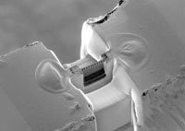
Liftout FIB / TEM analysis
Unused sample
Superlattice layers
Focused Ion Beam used to mill cross sectional depth profile for TEM
Au/Pd evaporated, Pt sputtered to protect surface (misalignment = shadows)
Uniform layers, no darkening
Fred Stevie NCSU, former AVS M-A chair
F.A.Steve et al., Surf. Interface Anal. 31, 345, (2001).

Slide 18
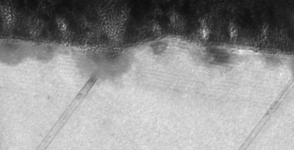
Liftout FIB / TEM analysis
Used sample
Superlattice
layers
Implantation damage evident
Dislocations – strain relaxation during heat cycles?
Why is implantation non-uniform?

Slide 19
Liftout FIB / TEM analysis
The residual gasses in the chamber are implanted
The implantation is non-uniform
Open questions
What species are most harmful?
Damage evident, but polarization and QE are fully restored with heat cycle and re-activation – why?
Used sample

Slide 20
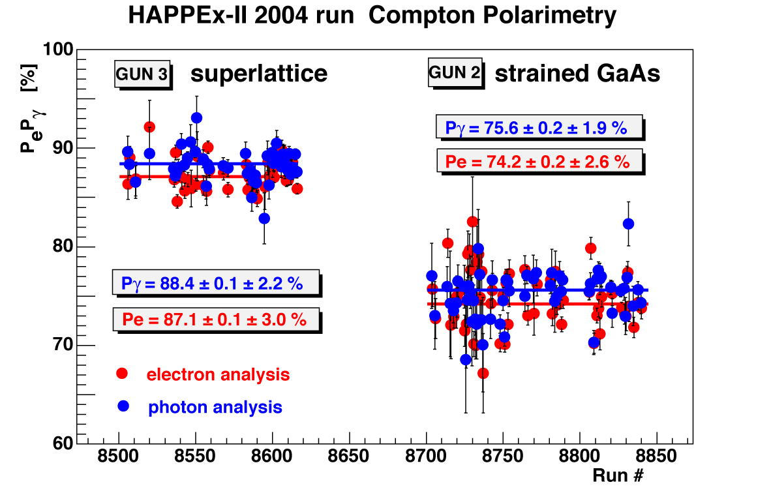
Beam Polarization at CEBAF

Slide 21
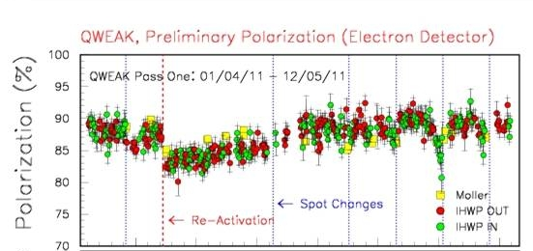
Variation in polarization: open questions
Why does heating/reacitivating the wafer cause polarization to decrease so significantly?
Why did polarization drop so significantly before the spot move?

Slide 22
Polarization variation?
Low QE:
Run constant current. Low QE requires more laser power (~ 500mW).
Is the wafer heating, shifting the bandgap?
High QE:
Do we have depolarization in the Band Bending Region while electrons move through surface chemicals?

Slide 23
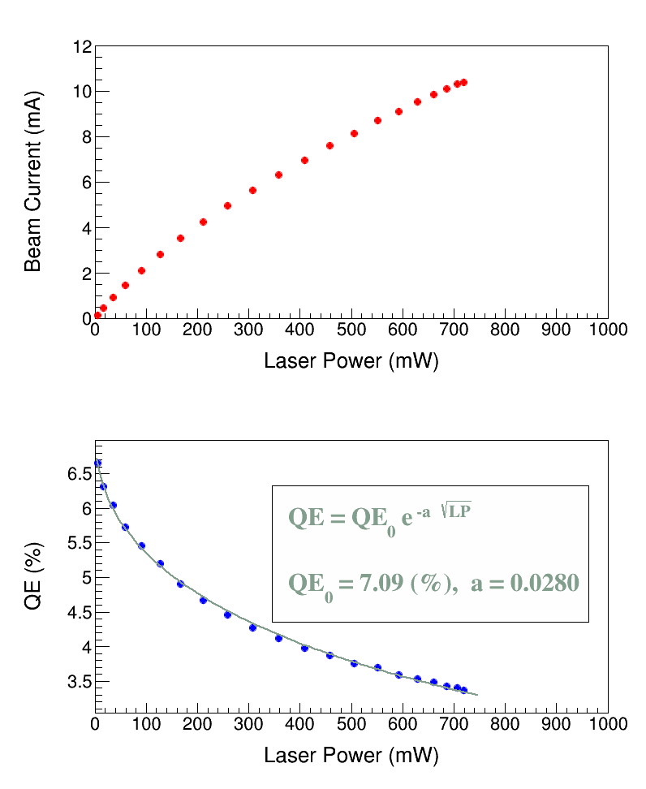
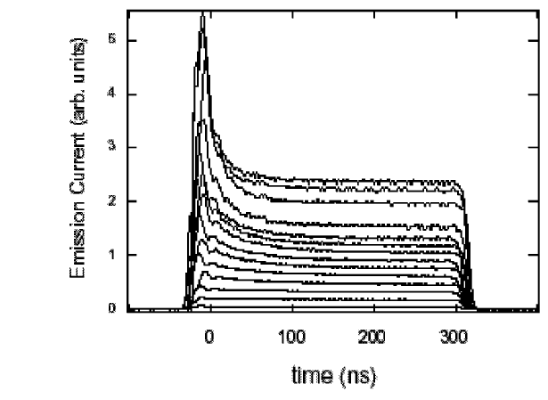
Surface Charge Limit
Surface Charge Limit (or Surface Photovoltage Effect) affects cathode yield
Doubling of laser power doesn’t double electron beam current
Bulk GaAs,
532 nm,
100 kV
SCL high bunch charge at SLAC
Non-uniform emission during electron bunch
More pronounced at higher currents
JLab data
T.Maruyama et al., AIP Conf.Proc. 675 (2003).
Notes:
SCL data:
https://logbooks/entry/1519971
https://logbooks/entry/1519969
https://logbooks/entry/1564645
Bulk GaAs Doping: Zn at 8 e+18 atoms/cm³

Slide 24
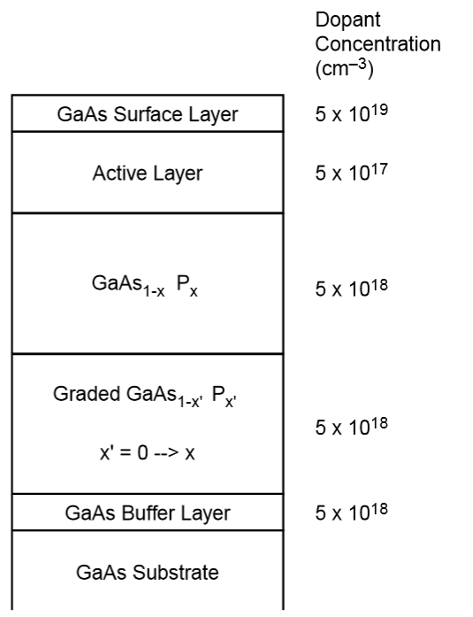
Surface Charge Limit
Vacuum level increases with high current
Surface becomes less “Negative Electron Affinity”
Yield (quantum efficiency) drops
χ^{NEA} ~ 0.2 eV typical
E_{gap}
Mitigation to reduce SCL?
Heavily dope surface layer
Increase gun voltage
Maruyama et al., Nucl. Instrum. Meth. A 492 (2002) 199.
Notes:
SCL data:
https://logbooks/entry/1519971
https://logbooks/entry/1519969
https://logbooks/entry/1564645
Bulk GaAs Doping: Zn at 8 e+18 atoms/cm³

Slide 25
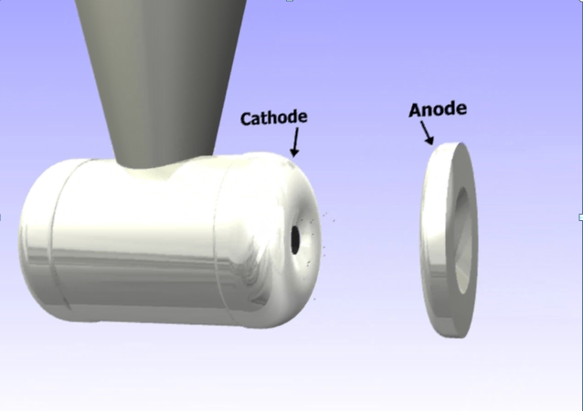
Operational parameters to Prolong Photocathode Lifetime?
Laser spot position variation
Laser spot size variation
Activated area of photocathode
Gun voltage
“Charge and fluence lifetime measurements of a DC high voltage GaAs photogun at high average current.,” J. Grames, … M.L. Stutzman, et al., Phys. Rev. ST Accel. Beams 14, 043501 (2011)

Slide 26
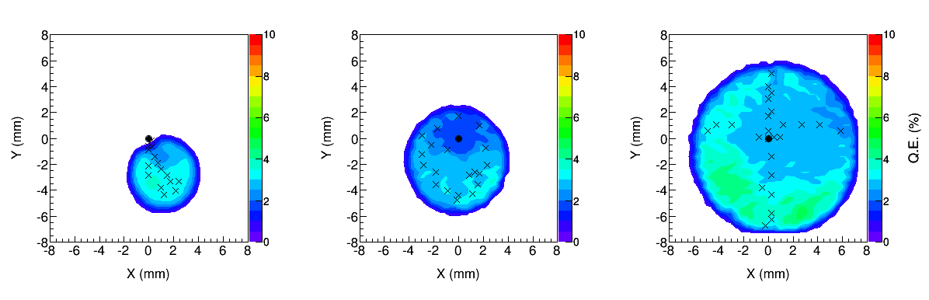
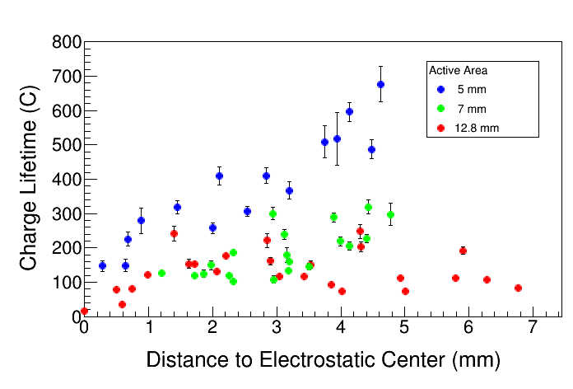
Laser spot position vs. electrostatic center
11 mm
7 mm
5 mm
Use physical mask to limit area where Cs is deposited
Vary size of activated area
Vary laser position
Conclusions
Smaller active area better
Less stray beam
Lifetime bad at EC
Notes:
What is the source of the anode current? Photo-emission from active area by diffusion of light.

Slide 27
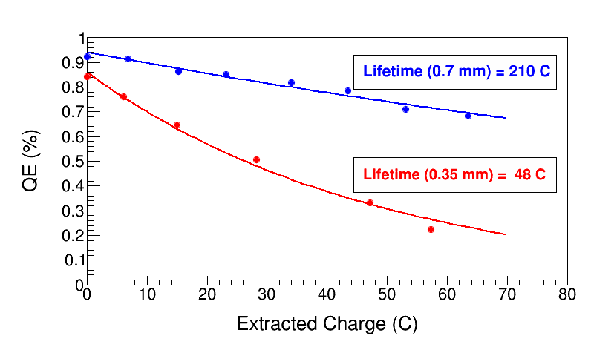
Lifetime vs. Laser spot size
Enhanced Charge Lifetime for QWeak: Increase laser size from 0.35 mm to 0.7 mm (diameter)
Notes:
What is the new beam diameter at CEBAF? Joe is recalling 1.0 mm.
This POLOG entry:
https://logbooks/entry/1643854
says at least a factor of two.
I will keep using 0.7 mm.

Slide 28
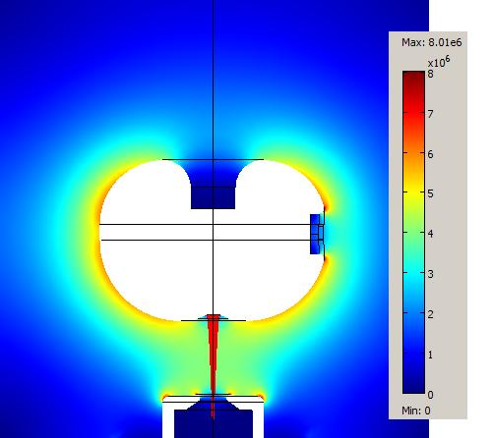
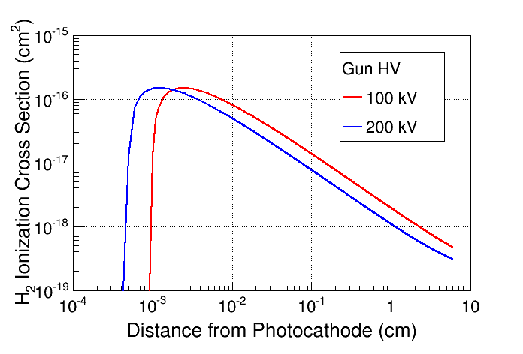
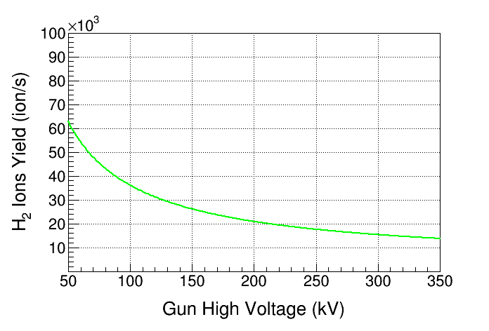
Higher Gun Voltage to Improve Lifetime?
At 200 kV, only 60% of ions are created compared to 100 kV
Issues at higher operational voltages
Better emittance, beam handling
Better lifetime???
Field emission
surface polishing of electrodes
noble gas processing
Insulator breakdown,
punch-through

Slide 29
How to Prolong Photocathode Lifetime?
Larger Laser Size
Distribute damage over larger area
Less effect from surface charge limit
Laser Position on Photocathode and Active Area
Run the laser farther from the electrostatic center
Higher Gun Voltage
Ionization cross section for residual gas peaks around 150eV
Higher gun voltage reduces volume in which max ionization occurs
Better beam profile and less potential beam scraping
Field emission and HV insulator problems
“Charge and fluence lifetime measurements of a DC high voltage GaAs photogun at high average current.,” J. Grames, … M.L. Stutzman, et al., Phys. Rev. ST Accel. Beams 14, 043501 (2011)

Slide 30
Open issues
Ongoing research
Better GaAs based photocathodes?
Longer lifetime
Higher polarization
SBIR partnership with SVT Associates
Polarimeter improvments
Vacuum research toward XHV
Other Photocathode materials?
100% emission from half metals?
Novel emission processes (surface plasmon polaritons)
Can robust materials such as CsK₂Sb emit polarized e-?
Collaborations with university partners (William and Mary)
Multialkali research program at JLab (Md. A. Mamun)
Insulator research and characterization
Gas processing and surface finish studies to reduce field emission (M.BastaniNejad, Md. Mamun, E. Forman)
Higher gun voltage
Less Surface Charge Limit
Better emittance
Superconducting Radio Frequency (SRF) photoguns with GaAs photocathode?
High brightness for light source
High bunch charge
High polarization
Jefferson Lab SRF institute well suited for SRF and GaAs characterization, similations

Slide 31
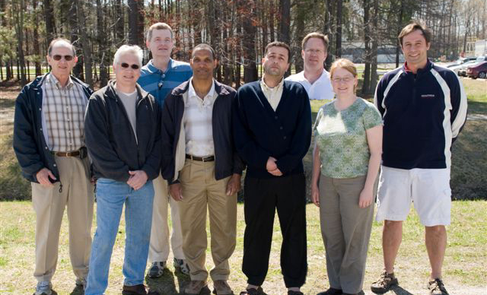
Thank you for your attention
Acknowledgements
Jefferson Science Associates U.S. DOE Contract
No. DE-AC05-06OR23177
Recent Students: M.BastaniNejad, Md. A. Mamun, E. Forman, J.L.McCarter, K. Surles-Law,
(L-R)Jim Clark, Matt Poelker, Steve Covert,
Phil Adderley, Riad Suleiman, John Hansknecht,
Marcy Stutzman, Joe Grames,
Not shown: Carlos Hernandez Garcia, Shukui Zhang, Don (Bubba) Bullard

Slide 32
backup

Slide 33
Electric Field Enhancement of QE
NEA of GaAs depends on Gun HV. QE increases with external Electric Field at GaAs surface, E_{s},
Where χ (~200 meV) is the zero-field NEA value (Physics Letters A 282, 309) and potential barrier lowering due to Electric Field (Schottky Effect) is
χ
Where ε_{s} (= 13.1) is GaAs relative permittivity.
E_{gap}
δU(E_{s})
Gun HV (kV) | E_{s} (MV/m) | δU(E_{s}) (meV)
100 | 2.0 | 50
200 | 4.0 | 70
Notes:
Schottky Effect: Applied Physics Letters 23, 123, (1973).

Slide 34
Space Charge Limit
Maximum current density that can be transported across cathode-anode
gap is (for an infinite charge plane):
Child’s Law (1D)
[A/cm²]
For electron emission from a finite circular spot on the cathode:
Child’s Law (2D) (PRL 87, 278301)
For CEBAF electron beam (499 MHz):
Short Bunch (PRL 98, 164802)

Slide 35
NEA Activation of GaAs
QE
“Activate” GaAs photocathode by applying about one mono-layer of Cesium and NF₃ to very clean surface
NF₃
Cs
0
Time
Cs
Cs
Cs
Cs
R | GaAs Light Reflection Coefficient (~ 0.3)
d | GaAs layer thickness (~ 0.1 μm)
α(Һω) | Photo-absorption Coefficient (~ 5x10³ cm⁻¹)
B(χ) | Surface Tunneling Probability(~ 0.2)
F
F
F
F
GaAs

