Slide 1
ASY-R30-3: Upper shield
Gabriel Palacios Serrano
03/04/2021
gabrielp@jlab.org

Slide 2
3D model

Slide 3
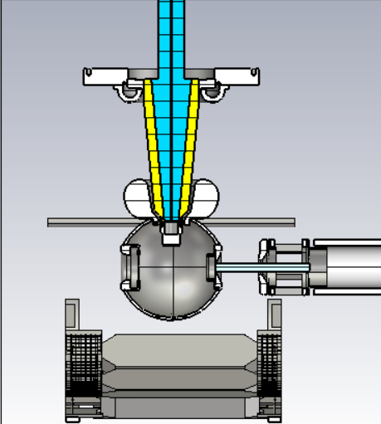
3D model

Slide 4
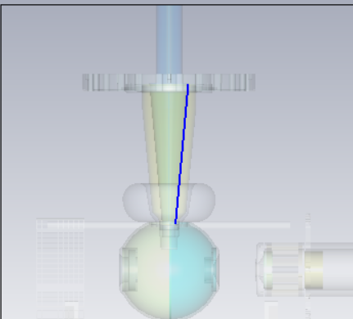
Potential

Slide 5
Electric field Ey

Slide 6
Electric field Ez

