Slide 1
UITF (10/28/19)
Deliverables/Milestones
    Commission the QCM before installation at CEBAF during the 2020 shutdown, eight months from now
    Provide beam to HDIce for target tests (four or five run periods requested)
Staffing for FY2020
    FTEs: 2.5 FTEs requested for upkeep (0.5 FTE) and operations (2 FTE)
    FTEs: RSRUIT
    Skills :
      Facility Manager and Operators
      I&C (viewers, bpms, vacuum, etc.)
      DC power (magnets)
      Survey and Alignment
      Safety System Group
      Software, High Level Apps
      Installation to remove/replace roof tiles
    When needed: now
Issues/Concerns that are/could affect on time delivery
    It remains difficult to control/force the schedule, and now complicated by planning for injector work May 2020, which is a big job
  QCM installation at CEBAF during 2020 SAD presents a small window of opportunity for timely HDIce tests
  There remains the LHe issue at CTF….
Recommended Mitigation

Slide 2
UITF (10/28/19)
Deliverables/Milestones
    Commission the QCM before installation at CEBAF during the 2020 shutdown, eight months from now
    Provide beam to HDIce for target tests (four or five run periods requested)
Staffing for FY2020
    FTEs: ~ 2 FTEs requested to continue “building” UITF
    FTEs: ITFPTB (but PSS BCM and trim card work can be assigned to another account)
    Skills :
      Complete the PSS BCM: 44 wks total from SSG and EESICS
      Complete the trim cards: 32 wks total DC Power and EESSUP
      Need a buncher that works: 10 more wks

Slide 3
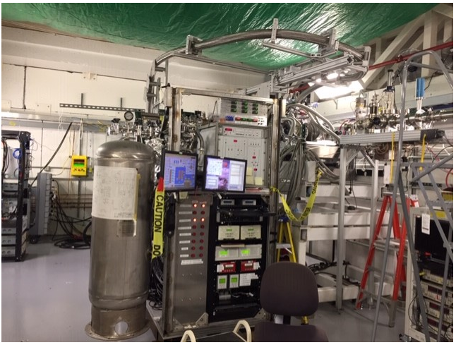
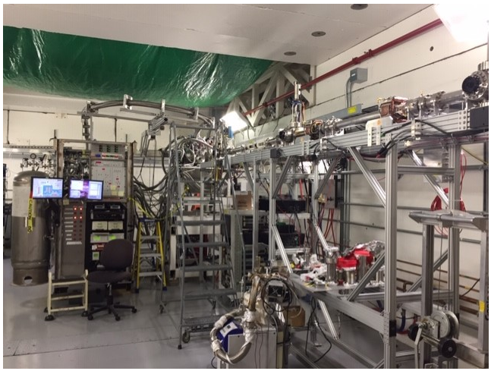
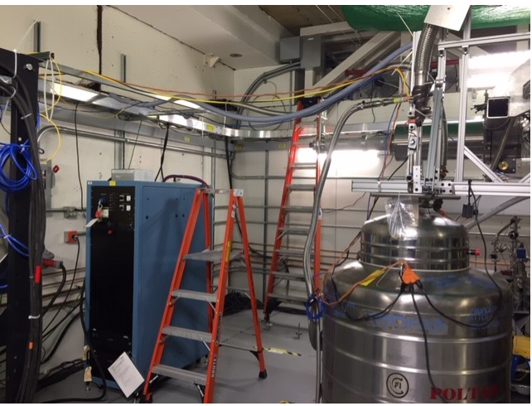
UITF update, HDIce re-installation, dump installation
Repairs to IBC successful
Now installing the dump magnet and power supply
Vacuum all the way to IBC

Slide 4
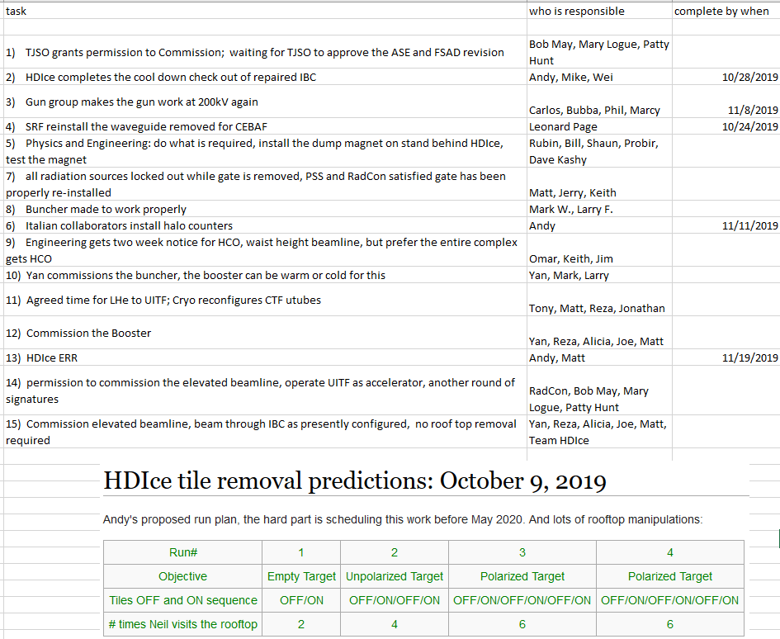

Slide 5
UITF – status and mitigation
Future challenges:
  The Gun and Injector Groups (nominally, the people we originally imagined operating UITF) need to focus on the CEBAF injector upgrade
  Team HDIce requesting four multi-week run periods, preferably before we remove the booster May 2020
  Formality of DOE requirements….suggests fulltime Facility Manager and Operations staffing required
  Liquid helium: the CTF refrigerator at building 58 cannot provide sufficient LHe to operate Vertical Test Area, Cryomodule Test Facility and UITF simultaneously

Slide 6

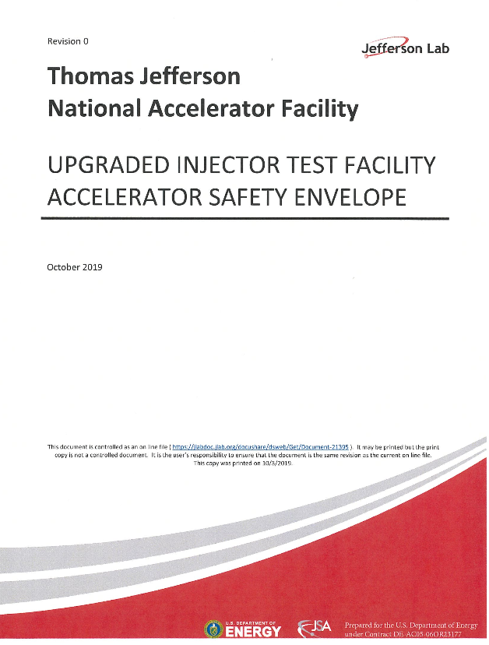
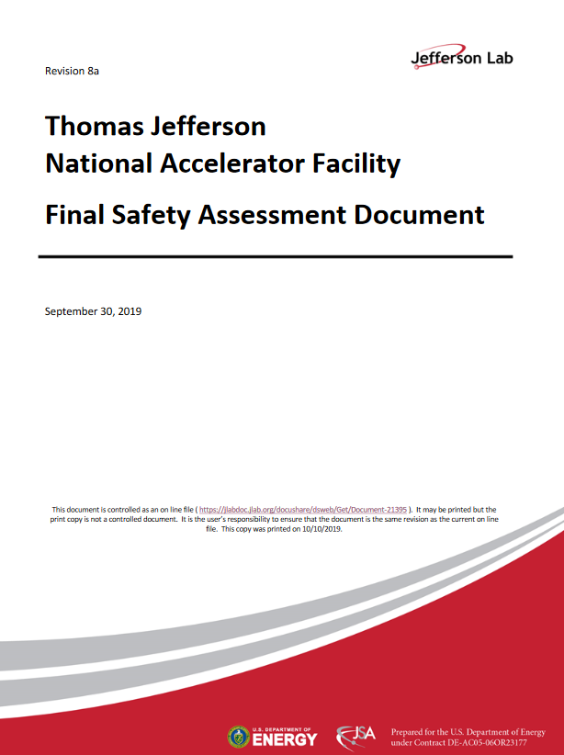
Official Documentation
Waiting for TJSO to approve these documents, and then grant permission to commission
https://wiki.jlab.org/ciswiki/index.php/UITF_Official_Documents
https://www.jlab.org/eshq/ProgramDocs

