Slide 1

200 kV Gun and Electron Transport
Operations and Concerns from Source Group Perspective
Joe Grames
June 13, 2018

Slide 2
Outline
Motivation
  130 keV Gun
  Injector Upgrade
Major Components of the Upgrade
  200 kV Electrode
  High Voltage Power Supply
  SF6 Management
  Addition of modified M20 BPM’s
Injector Operations
  Routine 130 keV operations (until QCM 2020)
  Test injector performance w/ 200 keV “probe beam’
  Study 200 keV beam (PQB, Lifetime, Transmission)

Slide 3

CEBAF Gun 2 (130kV)
CEBAF Polarized Inverted Load Lock Gun (Spring 2017)

Slide 4
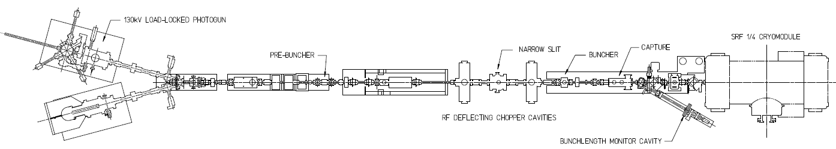
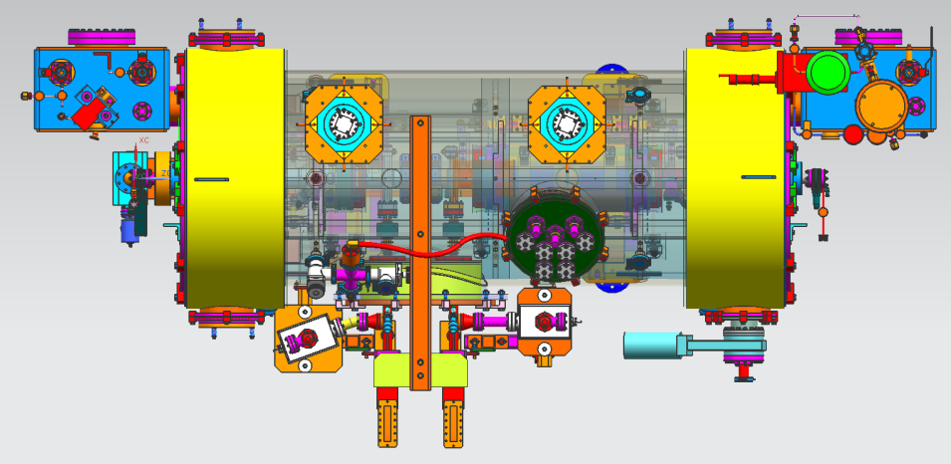
Injector Upgrade Project
200 kV
Stage 1 - Increase gun voltage and Wien filters for 200kV operation
Stage 2 - Locate Wien filters (energy filter) upstream of pre-buncher cavity
Stage 3 - New SRF booster eliminates warm capture, RF deflection and x/y coupling
Our new “1/4 cryomodule”:
2 cell capture section + 7 cell cavity,
should provide 10 MeV beam and introduce no x/y coupling, allow better matching, more adiabatic damping

Slide 5
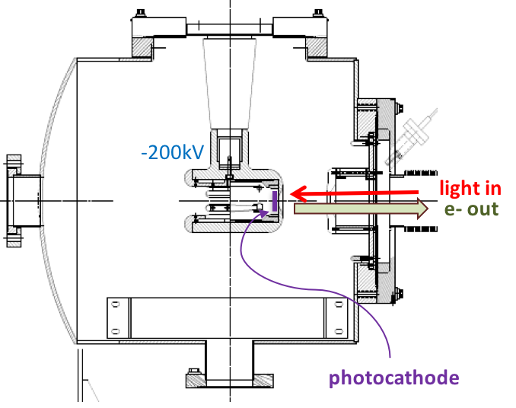

200 kV Gun Design Goals
Modify spare CEBAF/ILC gun for reliable 200 kV operation
  Retain extreme high vacuum (XHV) 1E-12 Torr
  Reliable 200 kV operation w/o field emission
Work of G. Palacios, C.H. Garcia

Slide 6
COMSOL model of gun improvements
Original CEBAF Inverted Electrode @ 200 kV
Upgraded Electrode @ 200kV
Pure alumina insulator
No triple point shielding
Mildly conductive alumina insulator for charge dissipation
Triple point shielding to prevent arcing across HV plug
Work of G. Palacios, C.H. Garcia

Slide 7
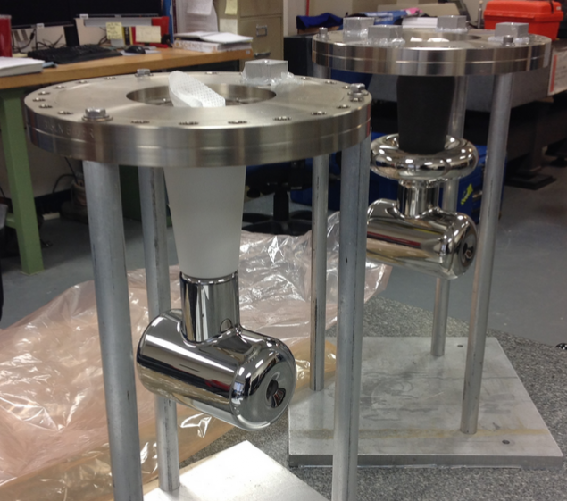
Side-by-Side Comparison (May 2018)

Slide 8
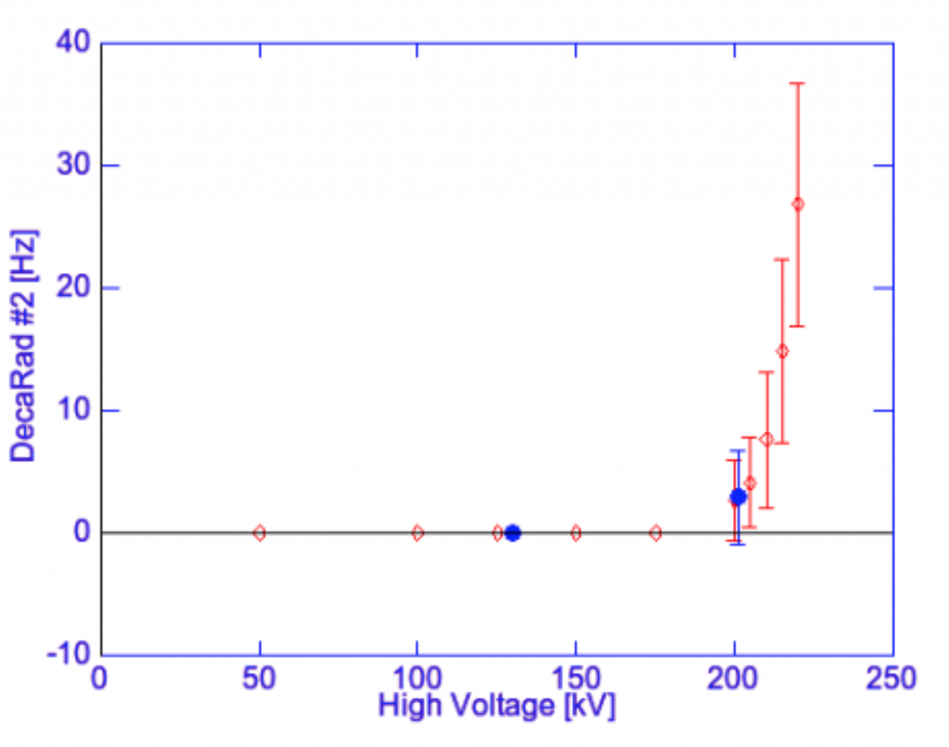
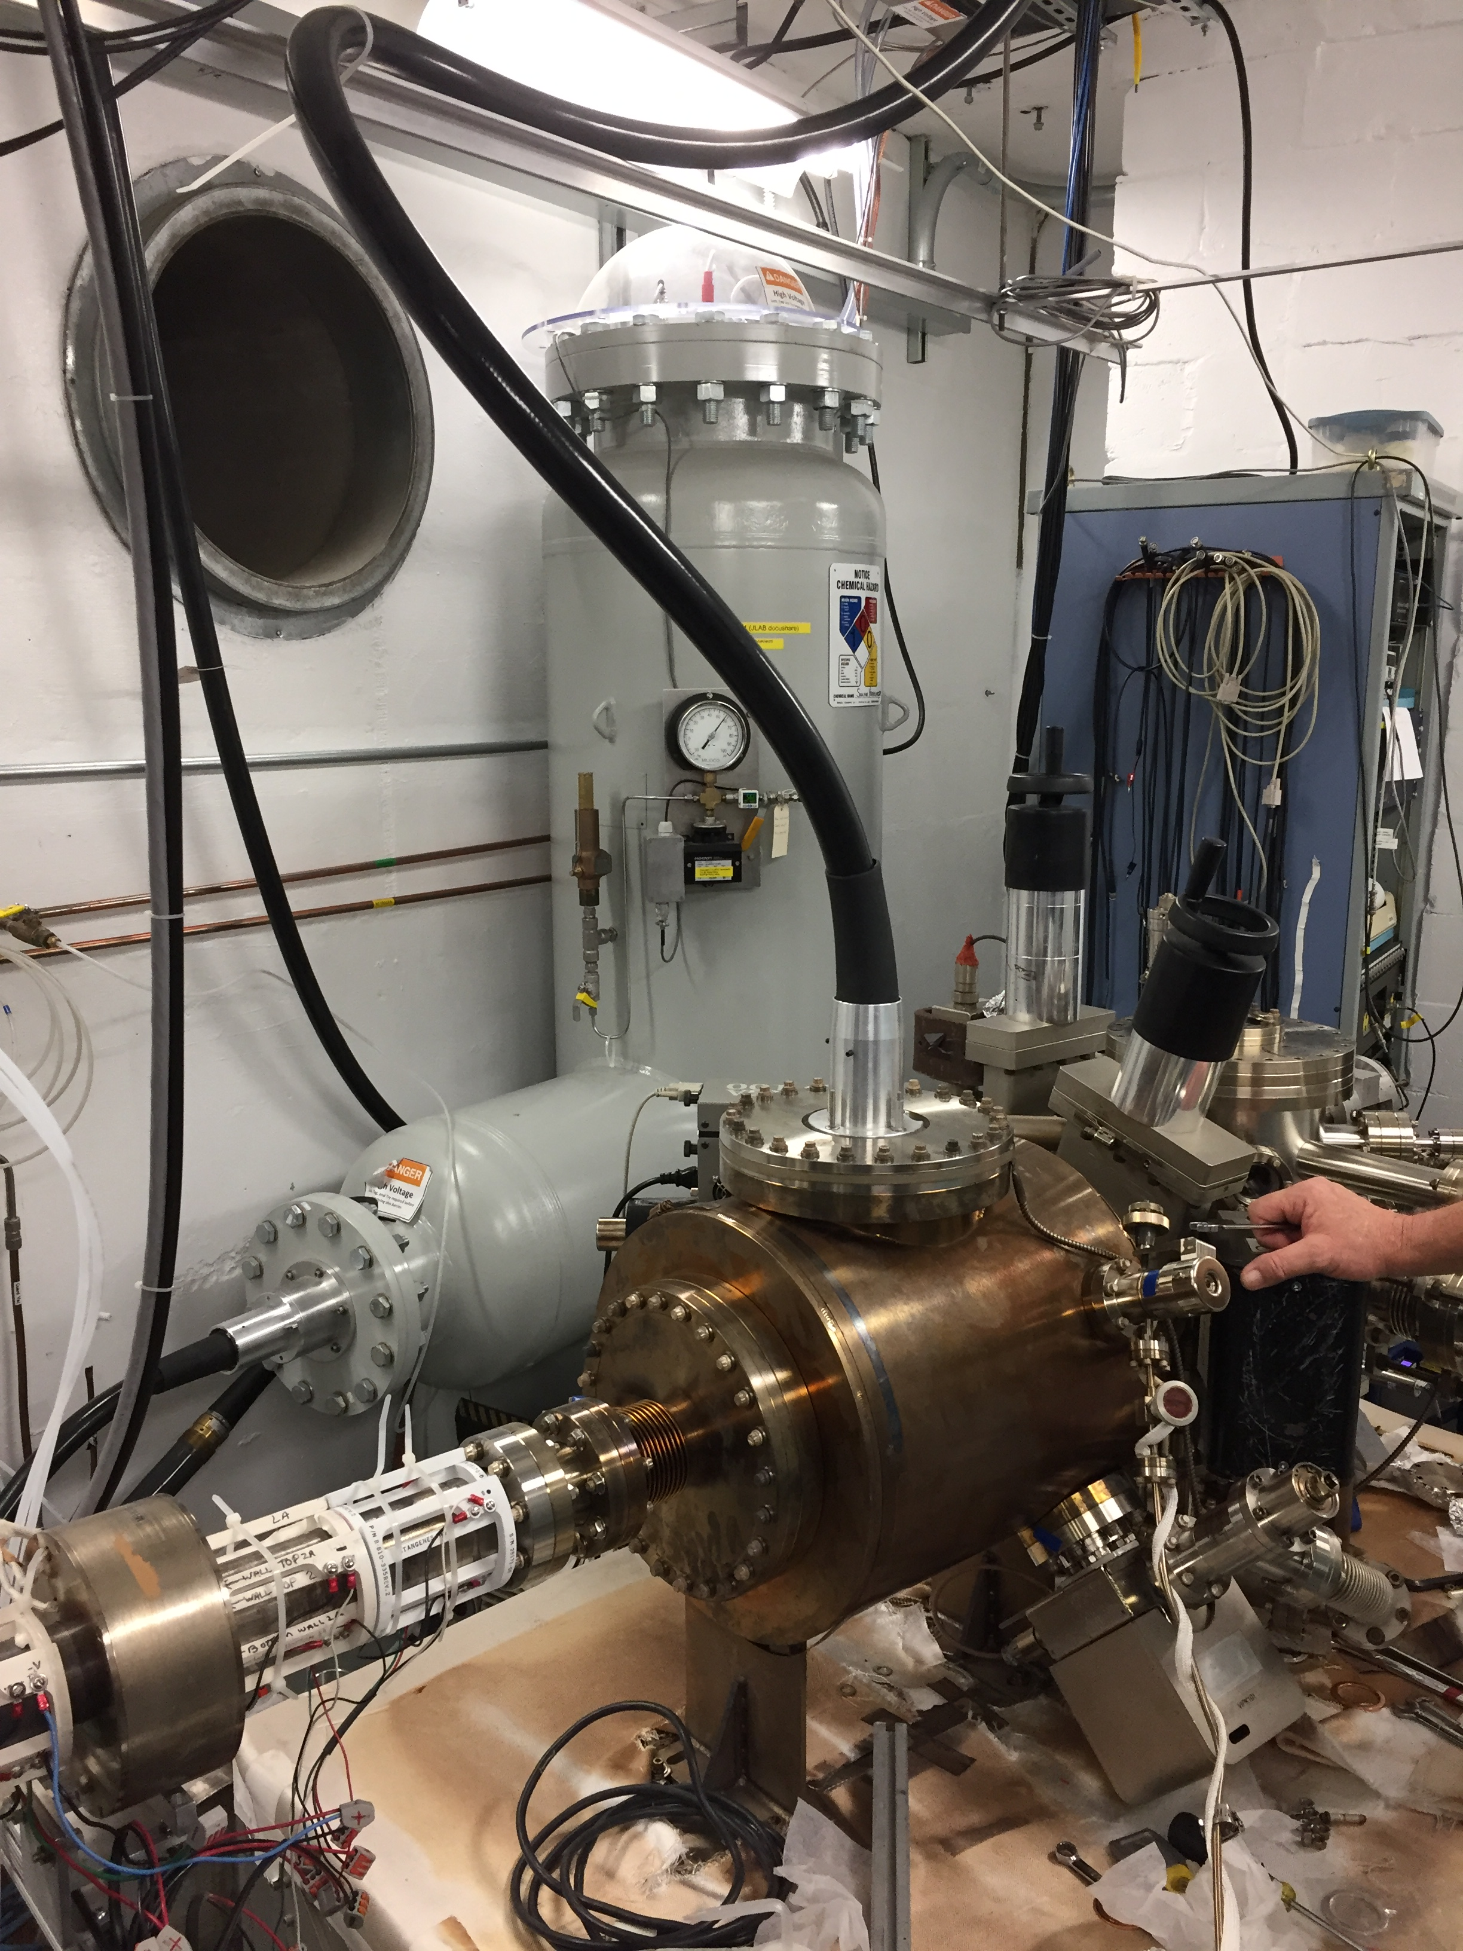
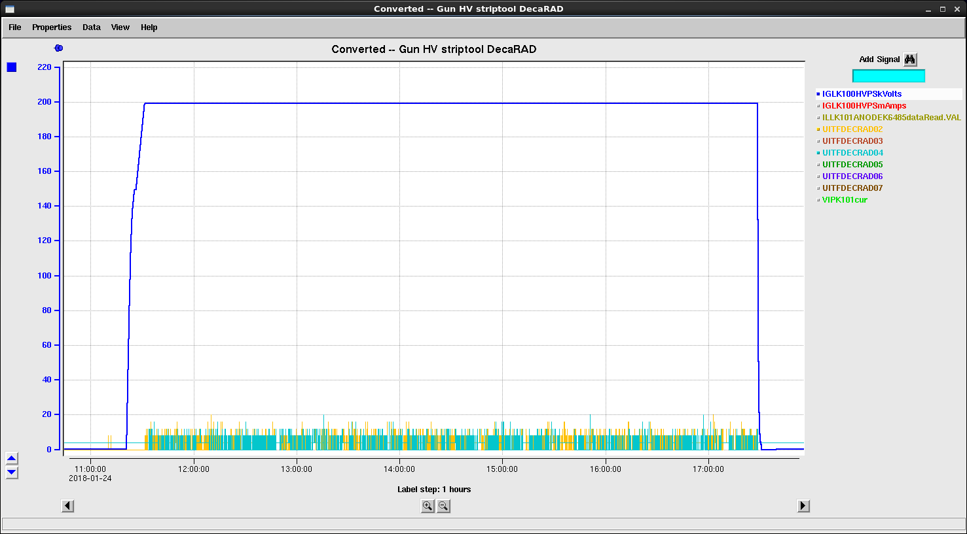
Testing the 200 kV Electrode/Gun at UITF
Field emission onset >200 kV
Operated the gun at 200 kV routinely w/ stable vacuum and low radiation monitor levels
HV conditioned to 227 kV (w/ Kr) using the 450 kV Glassman HVPS

Slide 9
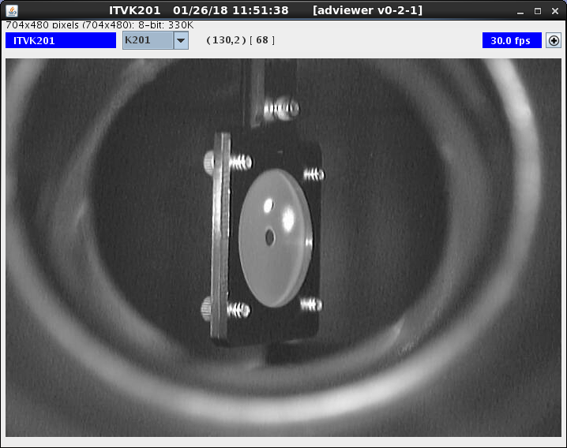
Making 200 keV Beam using the 200 kV Electrode at UITF
  Delivered beam to dumps (upstream of new QCM)
200 keV beam on first viewer
Retroreflection from photocathode
Incident laser through hole

Slide 10
Upgrading the CEBAF HVPS for 200 kV Operation
Before (150kV)
HV Interlocks
PSS/MPS
Now (350kV max)
HV Interlocks
PSS/MPS
ISB Rack
ISB Rack
Glassman (150kV)
Software
HV Enable
Knife Switch
Glassman (350 kV)
Software
HV Enable
Knife Switch
Big Oil Tank
Ross Probe (1000:1)
Ross Probe DVM
Slow Lock (software)
HV Switch
Bias Switch
Battery Bias (cathode)
QE scan
Battery Bias (anode)
QE scan
Bus Bar
Gun Switches (x3)
Tunnel Penetration
Tunnel Penetration
Gun
350kV HVPS
SF6 Tank
(Short or 200 Mohm)
Gun
Little Oil Tank
Short
Resistor
Bus Bar
Tunnel Floor
Tunnel Floor

Slide 11
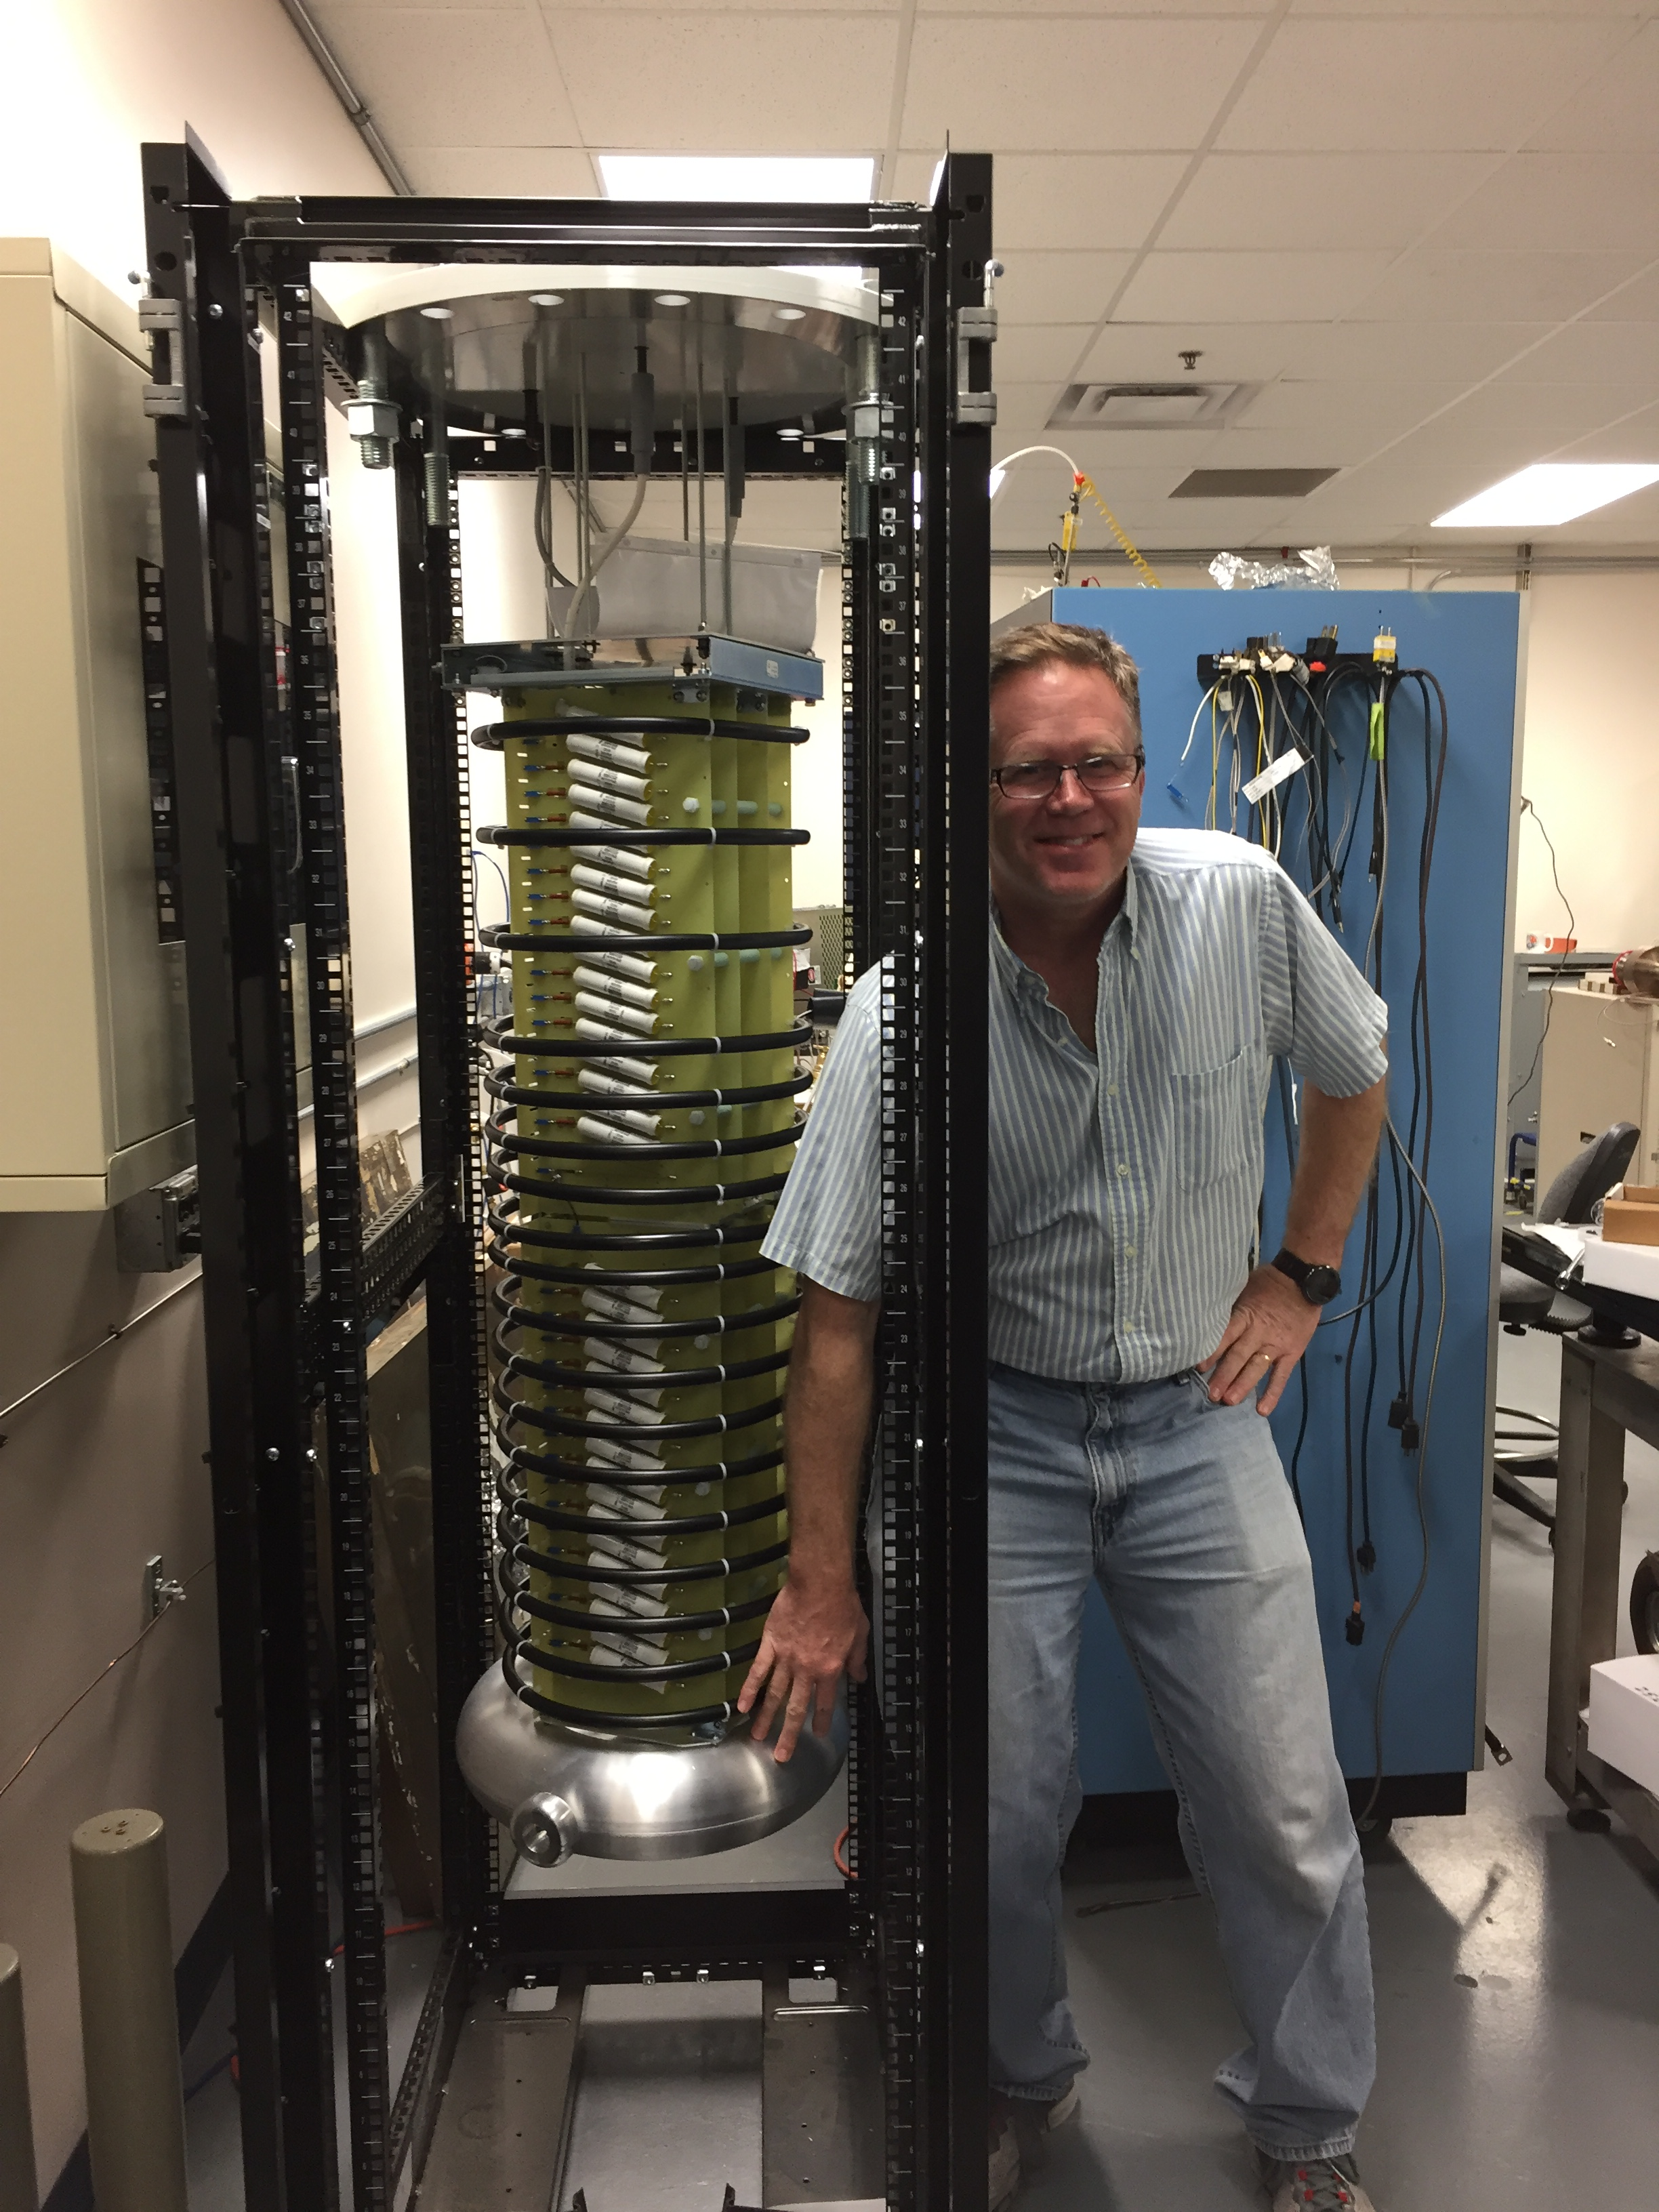
CEBAF Glassman 350 kV HVPS
High Voltage Ops (Power/Beam)
HVPS Enabled = Making Beam
Stages rectify 5 kV AC waveform
Max voltage at torus : -350 kV
Max current at torus : 4.5 mA
Low Voltage Ops (Restricted)
HVPS Disabled = QE Wafer Scan
Stages rectify X V AC waveform
Max voltage at torus : -28 V
Max current at torus : X microAmp

Slide 12
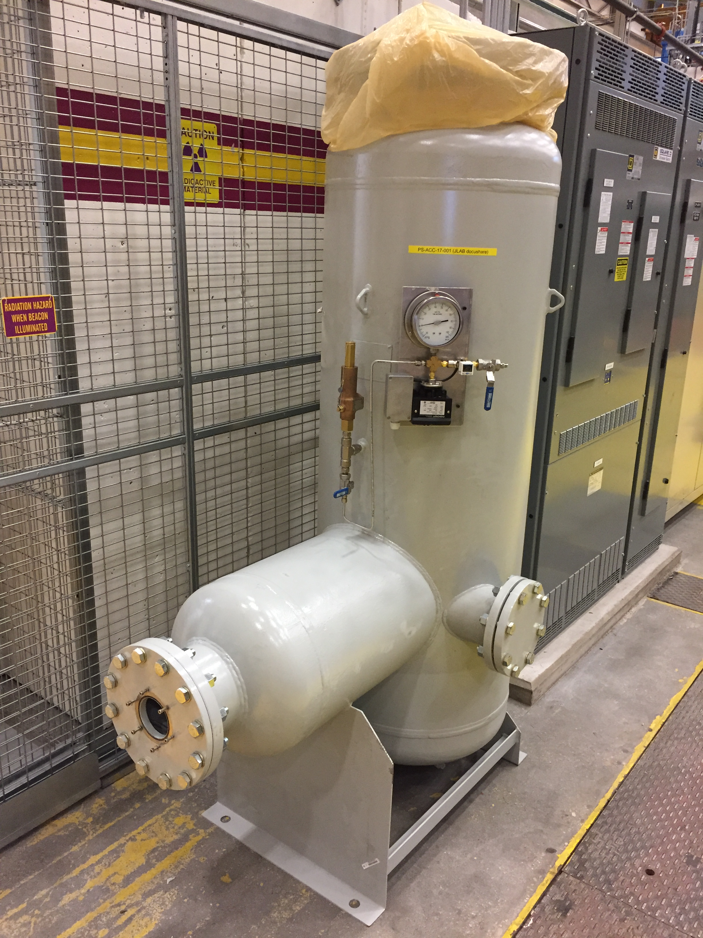
SF6 Pressure Tank
Design Authority : Mike Martin
Docushare : Design #
Parameter | Pressure
Vessel rating | 100 psi
Burst valve | 75 psi
Operating | 60 psi
HVPS Interlock | 55 psi

Slide 13
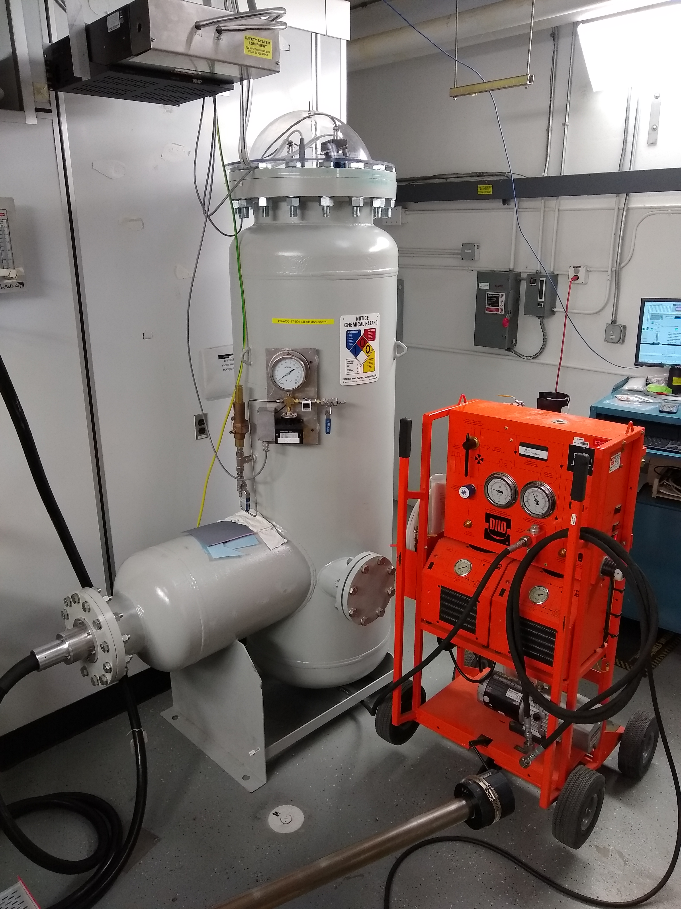
SF6 Recovery System (June 11, 2018)
J. Hansknecht, “SF6 Gas Transfer Tech Note” (February 1, 2017)
SF6 transfers are performed using the DILO D-320-R006 B143R01 Gas transfer and recovery unit.
Charging : SF6 Alum. Cylinder to Tank
Recovery : Tank to SF6 storage
Pumpdown : Tank evacuation (venting)
Parameter | Value
Tank Volume | 25 cf
SF6 weight (60psi) | 47 lb
Alum. Bottle Capacity | 75 lb
Alum. Bottle Lifetime | 5 years
EHS&Q (Jennifer) is making an assessment for total volume loss

Slide 14
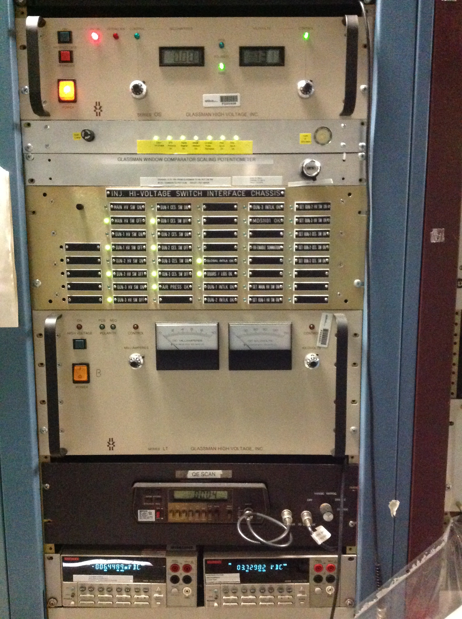
150kV/350kV HVPS Controls (IN01B01)
Glassman 350 kV Controller
350 kV Interlock Interface Unit
Glassman 150 kV Controller/Supply
150 kV Interlock Interface Unit
Multimeters (PS Voltage/Current)
Same for 150/350 kV Systems

Slide 15
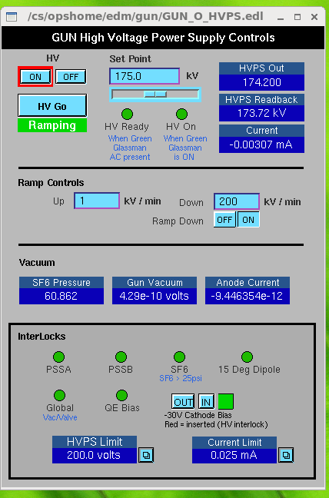
350 kV HVPS Operations Control (Software)
Glassman Interface
Turn supply ON/OFF (when HV Ready)
Set and Read PS Voltage and Current
Controls Ramp rates
Monitors Gun Performance + SF6
HV Enable Interlocks (PSS, SF6, Dipole, Gun Valve, Gun Vac, Bias Circuit)
Writes limits to Glassman controller

Slide 16
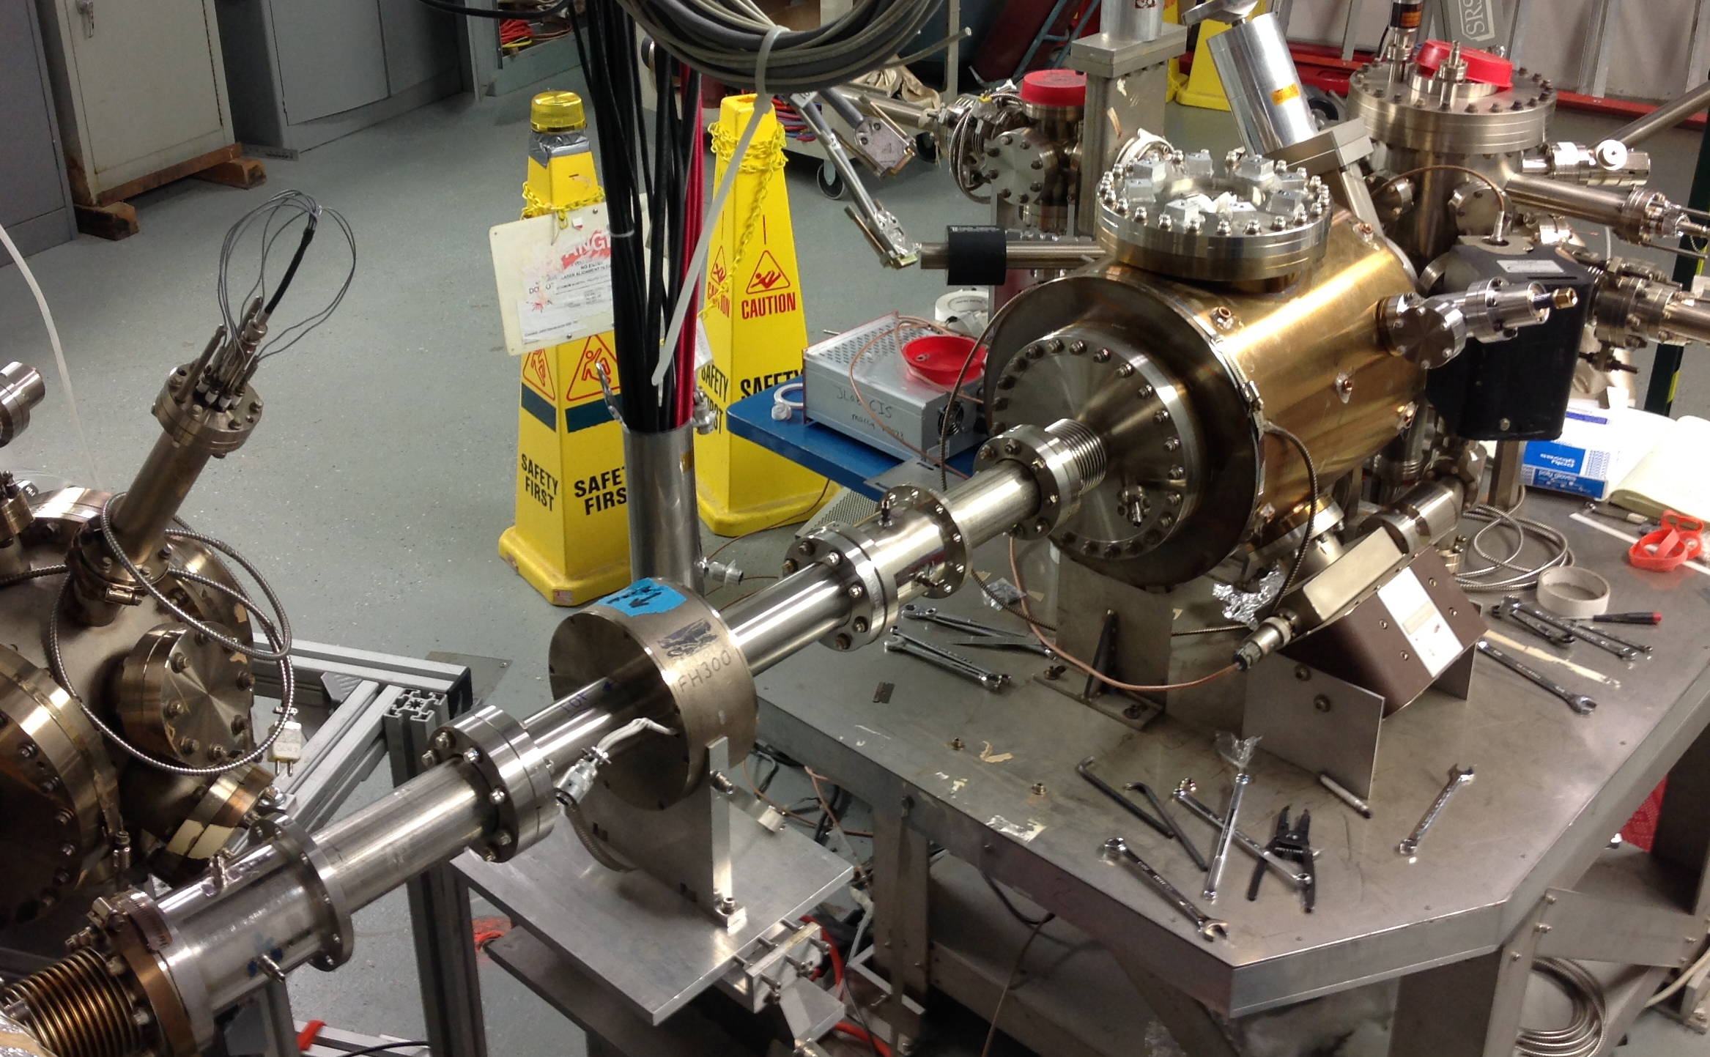
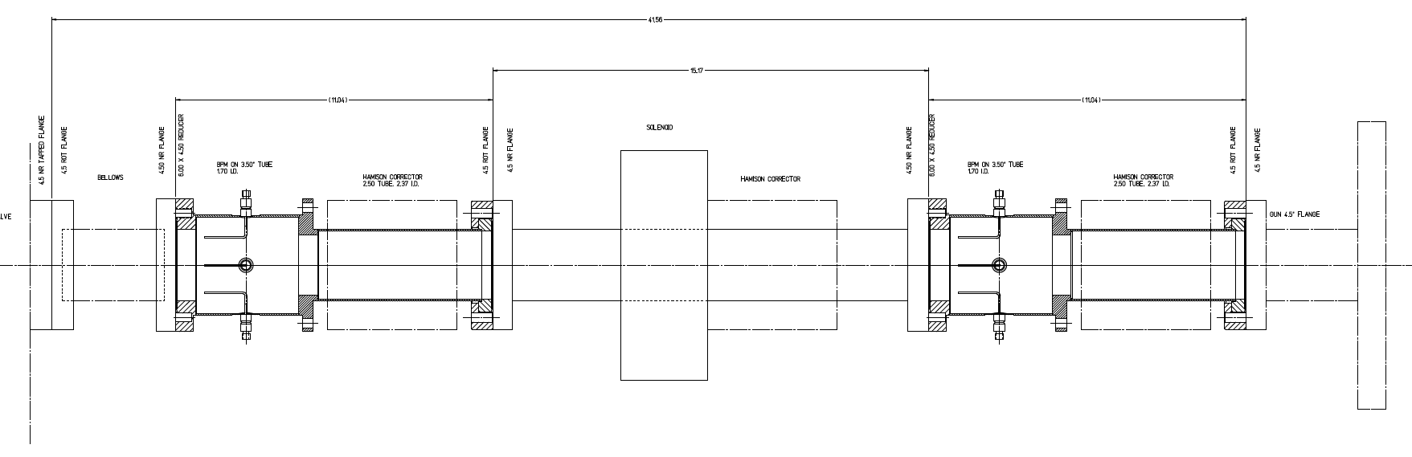
Adding Modified M20 BPM’s to the NEG tube
Augment NEG tube w/ BPM’s
Improve gun monitoring
Restore “Spot Move Steer”
Include S/H cards for PQB tests
Mapped on Gabou test stand
Explore 2nd moment

Slide 17
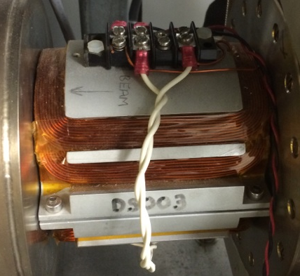
15° Dipole (MDS1I01) at 200 keV
We have safely operated the DS dipole at UITF for 200 keV beam.
AWG#18 Round Ampacity = 7 A
Designers Rule of Thumb < 5 A/mm²
 |  |  |  |  |  |  | AWG18
 |  |  |  |  |  | As-found | Measured
 |  |  |  |  |  | Diameter | 0.0403"
 |  |  |  |  |  | Area | 0.823 mm²
 |  |  |  |  |  | Ampacity | 7 Amp
 | T | E | γ | p | BL | PS | Current Density
 | [MeV] | [MeV] | [#] | [MeV/c] | [G-cm] | [A] | [A/mm²]
T-Gun | 0.100 | 0.611 | 1.196 | 0.335 | 291.476 | 2.024 | 2.459
Inv. Gun | 0.130 | 0.641 | 1.254 | 0.387 | 336.747 | 2.339 | 2.841
 | 0.150 | 0.661 | 1.294 | 0.419 | 364.851 | 2.534 | 3.079
Upgrade | 0.200 | 0.711 | 1.391 | 0.494 | 430.186 | 2.987 | 3.630
 | 0.250 | 0.761 | 1.489 | 0.564 | 490.704 | 3.408 | 4.141
 | 0.300 | 0.811 | 1.587 | 0.630 | 548.002 | 3.806 | 4.624
UITF (Max) | 0.350 | 0.861 | 1.685 | 0.693 | 603.000 | 4.187 | 5.088
 | 0.400 | 0.911 | 1.783 | 0.754 | 656.275 | 4.557 | 5.538
MAX HVPS | 0.450 | 0.961 | 1.881 | 0.814 | 708.217 | 4.918 | 5.976

Slide 18
CEBAF Solenoids at 200 keV
 |  |  |  |  |  | FH | FB | FA | FQ |  | FH | FB | FA | FQ
 | T | E | γ | p | F=0.5m | 861.780 | 998.820 | 1111.030 | 1342.440 | F=0.75m | 861.780 | 998.820 | 1111.030 | 1342.440
 | [MeV] | [MeV] | [#] | [MeV/c] | [G2-m] | [A] | [A] | [A] | [A] | [G2-m] | [A] | [A] | [A] | [A]
T-Gun | 0.100 | 0.611 | 1.196 | 0.335 | 998.729 | 1.077 | 1.000 | 0.948 | 0.863 | 665.820 | 0.879 | 0.816 | 0.774 | 0.704
Inv. Gun | 0.130 | 0.641 | 1.254 | 0.387 | 1333.063 | 1.244 | 1.155 | 1.095 | 0.997 | 888.709 | 1.016 | 0.943 | 0.894 | 0.814
 | 0.150 | 0.661 | 1.294 | 0.419 | 1564.854 | 1.348 | 1.252 | 1.187 | 1.080 | 1043.236 | 1.100 | 1.022 | 0.969 | 0.882
Upgrade | 0.200 | 0.711 | 1.391 | 0.494 | 2175.486 | 1.589 | 1.476 | 1.399 | 1.273 | 1450.324 | 1.297 | 1.205 | 1.143 | 1.039
 | 0.250 | 0.761 | 1.489 | 0.564 | 2830.624 | 1.812 | 1.683 | 1.596 | 1.452 | 1887.082 | 1.480 | 1.375 | 1.303 | 1.186
 | 0.300 | 0.811 | 1.587 | 0.630 | 3530.269 | 2.024 | 1.880 | 1.783 | 1.622 | 2353.512 | 1.653 | 1.535 | 1.455 | 1.324
UITF (Max) | 0.350 | 0.861 | 1.685 | 0.693 | 4274.420 | 2.227 | 2.069 | 1.961 | 1.784 | 2849.614 | 1.818 | 1.689 | 1.602 | 1.457
 | 0.400 | 0.911 | 1.783 | 0.754 | 5063.079 | 2.424 | 2.251 | 2.135 | 1.942 | 3375.386 | 1.979 | 1.838 | 1.743 | 1.586
MAX HVPS | 0.450 | 0.961 | 1.881 | 0.814 | 5896.244 | 2.616 | 2.430 | 2.304 | 2.096 | 3930.829 | 2.136 | 1.984 | 1.881 | 1.711
We have re-mapped lens types for 200 keV operation and safely operated at UITF
  FH
  FB
  FA
  FQ
The chopper solenoids (FD) are highly resistive. We operate them from a 20A PS.

Slide 19
Chopper Operation at 200 keV
CEBAF 499 MHz chopper studies for 200 keV Ops (May-June 2018)
  200 keV operation requires 200 W per channel (C1X,C1Y,C2X,C2Y)
  Drive line attenuators (not probes) removed to provide higher power
Cable maintenance performed
  Requires standard chopper setup (phasing), to be done initially at 130 keV
  Restore original 130 keV probe values (measure new drive values)
Test performance at 200 keV
  Perform chopper setup with increased power levels to set (measure) chopping circle
  Benchmark R/Q at desired power levels for chopping
Parameter | Forward (W) | Reflected (W)
C1X | 200 | 1
C1Y | 200 | 10
C2X | 194 | ?
C2Y | 215 | ?

Slide 20
Spares and Contingencies
The following table is in the context of a 200 keV capable gun.
Items in red need to be purchased or fabricated.
Function | Spare | Contingency
Electrode | Fabricate w/ shed(s) | 130 kV SS electrode 200 kV Nb electrode
High Voltage Power Supply | 450 kV Glassman | 150 kV Glassman Rollback
350 kV Interface Unit | (2) Tested Spares | 150 kV Glassman Rollback
R350 Socket | (2) Spare on shelf | 150 kV Glassman Rollback
R350-R28 HV Cable | (1) Spare due July (1) Purcahse add’l | 150 kV Glassman Rollback
200 MOhm resistor pair | (1) Spare UITF | 150 kV Glassman Rollback
Short | (1) Spare UITF | 150 kV Glassman Rollback
SF6 Tank | (1) Spare UITF | 150 kV Glassman Rollback
SF6 Gas | (1) Order cylinder or GTS | 150 kV Glassman Rollback
SF6 Recovery Al Cylinder | (1) Replace 2nd cylinder (5 yr) | 150 kV Glassman Rollback

Slide 21
Spares and Contingencies (con’t)
The following table is in the context of a 200 keV capable gun.
Items in red need to be purchased or fabricated.
Function | Spare | Contingency
SF6 Pressure Monitor | (1) Spare system at UITF | 150 kV Glassman Rollback
Low Voltage Bias Circuit | (X) Spares??? | Ground electrode
Keithley PS Voltage Monitor | (X) Spares??? | n/a
Keithley PS Current Monitor | (X) Spares??? | n/a

Slide 22
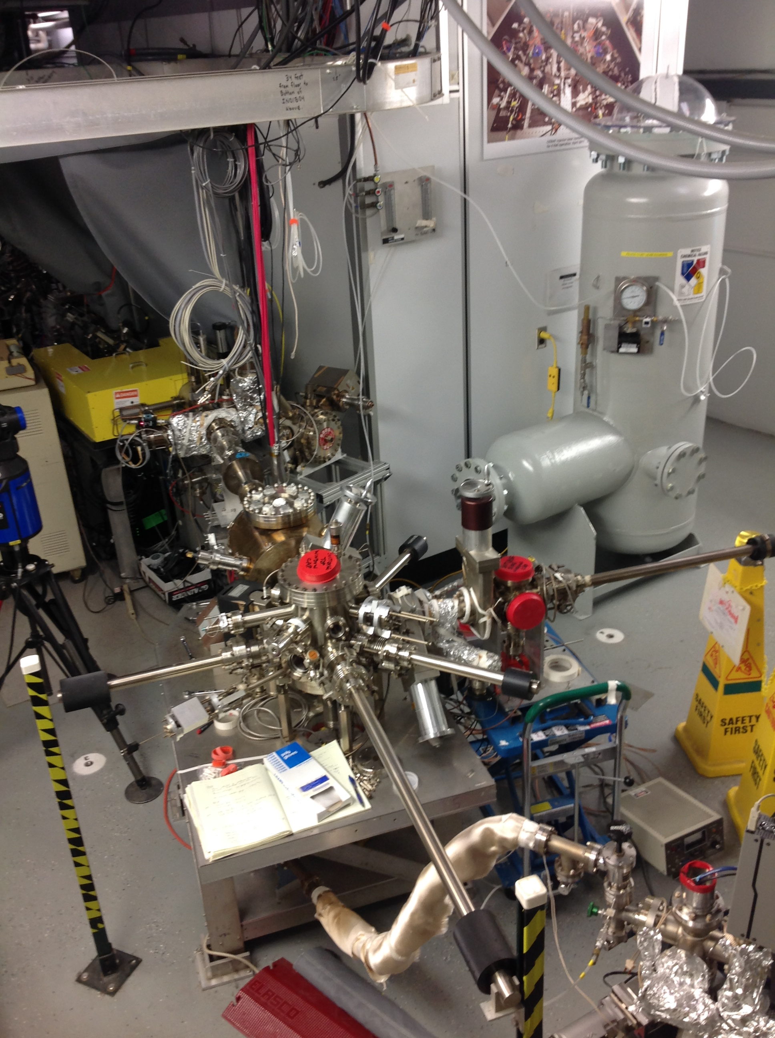
Summer 2018 SAD Plans and Gun2 Status
May – June
  Replace Gun2 electrode one w/ shed + conductive insulator
  Install and commission 350 kV HVPS
  Replace existing NEG tube w/ one that has two BPM’s
June – July
  High voltage condition to 200 kV (no beam)
  Restore at 130 keV to quantify electrode, HVPS stability, NEG tube BPM’s, PSS kicker
  Transition to 200 keV beam, define PSS kicker, test beam line (magnets + choppers at 200 keV)
  Quantify 200 keV beam (lifetime, PQB, transmission/emittance)

