Slide 1


350 kV Photoelectron Gun with Inverted-Insulator Geometry
P. Adderley, D. Bullard, E. Forman, J. Grames, J. Hansknecht,
C. Hernandez-Garcia, M. Poelker, M. Stutzman,
R. Suleiman, S. Zhang
Students: M. BastaniNejad, Md. Abdullah A. Mamun, Y. Wang
Polarized Sources, Targets and Polarimeters Workshop, Bochum Germany, Sept. 14-18, 2015
Matt Poelker, Jefferson Lab
Notes:
Interior Page Design 2

Slide 2
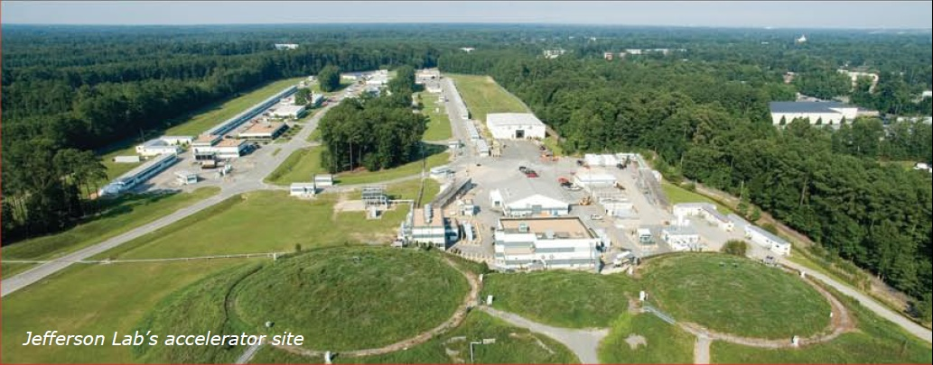
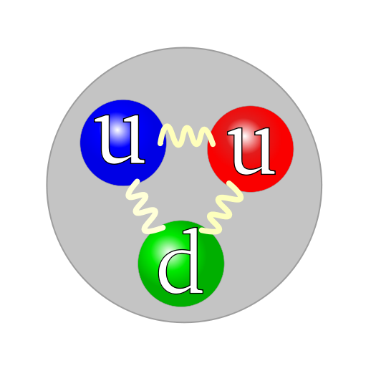
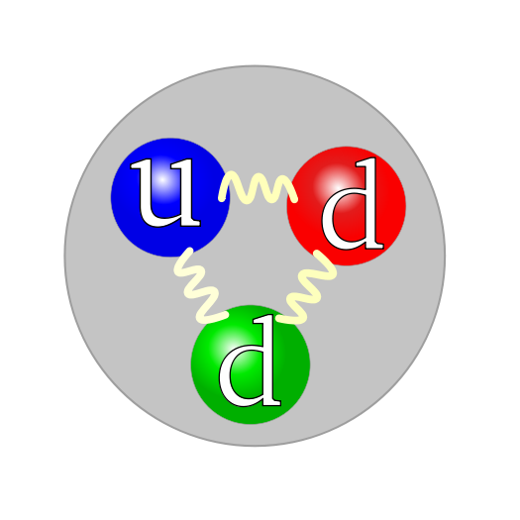
Things we’ve been Studying
Electron
Proton
Neutron
Matt Poelker, Jefferson Lab
Notes:
Interior Page Design 2

Slide 3
A New Photogun for New Initiatives
Compact 10 MeV accelerator to commission new hardware destined for CEBAF
  HDIce
  New SRF capture section for injector
  Test bed to improve beam quality for demanding parity-violation experiments
Load-locked gun for JLab’s FEL/ERL for DarkLight and other experiments
  DC high voltage gun, but with CsK₂Sb photocathode
Electron Ion Collider (MEIC, eRHIC, LHeC)
  High average current polarized beams and very high current un-polarized beams for cooling proton beams
  Magnetized beam
Matt Poelker, Jefferson Lab
Notes:
Interior Page Design 2

Slide 4
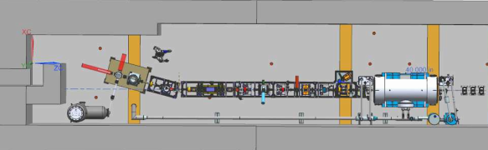
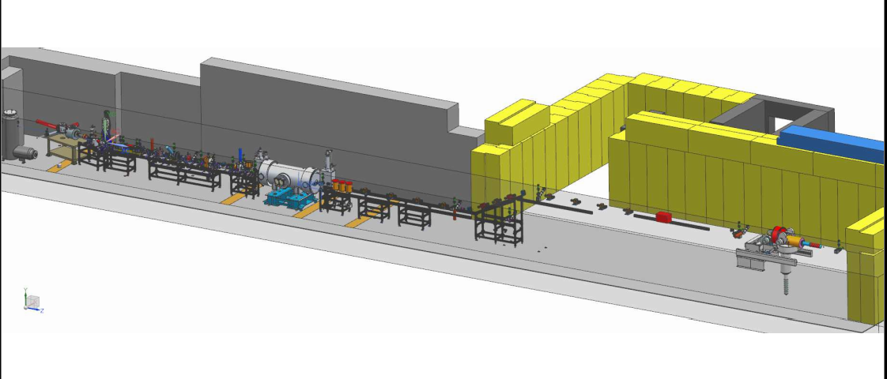
10 MeV beam to commission HDIce
350kV inverted gun + chopper + buncher + “traditional” JLab ¼ cryomodule

Slide 5
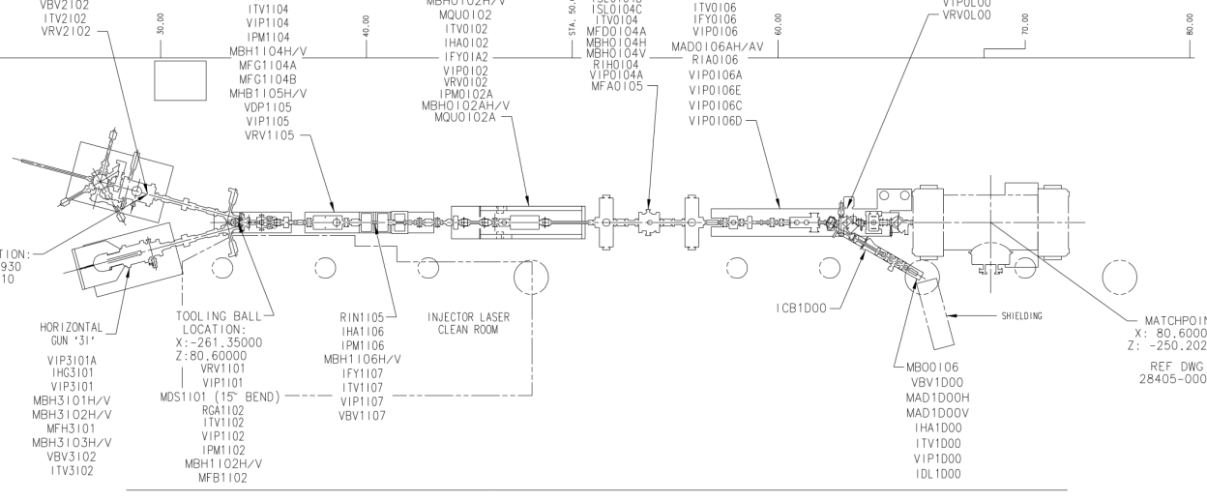
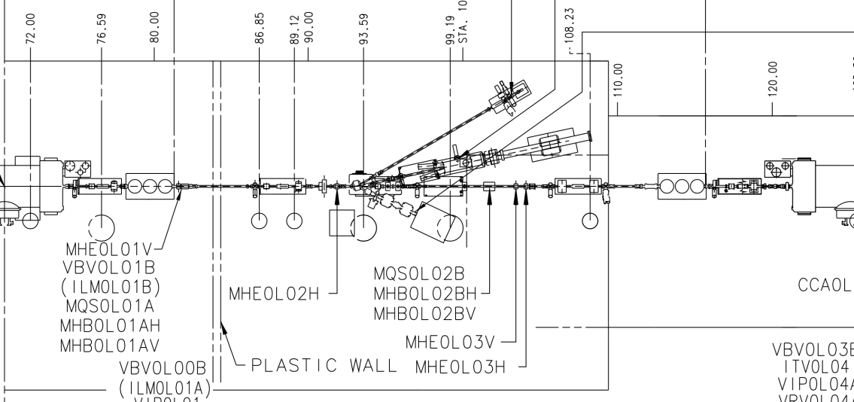
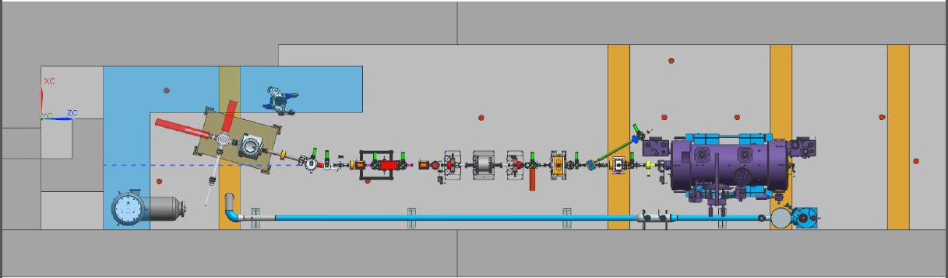
Preparing for the next generation Parity-Violation Experiment
deliver 100% long polarization to two halls simultaneously - each gun/beamline has spin manipulators
parity violation experiments can monitor helicity correlated beam properties directly from gun. No other superimposed beams from gun to merger point
apertures at injector are good for non-parity users, they keep them. Apertures are bad for parity Users, the new line could eliminate them, hopefully even the chopper
Parity violation experiments get a laser "clean-up polarizer" to provide near perfect circular polarization, which helps reduce helicity correlated beam asymmetries
Proposed by Joe Grames

Slide 6
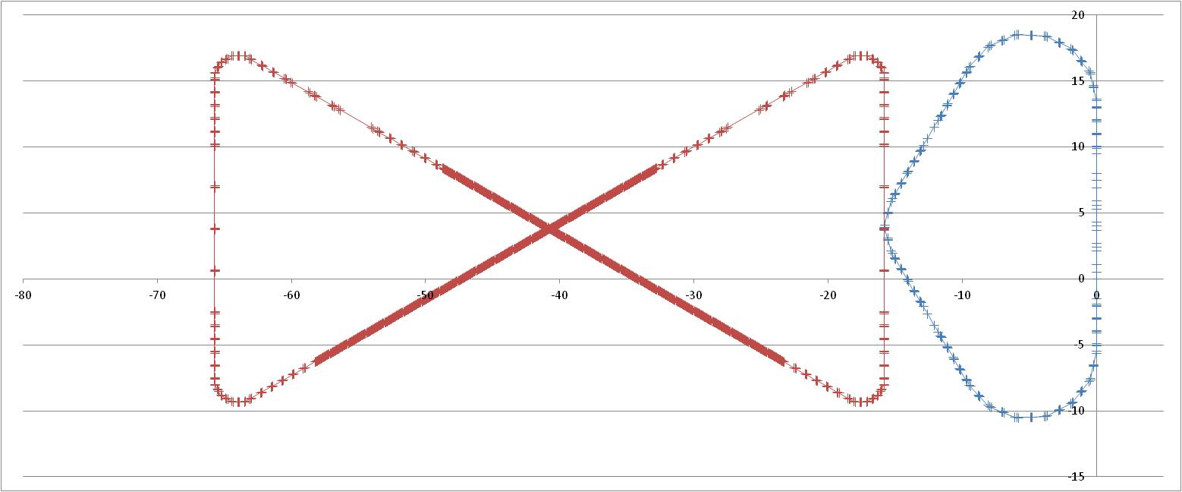
ERL Circulator Cooler Concept
solenoid
Design Choices
Energy Recovery Linac (ERL)
Compact circulator ring to meet design challenges
Large RF power, up to 81 MW
Very high electron beam current: 1.5 A
Required technologies
High current ERL (55 MeV, 15 to150 mA)
Magnetized beam
High bunch charge (2 nC)
Ultra fast kicker
ion bunch
electron bunch
Cooling section
Fast kicker
circulator ring
Fast kicker
energy recovery
dump
injector
SRF Linac
recirculating 10+ turns ➔ reduction of current from an ERL by a same factor
decompression
CCR
dump
beam exchange system
dechirper
cooling solenoids
ERL
SRF
rechirper
injector
Proposed by S. Derbenev
D. Douglas C. Tennant
recompression
Matt Poelker, Jefferson Lab
Notes:
Interior Page Design 2

Slide 7

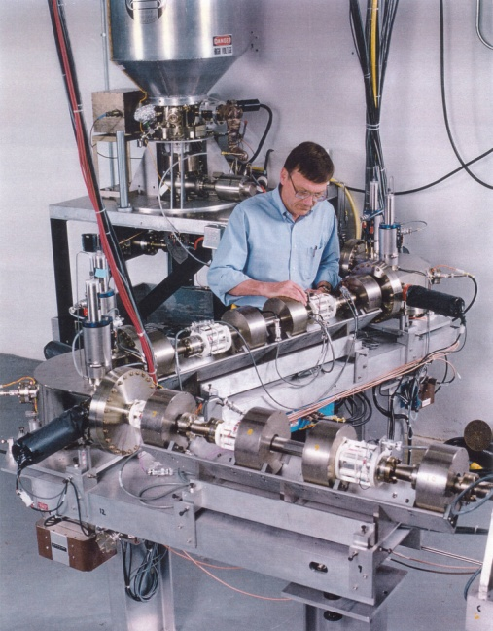
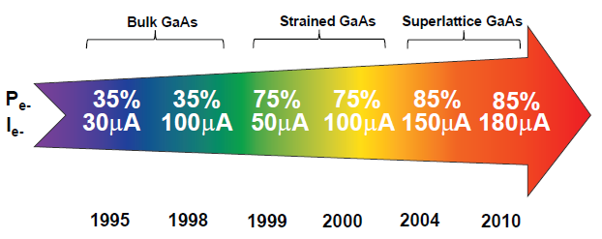
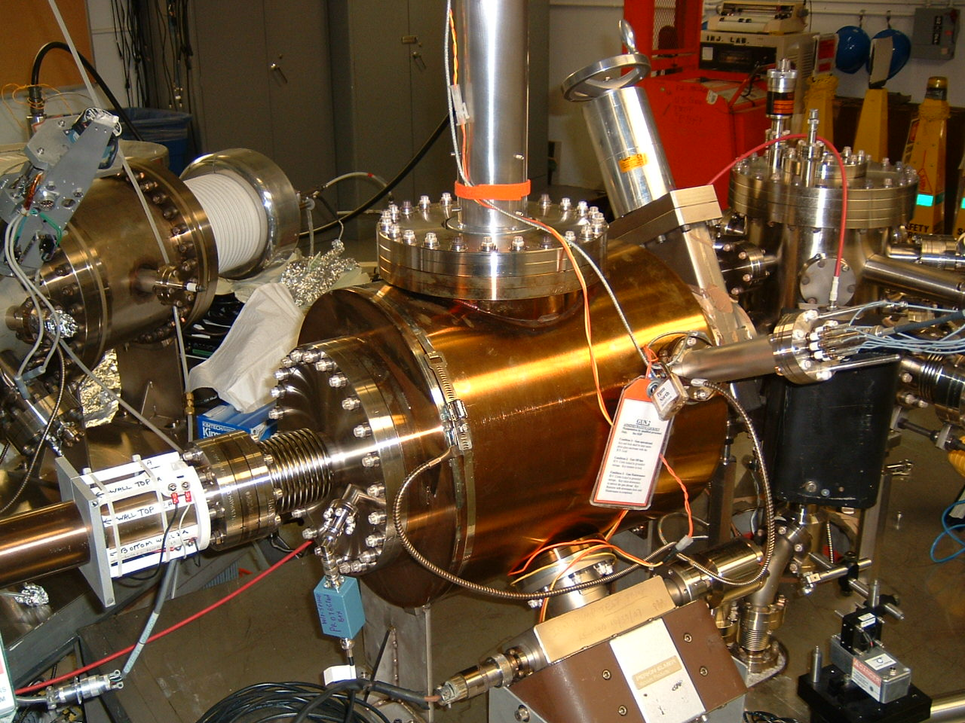
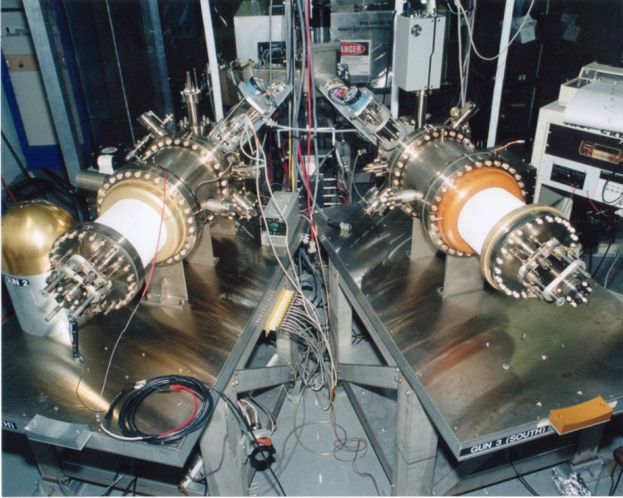
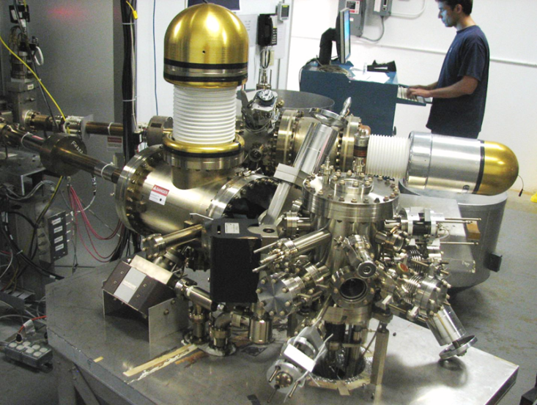
Always Tweaking the Design
1
Text goes here
4
Endless (?) quest for perfection
2
3
Matt Poelker, Jefferson Lab
Notes:
Interior Page Design 1

Slide 8

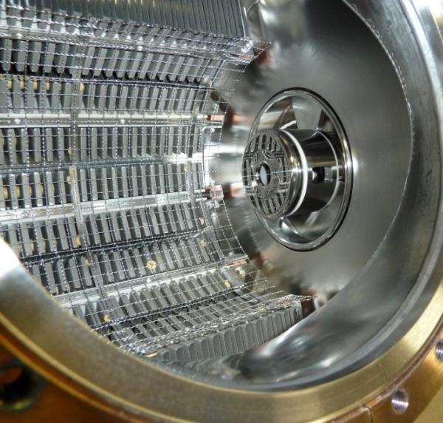
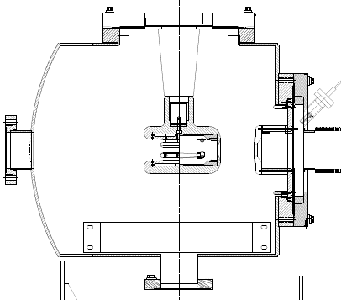
The CEBAF - ILC 200kV Inverted Gun
NEG pumps
New design
Our “Load-locked” GaAs photogun:
Gun Vacuum ~ mid to low 10⁻¹² Torr
Beamline vacuum could be improved…
Matt Poelker, Jefferson Lab
Notes:
Interior Page Design 2

Slide 9
Benefits of Higher Gun Voltage
Reduce space-charge-induced emittance growth, maintain small transverse beam profile and short bunch-length. In other words, make a “stiff” beam right from the gun
Reduce problems associated with Surface Charge Limit (i.e., QE reduction at high laser power)
Prolong Charge Lifetime (?)
Compact, less-complicated and less-expensive injector
Biggest Obstacle: Field Emission and HV Breakdown… which lead to bad vacuum and photocathode death
Matt Poelker, Jefferson Lab
Notes:
Interior Page Design 2

Slide 10
Field Emission
Sources of Field Emission: micro-protrusions, contamination on surface, material defects and impurities, ionization of desorbed gas, etc.,
Material choices: hardness, work function, grain structures and grain boundaries, electrical conductivity, thermal conductivity
Surfaces: generally people assume smooth is better than coarse, although experiments indicate smooth does not guarantee “good”
Mostly, people assume 5 MV/m is “easy” - we want to operate at 10 MV/m or higher
Matt Poelker, Jefferson Lab
Notes:
Interior Page Design 2

Slide 11
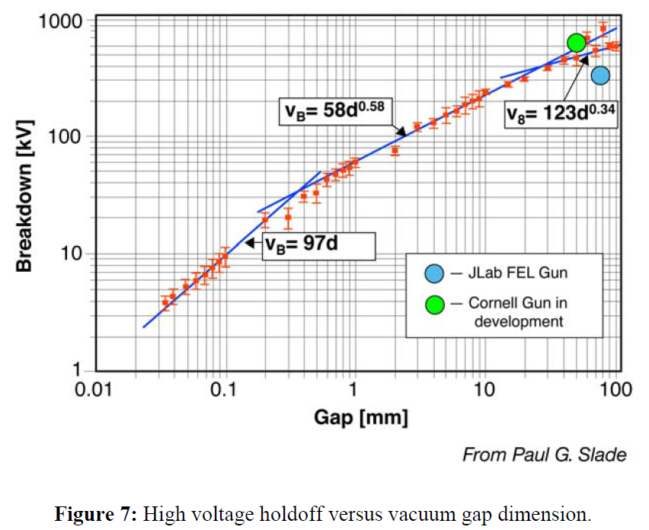
Breakdown in Vacuum
Matt Poelker, Jefferson Lab
Notes:
Interior Page Design 2

Slide 12
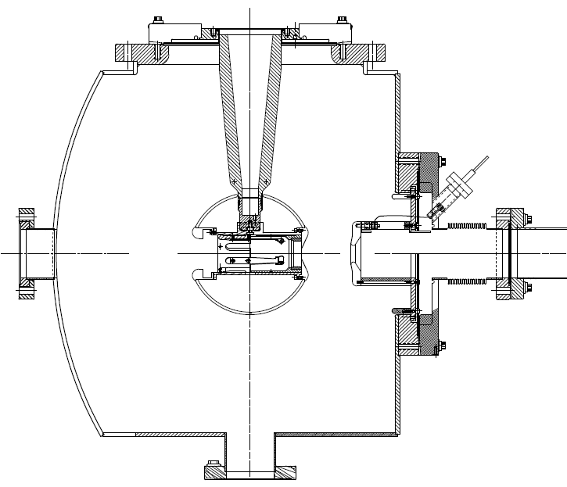
350 kV Photogun
Maximum Field strength ~ 10 MV/m
CEBAF 200kV Inverted Gun
“R28” insulator
Longer “R30” insulator
Spherical electrode
Thin NEG sheet - move ground plane further away
Matt Poelker, Jefferson Lab
Notes:
Interior Page Design 2

Slide 13
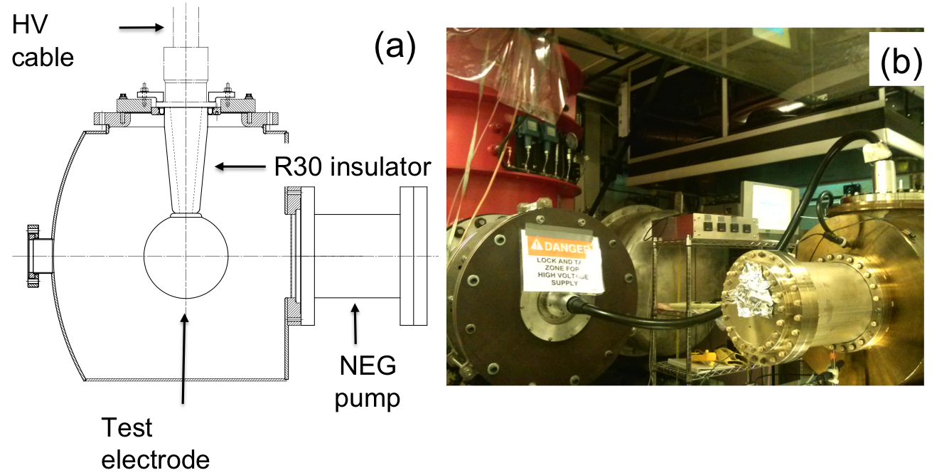
Building the 350 kV Gun
Start with “dummy” electrodes and test different insulators and cathode screening electrode
Notes:
Interior Page Design 2

Slide 14
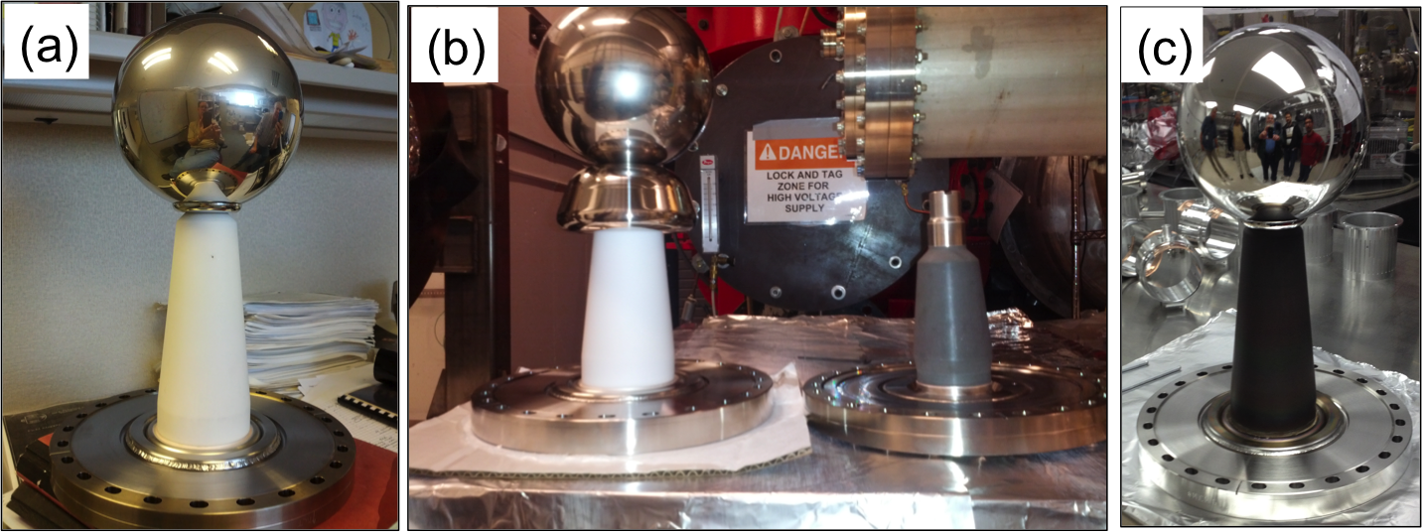
Insulators and Screening electrode
Longer R30 insulators, conventional alumina
Short R28 insulator, bulk resistivity, mildly conductive
Longer R30 insulator, bulk resistivity, mildly conductive
ZrO-coated R30 insulator, also mildly conductive
dummy electrode with a screening electrode (shed)
Notes:
Interior Page Design 2

Slide 15
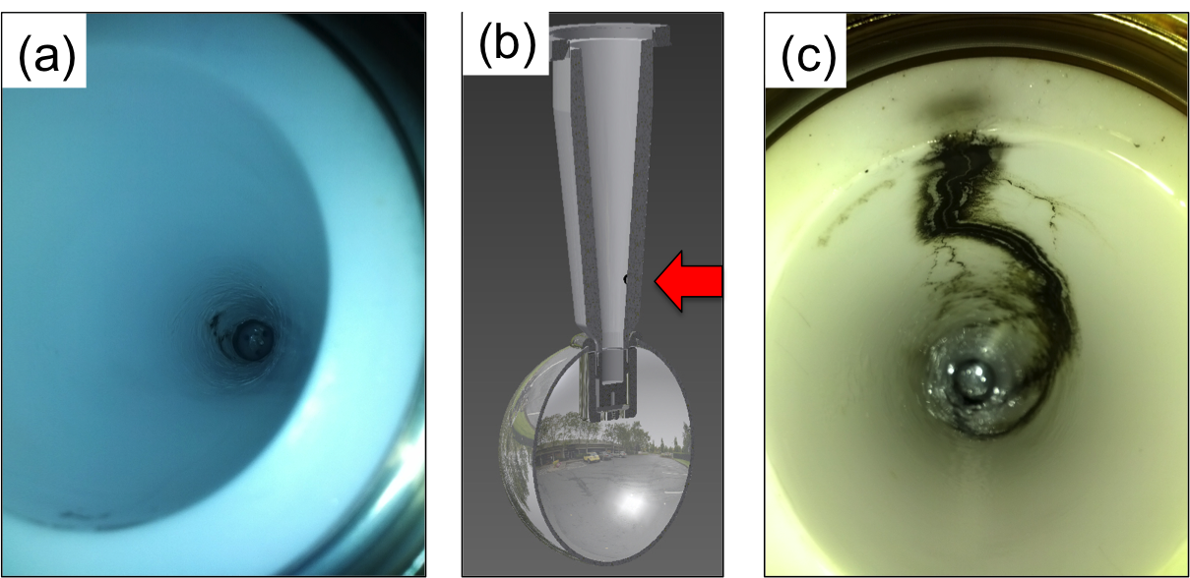
Breakdown at Cable/Insulator Interface
Problems at the cable junction, atmosphere side
Note: Field emission was managed via krypton-processing. i.e., voltage first applied with ~10⁻⁵ Torr krypton added to gun chamber
Notes:
Interior Page Design 2

Slide 16
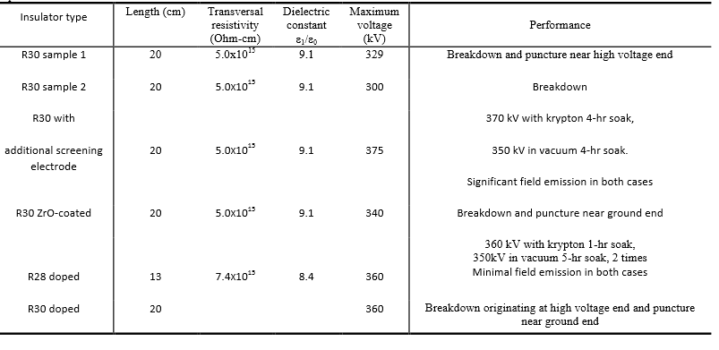
Summary of Tests
Two and 1/2 configurations reached our voltage goal
Notes:
Interior Page Design 2

Slide 17
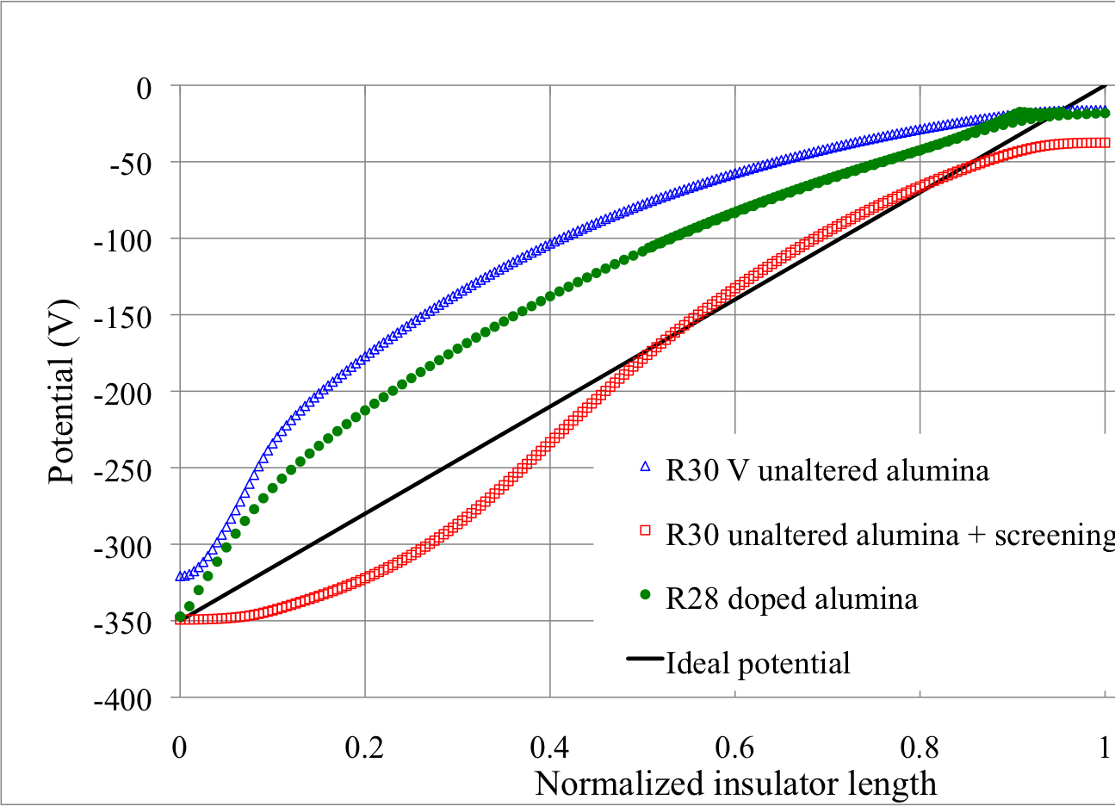
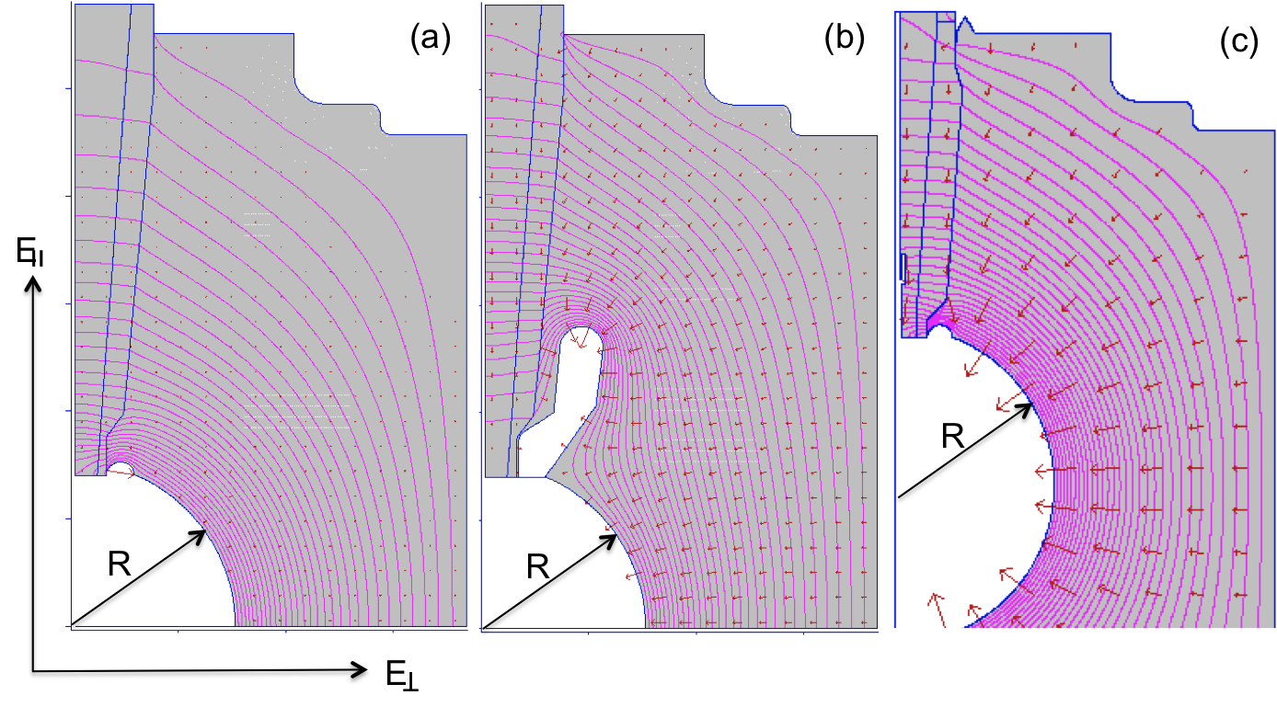
Linear Potential Drop
Want a linear potential gradient along length of the insulator
Note - POISSON does not accurately model the mildly-conductive feature of the black insulator
Notes:
Interior Page Design 2

Slide 18
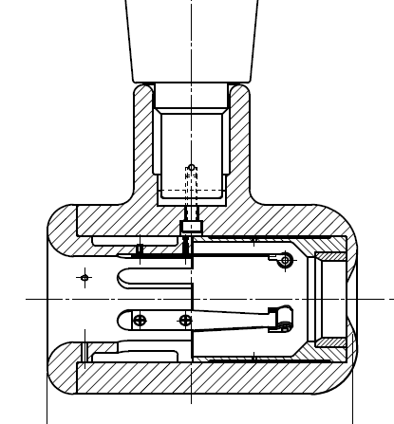
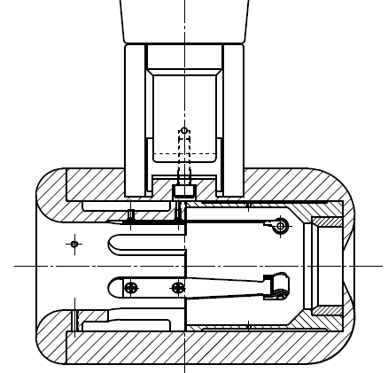
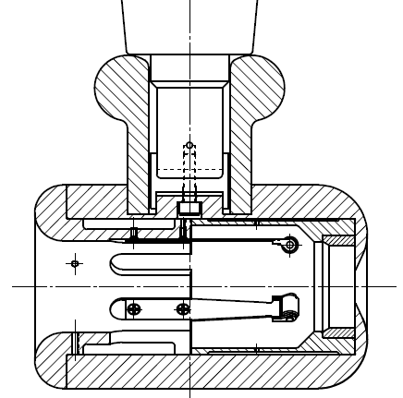
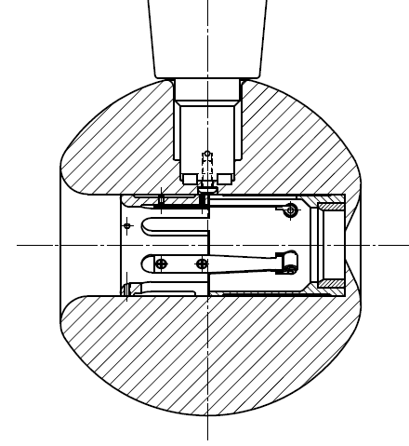
Plan B
Insulator sleeve
Plan A
No Improvement
Plan D
Plan C
In hand, but untested

Slide 19
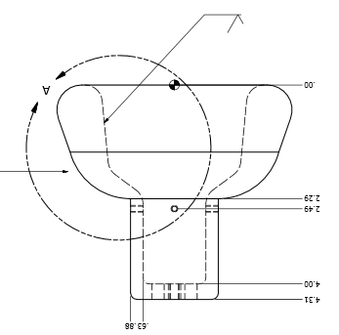
Plan Y: Combine the two features that provided incremental success: screening electrode and doped black R30 insulator
Replace dummy ball with electrode that can hold photocathode

Slide 20
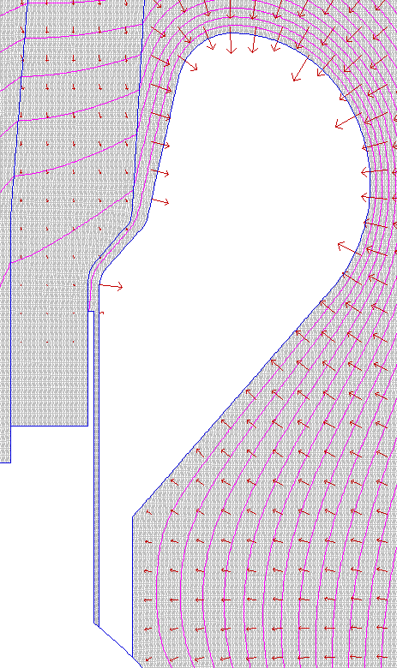
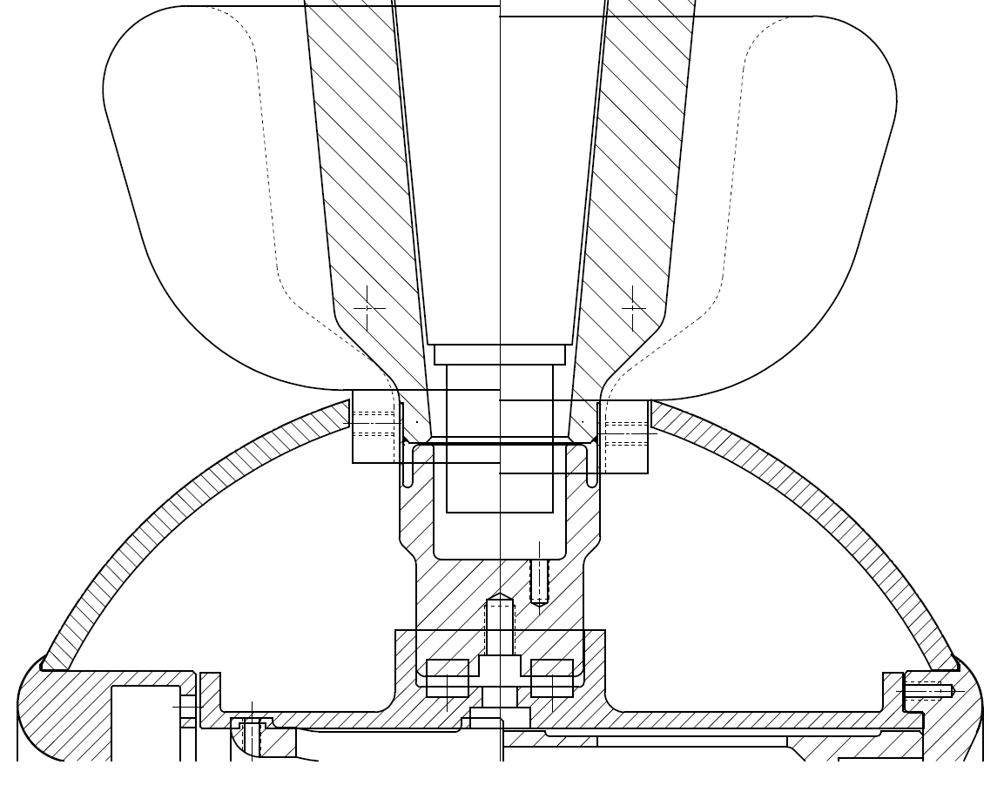
The gap between shed and insulator
reduce
7 MV/m
9.5 MV/m
10 MV/m
10.8 MV/m
Keep field strength low at triple point (metal, insulator, vacuum)
8 MV/m
9.5 MV/m
7 MV/m
8 MV/m
Gap = 1 mm

Slide 21
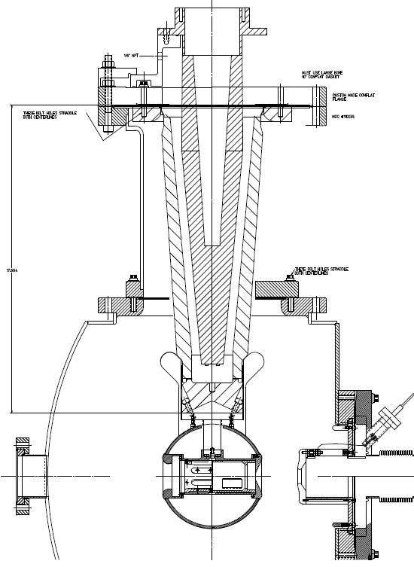
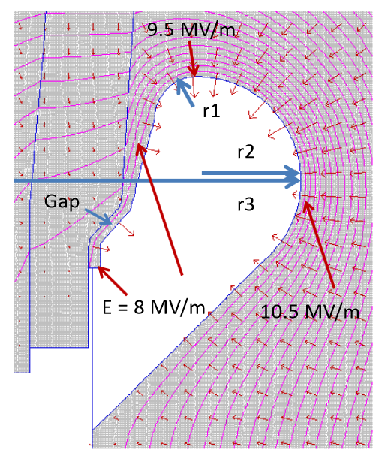
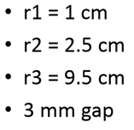
R350 epoxy receptacle
Plan Z
Combination of doped insulator and shed, SF6 and epoxy receptacle, plus added length
the screening electrode, a good design…
SF6
Doped insulator
Screening electrode
Work of Yan Wang

Slide 22
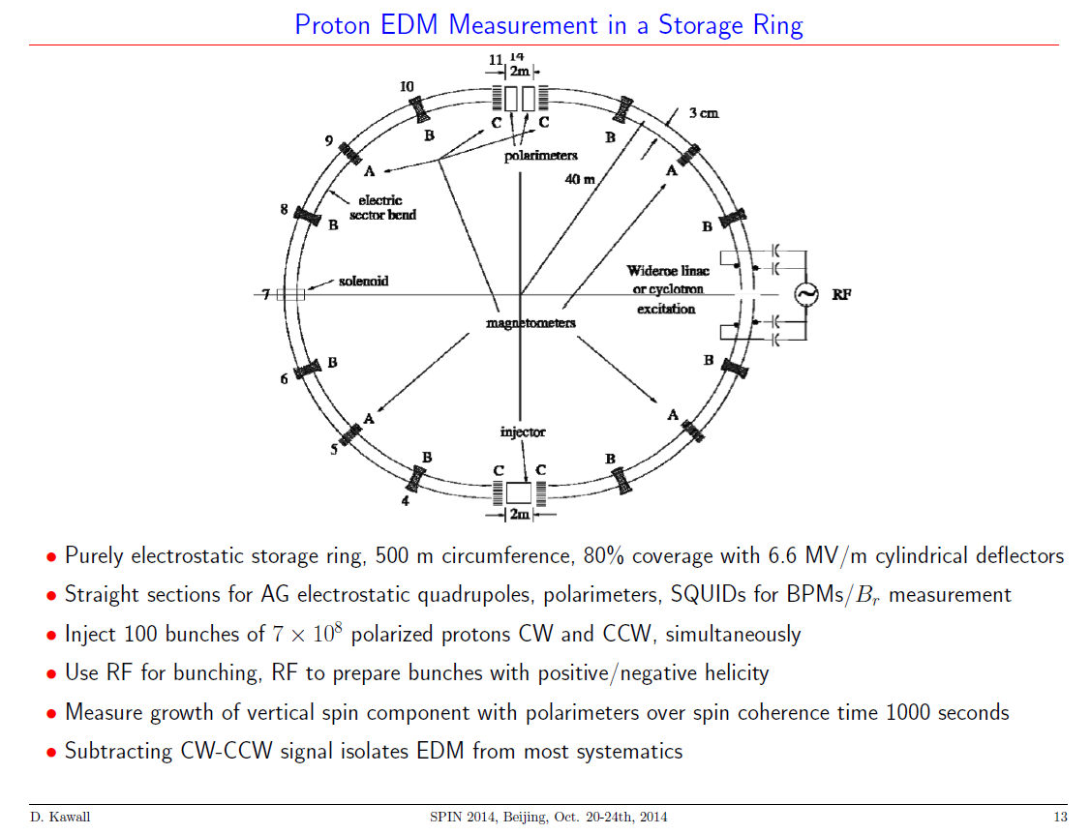
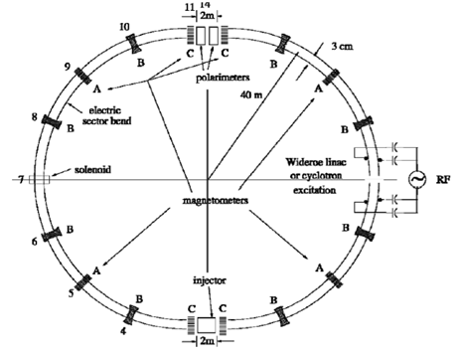
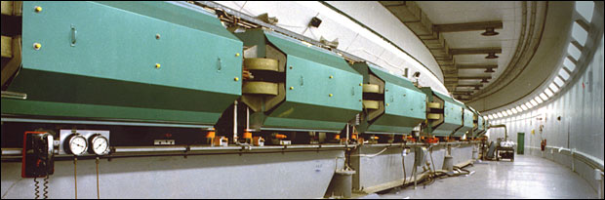
Field strength between capacitor plates
~ 4.5 MV/m
3 cm gap, +/- 70 kV
~ 650 m x 2 = 1300 m of electrode!
AGS Ring at BNL
Matt Poelker, Jefferson Lab
Notes:
Interior Page Design 1

Slide 23
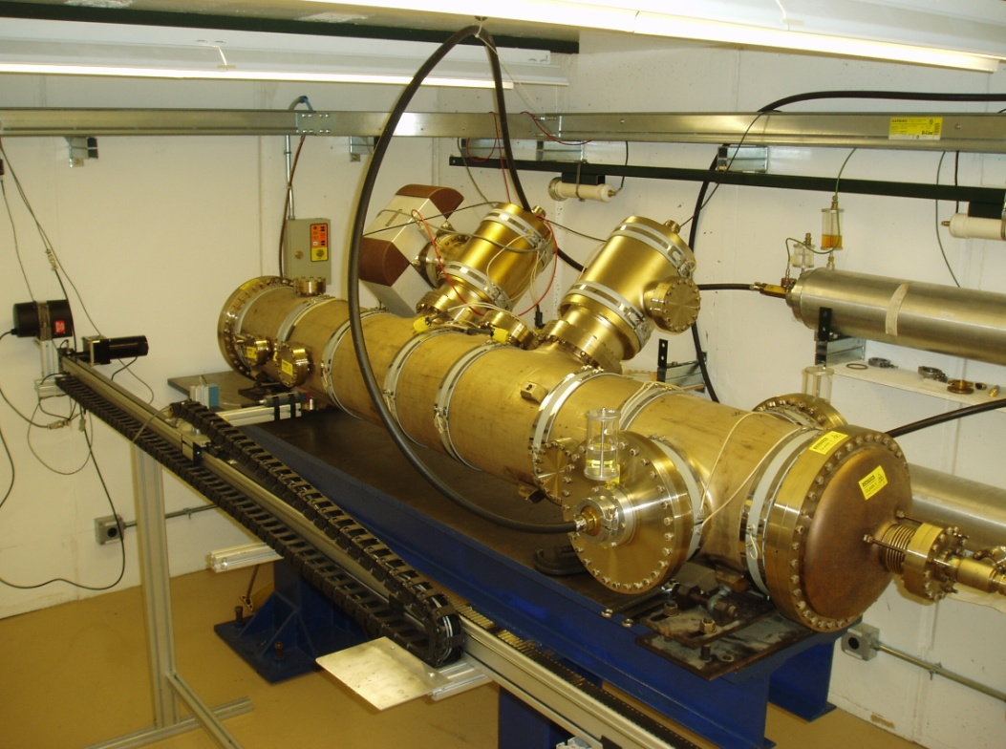
E-field plate module: Similar to the (26) FNAL Tevatron ES-separators
Beam position
0.4 m
How is field emission a problem for Ring EDM?
3 m

Slide 24
Field Emission: Things we’ve been Studying
Fowler-Nordheim Theory: a good place to start, but it will disappoint …
Diamond-paste polished stainless steel
  Is it necessary to have such a smooth surface?
Gas conditioning: an essential tool
Electropolished stainless steel: speed the process?
Barrel-polished stainless steel: another option
BCP-d niobium: expensive
TiN-coated aluminum: promising…
900 ºC degas, CO₂ snow, high pressure rinsing…
Matt Poelker, Jefferson Lab
Notes:
Interior Page Design 2

Slide 25
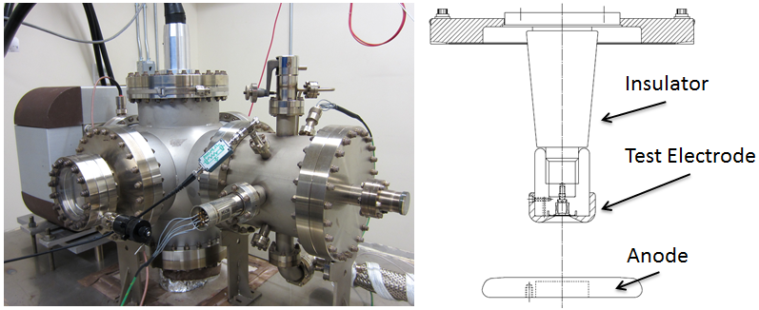
Field Emission Test Stand
Spellman -225kV supply, small “R28” inverted insulators, variable cathode/anode gap from to 10 to 50mm, field strength to ~ 20 MV/m
Build a test stand that resembles an actual gun (tests with small gaps and high field strength but low voltage, don’t appear to be very useful)
Matt Poelker, Jefferson Lab
Notes:
Interior Page Design 2

Slide 26
Diamond-Paste Polishing
Receive the electrode from the machine shop with “32” surface finish
Silicon carbide polishing with 300 grit paper to remove obvious visible scratches
Solvent cleaning in ultrasonic bath of alkali solution
Silicon carbide polishing with 600 grit paper
Solvent cleaning in ultrasonic bath of alkali solution
Polish with 6mm grit
Ultrasonic clean
Polish with 3mm grit
Ultrasonic clean
High pressure rinsing (1200 psi) for 20 minutes with ultrapure de-ionized water with resistivity > 18 MΩcm.
High temperature (900ºC) vacuum degas for one hour
Two months later and the electrode is ready for high voltage!
Maybe it will work!?
Matt Poelker, Jefferson Lab
Notes:
Interior Page Design 2

Slide 27
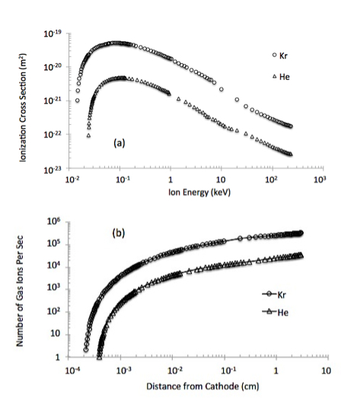
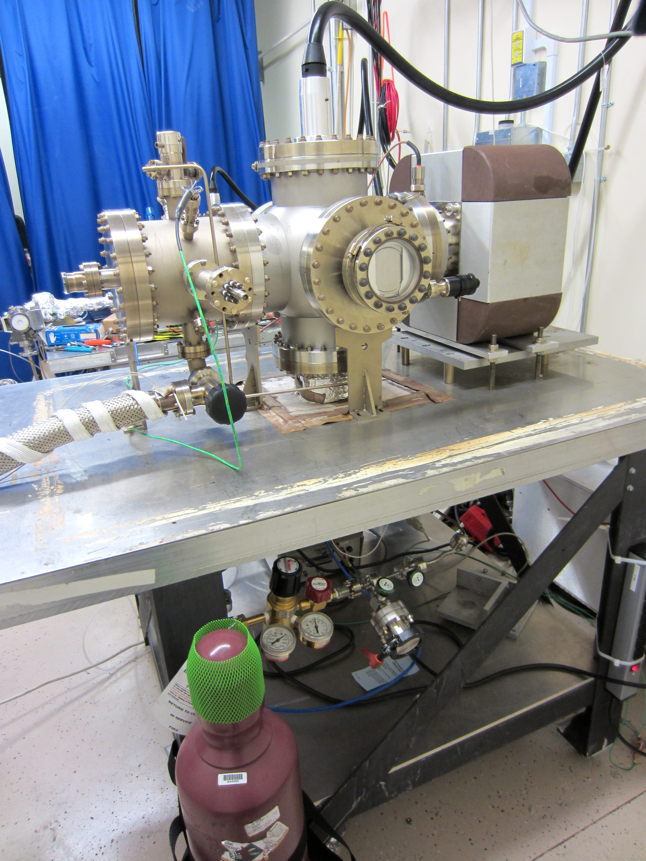
Gas Conditioning
Leak Valve
Field emission ionizes inert gas
Ions bombard electrode, hopefully near field emitter, which can be sputtered away
And ions get implanted, increasing work function
Gas Bottle
Matt Poelker, Jefferson Lab
Notes:
Interior Page Design 2

Slide 28
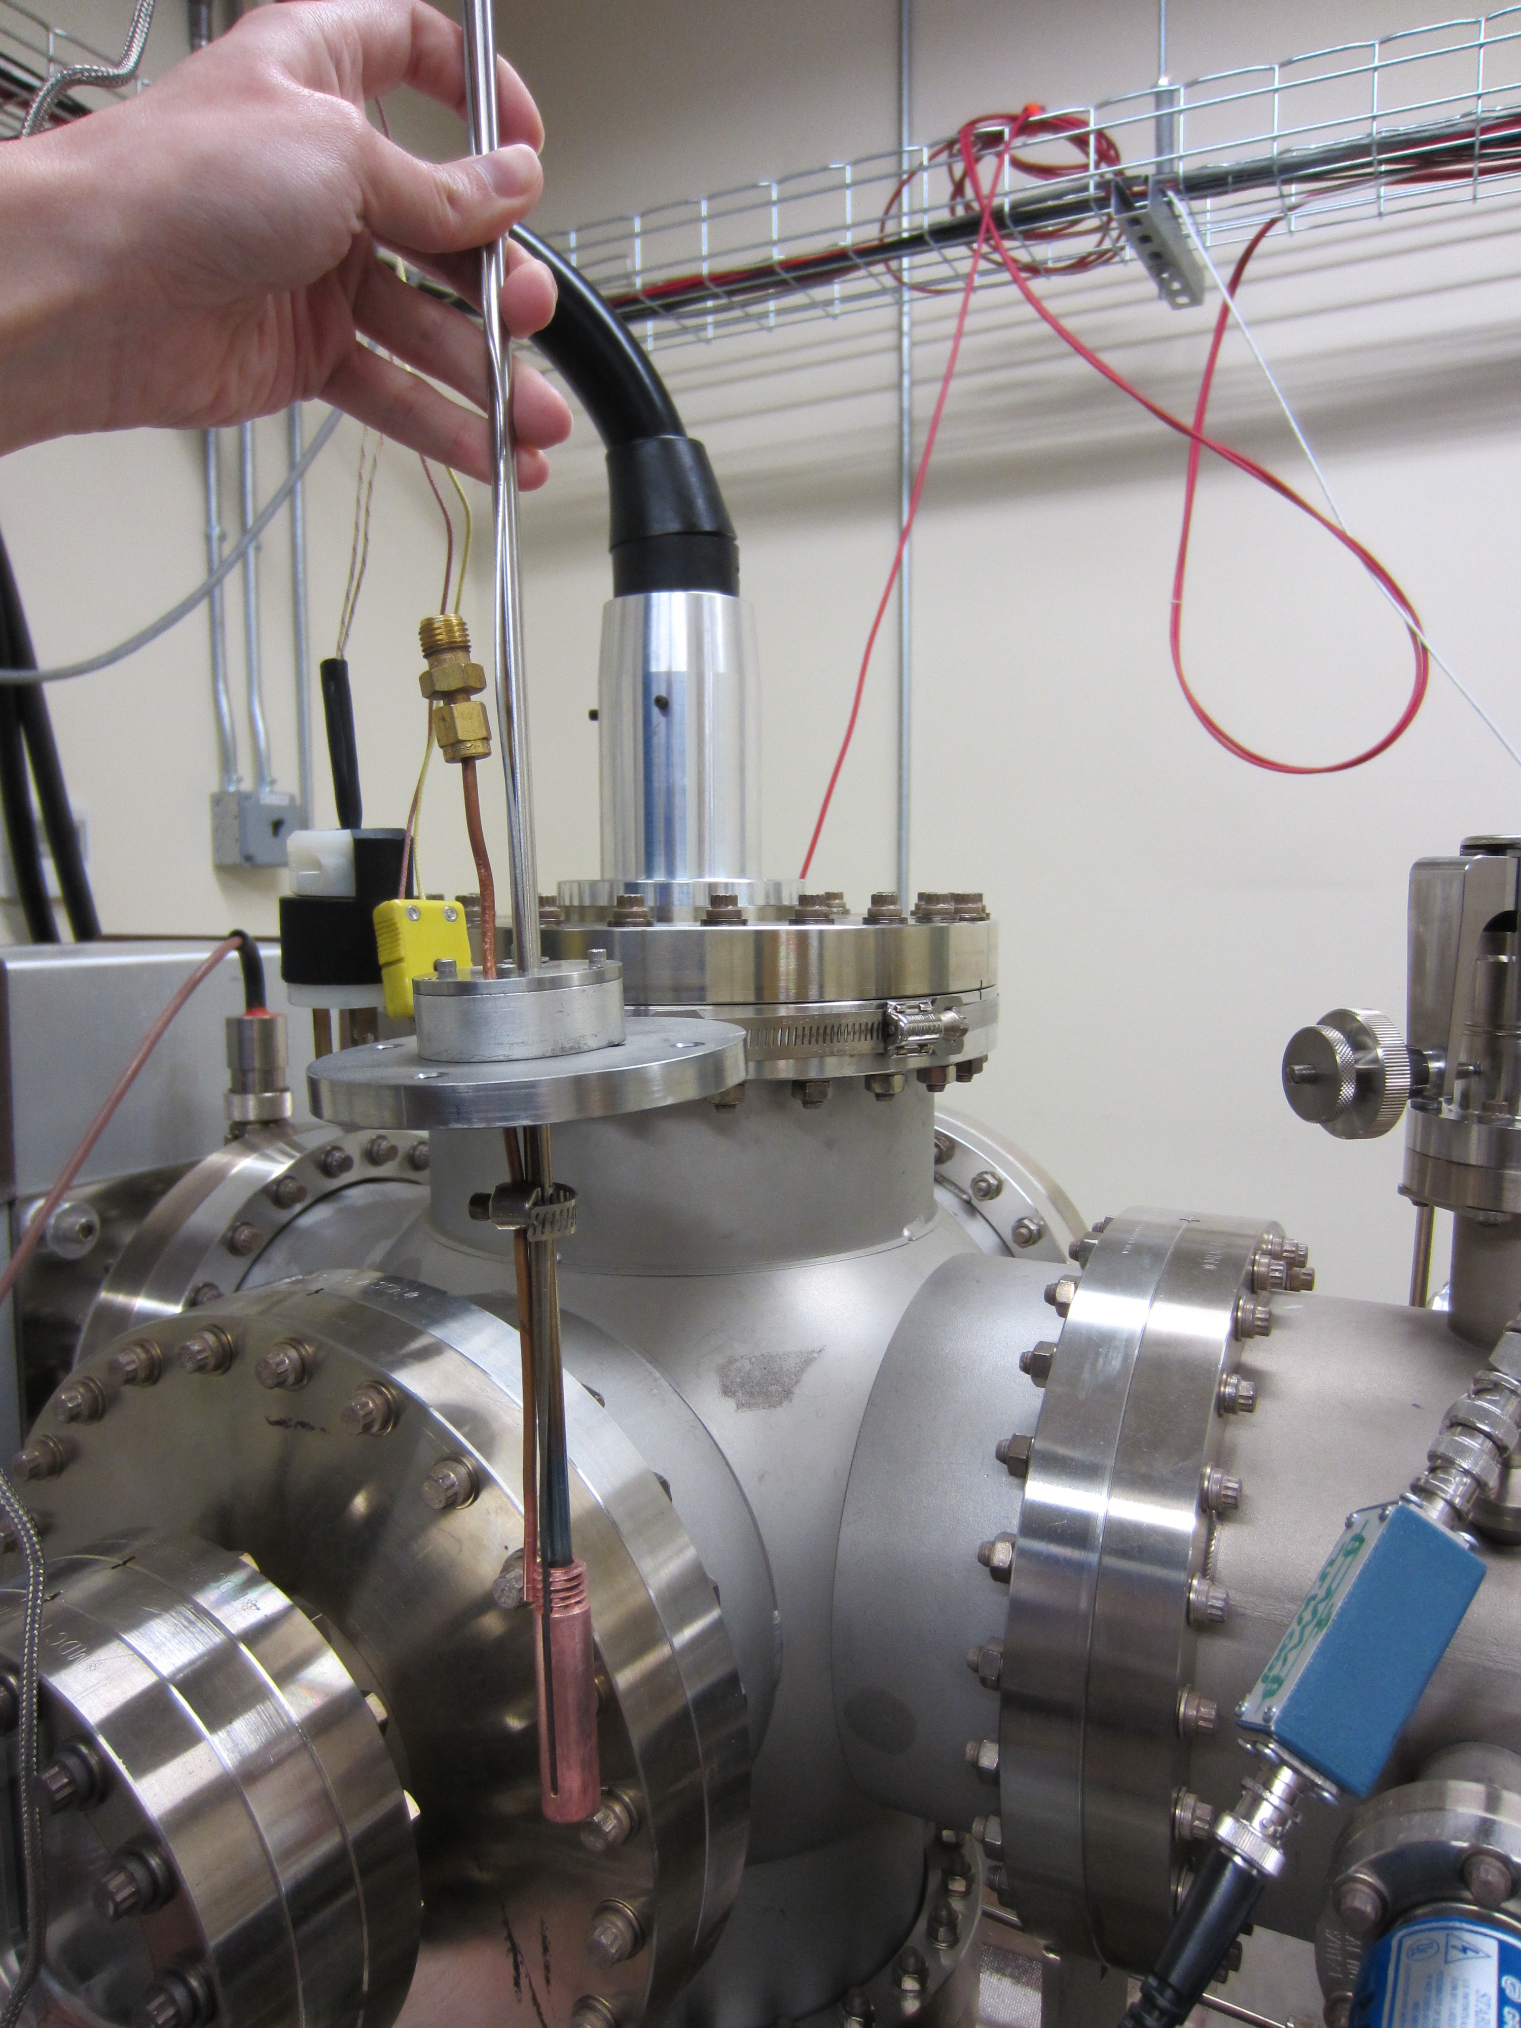
What Does Gas Conditioning Do?
Benefits of implantation are reversible
Work of M. BastaniNejad, E. Forman, C. Hernandez-Garcia
Matt Poelker, Jefferson Lab
Notes:
Interior Page Design 2

Slide 29
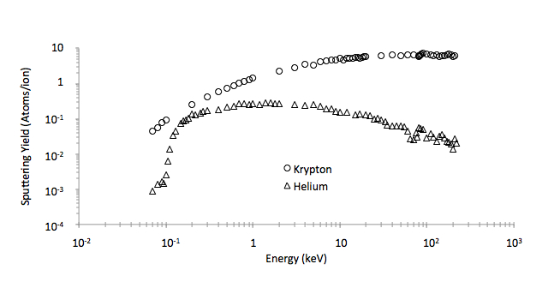
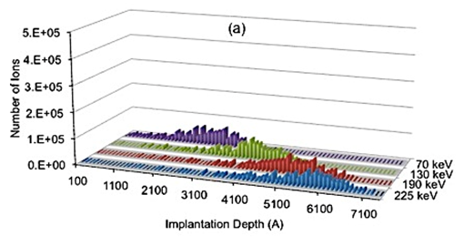
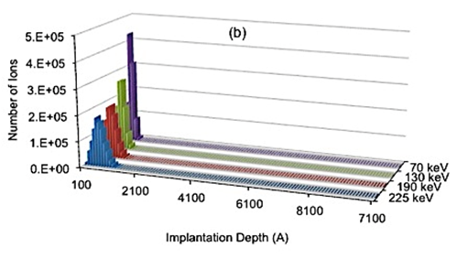
What Does Gas Conditioning Do?
Sputtering and Implantation
Helium: provides a shallow implantation depth, so it seems to work best when FE turns ON at lower voltages, and/or with small gaps (10 to 20mm), don’t expect much sputtering
Krypton: can work at any voltage, good for larger gaps (30 to 50mm), sometimes too much sputtering creates a new field emitters
Helium
Krypton
Implantation
Sputtering Yield
Matt Poelker, Jefferson Lab
Notes:
Interior Page Design 2

Slide 30
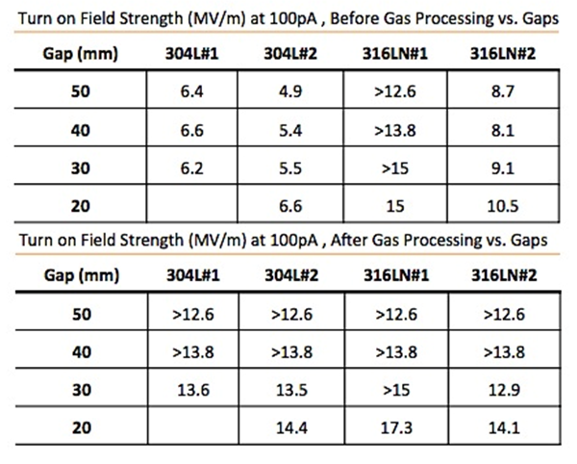
A Powerful Technique
Gas conditioning can turn a BAD electrode into a GOOD electrode
TURN OFF ion pump
NEG pumps don’t pump inert gas
Set voltage to excite field emitter
Add gas at 10⁻⁵ Torr, apply voltage and watch for sharp decrease in FE current
Perhaps 316L is better than 304L?
Matt Poelker, Jefferson Lab
Notes:
Interior Page Design 2

Slide 31
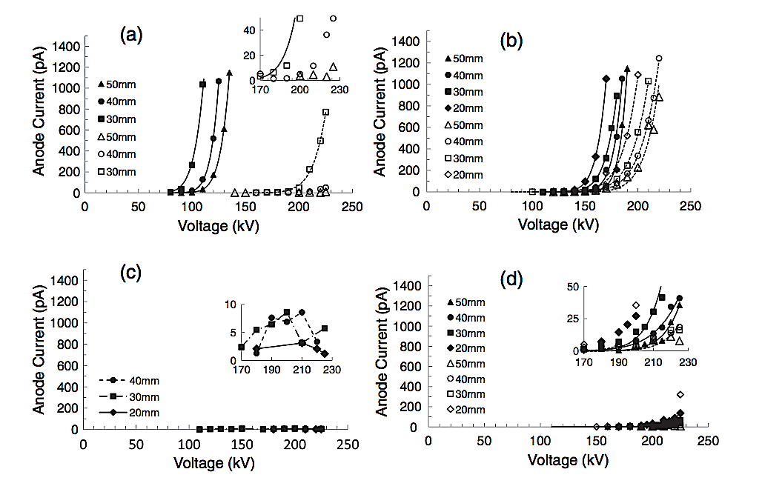
I to V curves for Niobium
304-SS
Fine Grain Nb
Text goes here
Large Grain Nb
Single Crystal Nb
Work of M. BastaniNejad
Notes:
Interior Page Design 2

Slide 32
Buffered Chemical Polishing of Niobium
Receive the electrode from the machine shop with “32” surface finish
Silicon carbide polishing with 600 grit paper, if necessary, to remove obvious visible scratches
Solvent cleaning in ultrasonic bath of alkali solution
Buffered-chemical polishing to remove ~ 100 μm material
High pressure rinsing (1200 psi) for 20 minutes with ultrapure de-ionized water with resistivity > 18 MΩcm.
High temperature (900ºC) vacuum degas for one hour
Work of M. BastaniNejad
Notes:
Interior Page Design 2

Slide 33
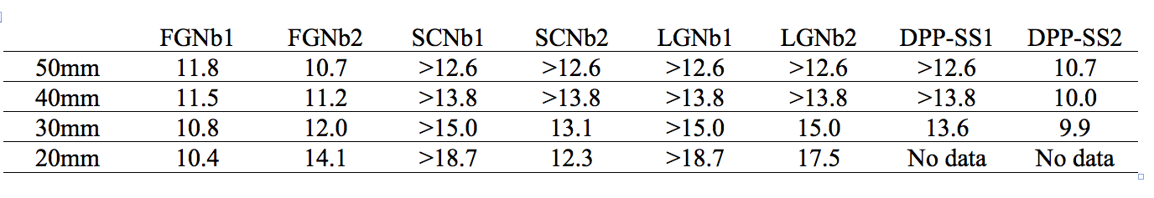
FE results of BCP-ed Niobium
Field strength at which the electrode exhibited 100pA of field emission, post krypton gas conditioning
“>” symbol….the electrode did not produce 100pA of field emission
Work of M. BastaniNejad
Notes:
Interior Page Design 2

Slide 34
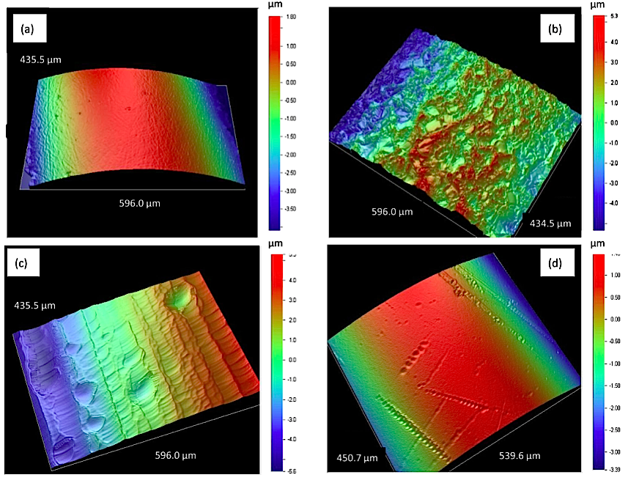
Niobium Electrodes
More evidence that there’s more to field emission than topography
SS Roughness: 10.9 nm
FGNb Roughness: 215.1 nm
LGNb Roughness: 141.01 nm
SCNb Roughness: 17.6 nm
This one performed best!
Work of M. BastaniNejad
Notes:
Interior Page Design 2

Slide 35
TiN-coated aluminum
Aluminum is cheap and easy to machine
Takes just hours to polish to mirror-like finish with silicon-carbide paper
Good thermal conductor, compared to steel, a nice feature when gun provides high current
We used a “boutique” vendor to coat our small electrodes
Can an industrial TiN-coating provide the same benefit? Need to test
Work of Md. A. Mamun, E. Forman, R. Taus
Matt Poelker, Jefferson Lab
Notes:
Interior Page Design 2

Slide 36
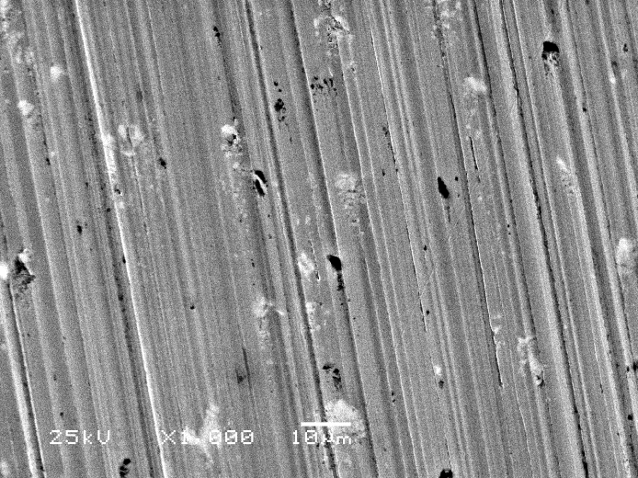




Surface Images Al and TiN-Al
Al: 400 grit
Al: 600 grit
Al: 800 grit
Al: 1200 grit
TiN coated: 1200 grit
Note, the black spots are voids and defects, not particulate contamination from sand paper polishing
Work of Md. A. Mamun, E. Forman, R. Taus
Matt Poelker, Jefferson Lab
Notes:
Interior Page Design 2

Slide 37



TiN-coated aluminum
Bare aluminum:
easily damaged with high voltage
TiN-coated
aluminum
Diamond-paste polished Ti-alloy:
a traditional “hard” electrode
Work of Md. A. Mamun, E. Forman, R. Taus
Matt Poelker, Jefferson Lab
Notes:
Interior Page Design 2

Slide 38


Surface Appearance before HV testing
1200 grit polished
Uncoated Al
TiN Coated Al
Work of Md. A. Mamun, E. Forman, R. Taus
41st ICMCTF, April 28 - May 2, 2014, San Diego, CA, USA

Slide 39

Surface images of bare aluminum
SEM images of HV-conditioned Al electrode
(a) prior to He processing and (b) post-He processing.
Lots of craters developed during gas conditioning at the field emitted sites
Work of Md. A. Mamun, E. Forman, R. Taus
41st ICMCTF, April 28 - May 2, 2014, San Diego, CA, USA

Slide 40

Surface images of bare aluminum
SEM and EDS of post-He processed and HV conditioned bare Al electrode depicting
(a) a field emission site, and (b) the chemical analysis of the emitted area.
No silica contamination
Lots of oxide formation in the FE sites
Work of Md. A. Mamun, E. Forman, R. Taus
41st ICMCTF, April 28 - May 2, 2014, San Diego, CA, USA

Slide 41

Surface images of TiN coated Al6061 electrode
As fabricated and before HV application
(a) prior to TiN coating and (b) post-TiN coating.
TiN coating effectively serves to hide the underlying material defects
800 grit 1200 grit 1200 grit uncoated uncoated TiN coated
RMS roughness 20 nm 16 nm 13 nm
(2 mm line scans using profilometer on representative coupons)
Work of Md. A. Mamun, E. Forman, R. Taus
41st ICMCTF, April 28 - May 2, 2014, San Diego, CA, USA

Slide 42


Electropolished Stainless Steel
Can we avoid time-consuming diamond-paste polishing?
Start with three test electrodes having different surface finish, and send them to commercial electropolishing company
Work of M. BastaniNejad, E. Forman
Matt Poelker, Jefferson Lab
Notes:
Interior Page Design 2

Slide 43



Electropolished Stainless Steel
EP-d only electrodes did better before gas processing
EP-d only electrodes did not respond favorably to gas conditioning
Best electrode was DPP-d and EP-d
Work of M. BastaniNejad, E. Forman
Matt Poelker, Jefferson Lab
Notes:
Interior Page Design 2

Slide 44


Barrel Polishing of Stainless Steel
On our to-do list for testing
Work of F. Hannon
Notes:
Interior Page Design 2

Slide 45




Fowler-Nordheim Line Plots
$$I= C_{1}{A_{e}β}^{2}E^{2}e^{{−C_{2}}/{βE}}$$
$C_{1}=\frac{1.54x{10}^{−6 }∙{10}^{4.52⋅φ^{−0.5}}}{φ}$
$C_{2}=6.53x{10}^{9}φ^{1.5}$
$slope= \frac{d(\log_{10}I/{E^{2})}}{d(1/E)}$= - $\frac{2.84×{10}^{9}φ^{1.5}}{β}$
intercept = ${{Log}_{10}({I_{F}}/{E^{2})}}_{E→∞}={Log}_{10}[\frac{1.54×{10}^{−6}A_{e}β^{2}{×10}^{4.52φ^{−0.5}}}{φ}]$
But it’s wrong to assume work function, Φ , is a constant
With three variables, there are an infinite number of solutions that provide a good fit
These plots tell you β, the field enhancement factor, and A_{e}, the field emitter area
Notes:
Interior Page Design 2

Slide 46


Fowler-Nordheim Line Plots
Text goes here
Why not identical here?
Identical here
Notes:
Interior Page Design 2

Slide 47
Backup Slides
Thank You
Matt Poelker, Jefferson Lab
Notes:
Interior Page Design 2

Slide 48
CEBAF – Just a big Microscope
Continuous Electron Beam Accelerator Facility
A B C A B C
two SRF Linacs
1497 MHz
111 ps
RF Synchronous
Lasers
499 MHz,
ΔФ = 120°
A
B
C
B
A
RF Separators
499 MHz
A
B
Pockels Cell
C
C
Gun
Photoemission from GaAs photocathode
Matt Poelker, Jefferson Lab
Notes:
Interior Page Design 2

