Slide 1
MOLLER Accelerator Jobs
Operations StayTreat
June 6, 2023
Riad Suleiman

Slide 2
Introduction
MOLLER: Measurement Of Lepton Lepton Elastic Reactions
Physics Outcome: an ultra-precise measurement of the weak-mixing angle using Møller scattering
https://moller.jlab.org/cgi-bin/DocDB/public/DocumentDatabase
Organization:
Accelerator Parity-Quality-Beam Liaison: Riad Suleiman
APEL: Yves Roblin
Ops Hall A Liaison: Daniel Moser and Adam Schoene
Hall A Liaison: Ciprian Gal
MOLLER Liaison: Caryn Palatchi and Kent Paschke

Slide 3
Parity-Violating Experiments at CEBAF
PV Experiment | Energy (GeV) | Pol (%) | I (µA) | Target | A_{pv} (ppb) | Charge Asym (ppb) | Position Diff (nm) | Angle Diff (nrad) | Size Asym(δσ/σ)
HAPPEx-I 1998 – 1999 | 3.3 | 38.8 68.8 | 100 40 | ¹H (15 cm) | 15,050 | 200 | 12 | 3 | <10⁻³
G0-Forward 2003 – 2004 | 3.0 | 73.7 | 40 | ¹H (20 cm) | 3,000-40,000 | 300±300 | 7±4 | 3±1 | <10⁻³
HAPPEx-II 2004 – 2005 | 3.03 | 87.1 | 55 | ¹H, ⁴He (20 cm) | 1,580 | 400 | 2 | 0.25 | <10⁻³
G0-Backward 2006 – 2007 | 0.359, 0.688 | 85.8 | 60 | ¹H, ²H (20 cm) | 9,700-37,400 | -30±300 | 47±9 | 1.2±0.5 | <10⁻³
HAPPEx-III 2009 | 3.484 | 89.4 | 100 | ¹H (25 cm) | 23,800 | 200±10 | 3 | 0.5±0.1 | <10⁻³
PVDIS 2009 | 6.067 | 89.0 | 105 | ²H (20 cm) | 60,000-160,000 | 100 | 100 | 40 | <10⁻³
PREx-I 2010 | 1.056 | 89.2 | 70 | ²⁰⁸Pb (0.5 mm) | 657±60 | 85±1 | 4 | 1 | <10⁻⁴
QWeak 2010 – 2012 | 1.162 | 88.7 | 180 | ¹H (34 cm) | 226.5±9.3 | 20.5±1.7 | -4.6±0.2 | -0.07±0.01 | <10⁻⁴
PREx-II 2019 | 0.953 | 89.7 | 70 | ²⁰⁸Pb (0.5 mm) | 550±18 | 20.7±0.2 | 2.2±4 | 0.3±0.3 | <6x10⁻⁵
CREx 2019-2020 | 2.18 | 87.1 | 150 | ⁴⁸Ca (5 mm) | 2668±113 | -88±26 | -5.2±3.6 | -0.13±0.08 | <6x10⁻⁵
MOLLER 2026-2028 | 10.8 | 90 | 65 | ¹H (125 cm) | 35.6±0.74 | <10 | <0.6 | <0.12 | <10⁻⁵

Slide 4
MOLLER Quick Summary – Notable Things for MOLLER
MOLLER Apparatus is designed for nominal beam energy: $10.8±0.2$ GeV with low RF trip rate (<6/hr)
65 µA with 90% polarization (max 70 µA for target studies)
Fast helicity reversal:
1920 Hz, 10 µsec settle time, 64-window pattern, 128-window delay
Slow helicity reversals:
Insertable half-wave plate (IHWP)
Wien Filters (using new 200 keV injector)
g_{e}-2 ($∆E\sim 0.10$ GeV)
Feedbacks on:
Helicity-correlated beam charge
Helicity-correlated position and angle
Polarization orientation
Small helicity-correlated beam asymmetries
Adequate adiabatic damping of transverse phase-space (for both $xx^{′}$ and $yy^{′}$) – a factor of 100 is desired, a factor of 10 is required. Ideally, $\sqrt{{P_{f}}/{P_{gun}}}=\sqrt{{10800}/{0.494}}=148$
Acceptable beam halo (MOLLER Halo Monitor: to be specified, Compton Polarimeter: <100 Hz/µA)

Slide 5
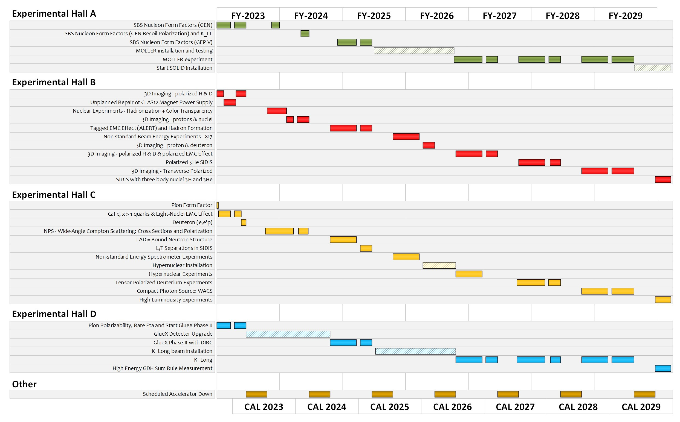
CEBAF Long Term Schedule – potential conflicts
MOLLER experiment in Hall A: installation starts in Jan 2025 and physics run starts in Jan 2026 for three years
Hall A (MOLLER)
0.26 pC @ 249.5 MHz (4 ns, 65 µA average beam current)
Hall B
0.002 pC @ 249.5 MHz (4 ns, 50 nA average beam current)
Hall C
0.12 pC @ 249.5 MHz (4 ns, 35 µA average beam current)
Hall D (K_{L})
0.32 pC @ 15.6 MHz (64 ns, 5 µA average beam current)
One task aims to study co-operation of MOLLER with K-long experiment in Hall D

Slide 6
MOLLER Requirements
Details about MOLLER action items can be found here: https://wiki.jlab.org/ciswiki/images/2/2b/MOLLER_Accelerator_MainJobs_details_June2023.docx
MOLLER has other requirements that can be found here: https://wiki.jlab.org/ciswiki/images/7/7b/MOLLER_beam_requirements_22March2023.pdf
Accelerator jobs are summarized in next four slides (listed are Deliverable Dates)
Abbreviation | Staff/People | Group
CIS | Accelerator | Center for Injectors and Sources
CASA | Accelerator | Center for Advanced Studies of Accelerators
Ops-SW | Accelerator | Accelerator software Group
Ops-Inj | Accelerator | Injector group
Ops-MCC | Accelerator | MCC Operations Group
I&C | Engineering | Instrumentation and Controls Group (EESICS)
RF | Engineering | Radio-Frequency Group
SSG | Engineering | Safety Systems Group
Fast Electronics | Physics | Fast Electronics Group
Hall A | Physics | Hall A group
RCG | EH&S | Radiological Control Group
MOLLER | Users | MOLLER Collaboration

Slide 7
MOLLER Accelerator Jobs
Helicity Generator boards (SAD 2024)
Groups (CIS, MOLLER, Fast Electronics, Ops-SW)
Helicity Decoder boards (SAD 2024)
Groups (CIS, MOLLER, Fast Electronics)
New RTP High Voltage (HV) Driver (SAD 2024)
Groups (CIS, MOLLER, I&C, Ops-SW)
Upgrade laser Intensity-Attenuator (IA) system (SAD 2024)
Groups (CIS, MOLLER, I&C, Ops-SW)
Upgrade Helicity Magnets control (SAD 2024)
Groups (CIS, CASA, MOLLER, I&C)
Feedback on polarization orientation (December 2024)
Groups (CIS, Ops-Inj, MOLLER, CASA)
Wien filters slow reversal – Wien Flip (December 2023)
Groups (Ops-Inj, CIS, MOLLER)

Slide 8
MOLLER Accelerator Jobs … continued
Injector transmission and parity-quality beam (December 2023)
Groups (Ops-Inj, MOLLER)
Matching and adiabatic damping from 200 keV to Hall A (December 2024)
Groups (CASA, CIS, Ops-Inj, MOLLER)
Fast Feedback (FFB) system resurrection (December 2024)
Groups (CASA, Ops-SW, I&C)
Compton Polarimeter setup (December 2024)
Groups (CASA, Hall A)
Beam Modulation (December 2024)
Groups (Hall A, CASA, Ops-SW, I&C, MOLLER)
Phase Advance (December 2024):
Groups (CASA, MOLLER)

Slide 9
MOLLER Accelerator Jobs … continued
Study co-operation of MOLLER with K-long experiment in Hall D (SAD 2024)
Groups (CIS, Ops-Inj, CASA, MOLLER, Hall A)
Control of charge asymmetry on Halls B, C, and D beams (December 2024)
Groups (MOLLER, CIS, Ops-SW)
Parity-Quality Beam (PQB) studies in Injector and Hall (December 2024)
Groups (MOLLER, CIS, Ops-INJ, CASA)
17. Halo Monitors in Hall A (March 2025)
Groups (Hall A, MOLLER, I&C, Ops-SW, SSG)
18. Robust beam mis-steer protection / fast shutdown detectors in MOLLER apparatus (March 2025)
Groups (Hall A, MOLLER, RadCon, Ops-MCC)

Slide 10
MOLLER Accelerator Jobs … continued
New BPM Digital Receivers in Hall A line – instead of Sample/Hold cards (March 2025)
Groups (Hall A, MOLLER, I&C, Ops-SW)
New BCMs electronics in Hall A line (March 2025)
Groups (Hall A, MOLLER, I&C, Ops-SW)

Slide 11
Accelerator Beam Tests (June – July 2023)
200 kV Gun Optics and Gun-Exit Steering: measure beam angle and displacement from new gun as a function of laser spot position
Beam studies of New Booster: measure beam emittance upstream and downstream of Booster, beam kicks, energy spread, and x/y coupling caused by Booster
Injector Optics: study gun kick, MFX2I01 auto-centering, 200 keV Wien, and 15 degree dipole
200 keV Wien Filter Optics: optimize Wien filter operation at any angle with no significant impact on transmission (>95%) or downstream optics
200 keV E/B Calibrations of V-Wien and H-Wien: determine E and B field settings which do not deflect electron beam at 200 keV energy
200 keV Spin Dance Calibrations of V-Wien, H-Wien, and Spin Solenoids: Calibrate spin rotators using Mott polarimeter

Slide 12
PQB Beam Tests (June – July 2023)
Measure beam properties (e.g. widths of beam asymmetries, position differences along injector) from new gun and Booster and compare to before
DAQ and Channel Access Setup
RHWP Scan – Vacuum Window Assessment
Wein-Flip Symmetry Measurement
200 keV Transmission and Noise
Post Upgrade 200 keV RTP Position Difference Sensitivity and Feedback Convergence FC2
Post Upgrade Chopper Scan at 200 keV

Slide 13
Summary
MOLLER installation starts in Jan 2025 and physics run starts in Jan 2026 for three years
Very demanding experiment – preparations must start now
Managers: please use MOLLER Accelerator Jobs document to plan resources: https://wiki.jlab.org/ciswiki/images/2/2b/MOLLER_Accelerator_MainJobs_details_June2023.docx
More info about parity-violating experiments can be found at CIS Wiki: https://wiki.jlab.org/ciswiki/index.php/Parity_Quality_Beam

