Slide 1

The PEPPo method for polarized positrons and PEPPo II
L. S. Cardman
Physics Division, Jefferson Lab
(for the PEPPo Collaboration)
The PEPPo experiment
Positron Beams at CEBAF
PEPPo II Ideas

Slide 2
Why Polarized Positrons?
Polarized Electrons have supported some of the highest impact results from the JLab program:
  The strangeness distribution in the nucleon (HAPPEX and G0)
  Precision Tests of the Standard Model (Q_{Weak})
  Measurement of the neutron skin in ²⁰⁸Pb
  Polarization transfer measurement of G_{E}/G_{M} for the proton
Positron beams provide a key tool for further pushing the precision of electron scattering experiments
  Comparison of e⁻ with e⁺ tests our understanding of two photon effects
Polarized positrons will
  Expand the nature of these tests (e.g. for G_{E}/G_{M} via polarization transfer)
  Provide an essential tool for unraveling nucleon structure through the measurement of charge-sensitive GPDs, and
  Many more ideas to be discussed at this workshop
  They are also of great interest for condensed matter physics

Slide 3
JLab’s e⁻ Beams Provide the Basis for e⁺ Beams
Bulk GaAs
Strained GaAs:
GaAs on GaAsP
Superlattice GaAs:
Layers of GaAs on GaAsP
100 nm
100 nm
2 μm
14 Layers
625 μm
350 μm
QE ~ 5%, 30 mA/W
Pol ~ 35% @ 780 nm
QE ~ 0.2%, 1 mA/W
Pol ~ 75% @ 850 nm
QE ~ 1%, 6 mA/W
Pol ~ 85% @ 780 nm
P_{e-} 35% 35% 75% 75% 85% 89%
I_{e-} 30μA 100μA 50μA 100μA 150μA 200μA
1995 1998 1999 2000 2004 2012 2017
FOM (P²I) has improved by a factor of 43
over the life of the “6 GeV” Program

Slide 4

PEPPo Demonstrated Efficient e⁺ Production
The purpose of the PEPPo (Polarized Electrons for Polarized Positrons) experiment at the CEBAF Injector was to demonstrate the feasibility of using bremsstrahlung radiation of MeV energy Polarized Electrons for the efficient production of Polarized Positrons.
J. Grames, E. Voutier et al., JLab Experiment E12-11-105 (2011)

Slide 5



Use Polarized Bremmstrahlung and Pair Creation
And do the two steps in
the same physical target
Bremsstrahlung
Pair Creation
P_{circ}(γ) / P_{z} (e⁻)
P_{z} (e⁺) / P_{circ} (γ)
E_{γ} / T_{e-}
T_{e+} / (E_{γ} – 2m_{e+})
E.A. Kuraev, Y.M. Bystritskiy, M. Shatnev, E.Tomasi-Gustafsson, PRC 81 (2010) 055208
5

Slide 6
PEPPo Principle of Operation
Polarized Electrons
(< 10 MeV/c) strike production target
e⁻
T₁
1. BREMSSTRAHLUNG
Longitudinal e⁻ (P_{e-}) produce elliptical γ whose circular (P_{γ}) component is proportional to P_{e-}

Slide 7
PEPPo Principle of Operation
Polarized Electrons
(< 10 MeV/c) strike production target
e⁺
e⁻
e⁻
T₁
2. PAIR PRODUCTION
In the same target, γ produce e⁺e⁻ pairs and transfer Pγ into longitudinal (P_{e+}) and transverse polarization averages to zero

Slide 8
PEPPo Principle of Operation
Polarized Electrons
(< 10 MeV/c) strike production target
Positron Transverse and Longitudinal Phase Space Selection
S₁
e⁺
D
e⁻
e⁻
T₁
S₂
D
e⁺
3. Phase Space Definition
The emittance of the positron beam is defined by slits and magnetic fields

Slide 9
PEPPo Principle of Operation
Polarized Electrons
(< 10 MeV/c) strike production target
Positron Transverse and Longitudinal Phase Space Selection
S₁
e⁺
D
e⁻
e⁻
T₁
S₂
P_{T}
D
Calorimeter
e⁺
T₂
Compton Transmission Polarimeter
4. COMPTON TRANSMISSION POLARIMETER
Polarized e⁺ convert into polarized γ (P_{γ}) whose transmission through a polarized iron target (P_{T}) depends on P_{γ}.P_{T}

Slide 10
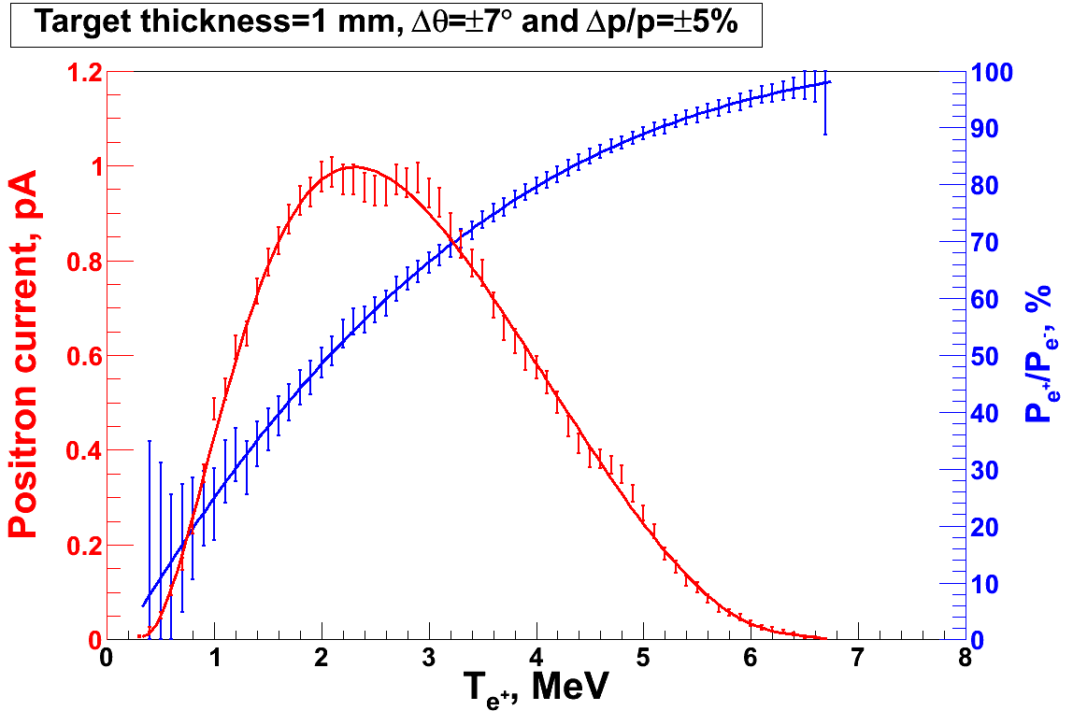
PEPPo Principle of Operation
Polarized Electrons
(< 10 MeV/c) strike production target
Geant4
Positron Transverse and Longitudinal Phase Space Selection
J. Dumas, PhD Thesis (2011)
E_{e} = 6.3 MeV
I_{e} = 1 µA
T₁ = 1 mm W
S₁
e⁺
D
e⁻
e⁻
PEPPo
T₁
S₂
P_{T}
D
Calorimeter
e⁺
T₂
Compton Transmission Polarimeter
PEPPo measured the longitudinal polarization transfer from 8.25 MeV/c e⁻ to e⁺ in the 3.07-6.25 MeV/c momentum range.

Slide 11

PEPPo Result
(PEPPo Collaboration) D. Abbott et al. , Phys. Rev. Lett. 116 (2016) 214801
PEPPo demonstrated efficient polarization transfer of 8.2 MeV/c polarized electrons to positrons, expanding polarized positron production using MeV electron beam energies.
electron beam polarization
85.2 ± 0.6 ± 0.7 %

Slide 12
PEPPo Result
(PEPPo Collaboration) D. Abbott et al. , Phys. Rev. Lett. 116 (2016) 214801
PEPPo demonstrated efficient polarization transfer of 8.2 MeV/c polarized electrons to positrons, expanding polarized positron production using MeV electron beam energies.
electron beam polarization
85.2 ± 0.6 ± 0.7 %
Whenever producing e⁺ from e⁻, polarization is coming for free
if initial electrons are polarized.

Slide 13
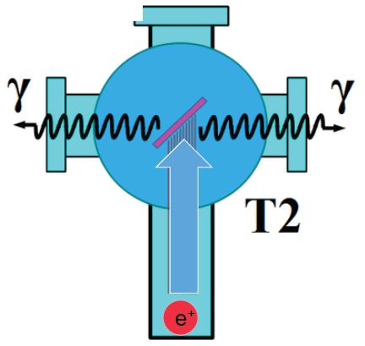
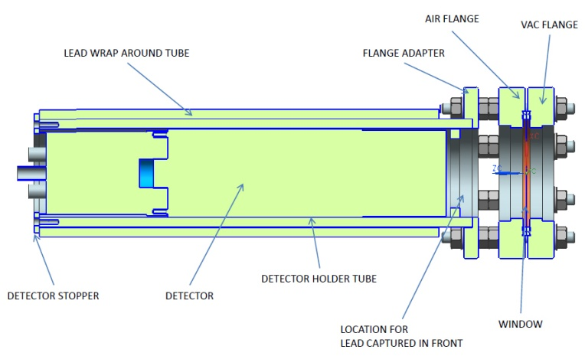
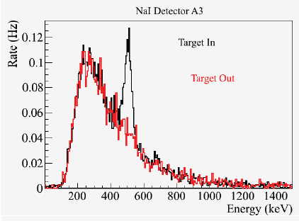
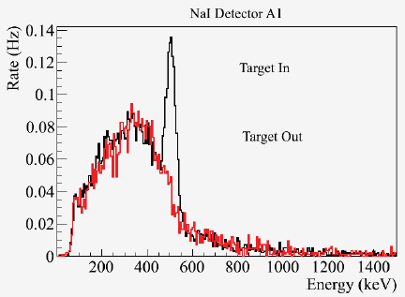
Positron Yield
S₁
Two NaI detectors measured coincidence of back-to-back photons emitted by annihilation of positrons in a viewscreen.
e⁻
e⁺
D
T₁
p_{e-}= 8.2 MeV/c
A3
D
e⁺
S₂
T₂
A1
For these data we had a yield of ~10⁻⁵ e⁺/e^{-.}
A3
A1

Slide 14
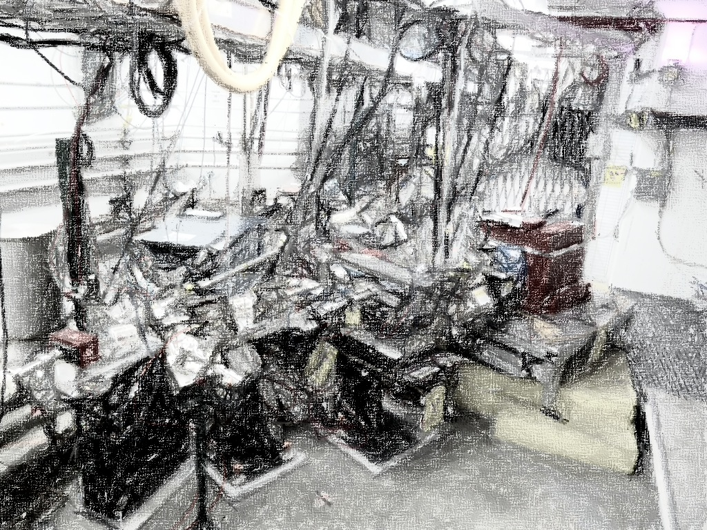
PEPPo Collaboration
P. Adderley¹, A. Adeyemi⁴, P. Aguilera¹, M. Ali¹, H. Areti¹, M. Baylac², J. Benesch¹,
G. Bosson², B. Cade¹, A. Camsonne¹, L. Cardman¹, J. Clark¹, P. Cole⁵, S. Covert¹,
C. Cuevas¹, O. Dadoun³, D. Dale⁵, J. Dumas^{1,2}, E. Fanchini², T. Forest⁵, E. Forman¹,
Freyberger¹, E. Froidefond², S. Golge⁶, J. Grames¹, P. Guèye⁴, J. Hansknecht¹,
P. Harrell¹, J. Hoskins⁸, C. Hyde⁷, R. Kazimi¹, Y. Kim^{1,5}, D. Machie¹, K. Mahoney¹,
R. Mammei¹, M. Marton², J. McCarter⁹, M. McCaughan¹, M. McHugh¹⁰, D. McNulty⁵, T. Michaelides¹, R. Michaels¹, C. Muñoz Camacho¹¹, J.-F. Muraz², K. Myers¹²,
Opper¹⁰, M. Poelker¹, J.-S. Réal², L. Richardson¹, S. Setiniyazi⁵, M. Stutzman¹,
R. Suleiman¹, C. Tennant¹, C.-Y. Tsai¹³, D. Turner¹, A. Variola³, E. Voutier^{2,11},
Y. Wang¹, Y. Zhang¹²
¹ Jefferson Lab, Newport News, VA, US ² LPSC, Grenoble, France ³ LAL, Orsay, France
⁴ Hampton University, Hampton, VA, USA ⁵ Idaho State University & IAC, Pocatello, ID, USA
⁶ North Carolina University, Durham, NC, USA ⁷ Old Dominion University, Norfolk, VA, US
⁸ The College of William & Mary, Williamsburg, VA, USA ⁹ University of Virginia, Charlottesville, VA, USA ¹⁰ George Washington University, Washington, DC, USA ¹¹ IPN, Orsay, France
¹² Rutgers University, Piscataway, NJ, USA ¹³ Virginia Tech, Blacksburg, VA, USA
Many thanks for support from SLAC E166, DESY, Princeton, Cornell, International Linear Collider Project and Jefferson Science Associates

Slide 15
So how can we use the PEPPo production technique to get positrons and polarized positrons for the 12 GeV Upgrade?

Slide 16



Figure of Merit (e.g. E_{e-} = 60 MeV)
R. Dollan, K. Laihem, A. Schälicke, NIM A 559 (2006) 185,
J. Dumas, J. Grames, E. Voutier, JPos09, AIP 1160 (2009) 120
J. Dumas, Doctorate Thesis (2011)
The polarization distribution of generated positrons is dominated by low-energy events.
The positron energy at the optimum FoM (P²I) is about half of the electron beam energy.
Optimum
FoM
Optimum energy

Slide 17
Using the CEBAF Polarized Electron Injector
J. Dumas, Doctorate Thesis (2011)
In the 10-100 MeV electron beam energy one can simulate at the FoM, with dp/p < 10% and angle<10°
  conversion efficiency (ε) varies from about 10⁻⁵ - 10⁻³ e⁺/e⁻
  electron polarization transfer is “flat” ~75% at FoM
Using a 100 MeV electron beam and a more realistic momentum spread dp/p <1% (ΔE ~ 1 MeV) the conversion efficiency is 1-5 x 10⁻⁴.

Slide 18
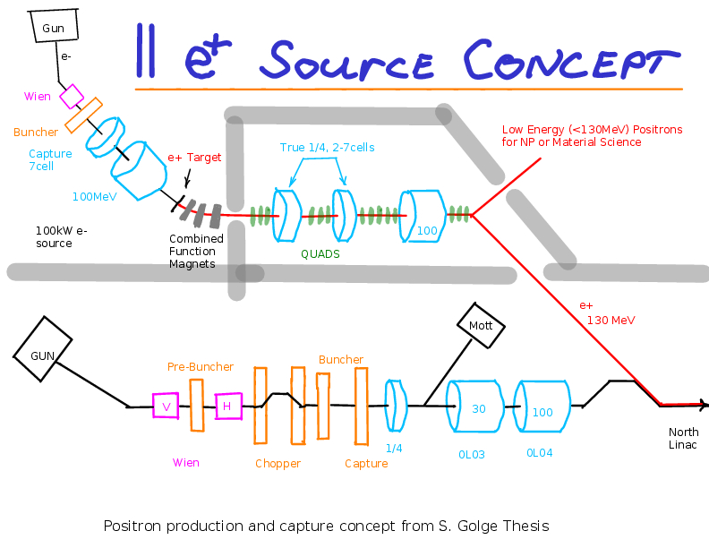
One Concept for a Dedicated e⁺ Source
Start with the existing CEBAF Injector
Existing
CEBAF
Electron
Injector
What are some requirements for a 100 MeV electron beam to generate a positron beam with intensity I_{e+} > 100 nA and polarization P_{e+} > 65% (at max FoM) ?
  Collecting e+ at 60 MeV with ~10⁻⁴ e⁺/e⁻ efficiency suggests ~1 mA polarized electron beam and a high power conversion target (typ. >10% in target).

Slide 19
One Concept for a Dedicated e⁺ Source
Build a Second Injector Dedicated to Positrons
Concept S. Golge Thesis
Drawing A. Freyberger
Existing
CEBAF
Electron
Injector
What are some requirements for a 100 MeV electron beam to generate a positron beam with intensity I_{e+} > 100 nA and polarization P_{e+} > 65% (at max FoM) ?
  Collecting e+ at 60 MeV with ~10⁻⁴ e⁺/e⁻ efficiency suggests ~1 mA polarized electron beam and a high power conversion target (typ. >10% in target).

Slide 20
An Alternate Approach Using the CEBAF Injector
5 MeV Dump
Synchrotron Light Monitor
Wien Filter
Chopper
Cryounit
Bunchlength
Cavity
Cryomodules
Buncher
Capture
Injection Chicane
Gun#2
PCup
FC#1
FC#2
Prebuncher
Apertures
Wien Filter
500 keV Dump
45 MeV Dump/Spectrometer
Beam Energies:
Gun: 130 keV
After Capture Secton: 500 keV
After Cryounit: 6.3 MeV
After Cryomodules: 123 MeV

Slide 21
CEBAF Injector Modified for Polarized Positrons
5 MeV Dump
Synchrotron Light Monitor
Wien Filter
Chopper
Cryounit
Bunchlength
Cavity
Cryomodules
Buncher
Capture
Injection Chicane
Gun#2
PCup
FC#1
Prebuncher
Apertures
Wien Filter
E Select
Filter
Δφ Select
e⁺ production
target
Beam Energies:
Gun: 130 keV
After Capture Secton: 500 keV
After Cryounit: 6.3 MeV
After Cryomodules: 123 MeV
Set for E = 61.5 MeV
for maximum e⁺ FOM
Set φ = -30º relative to e⁻

Slide 22
If We Only Need (Unpolarized) Positrons
e⁻ → γ → e⁻ + e⁺
Take advantage of the fact that the positron yield increases dramatically as the positron energy is a smaller and smaller fraction of the electron beam energy (color code in this figure)
22

Slide 23
CEBAF Injector Modified for Positrons
5 MeV Dump
Synchrotron Light Monitor
Wien Filter
Chopper
Cryounit
Bunchlength
Cavity
Cryomodules
Buncher
Capture
Injection Chicane
Gun#2
PCup
FC#1
Prebuncher
Apertures
Wien Filter
E Select
Filter
Δφ Select
e⁺ production
target
Beam Energies:
Gun: 130 keV
After Capture Secton: 500 keV
After Cryounit: 6.3 MeV
After Cryomodules: 123 MeV
Set for E = 6.3 MeV* for maximum e⁺/e⁻ ratio
Set φ = -180º relative to e⁻
*Optimization may lead to a
Somewhat higher energy

Slide 24
Positrons IN CEBAF
The positron beam defining system will have
to be set stringently so that the positron beams
will be fully accepted in CEBAF
This means of order 100 keV energy spread and
10 degrees phase spread (per Geoff Krafft)
In addition, the standard Beam Monitoring System used to tune full energy CEBAF beams requires about 2 μA of beam current for the necessary accuracy (per Arne Freyberger)
If we cannot reach this current for polarized positron beams with excellent FoM, it may be interesting to consider using the much higher intensity unpolarized positron beams to tune CEBAF and then switch to polarized positrons for the experiment(s) of interest
E Select
Filter
Δφ Select

Slide 25
PEPPo II
So What Are the Next Steps? I would propose that:
The anticipated yields of polarized and unpolarized positrons feasible with the beams from the 123 MeV CEBAF Injector should be calculated precisely (expect >100 nA for polarized and > a few μA for unpolarized positrons)
Key apparatus (the E Select, ε Filter, and Δφ Select in the figures above, the production target, and the associated electron beam dump) should be designed and built
This apparatus should then be used (either at the CEBAF injector or at LERF) to measure the polarized and unpolarized positron yields and beam quality to verify the approach and prepare for positron beams at 12 GeV
If we have built the apparatus properly, installing it on CEBAF permanently should be straightforward

Slide 26
There are other issues to discuss and resolve…
Magnetic Recirculation (e⁻ beam goes clockwise)
  Clockwise direction requires reversal of unipolar dipole power supplies; focusing quadrupole and steering correctors have bipolar supplies
Low Current Operation (to tune-up and “see” the beam)
  Most of the Accelerator and Hall B is blind to <100 nA
  “Peak intensity” macro-pulse (1.5% duty factor) challenging
  May be able to use unpolarized positrons for setup, then switch to polarization
Delivering Positron Beams (setting up the machine)
  May require setting up CEBAF initially with an electron beam
  Additional LINAC beam position monitors are needed for monitoring the low intensity beam between recirculation arcs
  Requires a number of well-placed upgrade receivers for 10 nA operation
  Supplemental monitors (SLM, wire scanners/OTR screens) will be needed to monitor the beam during operation

Slide 27
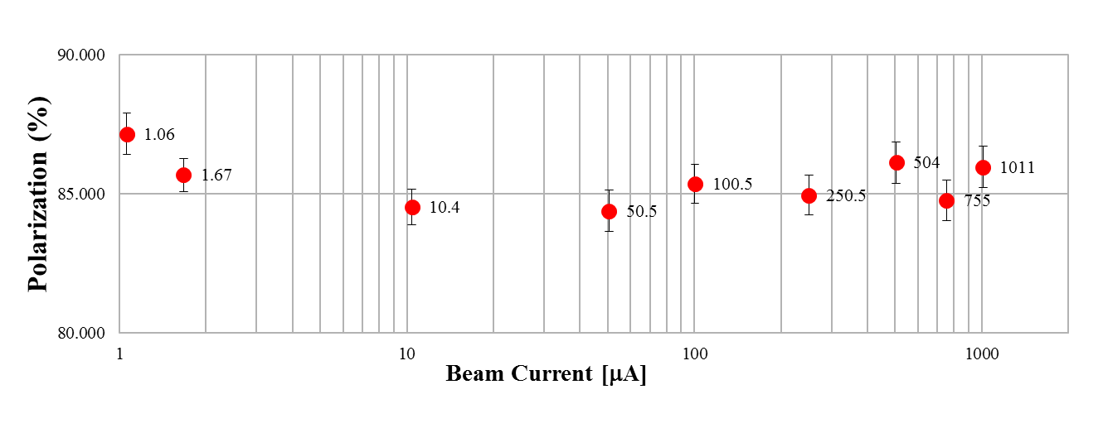
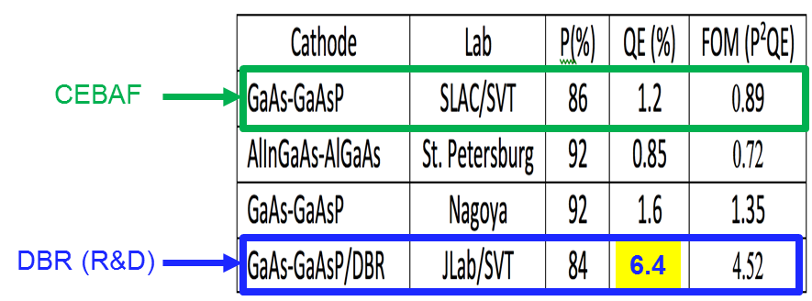
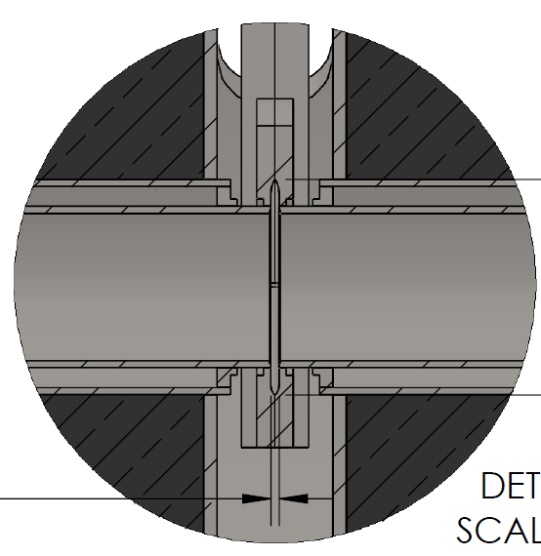

Work is Also Underway in Many Relevant Areas
Improving the lifetime of the polarized source at high beam currents
Phys. Rev. ST Accel.
Beams 14, 043501 (2011)
Further improvements in polarized electron photocathodes
(Distributed Bragg Reflector)
W. Liu, et al., Appl. Phys. Lett.
109, 252104 (2016)
Development of high power targets for the polarized positron production
Liquid Metal Target Approaching 10 kW power level, CW
Stainless Steel Windows (0.25mm)
LBE (2mm)
Input (e⁻)
Output (e⁻,e⁺,γ)

Slide 28
Summary
The PEPPo experiment demonstrated an excellent approach to providing highly spin-polarized positrons from moderate energy polarized electrons, opening a variety of possiblities.
This workshop provides both a review of the physics that can be done, an the relevant technology being developed to enable a high-energy polarized positron beam program for CEBAF @12 GeV (and JLEIC) based on the PEPPo technique
I would like to acknowledge Joe Grames, Eric Voutier, Arne Freyberger, Yves Robin, and Michael Tiefenback for their help in the preparation of this talk.

Slide 29
Back Up Slides

Slide 30
Compton Transmission Polarimeter Spectra
Energy
Central
Detector
Coincidence
Trigger and
Central Detector
Compton physics asymmetries are obtained from the polarization sensitive energy deposition in the central crystal.
The location of the 511 keV peak is an in-situ monitor of the gain of the detection chain and provides a link to radioactive source calibration data.
The coincidence time between the central crystal and a charge sensitive trigger scintillator allows for accidental subtraction.

Slide 31
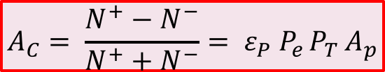
Compton Transmission Analyzing Power
A. Adeyemi (Hampton University)
The experimental Compton asymmetry for an electron beam of known polarization provides a measurement of the electron analyzing power (A_{e}) of the polarimeter.
A comparison between the experimental and the GEANT4 simulated response of the polarimeter establishes a calibrated model of the polarimeter.
The positron analyzing power (A_{p}) is then determined by simulation using the calibrated model.
Electron beam polarization
Target polarization
Electron-to-positron
polarization transfer
$$A_{C}= \frac{N^{+}−N^{−}}{N^{+}+N^{−}}= ε_{P} P_{e }P_{T }A_{p}$$
P_{T} = 7.06% ±0.05%_{Sta.}± 0.07%_{Sys.}

Slide 32
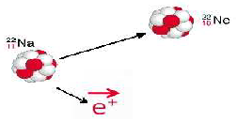




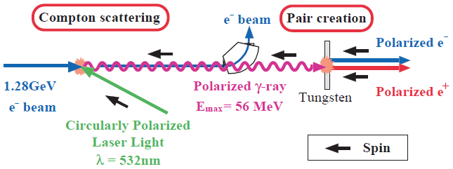
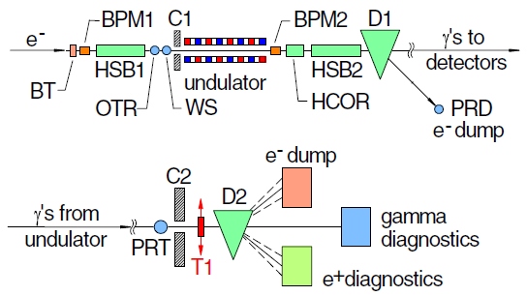
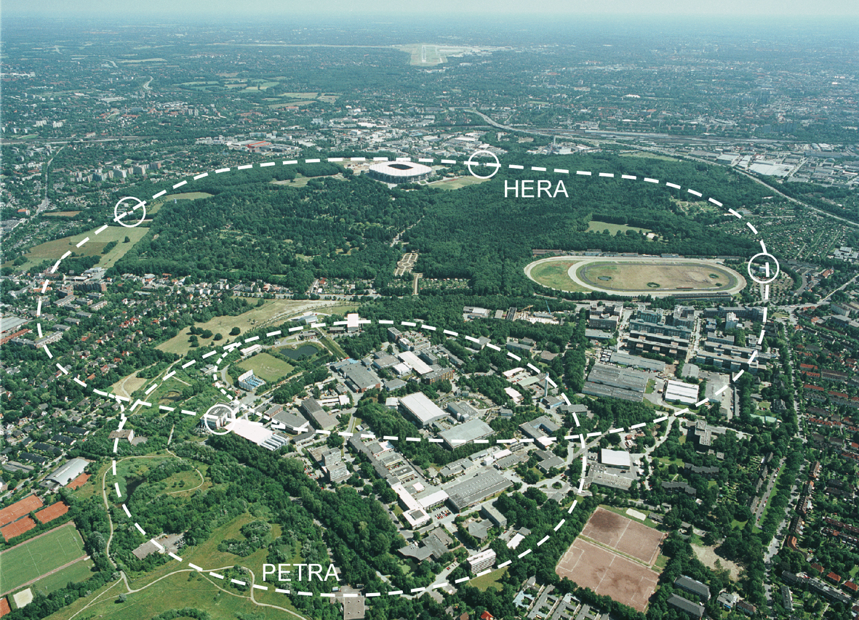
Collecting Polarized Positrons
Polarized β⁺ Decay
L.A. Page & M. Heinberg. Phys. Rev.
106(6):1220-1224 (1957)
Sokolov-Ternov Effect
D. Barber , AIP Conf. Proc. 588, 338 (2001)
HERA 27.5 GeV e+/e-
Polarized due to parity non-conservation in the weak interaction
P(e⁺) ~ 40 %
P(e⁺) ~ 70 %
Compton Backscattering (KEK)
T. Omori et al, PRL 96 (2006) 114801
Helical Undulator (SLAC E166)
G. Alexander et al, PRL 100 (2008) 210801
47.7GeV
P(e⁺) = 73 ± 15_{(stat)} ± 19_{(syst)} %
P(e⁺) = 80 ± 7_{(stat)} ± 9_{(syst)} %

Slide 33
CEBAF Polarized Electron 10 MeV Injector
PEPPo ran at the CEBAF injector, taking advantage of the existing beam diagnostics that determine with precision the properties of the polarized electron beam entering the PEPPo apparatus.
Intensity controls
10 pA – 1 µA
Energy measurement
dp/p < 0.5%
Polarization measurement
dP/P < 2%
Laser
PEPPo
Polarization controls
    30 Hz fast heilicity reversal (delayed)
    Slow laser polarization reversal (half-wave plate)
    4π spin rotator
Variable energy
3.1-8.2 MeV/c

Slide 34
JLEIC/CEBAF Positron Injector
Polarized
Electron
10 MeV Injector
500-Turn
Accumulator Ring
(22m)
Harmonic
Extraction Ring
(22m)
Positron Conversion/Collection Efficiency ~ 10⁻⁴
Bunch
Management
to CEBAF/JLEIC
10 MeV polarized e⁻
1.33 pC @ 1500 MHz
10 MeV pol e⁻
0.67 nC bunches
@ 1500 MHz
10 MeV polarized e⁻
0.67 nC @ 68.1 MHz
5-7 MeV Polarized e⁺
67 fC @ 68.1 MHz
 | Polarized Electron Source | Accumulator/ Extractor Rings | Electrons at Converter | Polarized Positron Source | R&D Challenge
JLEIC | Ave = 100 μA 1.33 pC @ 1500 MHz 2 mA w/ DF=5% | Ave = 1 A 1500 MHz | Ave = 100 uA 68.1 MHz 44 mA @ DF=0.23% | Ave = 10 nA 68.1 MHz 4.4 uA @ DF = 0.23% | Electron accumulator Harmonic extraction Target: 440 kW peak
CEBAF | Ave = 1-10 mA 4-40 pc @ 250 MHz (cw) | Not Necessary | Ave = 1-10 mA 250 MHz (cw) | Ave = 100 nA - 1 μA 250 MHz (cw) | High-QE photocathode High voltage gun Target: 10-100 kW ave
Slide courtesy of Fanglei Lin

Slide 35


Photocathode Lifetime at mA Beam Currents
High current (1-10 mA) studies with low-P photocathodes demonstrated that charge lifetime is improved by increasing laser spot size (spreading out ion damage).
Measurements are underway using the CEBAF polarized source to characterize lifetime vs. spot size with high-P (>85%) photocathodes with intensities of 0.5-2 mA
Phys. Rev. ST Accel. Beams 14, 043501 (2011)
CEBAF Polarized Inverted Load Lock Gun
Slope is proportional to QE Decay
Increasing laser size reduces QE decay proportionally
1mA

Slide 36

Electron Polarization at mA Beam Current
CEBAF Mott Polarimeter
For the first time, the spin polarization of a high-P superlattice photocathode is measured from low to milliAmpere intensity.
The spin polarization of a high current (mA) beam is measured at CEBAF by extracting and accelerating a small fraction of the beam to a sub-percent accuracy Mott polarimeter.

Slide 37
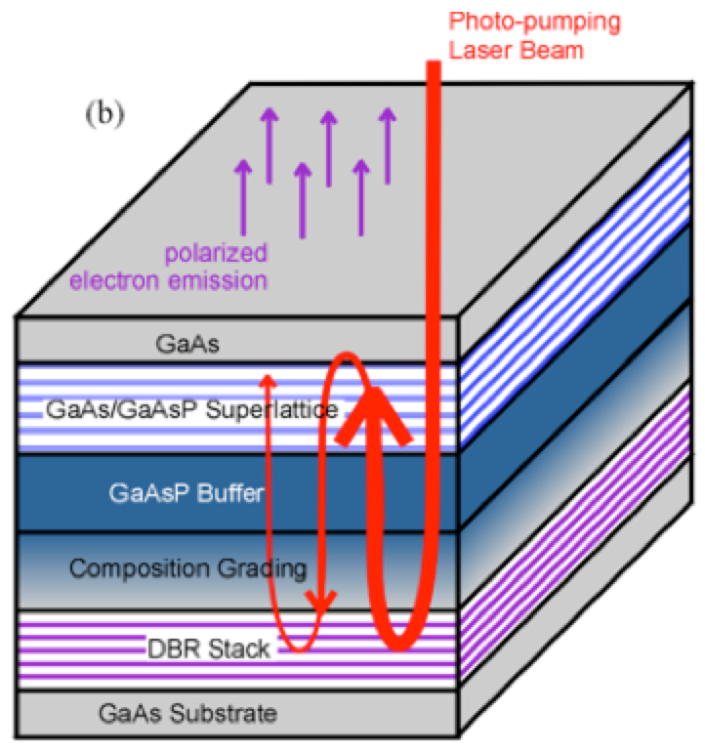
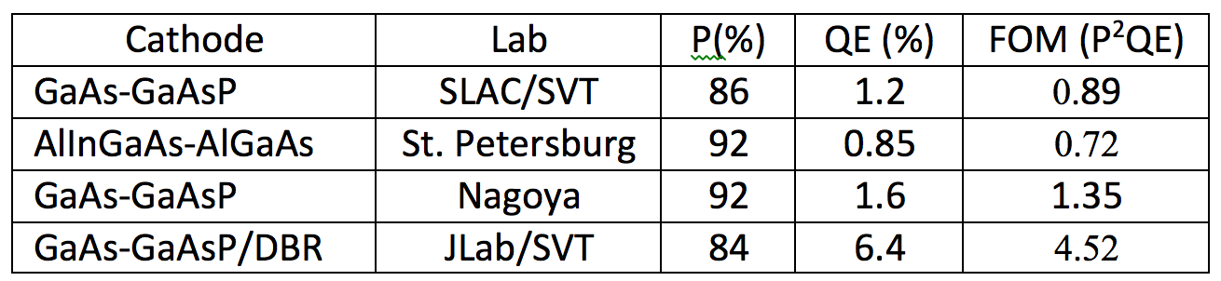
High Polarization Photocathode R&D
GaAs/GaAsP superlattice photocathode with GaAsP/AlAsP Distributed Bragg Reflector (DBR)
The highest QE & FOM of any reported high polarization photocathode
CEBAF
SLSP
Photocathode
DBR Stack
DBR (R&D)
6.4
Substrate
W. Liu, S. Zhang, M. Stutzman, M. Poelker, Y. Chen, W. Lu, and A. Moy
Appl. Phys. Lett. 109, 252104 (2016)

Slide 38
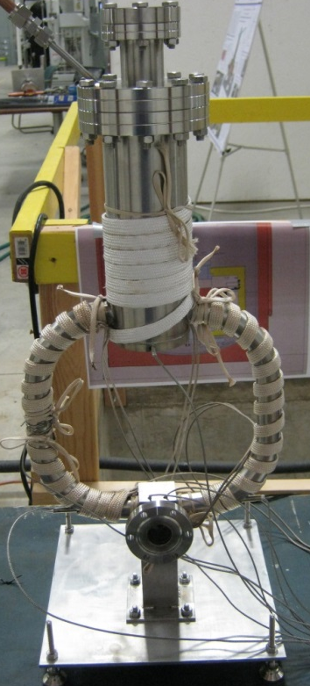
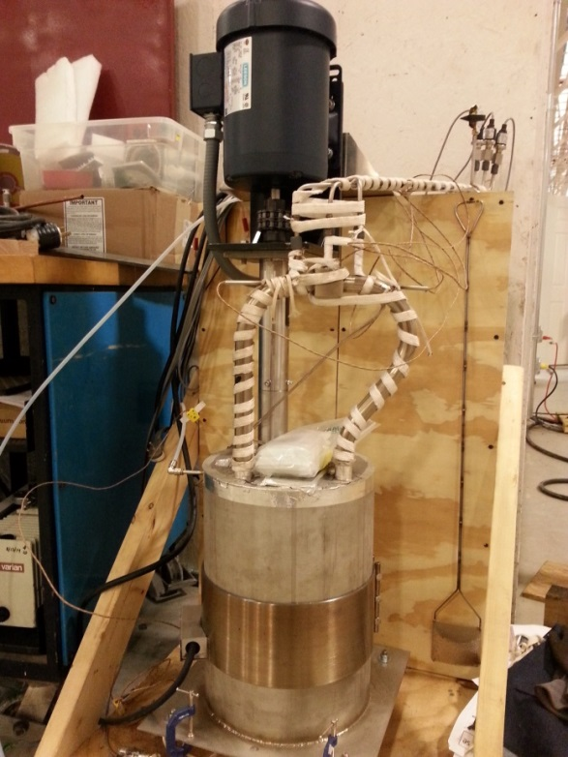
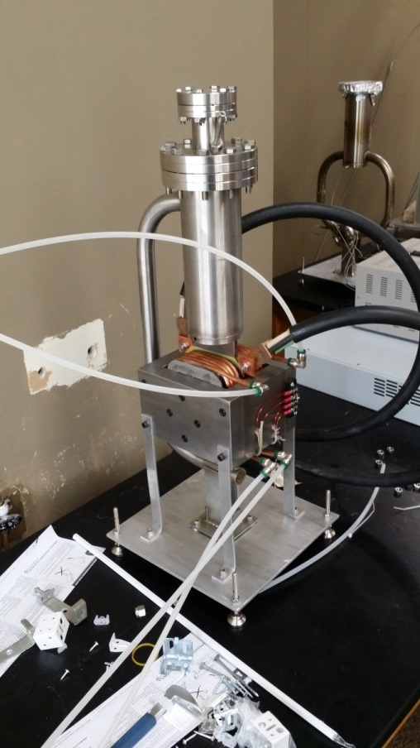
High Power Target R&D
Liquid Metal Target – lead-bismuth eutectic (LBE)
  High Z = 82, 83
  Low melting point: 124°C
  High boiling point: 1670°C
Multiple LBE targets tested on various accelerators
  Natural Circulation
  Mechanical Pumping
  Electromagnetic Pumping
Approaching 10 kW power level, CW
Stainless Steel Windows (0.25mm)
LBE (2mm)
Output (e⁻,e⁺,γ)
Input (e⁻)

