Slide 1
Positron R&D 5 Year Plan:
“Creating Value with Hardware”
 | 24 | 25 | 26 | 27 | 28 | 29 | 30 | 31 | 32 | 33 | 34
Degrader LDRD (Amy) | X
PEPPo-II LDRD (TBD) | ? | ?
Sol. Tgt.(Jlab/IJCLab) | ? | ? | ?
Liq. Tgt (Xelera) | ? | ? | ?
Base Gun (Carlos) | ? | ? | ?
Adv. Gun (Mamun) | ? | ? | ? | ? | ?
Recover 10 MeV e- | ? | ? | ?
10 MeV e+ prg |  |  | ? | ? | ?
100 MeV e+ prg |  |  |  | ? | ? | ?
LERF partner (LCLS-II) | X | X
LERF partner (EIC) |  | X | X | X | X | X | X
Uses CEBAF
Uses LERF

Slide 2
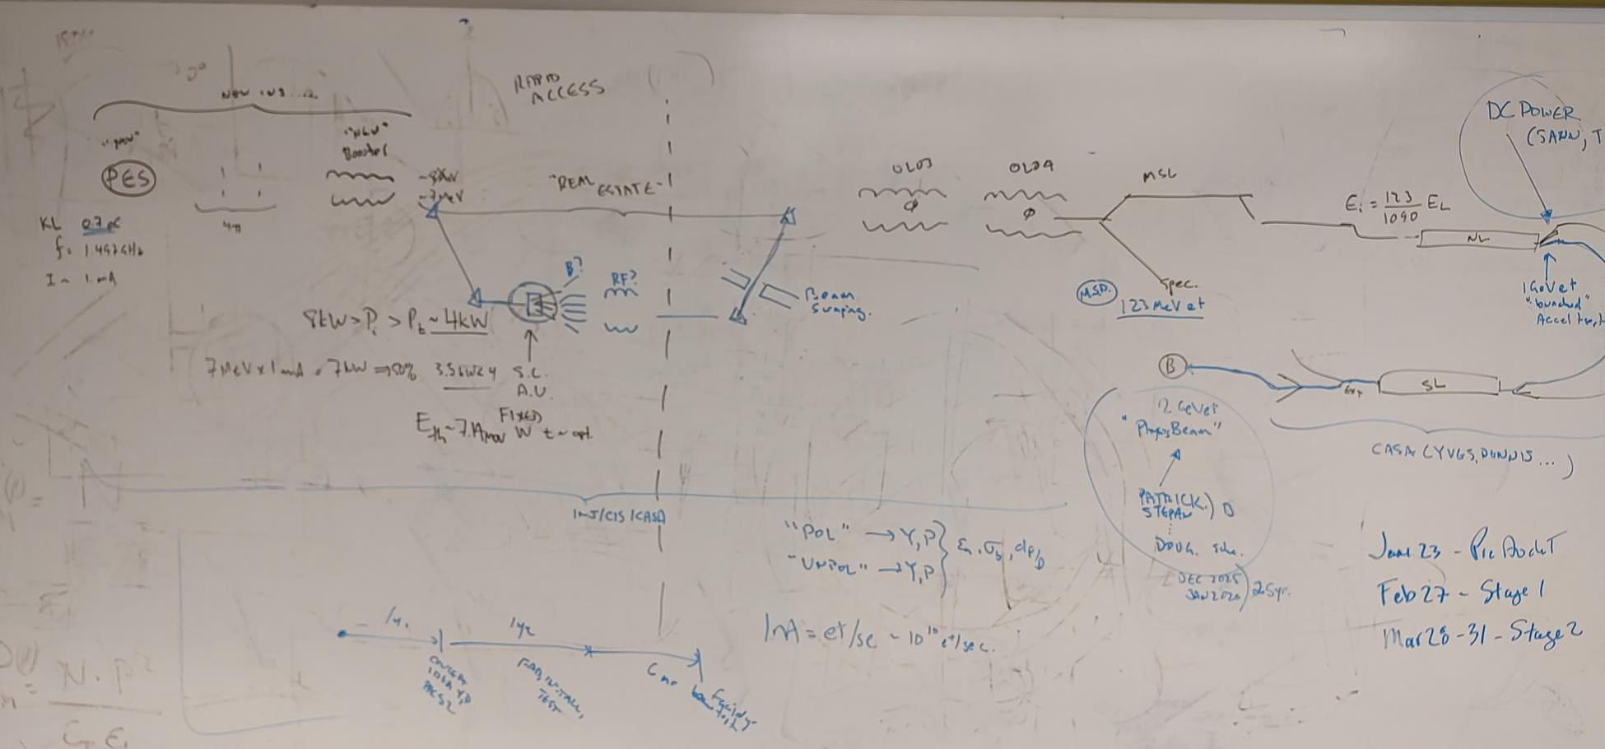
PEPPo – II ???

Slide 3
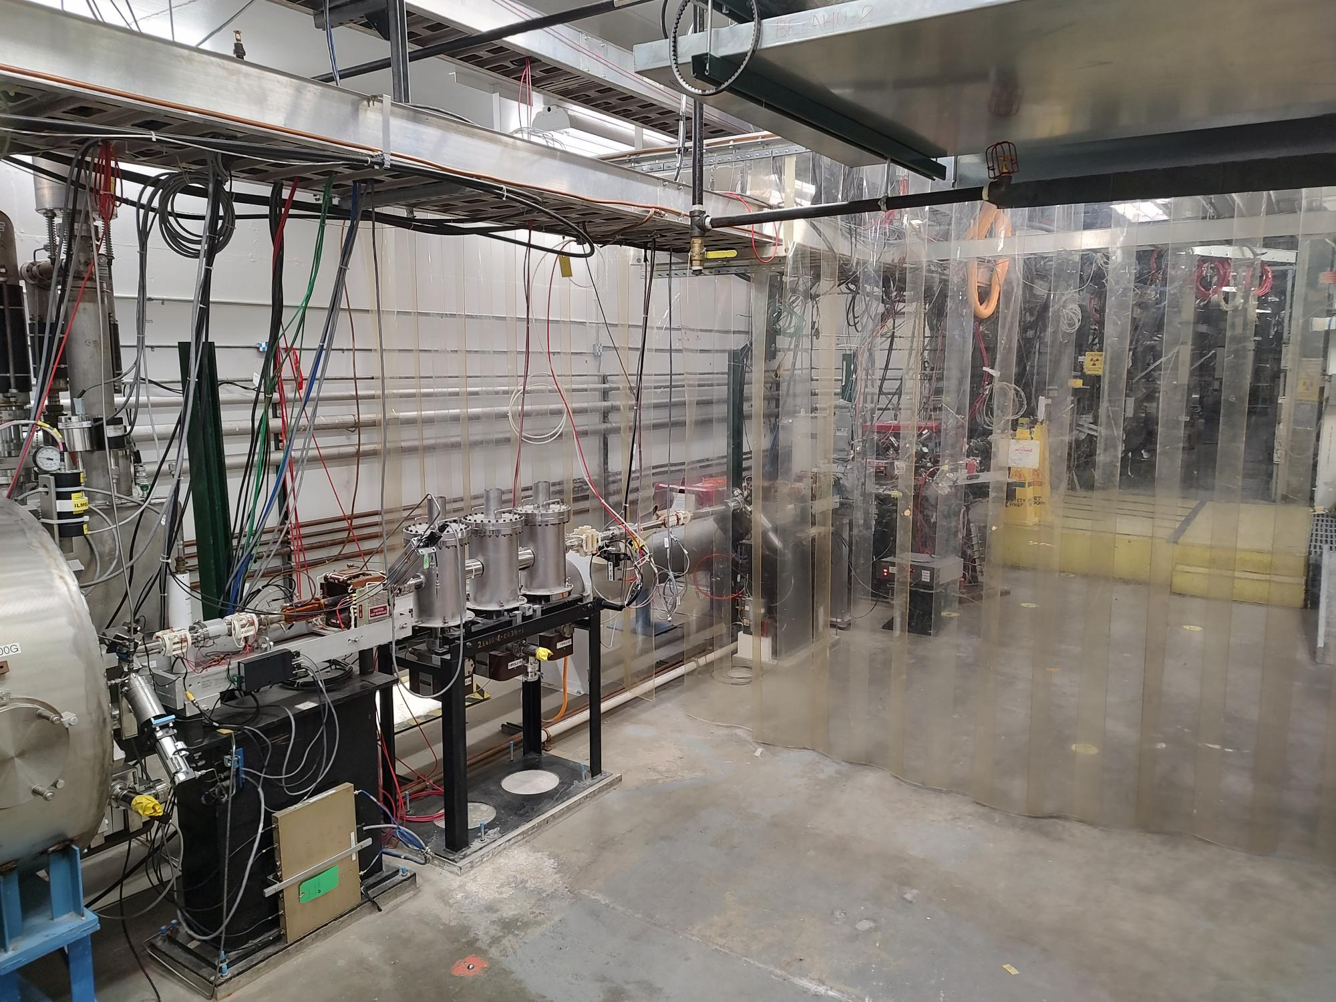
Time to walk the tunnel…

