Slide 1
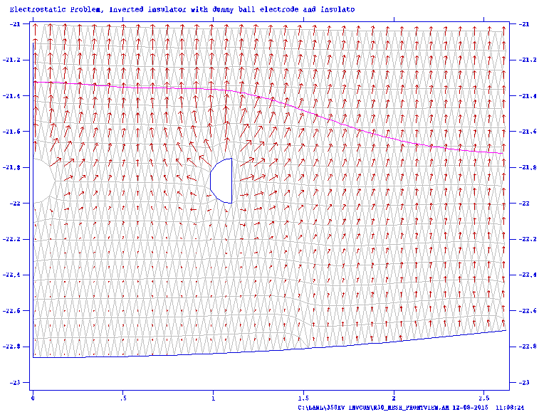
Is the mesh sufficient to keep the electric field from reaching the NEG sheet?
Not likely!!!
Ey=1 MV/m

