Slide 1
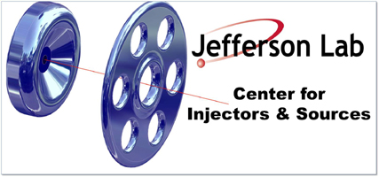
Polarized Injector Status
P. Adderley, J. Clark, J. Grames, J. Hansknecht, M. Poelker,
M. Stutzman, R. Suleiman, K. Surles-Law
QWeak Collaboration Meeting
February 1, 2010

Slide 2
Outline
Inverted Gun & Higher Voltage
Electron Polarization Reversal
Fast Helicity Reversal & New Helicity Board
New QWeak IA Electronics
Injector Commissioning & Optimization for QWeak

Slide 3
Inverted Gun at CEBAF
First Inverted Gun (with Stainless Steel electrode) installed at CEBAF, operational since July 23, 2009
Running at 100 kV. Conditioned to 110 kV
Lifetime about 75 C at 130 µA average current
2 weeks between spot moves, 2-3 months between heat/activations
HAPPEx-III, PVDIS, and PREx: 100 kV. QWeak: > 100 kV
Maximum possible Gun Voltage is 150 kV (limited by Safety System and HV Power Supply)

Slide 4
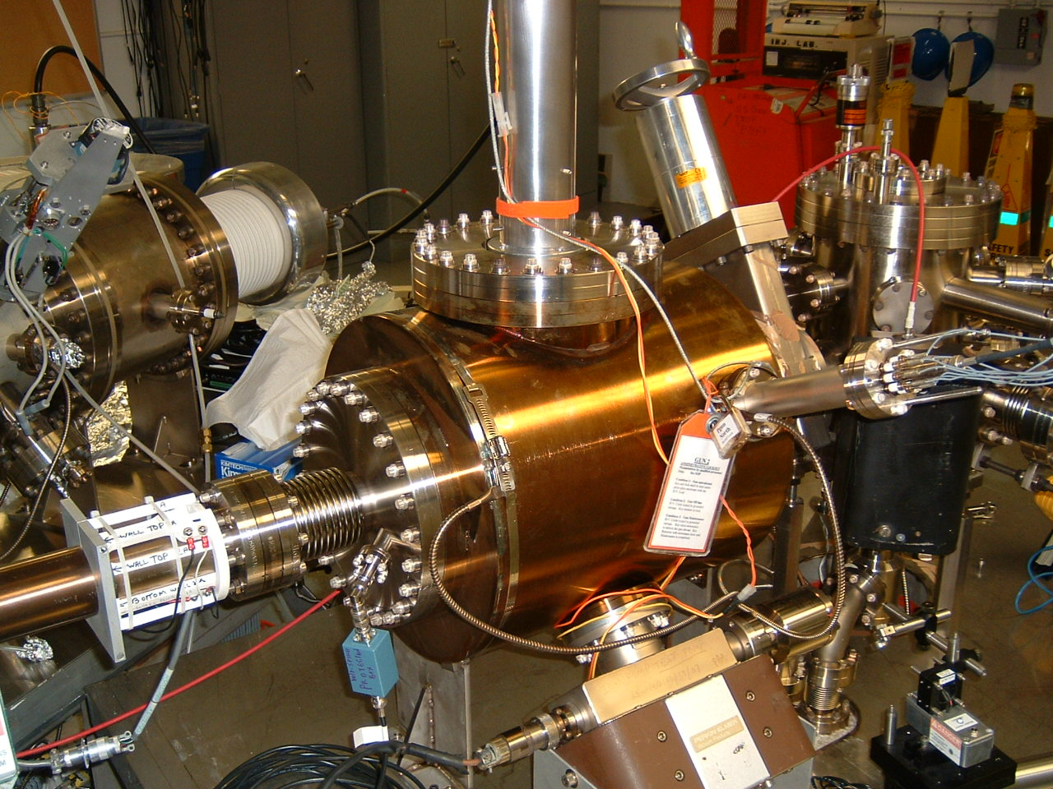

Slide 5
Inverted Gun at Test Cave & Higher Voltage
Second Inverted Gun (with Nb electrode) installed at Test Cave by in November 2009
Conditioned to 150 kV (no vacuum activities, small FE)
Measured lifetime at 100 kV
Will measure lifetime at 140 kV this week
Reminder: still need to test the CEBAF injector up to 150 keV for compatibility with higher voltage gun, mainly warm RF: PreBuncher, Chopper, Buncher, Capture.

Slide 6
HV (kV) | FE (pA) | Radiation (mR/h)
135 | -0.1 | 0.07
140 | -0.6 | 0.20
145 | -1.4 | 0.45
150 | -3.1 | 1.00

Slide 7
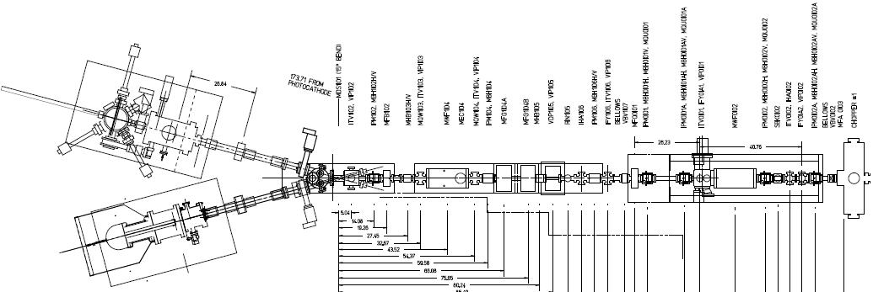
Electron Polarization Reversal
“Spin Flipper”
Vertical Wien = 90 deg
Two Solenoids = ±90 deg
“Longitudinal Polarization”
Horizontal Wien = {-90 … +90}
From Gun
FLIP - LEFT
FLIP - RIGHT

Slide 8
Spin Flipper = Wien + Solenoid
Long. Pol = Wien
4 Most Important Configurations | Vertical Wien (MWF1I04) | Two Solenoids (MFG1I04A/B) | Horizontal Wien (MWF0I02)
NO FLIP (old method) | 0 deg | 0 deg | +43 deg
VERTICAL POL | 90 deg | 0 deg | +0 deg
FLIP - LEFT | 90 deg | -90 deg | -47 deg
FLIP - RIGHT | 90 deg | +90 deg | -47 deg
Some facts…
“Spin Flipping” is accomplished without changing Wien filters
Vertical Polarization is a “subset” of “Spin Flipper” operation
“Old Method” achieved by turning Vertical Wien off
Ability to uniquely define spin in 4π

Slide 9
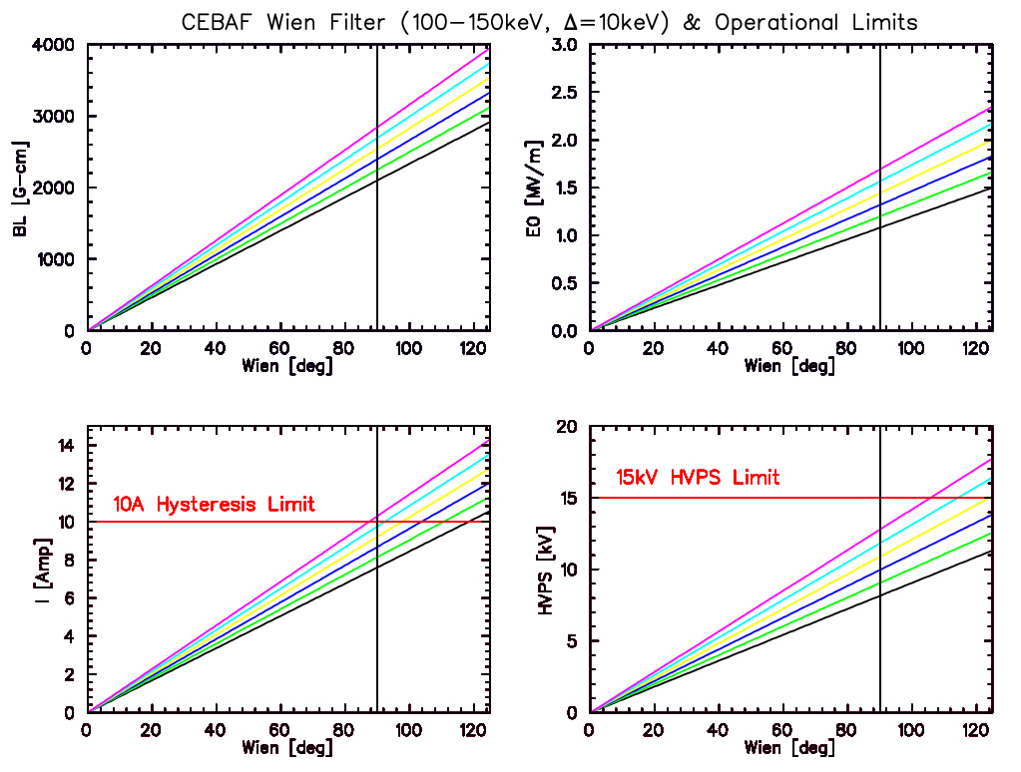
Functionality of spin controls – operate to 140 keV
150 keV
140 keV
130 keV
120 keV
110 keV
100 keV

Slide 10
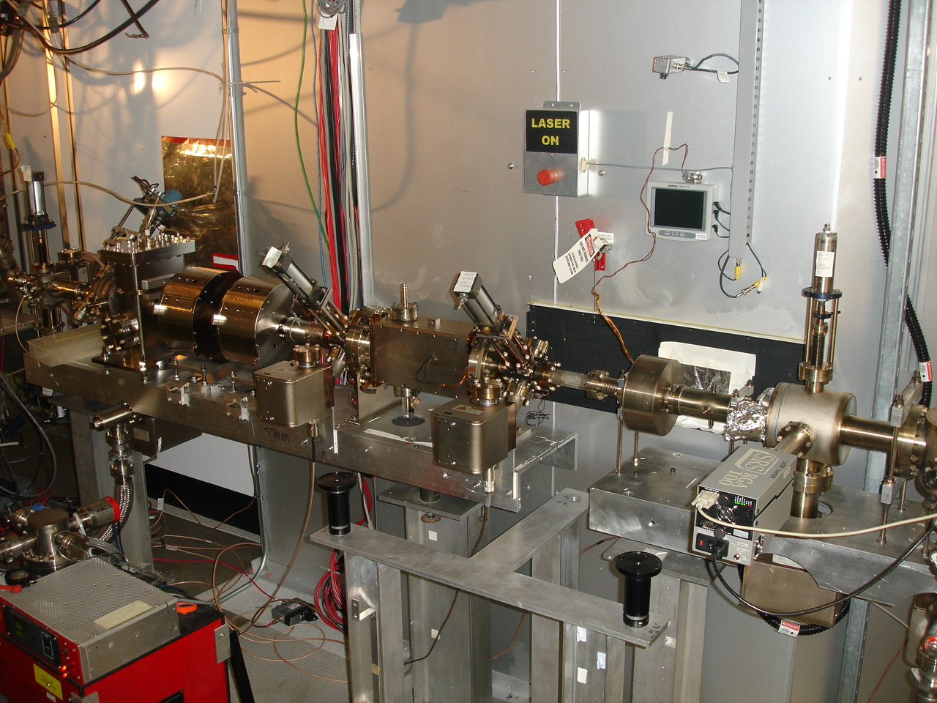
January 27, 2010
Region 1 Girder – “Spin Flipper”

Slide 11
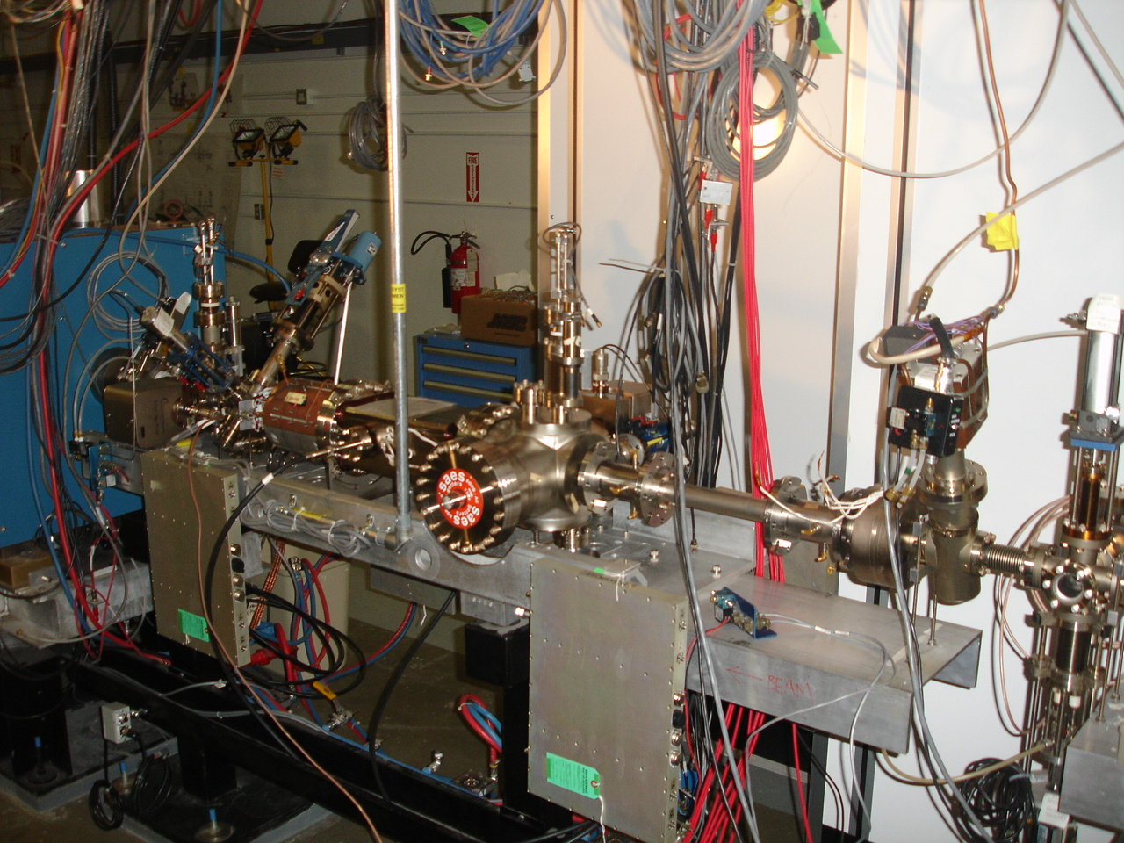
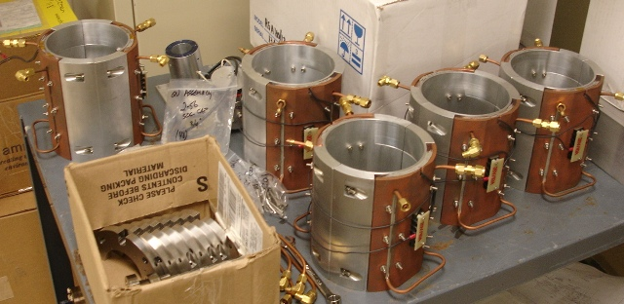
January 27, 2010
Region 2 Girder – “A1/A2 + Horizontal Wien Filter”

Slide 12
Fast Helicity Reversal
New Helicity Board installed on Nov 2, 2009
Features:
Transition to T-Settle will start 1 µs before all other signals
30-bit Pseudo-random Shift Register
Patterns: Toggle, Pair, Quartet, Octet
T-Settle: 10 µs – 1,000 µs
Clock:
Line-Locked: Helicity Reversal of 30 Hz, 120 Hz, or 240 Hz
Free: T-Stable of 400 µs – 1,000,000 µs
More Fiber Outputs:
Real Time Helicity:
Standard: Pockels Cell & IAs
Complementary: Helicity Magnets
20 MHz board internal clock
Two outputs indicate current and previous helicity patterns to QWeak IA

Slide 13
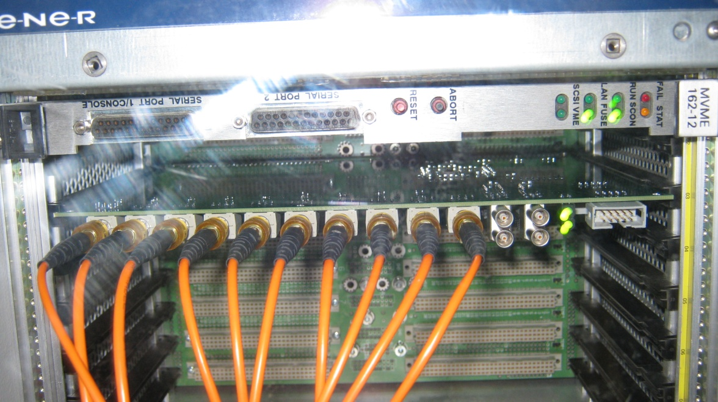
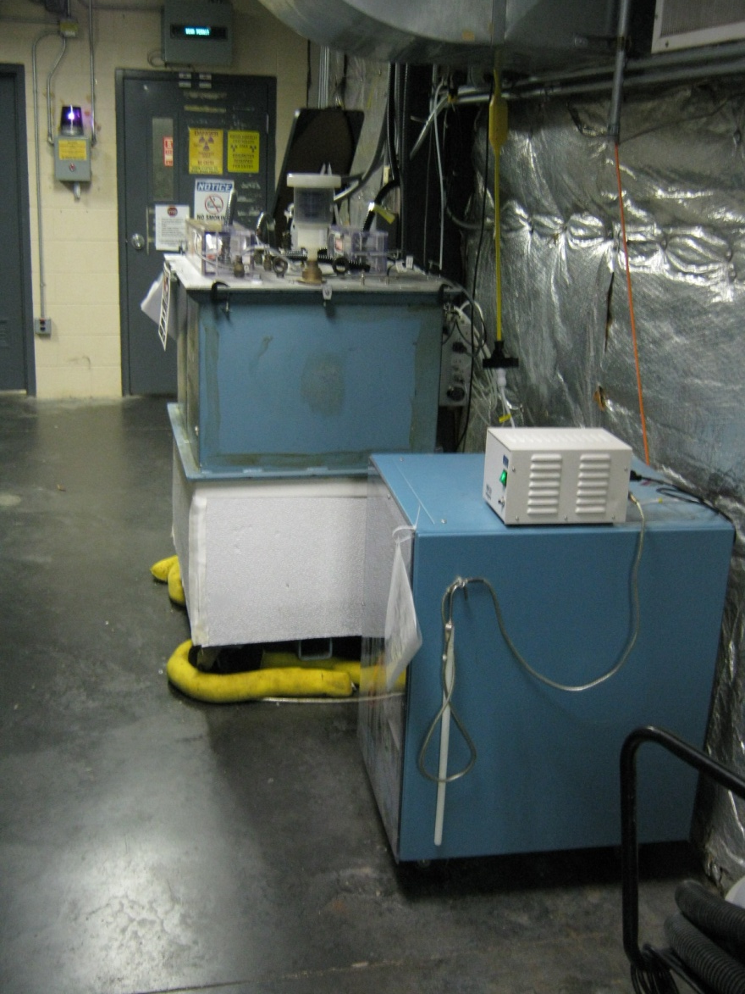
Experiment | Rate | Clock | Pattern
HAPPEx III & PVDIS | 30 Hz | Free | Quartet
PREx (Preliminary) | 240 Hz | Line-Locked | Octet
QWeak (Preliminary) | 1 kHz | Free | Quartet

Slide 14
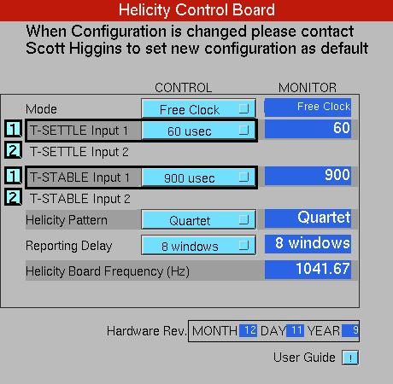
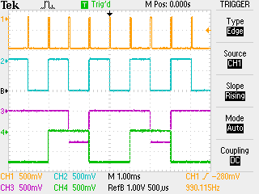
T_Settle
Pair Sync
Pat Sync
Del Hel

Slide 15
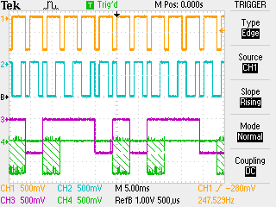
QWeak New IA Electronics
Hardware to be installed in Feb 2010
Commission during QWeak in May 2010
Pat Sync
HEL
IA0
IA1

Slide 16
Injector Commissioning & Optimization
Coordinator: Suleiman
Members: Poelker, Grames, Hansknecht, King, Carlini, Paschke, Ramsay
Plan:
Higher Voltage:
Gun: Feb 2010, Test Cave
CEBAF Beamline: May 2010
Electron Polarization Reversal: Commission at 100 kV during PREx, >100 kV in May 2010
New Helicity Board: Commission during PREx
QWeak Reversal Rate: May 2010
QWeak Pattern: May 2010
New IA (Charge Feedback): May 2010 (need analysis support)

