Slide 1
UITF Project Status Meeting
Matt Poelker
October 20, 2016

Slide 2
Outline
Purpose: to inform Lab Leadership of the UITF status
Action Items (from previous meetings)
Project Update
Progress Update
Milestones Update
Budget Update
Highlights & Concerns
Next meeting agenda
Notes:
RW=Roy Whitney

Slide 3
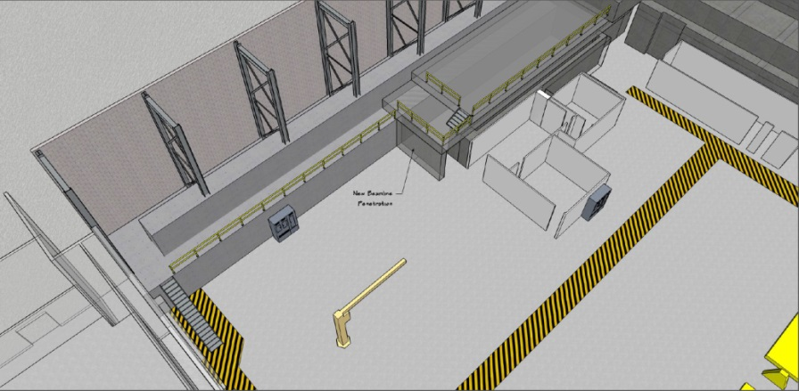
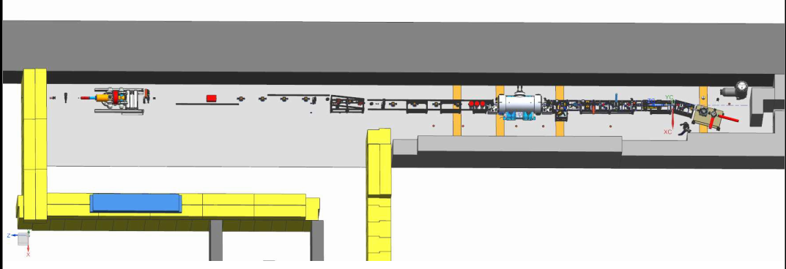
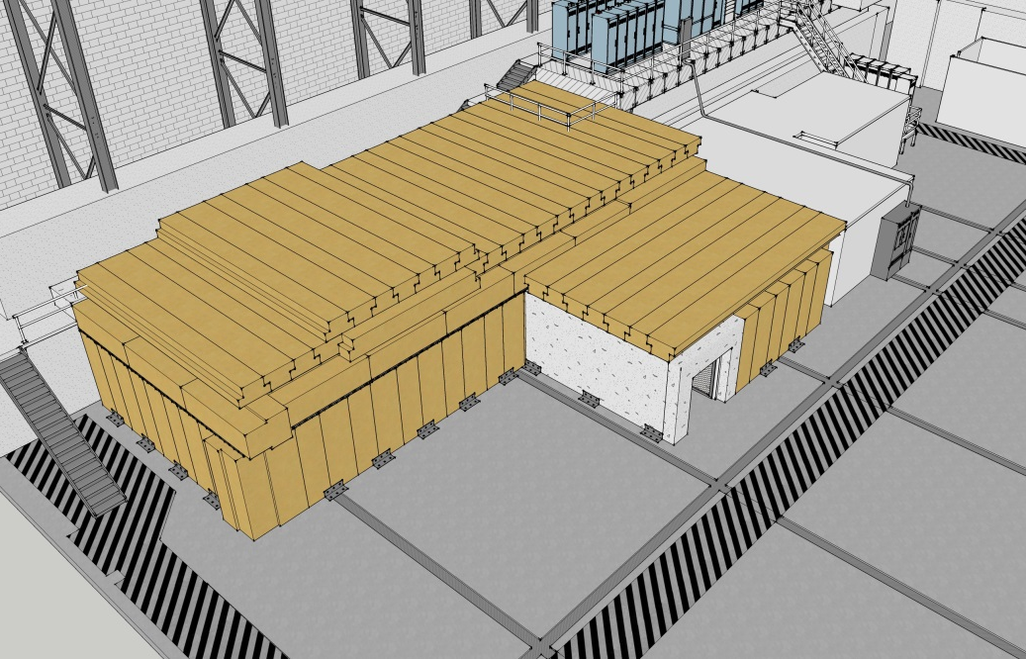
Proposed re-scoping
ITFCRY
ITFPTB
UITFBL
Facilities
Cryo Infrastructure including some RF
Polarized Target Beamline
UITF
Facilities

Slide 4
Action Items – April 12, 2015 Minutes
New Action Items:
Wrap up UITFBL by October 1, 2016
Share resources with CEBAF and LERF: gun group, software, I&C, low level RF, high power RF, safety system group
Notes:
RW=Roy Whitney

Slide 5
Progress Update
Major components
Facilities
Engineering
Mech Design
Installation
Cryo
Safety Systems
I&C
DC Power
Low Level RF systems
High Power RF
Survey & Alignment
SRF
Build new ¼ CM
Commission with RF
Ops and CASA
Network and communications
Software
Beamline design
Green means we can see progress

Slide 6
Progress Update
Major components
Source Group
Reliable 200kV ops
Beam to cup in front of ¼ CM
Beam to cup in front of HDIce
EHSQ
Shielding approval, ODH assessment, Ops Review
Global hazard review
FSAD
Accel Readiness Review
Commissioning Plan
HDIce
Installation at Cave
Beam on HDIce
Green means we can see progress

Slide 7
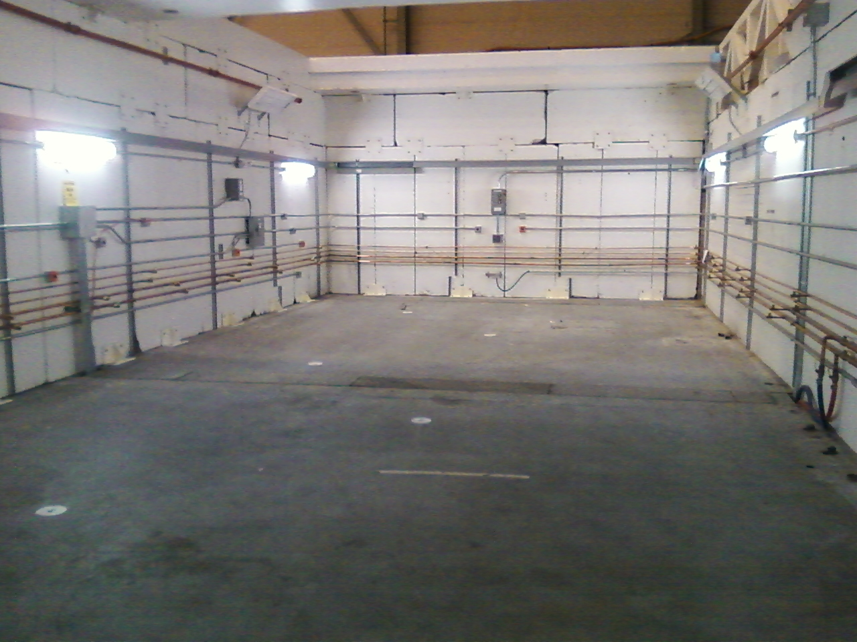
Facilities ~ Done
Paint Cave2 floor soon
Ceiling blocks will be put in place once ¼ CM is craned in…
Install a few more seismic brackets

Slide 8
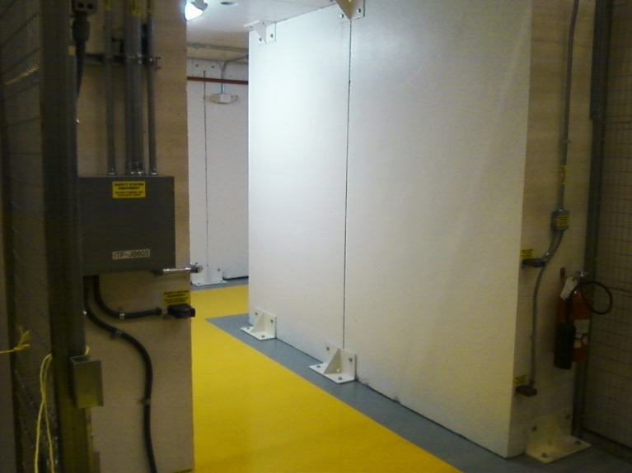
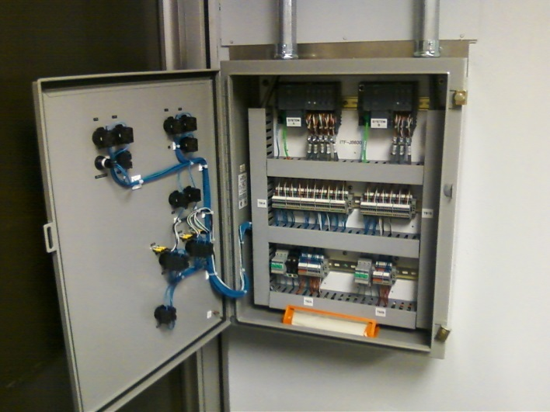
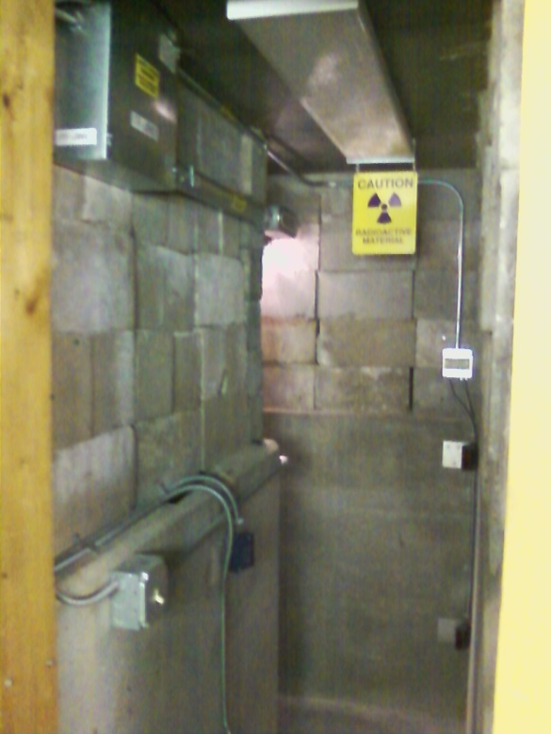
Status Safety System Group
Still competing with CEBAF but making progress
Four person weeks labor gets us a lockable enclosure for Gun high voltage conditioning
RF interlocks will be bypassed until needed

Slide 9
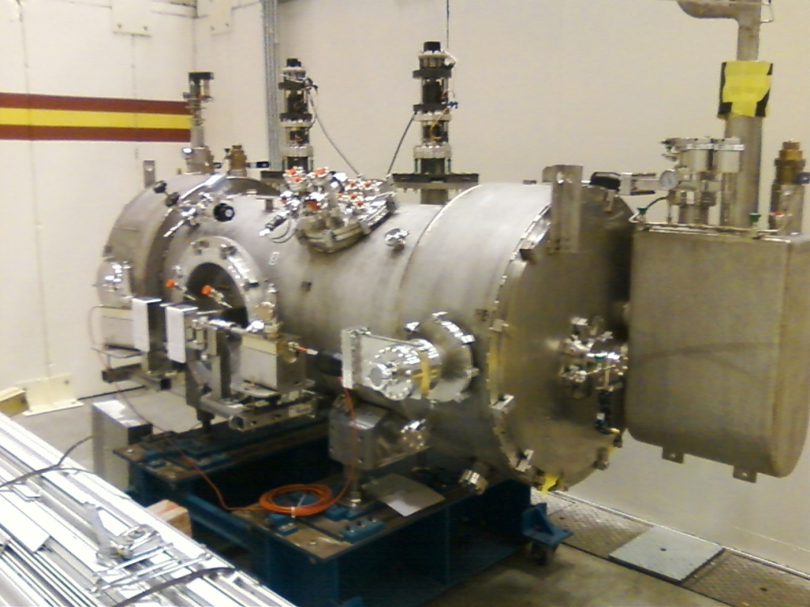
Status New ¼ CM – Done!
Tests at CMTF complete, reached high gradients without field emission
Sitting outside the cave, waiting to be craned in
Cryo needs to install some warm return pipe….
SRF knows there’s work to do inside cave….

Slide 10
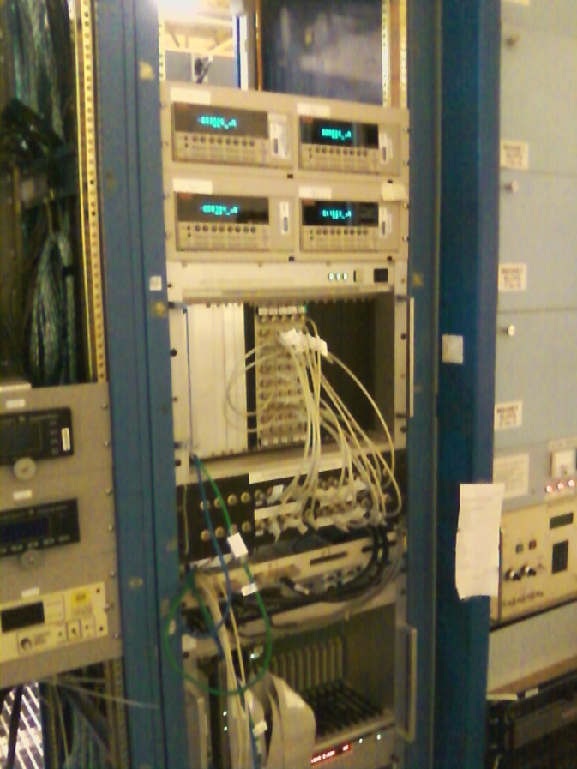
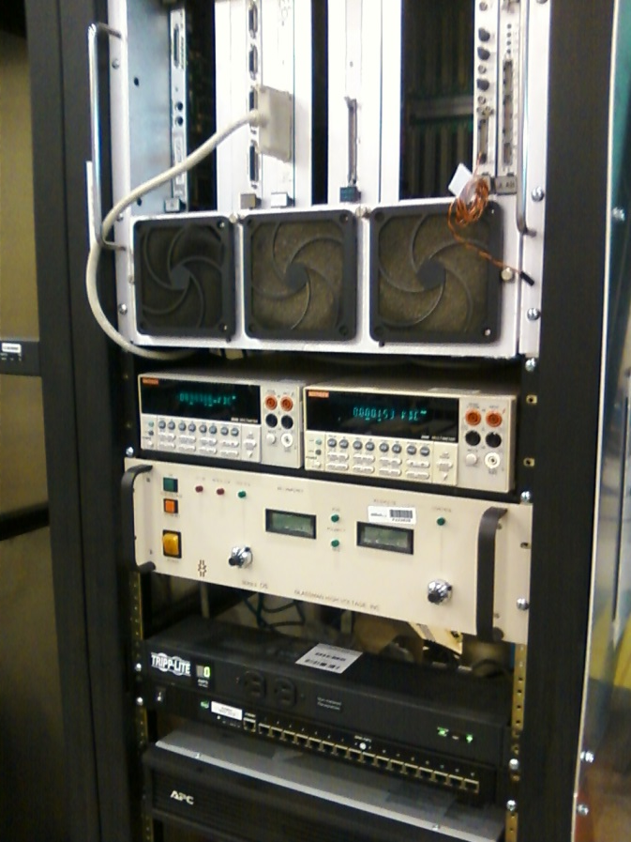
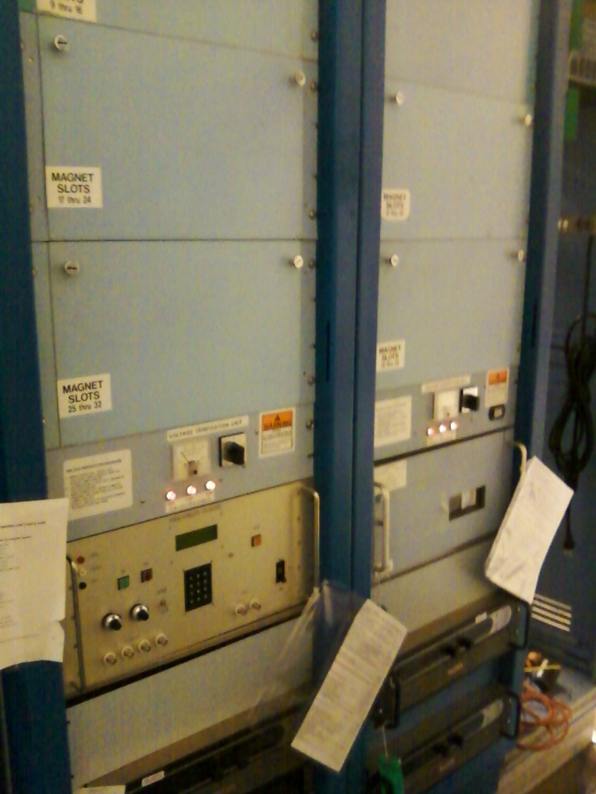
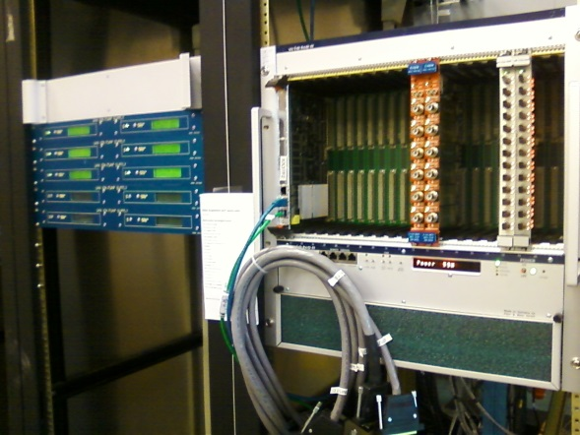
Status Electronics and Software
Current monitoring, ion pump power supplies, gun HV power supply, magnet racks

Slide 11
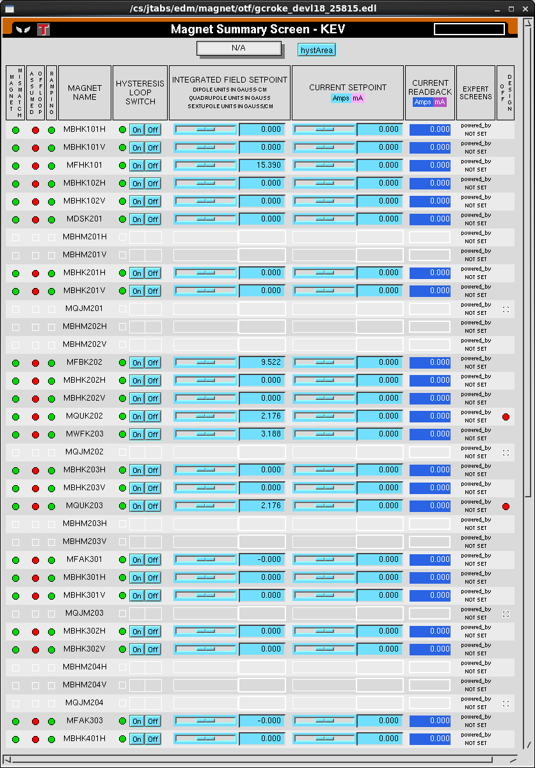
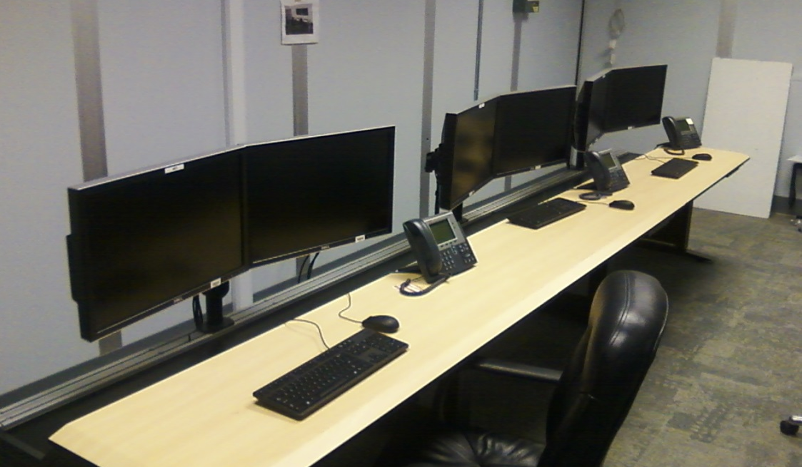
Status Operations
Software requests are coming in: Magnets, Gun HV power supply, RF controls
But many more required: viewers, video, valves, current monitoring, laser controls, etc.,

Slide 12
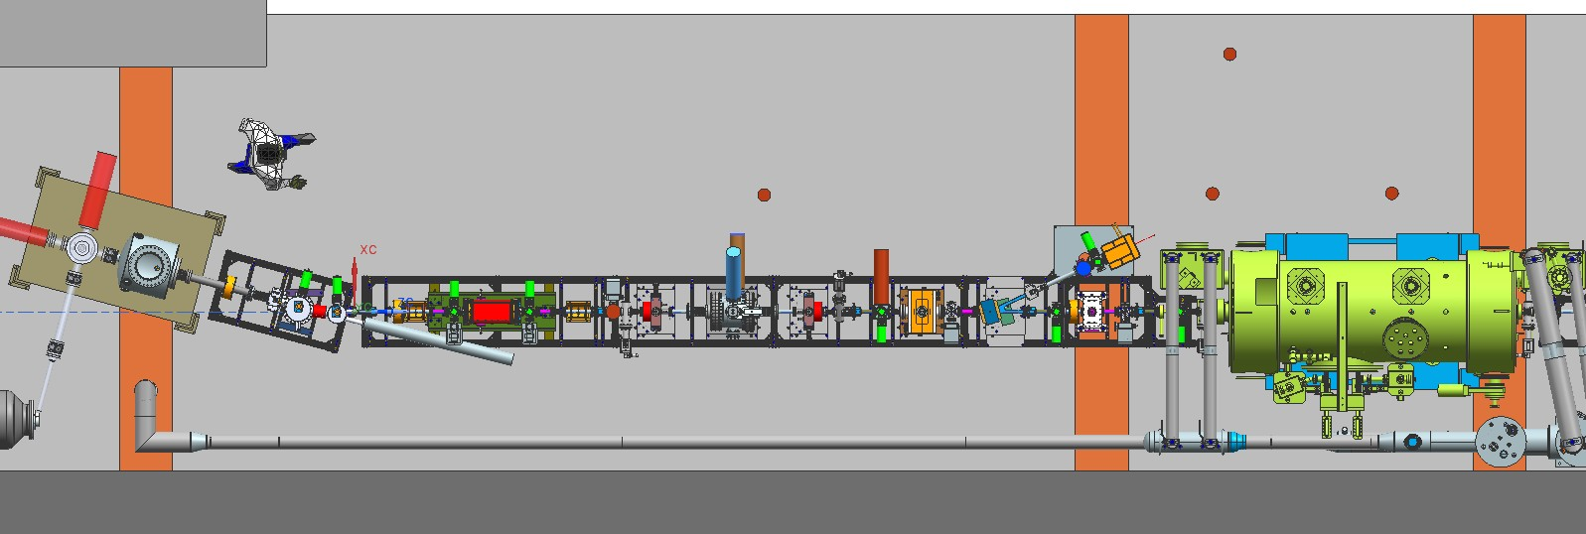
keV beamline

Slide 13
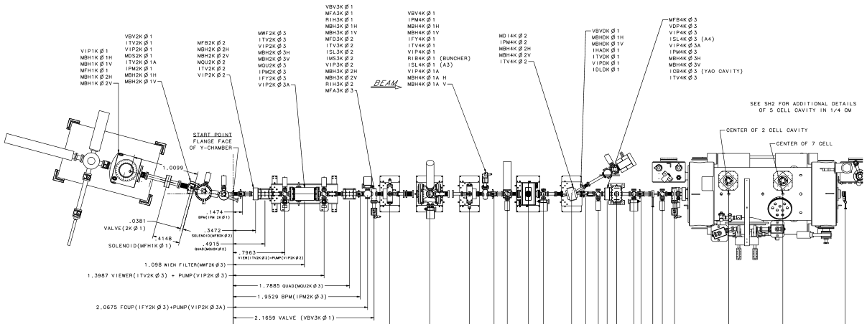
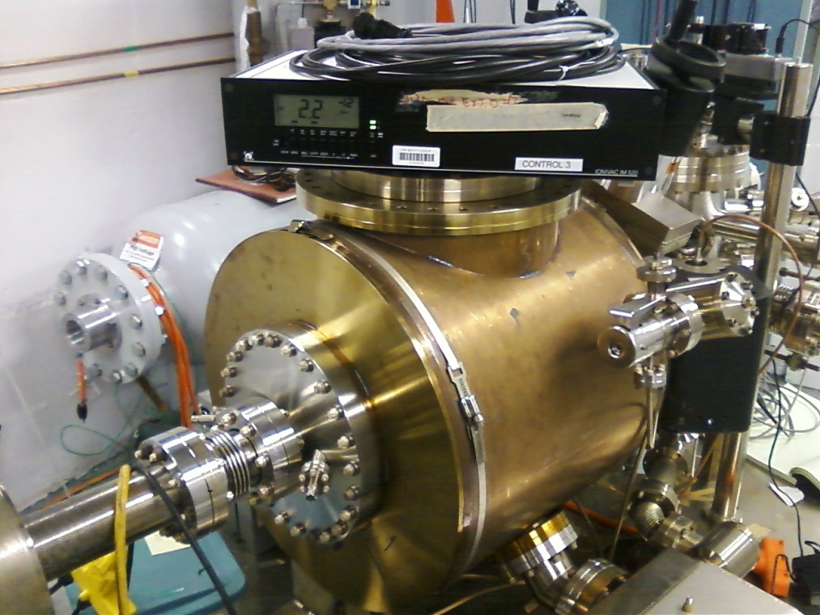
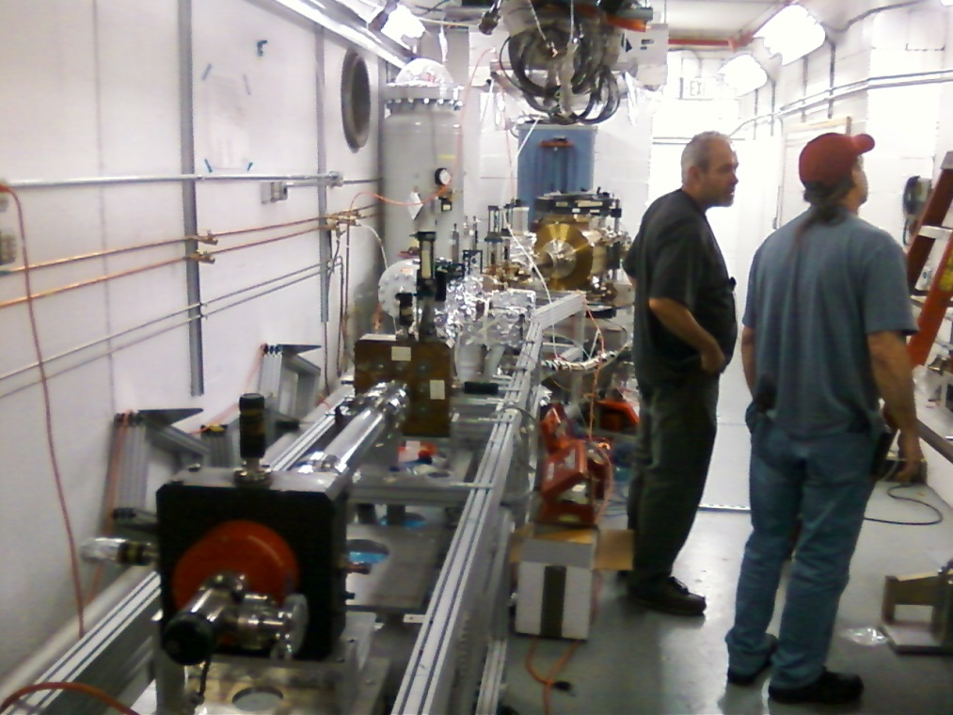
Status Gun Group
Gun vacuum 2x10⁻¹² Torr (very good)
Waiting for chopper chamber flange, Wien filter modification and the repair of two solenoid coils at chopper….
Still hope to put beam on viewer before 2017

Slide 14
Making keV beam
Connect magnets, ion pumps, associated software
I&C and associated software: viewers, valves, cups, aperture and dump
Then need rf applied to laser, tune mode generator, stepper motor control (STAK5)
Then need BPMs, rf to chopper and buncher,

Slide 15
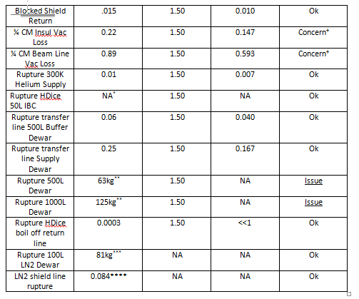
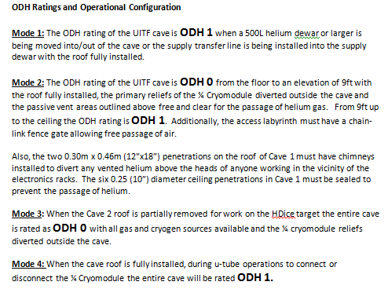
Status Safety
ODH Final Document
Asking for signatures

Slide 16
Status Safety
Hari pushing this forward

Slide 17
Status Reviews
UITF Accelerator Review: beamline design reviewed by Ops/CASA/SRF, March 18, 2016, “Will it work?” review
Geoff Krafft, Mike Spata, Reza Kazimi, Arne Freyberger, Todd Satogata, Fay Hannon
Yes, it will work. Summary distributed, Bruce Lenzer helping to make the review “official”
Internal Safety Review, May 10, 2016
Personnel safety, including radiation protection, and machine protection, assessment will be sent to SCMB
Key outcome of Internal Safety Review - Bob May recommended in-house mini-review of our PSS BCM system, suggested time frame August 2016
Met with RadCon, SSG, I&C and RF groups: schedules dictate mid-October for review : Specification on allowed Integrated Dose, and sensitivity of CEBAF PSS BCM downconverter

Slide 18
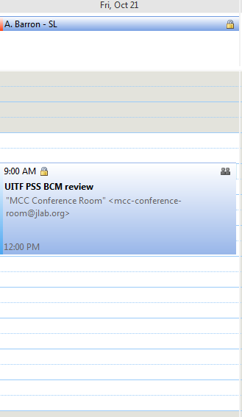
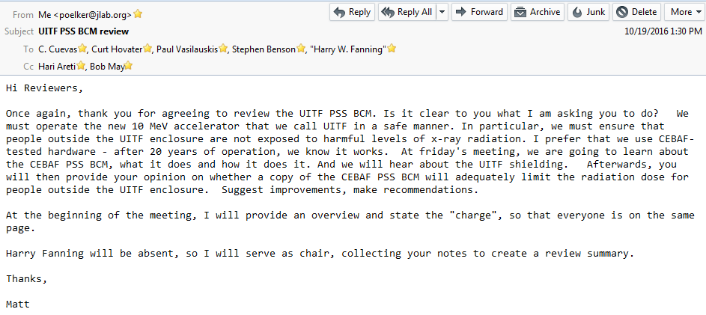
Status Safety – PSS BCM Review
Can we use the CEBAF PSS BCM as Credited Control for UITF?

Slide 19
Status Reviews
Conduct of Operations Review, November 2016?
Commissioning and Operations plans (the SCMB review)
Accelerator Readiness Review, December 2016?
Bob recommends not until we have 90% of MeV beamline ready…
Documentation in place, systems ready and checked out, staff trained
Experimental Readiness Review, early 2017

Slide 20
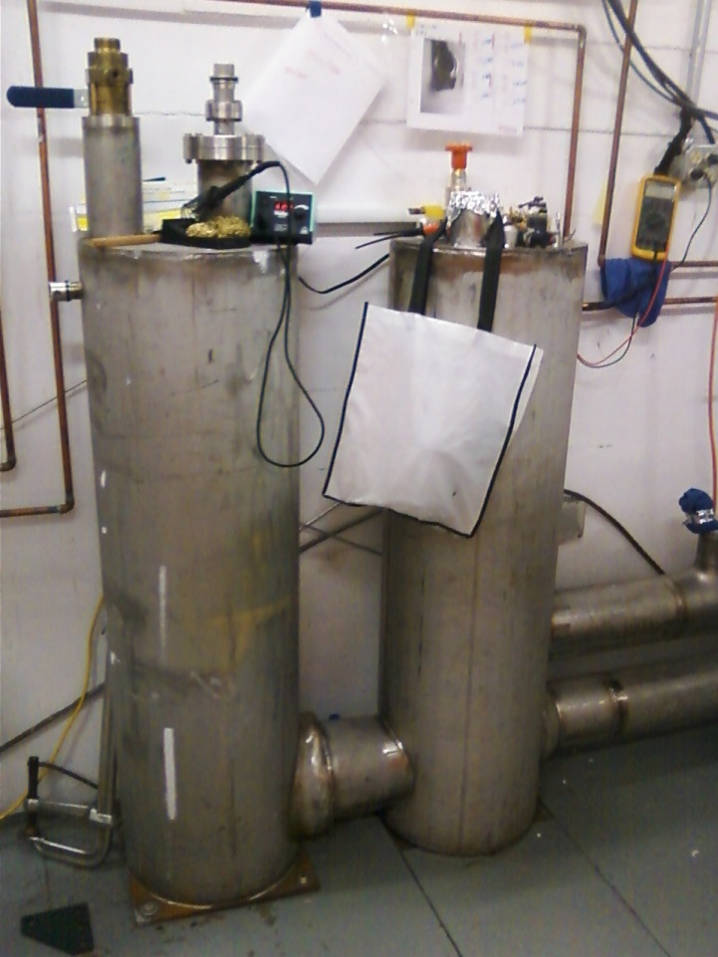
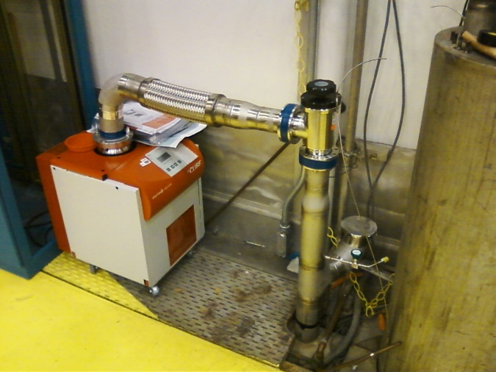
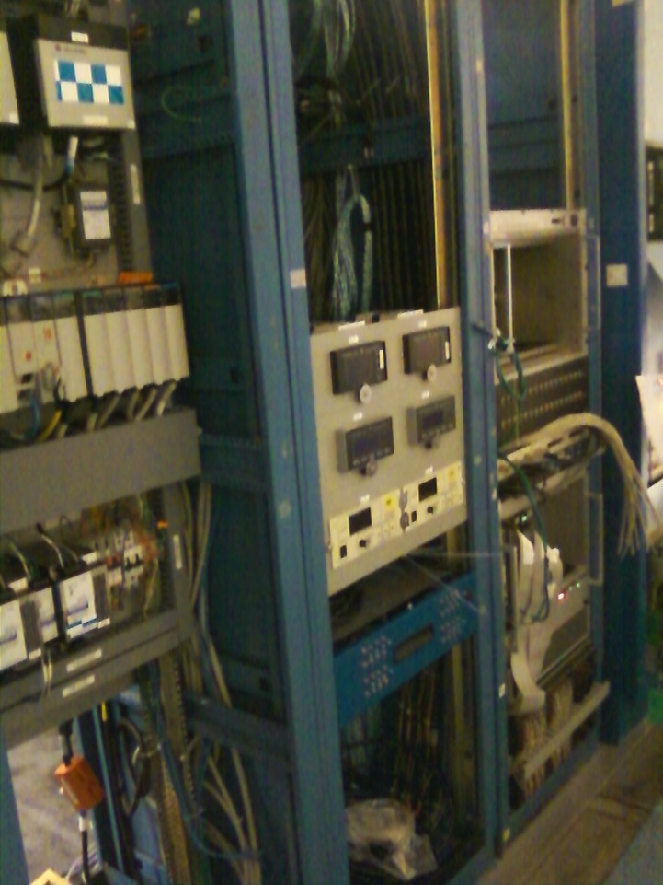
Status Cryo Group – on hold
Need to leak check ¼ CM plumbing, wrap up electronics, plumb-in the turbo pump, fabricate U-tubes, add the HDIce warm return

Slide 21
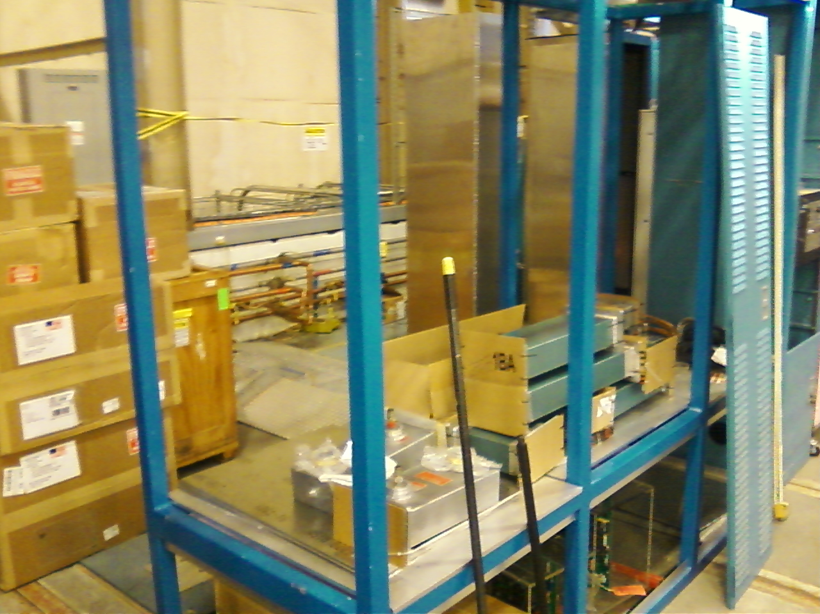
Status RF: mostly on hold
Klystrons, waveguides and assorted components, all on top of cave – hoping RF group can put it all together soon
Control modules ready, Scott Higgins working on software
Chopper amps ordered, water skids can now be installed

Slide 22
Status MeV beamline – on hold
Insertable Faraday Cup
Fixed Dump
BLM locations
PSS BCM
Insertable Faraday Cup

Slide 23
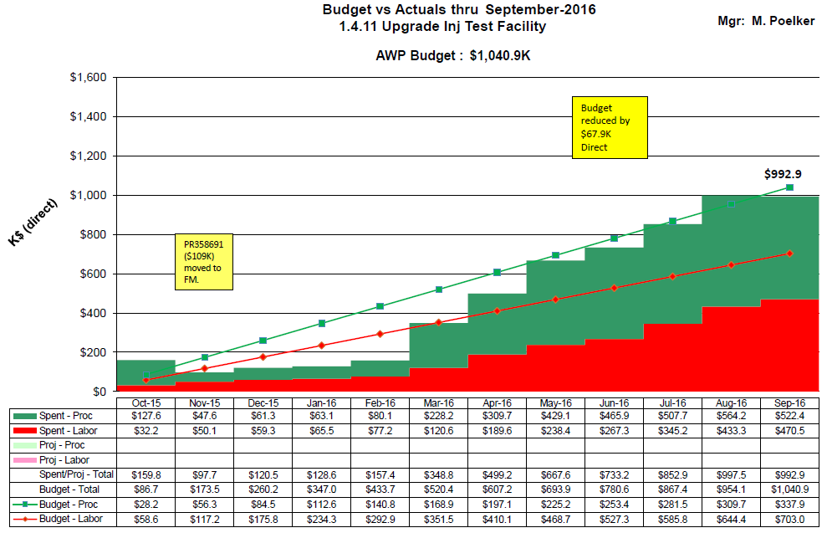
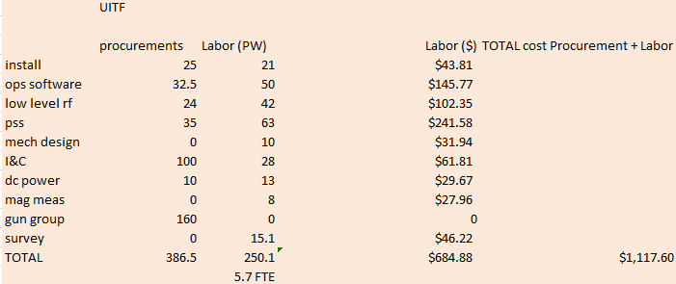
Budget UITFBL

Slide 24
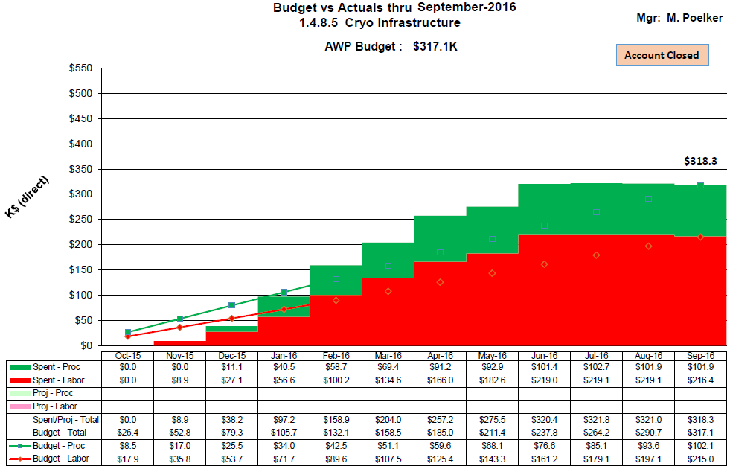
Budget ITFCRY – account closed

Slide 25
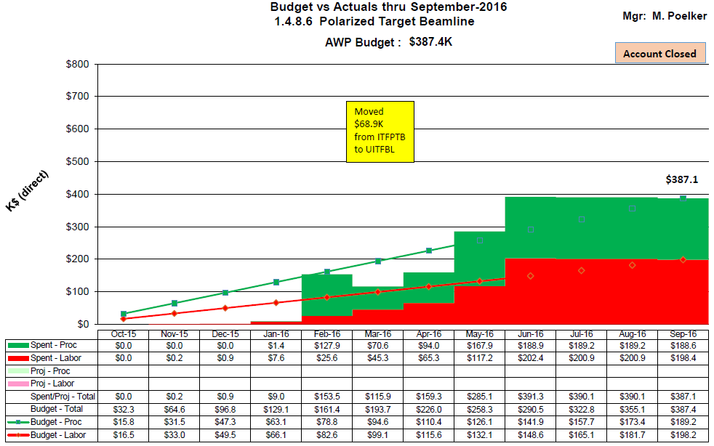
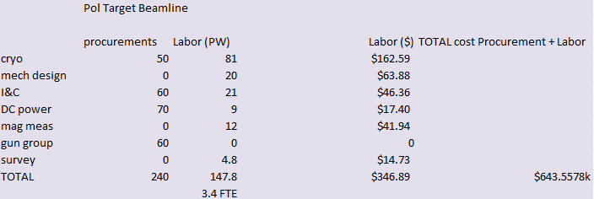
Budget ITFPTB – account closed

Slide 26
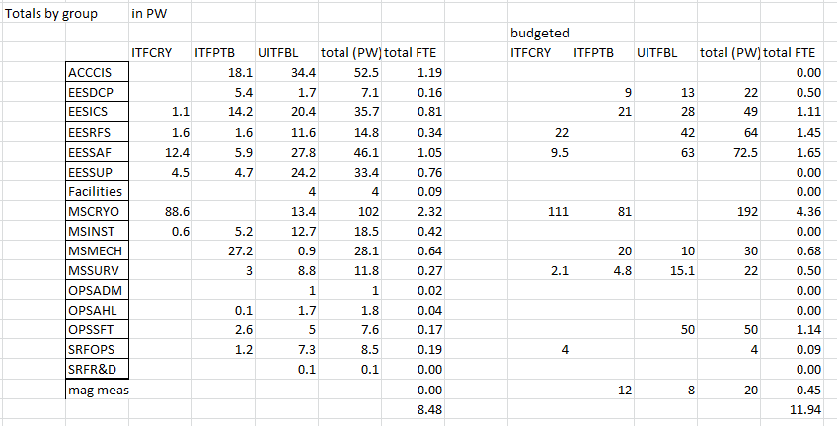
FY16 totals (need to revisit final numbers)
spent
budgeted
Procurements $818k $747k

Slide 27
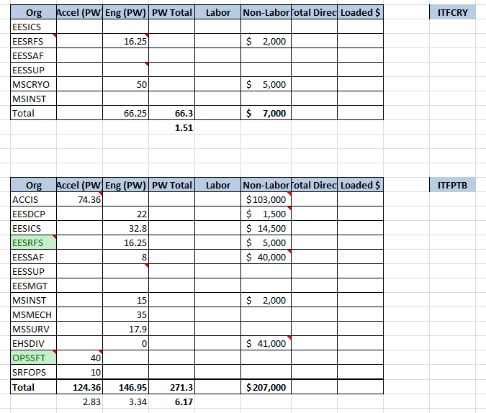
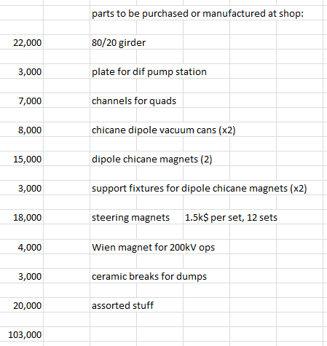
FY17 budget

Slide 28
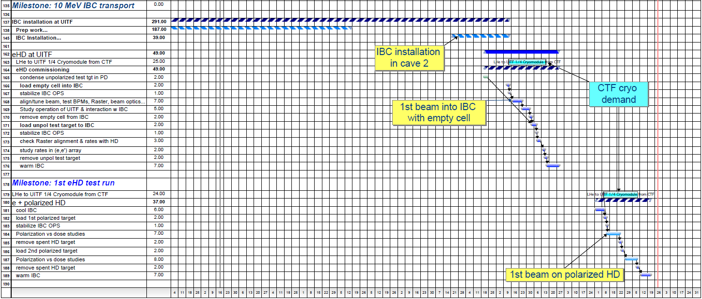
Status HDIce
Planning beam tests…..

Slide 29
Summary
Wrapping up FY16 and into 1st quarter FY17
Facilities work complete
PSS/ODH systems fully functional, at least related to the gun, RF can come later…
By end of 2016, keV beamline complete and the new ¼ CM in place and connected to the keV beamline, but NOT connected to CTF
Starting to put beam on viewers, adding incremental capability (RF structure, choppers, BPMs, etc.)
Begin lifetime tests at keV beam energy, high polarization photocathodes
Paperwork, procedures and approvals….

Slide 30
Summary
When Can HDIce expect beam?
CTF: no final word on scheduling. The CTF down lasts four months. The soonest this work might happen is during the winter break of 2017. Imagine start January 2017 through April 2017
CTF down provides time to finish the MeV beamline design and build it
Accelerator Readiness Review
Making MeV beam May 2017. HDIce beam tests Summer 2017...

Slide 31
Concerns
Availability of Cryo, RF and MeV beamline designer
Can Andrew afford 5 engineering FTEs?
“typical” procurements required
Machine shop work adds up
Safety costs money: PSS BCM and Radiation monitoring, expensive
PSS BCM – a viable solution to limit beam current?
Sharing CTF…
HDIce beam dump, cryoconda support?
Managing expectations…

Slide 32
Backup Slides
Backup slides from past meetings, P&C meetings

Slide 33
Summary
Hope Cryo and MeV beamline design work can resume October 1
At least 3 month delay, maybe more (e.g., after the 80/20 girder is designed, we still need to order it)
We can make keV beam and deliver it to cup in front of ¼ CM during Fall 2016
Hope we can commission the ¼ CM with RF before CTF shutdown
Going to focus on PSS BCM mini-review and the Conduct of Operations review. Hold off on Accelerator Readiness review until we have MeV beamline
Preparing budget estimates for FY17

Slide 34
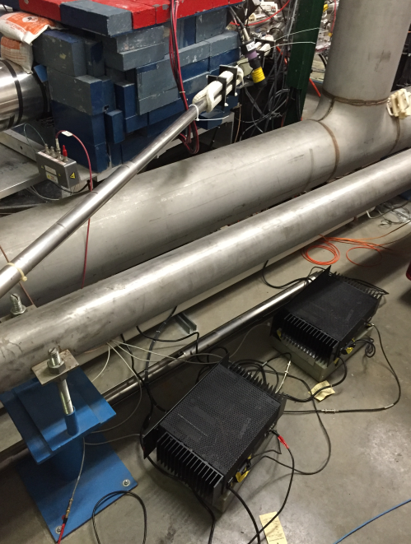
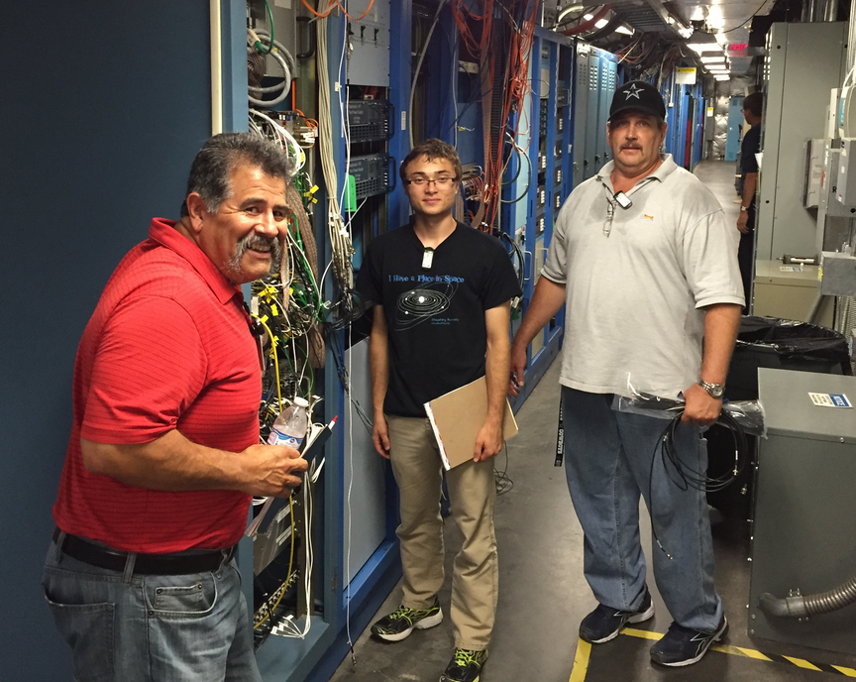
Status HDIce
Successful installation of 0.04 um radiation baffles
The In Beam Cryostat (IBC) modification are complete
Trouble-shooting NMR coil
Opportunistic testing of raster coil at CEBAF injector

Slide 35
Milestones Update
WBS | Item | Milestone Description | Start Date | Projected Finish | % Complete | Days Float? | Change (%) | Change (Days)
1.04.xxx | Facilities | Civil work complete | 6-4-15 | August 2016 | 100% |  | 95 to 100%
 | Gun | Demonstrate gun ok at 200 kW at FEL GTS |  | December 2015 | 100% |  | done
 | CM | Commission cold ¼ CM, no beam |  | November 2016 | 60% |  | 50 to 60%
 |  | Beam from Gun to Cup in front of ¼ CM |  | November 2016 | 40% |  | 30 to 40%
 |  | Beam thru ¼ @ MeV energy delivered to cup in front of HDIce |  | ? | 10% |  | 0 to 10%
 |  | Beam to HDIce |  | ? | 0
Facilities work nearly complete, followed shortly thereafter by Safety System Group
keV beamline complete by October, followed by controls
New ¼ CM installed inside cave by October 1

Slide 36
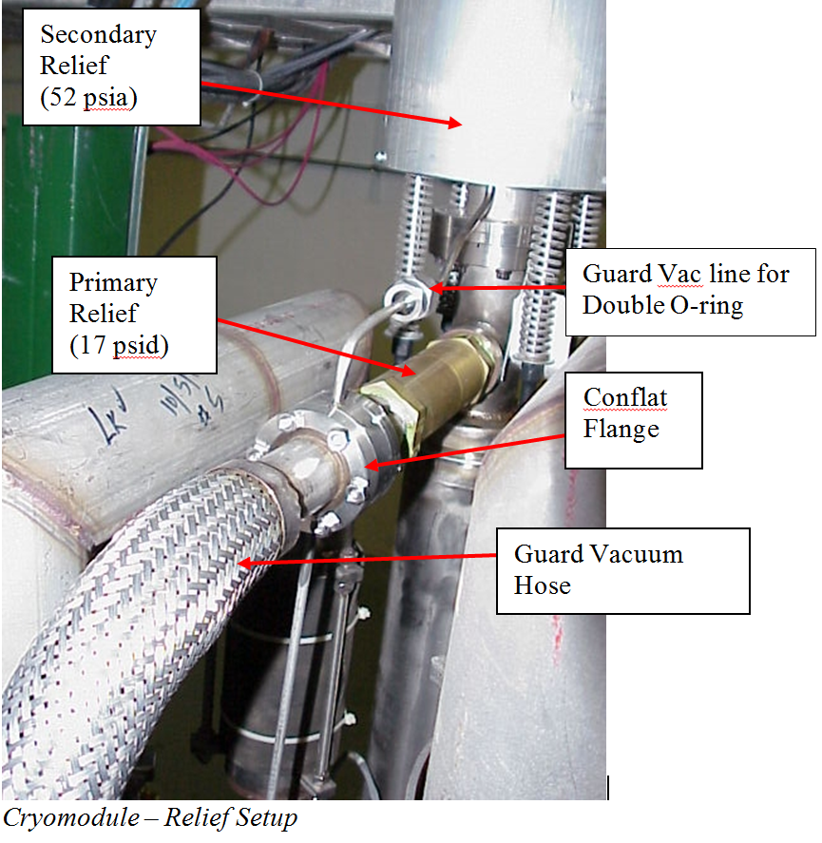
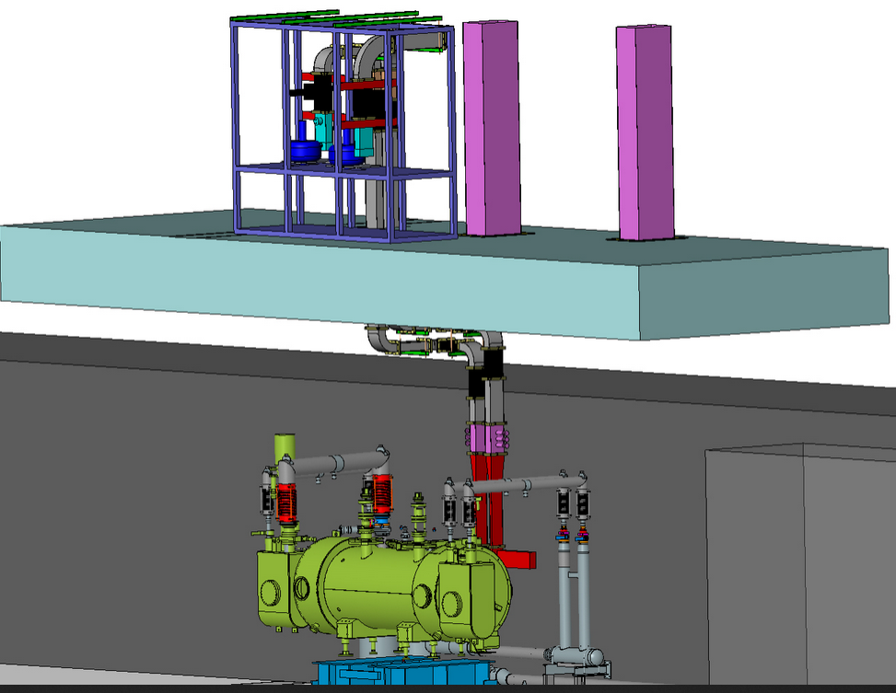
ODH Concern Mitigation – Cave 1
Vent stacks installed 7’ tall located over two rectangular penetrations
¼ Cryomodule in Cave 1

Slide 37
Status HDIce
HDIce Issues
What does beamline downstream of HDIce look like?
Raster (we seem ok with what is available)
Seeing < 1nA beam (want to get RF guys working on this now)
Build a “beam good” FSD node (one of our BLMs)
Another BCM, like PSS BCM, near the target
Where to put HDIce electronics? (Cave2 with network connection)
Energy spread, slits in chicane to reduce energy spread?
Accuracy of GEANT model
500 L dewar, ordering it with manifold to capture boil off

Slide 38
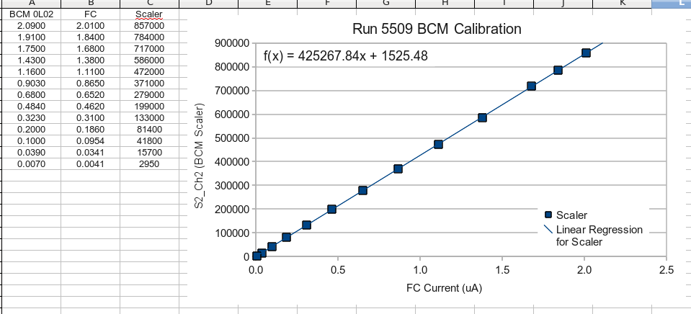
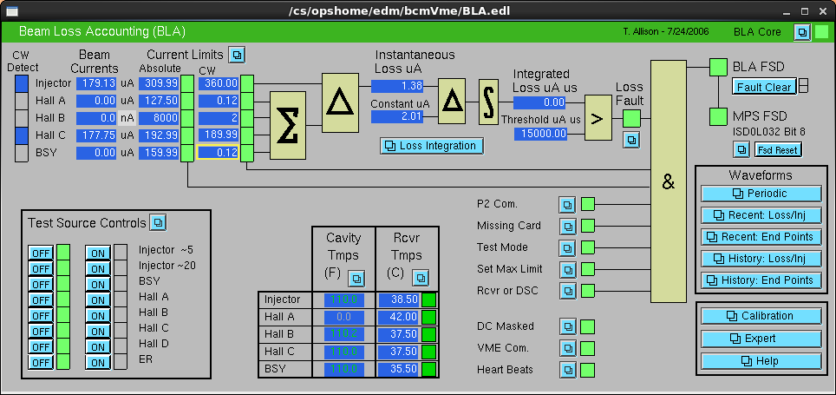
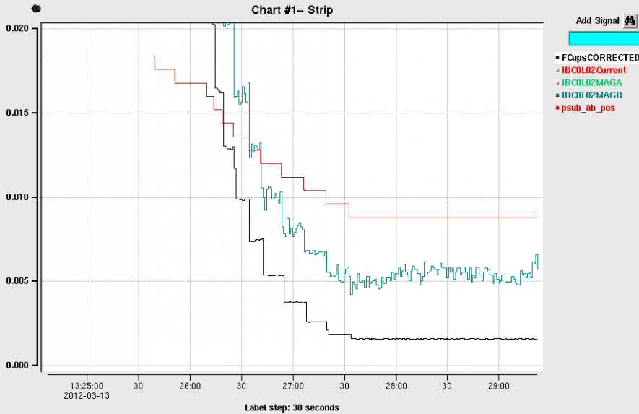
PSS BCM
PSS BCM
Insertable Faraday Cup
Can resolve ~ 1nA

Slide 39
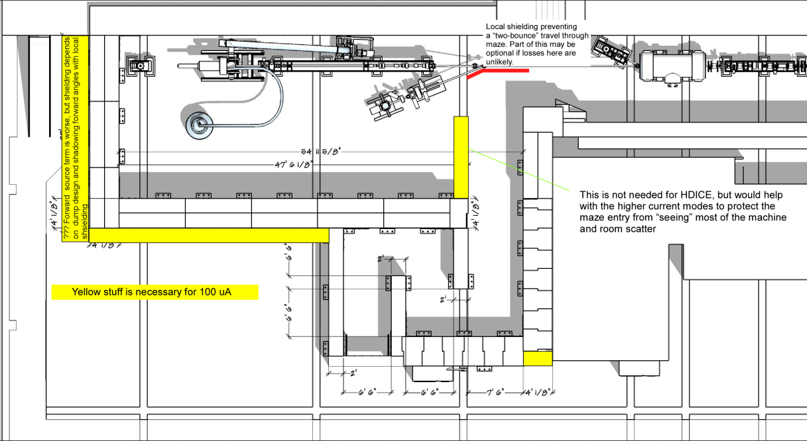
To refresh your memory…
What we started with…
UITF as imagined

Slide 40
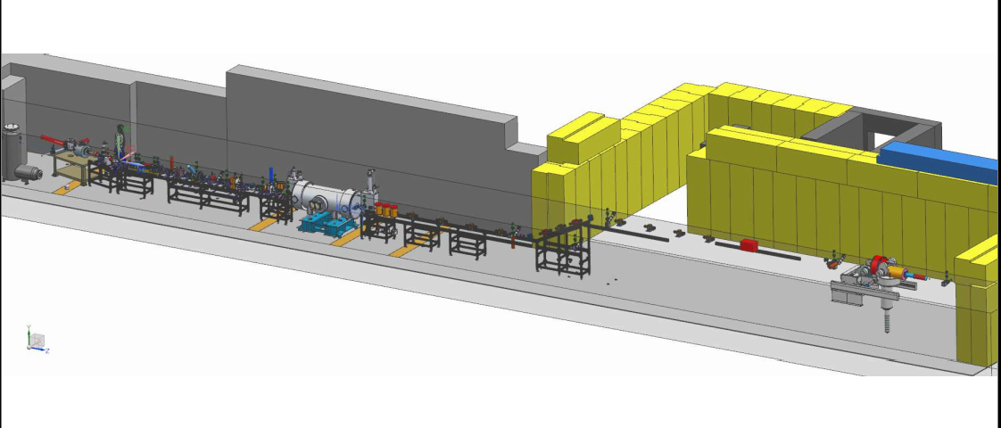
Design work was stopped…would like it to continue

Slide 41
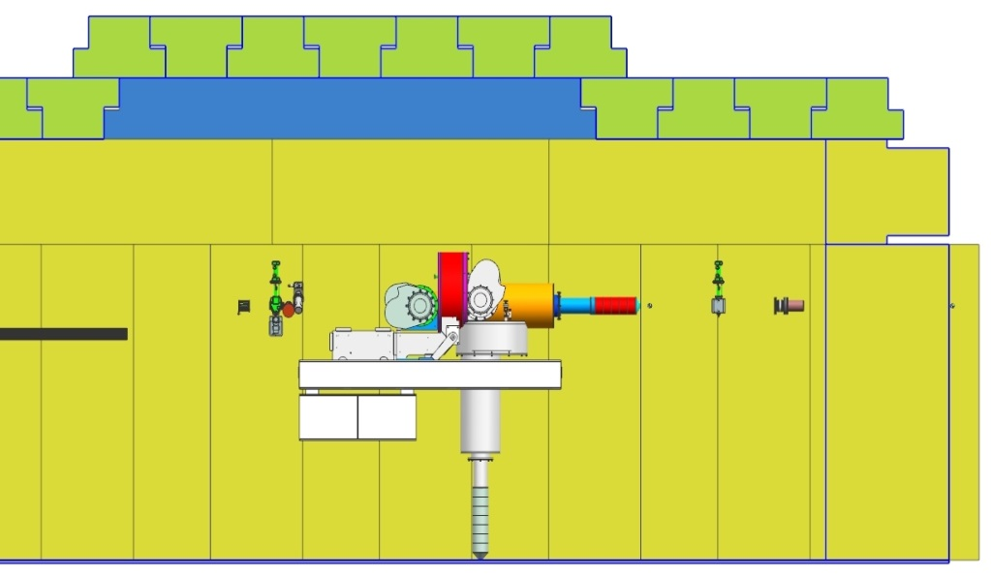
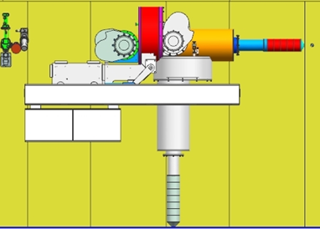
Status HDIce
Lots of scattering at MeV energy. Beam size very large at target. Decided to flip the orientation of the target
Cave2 design seems fine either way, need a Physics designer to be responsible for installation at UITF
Target here
Target here, better
e-beam
e-beam
Upstream radiation baffle blows up beam
In this configuration, we can achieve desired small beam size at target

Slide 42
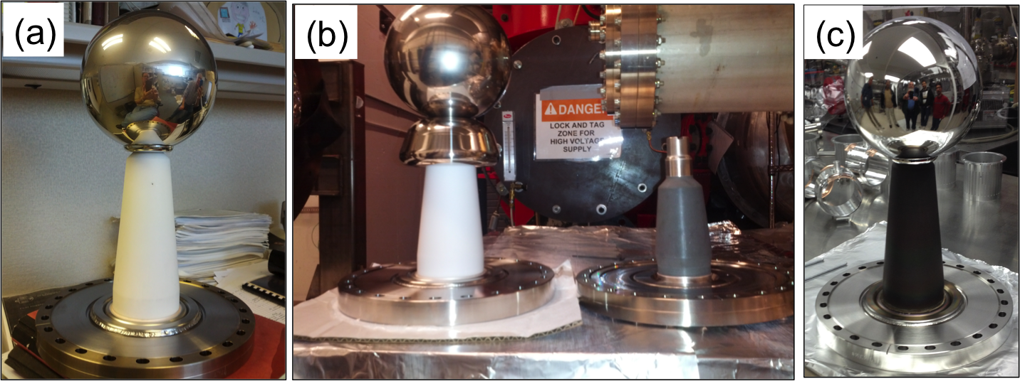
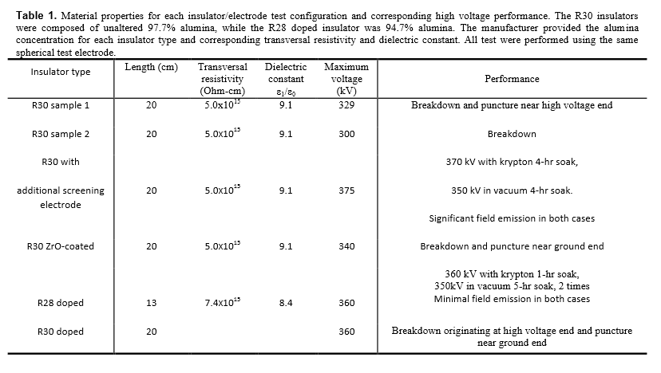
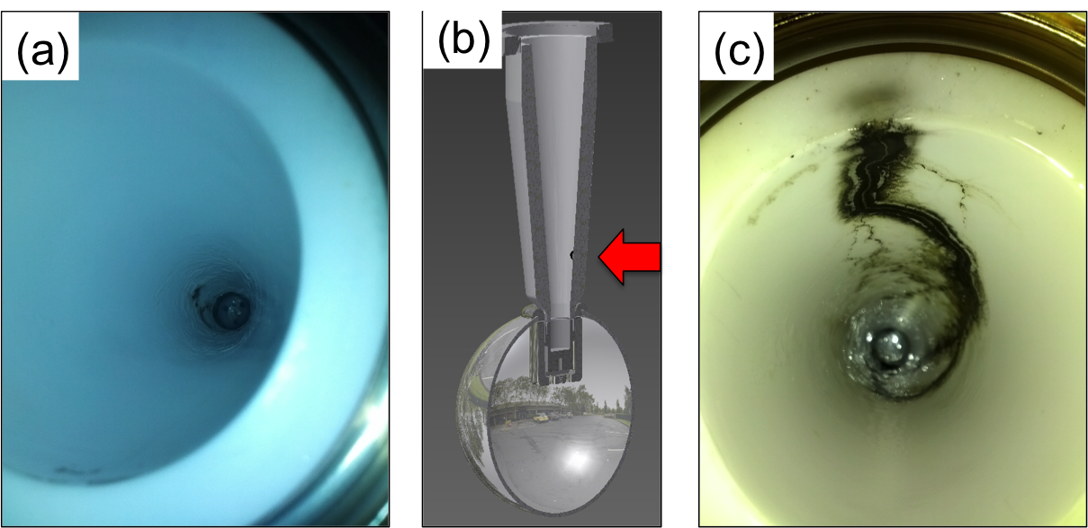
Notes:
Interior Page Design 2

Slide 43
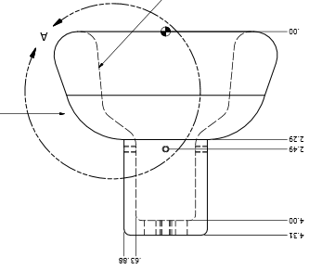
Next test late September
Combine the two features that provided incremental success: shed and doped insulator

Slide 44
Building the electron gun at LERF GTS
The new gun happy at 325 kV, stopping at this voltage for now. Shifting focus to building the beamline and photocathode deposition chamber (LDRD magnetized beam tests)

Slide 45
Gun and Beamline at GTS

Slide 46
Status HDIce
Stripline BPMs see 7nA beam with 1 Hz integration time. But we want to see 1nA beam, or even less at UITF. Don’t want to fly blind

Slide 47
Status HDIce
$$1nA=DutyFactor Ipeak+Ibaseline$$
$\frac{0.1msec}{16.7msec}$ x 10 nA = 0.06 nA ; I_{baseline} = 0.94nA
I_{peak}
Acceptable duration of high peak current: long enough to see but not long enough to depolarize
I_{baseline}
Need to work out details with HDIce and T. Allison, J. Musson

Slide 48
Schedule Ramifications
Commission ¼ CM (no beam), scheduled for Feb 2016
Electric/FM – ($78k + $23k for com. conduit) 101 k$
Control room – -
SRF checkout of ¼ CM present condition – -
Low Level RF – 16 k$
High Power RF – 25 k$
Network controls – 33 k$
Software control of RF – -
adequate shielding (Cave2 with a roof) – -
Cryo – (controls and pipe) 68 +/- k$
Installation group 9 k$
ODH - SSG 2 k$
EHS&Q approvals… -
Total 254 k$

Slide 49
Klystrons and Max UITF Beam Energy
Curt,
With 40uA beam current only, you can run at 8MV/m with less than 3kW from klystron. But you need a stub tuner to tune the FPC coupling Qext from the design value of 9e6 to 2e7.
Haipeng
Haipeng,
So the take away is that with 40uA and a 5 kW klystron, we can expect the 7 cell cavity to operate at 8 MV/m. Assuming microphonic detuning is in the 15 Hz range.
Curt
Matt, For the new ¼ CM, we will get a 5 kW tube for the 7 cell cavity. For the two cell maybe one that does 3-4 kW which should be ok. Then expect 200 kV from the gun, the two cell gives 1-2 MV, add the 5.6 MV from 7-cell and voila, we are close to 8 MeV ... Curt

Slide 50
Cryo, SRF, RF, Software and new 1/4 CM
Continuing to appreciate the interface between groups: cryo controls, SRF design features, the relief system, RF and I&C groups re: MPS, software
Software, getting started…
How to cool HDIce? Will use dewars for first tests
ODH assessment complete, sent to Dave Kashy for review, will need SRF to add pipe to vent relief valves, will need chimney stacks at two Cave1 penetrations

Slide 51
UITF MPS – what will it protect?
Protect the ¼ CM
Protect against beam loss and burn-through, maintain UHV
Protect viewers (this is a software interlock – Not FSD)
Protect magnets, ensure proper field for beam transport: comparator interlock, water flow or klixon interlocks
Protect RF beamline components: vacuum and water flow interlocks
Protect cups, apertures and dumps: water flow interlocks
Protect HDIce (mostly, this means putting the beam where it is supposed to go, protect against mis-steered beam)

Slide 52
Hardware configuration
Valves OPEN only when vacuum good
Current limiting resistors in series with magnets
Water flow interlocks at cups, dumps and apertures
Window comparators on dipoles and gun HV
Viewers inserted only when laser in pulsed-mode
Water flow interlocks at buncher and chopper cavities, RF can be applied to chopper and buncher only when vacuum reads “good”
Helium liquid level interlocked to klystron high power RF

Slide 53
FSD Input Signals
An FSD trip will shutter laser and sometimes close all valves
BLMs will shutter laser: CEBAF-style BLM modules (x2)
LLRF control boards with CEBAF-style FSD signals
Vacuum FSD signals from ¼ CM. Helium liquid level interlocked to klystron control panel
All beamline ion pumps ganged together, close laser shutter and close all pneumatic valves when pressure exceeds a setpoint
Window comparators using 16 bit ADC cards designed by EES
HDice “off target” detector (qty 1, suspect it will look like a BLM)

Slide 54
Similar to CEBAF
SSG BLM chassis, x2 units
New LLRF control boards
Cryo and SRF signals from ¼ CM
Window comparators using 16 bit ADC cards designed by EES
FSD signals summed using VME boards with 12 input channels each
FSD signals transmitted via fiber at 5 MHz
SCAM to create low duty factor modes
CEBAF style pockel cell tune mode generator: RTP cell with <250ns response time, backed by shutter that closes 5-10ms later

