Slide 1
Mott Update
December 19, 2016
By studying experimental super-ratio asymmetry we have chosen a range of events which provide a stable asymmetry vs. detector response (little or know energy).
We recognized in the rate analysis that there was a discrepancy in the 1um gold foil stability runs in Run I, correlated with whether the PMT discriminator threshold was LO or HI (set for the thinnest foils to maximize elastic rates).
We successively tested three methods:
Method I – Use exponential + gaussian to define MEAN/SIGMA
Realized exponential fit of HI runs failed and skewed MEAN/SIGMA
Method II – For HI runs use the MEAN/SIGMA derived from LO test runs
Realized MEAN was drifting over course of Run (setup, efficiency, ?)
Method III – Only use Gaussian fit in range close to elastic peak
Works well for both LO/HI runs, provides stable/continues MEAN/SIGMA

Slide 2
Status of Results
Target Thickness
Final FESEM target thickness report (11/30/16) with table posted on wiki
Total uncertainty is 5-6%, except for 50nm foil is about 9%
Extrapolation Asymmetries
Time-of-flight cut remains as -2σ:+2σ about fitted timing peak (σ ~ 0.36ns)
Energy cut remains as -0.5σ:2σ about fitted elastic peak
Physics, Detector and Beam asymmetries are calculated
Extrapolation Rates
LRUD (helicity independent) rate calculated using asymmetry cuts
Corrections
DAQ/FADC deadtime correction (<15%)
deE Coincidence deadtime correction 100ns (<0.1%)
Uncertainties
Statistics of LRUD events (square root of N)
BCM linearity, but Riad still working on pedestal corrections (low value)
1um gold stability for Run I/II

Slide 3
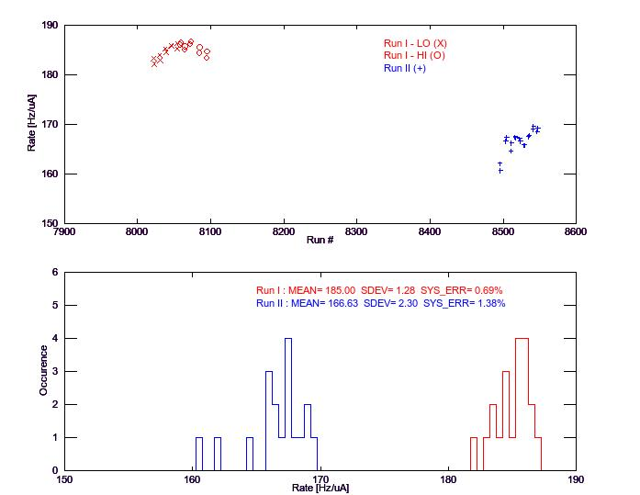

Slide 4
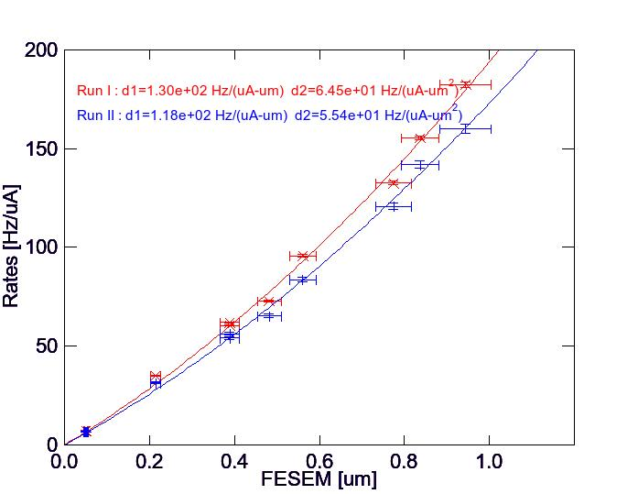

Slide 5
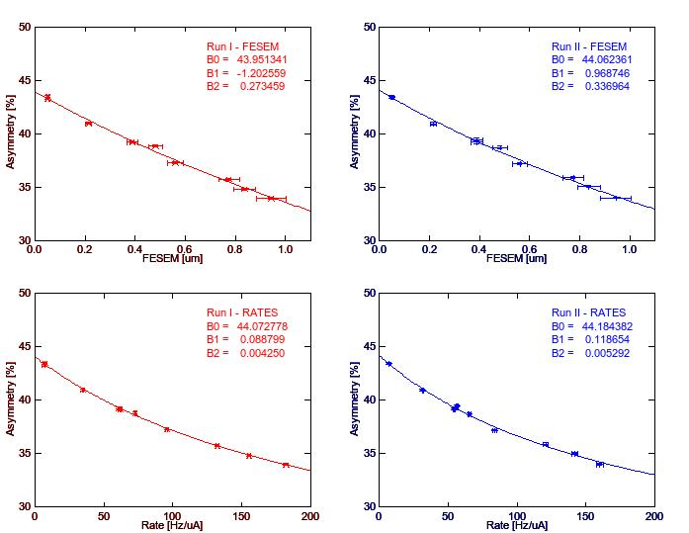

Slide 6
Summary and Outlook
Complete Run I/II extrapolation results available
Excel spread sheet 161216_MottExtrapolation
Final method instigated by resolving Run I LO/HI rate discrepancy
Stability run uncertainty I=0.69%, II=1.38%
Proposed work plan moving forward
(Riad) Complete BCM pedestal analysis, incorporate to Mott Analysis
(Daniel) Background analysis
Test on all runs (data, back, fit, sub data, rates of elastic/back)
Generate summary tabs like that for asymmetries and rates
Test liklihood/parameter sensitivity of extrapolations on bivariate uncertainties
(Marcy) Mathematica and (Riad) Root
(Joe) Systematics studies
List all tests for Runs I/II
Identify runs, define batch analysis files, analysis, summarize runs
Finish beam systematics analysis and write down
Energy (write down Run I, update Run II w/ Riad’s TN)
Emittance (almost done)
Spot size/Energy Spread (use energy/emittance measurements)
Position on target

