Slide 1
UITF: T-cathode electrode, BPM data @200 [kV]
05/15/2019
Gabriel Palacios, Carlos Hernandez
Matt Poelker, Joe Grames

Slide 2
Details
UITF gun
T-cathode electrode @200 [kV]
Bulk GaAs activated with with Cs and NF₃
Data taken with BPM 201 (on top of corrector 101H&V) and BPM 203 (after corrector 101H&V)

Slide 3
BPM linear response region
y
From -62 [Gauss cm] to 62 [Gauss cm] along the x-axis (With 101V corrector in 55 [Gauss cm]).
From 0[Gauss cm] to 142 [Gauss cm] along the y-axis (With 101H corrector OFF).
R
x
In the following plots the BPMs responses where mapped as a function of different 101 corrector H and V positions (increments of 1 [step], 3 [s] waiting time).

Slide 4
BPM203 linear response region
After readjusting the BPMs and checking hardware to be working OK, we analyze the linear response region of BPM203 by scanning correctors MBHK201H along the x-axis, and the MBHK201V along the y-axis.
We find that the BPM203 saturates outside the intervals:
-6 [mm]<x< 6[mm]
-6 [mm]<y< 6[mm]
Therefore inside the intervals is the linear response region.

Slide 5
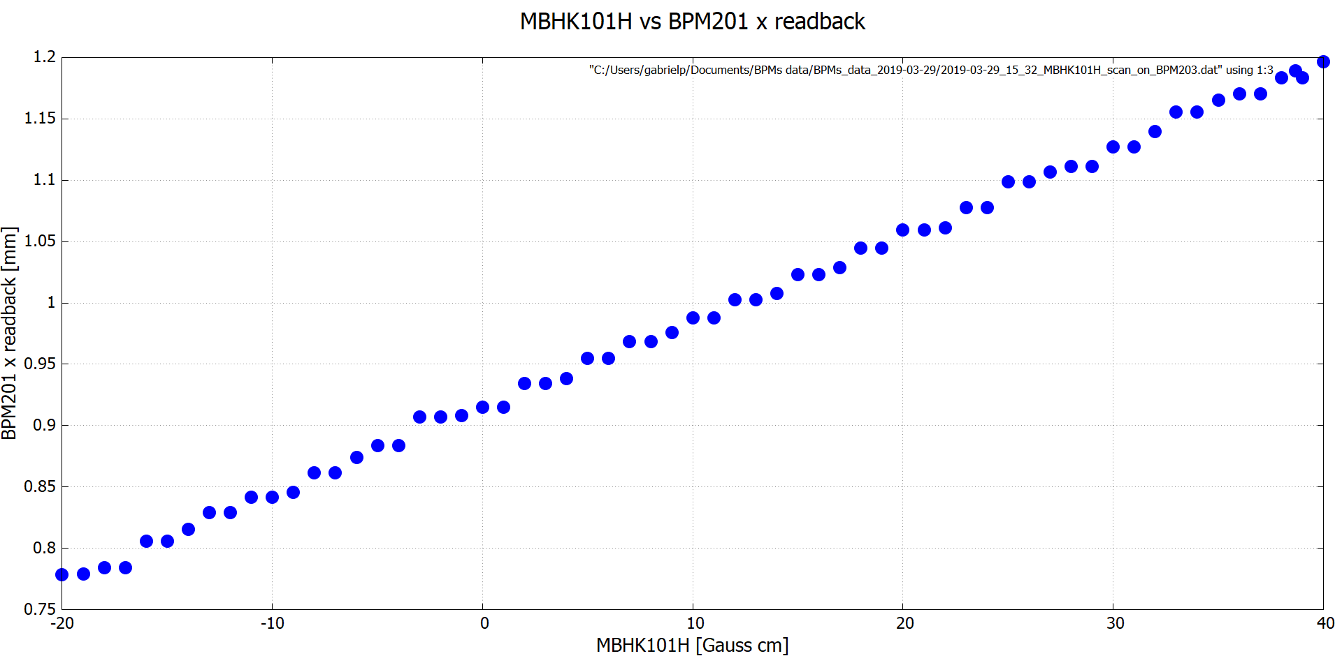
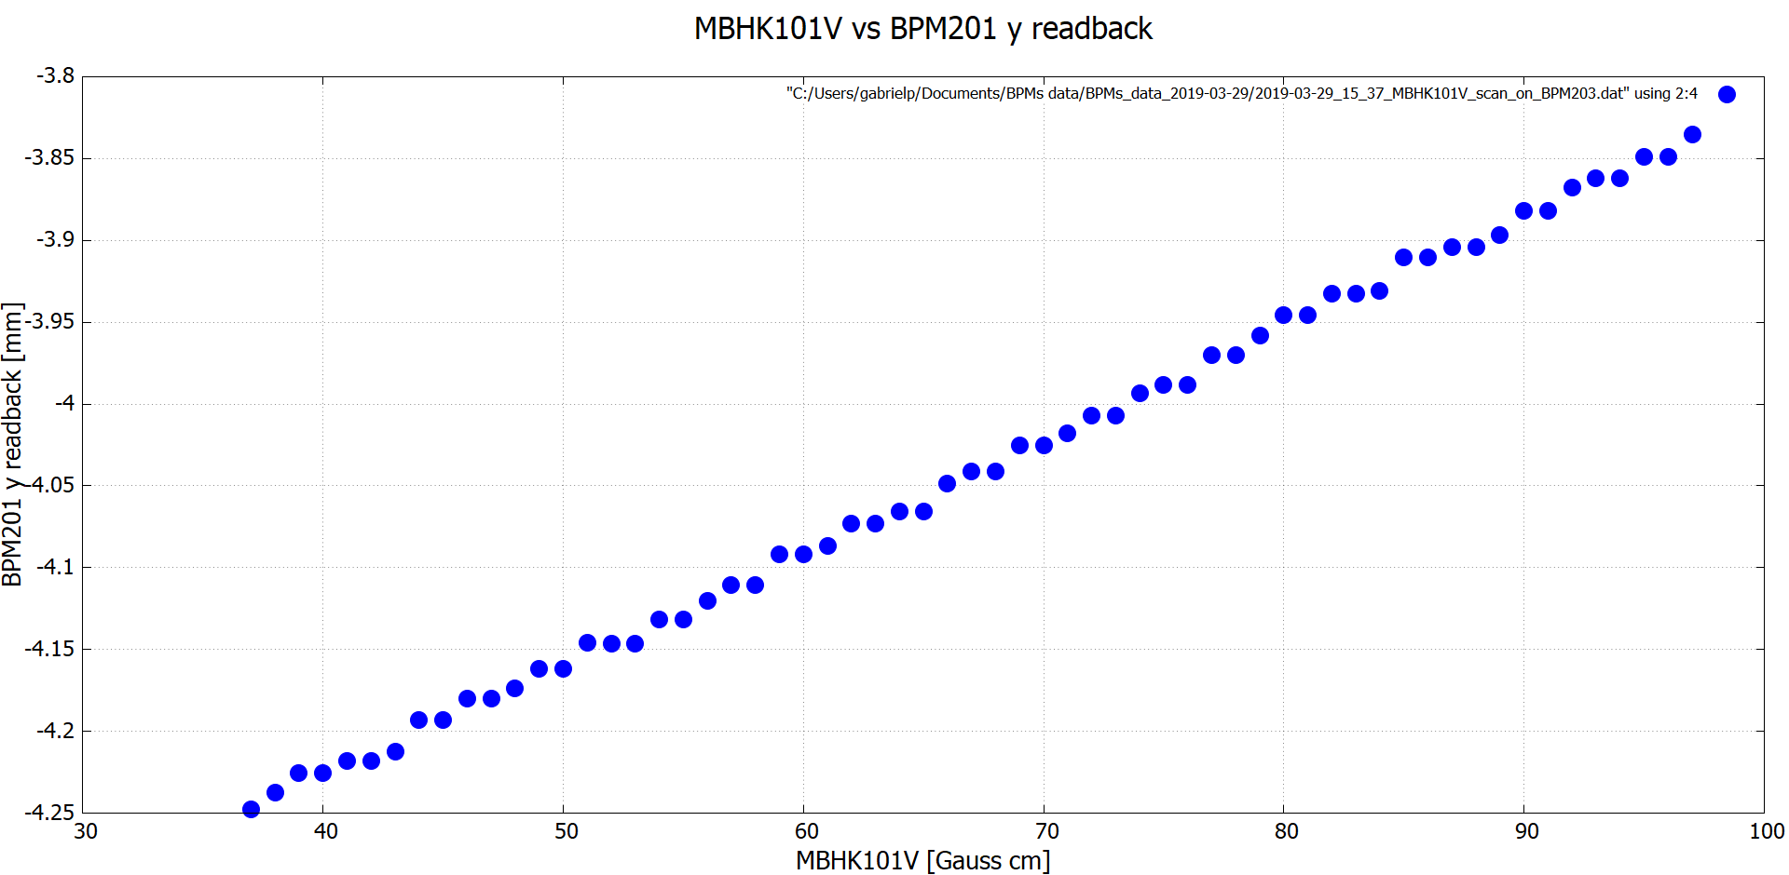
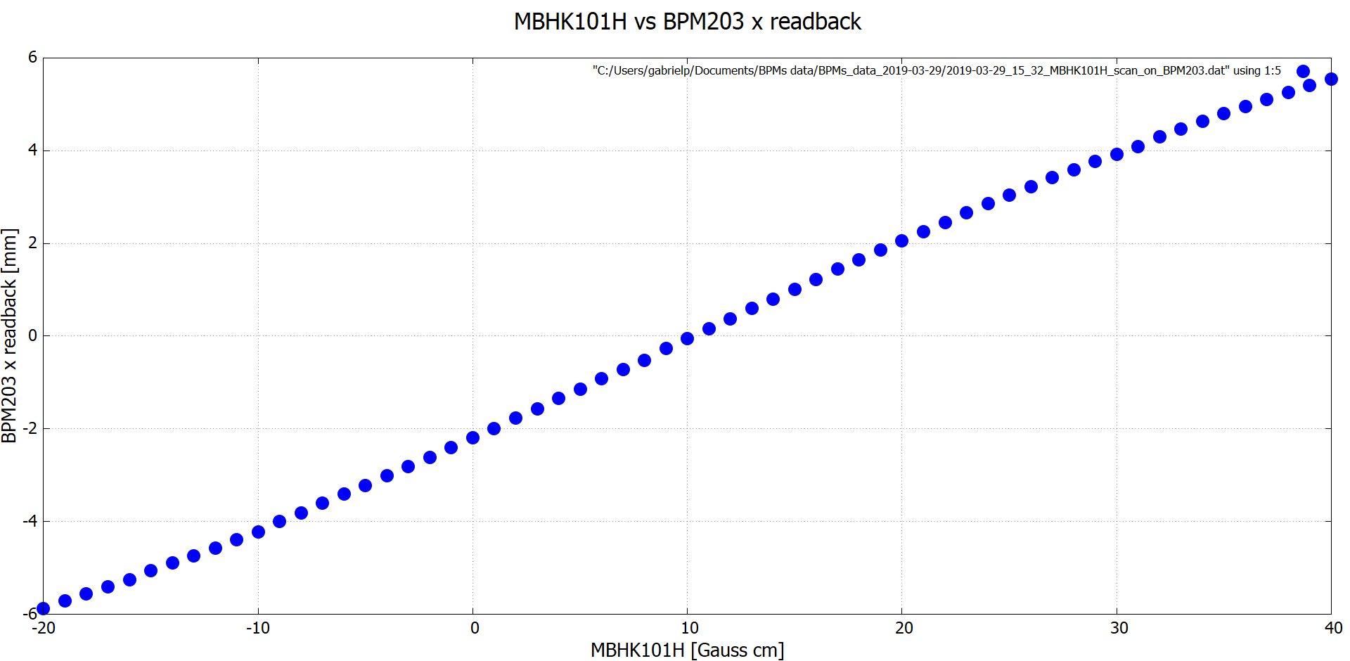
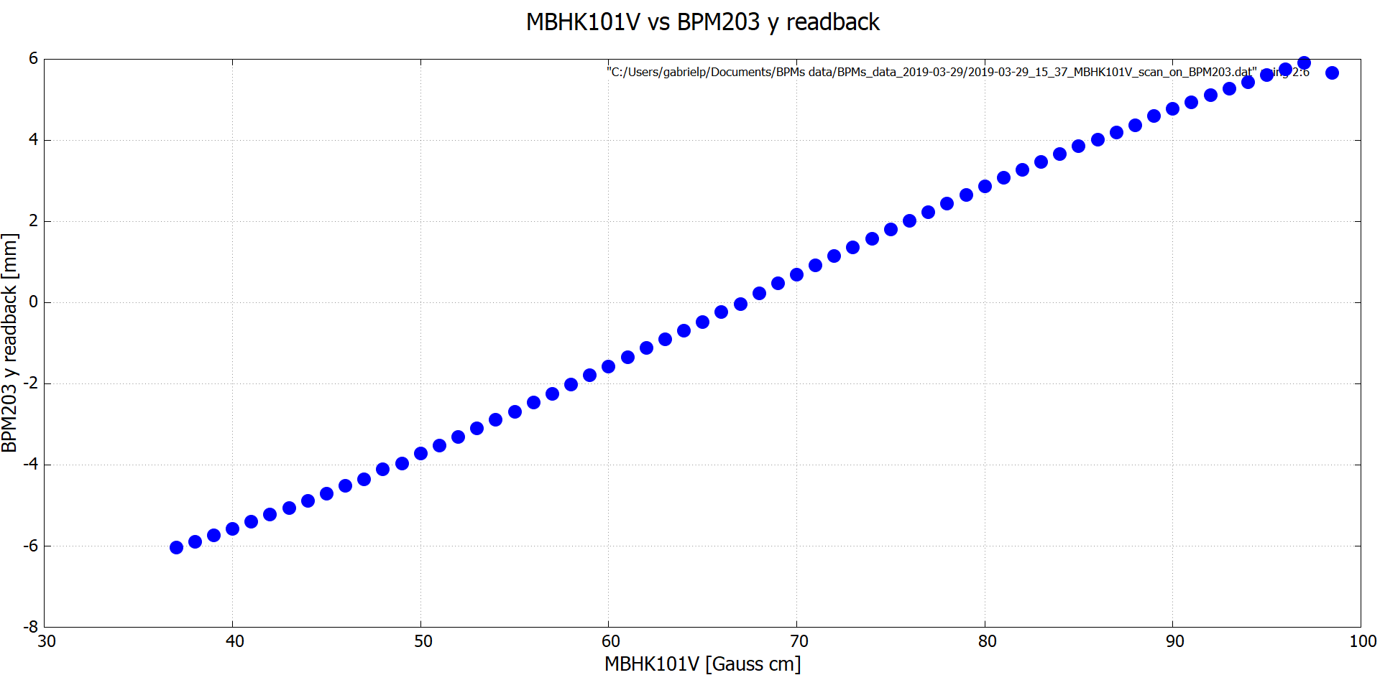
Original

Slide 6
BPM201 vs laser position
Assuming the BPM201 linear response region is the same as BPM203, we scan the laser position on the photocathode along the x and y-axis and plot the BPM201 response.

Slide 7
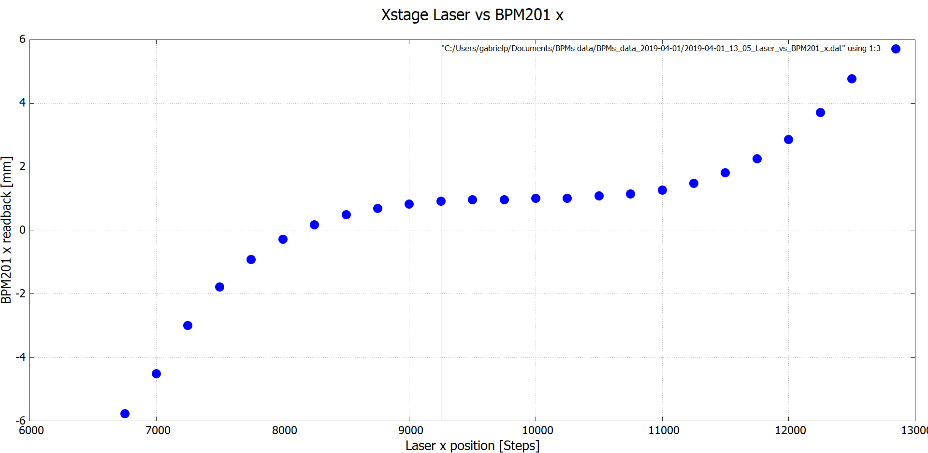
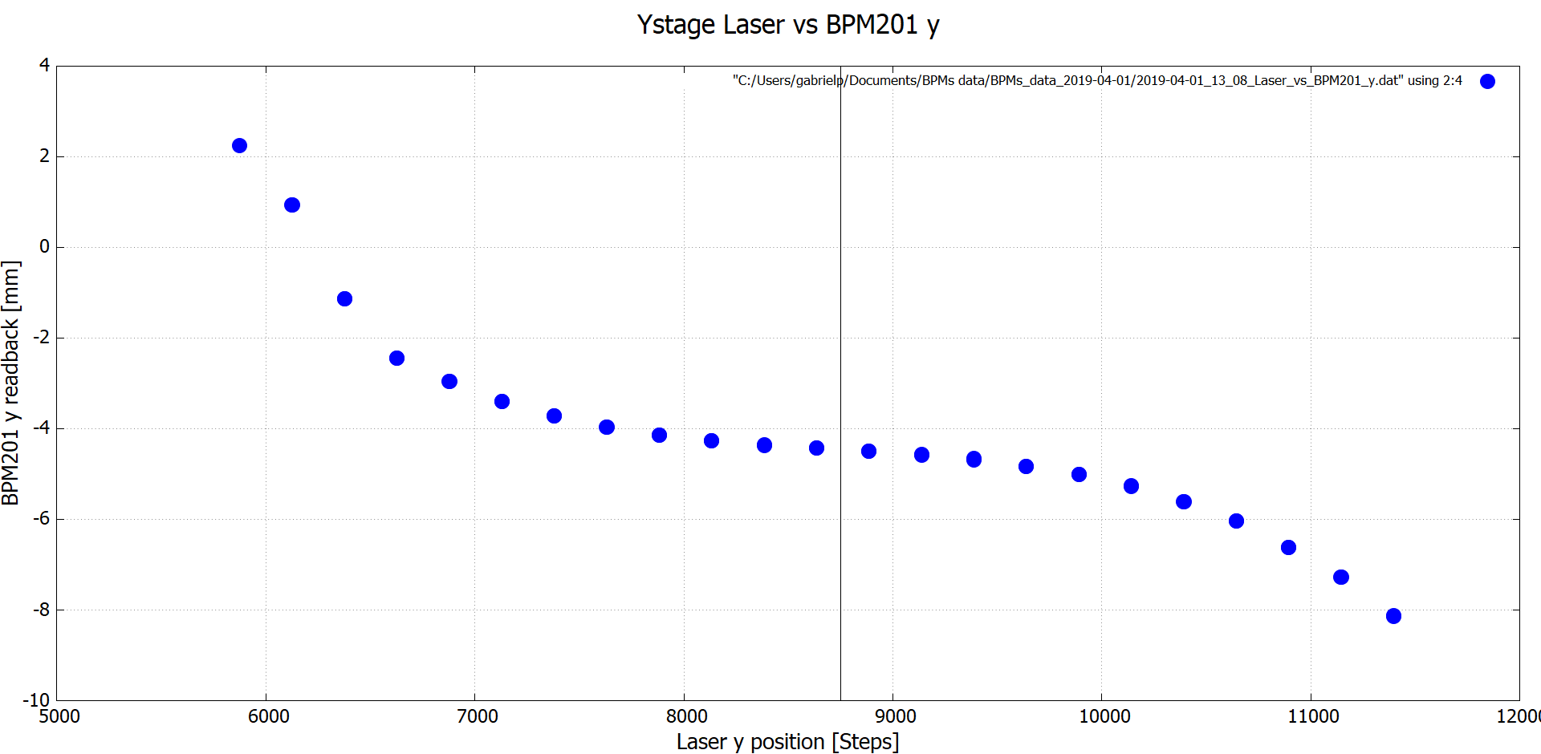
Original
Bona fide results inside the saturation interval:
-6 [mm]<BPM201 x< 6[mm]
-6 [mm]< BPM201 y< 6[mm]

Slide 8
Corrected positions according to S&A

Slide 9
Corrected positions according to S&A
BPM201
Solenoid?
US face?
DS face?
Photocathode
1.3 mm
12.6 mm
BPM203
8.9 mm
x
7.5 mm
7.6 mm
3.6 mm
BFS
z

Slide 10
Corrected positions according to S&A
BPM203
Solenoid?
BPM201
DS face?
US face?
1.2mm
y
0.3mm
0.3mm
BFS
z
0.6 mm
Photocathode

Slide 11
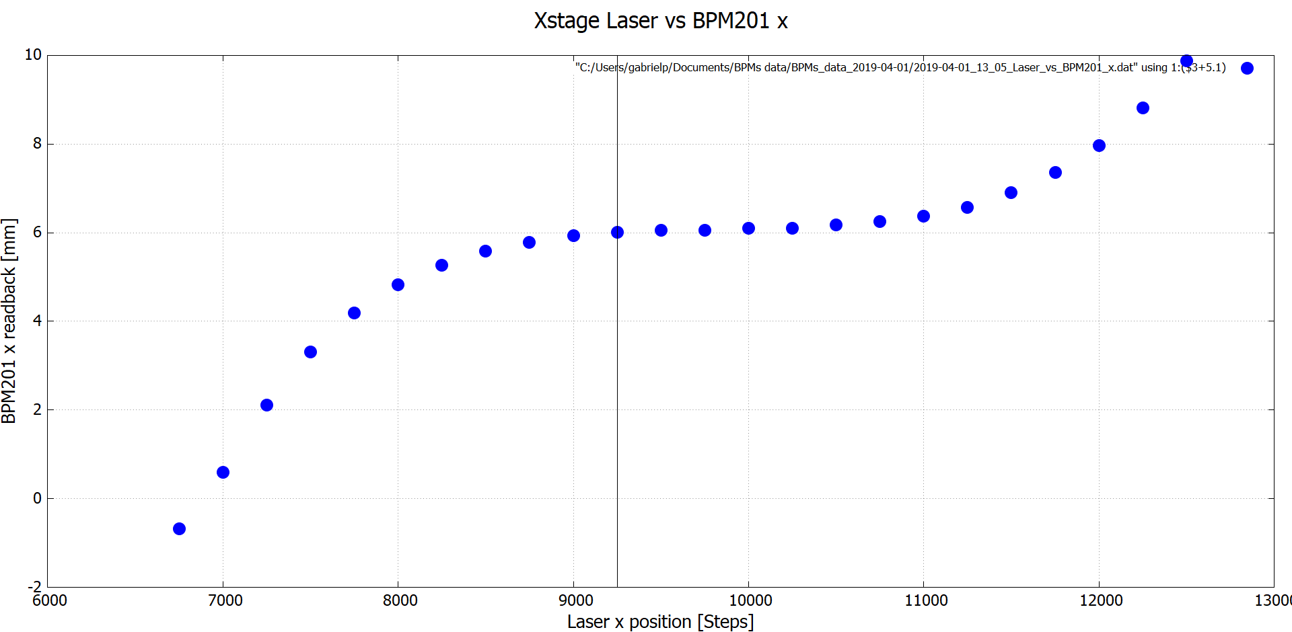
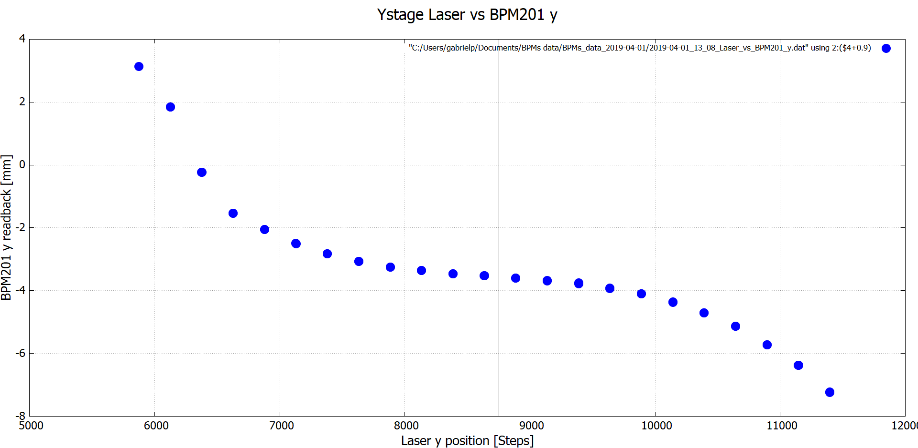
Relative to photocathode
+5.1 mm
+0.9 mm

Slide 12
As we move left and right from the photocathode center, the BPM201 “sees” the beam moving slightly in the same direction, up until the 3000 [step], where the x positions displace further away for each step.
+5.1 mm
Relative to photocathode
As we move above and below the center, the BPM201 “sees” the beam moving in a similar way, but this time the vertical displacement increases as we go below the center. Moreover, most positions on the photocathode result in BPM201 negative vertical readings. The beam experiences a negative vertical kick (as predicted by our simulations!)
+0.9 mm

Slide 13
Centered in lense
MBHK101V, corrector centered in the first viewer (201)
vs BPM201 x readback
vs BPM201 y readback

Slide 14
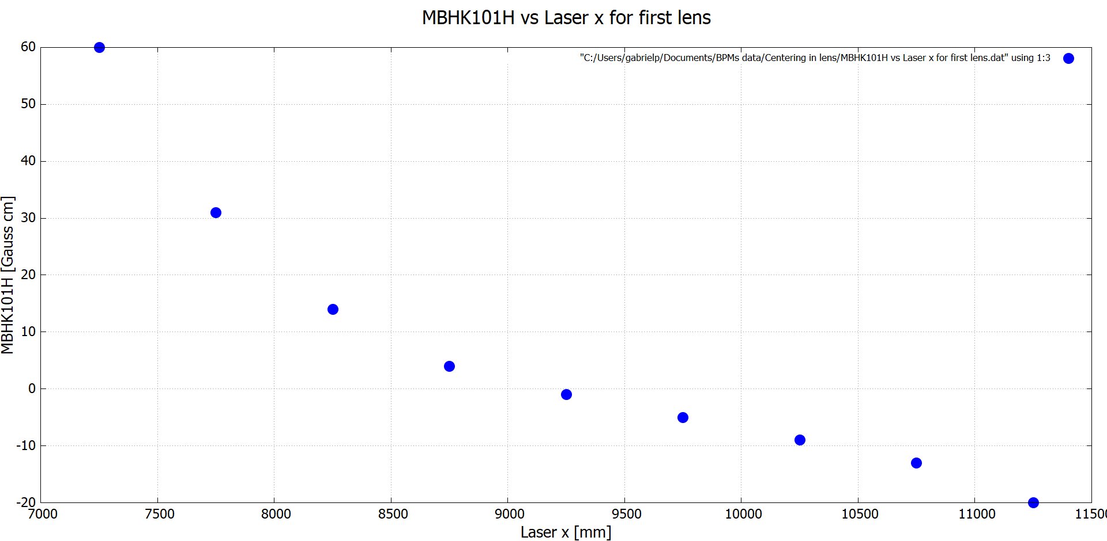
Check position of MBHK101

Slide 15
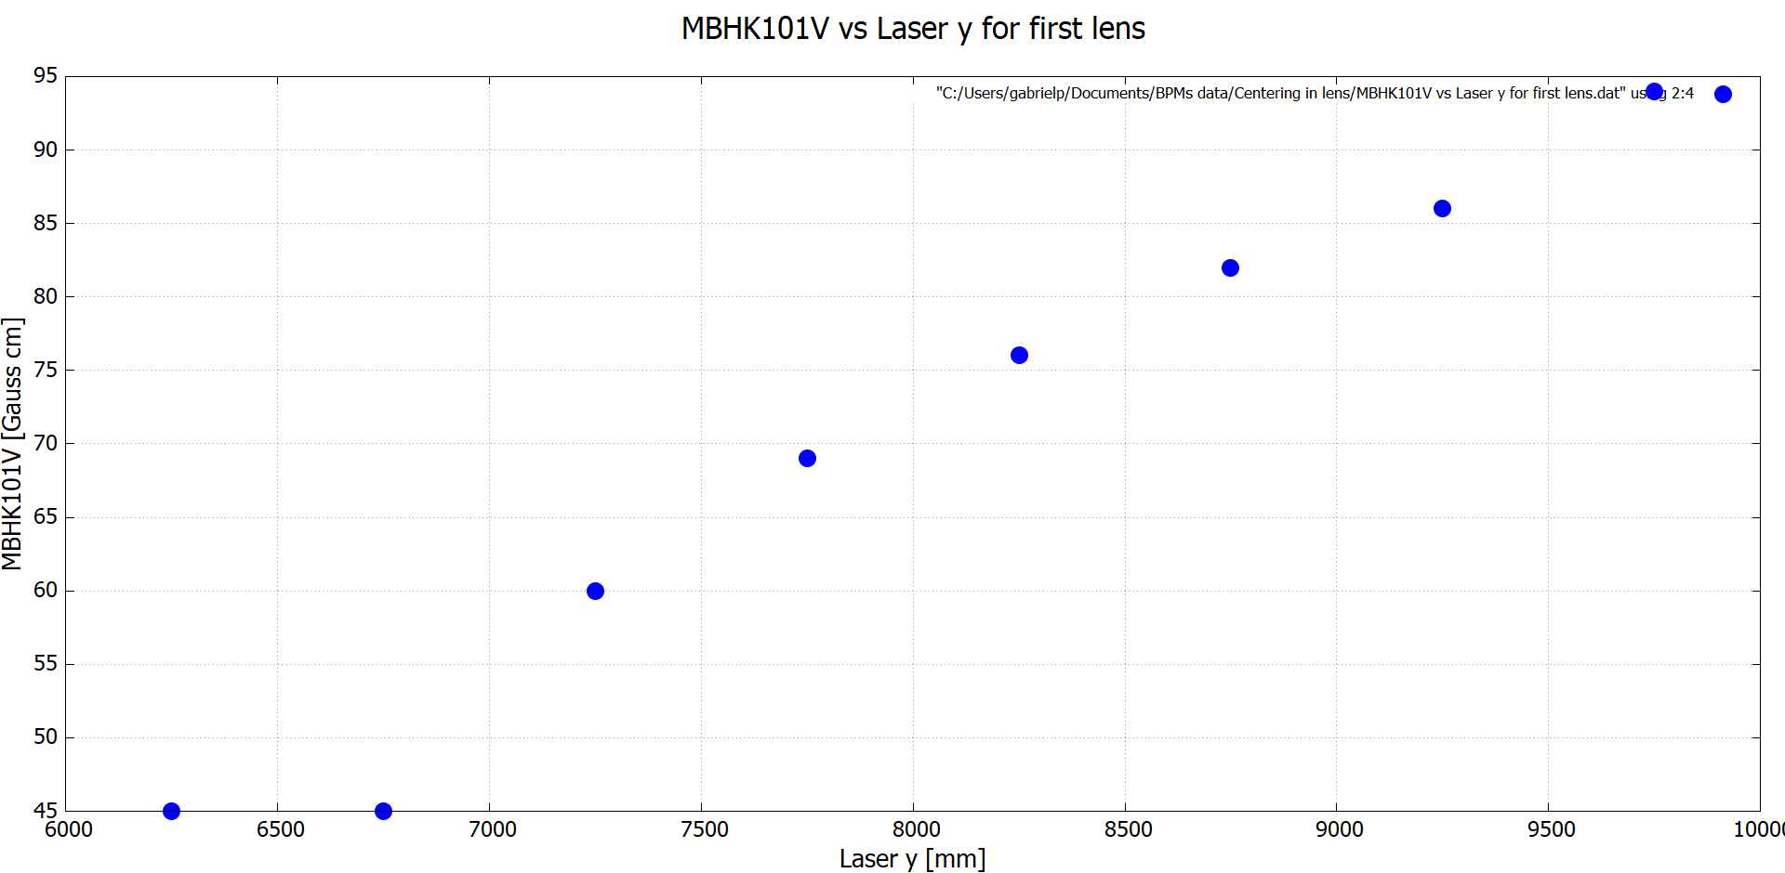
Check position of MBHK101

Slide 16
Active area
y
This corresponds to a diameter of 5 [mm] (radius R=2.5 [mm]).
Then: L=2.5/√2≈1.77
So: 1.77 [mm]≈1770 [steps] (assuming 1000 [steps]≈1 [mm])
Then I used 1800 [steps] to each side from the origin.
R
L
L
x
In the following color maps the laser was scanned on a square box of 3600X3600 [steps], centered in the photocathode (at position 9250,8750) as a function of different BPMs response (in increments of 300 [steps], 3 [s] waiting time).

Slide 17
Active area
Own coordinate systems
Relative to photocathode

Slide 18
Fin

Slide 19
Extras

Slide 20
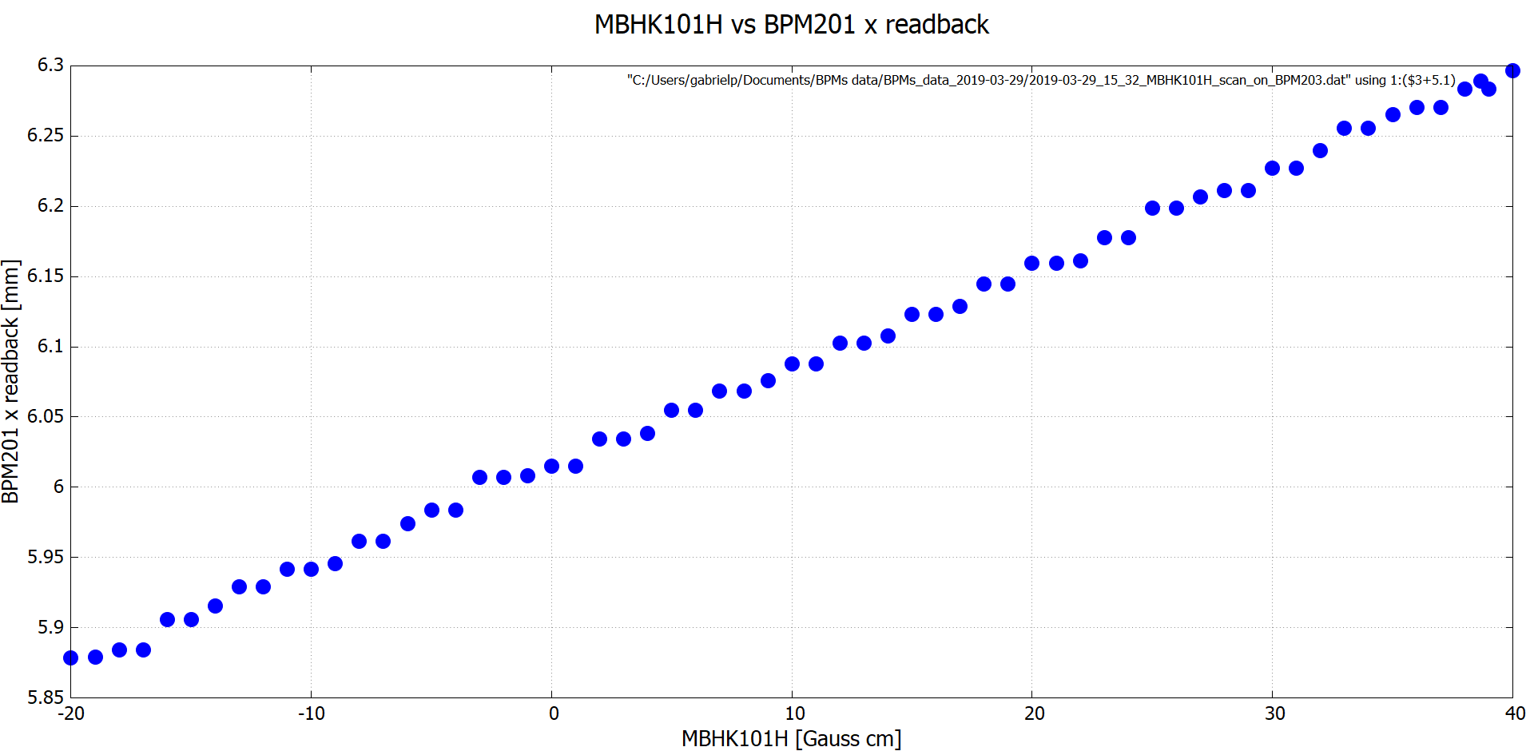
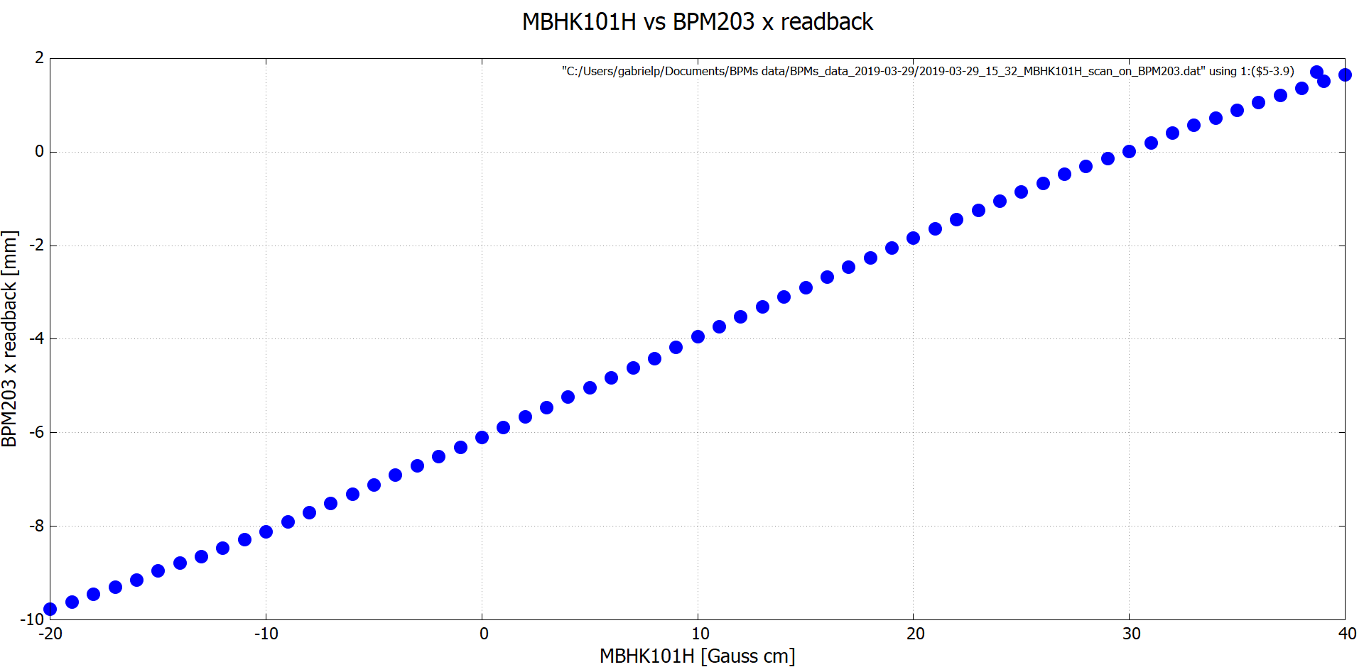
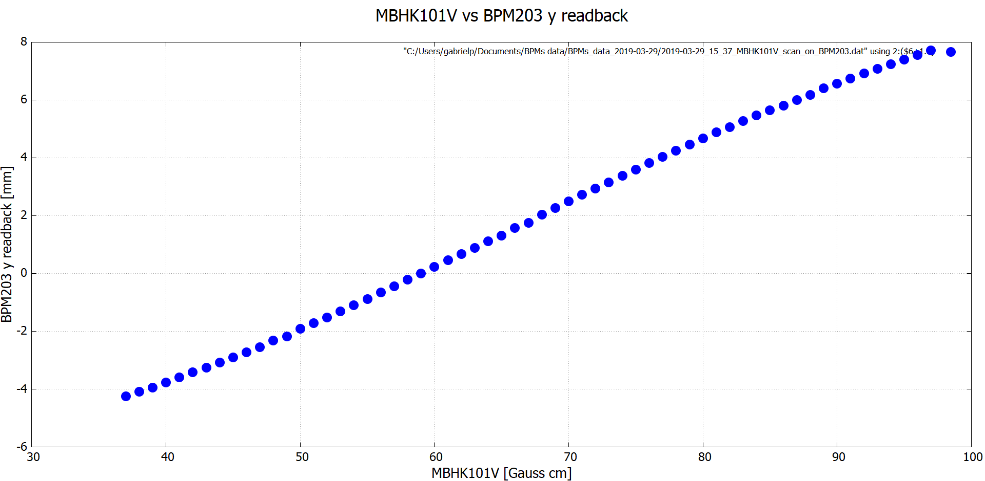
+5.1 mm
+0.9 mm
Relative to photocathode
-3.9 mm
+1.8 mm

Slide 21
BPM203 linear response region
Then, relative to the photocathode, the linear response regions are
-10 [mm]<x< 2[mm]
-4 [mm]<y< 8[mm]

