Slide 1
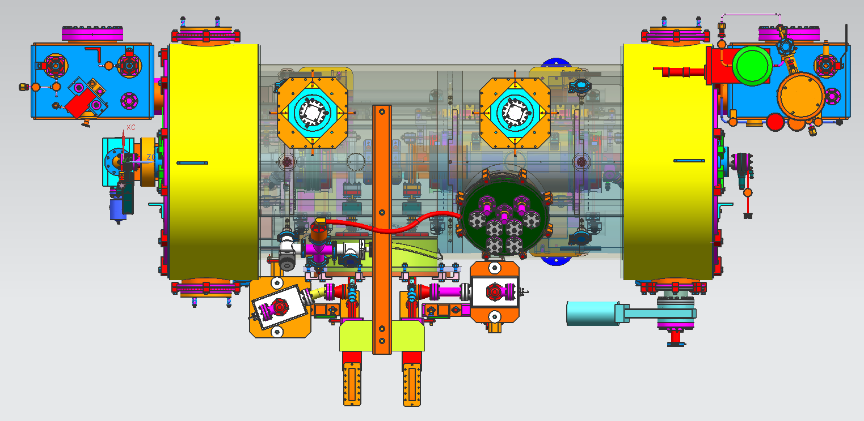
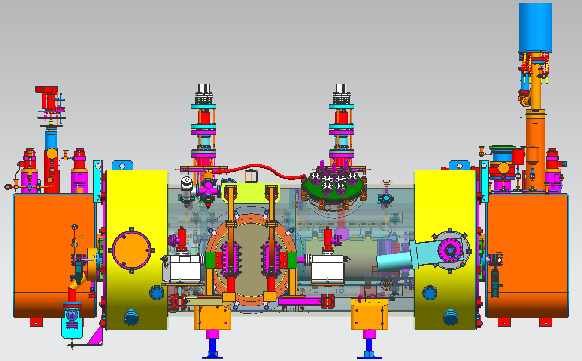
INJECTOR CRYOMODULE LAYOUT
SUPPLY
END CAN
RETURN
END CAN
2 CELL
CAVITY
7 CELL
CAVITY

Slide 2
Aisle, we walk on this side of beamline
SUPPLY
END CAN
RETURN
END CAN
New INJECTOR CRYOMODULE LAYOUT
HDIce
2 CELL
CAVITY
7 CELL
CAVITY
This is South
LHe SUPPLY
LHe Return
East Wall of Cave
This is North

Slide 3
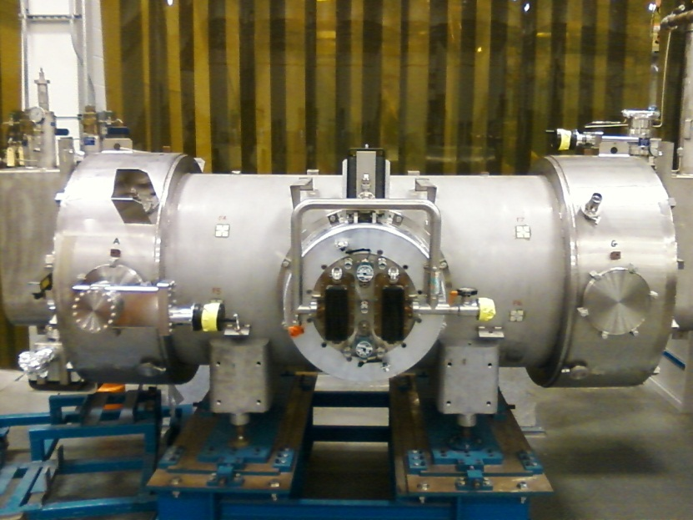
Aisle, we walk on this side of beamline
SUPPLY
END CAN
RETURN
END CAN
Old INJECTOR CRYOMODULE LAYOUT
HDIce
5 CELL
CAVITY
5 CELL
CAVITY
This is South
LHe SUPPLY
LHe Return
East Wall of Cave
This is North

Slide 4
