Slide 1
Upgraded Injector Test Facility
The recent highlights:
Waist height beamline complete, under vacuum
Mechanical design of beamline complete
North wall shielding enhancements in progress
SCMB meeting to review shielding requirements this Wednesday, March 27
COO review scheduled for Wednesday April 24

Slide 2
Tasks before running beam to HDIce for target commissioning
Mechanical design (Shaun Gregory), HDIce related components (apertures, dump, catwalk)
Gun Group: finish the MeV elevated beamline, pull vacuum from gun to HDIce target, keep making 200 keV beam for CEBAF SAD work
Survey and Alignment “2B” alignment
Magnet group: wire up magnets, build a third trim-card rack
I&C: Cable-up the MeV beamline - valves, ion pumps, viewers, BPMs, harps, water flow meters, interlocks, current monitors, ….
SSG install BLMs
Operations Software group: more screens, MPS system, UED, etc.,
RadConGroup: document shielding requirements, install all CARMs and electronics, neutron probe and rapid access system
Facilities implement north wall shielding solutions: purchase concrete, steel support structure
Safety and Approvals: OSP for roof tile removal (revision to address fall protection), OSP for MeV beam, SCMB review, UITF Accelerator Operations Directive/Conduct of Operations, Accelerator Readiness review
Work with SRF, Cryo and Facilities to imagine CTF improvements to boost return flow, independent pressure control, etc., to operate UITF at same time as CMTF and VTA
Install, operate the raster magnets (C. Cuevas)
Re-install HDIce
Electrical engineering and SSG: design and build the PSS BCM, a "credited control" to limit beam current/loss and prevent accidental exposure to x-rays, add PSS BCM to circuitry, PSS BCM credited control documentation

Slide 3
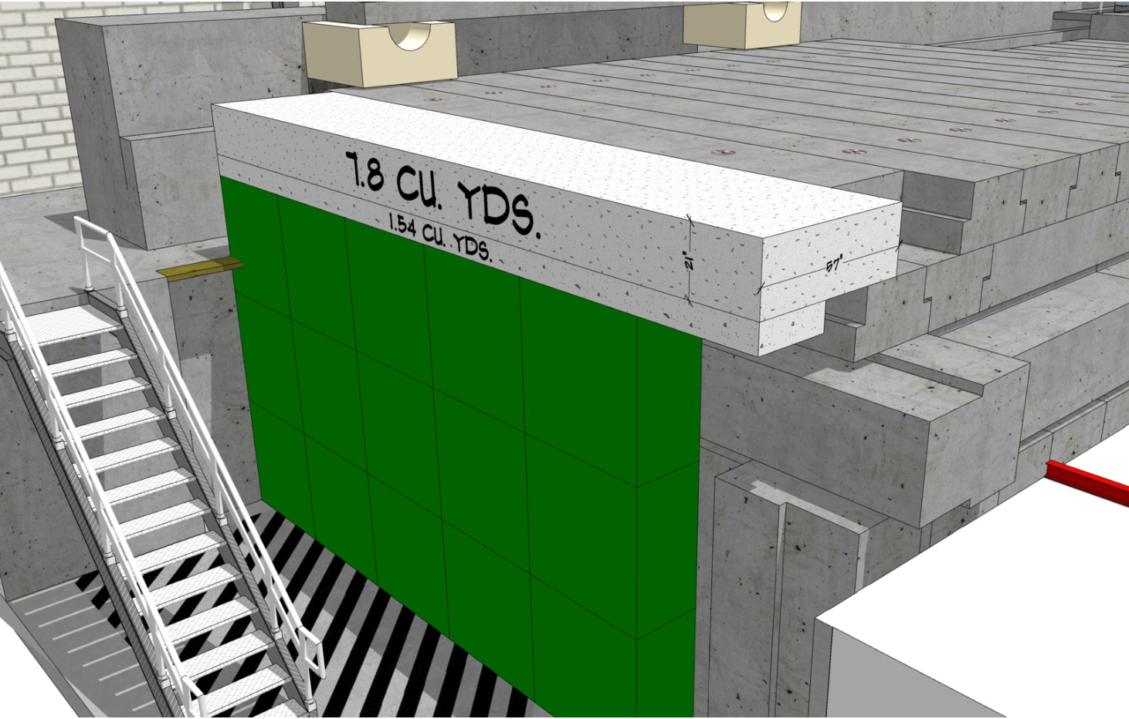
North Wall Shielding
thanks Walt Akers

