Slide 1
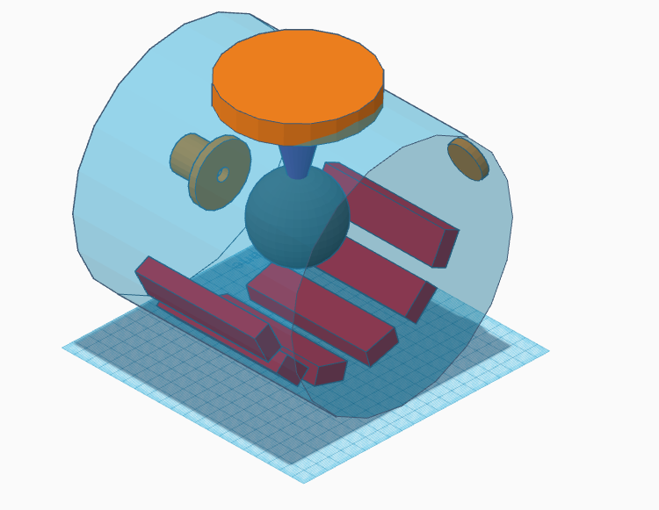
Tooling blocks
Blocks have groove cut out underside
To fit the chamber profile

Slide 2
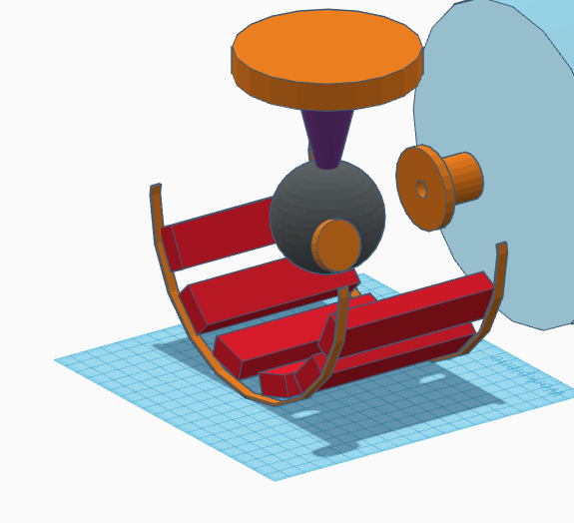
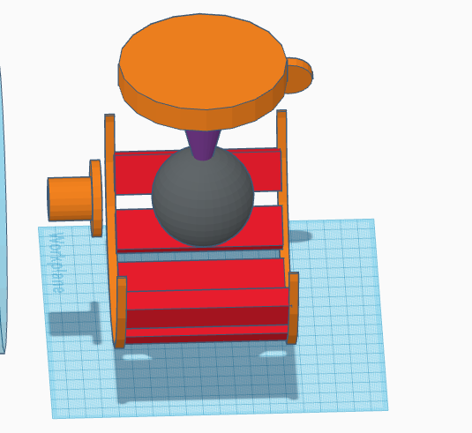

Slide 3
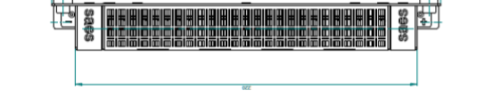

Slide 4
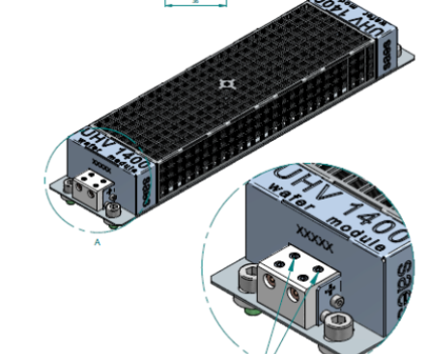

Slide 5
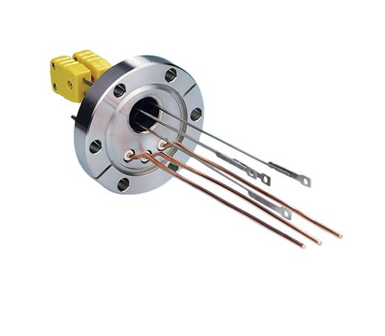
Wiring NEGs to feedthrough

Slide 6
Pumping Comparison
This is for WP1250 60% activated in bakeout
And fully activated UHV1400 pumps

Slide 7
Effect of stripping NEG coating measurements have shown larger difference

