Slide 1
500 kV project update: reached 450 kV!
04/17/2023
gabrielp@jlab.org

Slide 2
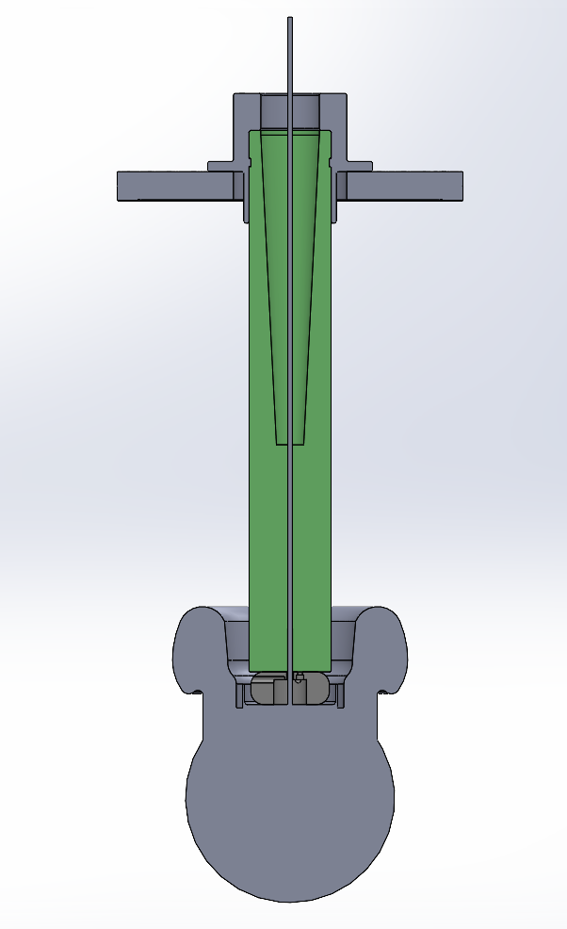
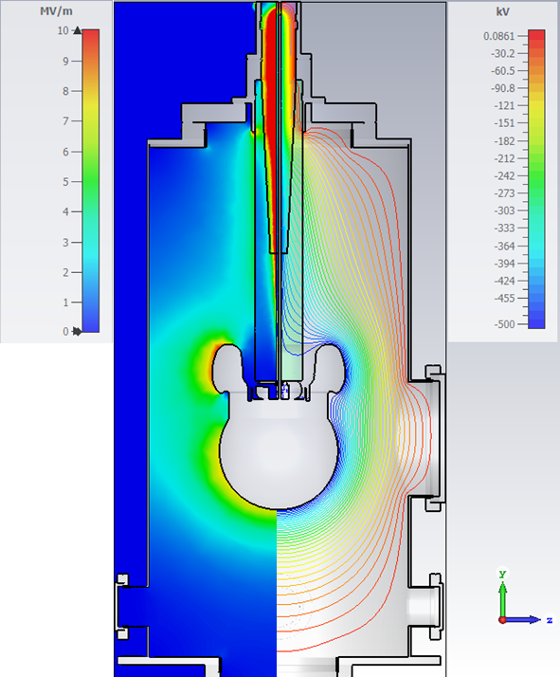
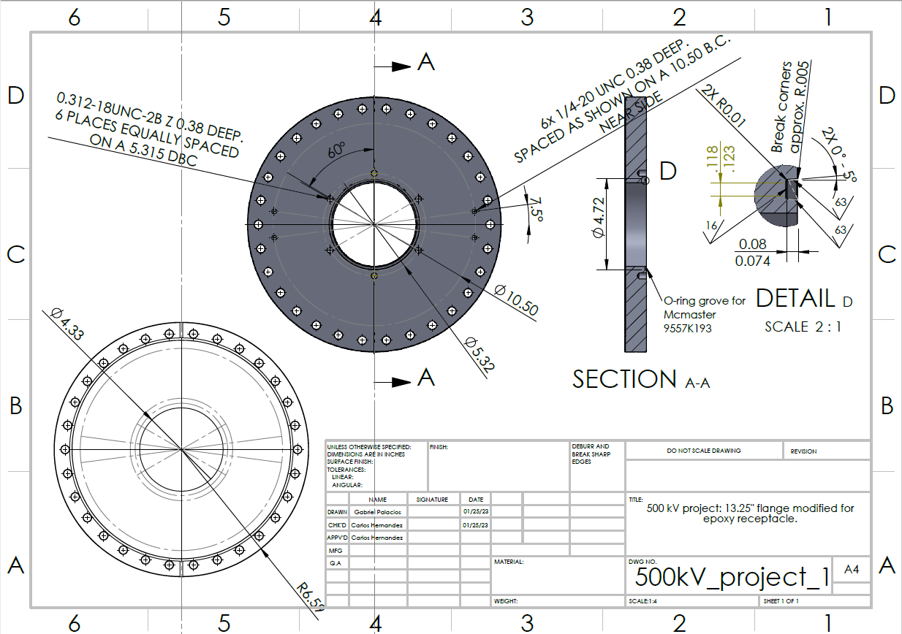
Model and simulation
Flange modification CAD
3D model cross section
Electric field color map (left) and potential isolines (right)

Slide 3
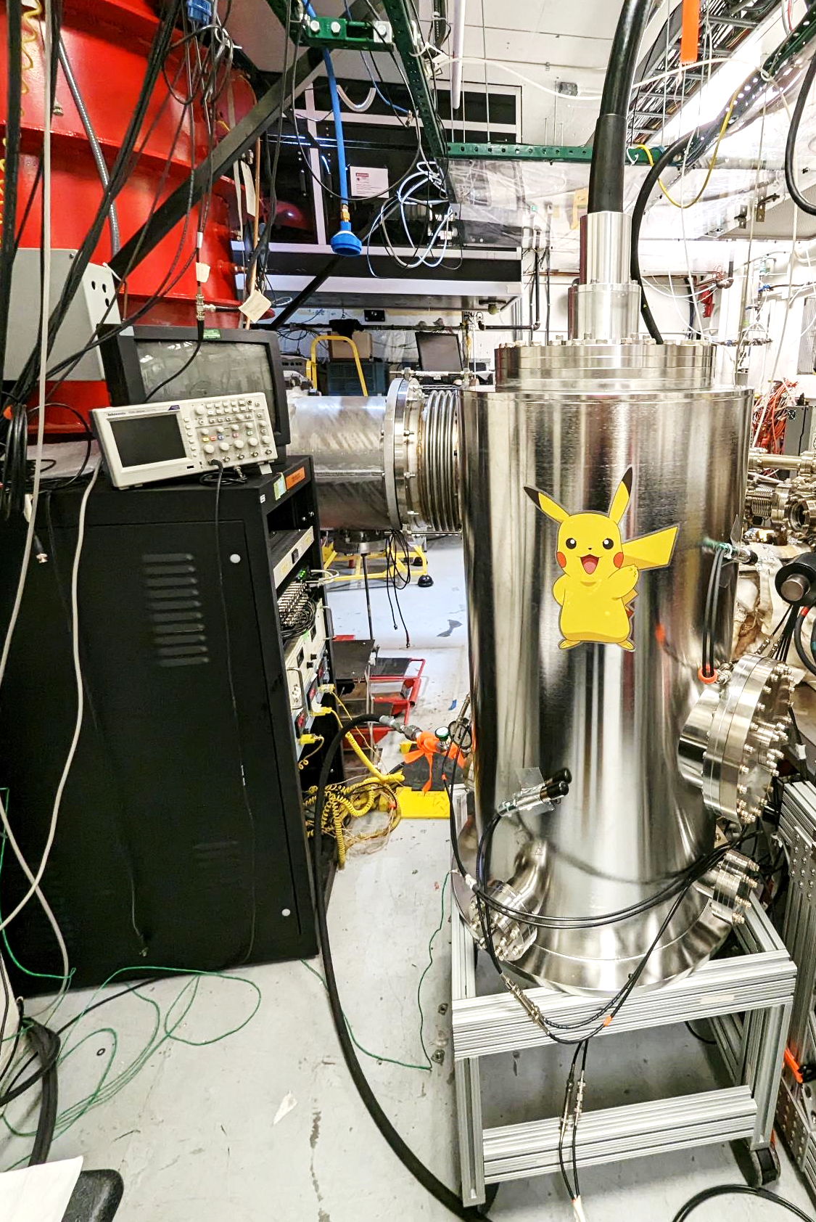
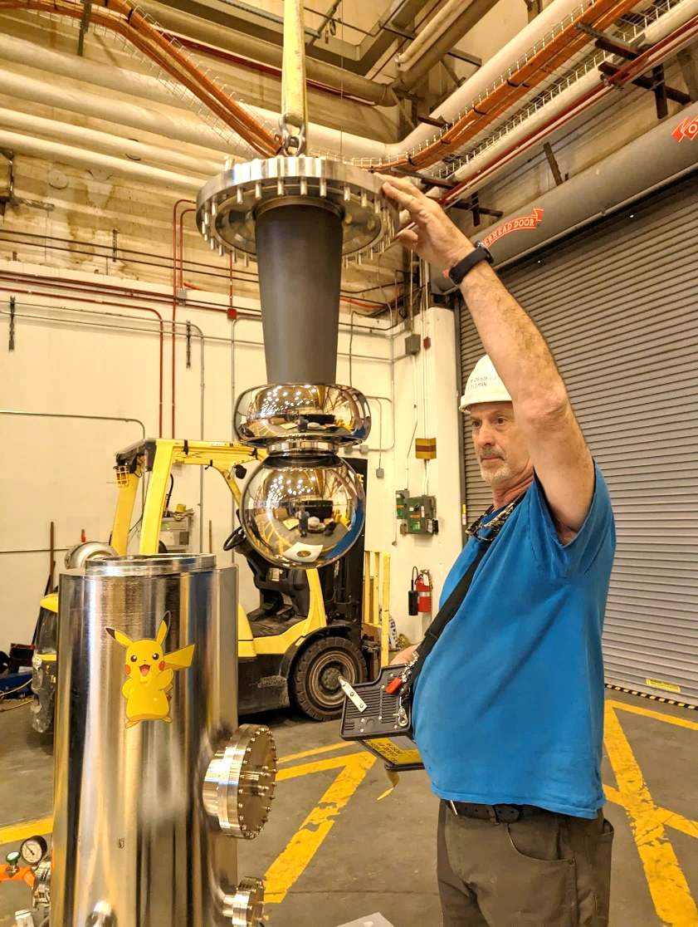
Installation
Tested at 10 psi of fresh SF6 in the test chamber
Unmodified epoxy receptacle installed
Alumina insulator uninstalled

Slide 4
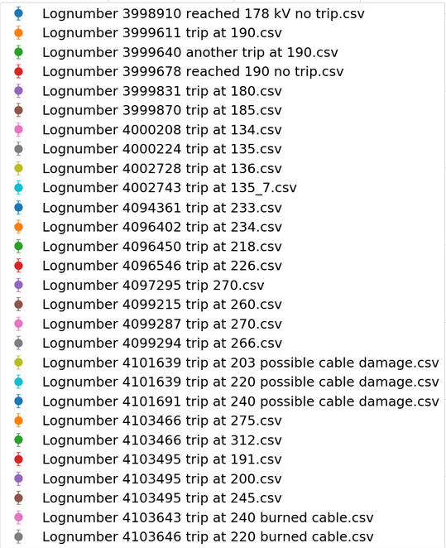
A lot of troubleshooting

Slide 5
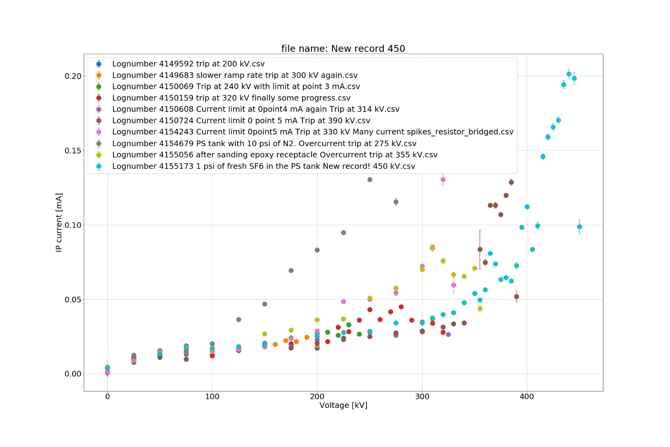
Reached 450 kV, current limit of 0.75 mA

Slide 6
Found the issue: Not-pure SF6
275 kV, 0.5 mA, Nitrogen
450 kV, 0.75 mA limit, +1 psi of clean SF6
390 kV, 0.5 mA limit
330 kV, 0.5 mA, resistor bridged
240 kV, 0.3 mA limit
355 kV, 0.5 mA, sanded epoxy
320 kV, 0.4 mA limit
200 kV, 0.2 mA limit

Slide 7
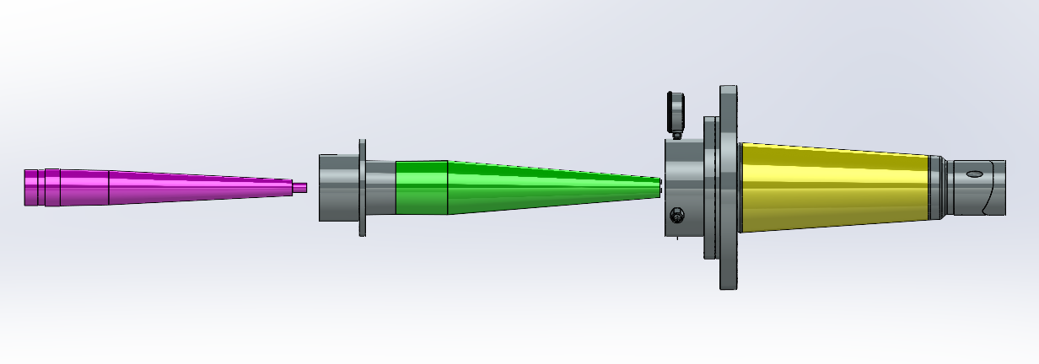
Next steps:
Use the tanks in the DILO to consolidate all the SF6 to one single tank.
Transfer SF6 from the PS tank to the outside bladder until reaching 0 psi in the tank. Then fill up the tank wit fresh SF6 from the bottle to 12 psi.
Test again and solve these questions 1) Can we reach 500 kV? 2) If so, can we hold 450 kV for 24 hrs or more? 3) If so, switch the unmod epoxy for the tapered epoxy and test again.
We get to try the intermediate layer of SF6 again
The PS should be maintained once a year (?)

