Slide 1
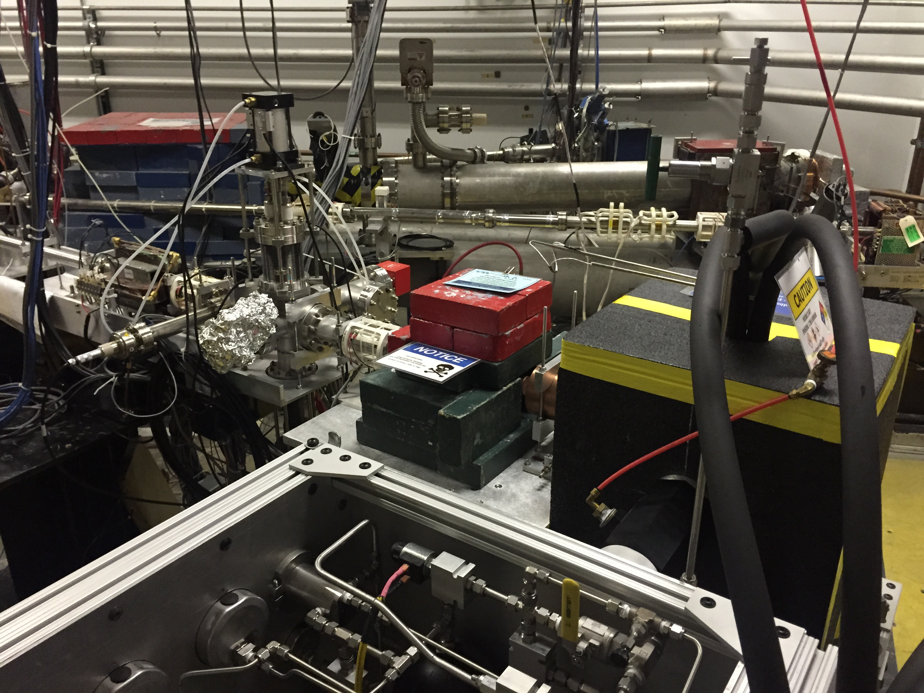
First day of tests (09/10/2015)
Filled bubble chamber with N₂O. Reached stability in operating temperature
Measured a very low cosmic ray background.
Tested sensitivity with neutron source.
Produced 7.7 MeV electron beam on 6mm Cu radiator
Claudio Ugalde

Slide 2
Filling with N₂O

Slide 3
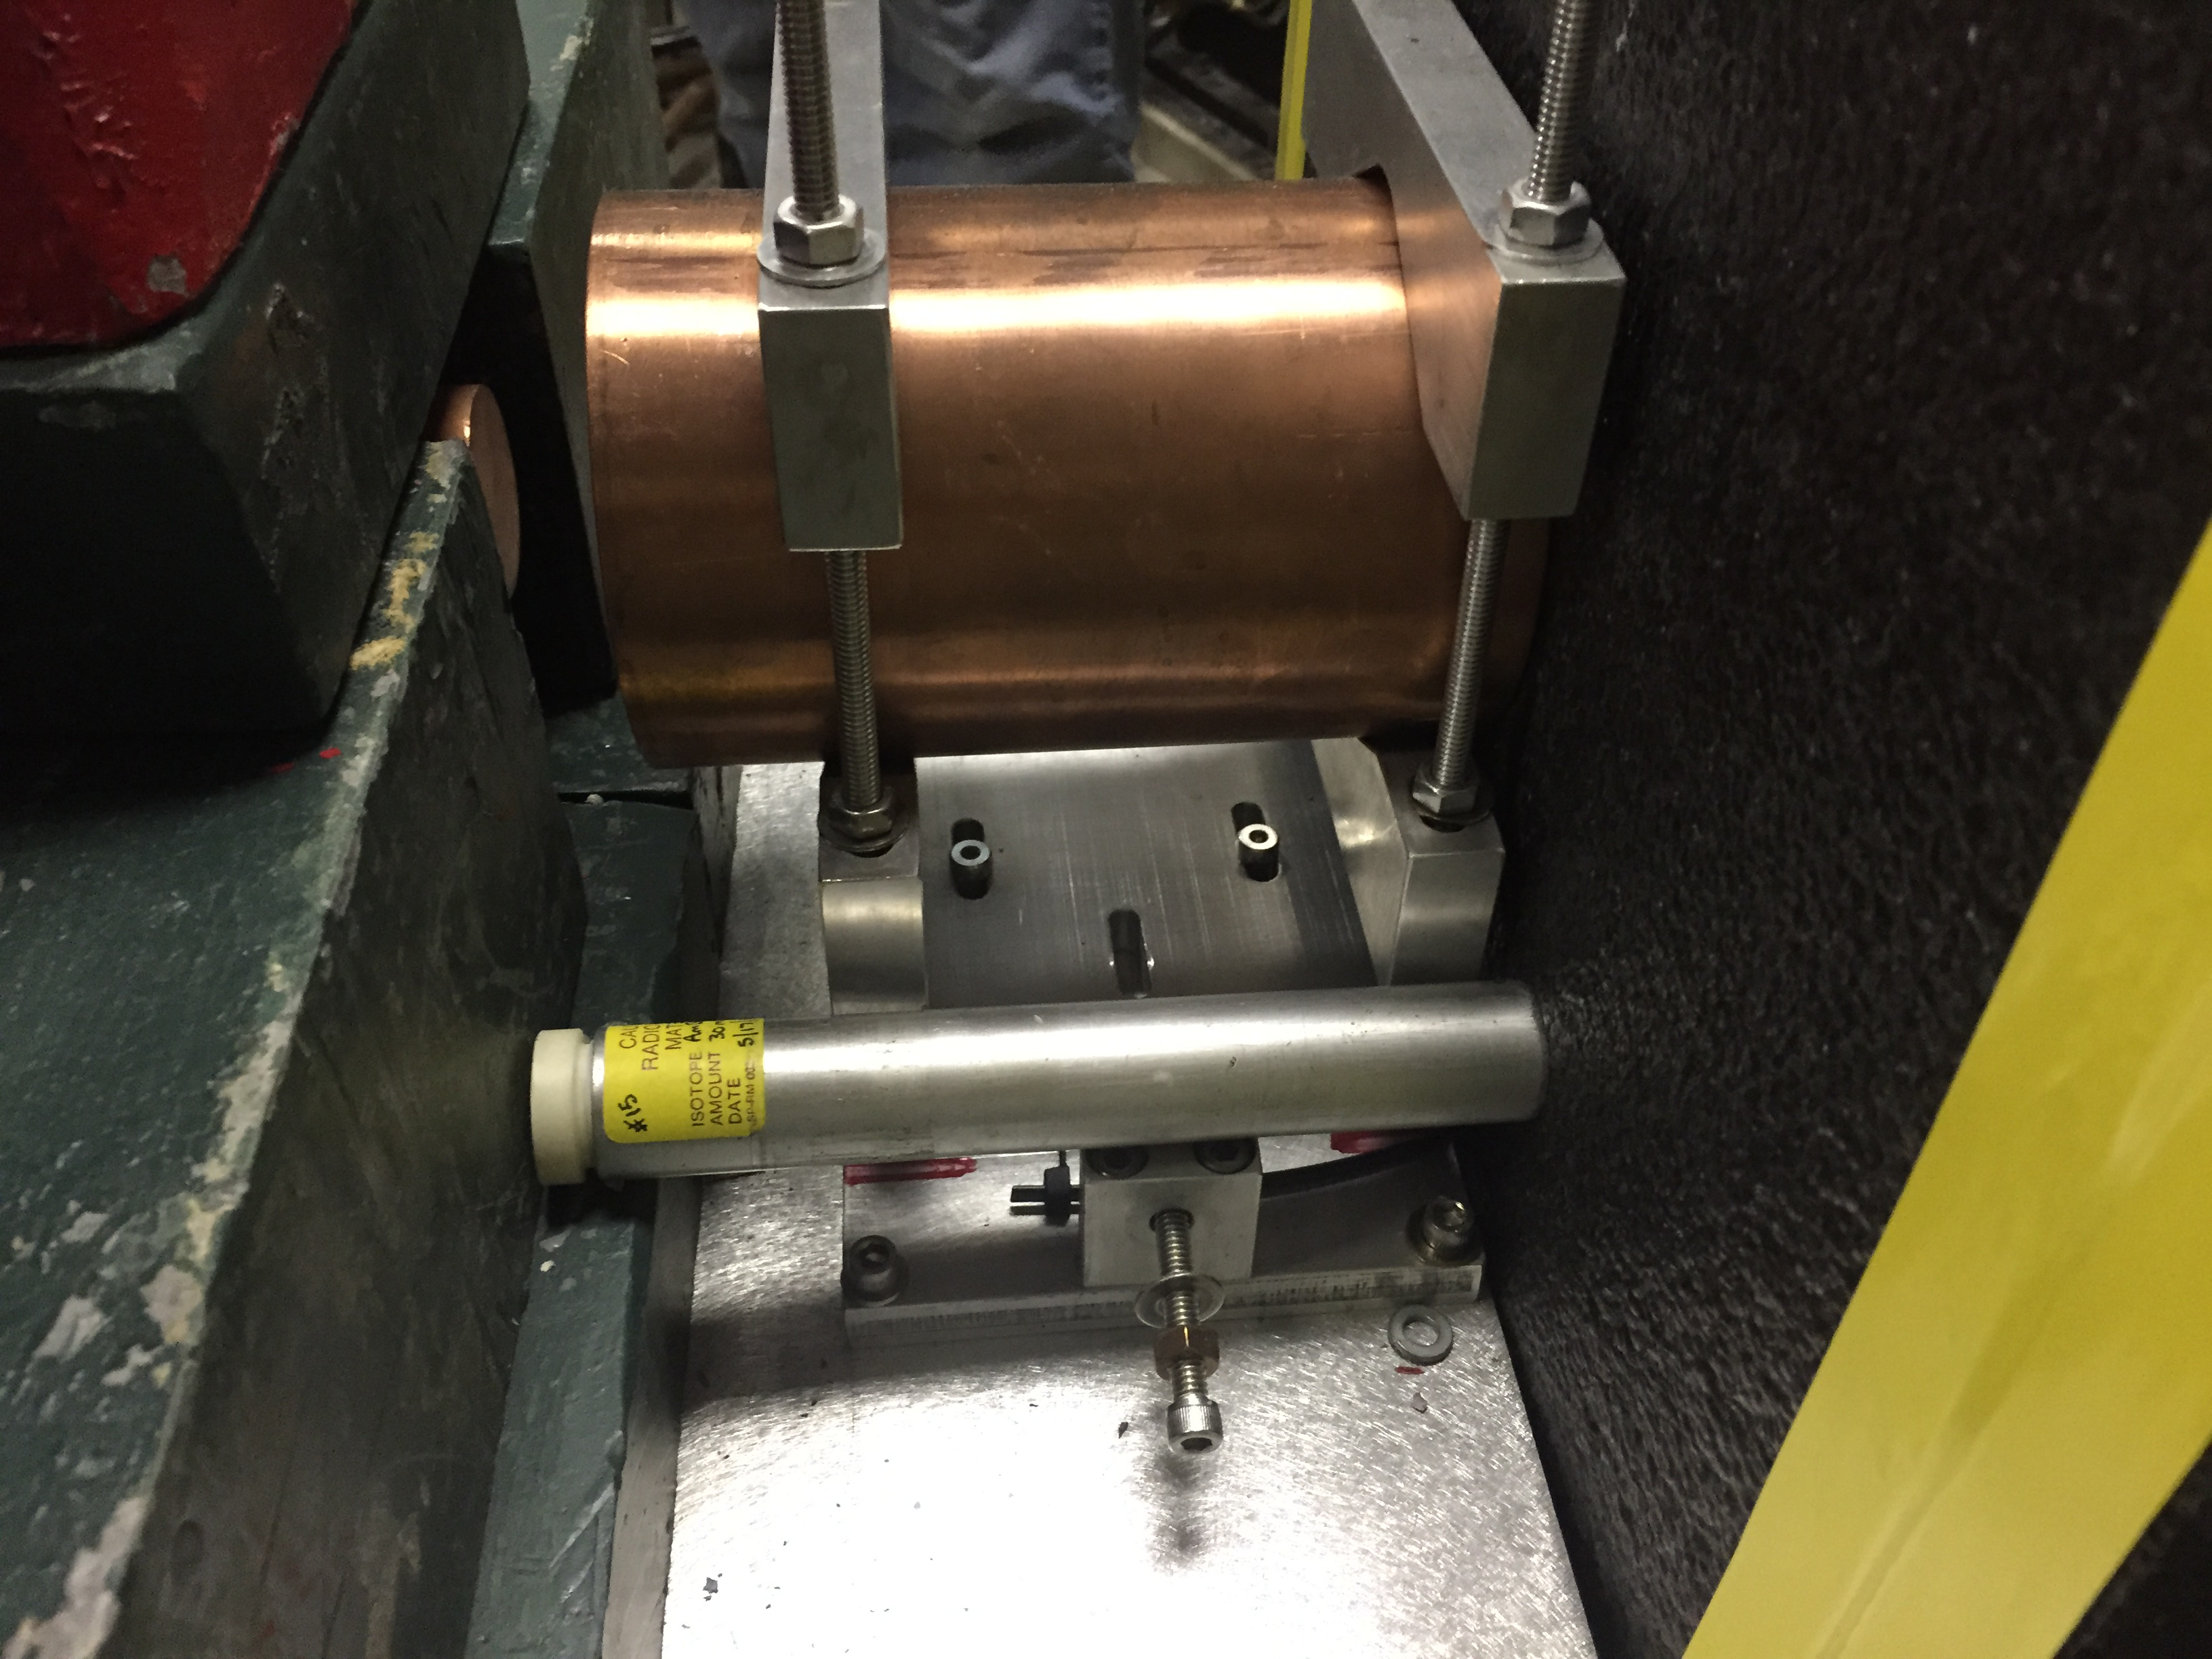
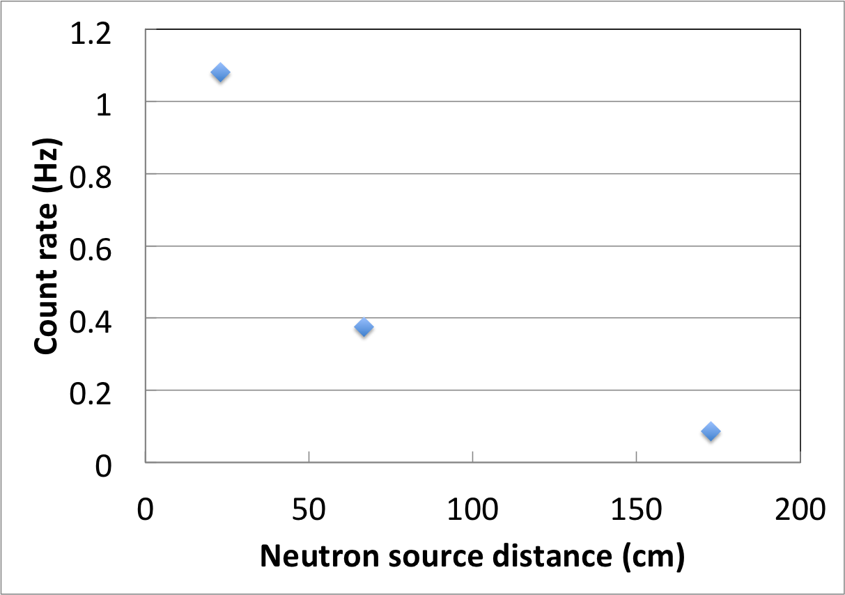
Neutron source (AmBe)
3 distances(source on thermal insulator, 17.3 in, 59 in).
Obtained expected drop in count rate

Slide 4
Event trigger at 0.4 μA
* Solution: Shield camera

Slide 5
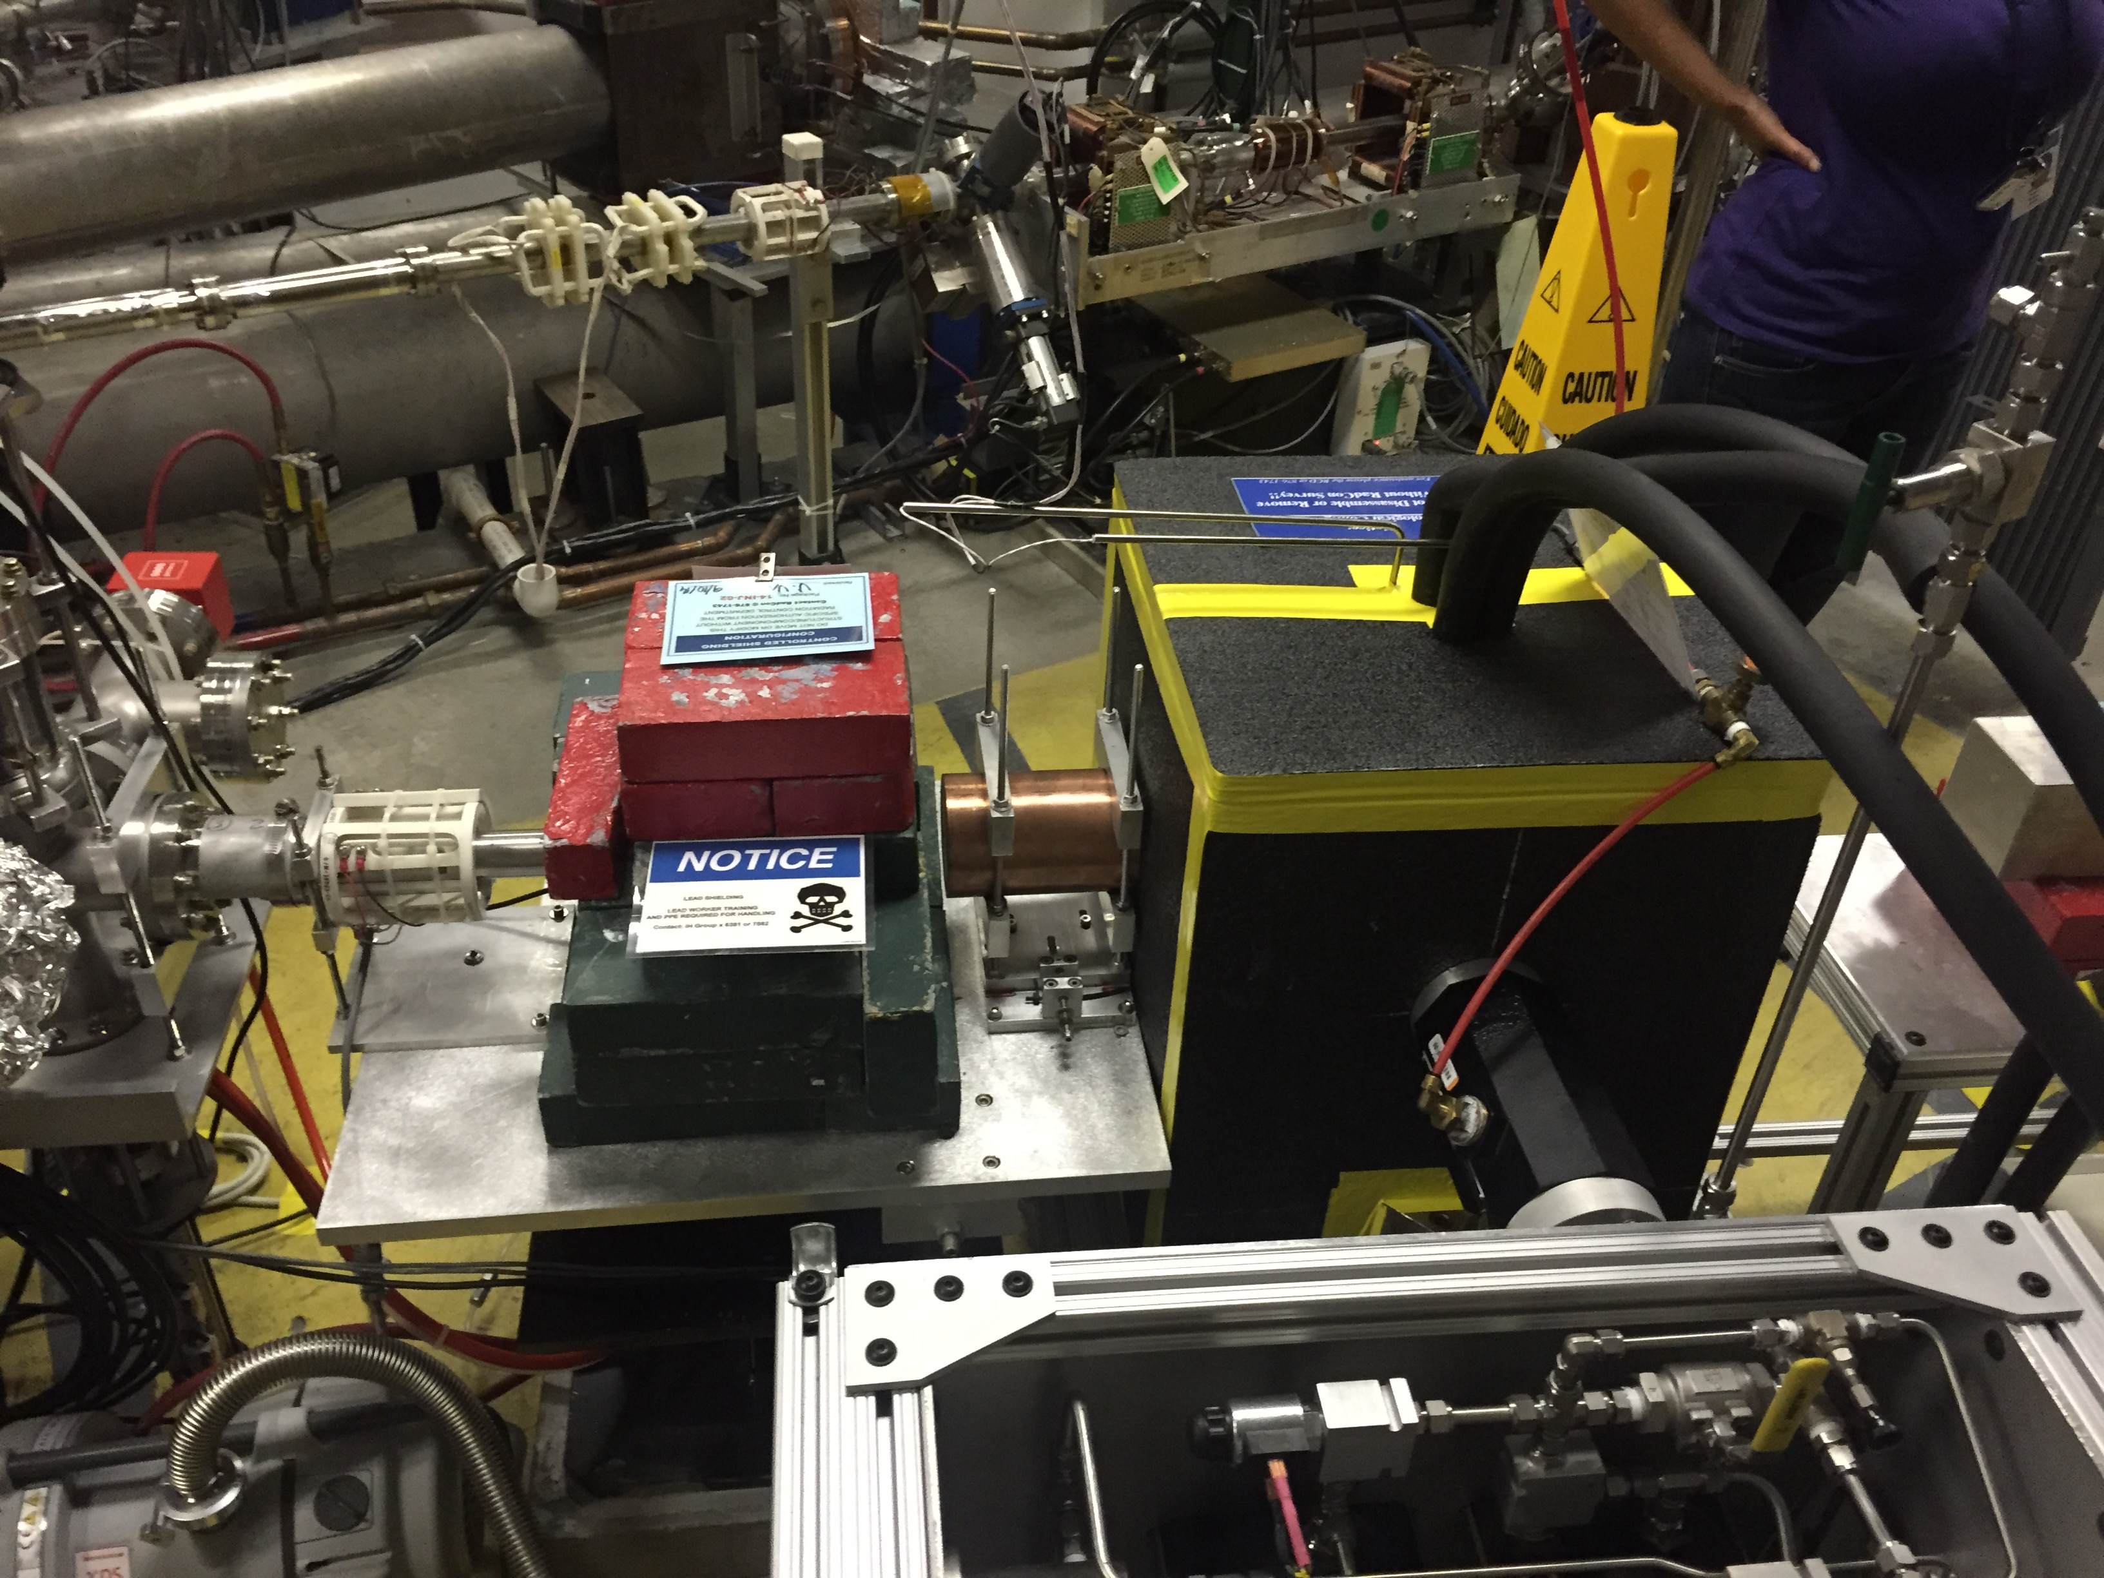
Radiation hitting camera

Slide 6
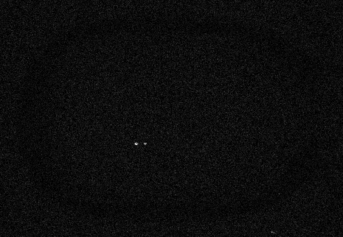
First photodisintegration event in bubble chamber with Bremsstrahlung
Sep 10, 2015 19:40

