Slide 1

KEK visit
High level topics…(with some low level details)
Joe Grames

Slide 2

12 GeV CEBAF
Machine Parameter | Electrons
Hall Multiplicity | 4
Energy (ABC/D) | 11/12 GeV
Beam Repetition | 249.5/499 MHz
Duty Factor | 100% cw
Beam Intensity (always polarized) | 10 pA to 150 μA
Beam Polarization | > 85%
Fast/Slow Helicity Reversal | 1920 Hz/Yes

Slide 3
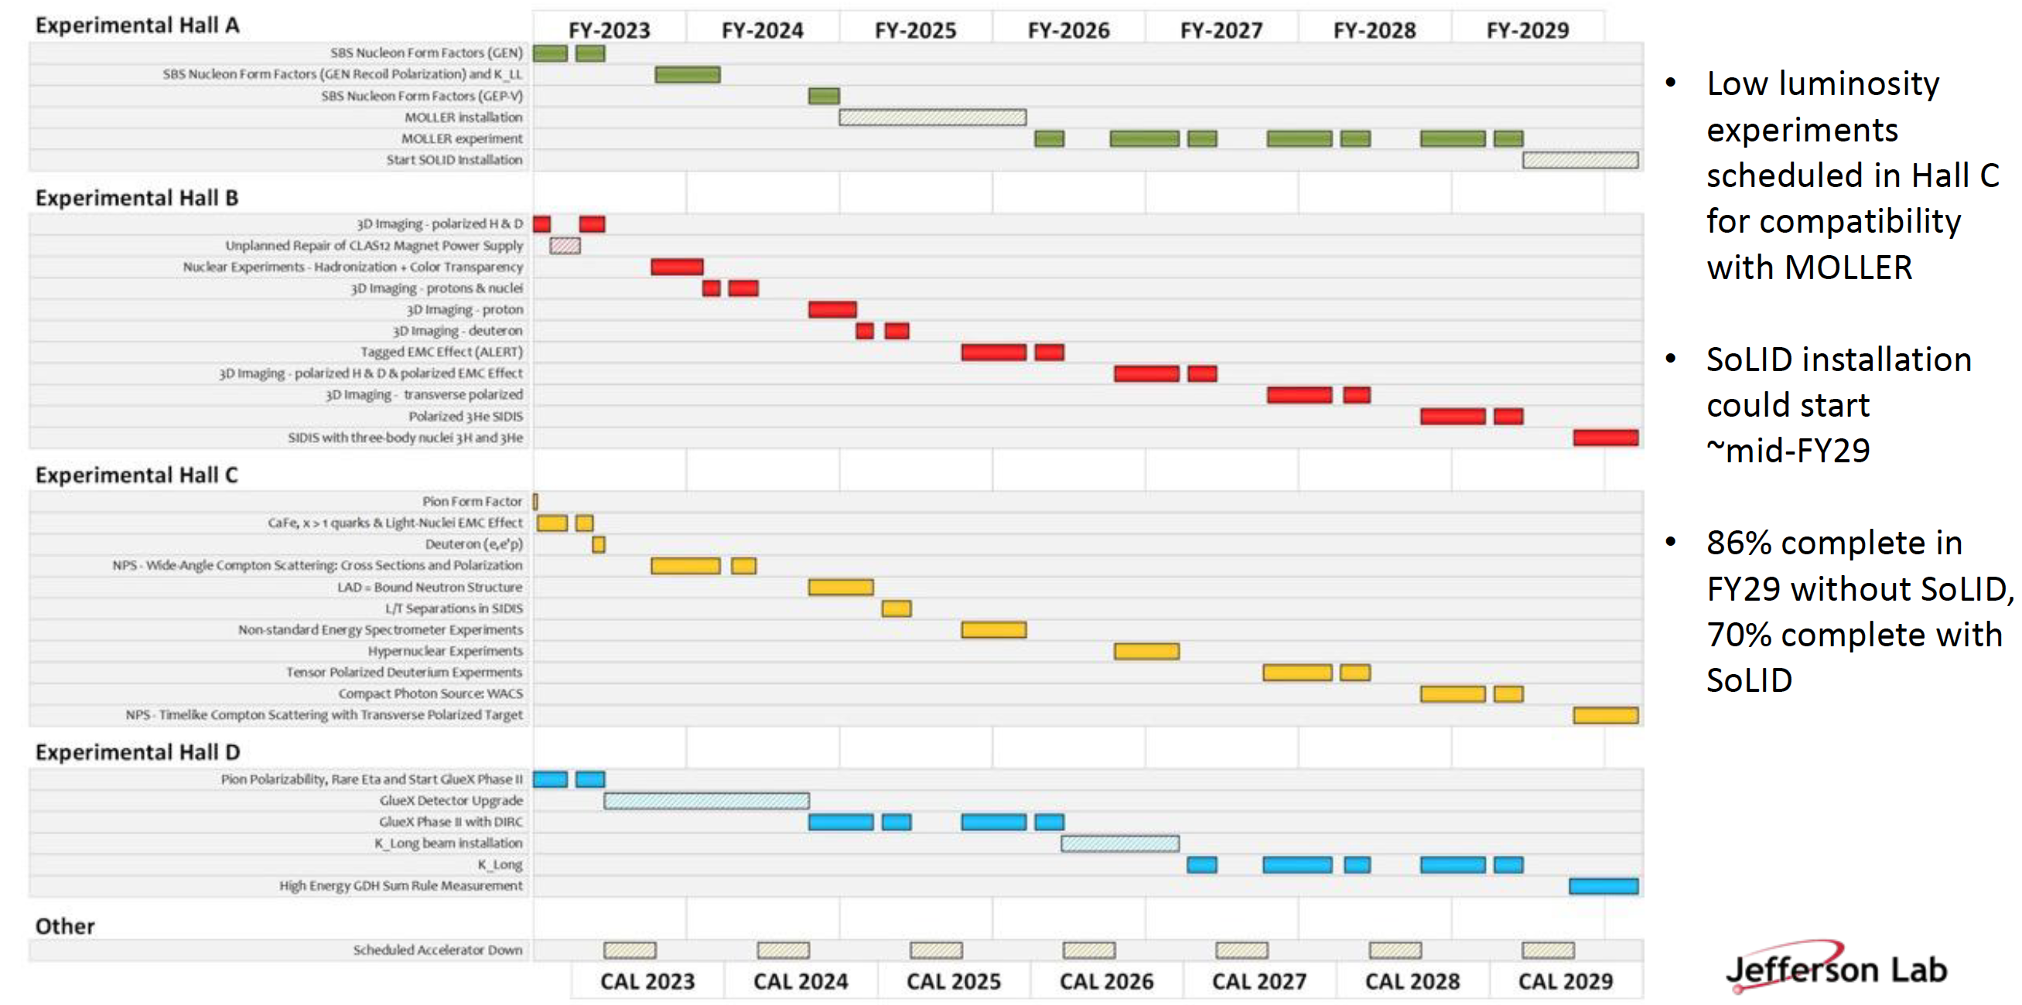
JLab – Long Term Schedule (in preparation…)

Slide 4
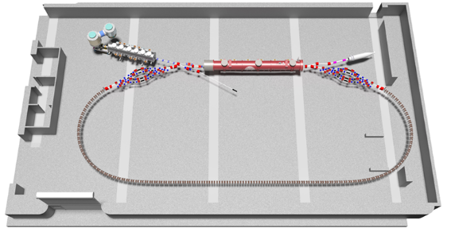
What is future of CEBAF ?
Polarized positron beams 12 GeV initially…
Builds new 123 MeV positron injector
Retains existing polarized e- injector
Multi-hall capability is a high priority
Capability happens after Moller
…and later upgrade for 22 GeV e- with FFA.
Builds new 650 MeV electron injector
Builds upon e+ infrastructure
Adds permanent magnets (FFA) for highest energies
Retains multi-hall capability
Production of Highly Polarized Positrons Using Polarized Electrons at MeV Energies, D. Abbott et al., Phys. Rev. Lett. 116 (2016) 214801
CBETA: First Multipass Superconducting Linear Accelerator with Energy Recovery, A. Bartnik, et al., Phys. Rev. Lett. 125 (2020) 4, 044803

Slide 5
12 GeV Ce⁺BAF : present high level goals
Machine Parameter | Electrons | Positrons
Hall Multiplicity | 4 | 1 or more
Energy (ABC/D) | 11/12 GeV | 11/12 GeV
Beam Repetition | 249.5/499 MHz | 249.5/499/1497 MHz
Duty Factor | 100% cw | 100% cw
Unpolarized Intensity | 170 μA | > 1 μA
Polarized Intensity | 170 μA | > 50 nA
Beam Polarization | > 85% | > 60%
Fast/Slow Helicity Reversal | 1920 Hz/Yes | 1920 Hz/Yes
Hall multiplicity tied to intensity and rep rate
Cannot copy existing pulsed mode technology
Beam distributions are characteristically different
Few positrons with highest spin polarization

Slide 6
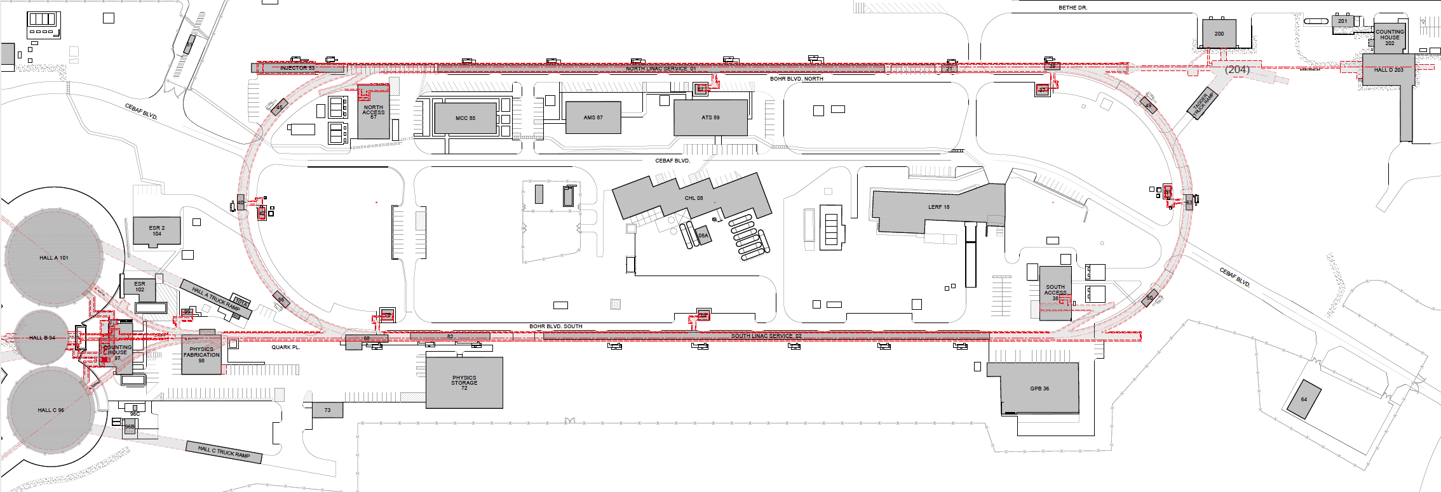
Where to stage a new e+ injector at an old e- lab ?
One year ago we were exploring e⁺ production at 10, 100, 1000, 10000 MeV…
Today we have a beams working group focused on creating e⁺ using the Low Energy Research Facility

Slide 7

Low Energy Research Facility (LERF)
We took a tour there in December…
…it’s the same plan today.

Slide 8
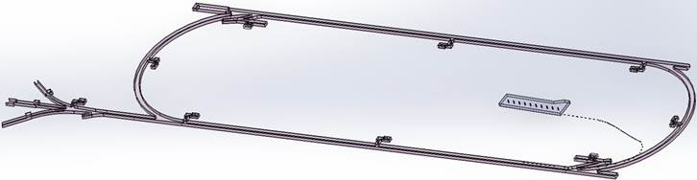
Turning the LERF into the new injector facility for CEBAF
123 MeV e+
(650 MeV e-)
Inject e⁺ into North Linac to usual 12 GeV (w/ magnets reversed)
Build e⁺ injector at the LERF
Build new LERF to CEBAF tunnel
123 MeV e+
(650 MeV e-)
Build new transport line along South Linac and West Arc

Slide 9

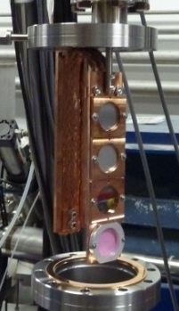
PEPPo : was approved as a proof-of-principle for e+ beam generation
J. Grames, E. Voutier et al.,JLab Experiment E12-11-105 (2011)
8 MeV, 1μA, 85% polarization
“e+ Beam” would’ve been ~10’s fA
Tungsten (1mm)
Record for linac positron polarization.
P(e+) = 82.2 %
PEPPo possible due to support from SLAC E166, DESY, Princeton, Cornell, International Linear Collider Project and the Jefferson Science Associates
Efficiency >95%
D. Abbott et al., Phys. Rev. Lett. 116 (2016) 214801

Slide 10


Exploit electron spin polarization to produce polarized positrons
When a longitudinally polarized e⁻ beam strikes matter, e⁺ produced in the shower carrying >50% of the e⁻ beam energy are significantly longitudinally spin polarized…
Polarized Bremsstrahlung
Polarized Pair Creation
P_{circ}(γ) / P_{z} (e⁻)
P_{z} (e⁺) / P_{circ} (γ)
…so why not take advantage of this?
E_{γ} / T_{e-}
T_{e+} / (E_{γ} – 2m_{e+})
E.A. Kuraev, Y.M. Bystritskiy, M. Shatnev, E.Tomasi-Gustafsson, PRC 81 (2010) 055208

Slide 11
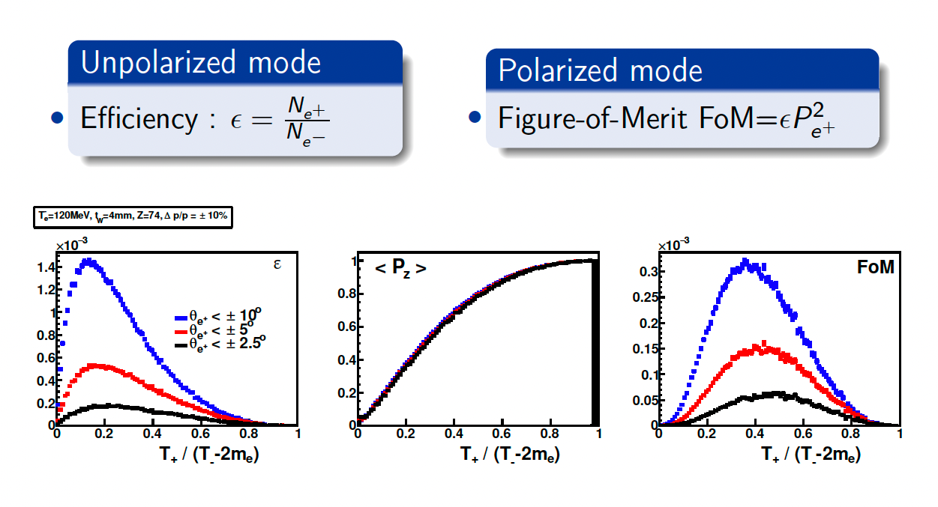
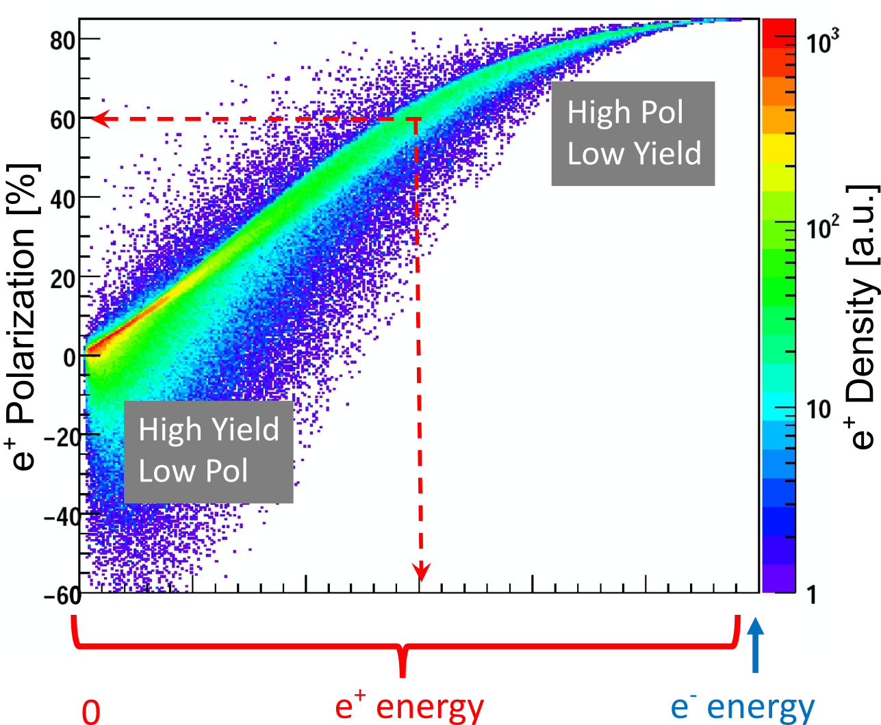
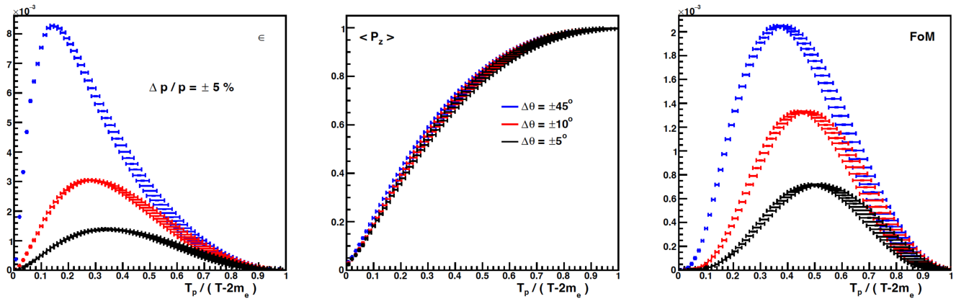
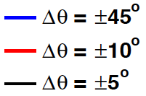
Yield and Polarization => multiply your desired e+ current by 10³ to 10⁴
e⁺ Polarization vs Energy
4 mm Tungsten Target
120 MeV e‒
Efficiency
FoM
e⁺
e‒
e⁺
e‒
Positron beamline has to be designed
for efficient capture and transport of e⁺ with different energies

Slide 12
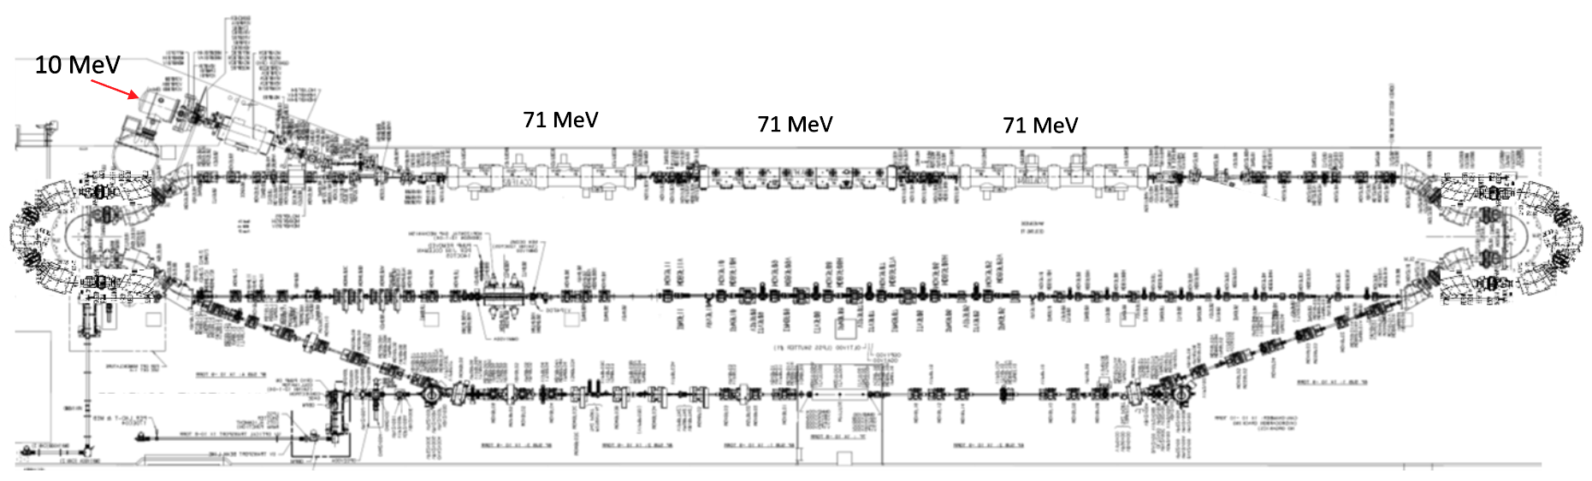
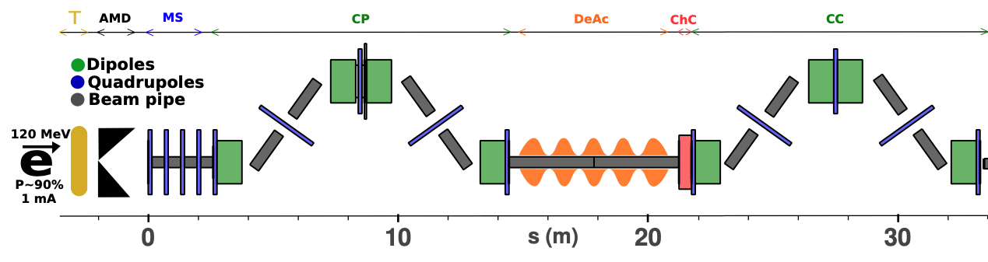
LERF Polarized Positron Injector Concept
Focus is developing a S2E technical report based on a polarized e⁺ injector at LERF
  High current polarized electron injector (10 MeV/10 mA)
  High current 1-3 mA LINAC (two C75 CM)
  Positron conversion target (~100 kW)
  Positron bunch collection and momentum selection
  Positron bunch compression and acceleration to 123 MeV
#1 – Compact 10 mA P-Gun, Wien filter, 10 MeV e- injector
#6 – SRF accelerate e+ to 123 MeV
#2 - SRF accelerate to 120 MeV
#5 – Transport e+
#3 – Extract e- to target
#4 - Produce and collect e+ 20 to 60 MeV
#7 – Evaluating 123 MeV spin rotator concept
#8 – Transport e+ at 123 MeV to CEBAF

Slide 13
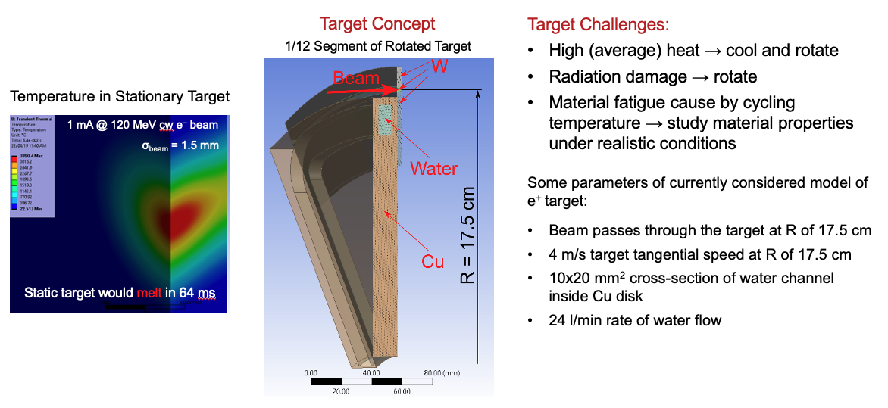
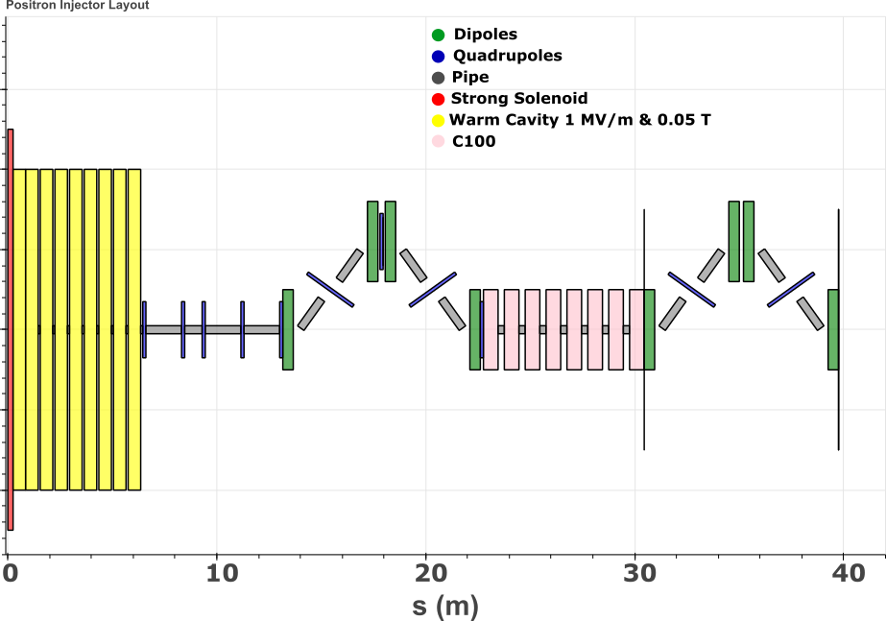
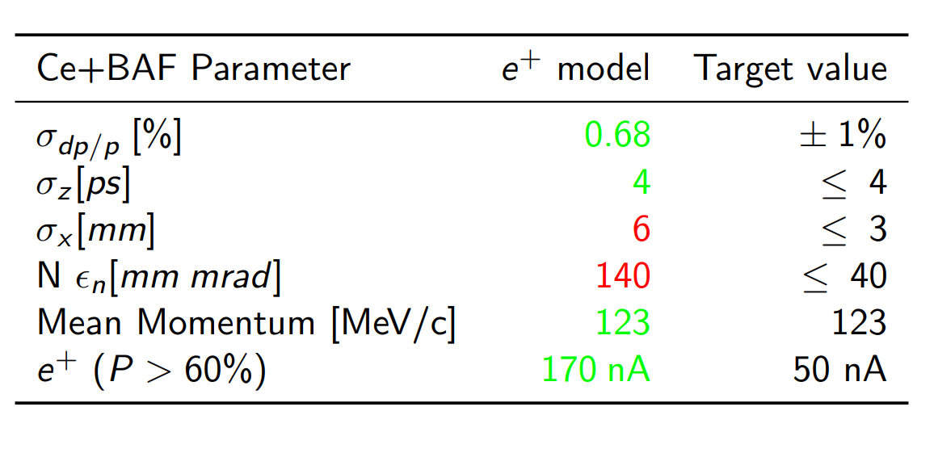
Jefferson Lab Accelerator Advisory Committee (Mar 8 – 10)
Andriy presented about what he, Silviu and target team have been considering…
Sami presented about what he, Yves, and collection beam have been considering…

Slide 14
Draft recommendations from recent division review
Topic 22: Ce+BAF Concept and High Power Target
  R37: Design a shielding configuration for LERF covering the target and positron capture areas.
  R38: Determine if remote handling is needed for removal of used targets and capture hardware.
  R39: Study the need for activated water cooling systems associated with production and capture systems.
Topic 23: Positron Collection Scheme for Ce+BAF
  R40: Continue to optimize the positron parameters to reduce the normalized emittances and horizontal beam size.
  R41: Since real world positron collection rates are typically lower than simulated, add as many technical effects as possible to the simulations including e- space charge and errors of component fields and alignment to optimize positron phase space collection.
  R42: Have a detailed technical review of the positron target and capture sections to see if external experts can help with more detailed aspects of the design.

Slide 15
So, we have a number of issues to ”conquer”
CW polarized e- source, high current >1 milliamp
  High power ”low” energy >100 MeV e- linac (50 -100 kW beam power)
Rotating High power target (50 – 100 kW)
  Anticipate 15-20% of beam power deposited
  Vacuum compatible and good isolation b/c “nearby” SRF cavities
Efficient e+ collection
  Must be cw (for our users high acceptance halls)
  Should minimize power required (target heat and radioactivity)
Reality!
  We have just recently launched into working with our lab’s SRF and Magnet groups, soon we have to engage our Radiological group, the list grows…

Slide 16
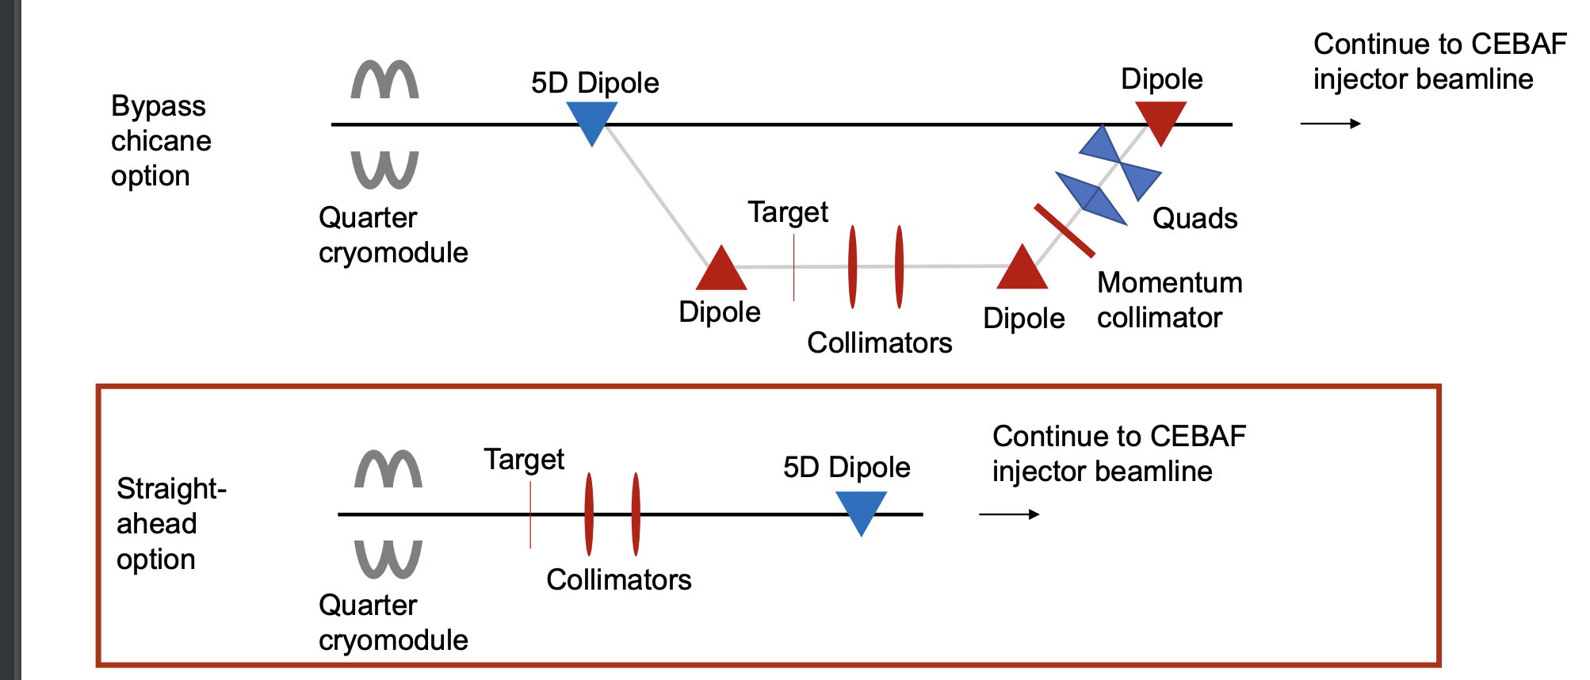
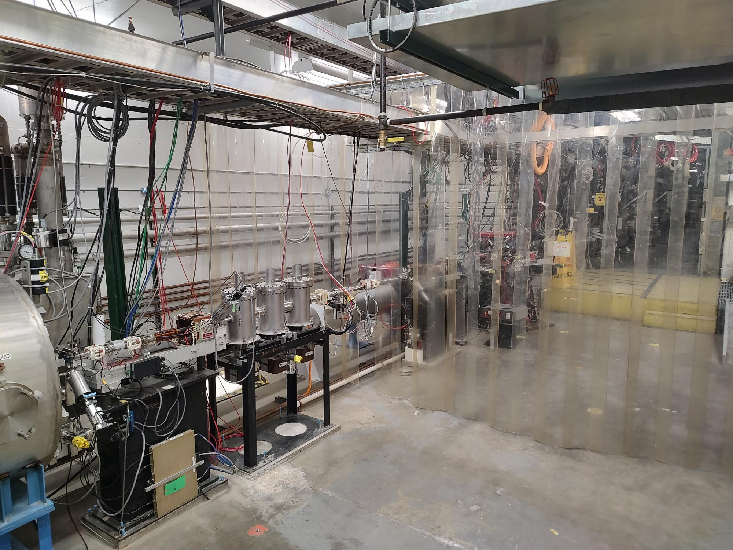
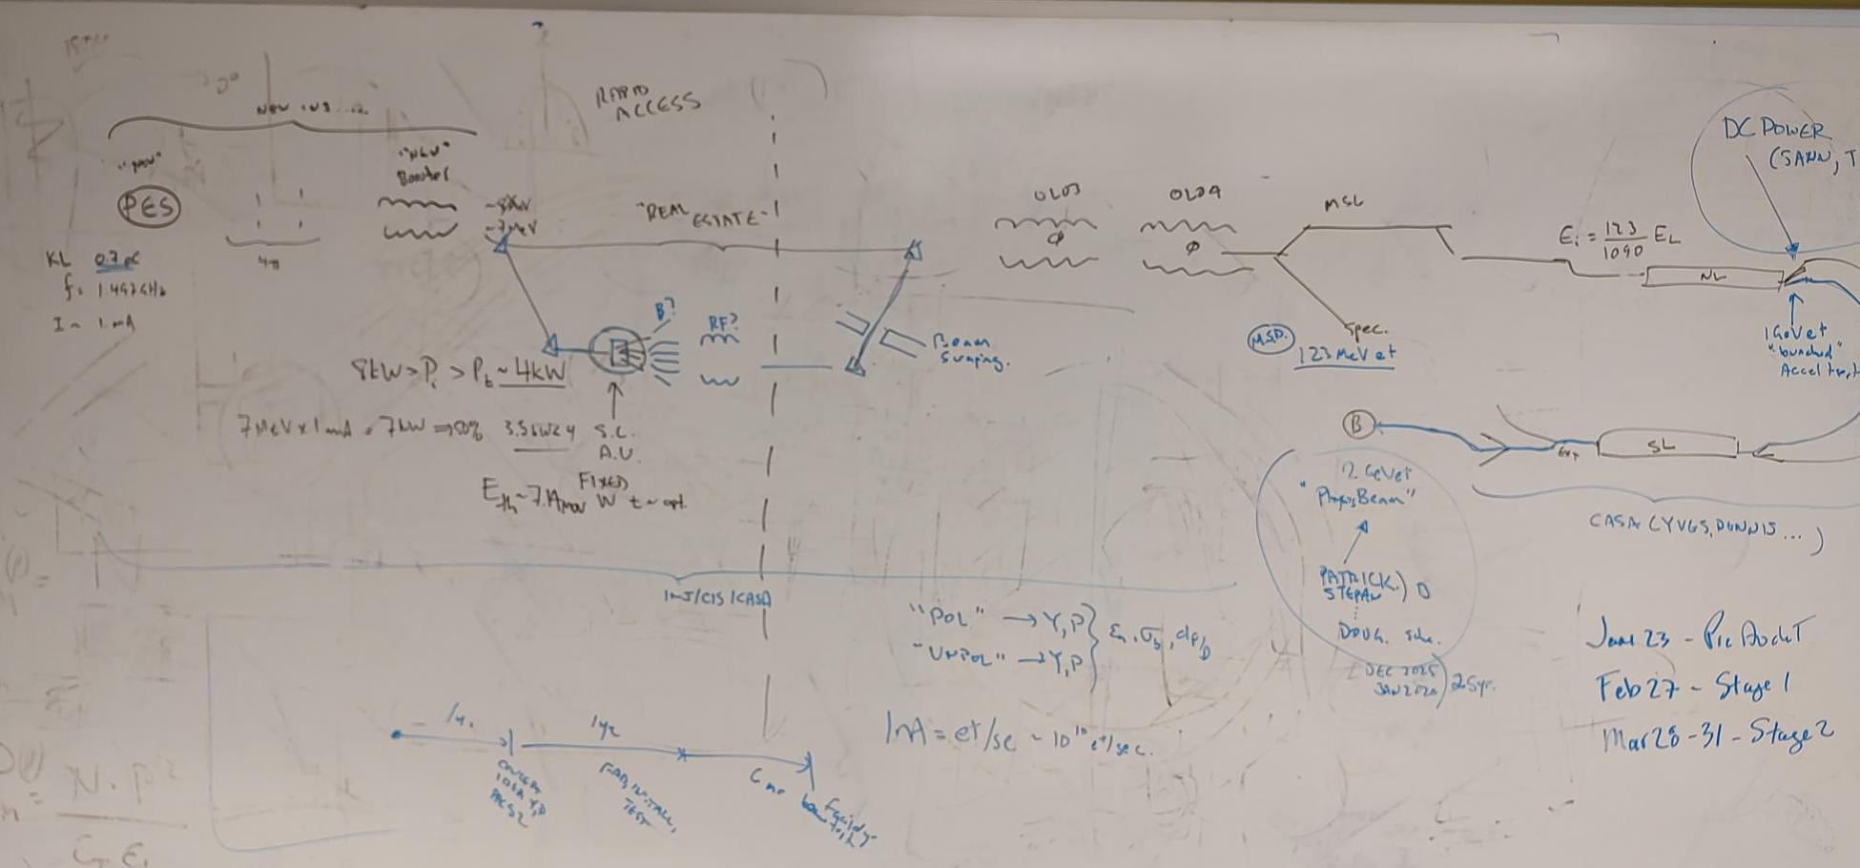
Until we can start in LERF the CEBAF injector is our beam test-bed today…
Funded project using degraded e- explore admittance of CEBAF
Considering a small-scale test to produce & accel e+ to 2 GeV

Slide 17
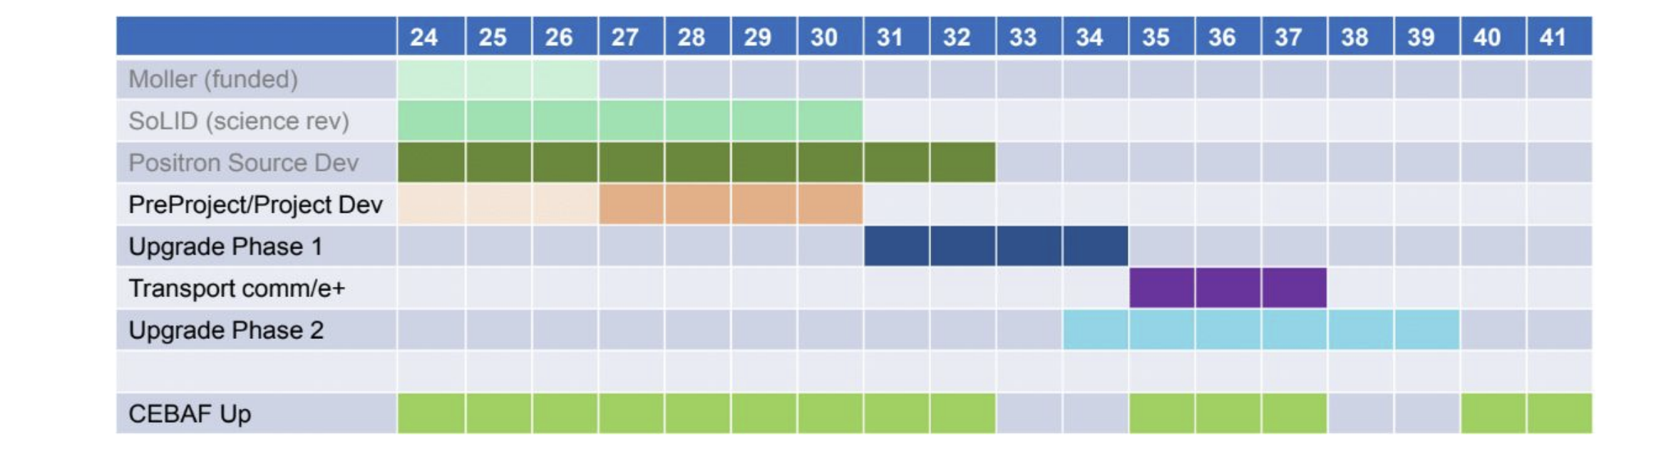
Positron R&D 5 Year Plan:
“Creating Value with Hardware”
 | 24 | 25 | 26 | 27 | 28 | 29 | 30 | 31 | 32 | 33 | 34
Degrader LDRD (Amy) | X
PEPPo-II LDRD (TBD) | ? | ?
Sol. Tgt.(Jlab/IJCLab) | ? | ? | ?
Liq. Tgt (Xelera) | ? | ? | ?
Base Gun (Carlos) | ? | ? | ?
Adv. Gun (Mamun) | ? | ? | ? | ? | ?
Recover 10 MeV e- | ? | ? | ?
10 MeV e+ prg |  |  | ? | ? | ?
100 MeV e+ prg |  |  |  | ? | ? | ?
LERF partner (LCLS-II) | X | X
LERF partner (EIC) |  | X | X | X | X | X | X
Uses CEBAF
Uses LERF

Slide 18
Stop here ?
This afternoon discussions for the e+ source are planned…
We can stop here for a break or lunch …. or I can spend another 15-20 min talking about the strategy for the polarized e- source.

Slide 19
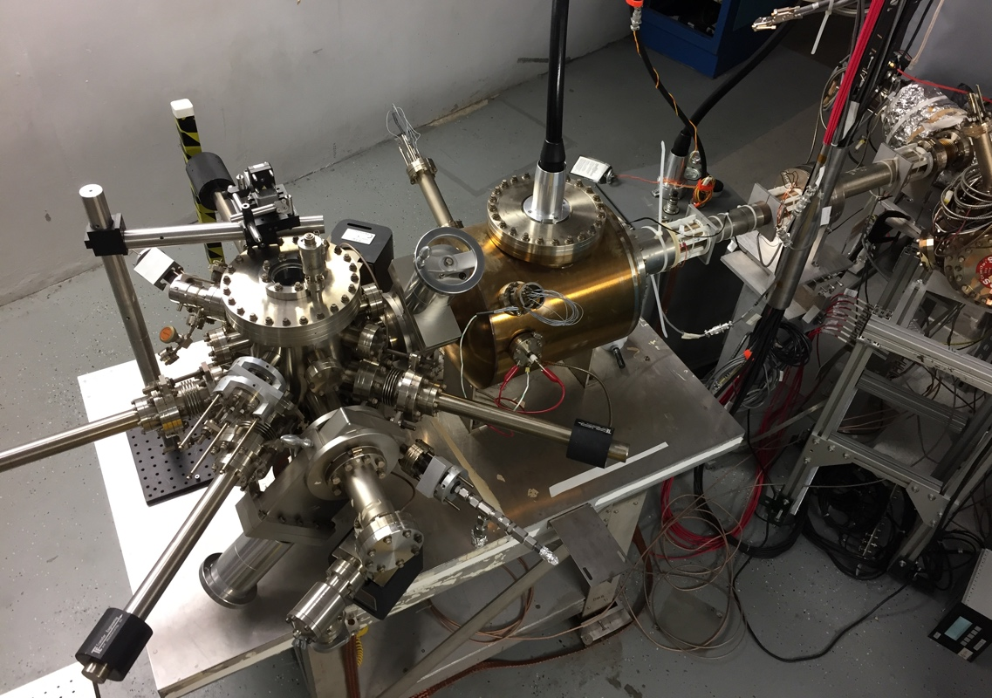
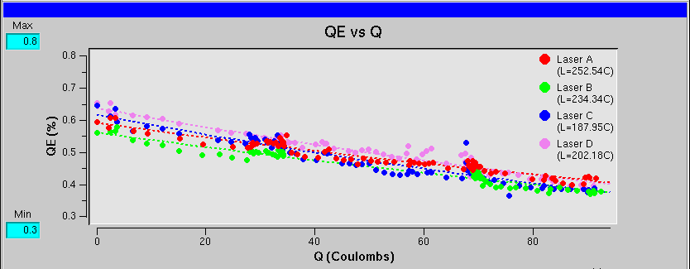
CEBAF polarized electron source
Gun2 Photocathode (Fall 2016 – Spring 2017)
  Lifetime ~200 C (σ_{4D} ~ 1mm) with intensity @ 200 μA
Gun vacuum ~ 1x10⁻¹² Torr
Preparation
Chamber
Activation Laser
HV Chamber
QE = QE₀ e ^{-(Q/Lifetime)}
GaAs
Storage
Loading
Chamber
P. Adderley et al., Phys. Rev. Accel. Beams 13, 010101 (2010)
[µA]

Slide 20
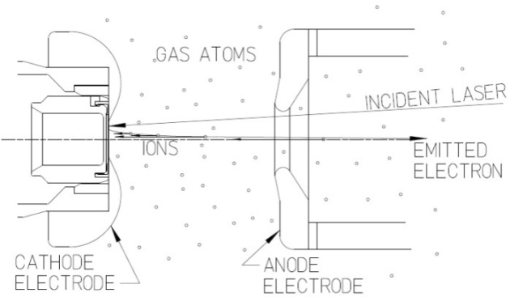

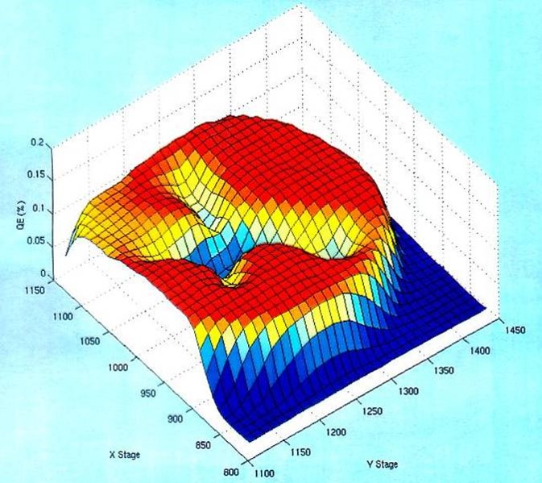
Imperfect Vacuum = Ion Bombardment
Ion bombardment – notice characteristic “trench” from laser spot to electrostatic center of photocathode
Active area = 5mm
Laser spot = 0.5mm dia.

Slide 21
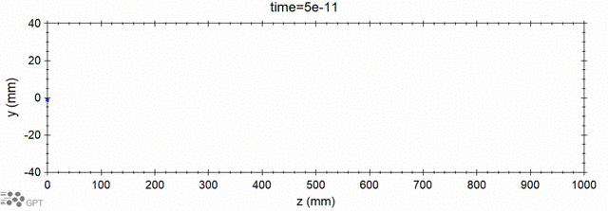
Modeling ion generation and bombardment
PhD work of J. Yoskowitz in preparation for PR-AB
GPT custom element IONATOR simulates electron-impact ionization of residual beam line gasses and tracks outgoing particles.
e- beam
ions
ejected e-
scattered e-
Simulation of biased anode
PhD work of Josh Yoskowitz
With a >400 C lifetime we could operate at 1 mA for almost 1 week

Slide 22
Extend electron source performance by factor of 100 – 1000…
Charge “used” in 2 weeks vs. gun current
JLab Polarized Positron Source (see Sami’s talk on Positron collection design for CEBAF )
JLab envisions a polarized e- driven PEPPo Injector, for generating e+ beams with polarization >60% and current >100 nA
Because overall efficiency is small, the polarized electron source must provide 1 to 10 mA (continuous wave, RF frequency of 1497 MHz)
And to satisfy experimental program, we need polarized electron source to operate without interruption for at least 2 weeks
Coulombs delivered in 2 weeks ≈ 10³ to 10⁴ C
New gun must be better than CEBAF by a factor 100 – 1000 i.e., factor of current increase multiplied by factor of charge (lifetime) increase
Ce+BAF
”bias
trick”
”laser
trick”
CEBAF
Today

Slide 23



PES: reducing ion surface density to increase lifetime
Increasing laser beam size at photocathode has increased charge lifetime…
J. Grames, et al., Phys. Rev. ST Accel. Beams 14 043501 (2011)
Bulk 532nm
GaAs/GaAsP 780nm

Slide 24
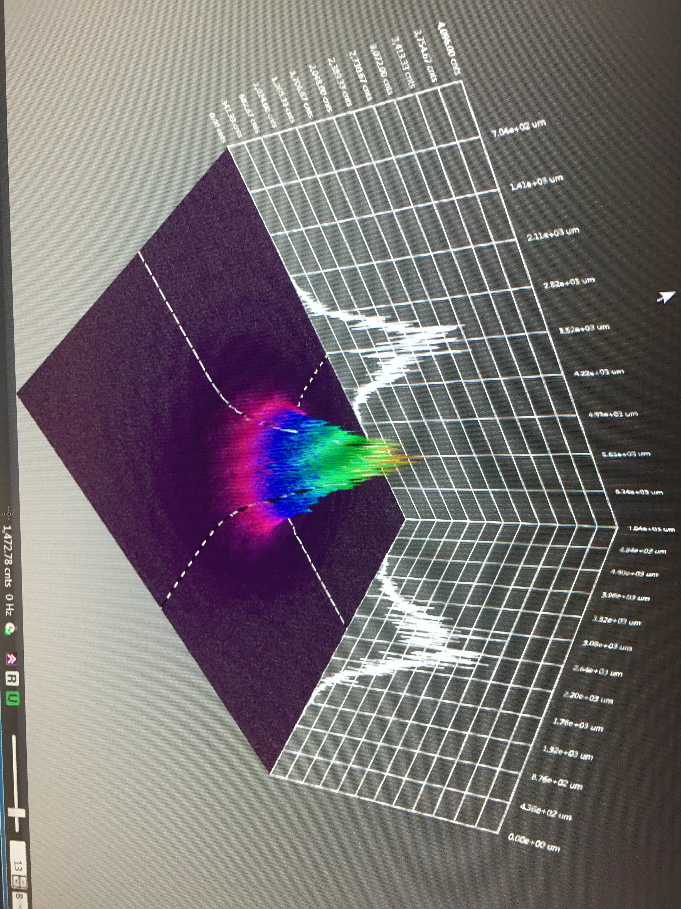

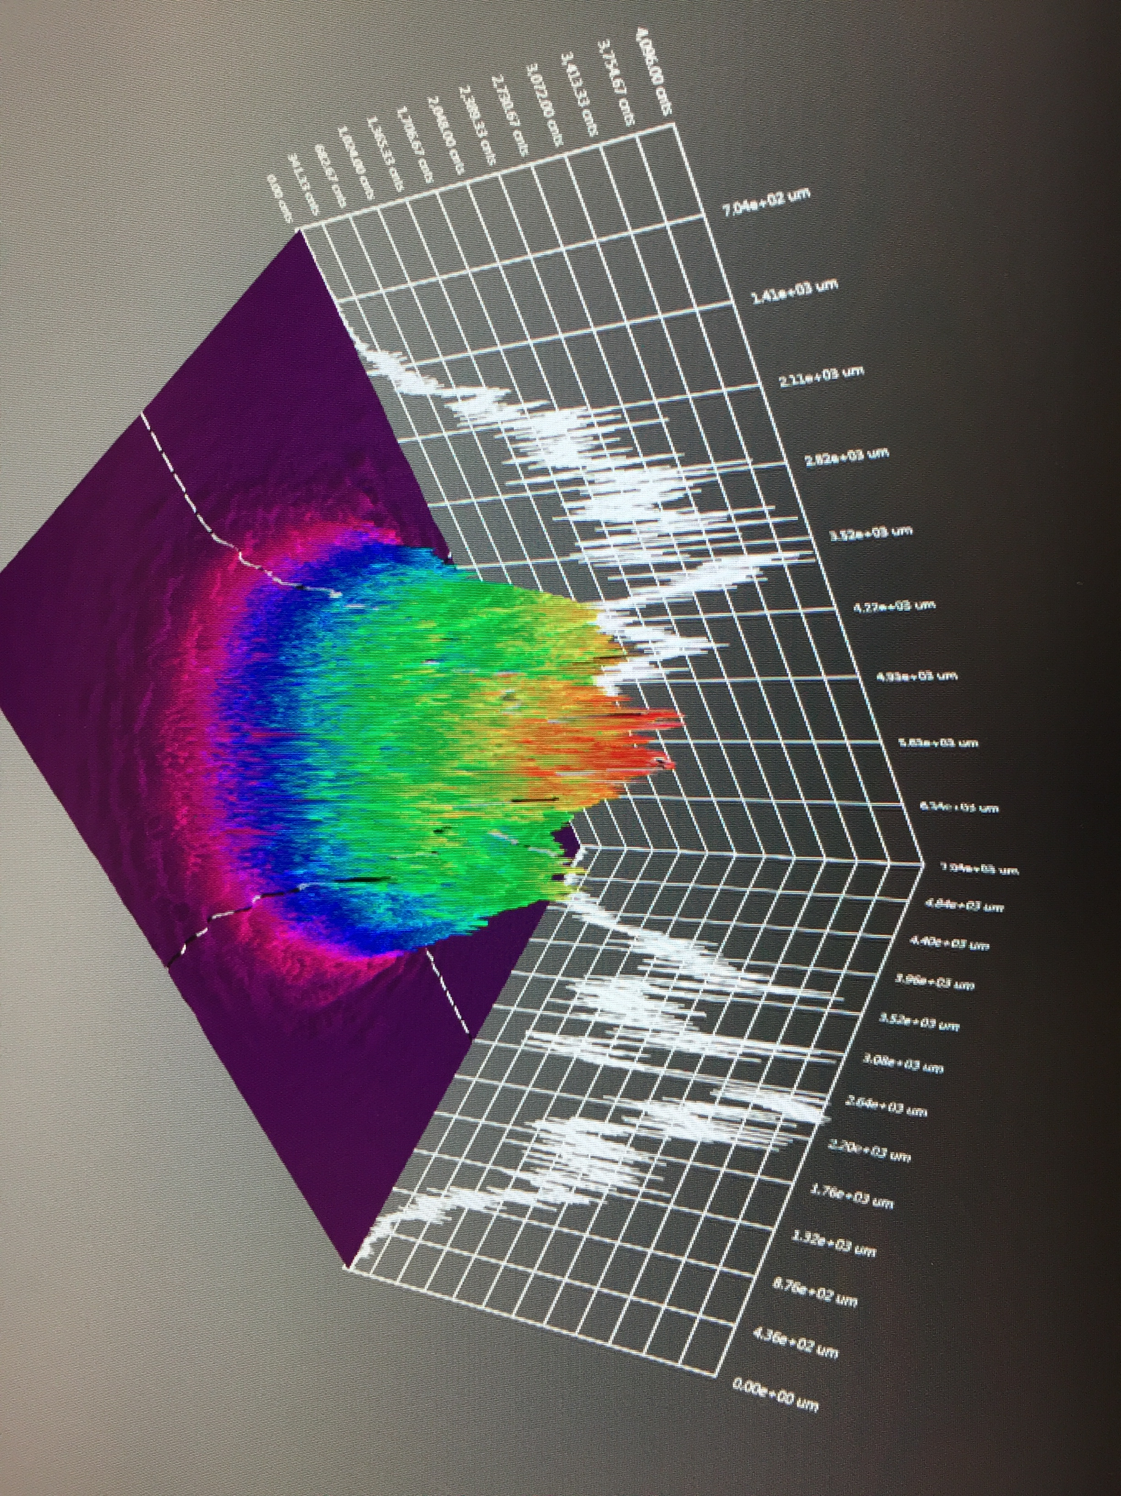
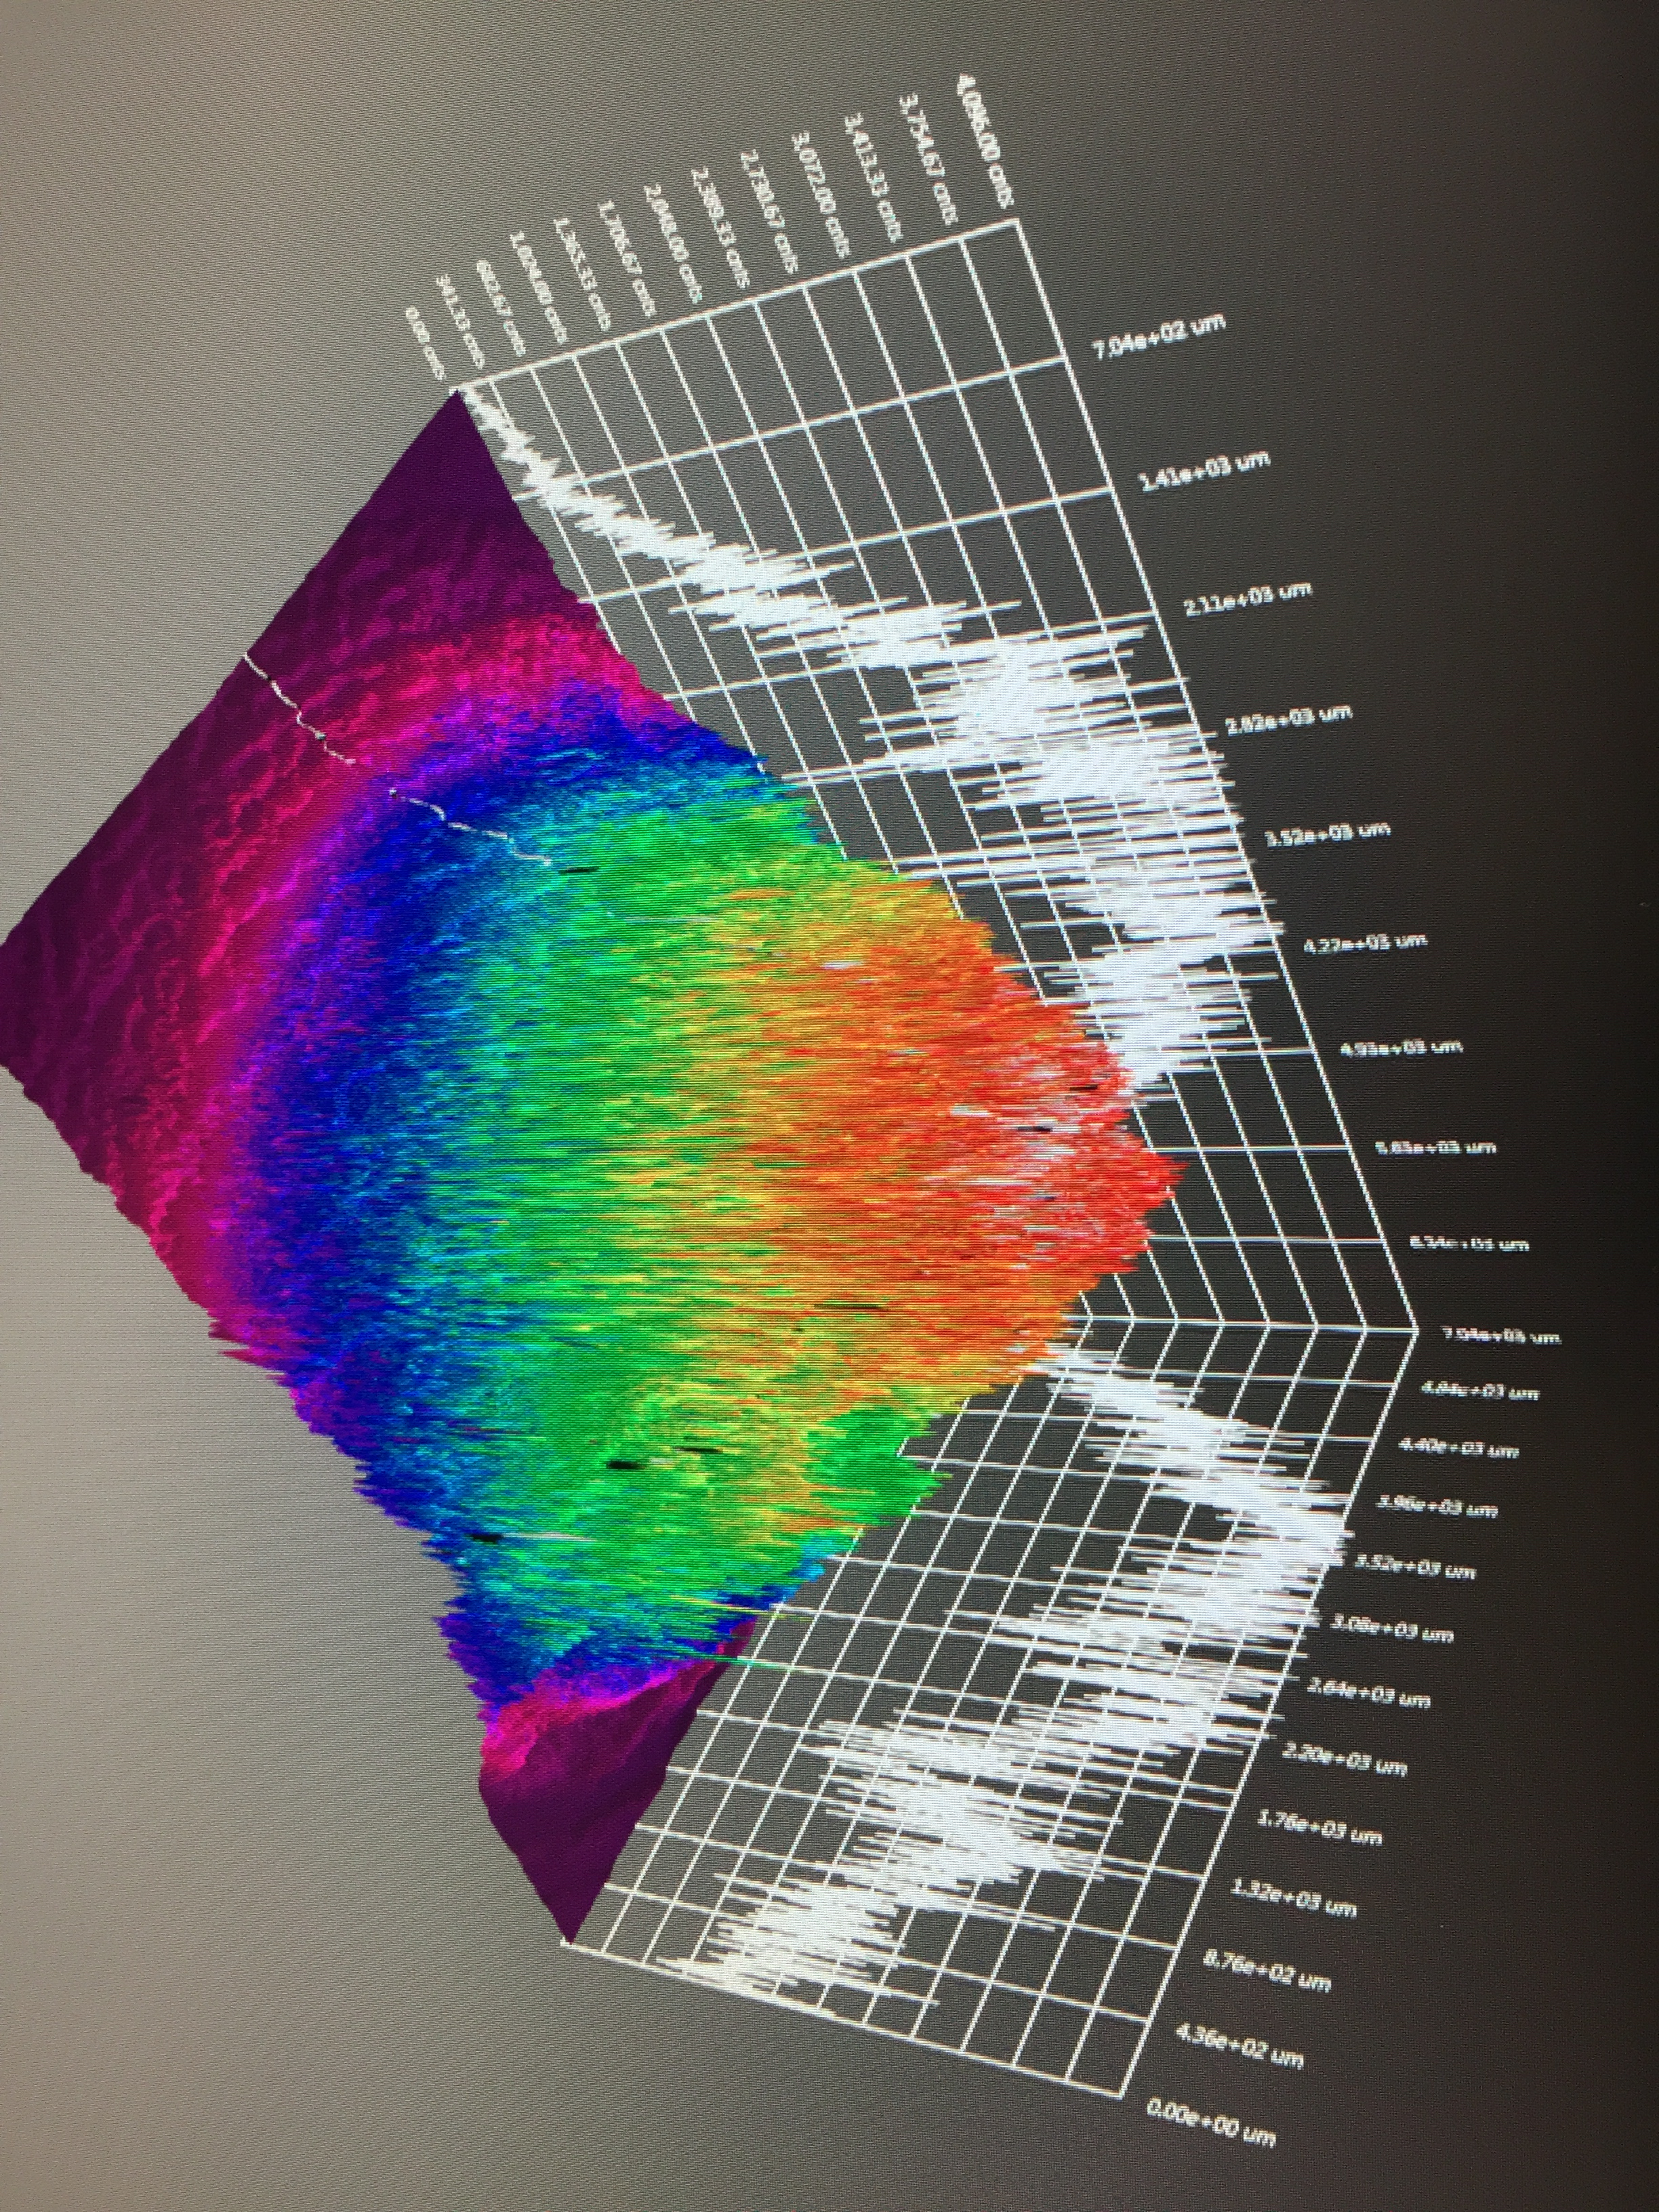
GaAs/GaAsP charge lifetime at milliamp current
Results from PSTP’17 suggests increasing laser spot size is viable to exceed >500 C lifetime; however we need to build another gun to test this assertion.
J. Grames, P. Adderley, J. Hansknecht, R. Kazimi, M. Poelker, D. Moser, M. Stutzman, S. Zhang, “Milliampere beam studies using high polarization photocathodes at the CEBAF Photoinjector” Polarized Sources, Targets and Polarimeters Workshop, Dajeon South Korea (2017)
Measurements were performed without anode biasing
Days
Trend we want to realize

Slide 25
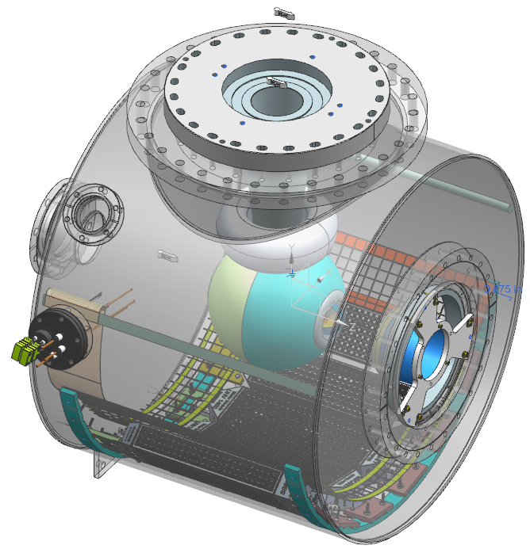
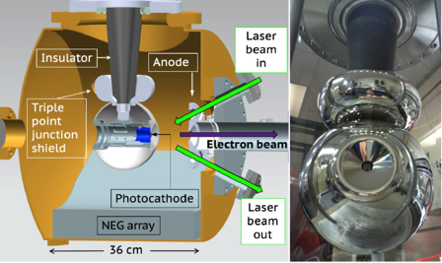
Build a mA polarized gun for e⁺
  We will combine our lessons learned and experience with the Magnetized 4mA/300 kV gun and new Polarized CEBAF 200 kV gun to build a new third gun optimized for positron generation…
300 kV Magnetized Beam Electron Source (CsKSb)
CEBAF 200 KV Polarized Gun (GaAs/GaAsP)
C. Hernandez-Garcia et al., Phys. Rev. Accel. Beams 22, 113401 (2019)
R30 inverted geometry ceramic insulator
Conditioned to 350 kV
Demonstrated 4.5 mA CW 300 keV
Operate at >200 kV without field emission
HV conditioning >350 kV (uses R30 inverted ceramic insulator)
Dynamic pressure (during beam delivery) ~ 1x10⁻¹² Torr

Slide 26
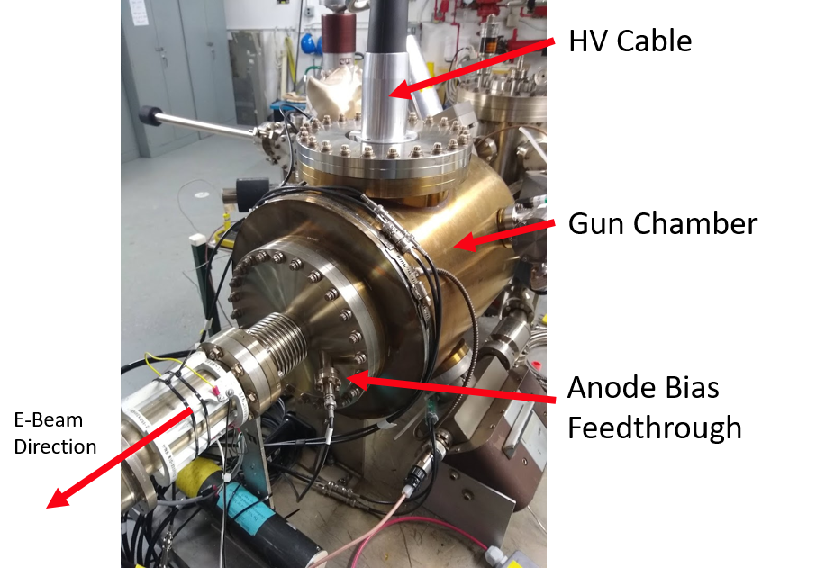
“Tricks” used to improve lifetime, to “get around” ion bombardment…
No short focal length elements near the photogun – these introduce beam loss and even small amounts are bad
Reduce the active area of photocathode
Off-axis illumination with laser
Large laser beam
Biased anode
Operate at higher bias voltage?
Black interior surface to minimize scattered light and unwanted photoemission?
Sadly, we’re run out of tricks
but milliampere applications require kiloCoulomb charge lifetime to provide uninterrupted operation of reasonable duration
J. Grames, R. Suleiman, P. A. Adderley, J. Clark, J. Hansknecht, D. Machie, M. Poelker, and M. L. Stutzman, "Charge and fluence lifetime measurements of a DC high voltage GaAs photogun at high average current", Phys. Rev. ST Accel. Beams 14, 043501 (2011)

Slide 27
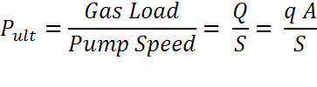

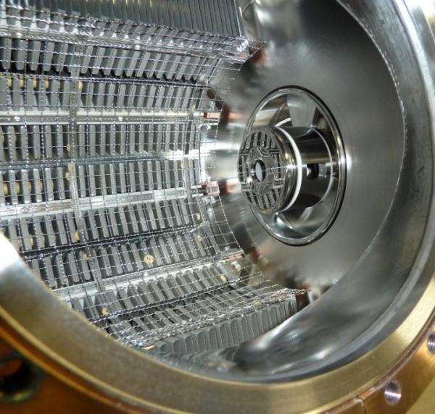
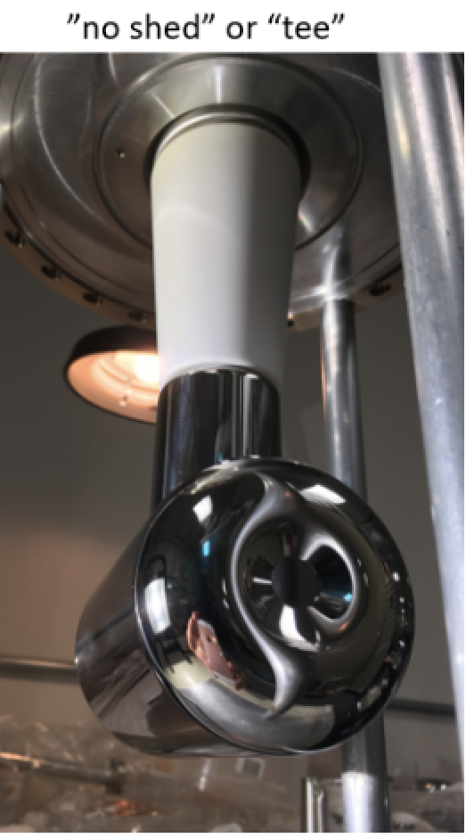
Improve Vacuum and Improve Lifetime
NEG pumps
Q= gas load, q= outgassing rate, A = surface area, S = pump speed
Strategy: Reduce Gas Load, Increase the Pump Speed
Baked gun, baked beamline, no leaks
Perform vacuum “dirty work” inside the preparation chamber, i.e., heat and activate the photocathode
Degas all vacuum components at 400 °C to reduce outgassing rate
Minimize the surface area of our chamber by adopting inverted insulator geometry
Lots of H₂ pumping - non-evaporable getter pumps. Plus a small ion pump for other gas (methane, argon, helium)
C. Hernandez-Garcia et al., Phys. Rev. Accel. Beams 22, 113401 (2019)

Slide 28
No alternative, we must improve vacuum…
Work of Md. Abdullah Mamun, M. Poelker and ODU student A. Al-Allaq
Original gun (1990’s) used only an ion pump: 1x10⁻¹⁰ Torr
NEG pumps (a CERN invention): 1x10⁻¹¹ Torr
400 °C bakeout (LIGO/VIRGO): 1x10⁻¹² Torr
Low carbon steel (Park*, CERN, LIGO): 1x10⁻¹⁴ Torr - 1x10⁻¹⁵ Torr
Recently growing interest about low-carbon steel….
Learned there’s likely a surface transformation that happens, ferrite transforming to magnetite, which could be good…faster pump down, lower temps and shorter bakeout time, black surface to reduce scattered light which reduces operating lifetime
Team meets regularly with Ranier Wiess (MIT Nobel prize winner for LIGO) and his Caltech team, CERN Vacuum Group headed by Paulo Chiggiato (mentored by Benvenuti), Fred Dylla (former Associate Director for the JLab Free-Electron Laser) and Dennis Manos of W&M
*C. D. Park, T. Ha, and B. Cho, JVST A 34, 021601 (2016)

Slide 29
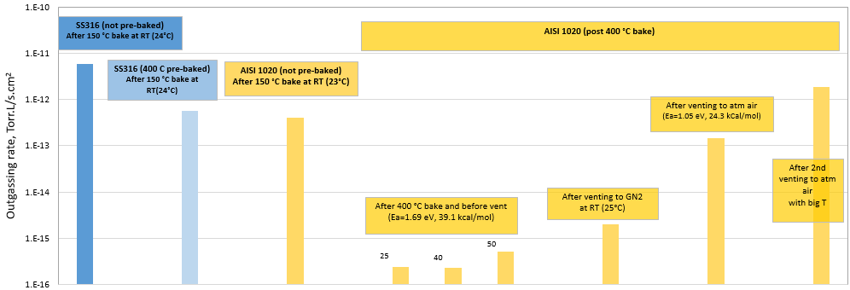
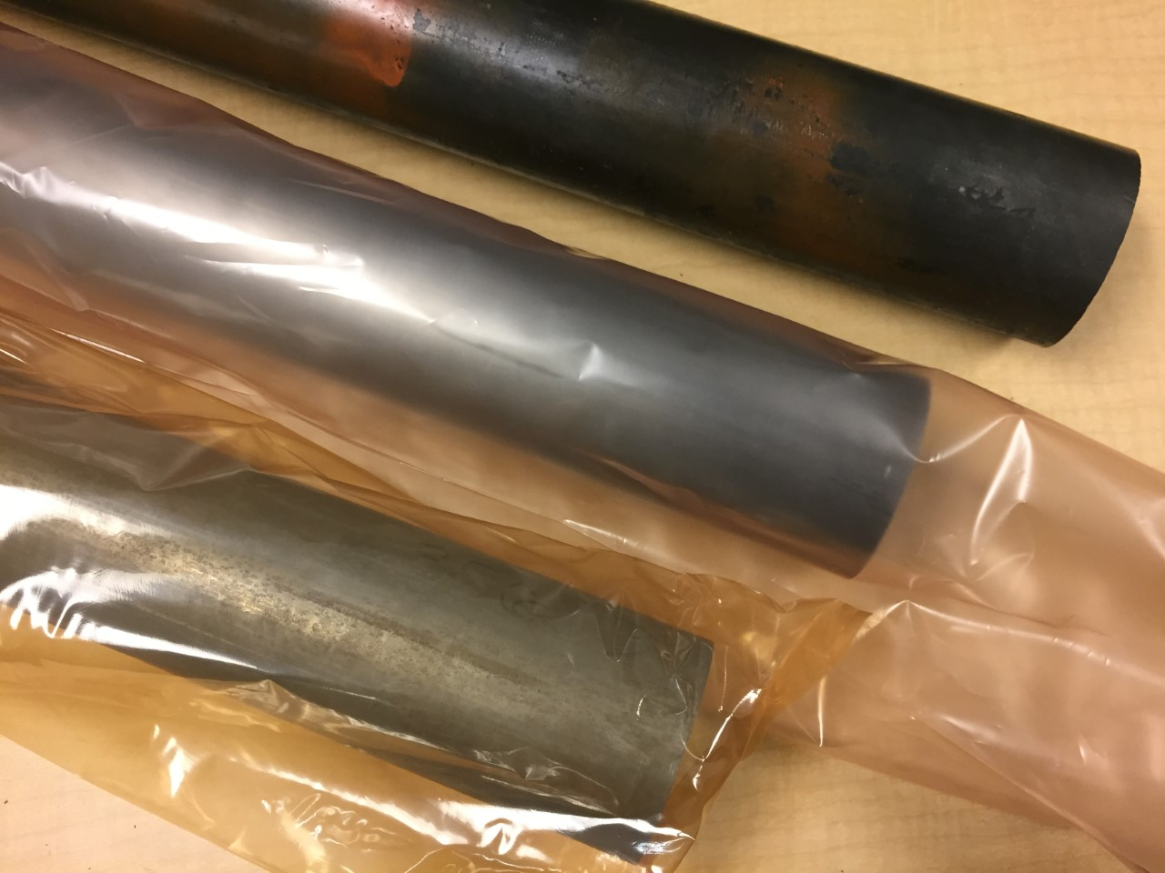
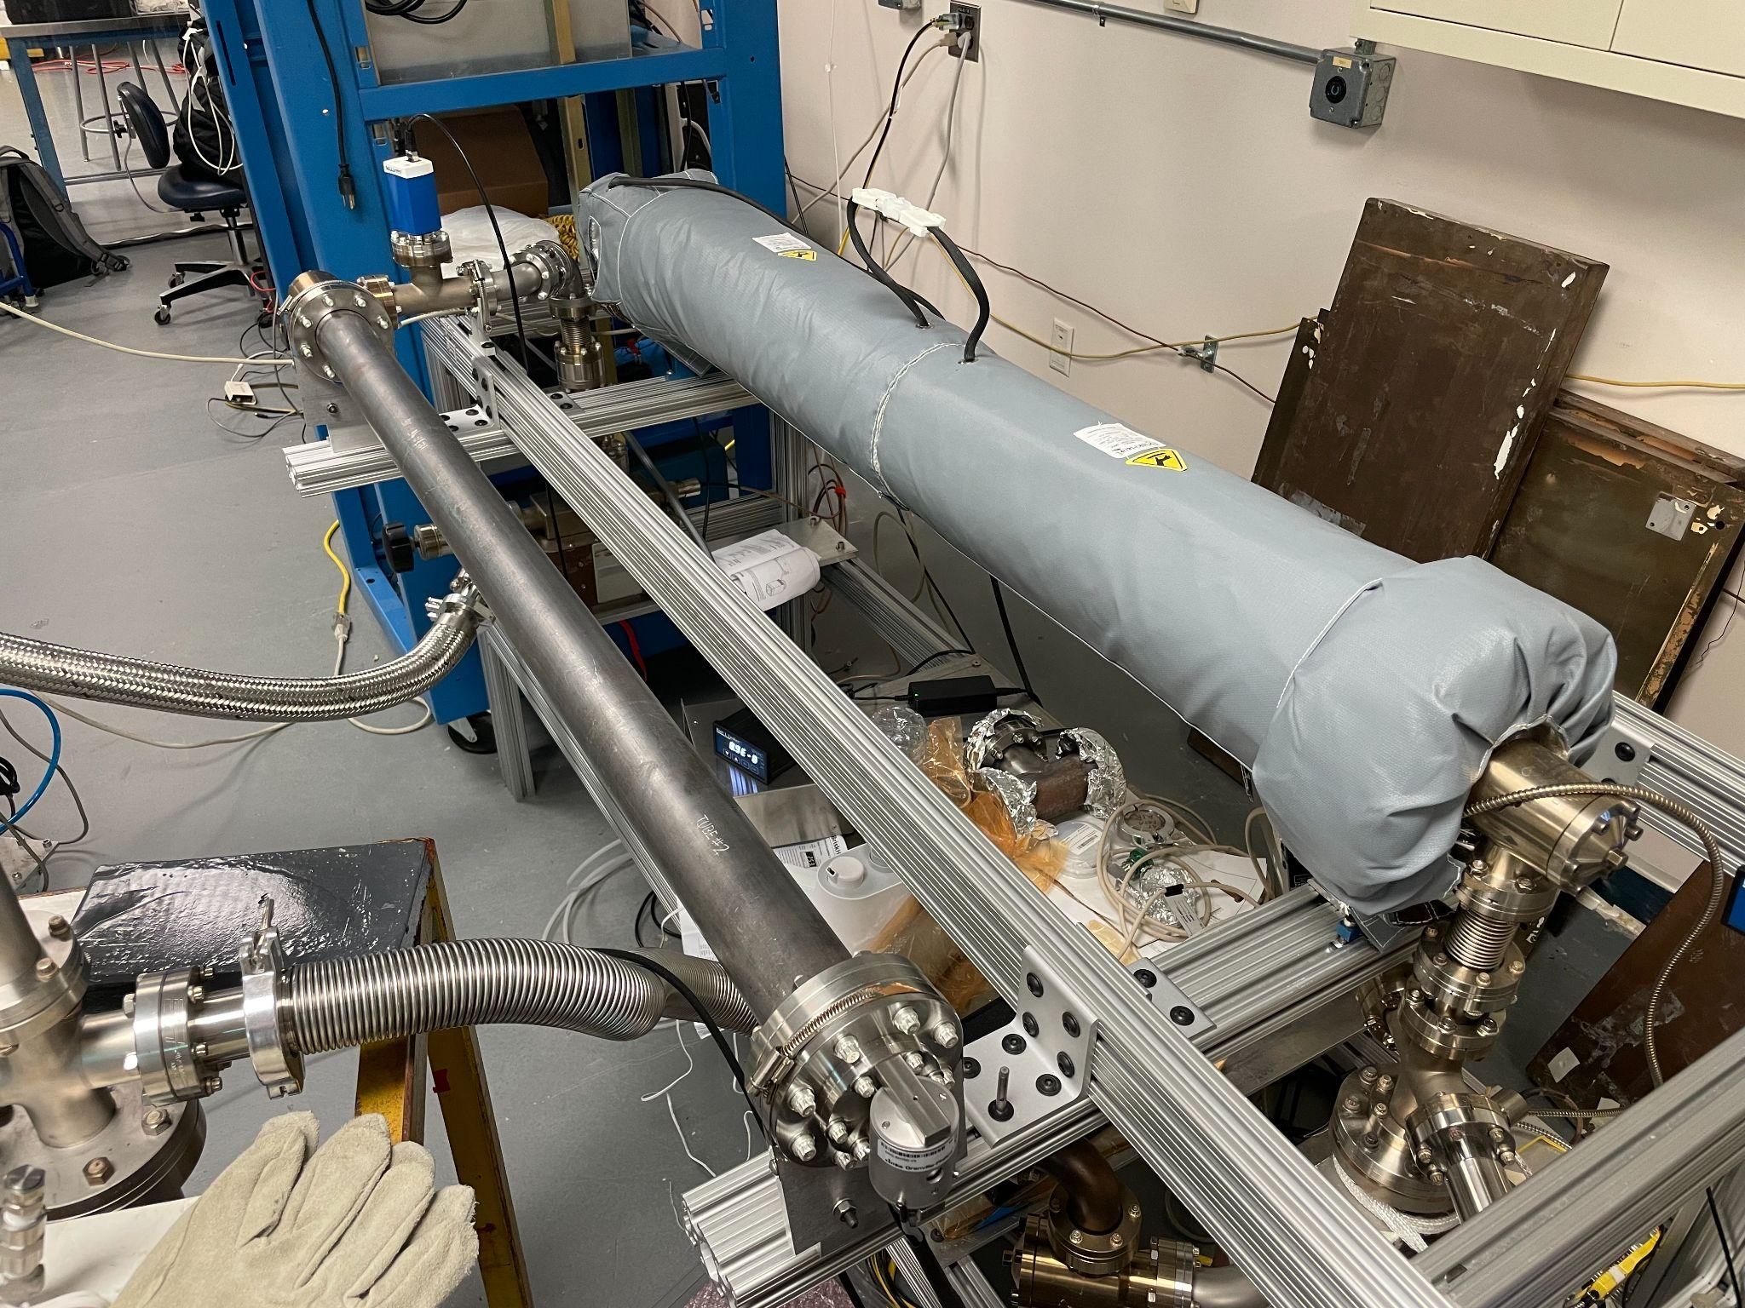
JLab’s first measurements of hydrogen outgassing rate,
AISI 1020 steel
Work of Md. Abdullah Mamun, M. Poelker and ODU student A. Al-Allaq
1020 as received
1020 high pressure rinsed
1020 acid etched
Two year long data taking during the COVID-19
Studies performed at JLab and W&M with baked vacuum chambers made of low carbon steel show very low H₂ outgassing, ~ 1000 times lower than stainless steel, ~ consistent with measurements made at CERN and reported by Park et al.*
The remarkably small outgassing rate of low-carbon steel represents the next major breakthrough in spin-polarized photogun development.
The idea of a photogun with black internal surface is appealing – could prolong operating lifetime of gun by eliminating scattered light
A recent study at CERN suggested that a low temperature heat treatment results in magnetite conversion in low carbon steel. Can this magnetite layer further reduce the pump down time?
*C. D. Park, T. Ha, and B. Cho, JVST A 34, 021601 (2016)

Slide 30
“Tricks” used to improve lifetime, to “get around” ion bombardment…
Charge “used” in 2 weeks vs. gun current
JLab Polarized Positron Source (see Sami’s talk on Positron collection design for CEBAF )
JLab envisions a polarized e- driven PEPPo Injector, for generating e+ beams with polarization >60% and current >100 nA
Because overall efficiency is small, the polarized electron source must provide 1 to 10 mA (continuous wave, RF frequency of 1497 MHz)
And to satisfy experimental program, we need polarized electron source to operate without interruption for at least 2 weeks
Coulombs delivered in 2 weeks ≈ 10³ to 10⁴ C
New gun must be better than our best trick’s by a factor 100 – 1000 i.e., factor of current increase multiplied by factor of charge (lifetime) increase
Ce+BAF
Improve vacuum
”bias
trick”
”laser
trick”
CEBAF
Today

