Slide 1
COMTRA DAQ to-do list…
Chris
confirm with Nick Falls power requirements for Kepco PS
finish populating rack, deliver to UITF
Brad
make sure UITF network jack in mechanical room is ‘on’
Bryan
confirm required “NIC” configuration in rack
work with Gary on communicating via a soft ioc
Riad
finalize list of cables/types from DAQ to Detector (we’ll double)
Joe
Coordinate space, cables, pulls, electrical work (next slides)

Slide 2
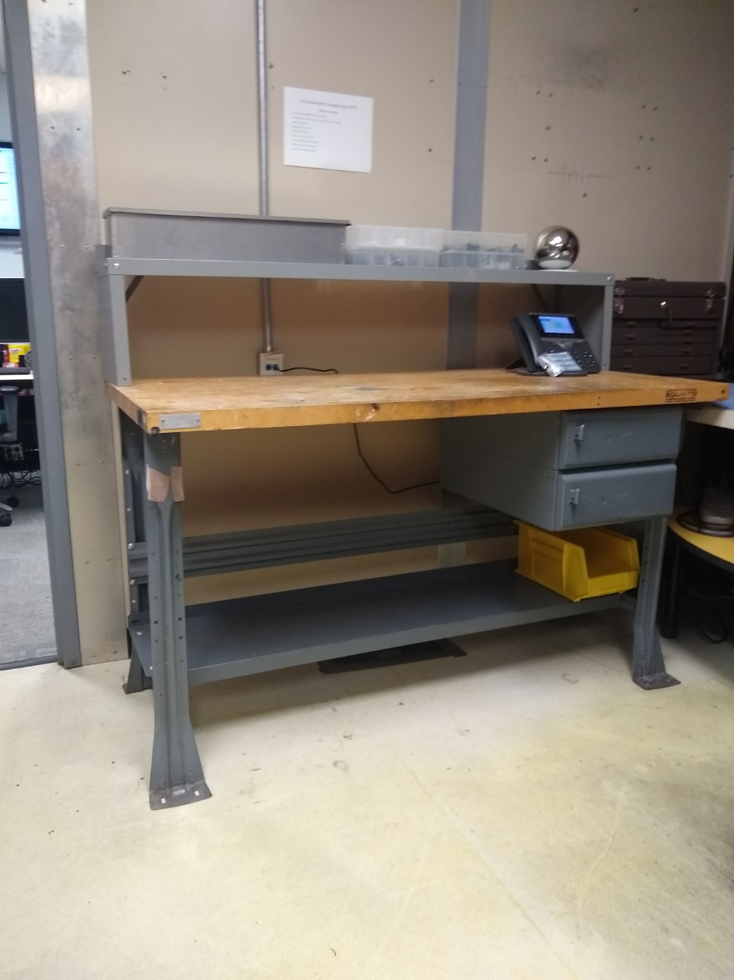
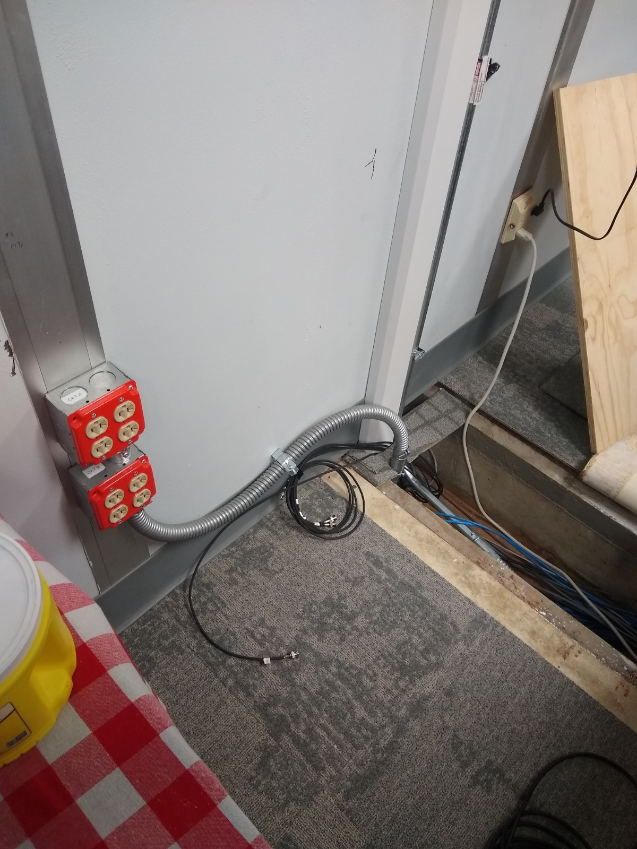
Mechanical Room
Control Room
We use this network jack
FML extend 20A circuit to mech room through trench
We use this penetration into cave
Bench gets moved and rack goes here
We use this penetration

Slide 3
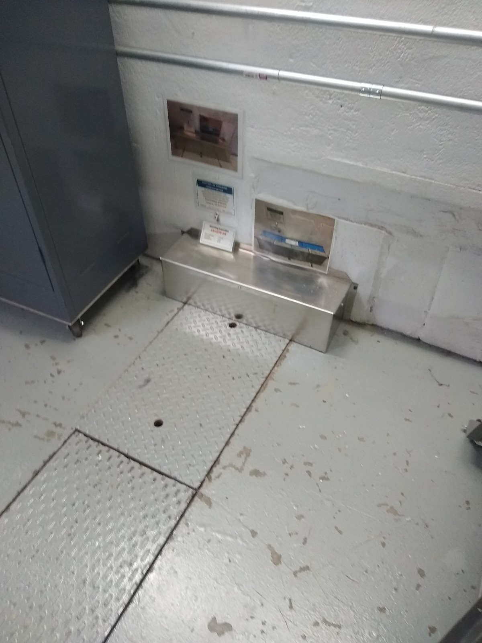
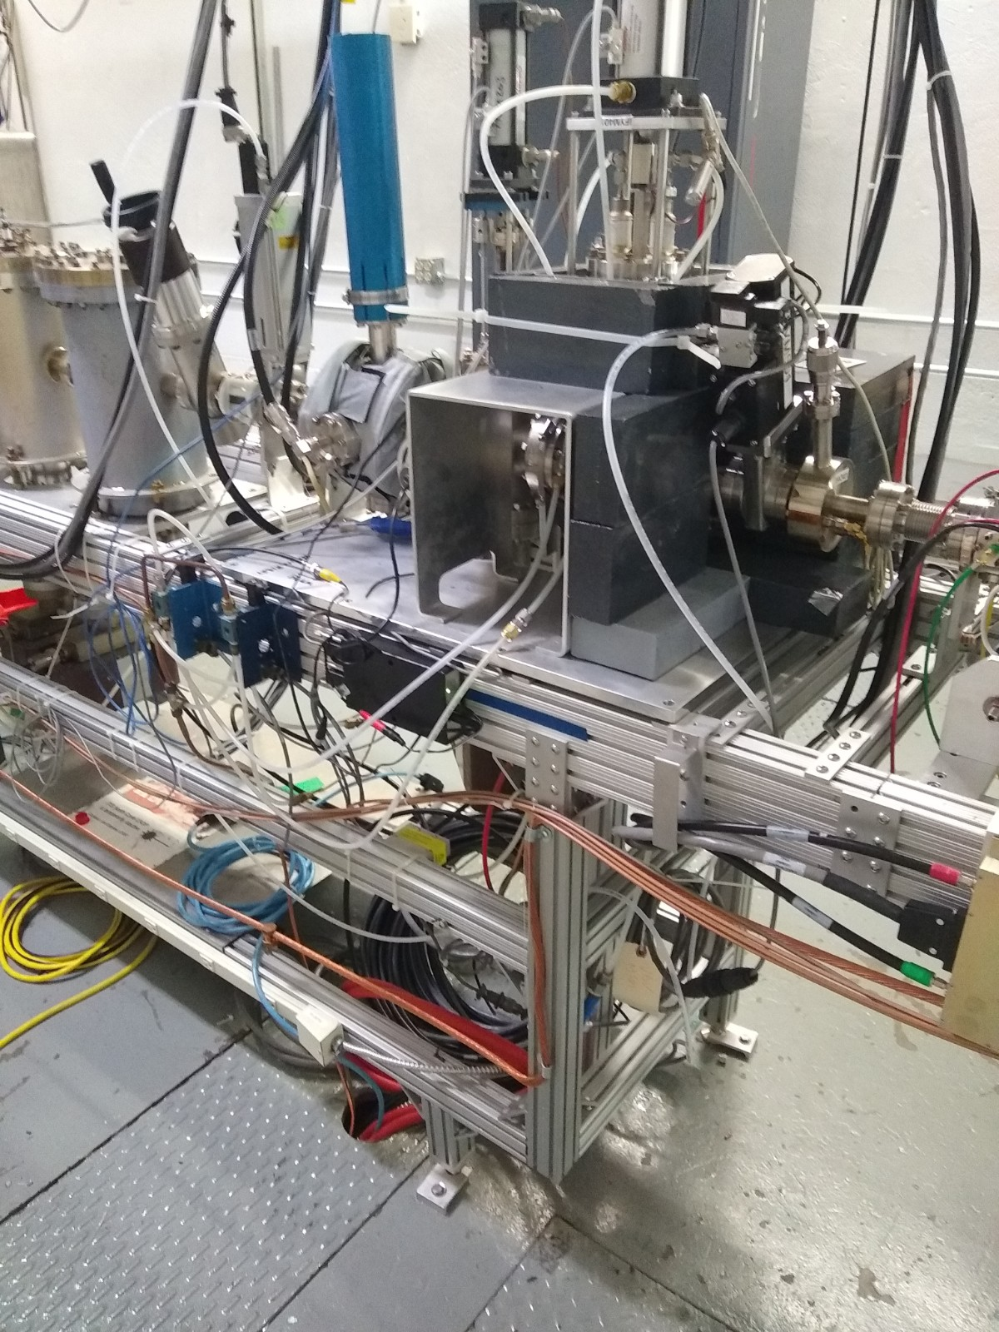
Cave (west wall)
Cave (beamline)
Cables up to tray with others
Ground wire from DAQ connects here
Trench from control room

Slide 4
Riad’s Cables/Connectors – From DAQ to Cave
(1) Ground wire to beam line ground (see previous page)
(4) Terminated TRIAX signal cable to detector box (2 + 2 spare)
(8) Connectors – TRIAX to BNC (4 + 4 spare)
(2) get connected at detector box
(4) space for 1 U patch panel at RACK?
(2) Terminated 5kV SHV cables to detector box (1 + 1 spare)
(1) get connected at detector box
(2) space for 1 U patch panel at RACK?
(2) Two 10A current leads from Kepco PS to magnet terminal block
FEMALE TRIAX to MALE BNC
TRIAX cable
MALE TRIAX CABLE

