Slide 1
Development of Beam Polarimeter for BNL SRF Gun
NP Accelerator R&D + Data Science AI/ML virtual PI Exchange meeting on November 30, 2021
Riad Suleiman

Slide 2
Goals, Timeline, and Budget
Co-Principal Investigator: Riad Suleiman, with Joe Grames and Matt Poelker (Jefferson Lab), and Eric Voutier (IJCLab, Orsay, France)
Jefferson Lab’s contribution to this project is to provide a Compton Transmission Polarimeter, which will be used to measure beam polarization when SRF photogun employs a GaAs photocathode. IJCLab is contributing to Jefferson Lab’s effort.
Goals:
Year 1: Design and build electron beam polarimeter
Year 2: Install and commission polarimeter at CeC accelerator
Current Status:
Design of polarimeter and new portable data acquisition system (DAQ) is completed
NCE for one more year was approved
 | FY20 ($k) | FY21 ($k) | Totals ($k)
a) Funds allocated | 200.1 | 200.1 | 400.2
b) Actual costs to date | 10.9

Slide 3
Compton Transmission Polarimeter
Calculated
Measured
Radiator
Polarized Iron (Longitudinally polarized Electrons, $P_{T}(B)\sim 8\%$)
PMT
(Compton Transmission Asymmetry, $A_{Comp}$)
Detector
Longitudinally Polarized Electron Beam, $P_{b}$
Circularly Polarized Gammas
$$P_{b}=\frac{A_{Comp}}{P_{T}×A_{p}}$$
Polarized Compton Scattering
( Analyzing Power, $A_{p}\left(E,t\right)$ )
$\left(P_{T}×A_{p}\right)$ from
Calibration at JLab
GEANT4 Simulation

Slide 4
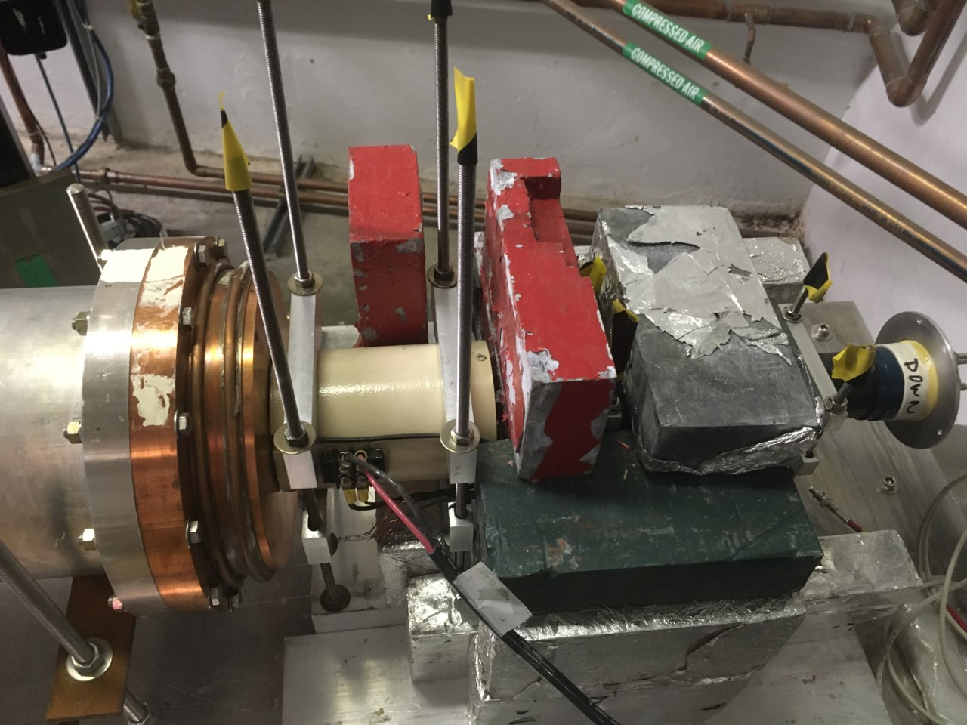
An Example of Polarimeter at Jefferson Lab CEBAF – Summer 2018

Slide 5
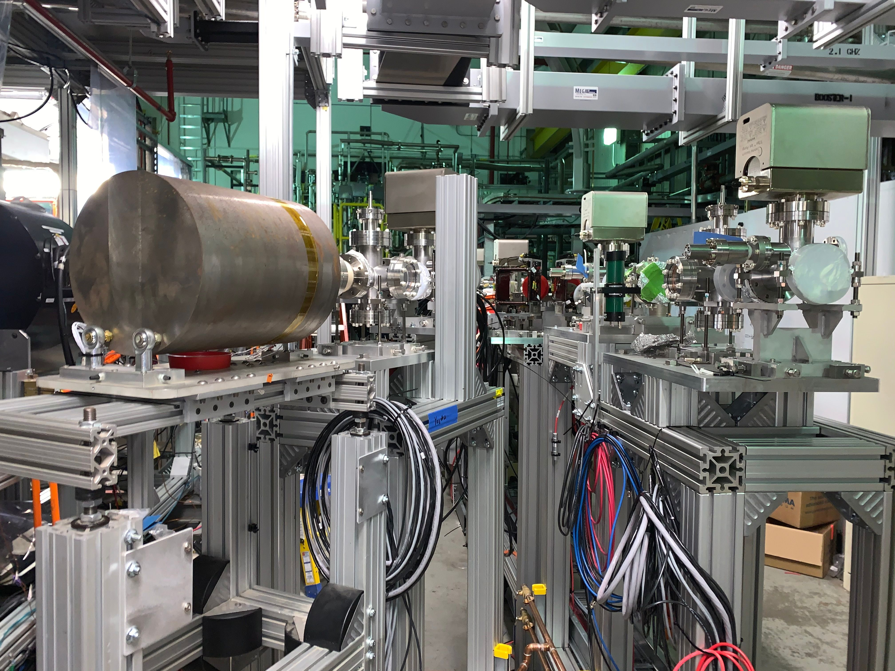
Polarimeter Parameters
CEBAF Injector can deliver electron beam with 5 – 9 MeV kinetic energy
CEBAF Mott polarimeter ideally works at 5 MeV kinetic energy
At BNL, electron beam kinetic energy will be 5.0 MeV (total energy 5.5 MeV)
Minimum radiation levels and no risk of activation
Compton Transmission Polarimeter will be installed in place of Low Power Beam Dump
Maximum average current is limited to 2.5 µA by Low Power Dump

Slide 6
Polarimeter Schematics at BNL
Pockels
Cell
GaAs
Photocathode
Laser
Compton Transmission Polarimeter
PMT
DAQ
BCM
IHWP
Delayed
Helicity
T-Settle
Pattern Sync
Helicity Generator
Synchronized
Helicity TTL 5V Signal
Pockels Cell is synchronized to laser
Helicity board will just provide a gate to determine which voltage (helicity) Pockels Cell gets set to

Slide 7
New Portable Data Acquisition System (DAQ)
DAQ Readout:
Delayed Helicity, T_Settle and Pattern Sync
PMT, BCM
Battery
Remote controllable IHWP
Portable Rack
HV Power Supply, -5kV
Magnet Power Supply, ±10 Amps
PMT
Magnet
Computer
DAC
PMT Signal
Mini VME Crate
Beam Current Monitor (1 V)
Delayed
Helicity Fiber
T-Settle Fiber
Battery (1 V)
Pattern Sync
FADC
Helicity
Generator
Helicity TTL 5V Signal to
Pockels Cell

Slide 8
Polarimeter Design Optimization
Student Benjamin Fernandes Neres (from France)
https://wiki.jlab.org/ciswiki/images/8/82/CompPol_Optimization_B.Fernandes-Neres.pdf
GEANT4 simulation model of Compton transmission polarimeter was successfully implemented
Optimization of polarimeter:
Radiator length = 7.0 mm, magnet iron core length = 8.0 cm, crystal detector radius = 3.5 cm and length larger than 18.0 cm
Evaluated of performance within BNL beam conditions (duration of a measurement, radiation damage to crystal detector)

Slide 9
Achievements, Milestones and New Timeline
Year 1:
Agreed upon basic operational parameters of polarized electron beam and polarimeter
Portable DAQ design completed and implementation started
Jefferson Lab Fast Electronics Group has finished programming of flash analog-to-digital convertor (FADC) and now working on user interface of DAQ
Polarimeter (radiator, magnet, and detector) design was optimized using GEANT4
Year 2:
Magnet engineer started design of electro-magnet with iron core
Build two polarimeters (radiator, magnet, and detector) and one portable DAQ – one polarimeter will stay at CEBAF
Year 3:
Calibrate polarimeter at CEBAF with portable DAQ
Install and commission polarimeter at CeC accelerator
When SRF photogun employs a GaAs photocathode: Measure electron beam polarization

