Slide 1
GaAs Photocathodes and Nano Pillar Array (NPA)
This work is supported by the Department of Energy under contract DE-AC05-06OR23177
Matt Poelker, Xincun Peng, Yun Liu, Dennis Manos, Marcy Stutzman, Shukui Zhang, Jijun Zou, Bin Tang
Engineering Research Center of New Energy Technology of Jiangxi Province, East China University of Technology, Nanchang, 330013, China
College of William and Mary, Williamsburg, Virginia, USA
Thomas Jefferson National Accelerator facility, 12000 Jefferson Avenue, Newport News, Virginia, 23606, USA
European Workshop on Photocathodes for Particle Accelerator Applications (EWPAA 2019)
Paul Scherrer Institut, Switzerland
September 11-13, 2019

Slide 2
The long campaign to improve QE and polarization

Slide 3
Recent CEBAF Polarized Source Performance
Strained Superlattice GaAs/GaAsP (SVT #5756-4)
Good Polarization 85-87%
Good QE > 1% after activation => 6 mA/Watt/% @ 780 nm
Lifetime about 200 C (σ_{4D} ~ 1mm) at currents < 200 uA
Heat and re-activate during scheduled long shutdowns

Slide 4
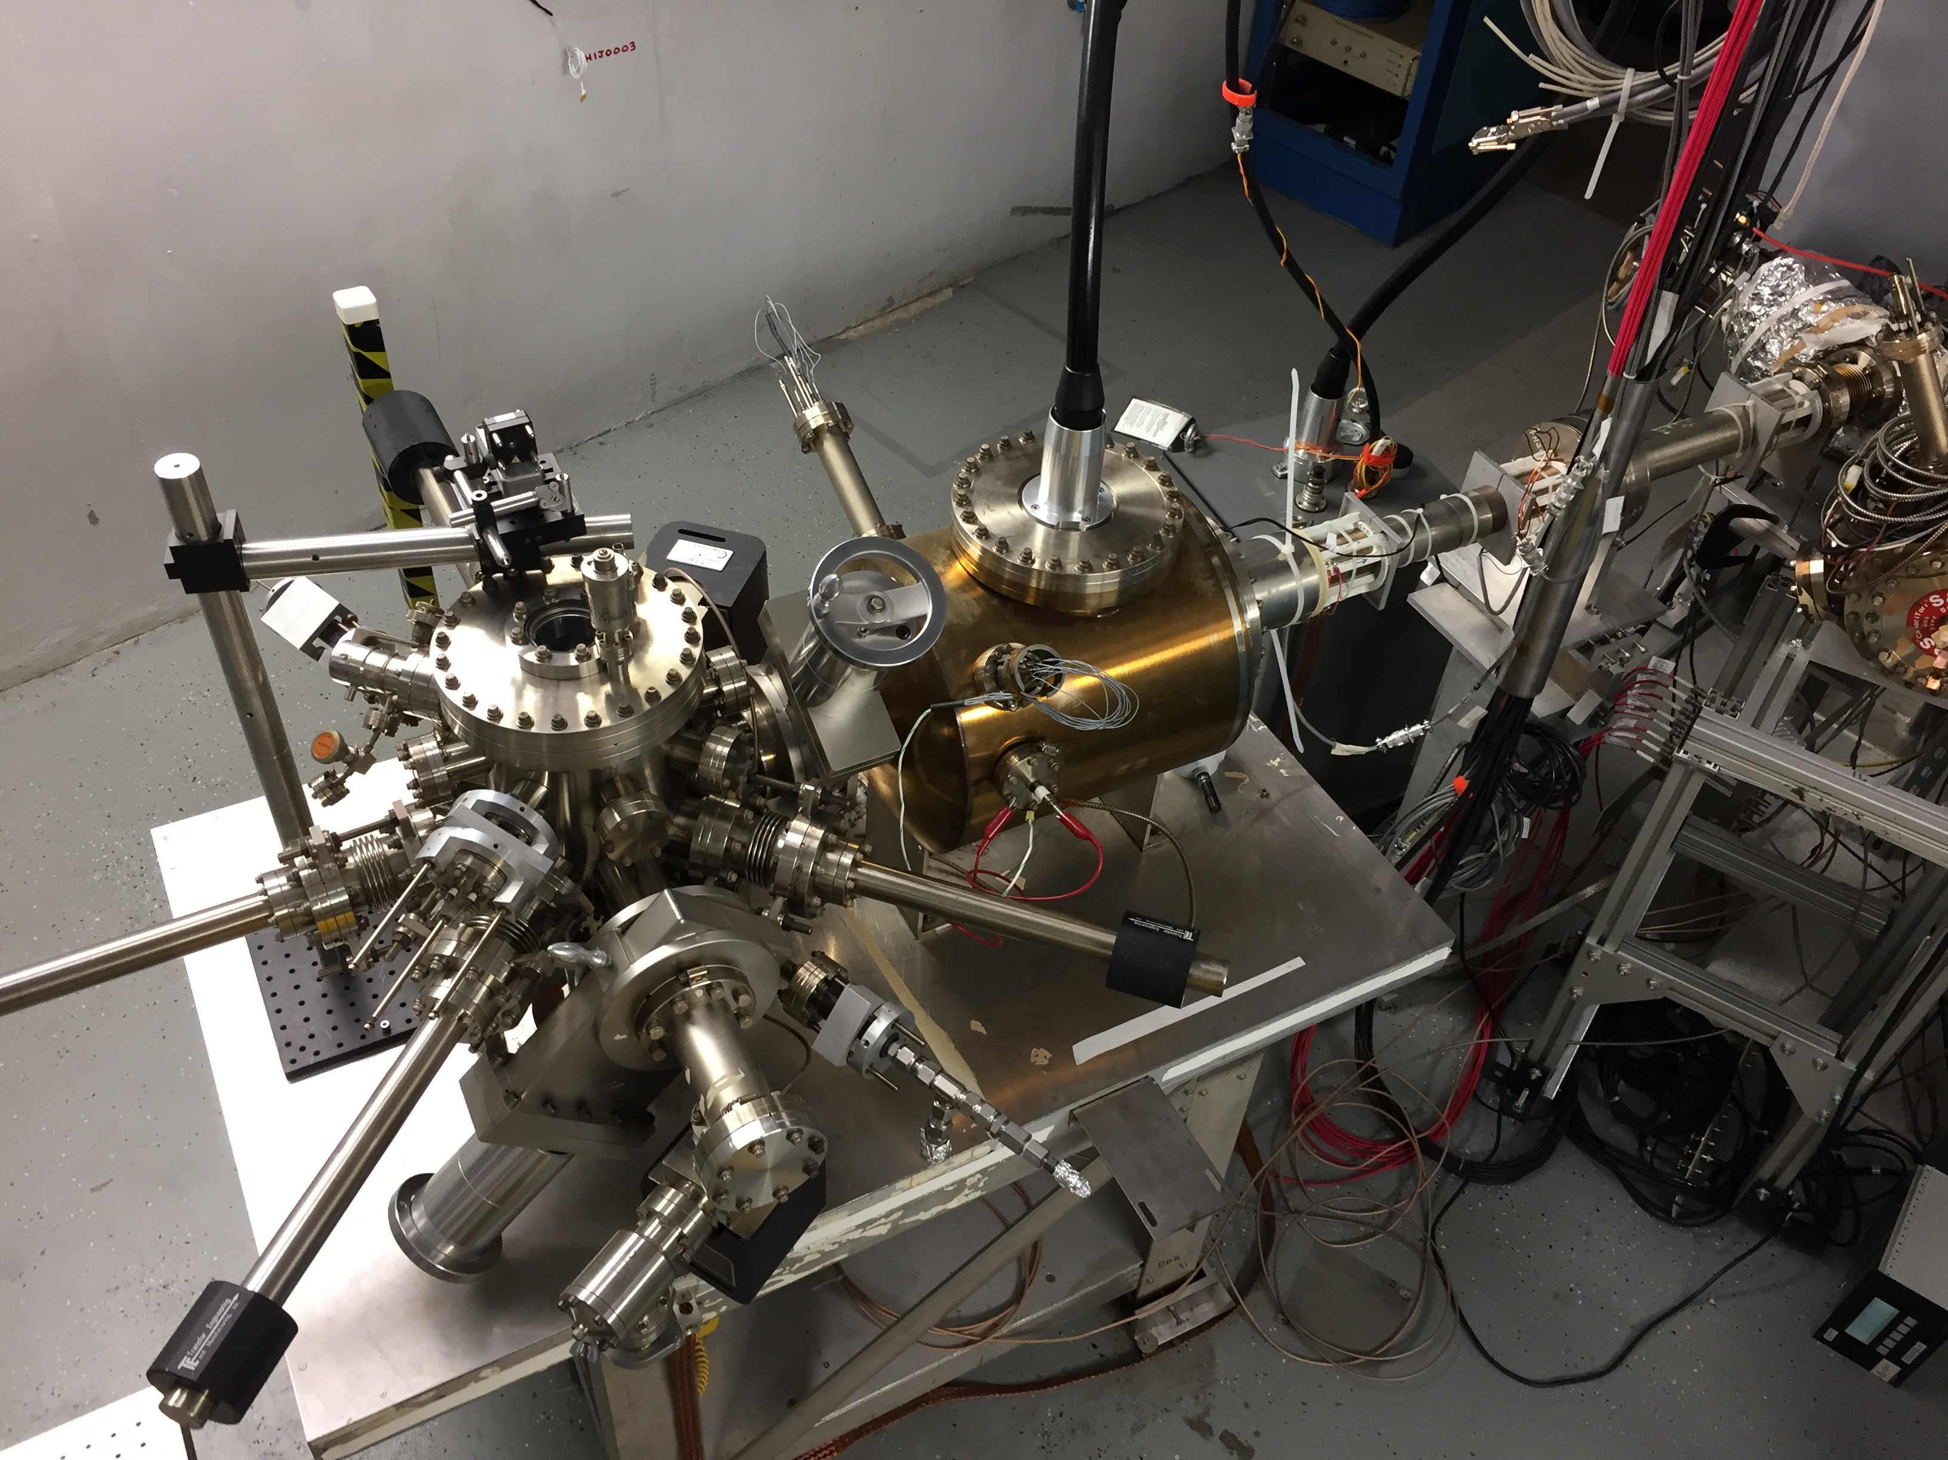
Lifetime Studies at mA Beam Current
Polarized positrons for CEBAF
High Current eRHIC EIC
Test the limits of lifetime scaling vs. laser spot size
Make beam here
(-130kV, 0-1.5mA, 0-3pC)
Monitor vacuum and radiation levels along beam line
Deliver beam here
(Faraday cup)
Vary the laser beam size
(f=499 MHz, σ_{t} ~ 50 ps)

Slide 5
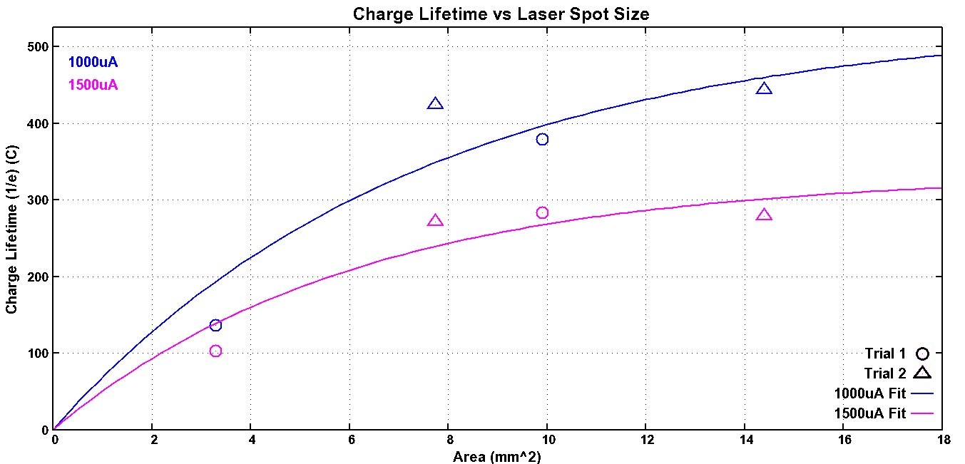
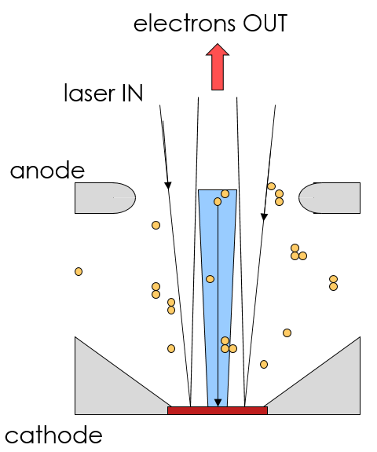
GaAs/GaAsP charge lifetime at mA Current
CEBAF charge lifetime improves with larger laser spot size, as expected, but eventually beam size becomes “too large”
Small amounts of beamloss adversely impact lifetime – to reap the reward of large laser spot size, no beamloss allowed!!
Must consider intended and unintended photoemission….
1 mA for 4.7 days
1mA(2007)
CEBAF
4mA(2011)

Slide 6
Detecting beam loss: x-ray detectors and ion pumps
X-ray monitors detect low level beam loss, sensitive to ~ 1 to 5 nA loss –
Even this level of beamloss adversely impacts lifetime
We always use ion pumps as beam loss monitors, but in this study, beamline pressure appeared constant

Slide 7
Lots of light bouncing around inside the photogun
Large fraction of laser light (~35%) is reflected, leads to stray light and stray electrons that hit the beampipe, degrading vacuum, ion bombardment and QE decay
Camera: looking inside vacuum chamber ~ 1m downstream of the photogun

Slide 8
Why GaAs nano-pillar array photocathode?
Laser reflections can generate unwanted beam not properly transported from the photogun
Motivation: want a “black photogun” to minimize unintended photoemission, that leads to beam loss and QE decay….
Nano-pillar photocathode will reduce reflectivity of GaAs surface: less unwanted photoemission, and QE enhancement of ~ 30%
Plus: More surface area, and localized, enhanced absorption can improve QE even more
Electrons emitted from sides of the pillar surface, more resilient to ion bombardment?
What about polarization?

Slide 9
NPA Photocathode Design & Study
GaAs NPA fabrication:
Substrate-Conformal Imprint Lithography (SCIL), Reactive-Ion Etching (RIE) and Inductively coupled ion etching (ICP)
Theoretical analysis:
Optical properties simulated by FDTD algorithm. Photoemission processes simulated based on the Spicer’s three-step model and Cogenda Technology Computer-Aided Design tool
Photocathode characterization:
Field-emission Scanning Electron Microscope (SEM) for morphology, Spectrometer to measure reflectance, Cs/NF₃ activation & NEA photoemission, QE measurement vs. wavelength scan
Driving force behind this work: Shukui Zhang of JLab; Xincun Peng and Jijun Zou of Engineering Research Center of New Energy Technology of Jiangxi Province, East China University of Technology, Nanchang, 330013, China

Slide 10
Fabrication Process
EBL: electron beam lithography
PDMS: poly-dimethyl-siloxane nano-hole array stamp
H-PDMS: rigid layer with high-Young’s modulus
L-PDMS: flexible layer with low-Young’s modulus
PECVD: plasma-enhanced chemical vapor deposition
PMMA: poly(methyl-methacrylate) photoresist layer
SCIL: substrate-conformal imprint lithography, a tool
RIE: reactive ion etching
ICP: inductively coupled plasma etch

Slide 11
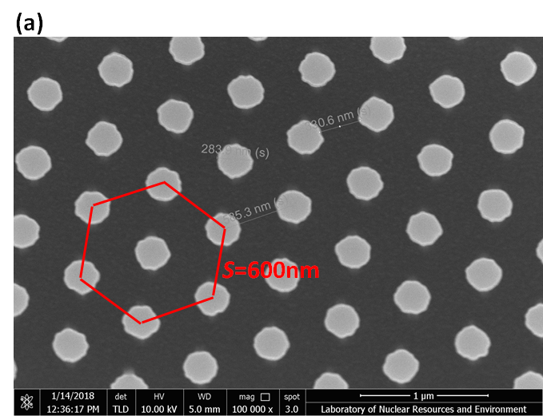
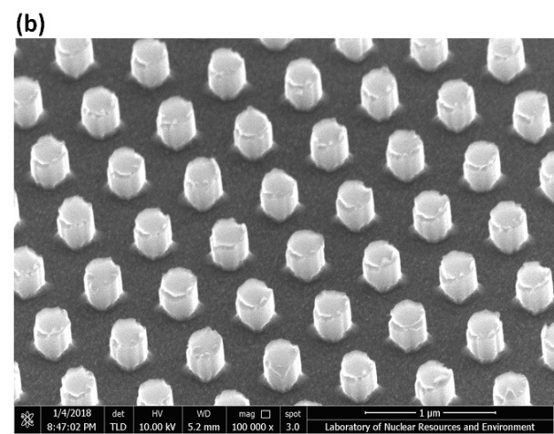
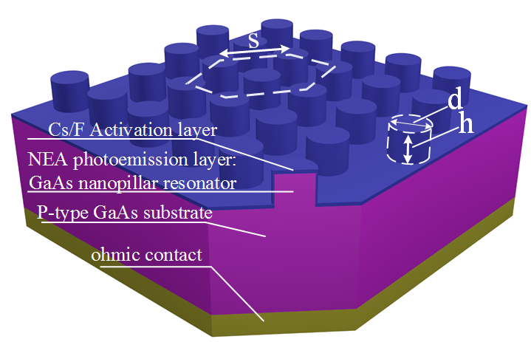
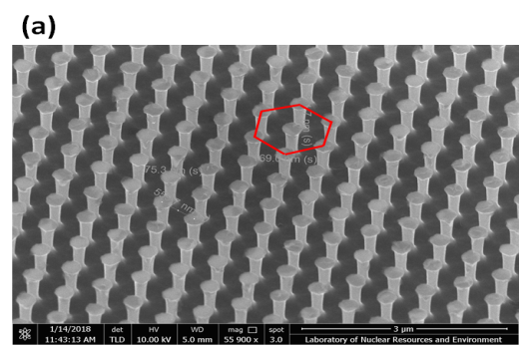
NPA Photoathode
SEM image of GaAs NPA fabricated by SCIL on GaAs substrate
illustration of device structure
Before 550°C heat clean and activation.
After 1 hour at 550°C heat clean and activation.

Slide 12
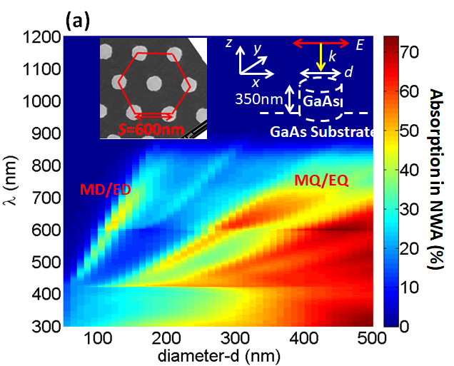
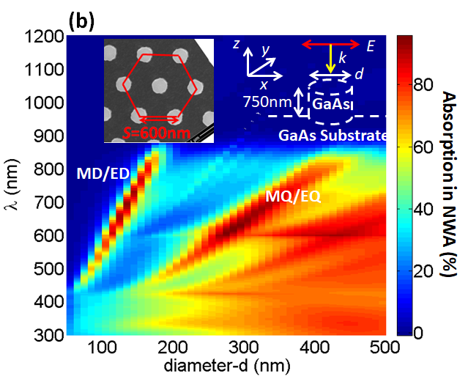
NPA Cathode Design and Simulations
Calculated absorption spectra: NPA on GaAs substrate
Light absorption in GaAs NPA as a function of λ and d, h=350 nm
Light absorption in GaAs NPA as a function of λ and d, h=750 nm

Slide 13
Reflectance Spectra vs. nano-pillar diameter and height
The surface reflectance of the GaAs NPA < 6% for the resonant condition
The electric and magnetic dipole (ED/MD) and quadrupole (EQ/MQ) mode resonances were excited
Resonance wavelength depends heavily on dimensions of the array parameters
(a) SEM image (b) Measured (solid line) and calculated (dash line) reflectance of GaAs NPA samples S1 (D =120nm, H = 350nm, P = 600nm), S2 (D =260nm, H = 750nm, P = 600nm) and S3 (D =280nm, H = 750nm, P = 600nm). Measured reflectance of a GaAs flat wafer sample W1 is also shown.

Slide 14
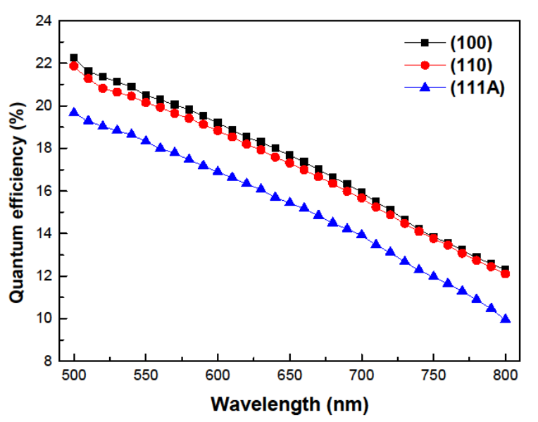
Experimental apparatus
JLab’s best flat wafer bulk GaAs results
Wei Liu et.al., "Effects of ion bombardment on bulk GaAs photocathodes with different surface-cleave planes", Phys. Rev. Accel. Beams 19, 103402 (2016)

Slide 15
QE Measurement
At the resonance peaks of NPA photocathode samples S1, S2 and S3, the QE was enhanced by factors of
3.5, 3 and 1.8, respectively, compared with flat wafer photocathode
QE enhancement observed even when considering best flat wafer results, factor ~ 1.35
QE of NPA GaAs photocathode samples

Slide 16
Summary
A new NEA photocathode based on GaAs NPA Mie-type resonators was demonstrated for the first time
Comprehensive simulations and experimental studies were performed:
Light reflectivity reduced to < 6% compared to typical value ~ 35%,
Enhanced density of optical states due to increased light concentration & increased electron emission area
These conditions provide significant QE enhancement – x3.5 greater than a flat GaAs wafer photocathode
Move the resonance to 780 nm, where we expect good polarization
Need to install a nano-pillar photocathode in a DC high voltage photogun
Measure polarization and lifetime
Mie-type resonators could be extended to other semiconductor surfaces, in particular SSL GaAs photocathodes – to increase the QE of high Polarization photocathodes
Great potential for further improvement

Slide 17
Summary
Paper submitted to Physical Review Applied, waiting for word on publication….
Optical Resonance Enhanced Photoemission from Nanostructured GaAs Photocathodes
Xincun Peng, Yun Liu, Dennis Manos, Matt Poelker, Marcy Stutzman, Shukui Zhang, Jijun Zou, Bin Tang
Engineering Research Center of New Energy Technology of Jiangxi Province, East China University of Technology, Nanchang, 330013, China
College of William and Mary, Williamsburg, Virginia, USA
Thomas Jefferson National Accelerator facility, 12000 Jefferson Avenue, Newport News, Virginia, 23606, USA

Slide 18
Some other GaAs photocathode studies at JLab
Wei Liu and Erdong Wang, "Monte Carlo modeling of thin GaAs photocathodes," J. Appl. Phys. 126, 075706 (2019)
Wei Liu, Yiqiao Chen, Aaron Moy, Matthew Poelker, Marcy Stutzman, and Shukui Zhang, "Evaluation of GaAsSb/AlGaAs strained superlattice photocathodes," AIP Advances 8, 075308 (2018)
Wei Liu, Matt Poelker, Xincun Peng, Shukui Zhang, and Marcy Stutzman, "A comprehensive evaluation of factors that influence the spin polarization of electrons emitted from bulk GaAs photocathodes", J. Appl. Phys., 122, 035703 (2017)
Wei Liu, Yiqiao Chen, Wentao Lu, Aaron Moy, Matt Poelker, Marcy Stutzman, and Shukui Zhang, "Record-level quantum efficiency from a high polarization strained GaAs/GaAsP superlattice photocathode with distributed Bragg reflector", Appl. Phys. Lett. 109, 252104 (2016)
Wei Liu, Shukui Zhang, Marcy Stutzman, and Matt Poelker, "Effects of ion bombardment on bulk GaAs photocathodes with different surface-cleave planes", Phys. Rev. Accel. Beams 19, 103402 (2016)

Slide 19
JLab Gun Group
P. Adderley, B. Bullard, J. Grames, J. Hansknecht, C. Hernandez-Garcia,
M. A. Mamun M. Poelker, R. Suleiman, M. Stutzman and S. Zhang
Graduate Students: G. Palacios, S. Wijiethunga, J. Yoskovitz, M. Stefani
Frequently working with others at JLab: D. Moser, F. Hannon, R. Kazimi, Y. Wang, A. Hofler, J. Benesch, M. Tiefenback, G. Krafft
Recent Visiting Scholars: Xincun Peng, Jijun Zou, Yoshitaka Taira, Maximillian Herbert

Slide 20
Backup slides

Slide 21
Nano-pillar Structure
QE can increase because:
More light absorbed
More surface area
Light concentration near the surface
Lifetime could increase because:
Less reflectivity, less scattered light
More QE means less light required
Electrons emitted from edge of pillars less sensitive to ion bombardment?

Slide 22
How to set the dimensions of the structure?
finite-difference time-domain (FDTD) analysis used to model the light absorption spectrum, η_{a}, and light concentration factor, C
Pillar height, diameter, and period can be adjusted to excite different resonant modes at specific wavelengths, and to move the light concentration to specific areas of the NPA (i.e., to the pillars instaed of the substrate)

Slide 23
Results: Reflectivity
Three nano-pillar test samples, and one flat bulk GaAs wafer used for comparison, were evaluated

Slide 24
QE Enhancement
QE can increase because:
More absorption of incident laser light
More surface area
Light concentration near the surface
Experimental Results:
Compared to the flat wafer evaluated during nano-pillar trials: QE was enhanced by factors of 3.5, 3 and 1.8
Compared to best flat wafer evaluated by Wei Lui, QE was enhanced by ~ 1.35

Slide 25
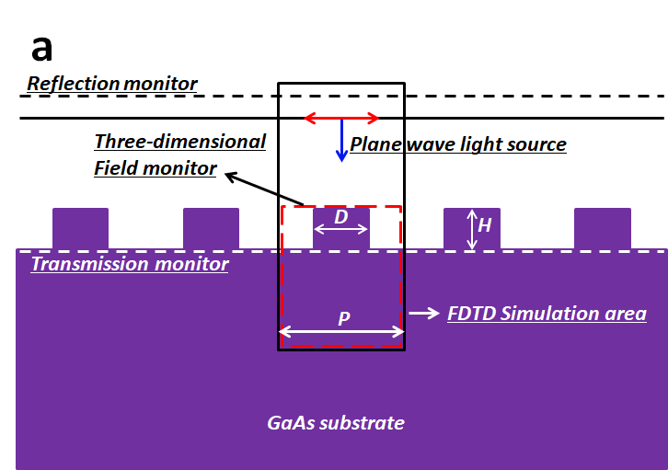
Simulation Model setup
b, TCAD setup for analyzing the photoelectric properties of the GaAs NPA photocathode
a, Cross-section of the FDTD setup.

Slide 26
Where do the electrons comes from?

Slide 27
NPA cathode fabrication

Slide 28
Ion Bombardment

Slide 29
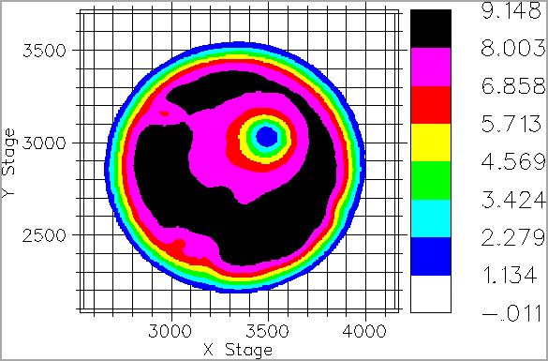
Ions Bombarding the Electrostatic Center
Ionized gas focused at electrostatic center
electrons OUT
laser IN
anode
cathode

Slide 30
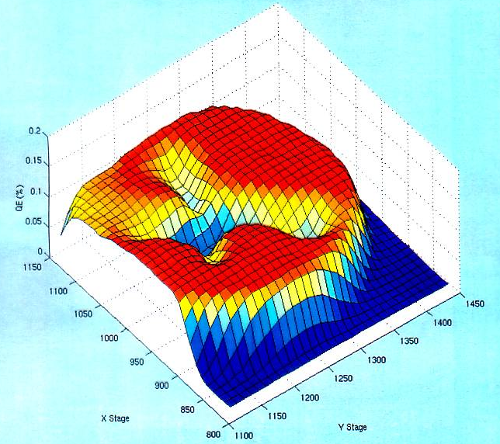
Pragmatically Avoiding the “EC”
We don’t run beam from electrostatic center
Laser spot diameter ~0.5 mm and can be moved to different locations on the photocathode.
electron beam
OUT
laser light IN
Ions create QE trough to electrostatic center

Slide 31
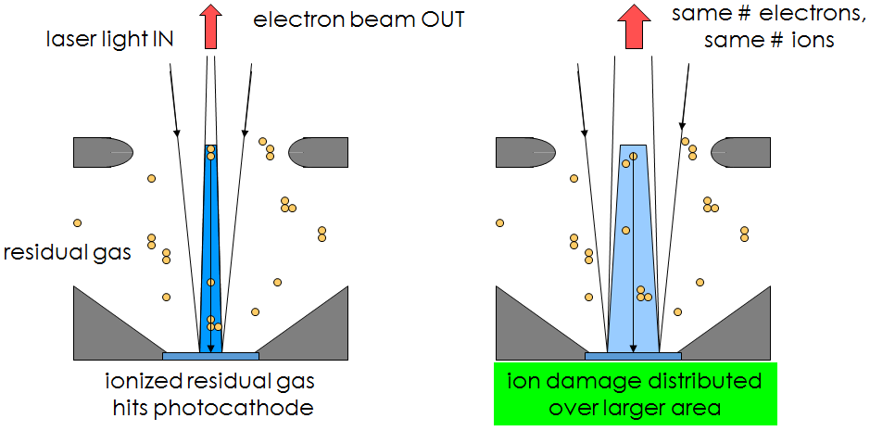
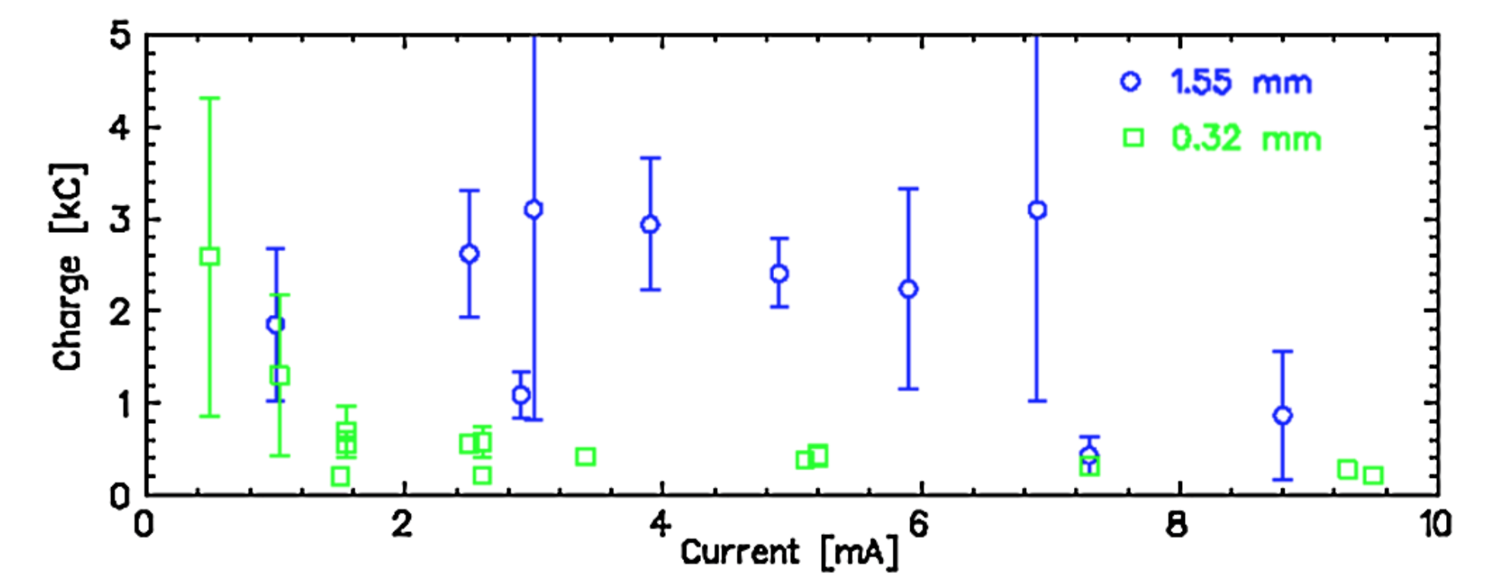
Improving Lifetime with Larger Laser Size
J. Grames, et al, Phys. Rev. ST Accel. Beams 14 043501 (2011)
GaAs @ 532nm

Slide 32
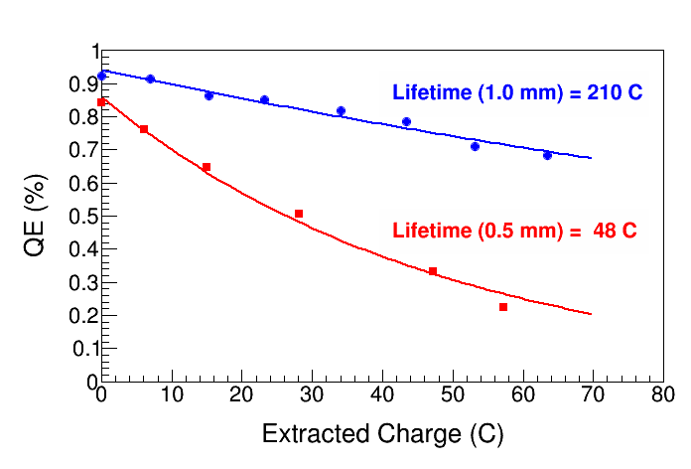
Improving charge lifetime with GaAs/GaAsP
Indeed, we enhanced the Charge Lifetime for Qweak by a factor of four when doubling the laser spot size from 0.5mm to 1.0 mm (diameter)
but milliampere applications require kiloCoulomb charge lifetime to provide uninterrupted operation of reasonable duration

Slide 33
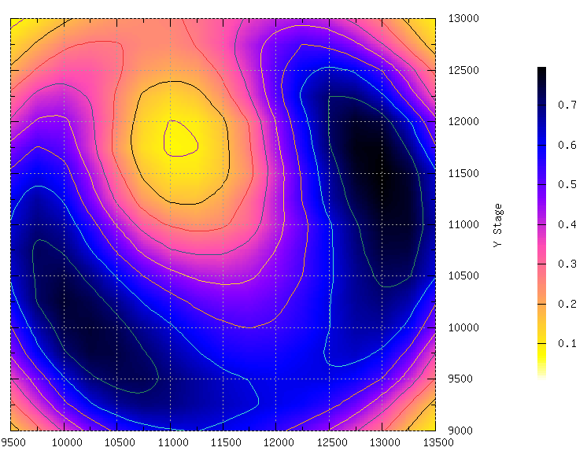
Photocurrent Dependence of Laser Profile
The scaling of photocathode lifetime, however, surely depends on the convolution of the laser profile, the photocathode QE and the ion production and dynamics in the photogun.

Slide 34
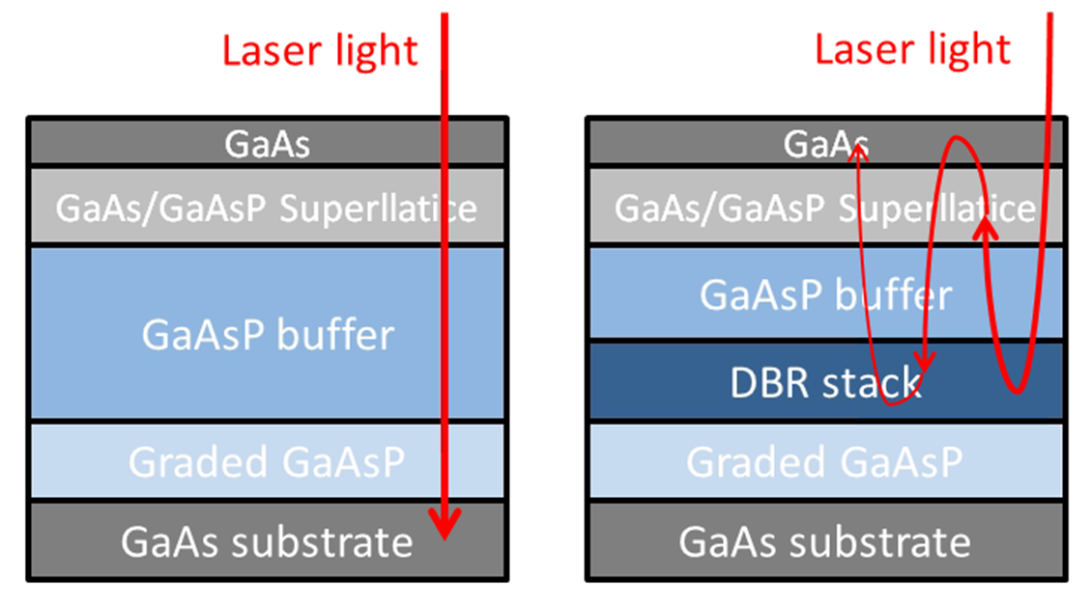
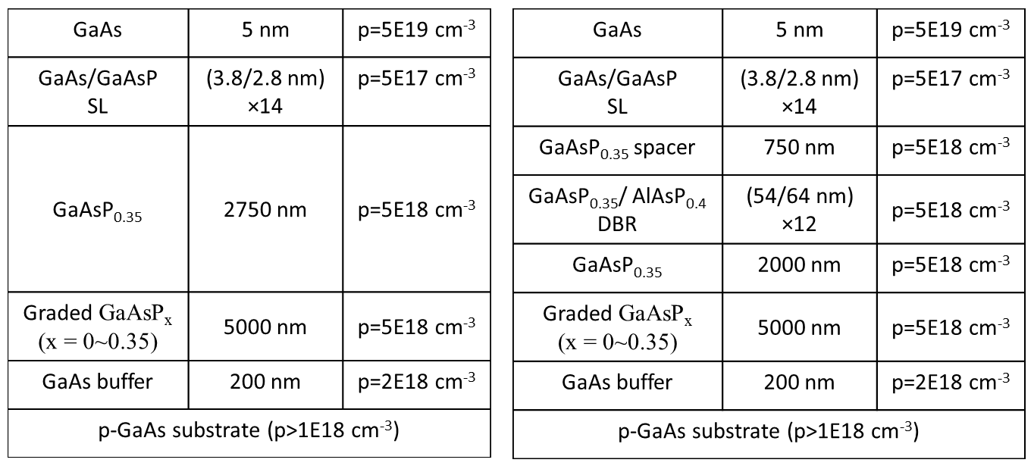
Benefits of Distributed Bragg Reflector
non-DBR Photocathode : absorption in the GaAs/GaAsP superlattice < 5%
Most light passes into the substrate leading to unwanted heating
DBR photocathode : absorption in the GaAs/GaAsP superlattice > 20%
Less light required to make required beam, less light means less heat
Great for high current initiatives like polarized positrons at CEBAF and EIC
Enhanced absorption occurs only at specific laser wavelengths
Non-DBR photocathode
DBR photocathode
(57 layers!)
Photocathode without DBR
Photocathode with DBR

Slide 35
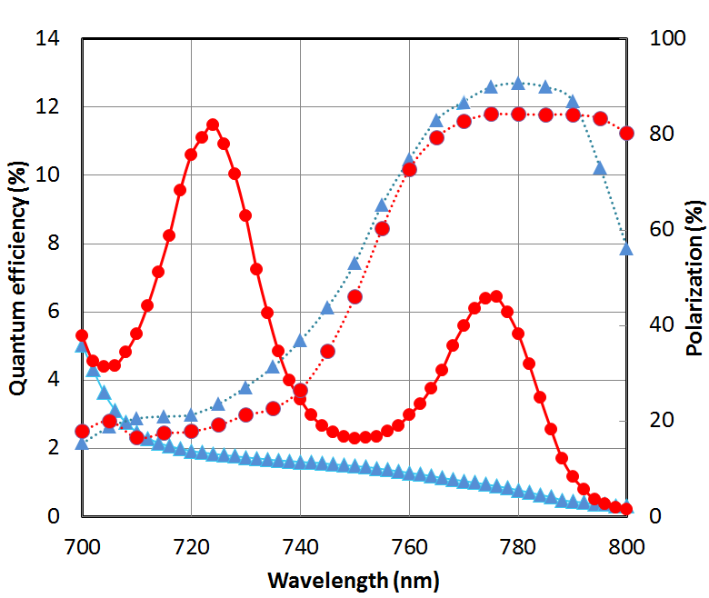
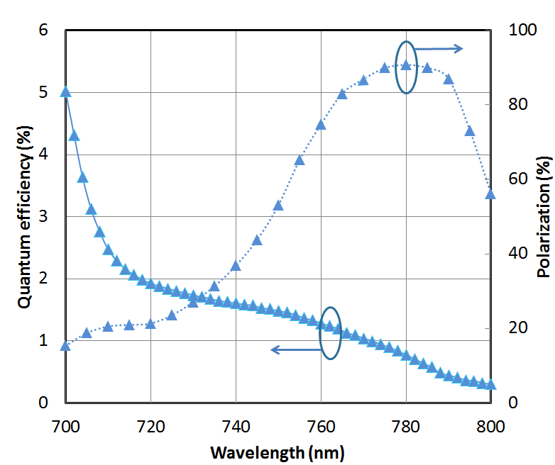
World Record QE from High Polarization Photocathode
Others have tried…but very difficult to obtain QE enhancement at the laser wavelength that also provides high polarization, CEBAF lasers operate at ~ 776 nm (doubled-telecom lasers)
Standard strained-superlattice
QE = 0.89%
Polarization = 92%
DBR
QE = 6.4%
Polarization = 84%
The highest reported QE of any high polarization photocathode
Excellent candidate for mA operations, will test at CEBAF this shutdown
SBIR partnership
W. Liu, S. Zhang, M. Stutzman, M. Poelker, Y. Chen, W. Lu, and A. Moy, Appl. Phys. Lett. 109, 252104 (2016)

