Slide 1
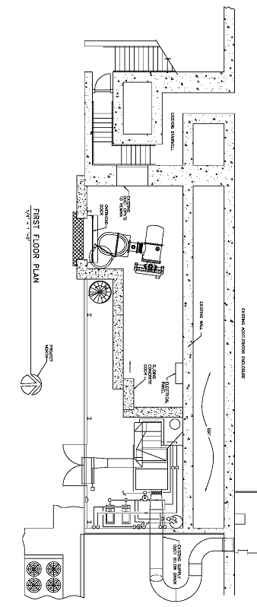
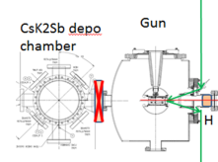
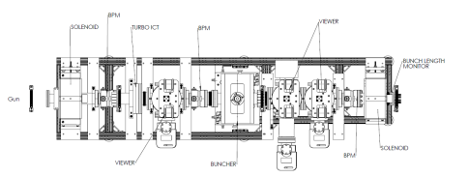

Slide 2
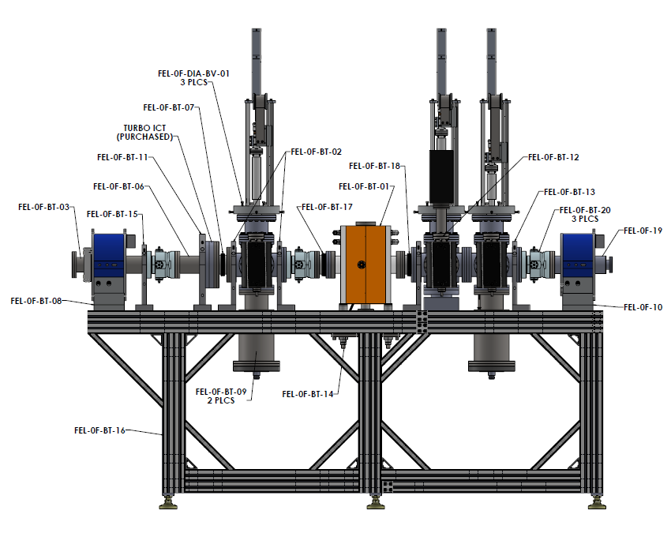
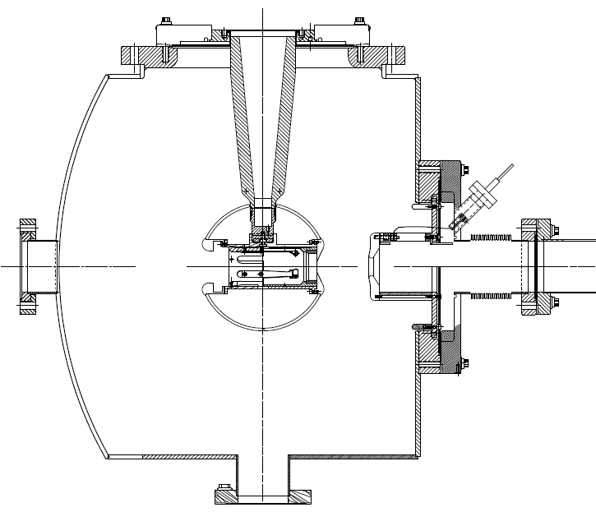
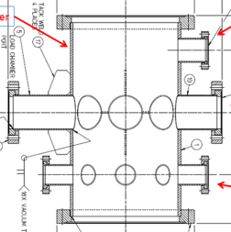
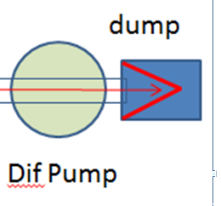

Slide 3
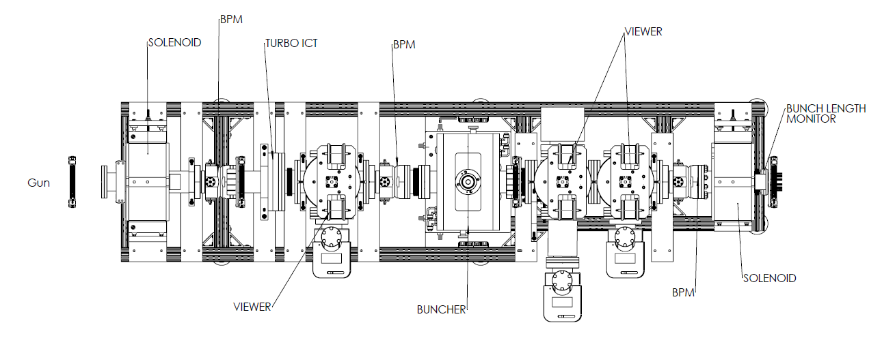
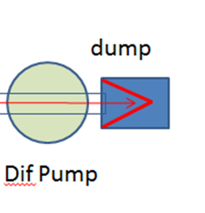
We will not need buncher. This could be Brock’s kicker, when he sends it to us

Slide 4
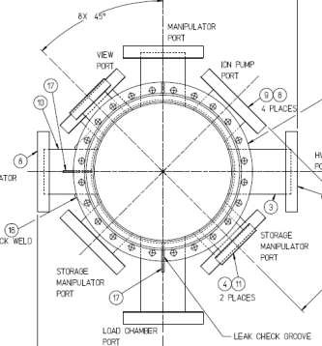
Gun
CsK2Sb depo chamber
Brock Cavity
Dif Pump
Dif Pump + Moveable Slits
Transverse emittance: divergent beam on narrow slit, move slit, capture beam profile on YAG viewer with video frame grabber (dipole OFF, solenoid 2 OFF)
Energy Spread: divergent beam on narrow slit, dipole ON, capture beam profile on YAG viewer with video frame grabber
Bunchlength: use brock cavity
Kicker: tilt the brock cavity, drive it with RF, look at beam on downstream viewer (dipole OFF, solenoids ON, slit OUT
Lifetime: high current beam to dump, both solenoids ON, slit OUT, dipole OFF

Slide 5
Pneumatic, with viewer
Vertical slit, could be on stepper motor stage
Horizontal slit, could be on stepper motor stage

Slide 6
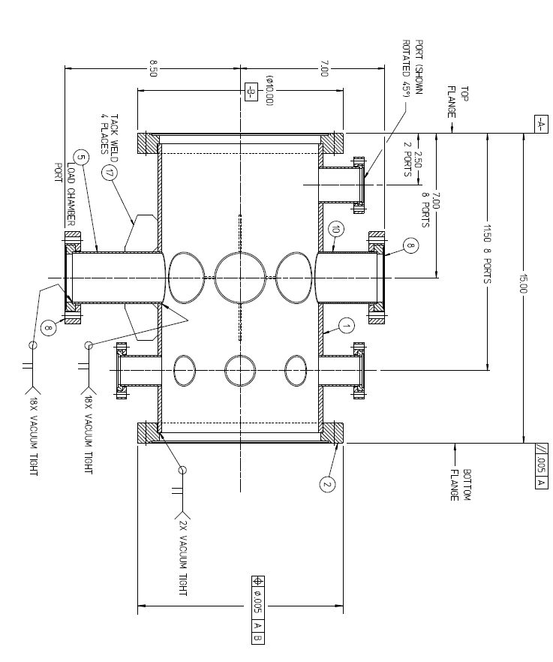
View port, Heater, hang NEGs?
RGA
manipulators
Anode ring, garage
chemical sources
heater, window

Slide 7
1) Gun a) we need to add WP1250 NEG pumps, with semi-circle shape, upstream and downstream of the electrode b) use the 5 hole anode and the 10" flange John designed (unfortunately, the half nipple on this flange is not long enough for a haimson) c) we need height supports for the gun chamber, such that gun ion pump clears table top 2) CsK2Sb depo chamber (sheep chamber) a) height consistent with gun b) manipulators c) heaters d) other things 3) Beamline a) A simple beamline to start with, mate the VA beamline to gun b) add a dif pump can and dump to the other end of VA beamline 4) Overall a) where to put the gun and beamline in the small room, rigid HV cable from supply to gun, manipulators, a spectrometer beamline, how to ensure walkway.

