Slide 1
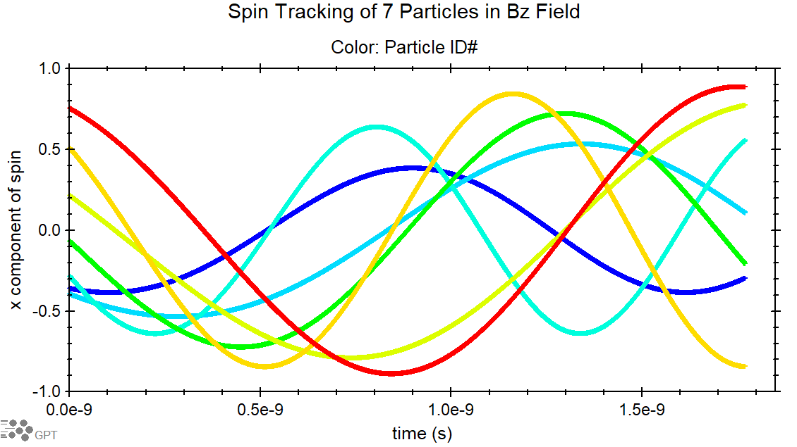
GPT -spin
New spin tracking feature of General Particle Tracer software
Generalized to any particle and spin distribution: g-factor, mass, charge, position, momentum, spin
Built-in optimizers: Multi-Objective Global Optimizer (Genetic Algorithm), Minimum Optimization Solver (Powell Algorithm)
Compatible with custom program elements and analysis programs by users

Slide 2
Early on ideas

Slide 3
Polarized Positron Capture for CEBAF
Collimation used to reduce normalized emittance
Multiple1497 MHz 5 cell cavities gives 123 MeV beam
Emittance is still larger and efficiency is below desired ${10}^{−4}$
Optimization of target geometry and beam size may help emittance.
Updating GEANT4 for a polarization of 0.9 instead of 1
Legend
Target
Conical Solenoid
Solenoid
Quadrupole
Dipole
Collimator/dump
RF Cavity

Slide 4
Need more particles/statistics
Results are looking promising but number of particles makes distribution look questionable.
With smaller histogram buckets, the distribution becomes disjoined and not a continuous distribution.
Calculation of emittance becomes questionable along with other quantities.

Slide 5
Unpolarized
Capture of lower energy higher emittance particles to reach efficiency goals.
Lowering emittance still requires many stages of collimation but the momentum spread becomes an disadvantage.
Introduction of an early bunching cavity may be able allow conditions for both polarized and unpolarized beam.
Here?
Here?
Here?

