Slide 1
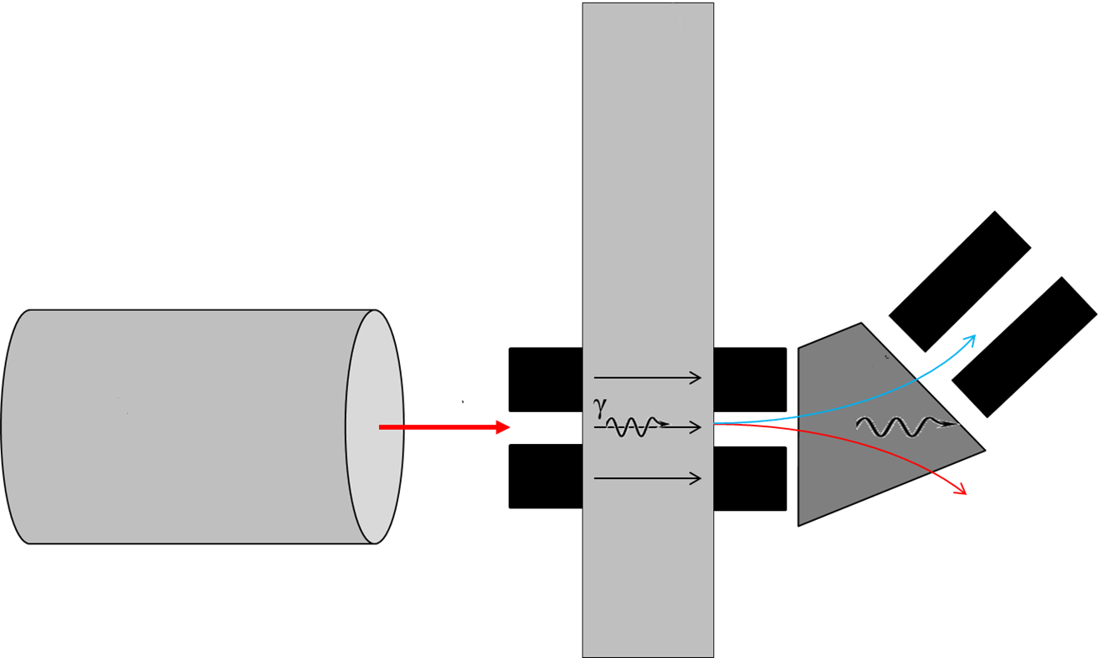
Positron Production Conceptual Design
flowing liquid metal target
solenoid magnets
flow
10 MeV, 100 kW CW Superconducting Electron Linac
positron-electron pair production
positron separation and capture

Slide 2
10 MeV Accelerator with Positron Target
Electron Source
350 MHz, 100 kV normal-conducting resonant cavity
integrated, gated thermionic cathode
10 MV superconducting cryomodule
3-cell, 350 MHz niobium resonator
thermal and magnetic shields
Proof of concept test successfully complete with simplified LBE target

Slide 3
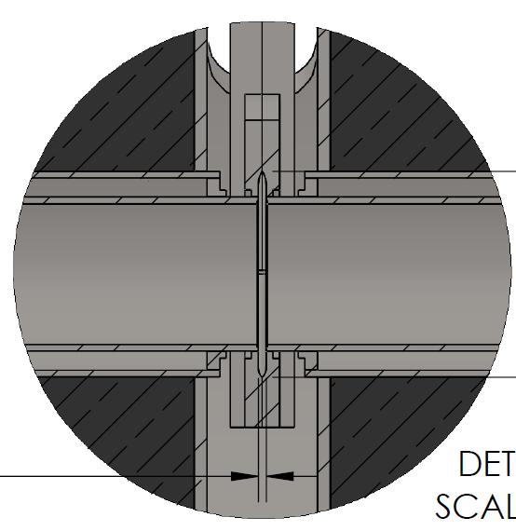
Liquid Metal Target Design
Input electron beam passes through:
0.25 mm SS
2 mm LBE, for highest rate of production of e⁺
0.25 mm SS
Prototype target expected to handle >10 kW
Stainless Steel
Thin layer of lead-bismuth eutectic
Output (e⁻,e⁺,γ)
Input (e⁻)

Slide 4
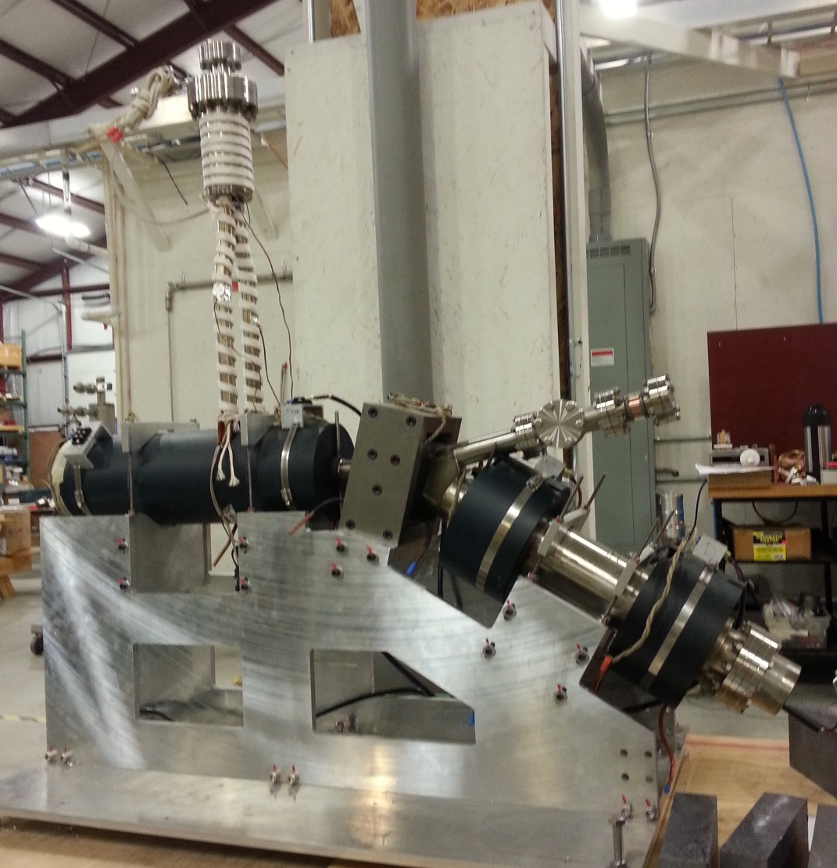
Positron System Hardware
Liquid Metal
Converter
Electron Dump
Separation
Dipole
Positron Target
Converter Solenoid
Capture Solenoid
Positron Solenoids

