Slide 1
Data shown for CEBAF upgrade Gun being tested in UITF
Anode current improved slightly over time, but field emission got slightly worse
Data taken from Archiver signals by summer student Elliott Holliday using “myStats” tool. All values shown are the averages over certain time.
NOTE the scale!

Slide 2
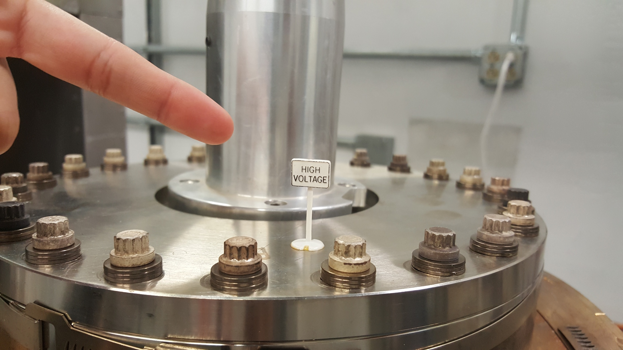
Data shown for CEBAF upgrade Gun being tested in UITF at 200kV
Hard to discern a pattern over time, but looks like field emission
NOTE the scale!
Data taken from Archiver signals by summer student Elliott Holliday using “myStats” tool. All values shown are the averages over certain time.
Go to next page….

Slide 3
