Slide 1
Extreme High Vacuum: why and how Marcy L. Stutzman Jefferson Lab Center for Injectors and Sources
Notes:
Title Page Design 3

Slide 2
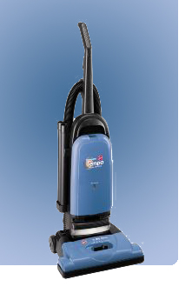
What is vacuum?
Vacuums are nothings. We only mention them to let them know we know they're there.
Middle school student’s answer on a science test

Slide 3
Modern Vacuum History
‘Ultimate’ Vacuum vs. Time
Improvements with pumps
Improvements with gauges
10⁻⁶
10⁻⁸
Ultimate Vacuum (Torr)
10⁻¹⁰
10⁻¹²
10⁻¹⁴
1900
1920
1940
1960
1980
2000
P.A. Redhead Vacuum 53 (1999) 137

Slide 4
Vacuum level definitions
Vacuum | Pressure (Torr) | Molecules/m^3 (bottom of range) | Mean free path
Atomsphere | 760 | 2.7x10²⁵ | 68 nm
Low vacuum | 300 – 1 Torr | 10²² | 100 µm
Medium vacuum | 1 Torr – 1 mTorr | 10¹⁹ | 100 mm
High vacuum | 1 mTorr – 1x10⁻⁷ | 10¹⁵ | 1 km
Ultra High vacuum | 1x10⁻⁷ – 1x10⁻¹² | 10¹⁰ | 10⁵ km
Extreme high vacuum | <1x10⁻¹² | <10¹⁰ | >10⁵ km

Slide 5
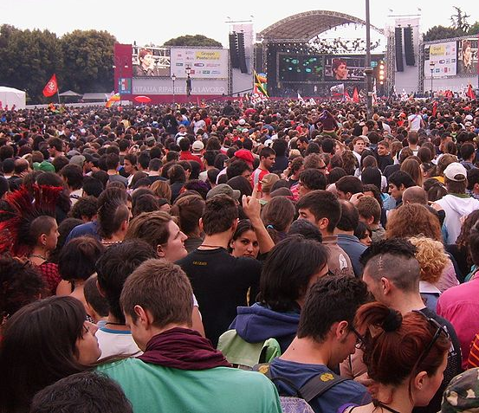
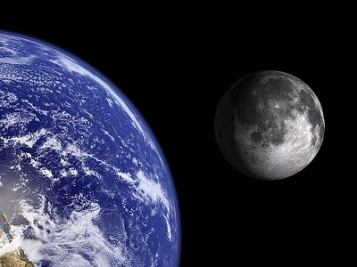
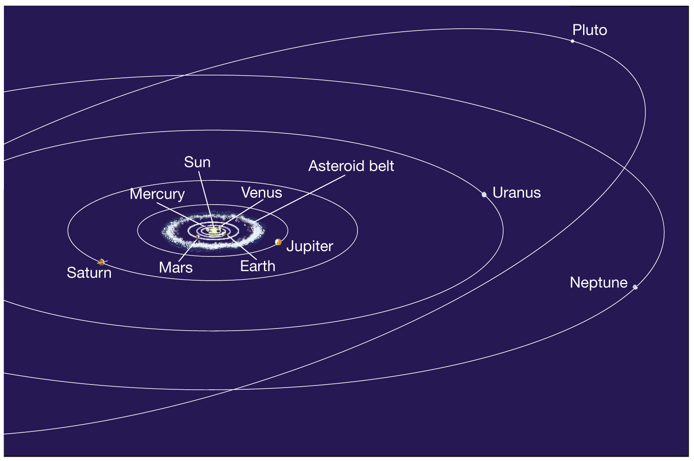
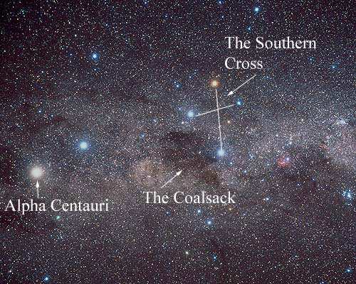
Vacuum Level | Where found | If people were molecules, you could move __ without hitting someone
Atmosphere | This room | About 1 foot away
Medium Vacuum | Bell jar, scattering chambers | Near the Newport News airport, almost 3 miles
High Vacuum | Low earth orbit, beamline | At the moon, 240,000 miles
Ultra High Vacuum (UHV) | Lunar atmosphere, Electron gun | Near Pluto, 4 billion miles
Extreme High Vacuum (XHV) | Interstellar space, Cryomodules | At the nearest star, Alpha Centauri, 25,000 billion miles
Atmosphere
Medium Vacuum
High Vacuum
UHV
XHV

Slide 7
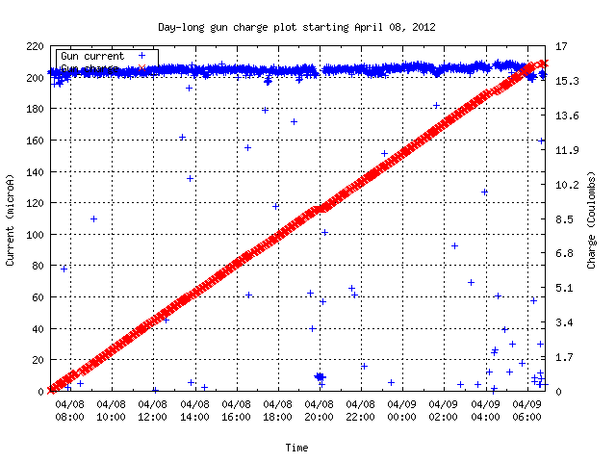
Beam required at Jefferson Lab
Outline
How do we emit polarized electrons?
What is required to keep the electron source working for the duration of experiments?
How do we achieve and maintain the required vacuum
24 Hours
High polarization for 3 (4) experimental halls simultaneously
24/7 beam operation
Beam Current: 200 µA
Charge Delivered: 16 Coulombs polarized electrons / day

Slide 8
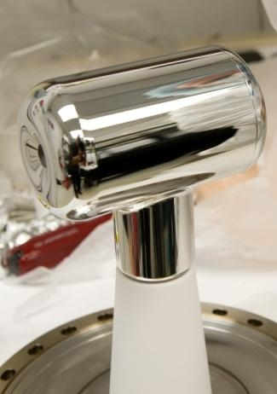
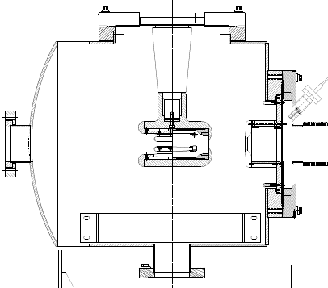
Photoemission Source
-130 kV DC (vs. RF) electrode bias
x-ray standard “inverted” insulator
Pumps with NEG modules and ion pump
Base pressure approaching XHV ≡ P < 1x10⁻¹² Torr
-130kV
light in
electrons out
photocathode

Slide 9
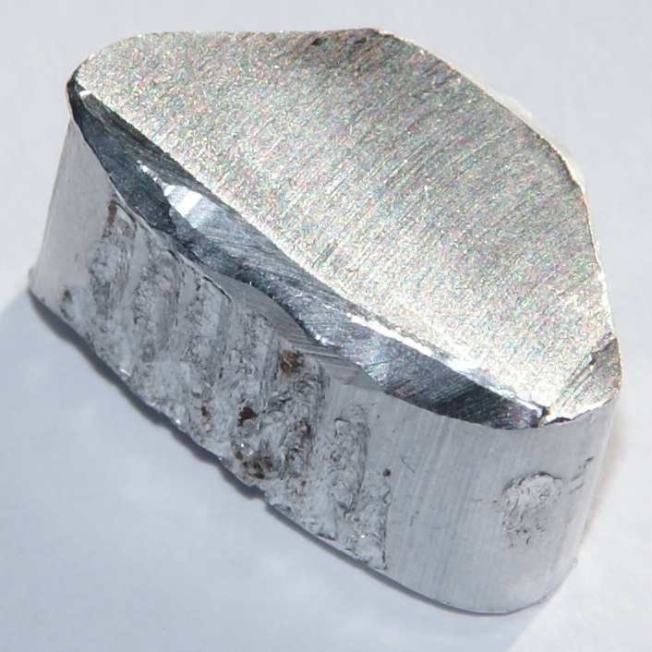
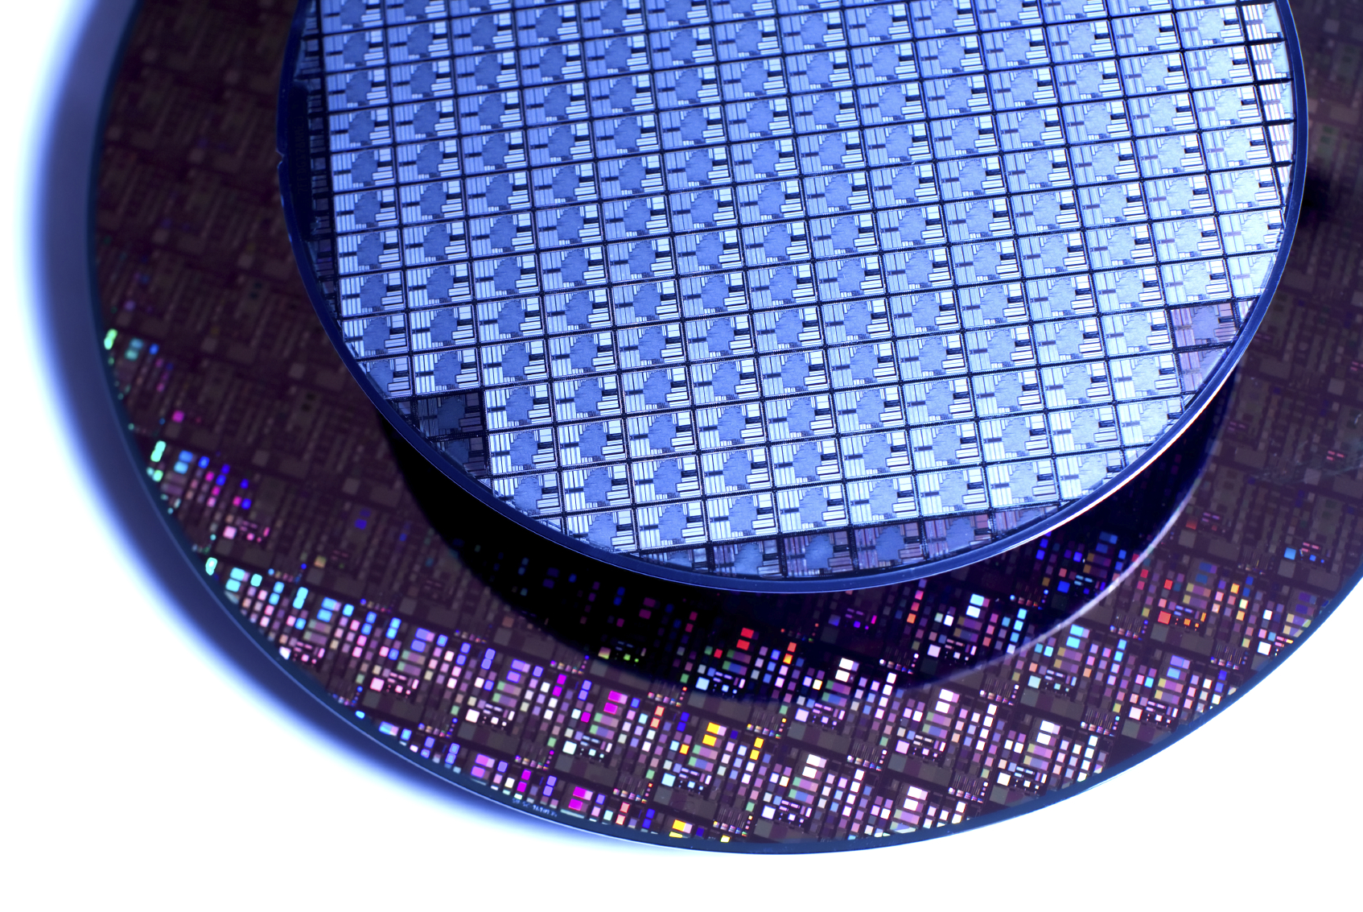
Metals, Insulators and Semiconductors
gap
unfilled
unfilled
unfilled
gap
Fermi
Level, E_{F}
E_{F}
gap
E_{F}
filled
E_{F}
unfilled
filled
filled
Metal:
Unfilled valance band
Insulator:
Large band gap
Semiconductor:
Small band gap

Slide 10
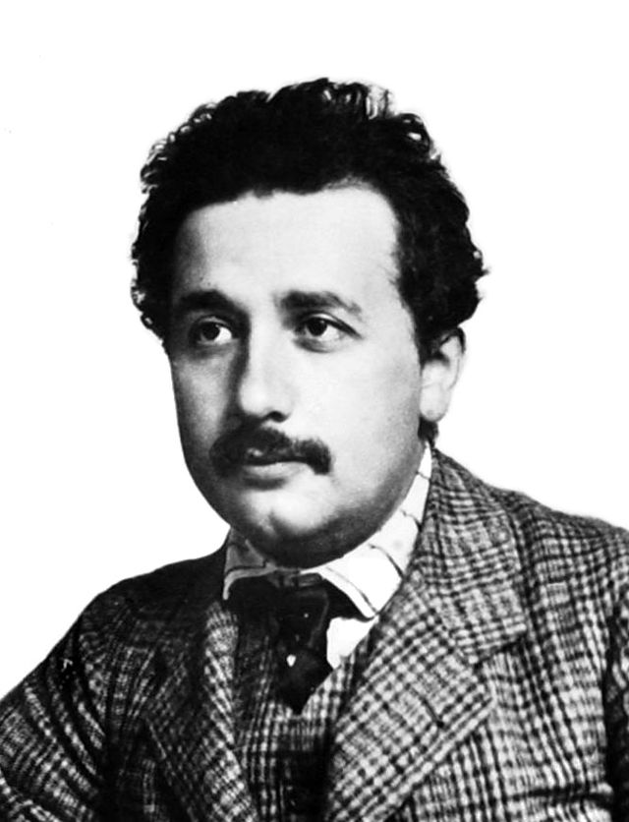
Photoelectric effect
No emission below cutoff wavelength
Increase in photocurrent with increase in intensity of light above cutoff wavelength
Metallic emission: typically UV wavelengths
Particle nature of light
The Nobel Prize in Physics 1921 was awarded to Albert Einstein "for his services to Theoretical Physics, and especially for his discovery of the law of the photoelectric effect".

Slide 11
Photoemission from GaAs
Bare GaAs surface
Large Work Function
Positive Electron Affinity (PEA)
NEA Surface Activation
Dipole layers of Cs + NF₃ or Oxygen
Reduces Work Function
Negative Electron Affinity (NEA)
PEA=4.07 eV
-
Conduction
Band
-
χ^{NEA} ~ 0.2 eV
E_{gap}=1.4 eV
Valence
Band
+
Light
GaAs
Vacuum
GaAs
Vacuum
GaAs Spin Polarized Electron Source, D.T. Pierce, R.J. Celotta, G.-C. Wang, W.N. Unertl, A. Galejs, C.E. Kuyatt, and S.R. Mielczarek, Review of Scientific Instruments 51(4), 478 (1980).

Slide 12
Any gas in chamber can be ionized by electron beam, accelerated back toward the photocathode and
limit photocathode operational lifetime

Slide 13
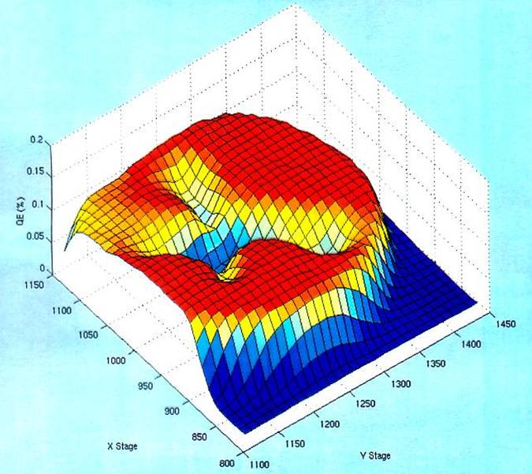
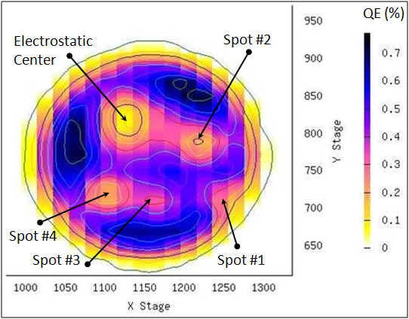
Photocathode Lifetime
Ion bombardment – with characteristic QE “trench” from laser spot to electrostatic center of photocathode – damages NEA of GaAs
High energy ions are focused to electrostatic center: create QE “hole”
Don’t run beam from electrostatic center.
QE can be restored, but takes about 8 hours to heat and reactivate

Slide 14
Operational Lifetime Limitations
Static vacuum approaching XHV (1x10⁻¹² Torr)
Baked, leak free, all metal vacuum systems
Ceramic insulators, glass windows bonded to metal
No machining oil, no fingerprints
Bake for 30 hours 250°C to largely eliminate water vapor
Hydrogen outgassing reduction
Pumping for nearly XHV
Dynamic vacuum issues
Eliminate field emission from electrodes
Eliminate beam halo, scraping

Slide 15
How to reach XHV ≡ P < 1x10⁻¹² Torr?
Pump gas away
Less gas in
Measure pressure

Slide 16
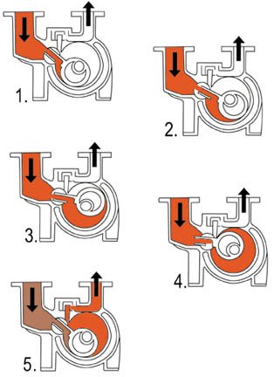
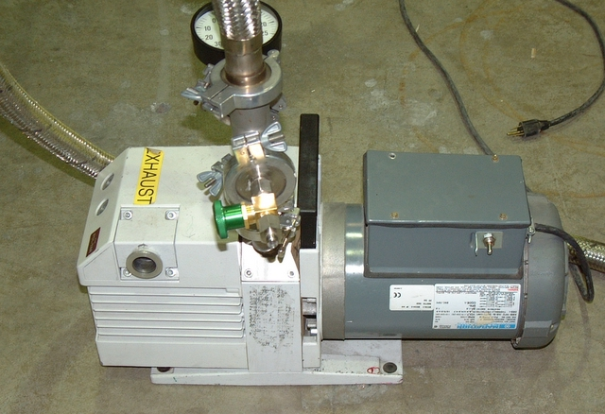
Vacuum Pumps – Rough Pumps
Low, Medium Vacuum (>10⁻⁵ Torr)
Mechanical (Oil Seal) Pump
Backs Turbo, Roots in
systems where oil isn’t
to detrimental

Slide 17
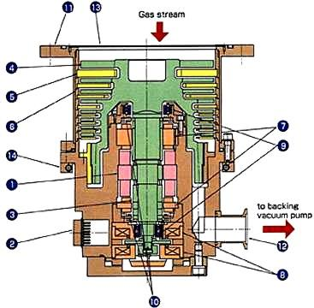
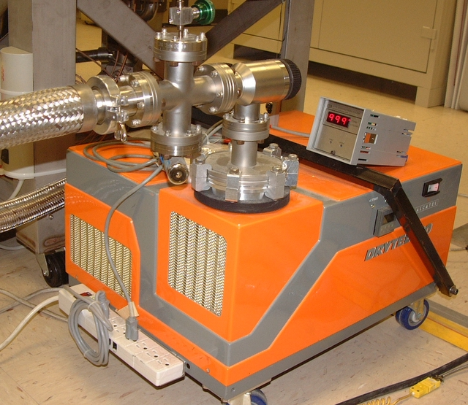
Dry pumps
Molecular Drag pump
Used to rough down systems that will go to UHV – no oil contamination
Rotating fan blades, like a turbo, but more robust blade design for higher pressure use
Typically backed with a diaphragm pump

Slide 18
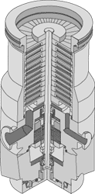
Generation of High, Very High Vacuum
Turbo pumps
High speed, precisely tuned fan blades
Backed with mechanical pump
System must be roughed down to medium vacuum before starting
Must be operated with a backing rough pump at all times
Can have some backstreaming of gasses from atmosphere into the system

Slide 19
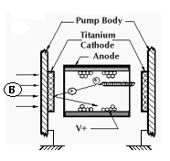
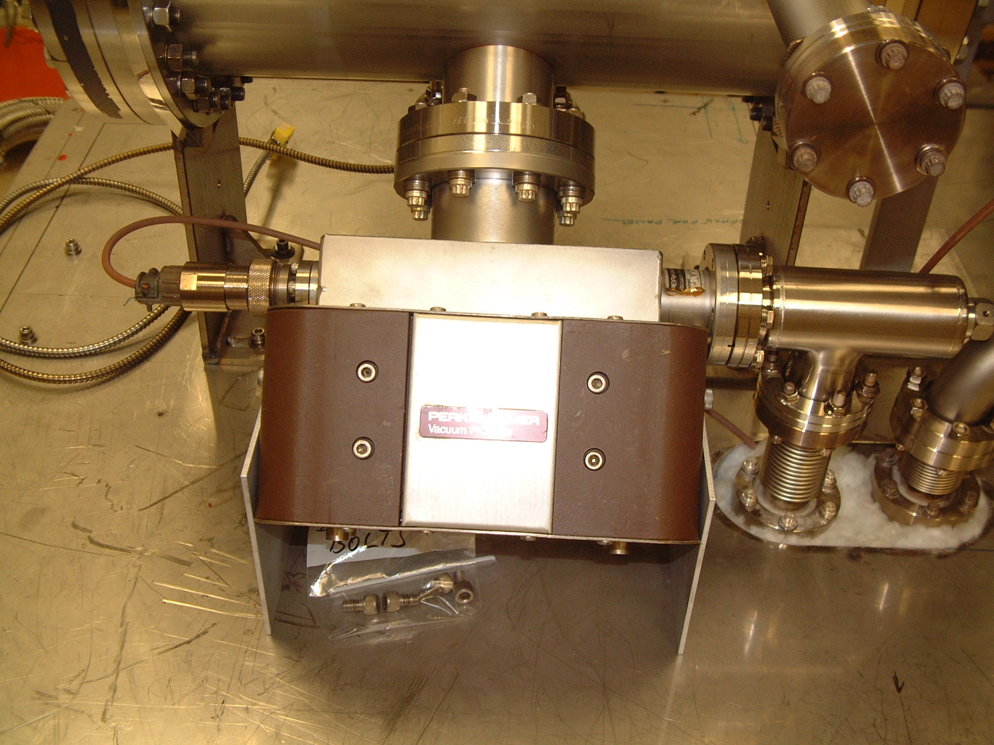
Generation of High, Very High Vacuum
Ion pumps
High voltage to ionize gas
Magnetic field to direct ionized gas into plates to trap gasses
System must be roughed down to medium vacuum before starting
Capture pump – requires no backing pump during operation

Slide 20
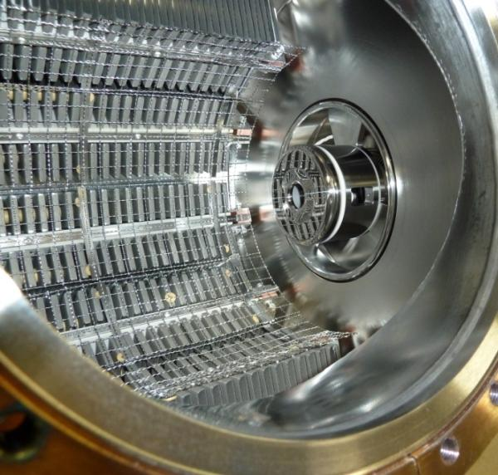
Ultra-High Vacuum: Bake and Add Getter Pumps
Getter Pumps
Chemically active surface
Titanium sublimed from hot filament
Non-Evaporative Getters
Molecules stick when they hit
Does not work for inert gasses such as Argon, Helium

Slide 21
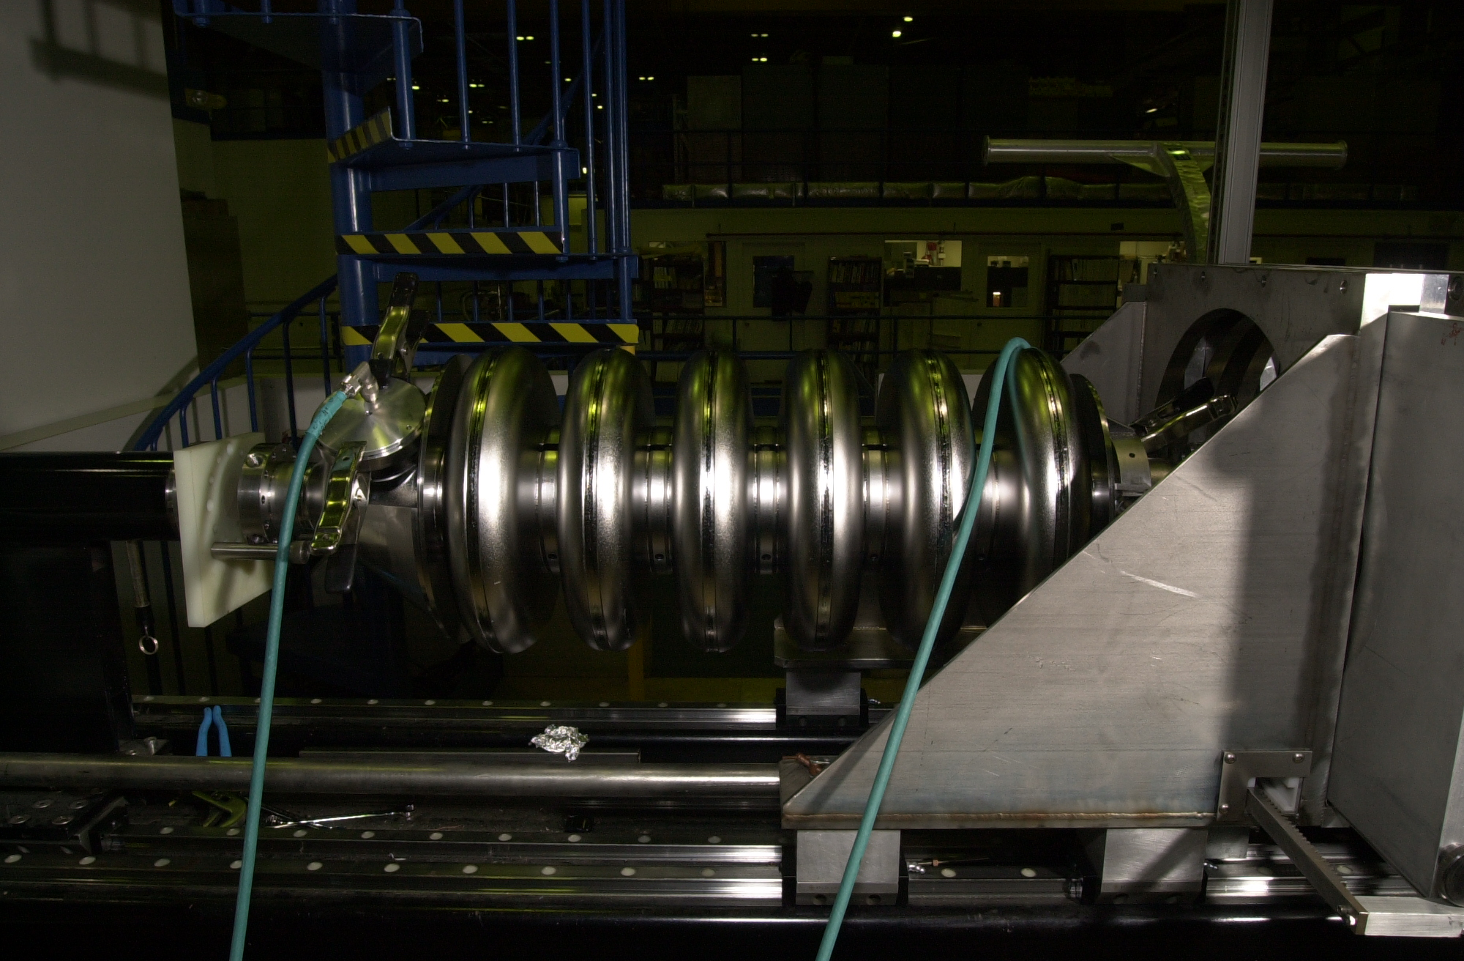
Extreme High Vacuum Generation
Typically a combination of Getter pumps and cryo or ion pumps is used to achieve Extreme High Vacuum (XHV)
At room temperature, materials selection and processing, pumping, and gauging are huge issues
Calculations tell us that pressure is very, very good (<10-14 Torr or better)
XHV in room temperature chambers harder!

Slide 22
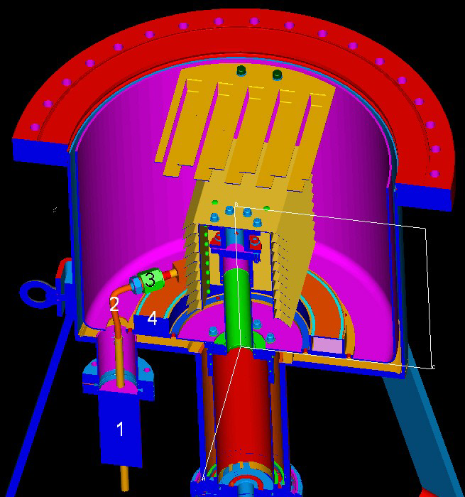
A novel system: Leybold XHV Cryopump
LN₂ chill circuit
cools cryosorber panels and compressor
allows bake of cryopump body
Operation
10K pumping surface
30K baffles
Presented at AVS 55 by Dieter Mueller

Slide 23
Effectiveness of adding a cryopump

Slide 24
Even more novel: Nanomaterial Cryopump
Typical cryopumps glue charcoal to cold surface
Large surface area allows cryosorption rather than cryocondensation
Lower pressure
Requires Low temperature adhesives
Can’t bake system well
Boron-Nitride Nanotubes have
Huge surface area
Good thermal
Are freestanding
Are manufactured across street (JLab spin-off)
Can we use these for cryosorber material?

Slide 25
First and second tries
1 g BNNT material
Copper grid
~4 g BNNT material
“sewn on” with wires
Veronica

Slide 26
First BNNT cryopump: cooldown
Baked 48 hours at or below 150°C
Coldhead temperature: 15.5K (14K before BNNT)
39K: pressure drop – Cryopumping!

Slide 27
Can we model this cryopump system?
Modeled geometry, temperature distribution of cryopump
Compare BNNT vs. charcoal
Predicting behavior of version 2
For more info: See Veronica’s poster

Slide 28
How to reach XHV ≡ P < 1x10⁻¹² Torr?
Pump gas away
Less gas in
Measure pressure

Slide 29
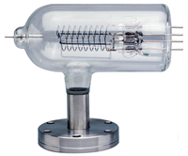
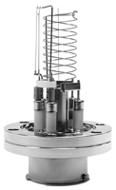
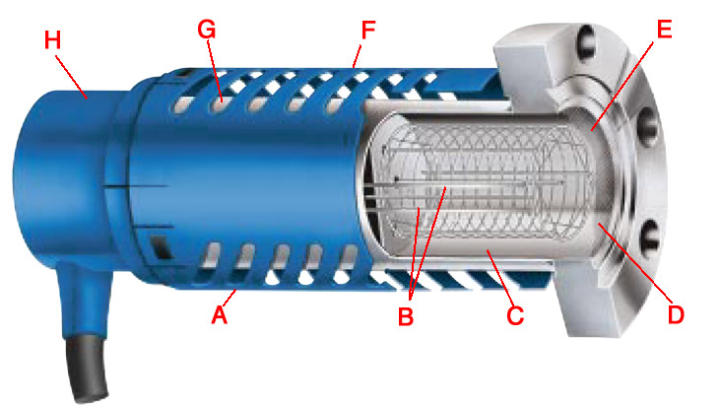
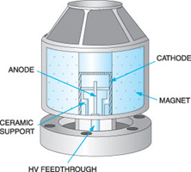
High/Ultra High Gauges
+V
Lowest pressures:
10⁻⁸ Torr – 10⁻¹¹ Torr
up to $4,000
Bayard-Alpert Gauges
+
filament
A
collector
Stabil-Ion gauge
Cold Cathode gauge

Slide 30
Measure Pressure:
Hot cathode gauge operation and errors
True gas ionization
Positive current
X-ray effect
e- on anode -> photons emitted
Photons on collector -> electrons emitted
Extra positive current
Anode
4
+
Inverse X-ray effect
e- on anode -> photons
Photons on walls -> electrons
Electrons to collector
Extra negative current
+
1
3
e⁻
2
e⁻
Electron stimulated desorption
e- strike gas molecules on anode
Gas ionized and reaches collector
can be distinguished with energy analysis
Neutral atom desorbed
Ionized within grid
Indistinguishable from real gas
Must eliminate souce
Cathode

Slide 31
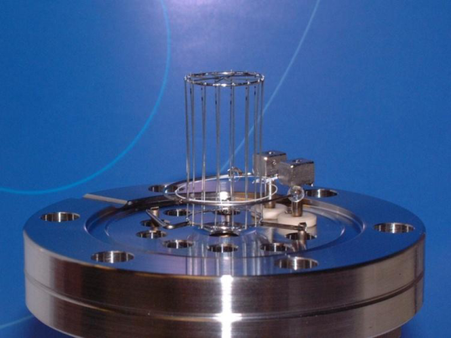
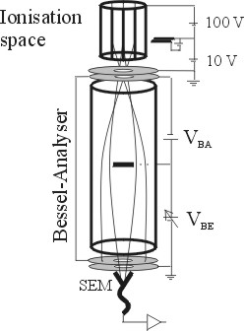
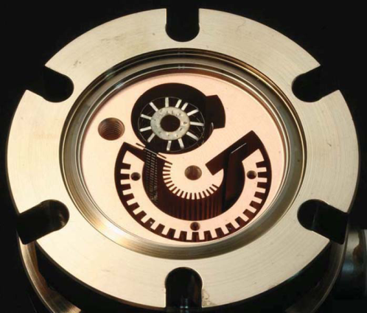
XHV gauges
Hot filament
extractor
Extractor gauge
available commercially for decades
x-ray limit reduced through geometry
x-ray limit quote: 7.5x10⁻¹³ Torr
$4,300
Axtran gauge
Bessel box energy discrimination
electron multiplier to assist in low current measurements
Quoted limit: 3.75x10⁻¹³ Torr
$7,500
Watanabe BBB (Bent Belt Beam) gauge
Uses Leybold IE540 controller
230° deflector BeCu housing
JVSTA 28, 486 (2010)
Quoted limit: 4x10⁻¹⁴ Torr
$13,000 + Ext. controller ($2,600)
Axtran
BBB

Slide 32
How to reach XHV ≡ P < 1x10⁻¹² Torr?
Pump gas away
Less gas in
Measure pressure

Slide 33
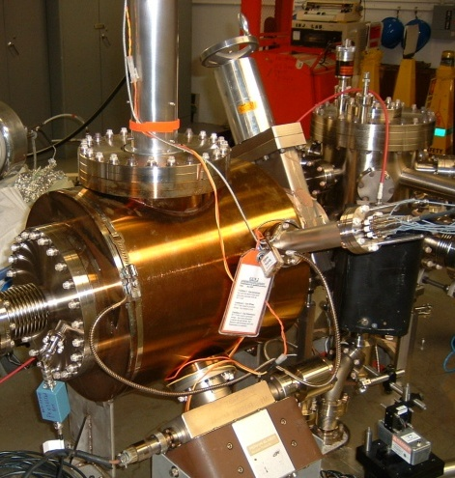
Less gas in: reduce outgassing
Primary source in stainless system: hydrogen outgassing
To reduce outgassing
reduce thick flange area
heat treatment
400°C bake
10+ days
thin dome replaces thick flanges

Slide 34
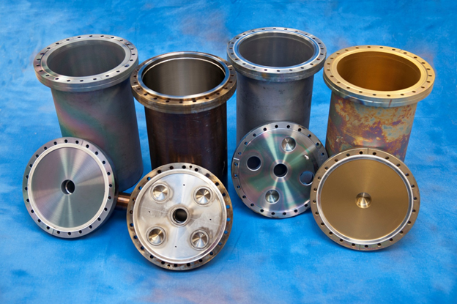
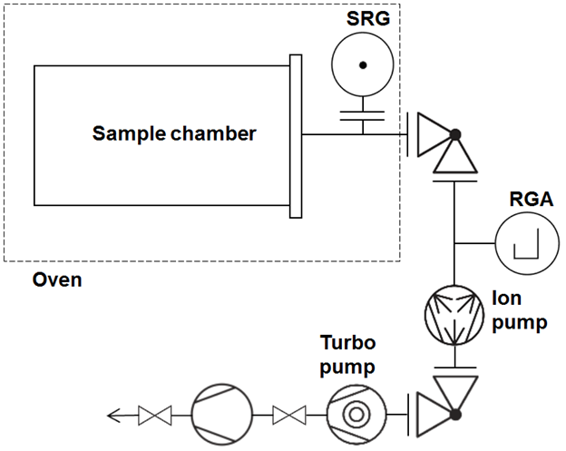
Outgassing rates vs. heat processing and coatings
Identical 304L chambers
Bare steel
TiN coating (9 µm)
a-Si (SilcoGuard-1000®~900 nm)
Outgassing rates
Spinning Rotor Gauge
Accumulation technique
Multiple bakes
Q(T_{room}) after each bake

Slide 35
Outgassing rates: bare and coated chambers
All data at T_{room} = 20°C
Notes:
Steel:
Expected reduction
with 400°C heat
treatment
Silco:
Little variation with
heat treatment
Silco on heated SS:
Retains prior
outgassing rate
TiN coating:
Very low outgassing
rates, consistent with
literature, elemental
Ti pumping?

Slide 36
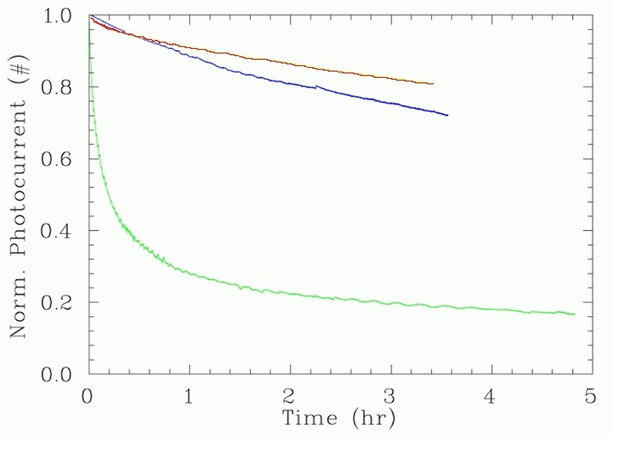
Remember: Better Vacuum, longer lifetime
~2.5x10⁻¹¹ Torr
~5x10⁻¹¹ Torr
System Leak

Slide 37
Summary
High polarization strained superlattice GaAs-GaAsP photocathodes susceptible to ion damage, gun vacuum level
Outgassing reduction, pumping combinations and measurements to verify improvements are being optimized
Vacuum improvements required for future proposed higher current polarized electron sources

Slide 38
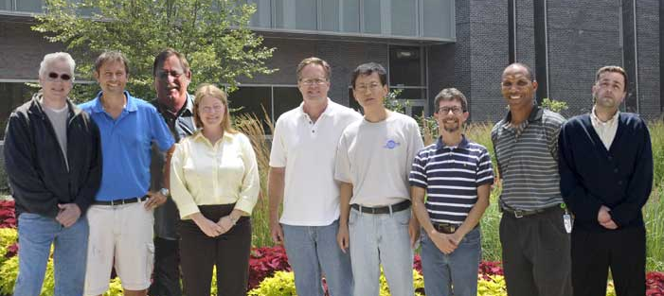
Thank you for your attention
(L-R) Matt Poelker, Joe Grames, Bubba Bullard
Marcy Stutzman, John Hansknecht, Shukui Zhang
Carlos Hernandez Garcia, Phil Adderley, Riad Suleiman

