Slide 1
CEBAF H & V Wien filters rebuild
Refurbishing CEBAF’s Horizontal & Vertical Wien filters for e-beam energy increase from 130keV to 200keV. This requires increasing the Wiens max operating voltage from ~+/-12 kV to +/- 18 kV for 90 deg spin rotation.
C. Hernandez-Garcia
Oct 2020

Slide 2
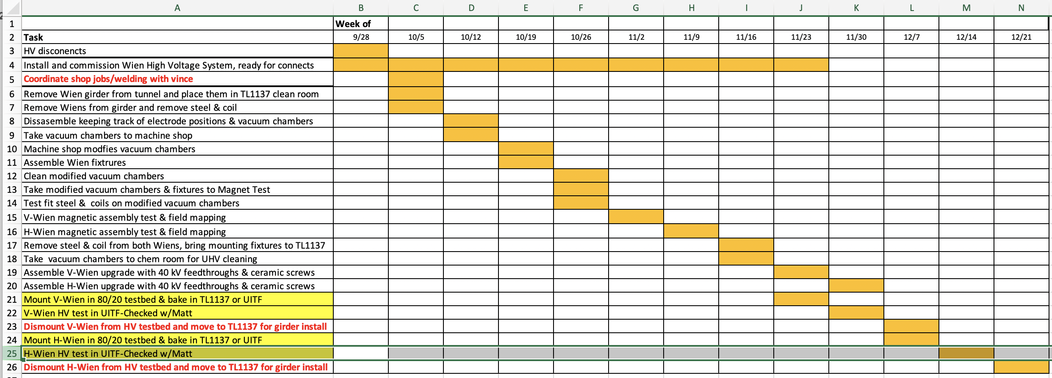
Major tasks

Slide 3
Week of Oct 5
Updates:
The two Wien filters have been disassembled and their vacuum chambers are ready to be taken to the machine shop.
Coils, steel and vacuum chambers have been labeled.
Coils, steel, and internal components have been stored in labeled containers and in the Wien cabinet.
Electrodes have been wrapped in heavy cotton cloth and placed inside labeled plastic containers.
Machine shop job request has been submitted with drawings and instructions provided by Danny. Carlos talked to Vince, but will touch base again once chambers are in the shop.
Findings:
H-Wien electrodes surface finish is not good, multiple scratches and overall surface finish is pretty rough. Mounting tabs look as if their corners had been filed down.
H-Wien electrodes profile is faceted (as expected)
H-Wien HV spring was found bent, as if the spring was too long.
V-Wien electrodes surface finish looks very smooth, no scratches.
V-Wien mounting tabs look like the ones in drawings, nicely curved and smooth surface finish.
V-Wien electrodes profile is NOT faceted (unexpected), rather is a smooth curve (spline?)

Slide 4
Horizontal Wien filter disassembly
Electrodes profile is faceted
Mounting tab looks as if it was filed on the corners

Slide 5
Horizontal Wien disassembly cont
Electrodes side view
Found the HV spring guide bent, spring seems to be too long

Slide 6
Horizontal Wien disassembly cont
Electrodes do NOT have a mirror-like finish and show some scratches
This is how we removed the electrodes from the vacuum chamber

Slide 7
Vertical Wien filter disassembly
Electrodes profile is not faceted, but rather a smooth curve (spline)
The surface finish is mirror-like, smooth and w/o scratches

Slide 8
Vertical Wien filter disassembly cont
Electrodes side view
Close up side view

