Slide 1
To manage the spin, it is preferable to have orthogonal bends (rather than coupled sloped bends).
By this, I mean the spin is preserved if bending from one plane to another plane.
To avoid the SAB, tunnel egress, cooling towers, wondered if it’s possible to have:
One long straight, then 180 horizontal arc….ideally all in same plane (can exit LERF at appropriate height)
Long straight
180 deg arc
The on the next page…

Slide 2
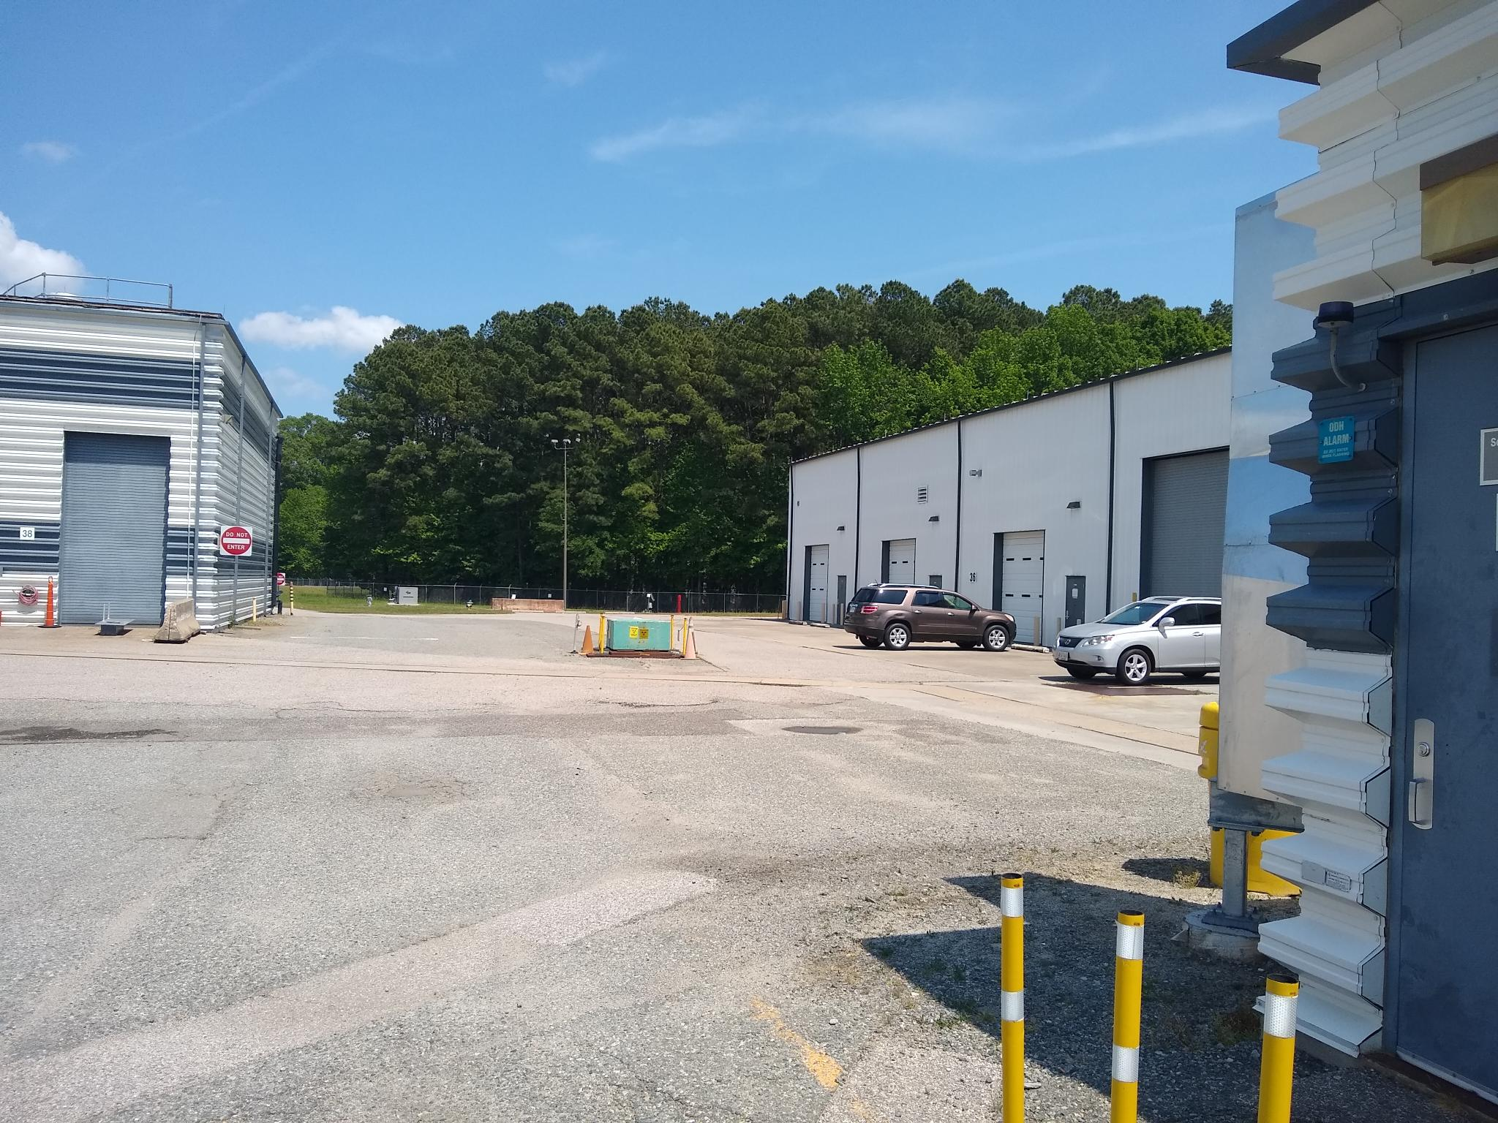
Then make a vertical dive, going down, about as far back as the Magnet Test building
Dive down here (parallel to parallel)

Slide 3
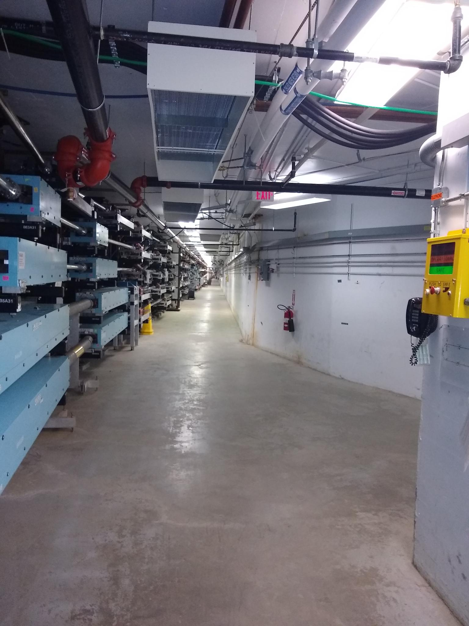
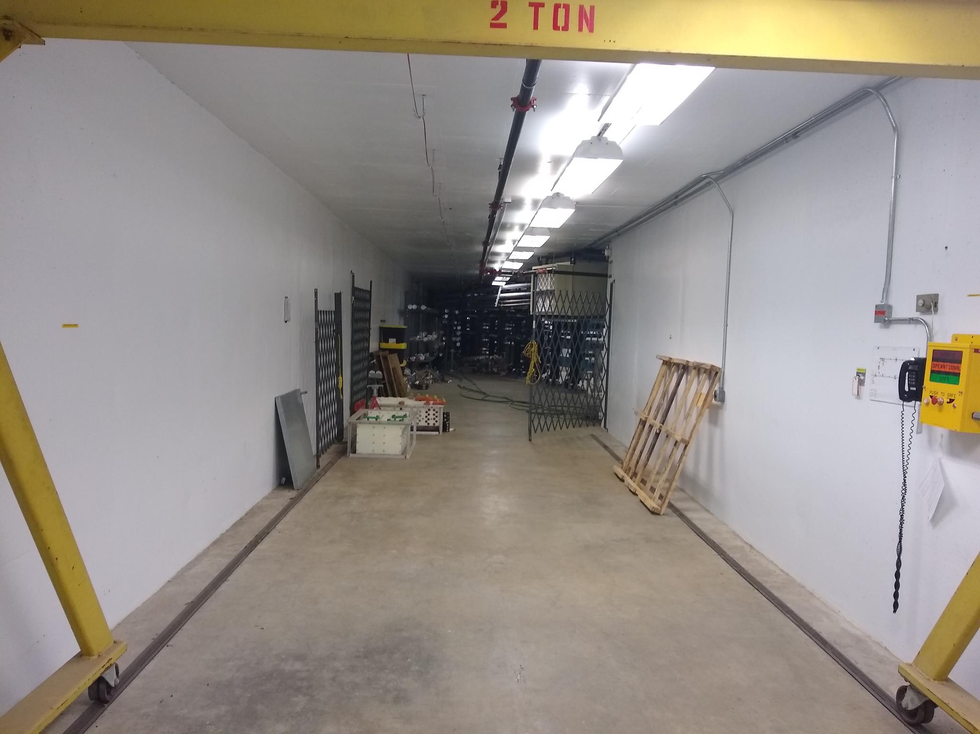
Then you can come down into the south access stub, making full use of this space.
Maybe you can even wall this off during connector tunnel construction.
If you shoot along near the right side wall, on the floor….
…you can snake below the ARC9 dipoles, and outside of the CM egress
Very accessible, to build a transport line on the floor.
Finally, snake up and combine, similar to NL injection
Keep access to tunnel, CM, access to magnets.
Cheaper to install in front of arc, grout/stands.

