Slide 1

Injector R&D
The Problems with Photoguns
M. Poelker
BNL, August 8, 2018

Slide 2
Gun Group
P. Adderley, B. Bullard, J. Grames, J. Hansknecht,
C. Hernandez-Garcia, M. Poelker, R. Suleiman, M. Stutzman, and S. Zhang
Postdoc: M. A. Mamun
Graduate Students: G. Palacios, Y. Wang*, S. Wijiethunga, J. Yoskovitz, M. Stefani
Frequently working with others: D. Moser, F. Hannon, R. Kazimi, A. Hofler, J. Benesch, M. Tiefenback, G. Krafft, many others….

Slide 3
New Photoguns
CEBAF Injector Full-Energy Upgrade
  Replace 130 kV gun with 200 kV gun
  New baked beamline, Wien filters at proper locations
  New Quarter Cryomodule
Upgraded Injector Test Facility
  Help commission the re-designed HDIce target
  Verify that the new QCM functions properly
  Pockels cell studies to support PV experiments
  Bubble Chamber astrophysics measurement
  Prepare polarized solid targets
  Polarized positron source
  Test coated SRF cavities
JLab Electron Ion Collider
  Very high average current un-polarized beams for cooling ions – magnetized cooling
  Exploring two options: DC high voltage photogun and rf-pulsed thermionic gun
Notes:
Interior Page Design 2

Slide 4
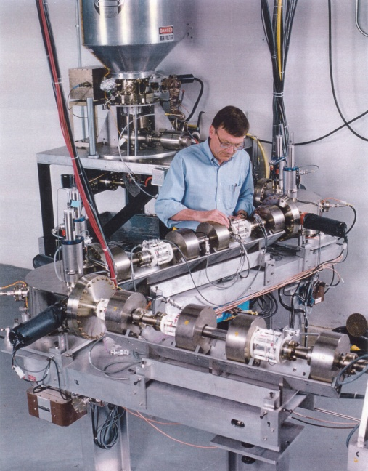
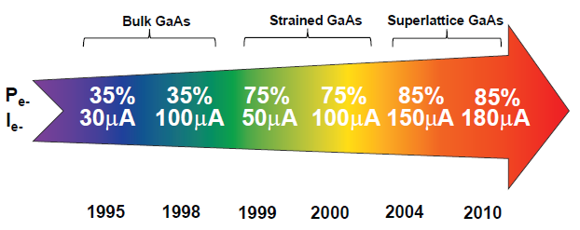
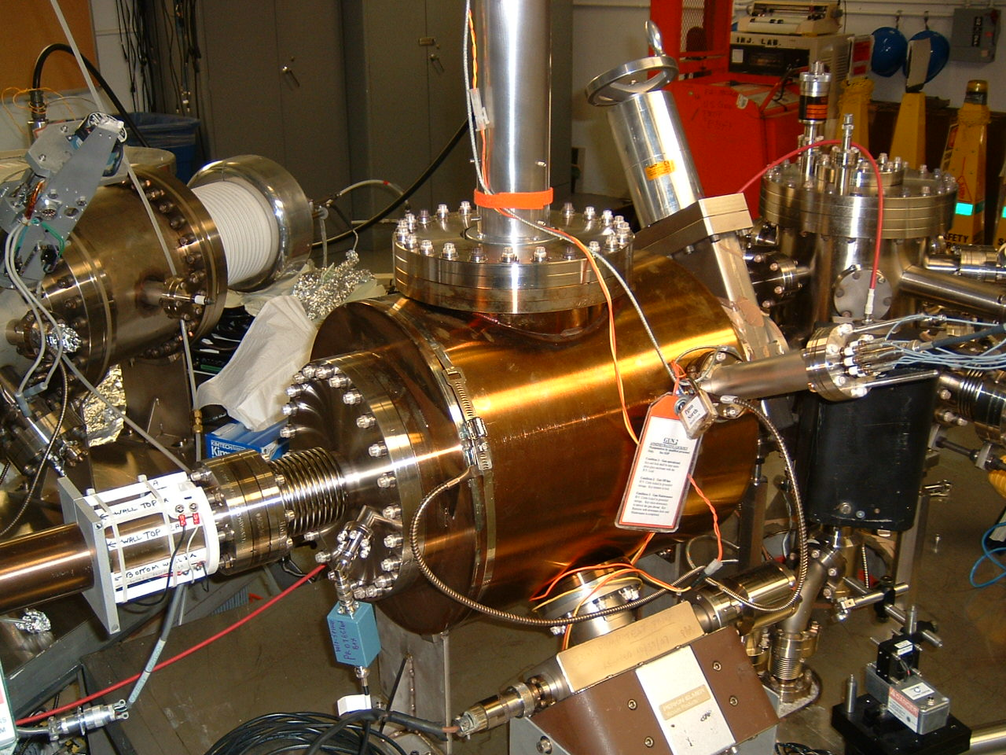
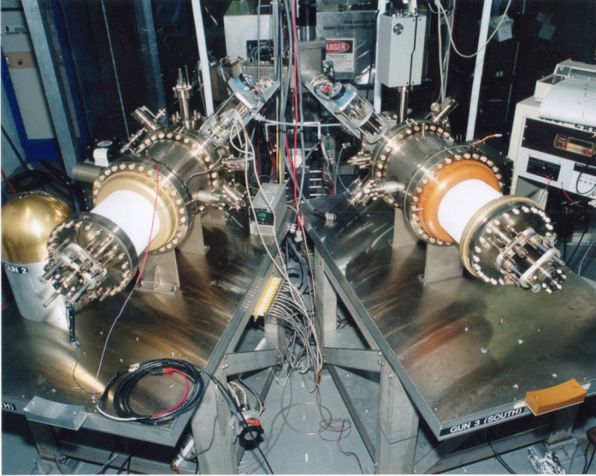
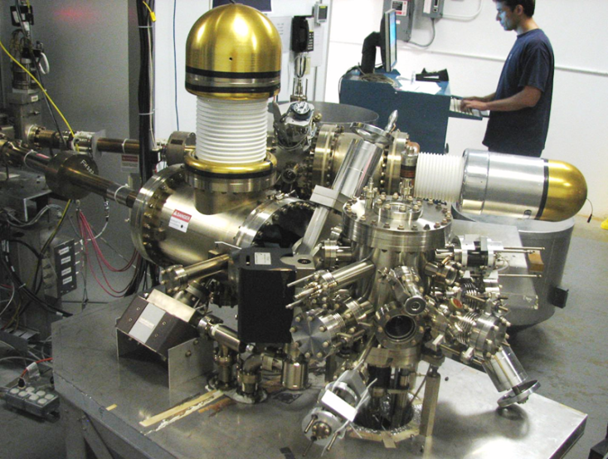
Always Tweaking the Design
1
4
Lifetime increased from 10s to 100s of Coulombs
The endless quest for perfection
2
3
Notes:
Interior Page Design 1

Slide 5
Key Features of a Polarized Photogun
Photocathode
  High Polarization
  High QE (photoemission yield)
  Long Lifetime
Vacuum
  Static Vacuum
  Dynamic Vacuum
High Voltage
  Must eliminate field emission
  No breakdowns, insulator failure
Drive Laser
  Reliable, phase locked to machine
  Adequate Power
  Wavelength Tunable
Notes:
Interior Page Design 2

Slide 6

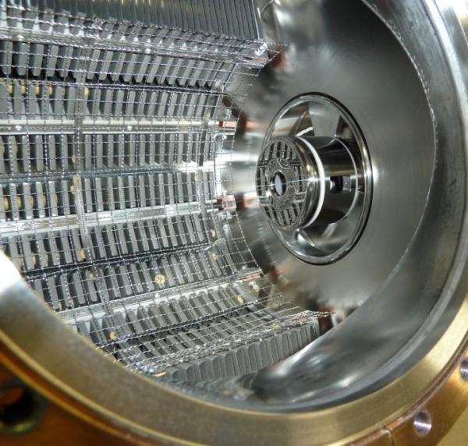
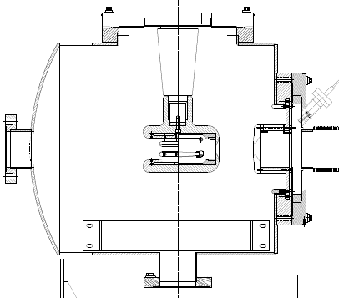
The CEBAF Inverted Gun
NEG pumps
Our “Load-locked” GaAs photogun:
Gun Vacuum ~ 10⁻¹² Torr
Beamline vacuum could be improved…
Matt Poelker, Jefferson Lab
Notes:
Interior Page Design 2

Slide 7
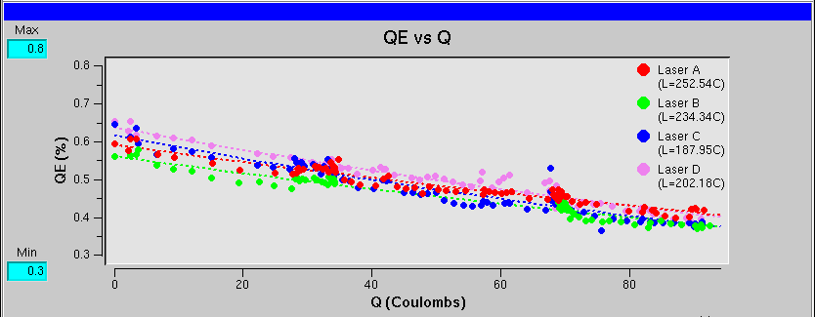
Recent CEBAF Polarized Source Performance
Fall 2016 – Spring 2017
  Strained Superlattice GaAs/GaAsP #5756-4
  Good Polarization 85-87% (measured at Mott)
  Good QE > 1% after activation => 6 mA/Watt/% @ 780 nm
  Lifetime about 200 C (σ_{4D} ~ 1mm) at currents < 200 uA

Slide 8


Improving Lifetime with Larger Laser Size
J. Grames, et al., Phys. Rev. ST Accel. Beams 14 043501 (2011)
GaAs @ 532nm

Slide 9

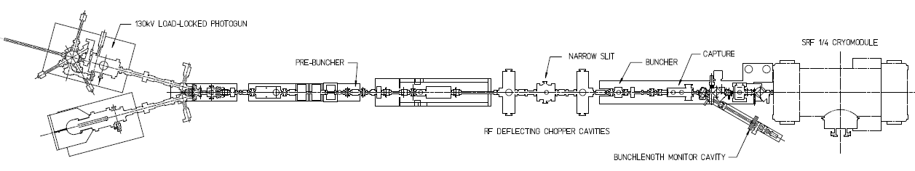
Lifetime Studies at mA Beam Current
CEBAF 130kV polarized “inverted gun” with load lock
Polarized positrons for CEBAF, and discussions with BNL related to high current eRHIC EIC, prompted experiments at CEBAF to characterize lifetime vs. laser spot size using high-polarization photocathodes
Make beam here
(-130kV, 0-1.5mA, 0-3pC)
Monitor vacuum and radiation levels along beam line
Deliver it here
(Faraday cup)
Vary the laser beam size
(f=499 MHz, σ_{t} ~ 50 ps)
Work of Joe Grames, PSTP2017

Slide 10

Lifetime Studies at mA Beam Current
Required laser power to maintain current, slope proportional to QE decay
Increasing laser size reduces QE decay proportionally
1mA
Adjust beam size to decrease x-ray level

Slide 11

First Results: GaAs/GaAsP at mA Current
1 mA for 4.7 days
1mA(2007)
CEBAF
4mA(2011)
  CEBAF charge lifetime improves with larger laser spot size, as expected, but eventually beam size becomes “too large”
  Laser diameters greater than ~4 mm (4 sigma) will require properly designed cathode/anode electrodes, to ensure 100% transmission, to maintain excellent vacuum, to minimize ion bombardment

Slide 12
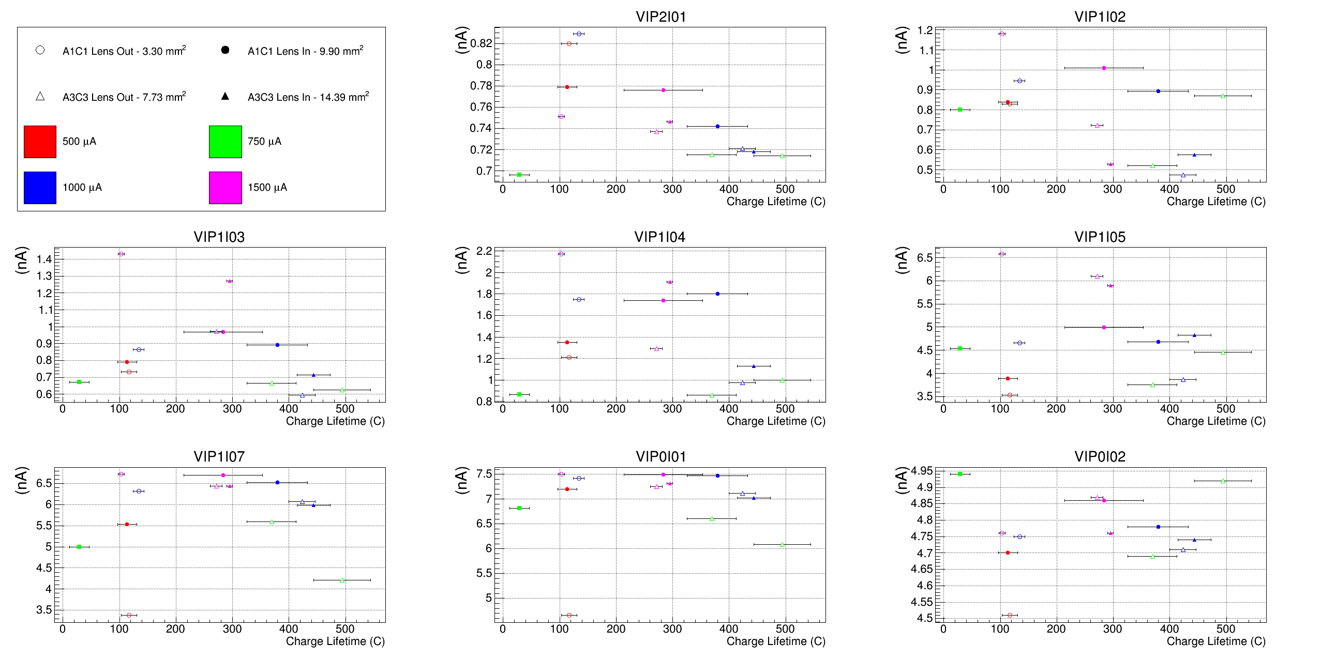
Vacuum vs. Lifetime
Vacuum levels vs. lifetime are not as highly correlated with radiation levels
Still gun vacuum remains (sensibly) the greatest correlation with lifetime

Slide 13
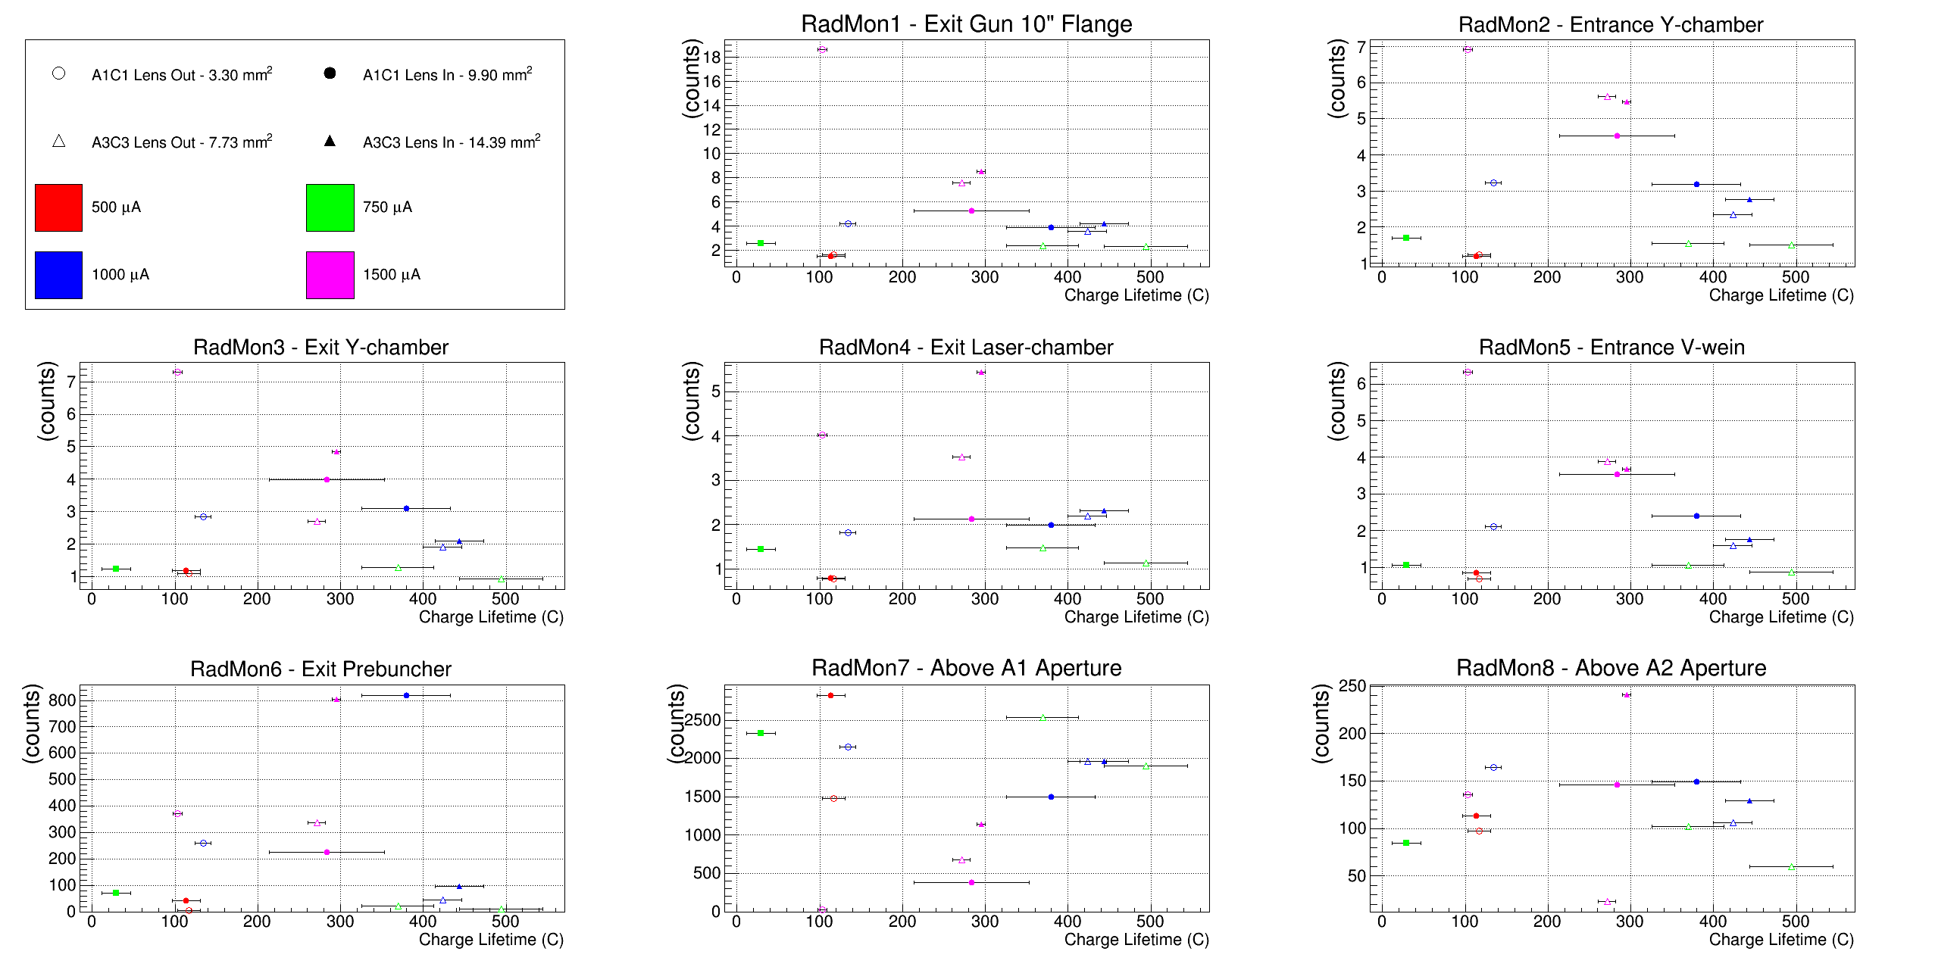
Radiation Level vs. Lifetime
Generally, charge lifetime improves with decreasing x-ray levels
Levels away from apertures (<10 Hz) more revealing than apertures (>250 Hz)

Slide 14
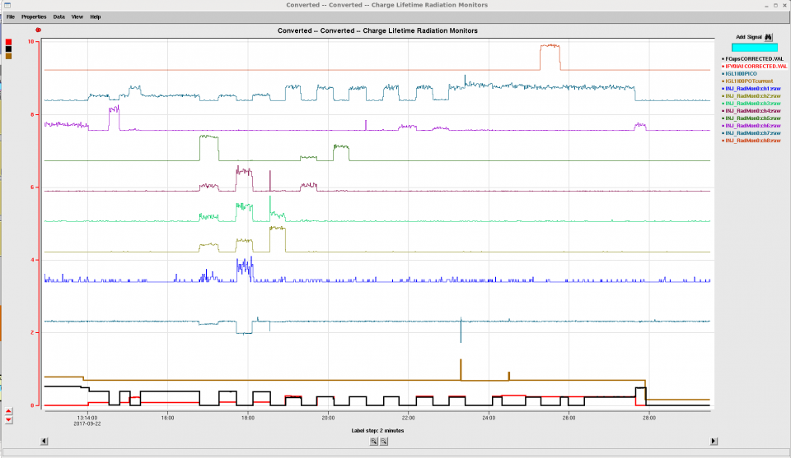
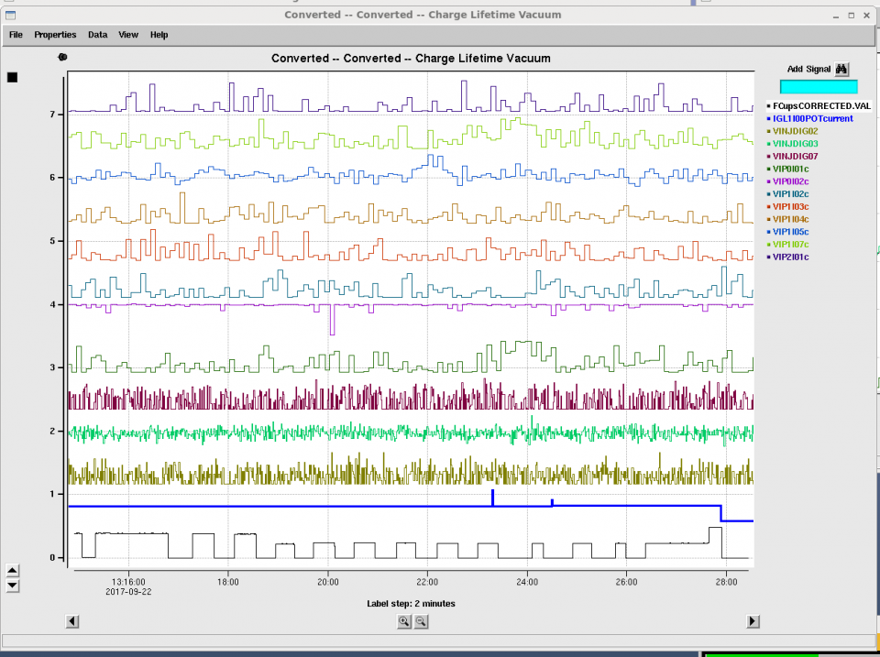
Sensitivity of x-ray detectors for beam loss
X-ray monitors detect low level beam loss, sensitive to ~ 60 pA loss (typ. 1-5 nA), an array of GM tubes can pinpoint loss
x-ray
loss
Always use ion pumps as beam loss monitors, but in this study, beamline pressure appeared constant
vacuum
loss

Slide 15

Polarization Studies at mA Beam Current
First measurement of beam polarization from strained superlattice GaAs/GaAsP photocathode at milli-Ampere current
CEBAF 5 MeV Mott polarimeter: on-going effort to ascribe sub-percent accuracy (collaborators D. Moser, X. Roca-Maza, Charles Sinclair, M.J. McHugh, and Tim Gay)
CEBAF 5 MeV Mott Polarimeter
Work of Joe Grames, PSTP2017

Slide 16

JLEIC High Energy Electron Cooler
High Energy Electron Cooler
ion beam
Magnetization flip
ion beam
cooling solenoid (B<0)
cooling solenoid (B>0)
beam dump
linac
injector
fast extraction kicker
circulating bunches
fast injection kicker
Circulator Cooler Ring
ERL Ring
injected bunches
exchange
septum
extracted bunches
dechirper
vertical
bend
to CCR
vertical
bend
into ERL
rechirper

Slide 17
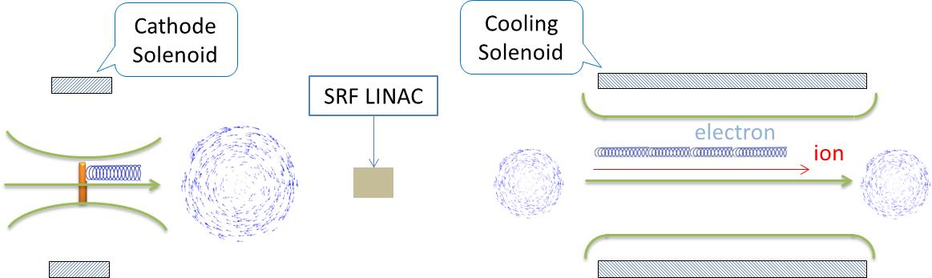

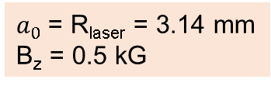
Magnetized Cooling Schematics
Electron beam suffers an azimuthal kick at entrance of cooling solenoid. But this kick can be cancelled by an earlier kick at exit of photogun. That is purpose of cathode solenoid
V
B
V
B
B
V
B
V
Electrons born in strong uniform B_{z}
Upon exit of Cathode Solenoid
Upon entering Cooling Solenoid
r_{e}= 0.7 mm
B_{cool} = 1 T
$a_{0}$= R_{laser} = 3.14 mm
B_{z} = 0.5 kG
= 36 µm

Slide 18
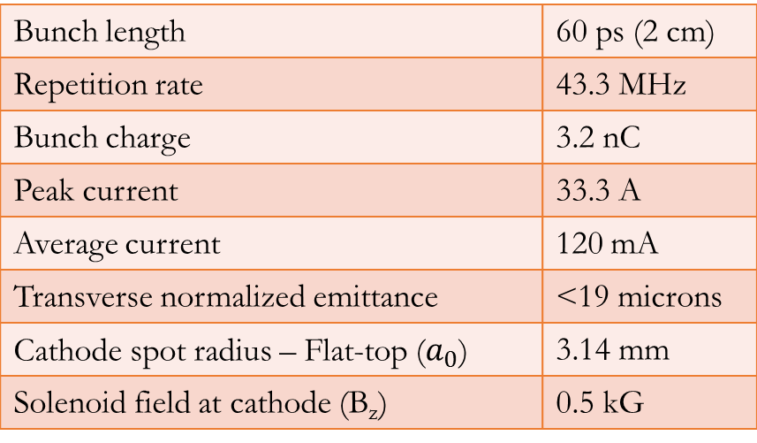
JLEIC Magnetized Source Requirements
Bunch length | 60 ps (2 cm)
Repetition rate | 43.3 MHz
Bunch charge | 3.2 nC
Peak current | 33.3 A
Average current | 120 mA
Transverse normalized emittance | <19 microns
Cathode spot radius – Flat-top ($a_{0}$) | 3.14 mm
Solenoid field at cathode (B_{z}) | 0.5 kG
Cornell University demonstrated 65 mA and 2 nC, but not at same time, and non-magnetized
Fermilab Magnetized Photoinjector Laboratory:
Pulsed NCRF gun with Cs₂Te photocathode and UV laser (λ=263 nm)
Bunch charge: 0.5 nC and bunch length: 3 ps
0.5% duty factor (average current: 7.5 μA)
  Bunch frequency: 3 MHz
  Macropulse duration: 1 ms
  Number of bunches per macropulse: 3000
  Macropulse frequency: 5 Hz

Slide 19
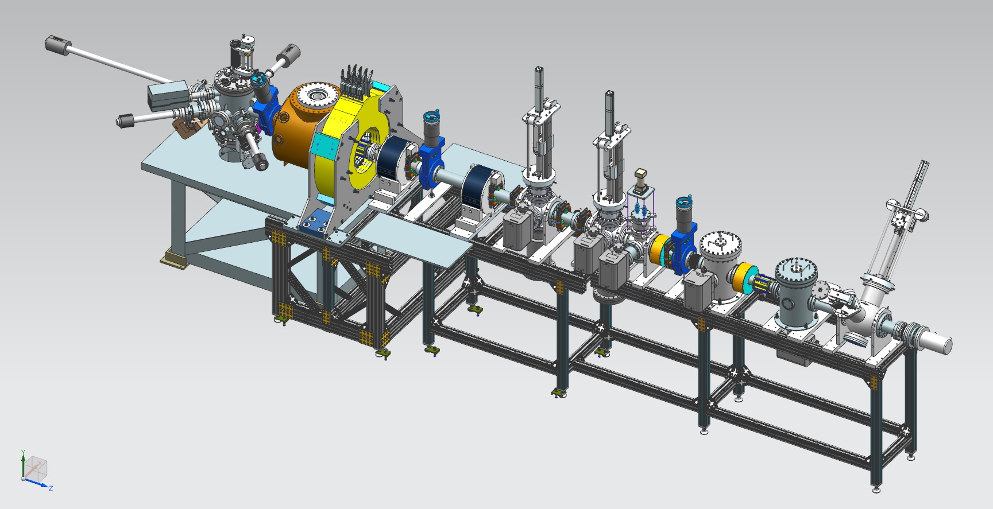
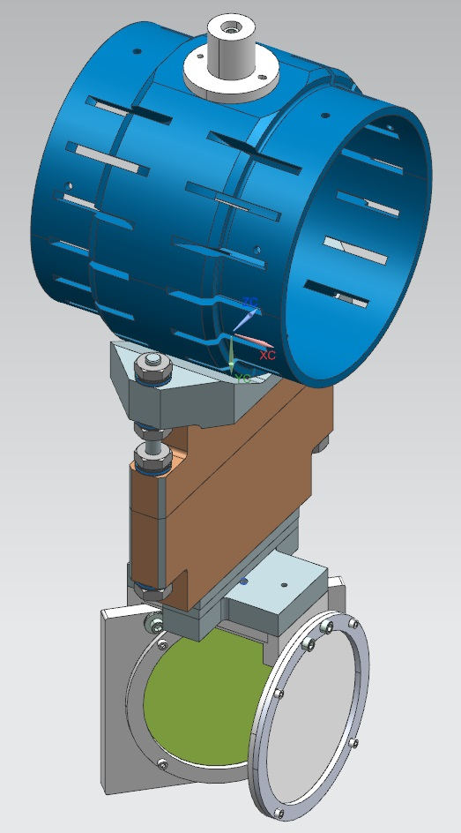
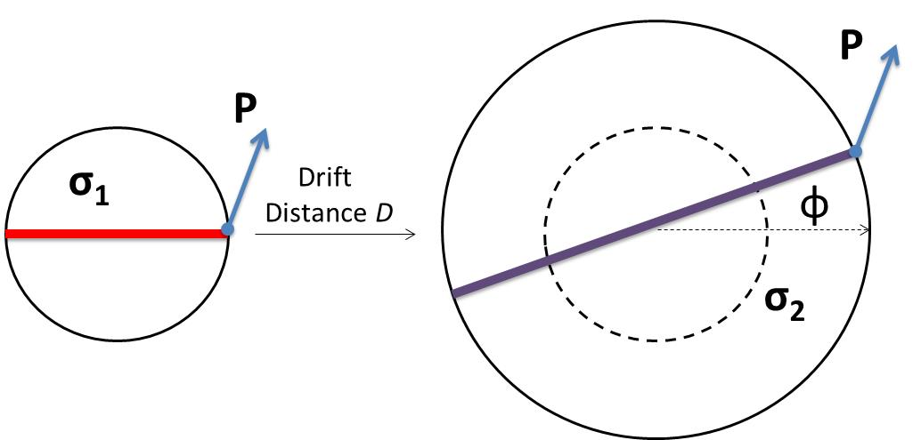
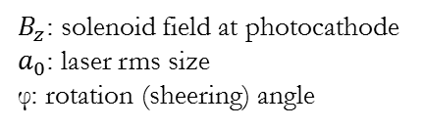
Magnetized Source Schematics
Gun HV Chamber
Photocathode
Preparation
Chamber
Beamline
Gun Solenoid
Shield Tube
Viewer 3 Screen
Beam Dump
Use slit and viewscreens to measure mechanical angular momentum:
Slit
$B_{z}$: solenoid field at photocathode
$a_{0}$: laser rms size
φ: rotation (sheering) angle
Viewer Screen

Slide 20
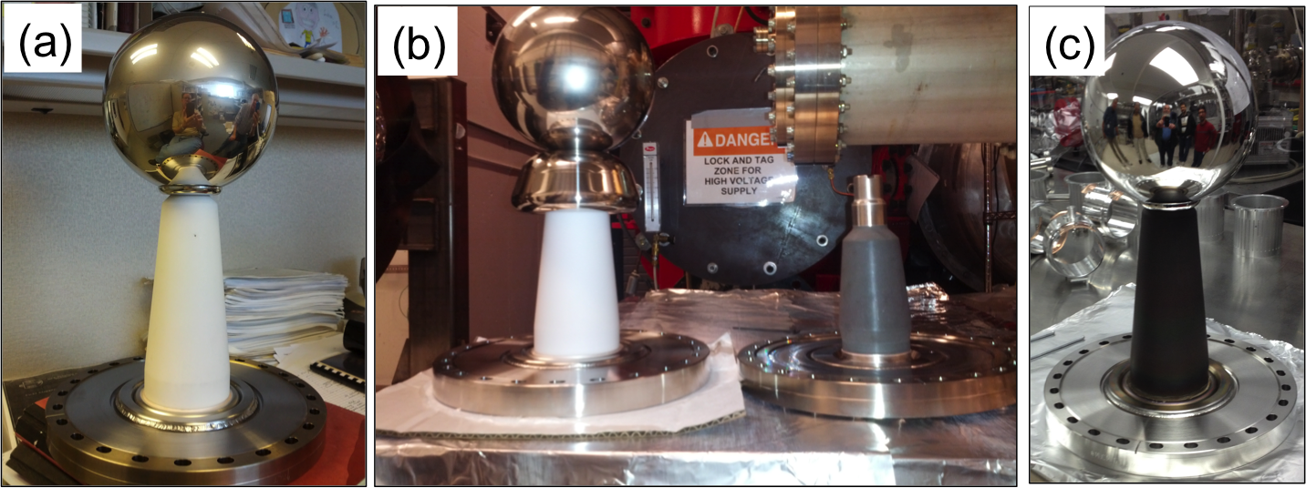
Building a 500 kV (?) Gun
Start with “dummy” electrode (no photocathode) and test different insulators and cathode screening electrodes
C. Hernandez-Garcia, M. Poelker, and J. Hansknecht, “High Voltage Studies of Inverted-geometry Ceramic Insulators for a 350kV dc Polarized Electron Gun,” IEEE Transactions on Dielectrics and Electrical Insulation, Vol. 23, No. 1; February 2016

Slide 21
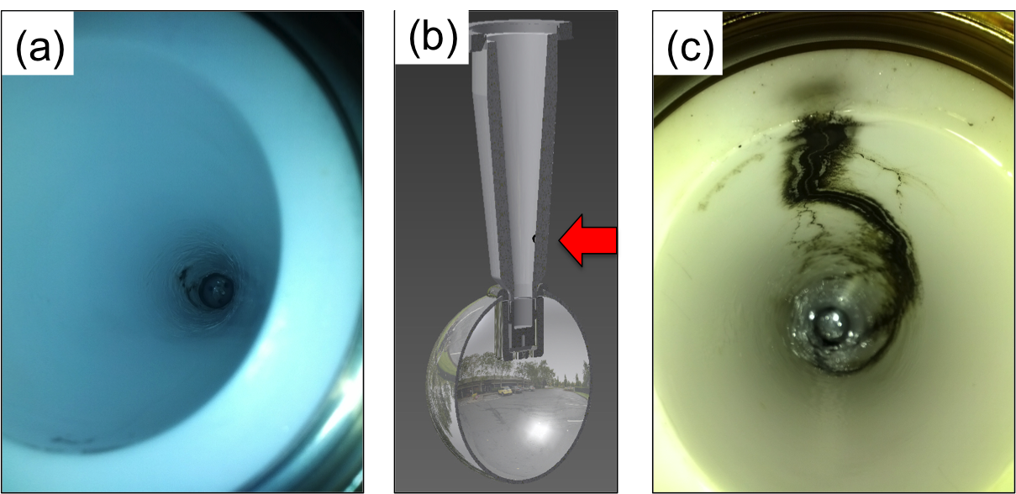
The Reality of HV Breakdown
The first test with R30 pure alumina ceramic suffered breakdown at ~315kV with subsequent puncture at 330kV.
A second test with a new R30 pure alumina suffered breakdown at ~315 kV.
Field emission managed via krypton-processing*, i.e., voltage was applied with ~10⁻⁵ Torr krypton added to gun chamber
* M. BastaniNejad, A. A. Elmustafa, E. Forman, J. Clark, S. Covert, J. Grames, J. Hansknecht, C. Hernandez-Garcia, M. Poelker and R. Suleiman, “Improving the performance of stainless-steel DC high voltage photoelectron gun cathode electrodes via gas conditioning with helium or krypton,” Nucl. Instr. and Meth. in Phys. Res. A, Vol. 762, pp. 135–141, 2014

Slide 22
Careful design of triple-junction-shield
Gradients shown for 350 kV
HV plug
Ceramic
Design overall shape for low gradient here !!
Simulationsby Y. Wang

Slide 23
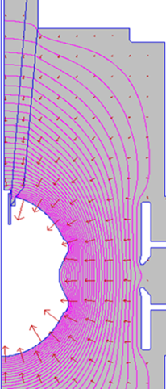
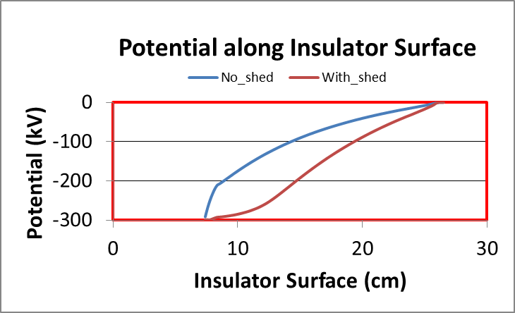
In Lieu of Segmented Insulator
Besides reducing field strength, the triple-point-junction shield “linearizes” the potential drop along insulator
<10 MV/m
> 100 MV/m

Slide 24
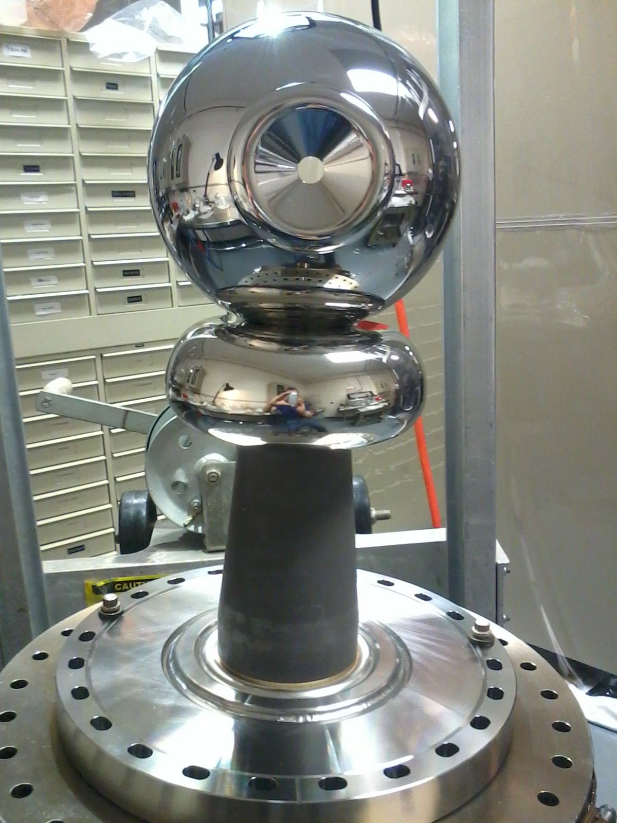
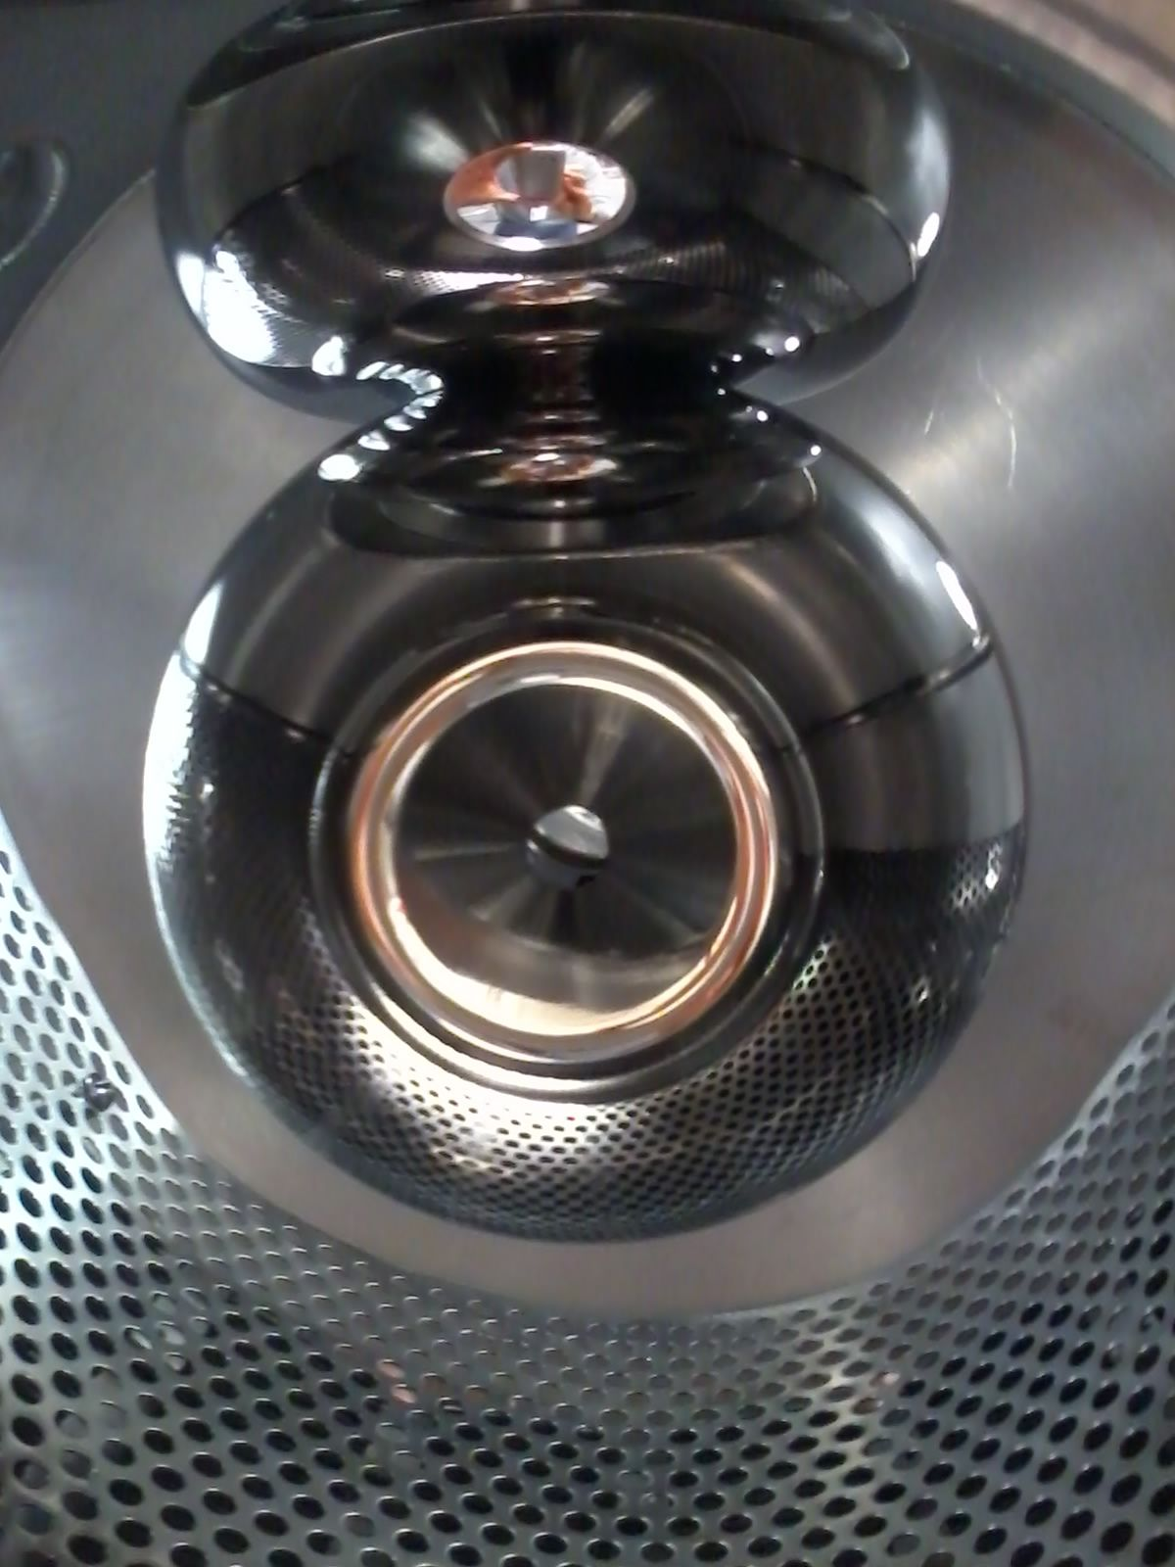
500 kV Gun?
Notes:
Interior Page Design 2

Slide 25
500 kV Gun? No
Notes:
Interior Page Design 2

Slide 26
Gun High Voltage Conditioning
Reached
360 kV
Vacuum and radiation levels
indistinguishable from bkgd at 350kV
Work by Carlos Hernandez-Garcia
Notes:
Interior Page Design 2

Slide 27
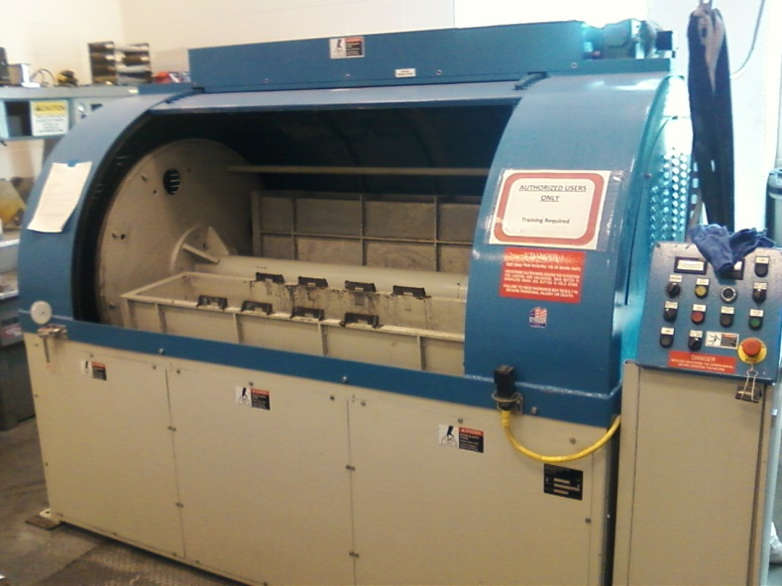
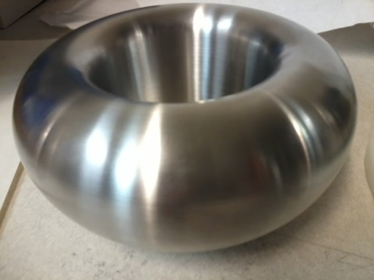
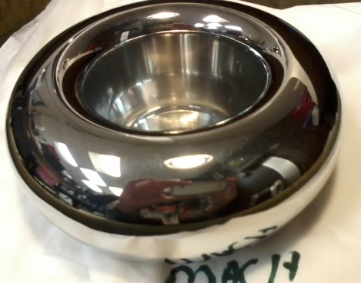
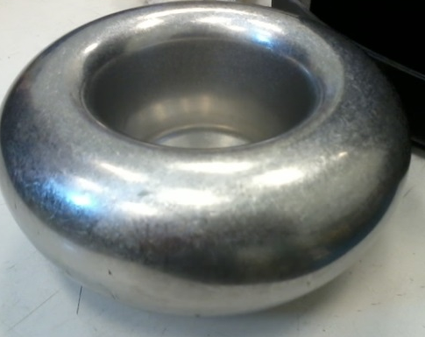
Barrel-Polished Electrodes
Gun electrodes traditionally polished using sand paper and diamond paste
Tedious process, takes about 30 days to complete
Now performed in 1 day using SRF barrel polishing machine
  From machine shop
30 minutes with corncob
Work by Don Bullard
30 minutes with plastic cones
Notes:
Interior Page Design 2

Slide 28
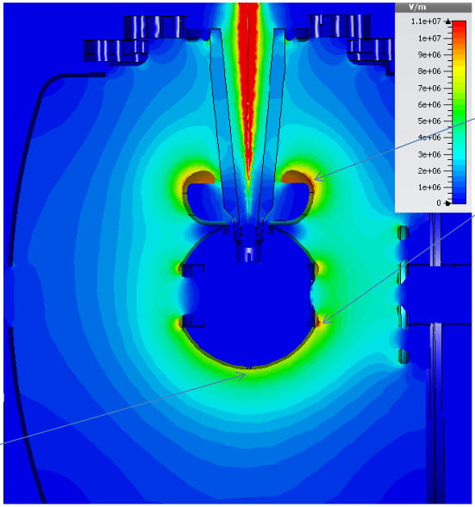
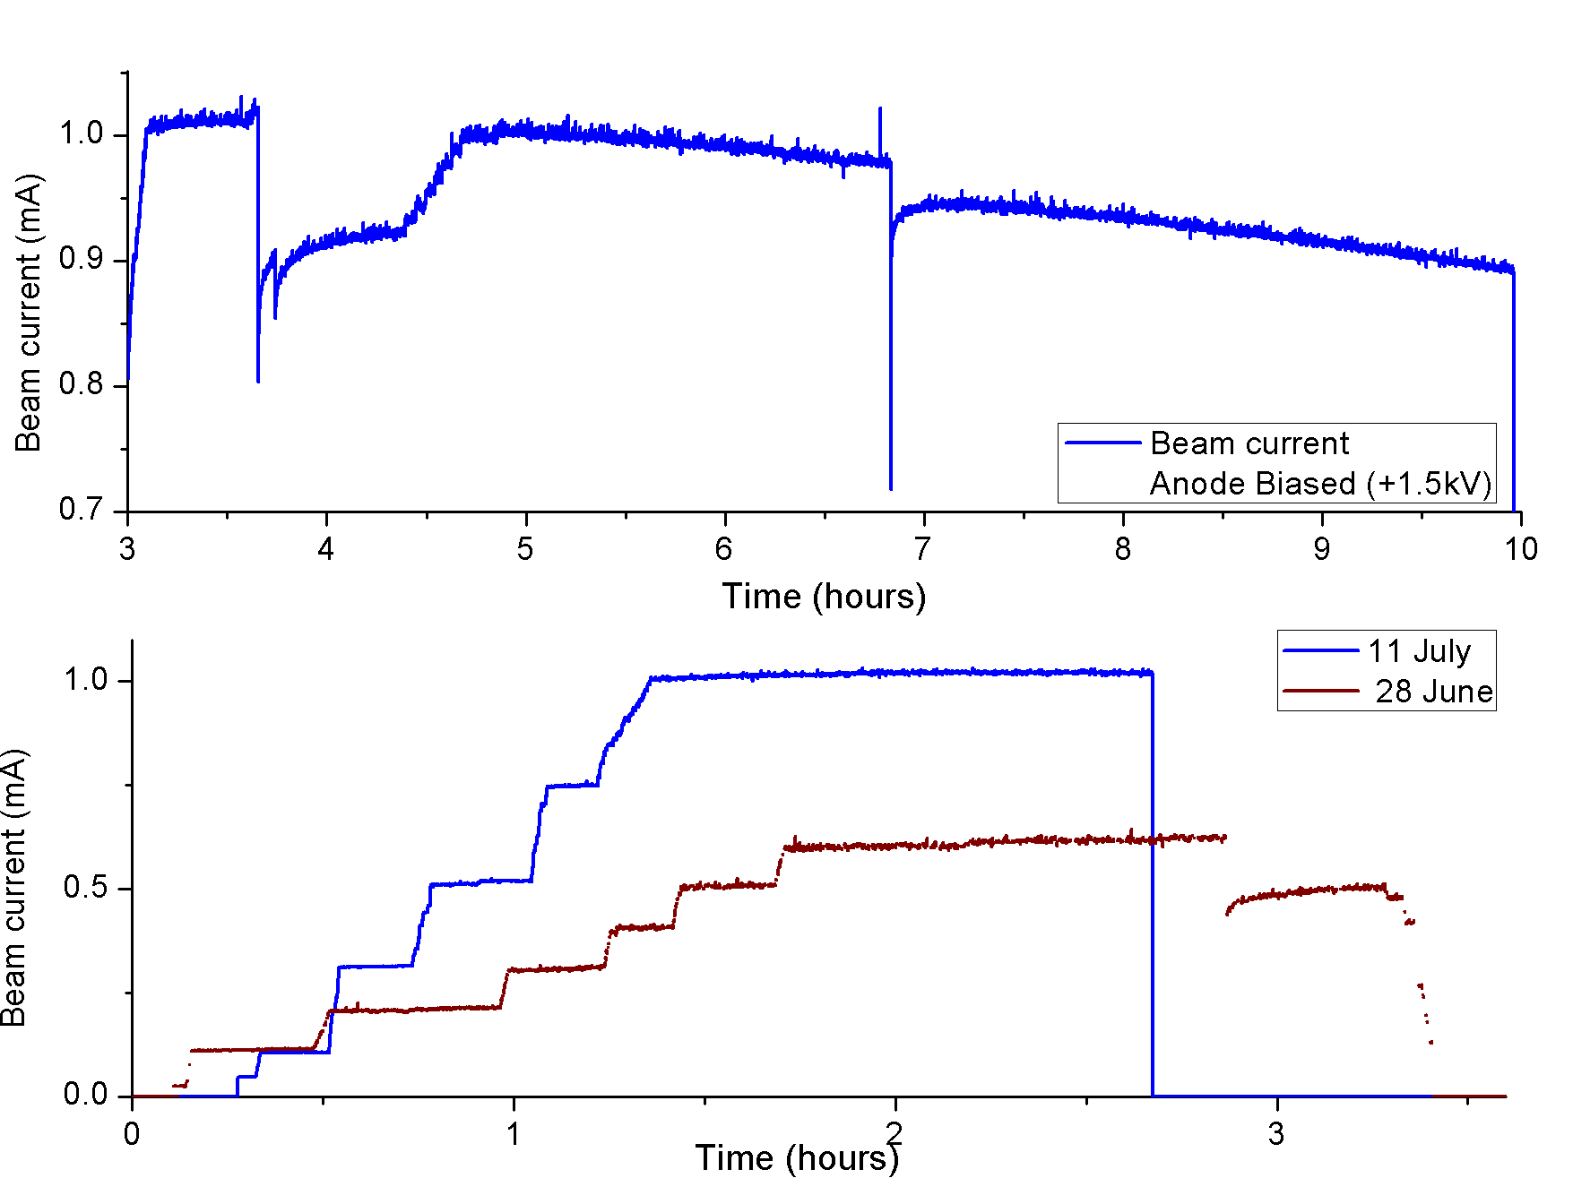
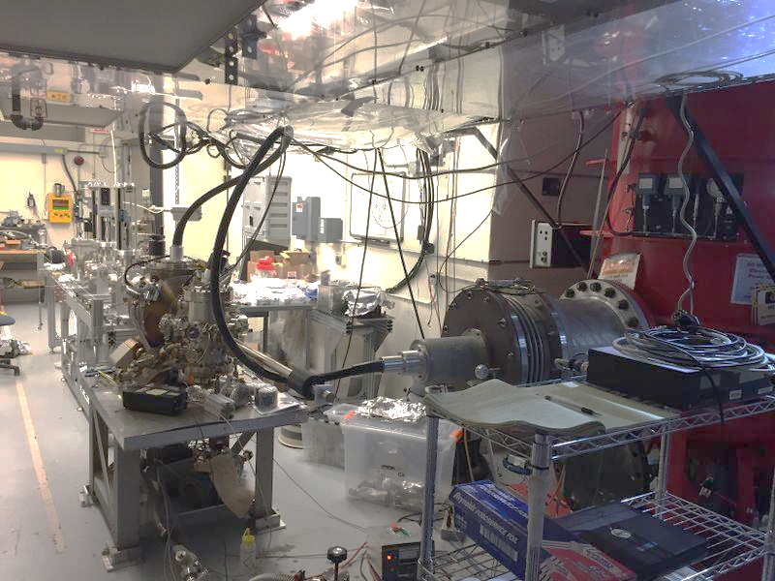
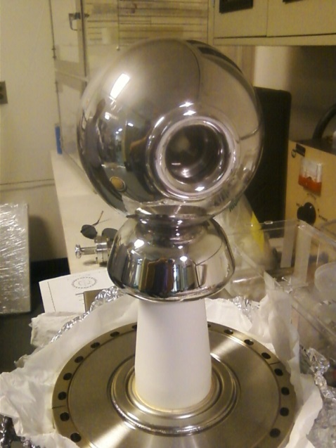
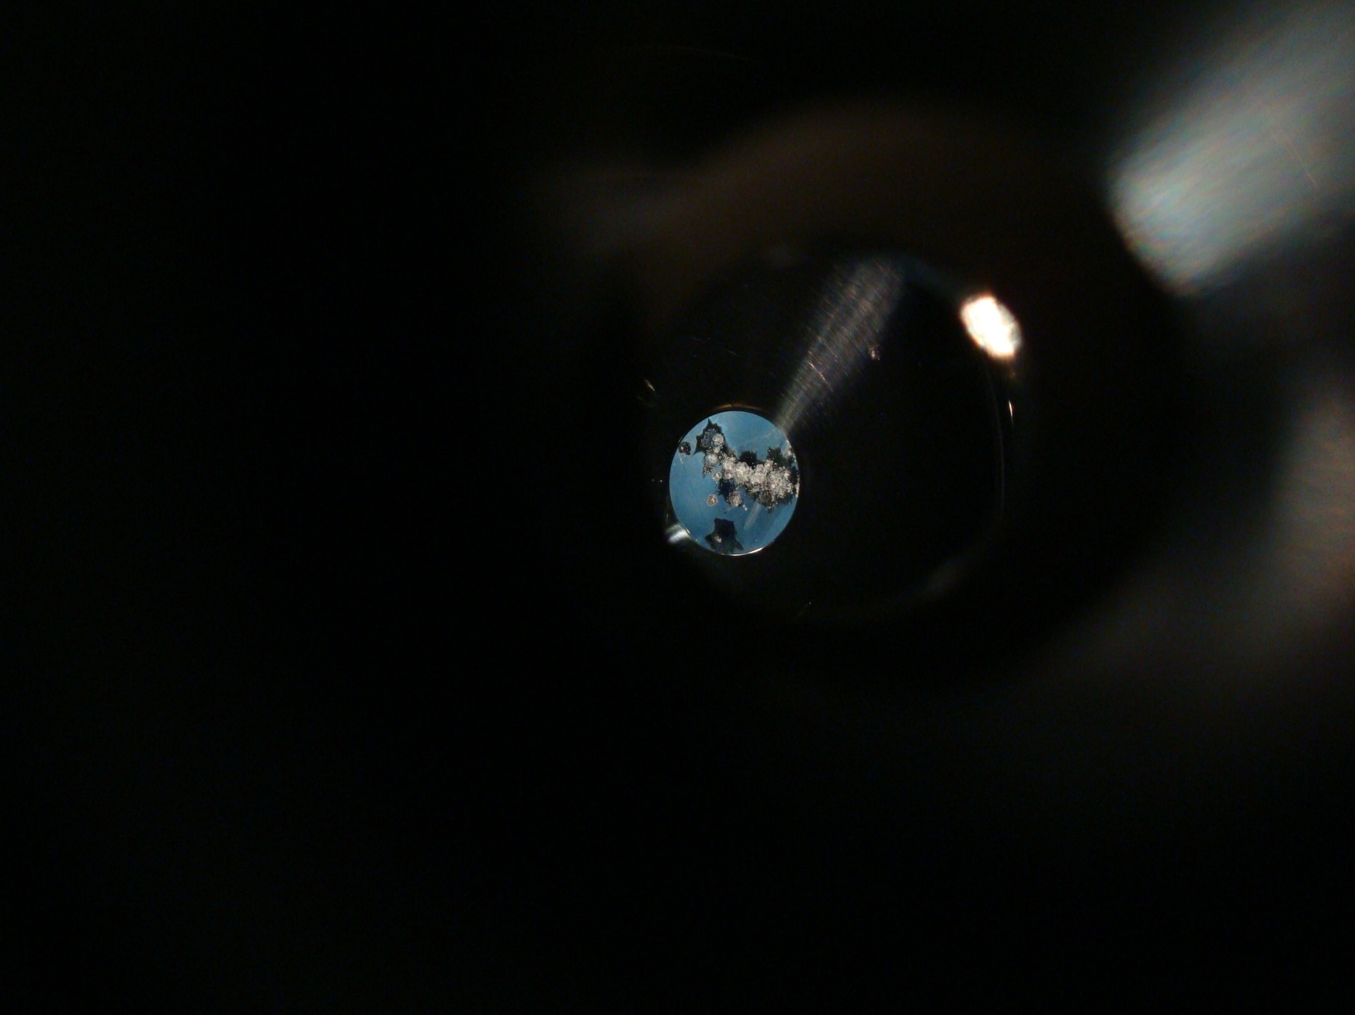
300 kV Inverted Gun and CsK₂Sb Photocathode
11 MV/m
1mA
QE drop
8 MV/m
Learning how to use the new photocathode
First insulator conditioned to 325 kV, then rebuilt gun with optimized triple-junction shield
28
Slide 28

Slide 29
Charge Lifetime of High Current Beam
Cs_{x}K_{y}Sb photocathodes on GaAs substrates
No apparent Lifetime dependence on gun HV, magnetization effect, or run sequence
Only 3 incidents of QE drop due to arcing, and this happened only with non-magnetized beam
Strong focusing of gun solenoid might help keep ions away from e-beam
Work of Md. Mamun, Y. Wang

Slide 30
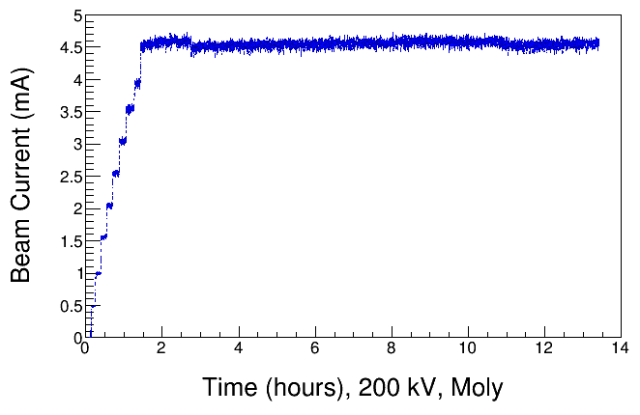
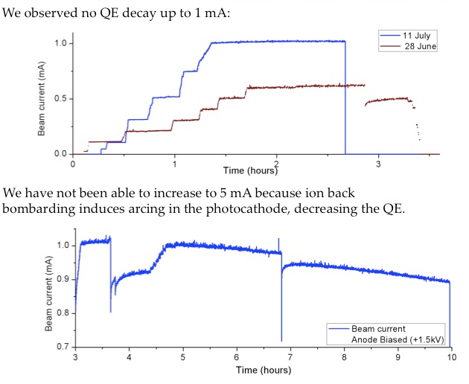
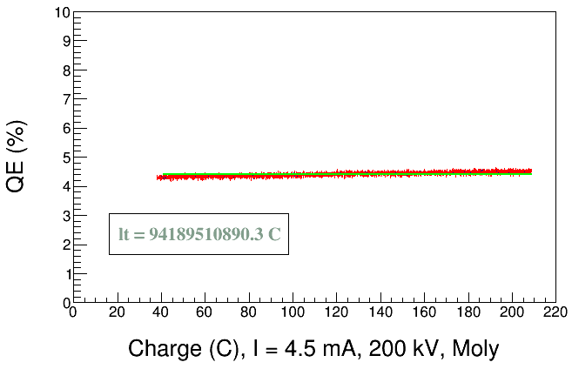
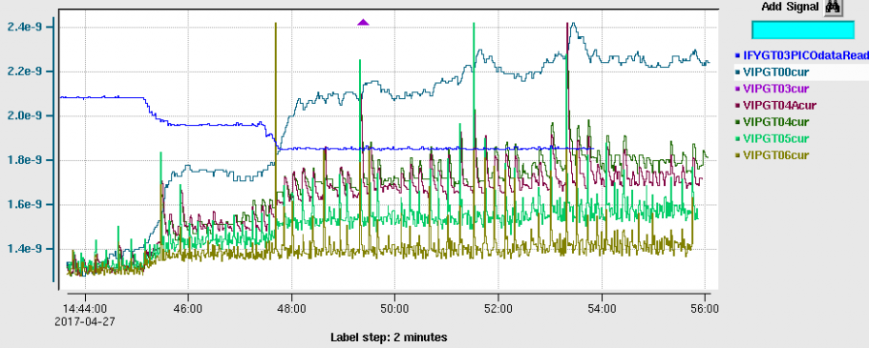
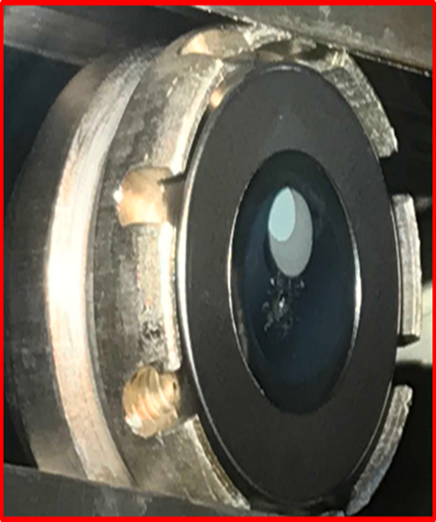
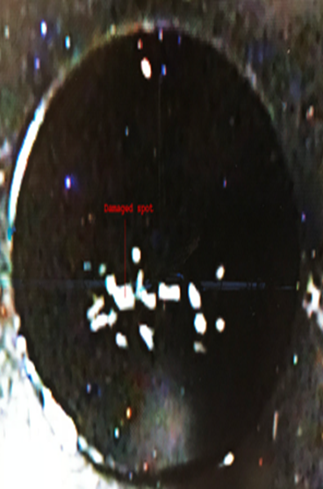
Molybdenum Puck, Biased anode, Precipitators
Biased anode
Uninterrupted Operation
Two beamline precipitators
Periodic vacuum bursts,
sometimes accompanied by step decrease in QE
30
Slide 30

Slide 31
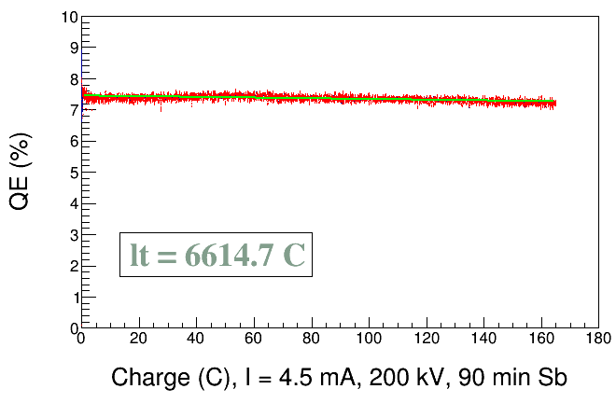
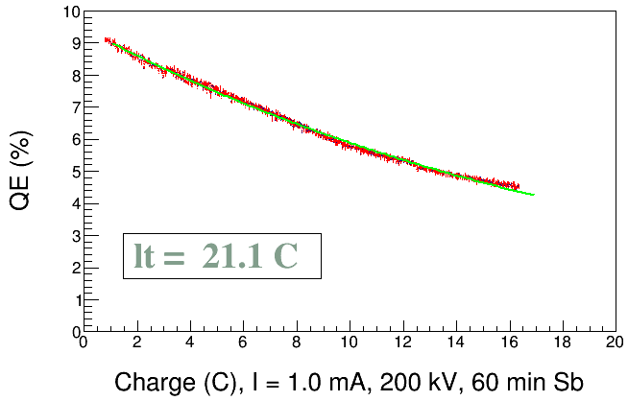
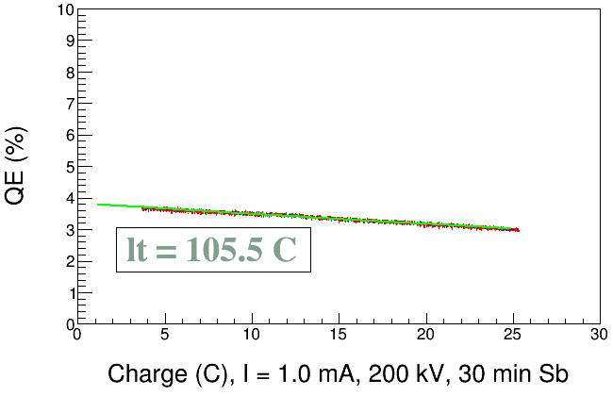
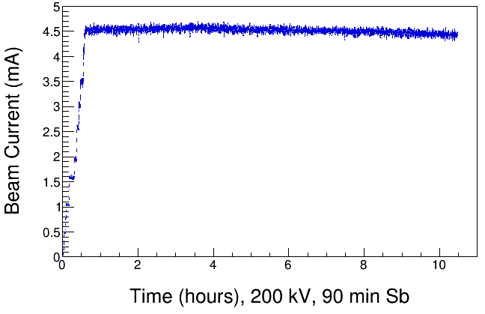
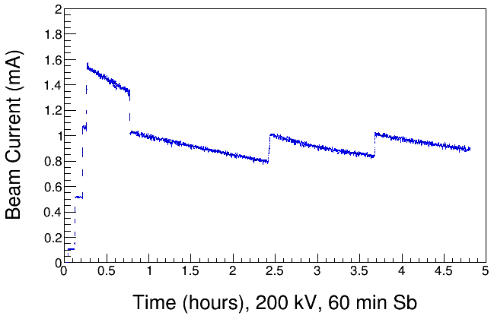
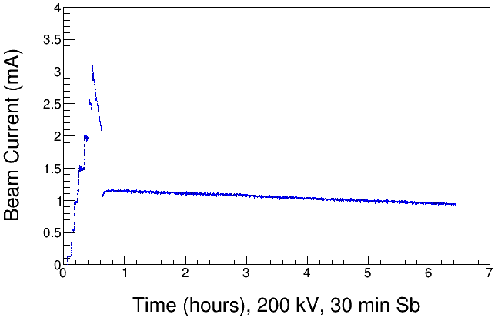
Good lifetime using GaAs Substrates (sometimes)
Lifetime runs using biased anode and beamline precipitators
Thick antimony layer
Thin antimony layer
work of Md. A. Mamun and Y. Wang, very preliminary
31
Slide 31

Slide 32
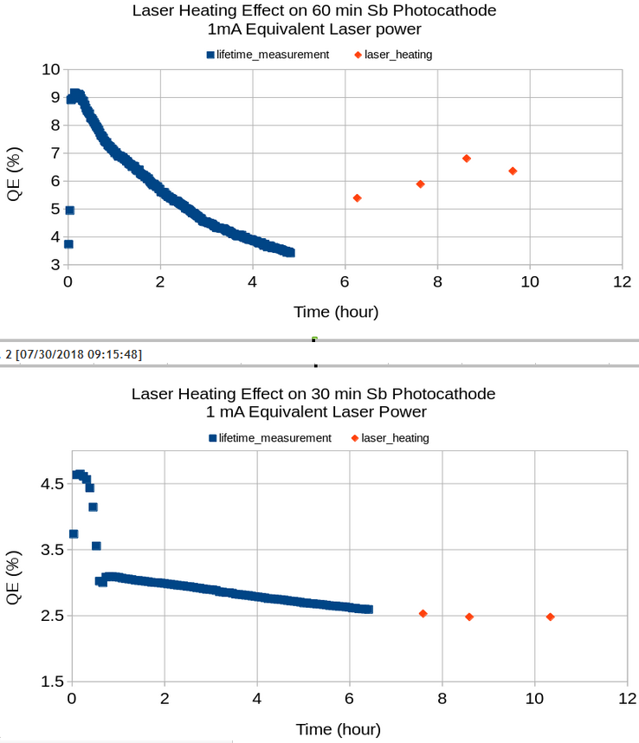
Alkali-Antimonide Photocathode Lifetime
Cs_{x}K_{y}Sb photocathode studies
Factors that effect photocathode lifetime:
HV micro-discharges
Field emission?
Beamline ions
laser heating
Recipe variations and chemistry
photocathode/substrate interface
work of Md. A. Mamun and Y. Wang, very preliminary
32
Slide 32

Slide 33
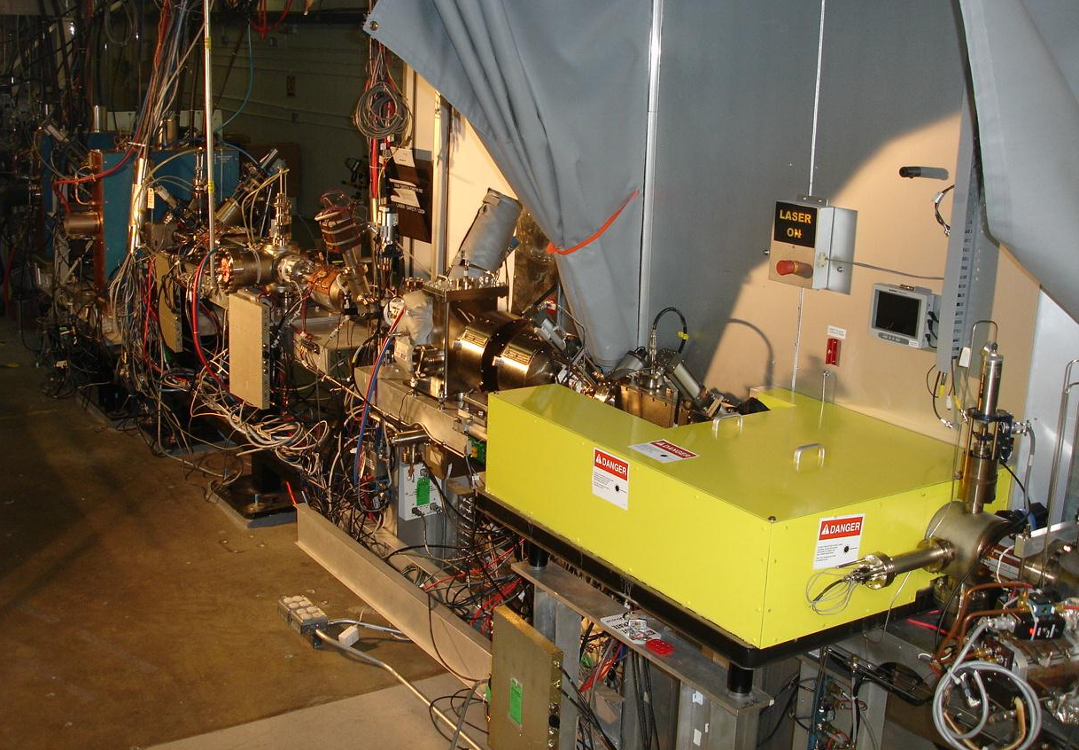
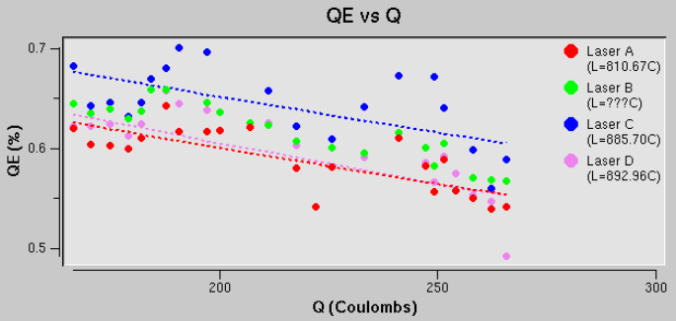
Improved lifetime at CEBAF with Wien “precipitator”
Vert. Wien ON and set to rotate polarization 50 degrees
33
Slide 33

Slide 34

    Parity Table
Upgrading the CEBAF Injector will help us conduct PREx, CREx and proposed parity violation experiments that are even more demanding
Notes:
Interior Page Design 2

Slide 35


Injector Upgrade
200 kV
Increase gun voltage, modify Wien filters for 200kV operation
Improve baked beam line vacuum so gun does not pump on beam line
Locate H-Wien (energy filter) upstream of pre-buncher cavity
New SRF booster eliminates warm capture, RF deflection and x/y coupling
Our new “1/4 cryomodule”, or QCM:
2 cell capture section + 7 cell cavity,
should provide 10 MeV beam and introduce no x/y coupling, allow better matching, more adiabatic damping

Slide 36

CEBAF Photogun at 200 kV
Deemed too aggressive
Field maps by G. Palacios
Notes:
Interior Page Design 2

Slide 37

Plan A
CEBAF 130 kV, used since 2010
< 10 MV/m, demonstrated performance at 300 kV,
a “sure thing” at 200 kV
Notes:
Interior Page Design 2

Slide 38


Upgraded Injector Test Facility - UITF
TEST HDIce
TEST NEW PHOTOGUNS
TEST 200 kV WIEN FILTER
COMMISSION NEW QUARTER CRYOMODULE
38

Slide 39

Upgraded Injector Test Facility

Slide 40


Homemade NEG coating
“It’s going to be the best polarized source ever”
anonymous
Work of P. Adderley, M. Stutzman

Slide 41


Homemade NEG coating

Slide 42

But wait…..
Gun vented at 229 kV
Field emission and excessive voltage–induced gas bursts
Voltage-induce gas bursts are normal, but not at this level
Neon, used for NEG coating, liberated by high voltage
42

Slide 43

Plan B
Only two R30 insulators left, need them for LDRD magnetized beam
Smaller R28 insulator, with optimized triple point shield and mildly conductive insulator
CEBAF 130 kV, used since 2010
Notes:
Interior Page Design 2

Slide 44


Plan B
Field maps by G. Palacios
Notes:
Interior Page Design 2

Slide 45



Beam Deflection and Astigmatism
Original CEBAF cathode electrode
Some Progress:
Beam delivery 180 kV
New power supply attached to PSS
But…
Beam deflection
Astigmatic beam harder to transport
Reaped no rewards for stiffer beam
New cathode electrode
Notes:
Interior Page Design 2

Slide 46
Summary
Polarized beam - How much beam loss is bad? Good evidence that nanAmp loss, a part in 10⁶ at mA current, is problematic
Radiation monitoring, now an essential tool for polarized beam operations
Scaling the laser beam size to ~ 1cm should be possible if gun electrodes are designed properly
Why don’t we bias the anode at CEBAF? Precipitators are exciting development
CEBAF gun group (finally) starting to perform realistic and useful modeling, but so far, I don’t think modeling has solved a problem BEFORE cutting metal
Students have been key to recent progress, and bringing projects to semi-conclusion
Alkali-antimonide lifetime studies very interesting, Similar/different compared to GaAs - ions, ion bombardment, laser heating, chemistry variations, photocathode/substrate interface

Slide 47
Summary
Fixing one problem can create another – NEG coating seems to have resulted in insulator failure, a result of excessive gas load liberated from coating during HV processing
High Voltage: no explosions, no field emission, (and now we appreciate) uniform field in the cathode/anode gap
High voltage R&D is expensive and takes a long time to complete
The inverted insulator design seems perfect for guns biased to 200 kV, but temperamental at voltage 300+ kV, although we did operate at 300 kV for > 1000 hours
Some JLab locations can’t accommodate a tall photogun
Segmented insulator, wonderful for pinning the voltage drop across the insulator, I wish there was a way to implement for inverted insulator
The best way to make progress is to keep the test apparatus ON every day

Slide 48
Gun Group
P. Adderley, B. Bullard, J. Grames, J. Hansknecht,
C. Hernandez-Garcia, M. Poelker, R. Suleiman, M. Stutzman, and S. Zhang
Postdoc: M. A. Mamun
Graduate Students: G. Palacios, Y. Wang*, S. Wijiethunga, J. Yoskovitz, M. Stefani
Frequently working with others: D. Moser, F. Hannon, R. Kazimi, A. Hofler, J. Benesch, M. Tiefenback, G. Krafft, many others….

Slide 49
Supplemental
Material

Slide 50

Ion Bombardment

Slide 51

Improving charge lifetime with GaAs/GaAsP
Indeed, we enhanced the Charge Lifetime for QWeak by a factor of four when doubling the laser spot size from 0.5 mm to 1.0 mm (diameter)
but milliampere applications require kiloCoulomb charge lifetime to provide uninterrupted operation of reasonable duration

Slide 52

Parity Violation Experiments
Increasing precision
Decreasing Physics Asymmetry
Notes:
Interior Page Design 2

Slide 53


Benefits of Distributed Bragg Reflector
non-DBR Photocathode : absorption in the GaAs/GaAsP superlattice < 5%
  Most light passes into the substrate leading to unwanted heating
DBR photocathode : absorption in the GaAs/GaAsP superlattice > 20%
  Less light required to make required beam, less light means less heat
Great for high current initiatives like polarized positrons at CEBAF and EIC
Enhanced absorption occurs only at specific laser wavelengths
Photocathode without DBR
Photocathode with DBR
(57 layers!)
Non-DBR photocathode
DBR photocathode

Slide 54


World Record QE from High Polarization Photocathode
Others have tried…but very difficult to obtain QE enhancement at the laser wavelength that also provides high polarization, CEBAF lasers operate at ~ 776 nm (doubled-telecom lasers)
Standard strained-superlattice
  QE = 0.89%
  Polarization = 92%
DBR
  QE = 6.4%
  Polarization = 84%
The highest reported QE of any high polarization photocathode
Excellent candidate for mA operations, will test at CEBAF this shutdown
SBIR partnership
W. Liu, S. Zhang, M. Stutzman, M. Poelker, Y. Chen, W. Lu, and A. Moy, Appl. Phys. Lett. 109, 252104 (2016)

Slide 55
Magnetized Bunched-Beam Electron Cooling
Ion beam cooling in presence of magnetic field is much more efficient than cooling in a drift (no magnetic field):
  Electron beam helical motion in strong magnetic field increases electron-ion interaction time, thereby significantly improving cooling efficiency
  Electron-ion collisions that occur over many cyclotron oscillations and at distances larger than cyclotron radius are insensitive to electrons transverse velocity
Long cooling solenoid provides desired cooling effect:
  Counteracting emittance degradation induced by intra-beam scattering
  Maintaining ion beam emittance during collisions and extending luminosity lifetime
  Suppressing electron-ion recombination
  but putting the electron beam into the cooling solenoid represents a challenge

Slide 56

Measuring Electron Beam Magnetization
Use slit and viewscreens to measure mechanical angular momentum:
$B_{z}$: solenoid field at photocathode
$a_{0}$: laser rms size
φ: rotation (sheering) angle

Slide 57






Slit and Viewscreen Measurement
0 G at photocathode
Beamlet observed on downstream viewer
1511 G at photocathode

Slide 58

Beam Size Oscillation
Gun solenoid magnetizes beam but also focuses beam
Three curves correspond to measurements at three beamline viewers
Rotation angle influenced by Larmor oscillation in gun solenoid
Mamun’s work

Slide 59



New Steel Photocathode Holders
Molybdenum
Steel
New steel holders (pucks) to enhance field to 2.0 kG at photocathode. Two types:
  Molybdenum and carbon steel hybrid puck
  Carbon steel puck
Steel

Slide 60



Photocathode Preparation Chamber
K₂CsSb grown with a mask – limit photocathode active area (3 mm diameter) to reduce beam halo, minimize vacuum excursions and high voltage arcing, prolong photogun operating lifetime
Active area can be offset from electrostatic center
5 mm active area available, Entire photocathode can be activated too
Consistently growing photocathodes with 5-7% QE

Slide 61

Gun Solenoid
Size | 11.811" ID, 27.559" OD, 6.242" Z
Conductor | L=500 m, A=0.53 cm² 16 layers by 20 turns
Coil Weight | 254 kg (560 lbs)
Resistance | 0.198 Ω
Field at Photocathode | 1.5 kG
Voltage | 79 V
Current | 400 A
Using spare CEBAF Dogleg magnet power supply (500 A, 80 V)
Learned that gun solenoid can influence field emission
First trials with gun at high voltage and solenoid ON resulted in new field emission and vacuum activity
Procedure to energize solenoid without exciting new field emitters

Slide 62

ASTRA Simulation
Lens 1
Lens 2
Viewer 1
At 400 A
Bz, T
Beam size on viewers depends on the initial beam size and the angular momentum at the exit of the solenoid field.
Sajini’s work

Slide 63
Beam Sizes at Viewer 1
Making good progress in modeling our apparatus and beam magnetization
Sajini’s work

Slide 64
  CEBAF Load Lock Photogun (-130kV)
CEBAF Polarized Inverted Load Lock Gun (Spring 2017)
1 mA 86 C/day
5 mA 432 C/day
10 mA 860 C/day
50 mA 4320 C/day

Slide 65

Inverted-Insulator Photoguns
CEBAF 130 kV, used since 2010
350 kV gun for GTS and UITF
Longer “R30” insulator
Spherical electrode
(At 350 kV, beam is sufficiently relativistic, don’t need a “capture” section )
Notes:
Interior Page Design 2

Slide 66
Inverted-Insulator Photoguns
with optimized triple point shields and mildly conductive insulators
CEBAF 200 kV Gun
350 kV gun for GTS and UITF
Both designs, maximum field strength < 10 MV/m
Notes:
Interior Page Design 2

Slide 67


Optimizing the Electrode Design
Pure alumina insulator replaced with doped alumina for higher voltage stand-off and robust operations
Electrode ‘shed’ (triple junction shield) re-designed to lower gradient from 12 MV/m to 10 MV/m at 350kV
Pure alumina insulator
Doped alumina insulator

Slide 68

3 photoguns with barrel polished electrodes
CEBAF 200 kV
Installed June 2018
Commissioning now.
GTS 350 kV
In operation since Nov. 2016 with CsK₂Sb photocathode:
500 uA magnetized beam
4.5 mA non-magnetized
UITF 350 kV
Polarized Gun
Under assembly

