Slide 1
Poelker, MOLLER collaboration mtg., January 23, 2015
Experiment | Energy (GeV) | Pol (%) | I (µA) | Target | A_{pv} (ppb) | Maximum Charge Asym (ppb) | Maximum Position Diff (nm) | Maximum Angle Diff (nrad) | Maximum Size Diff (δσ/σ)
HAPPEx-I (Achieved) | 3.3 | 38.8 | 40 | ¹H (15 cm) | 15,050 | 200 | 12 | 12
G0-Forward (Achieved) | 3.0 | 73.7 | 40 | ¹H (20 cm) | 3,000-40,000 | 300±300 | 7±4 | 3±1
HAPPEx-II (Achieved) | 3.0 | 87.1 | 55 | ¹H (20 cm) | 1400 | 400 | 1 | 0.2
HAPPEx-III (Achieved) | 3.484 | 89.4 | 100 | ¹H (25 cm) | 16900 | 200±100 | 3±3 | 0.5±0.1 | 10⁻³
PREx-I (Achieved) | 1.056 | 89.2 | 100 | ²⁰⁸Pb (0.5 mm) | 657±60 | 100±130 | 2±3 | 1 | 10⁻⁴
QWeak-I Run 2 (Achieved) | 1.155 | 89.0 | 180 | ¹H (35 cm) | 281±46 | 8±15 | 1±1 | 0.1±0.02 | ?
PREx-II | 1.0 | 90 | 70 | ²⁰⁸Pb (0.5mm) | 500±15 | 100±10 | 1±1 | 0.3±0.1 | 10⁻⁴
Møller | 11.0 | 90 | 85 | ¹H (150 cm) | 35.6±0.74 | 10±10 | 0.5±0.5 | 0.05±0.05 | 10⁻⁴

Slide 2
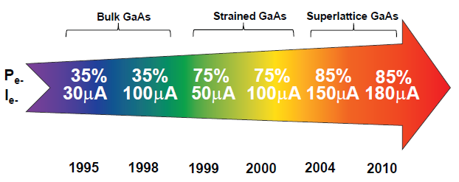
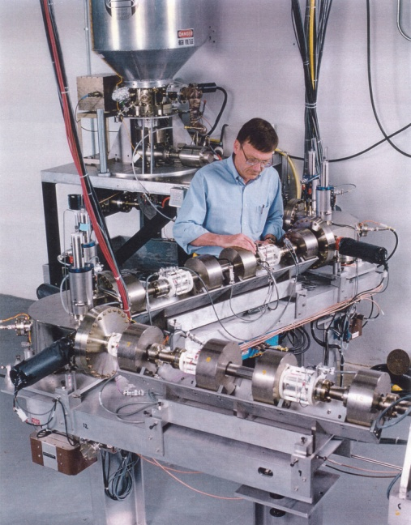
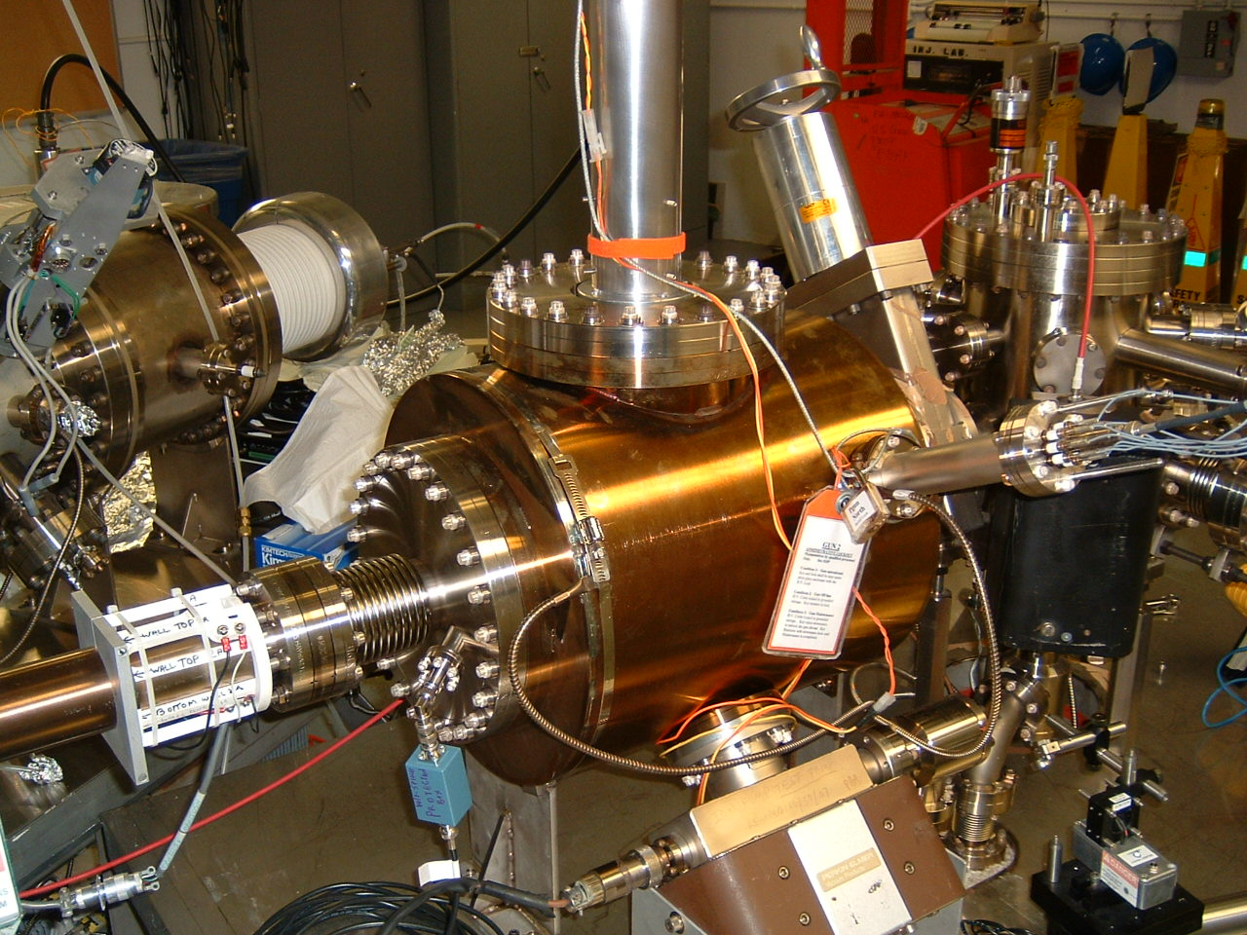
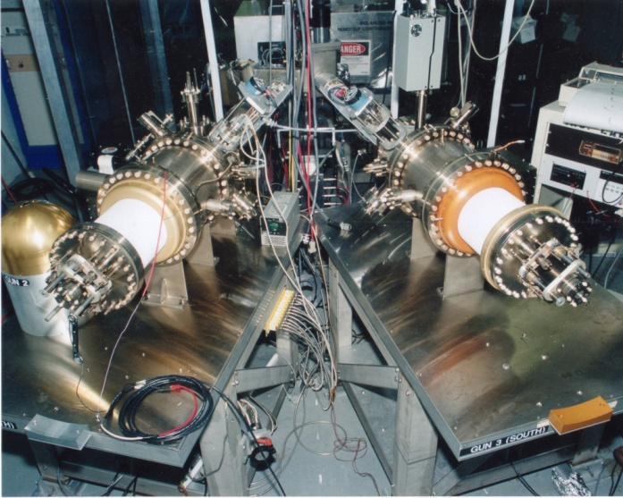
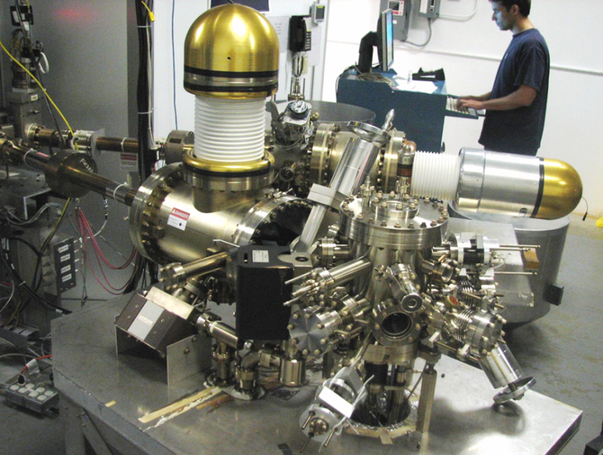
Always Tweaking the Design
1
4
Endless quest for perfection
Use this gun for PRex
2
3

Slide 3
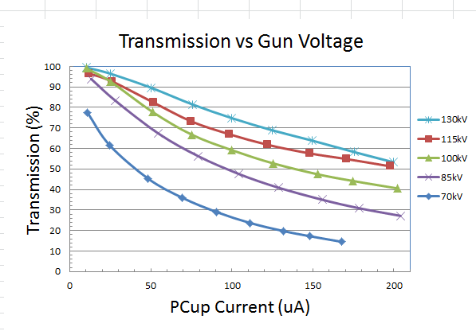
130 kV Inverted Gun
Higher Voltage = Better Transmission = Better Beam Quality
(and maybe longer lifetime)
Prebuncher operating at modest power takes care of the rest

Slide 4
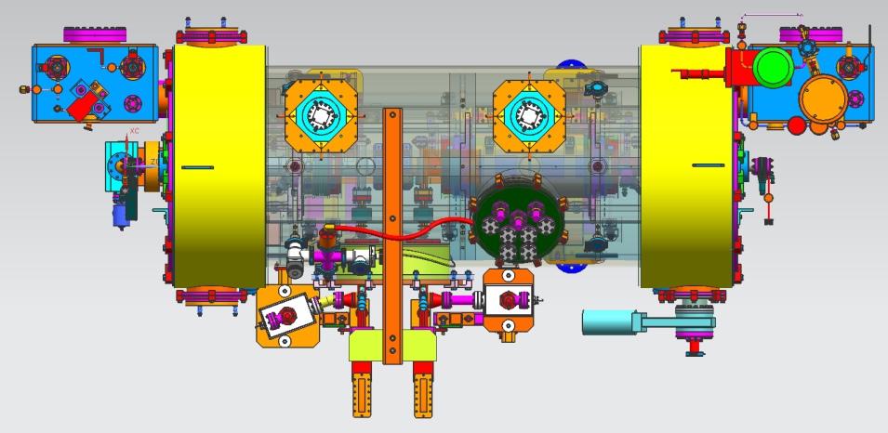
The MOLLER Injector: 200kV gun + New ¼ CM with SRF capture section
Replace 130kV gun with 200kV gun
Replace ¼ CM with an improved ¼ CM having an SRF capture section
No prebuncher
Improve the two-Wien spin flipper layout
More attention paid to beamline vacuum
Our new “1/4 cryomodule”:
2 cell capture section + 7 cell cavity,
should provide 10 MeV beam and introduce no x/y coupling, allow better matching, more adiabatic damping

Slide 5
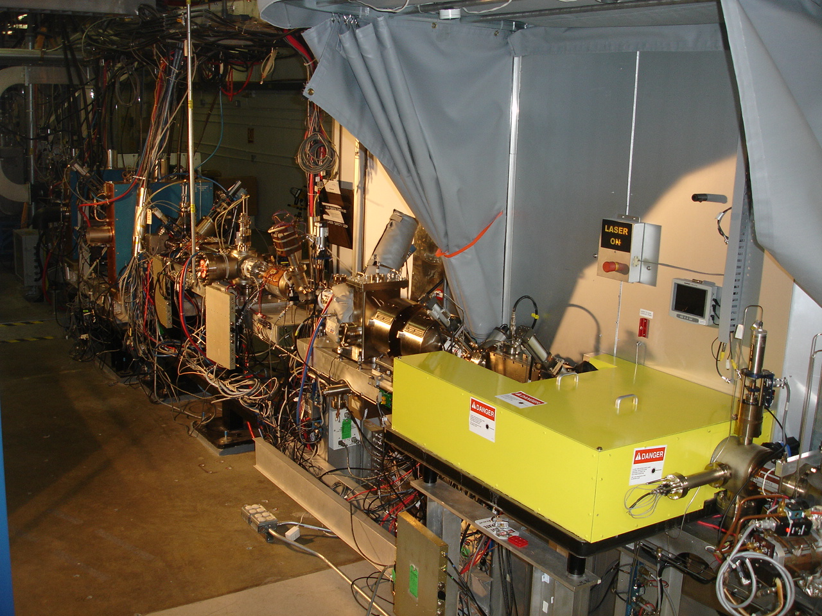
4π Electron Spin Manipulation
Horizontal Wien Filter
Two Solenoids
Vertical Wien Filter
Harder to flip spin than we imagined, more “things” change than just spin direction
Beam orbit downstream of HWien sensitive to laser/prebuncher (mis-)phasing
Don’t know what to do about this….

Slide 6
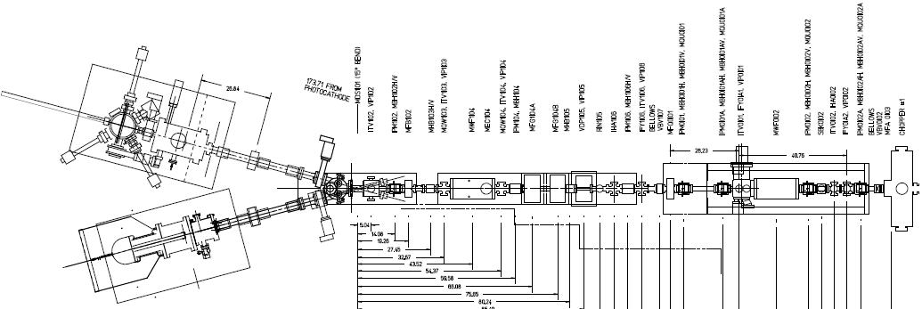
Electron Spin Reversal for PV
From Gun
“Spin Reversal”
Vertical Wien = 90 deg
Two Solenoids = ±90 deg
“Longitudinal Polarization”
Horizontal Wien = {-90…+90}
LEFT
RIGHT
Pondering a new beamline, but will it behave differently? Reluctant to move prebuncher for Prex. Would rather wait until we upgrade injector, and simply remove it.

Slide 7
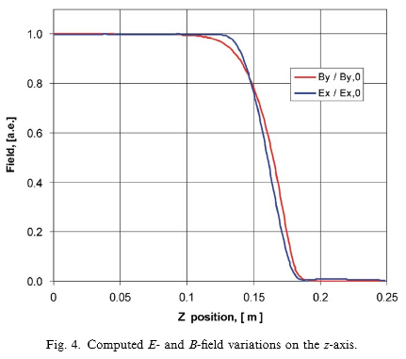
Two Wien Improvements
Do a better job characterizing optics, and compensate asymmetric focusing using quads, to achieve “perfect” spin flip
Mis-matched E and B fields create mini-chicane, with e-beam displaced from zero potential, which introduces a time delay…

Slide 8
All of the same knobs exist today….
Attenuator
IA
Rotatable GaAs
Photocathode
Gain-switched Diode Laser and Fiber Amplifier
LP HWP LP
PC WP LP
Shutter
Helicity Generator
Helicity Fiber
HV Supply
(0 – 90 V)
15° Dipole
nHelicity
Fiber
Vacuum
Window
Delayed
Helicity Fiber
T-Settle
Fiber
Hall
RHWP
Charge Feedback (IA)
V-Wien Filter
Target
Parity
DAQ
Spin Solenoids
BCM
Charge Feedback (PITA)
H-Wien Filter
BPMs
Position
Feedback
Pockels
Cell
HV Supply
(0 – 4 kV)
CEBAF
5 MeV
Helicity Magnets
PZT
Mirror
IHWP
Electron
Beam

Slide 9
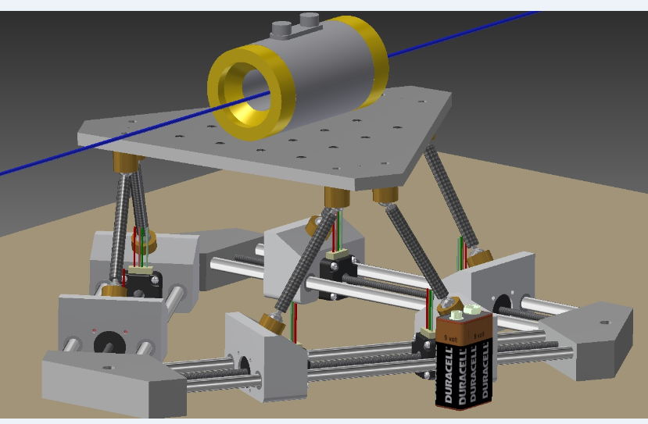
Stewart Platform: complete RC of PC alignment
LINUX-based software/freeware from hobbyists who build flight simulators
X, Y, pitch, roll and yaw

Slide 10
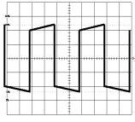
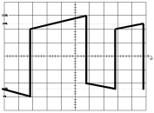
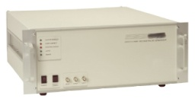
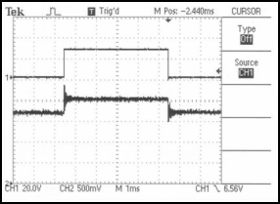
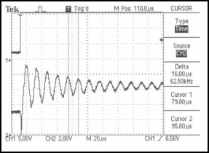
Initial attempts and problems encountered
This approach needed big capacitors…. lots of current
Two commercial high-speed / high-voltage transistor (~$8000)
Exaggeration of voltage droop on cell and subsequent re-charge after a helicity flip. Droop causes a serious problem when helicity flip rate was changed from a toggle to a pseudo-random pattern: pockels cell “memory”
high-voltage switch (~$10,000) All-in-one commercial bipolar
Charge droop was greatly improved, but high speed ringing of the cell was a problem for the settling time. In addition, the large high-speed switching currents created a noise induced helicity pickup on sensitive helicity DAQ components.
Work of John Hansknecht

Slide 11
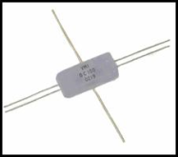
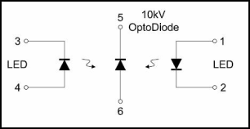
Solution: Opto-diode
Encapsulated Opto-diode $67 each
I = CΔV/ Charge time
+/- quarter wave voltage = 5120V
Cell capacitance = 6pf
Desired charge time = 100us
Calculated current is only 307uA !!
Work of John Hansknecht

Slide 12
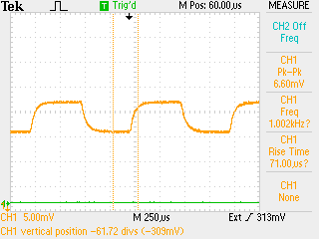
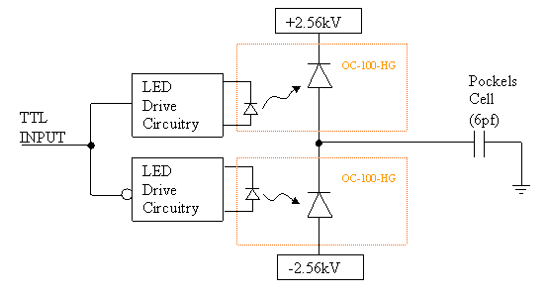
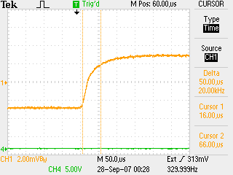
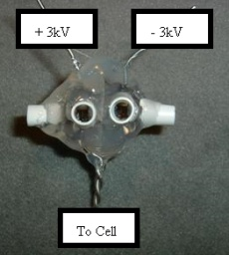
New Opto Diode Pockels Cell Switch
Pockels cell λ/2 flipping at 1kHz.
Perfect symmetry and no voltage droop over time.
Push-Pull Circuit
Pockels cell λ/2 transition optical result. ~70us with no ringing.
Reversal at 2kHz is possible, but with increased dead time.
Rise time of ~60-70usec appears limited by KD*P.
RTP is option (no piezo effect), but polarization quality suffers
Work of John Hansknecht

Slide 13
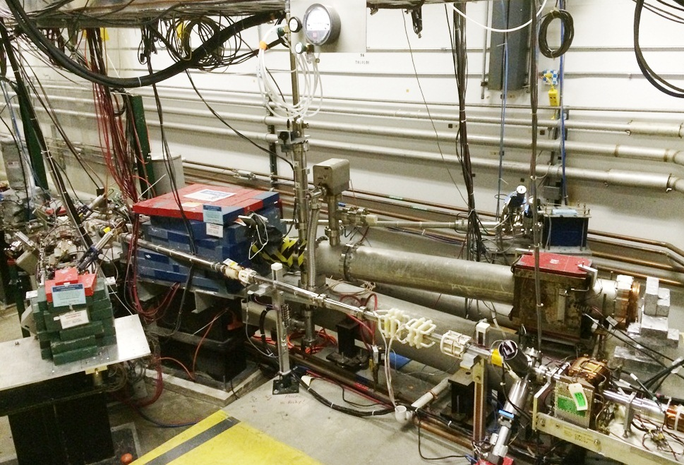
Mott Polarimeter at CEBAF

Slide 14
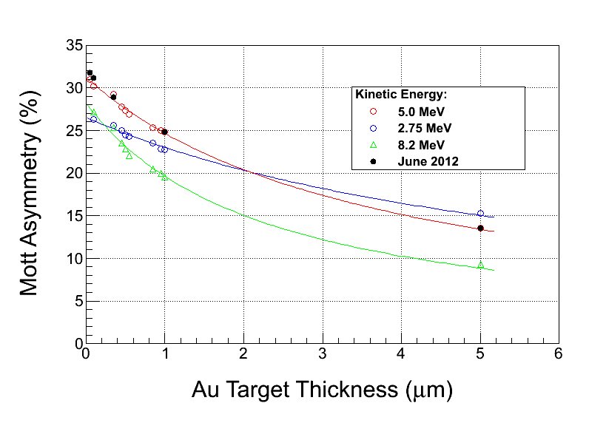
Tests of Mott accuracy in 2015
M. Steigerwald reported MeV Mott Polarimeter at SPIN 2000, with total accuracy 1.1% dominated by theory (~0.8%)
Still that accurate? Can we test theory ??? => motivates a new “campaign” to study 5 MeV Mott

Slide 15
Accurate Mott Polarimetry
List of improvements and tasks:
Reduce background using time of flight analysis, laser at 31 MHz
Reduce background using Be dump plate
Upgrade DAQ to operate at higher data rates, higher beam currents (i.e., measure polarization at your current)
Exhaustive studies of systematic errors
GEANT modeling and assistance from theorists to help pin down the Sherman function at zero foil thickness
Different Zs, different energies
Two run periods planned: Jan 2015 and Summer 2015
Gay, Grames, Horowitz, Mamun, McHugh, Opper, Poelker, Roca-Maza, Sinclair, Stutzman, Suleiman

Slide 16
Role of Beam Dump Background
12 ns round trip time
499 MHz (2ns)
Gold
0.1 um
Gold
1.0 um
Gold
10 um
M. McHugh
Joe Grames
Riad Suleiman

Slide 17
Time Of Flight Separation
12 ns round trip time
f_{beam} = 31.1875 MHz ⬄ 16 ns repetition rate > 12 ns “clearing time”
TARGET
STRAGGLERS
DUMP
TARGET
STRAGGLERS
DUMP

Slide 18
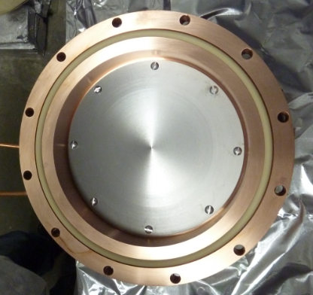
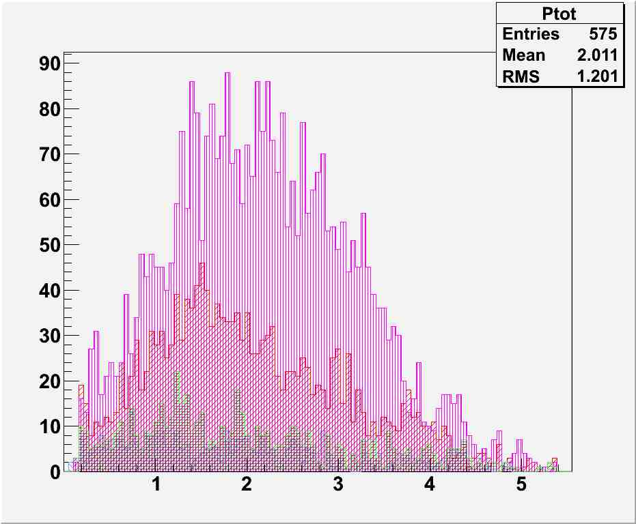
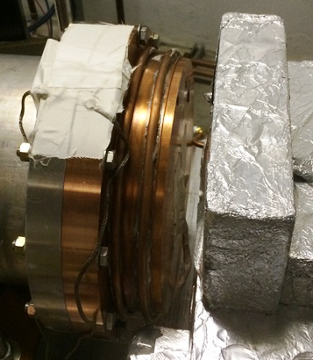
Be Dump Design
Kalrez™ high temp (240C) o-ring
Cu
Number of Electrons
Al
C
Dump should work fine to 1 kW (200uA @ 5MeV) so limitation will be deadtime.
Be
Total Momentum [MeV/c]
M. McHugh, Joe Grames, Riad Suleiman

Slide 19
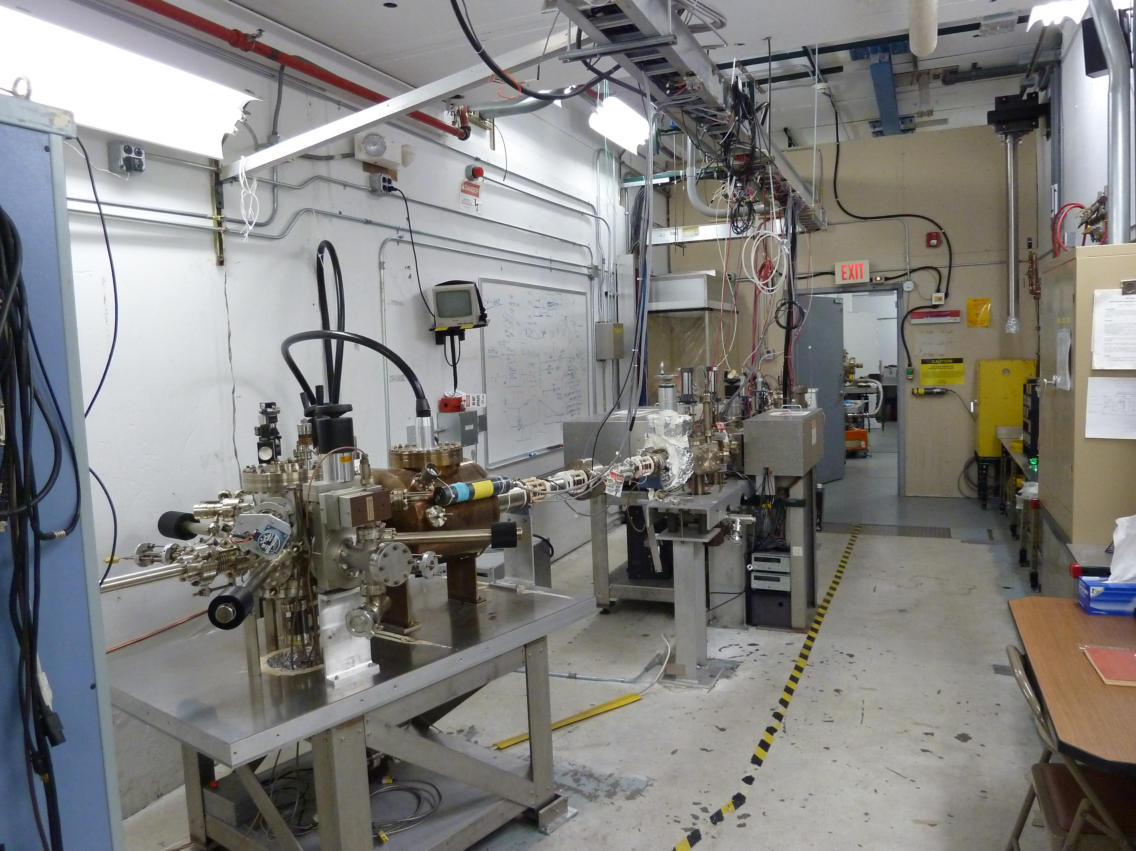
Old Injector Test Cave….
This “200kV gun” is identical to our “130kV gun”, except for a niobium cathode electrode….
Load-locked photogun
and baked beamline:
Pressure ~ 4 e-12Torr

Slide 20
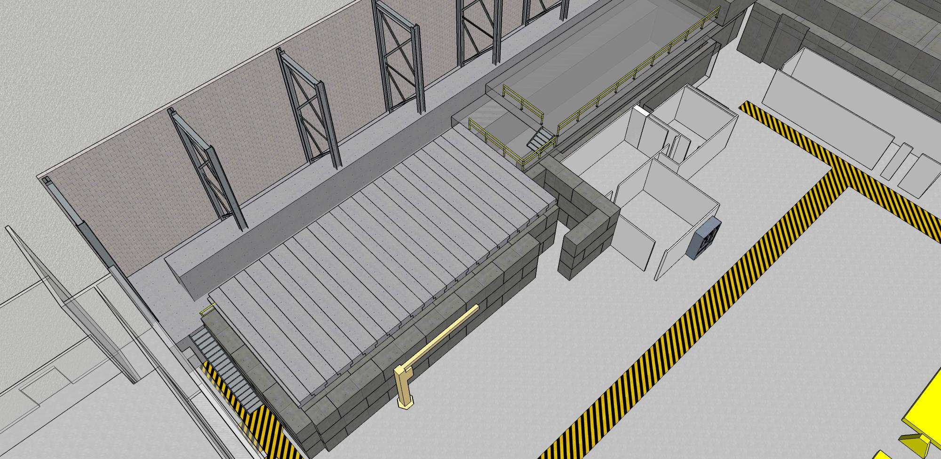
New Injector Test Cave

Slide 21
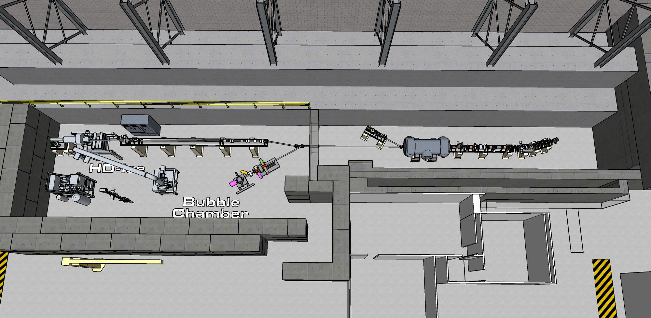
Might be a good place to develop PV-related upgrades

Slide 22
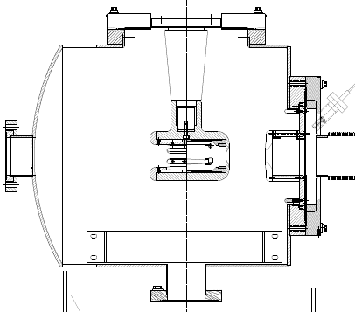
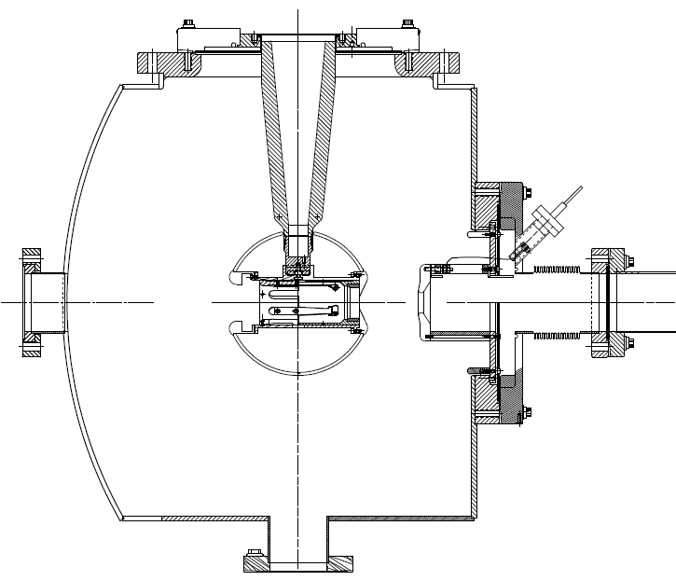
350kV Inverted Gun
200kV Inverted Gun
Longer insulator
Spherical electrode
Thin NEG sheet to move ground plane further away
What’s in a name? We will likely use our “350kV gun” for injector upgrade, plenty of voltage headroom means less likely to fail at 200kV…..

Slide 23
PRex To–Do List
Must
Install Stewart Platform for remote optimization of PC using e- beam
Prepare for beam matching to maximize damping
Test of Mott polarimeter absolute precision and systematics
Should
Optimize 2-Wien spin flipper optics, characterize limitations
Improve diagnostics to measure/compare “dc” vs. HC beam quality
Complete the upgrade of the helicity magnets controls
Like
Augment helicity steering dipoles with helicity size quads
Model E-field to maximize PC uniformity, buy a properly engineered pockel cell, one with the correct cell-diameter-to-laser-beam-diameter aspect ratio, with thoughtfully engineered electrodes to provide the most uniform electric field across laser beam profile

Slide 24
MOLLER to do list
Upgrade the injector, 200kV gun, new ¼ cryomodule
2 kHz Pockels cell switch, stable voltage and minimum transition time between helicity states
Improve 2-Wien Spin Flipper optics, one that can accommodate feedback to keep transverse polarization minimized….
Consider liquid crystal modulator array to control polarization over laser profile?
Helicity correlated beam size monitor?

Slide 25
Parity Beam Kick Off Meeting partial notes from Kent and some of my edits, from our Dec 17 meeting at JLab
Propose to meet every couple of months, to benefit PRex and MOLLER
Arne, Matt, Joe, Yves, Jay, Reza, Alicia, KK, Kent, Paul, Dave Armstrong, others welcome
We discussed the change in Moller proposal to lower beam current and higher polarization: now 60uA / 90%
Issues raised regarding running at high energy
Depolarization at higher passes?
Energy-stability -> precession to the Hall? How large an effect might this be?
synchrotron radiation – added noise and beam width/clipping might be spin-state dependent?
Feedback to minimize transverse polarization
Issues regarding injector
2kHz flip rates not yet demonstrated
4-hall operation and/or multiple A/B/C 5th pass requires 249.5 MHz bunch rep rate, and 2x charge density. Approaches Qweak levels at injector
New injector expected by 2019: 200 keV Gun, new 1/4 Cryo, new Wiens and different configuration, expect the prebuncher to be superfluous
More complete tests to learn limitations of present 2-wien system will be performed soon
Matching and optics: "phase trombone" is setup in Hall A line for 12 GeV (might also be possible for PREX)
Polarization and Polarimetry issues: Spin dance? Feedback on Horizontal Wien? Complete remote control of pockel cell alignment

