Slide 1
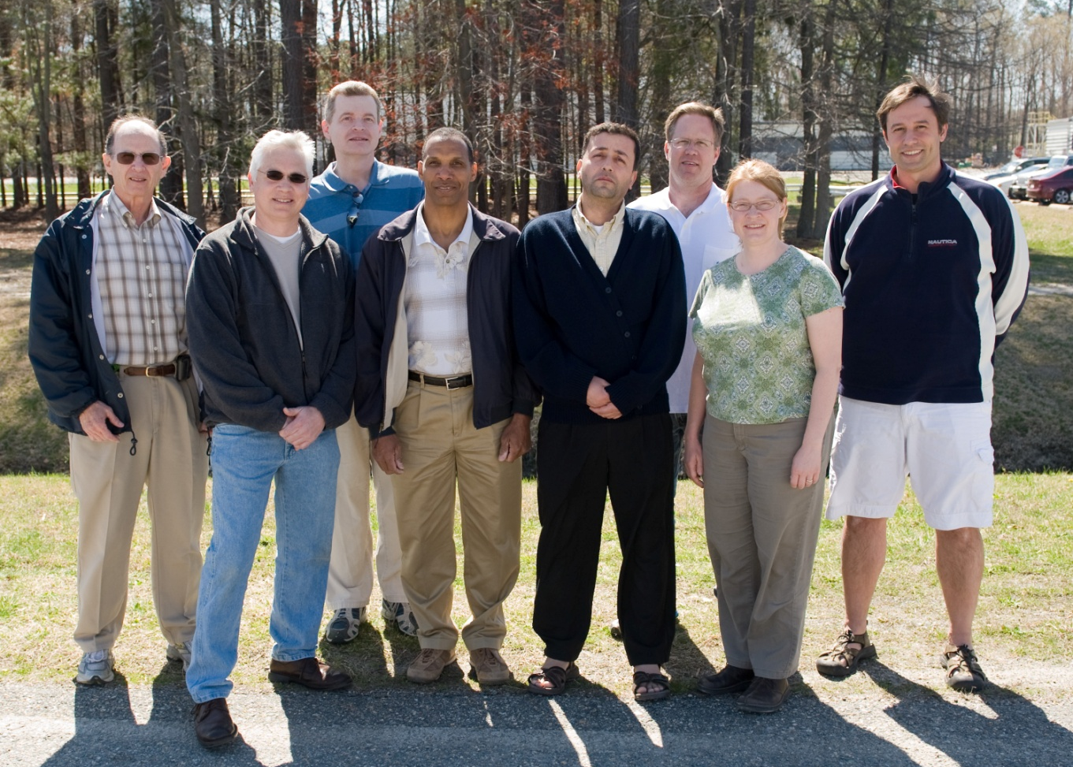
Jefferson Lab Polarized Photogun
P. Adderley, J. Clark, S. Covert, J. Grames, J. Hansknecht,
R. Mammei, M. Poelker, M. Stutzman,
R. Suleiman, K. Surles-Law
TRIUMF, Vancouver, Canada, January 19, 2011

Slide 2
Outline
Jefferson Lab
Polarized Electron Injector
Electron Spin Manipulation
Parity Violation (PV) Experiments
Polarized Electron Source:
Photoemission from GaAs
Fiber-based Drive Laser
Load-Lock Photogun
Key Features
Vacuum and Ion Back-bombardment
Measure Lifetime vs. Laser Position and Active Area
Benefits of Higher Gun Voltage
Road to Higher Gun Voltage
Summary and Outlook

Slide 3
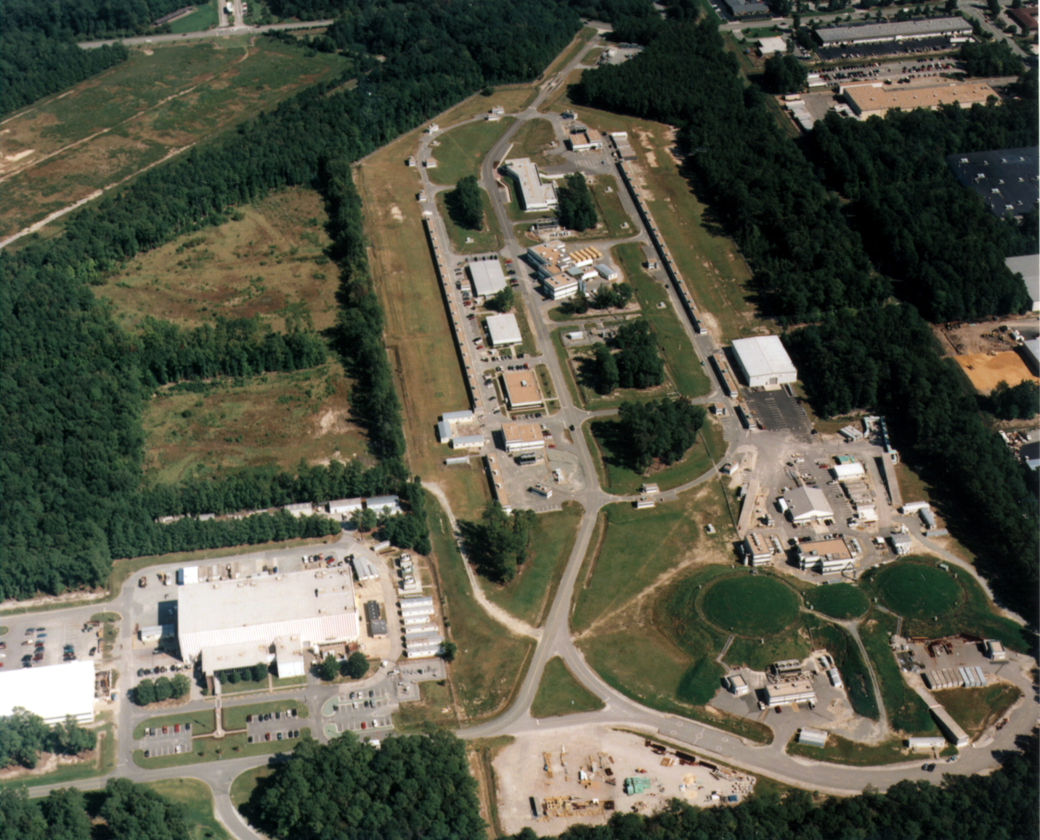
Jefferson Lab Accelerator Site
Arcs
2 SRF Linacs (600 MeV)
CEBAF Injector
Arcs
Injector
Test Cave
3 Experimental Halls

Slide 4
Continuous Electron Beam Accelerator Facility
A B C A B C
2 Linacs
1497 MHz
111 ps
RF Synchronous
Lasers
499 MHz,
ΔФ = 120°
A
B
C
B
A
RF Separators
499 MHz
B
Pockels Cell
A
C
C
Gun

Slide 5
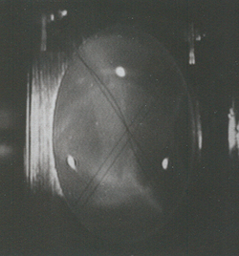
Polarized Electron Injector
Polarized Electron Source
(100 kV)
Synchronous Photoinjection
SRF Acceleration
(65 MeV)
5 MeV Mott
Polarimeter
Synchrotron
Light Monitor
Chopper
Cryounit
Cryomodules
Apertures
Buncher
Capture
Gun#2
Bunchlength
Injection Chicane
FC#1
Cavity
FC#2
V-Wien Filter
H-Wien Filter
Spin Solenoids
PreBuncher
Gun#3
100/500 keV Mott
Polarimeter
45 MeV Dump/
Spectrometer
Electron Spin Manipulation
Bunching & Acceleration
500 keV
SRF Acceleration
(5 MeV)

Slide 6
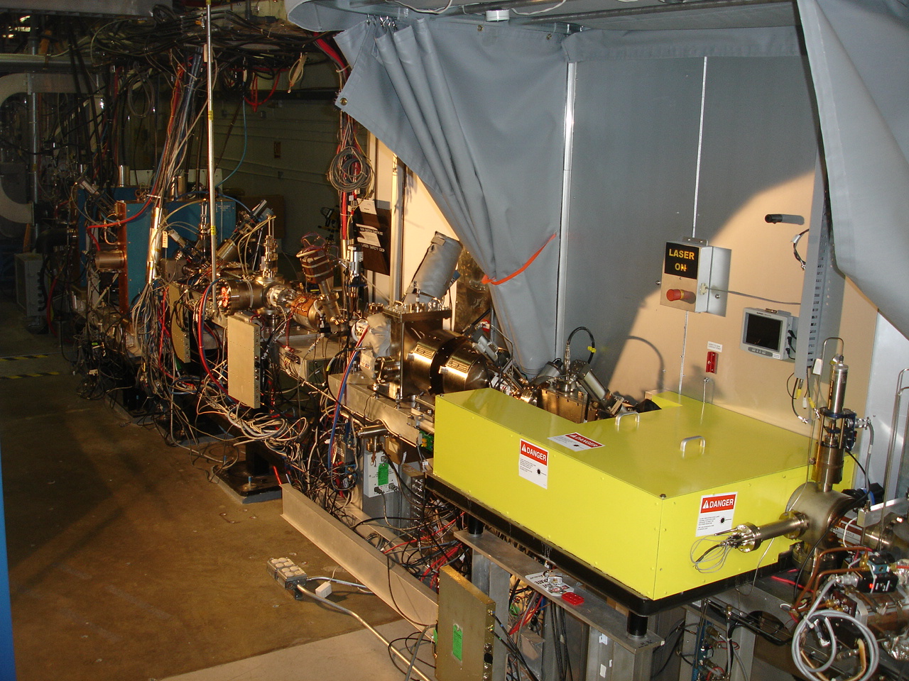
4π Electron Spin Manipulation
R(y) – Horizontal Wien Filter
R(z) – Two Solenoids
R(x) – Vertical Wien Filter

Slide 7
Parity Violation Experiments at CEBAF
Experiment | Energy (GeV) | I (µA) | Target | A_{pv} (ppb) | Maximum Charge Asym (ppb) | Maximum Position Diff (nm) | Maximum Angle Diff (nrad) | Maximum Size Diff (δσ/σ)
HAPPEx-II (Achieved) | 3.0 | 55 | ¹H (20 cm) | 1400 | 400 | 1 | 0.2 | Was not specified
HAPPEx-III (Achieved) | 3.484 | 100 | ¹H (25 cm) | 16900 | 200±100 | 3±3 | 0.5±0.1 | 10⁻³
PREx | 1.063 | 70 | ²⁰⁸Pb (0.5 mm) | 500 | 100±10 | 2±1 | 0.3±0.1 | 10⁻⁴
QWeak | 1.162 | 180 | ¹H (35 cm) | 234 | 100±10 | 2±1 | 30±3 | 10⁻⁴
Møller | 11.0 | 75 | ¹H (150 cm) | 35.6 | 10±10 | 0.5±0.5 | 0.05±0.05 | 10⁻⁴
PV experiments motivate polarized e-source R&D

Slide 8
Attenuator
IA
Rotatable GaAs
Photocathode
Gain-switched Diode Laser and Fiber Amplifier
LP HWP LP
PC WP LP
Shutter
Helicity Generator
Helicity Fiber
HV Supply
(0 – 90 V)
15° Dipole
nHelicity
Fiber
Vacuum
Window
Delayed
Helicity Fiber
T-Settle
Fiber
Hall
RHWP
Charge Feedback (IA)
V-Wien Filter
Target
Parity
DAQ
Spin Solenoids
BCM
Charge Feedback (PITA)
H-Wien Filter
BPMs
Position
Feedback
Pockels
Cell
HV Supply
(0 – 4 kV)
CEBAF
5 MeV
Helicity Magnets
PZT
Mirror
IHWP
Electron
Beam

Slide 9
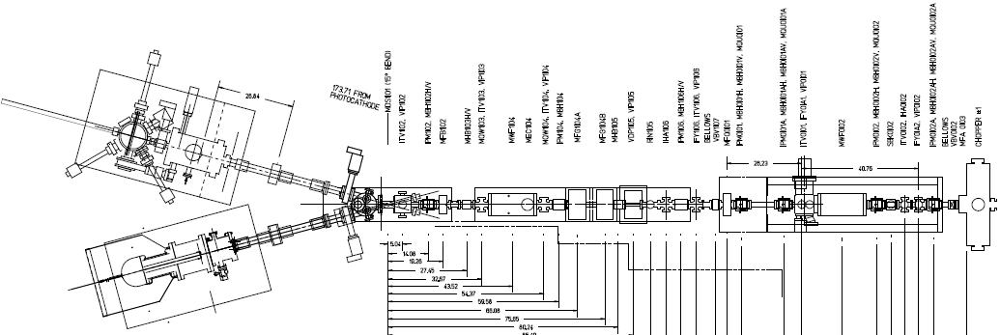
Electron Spin Reversal for PV
From Gun
“Spin Reversal”
Vertical Wien = 90 deg
Two Solenoids = ±90 deg
“Longitudinal Polarization”
Horizontal Wien = {-90…+90}
LEFT
RIGHT
Cancels all helicity-correlated beam systematic errors from laser and photocathode

Slide 10
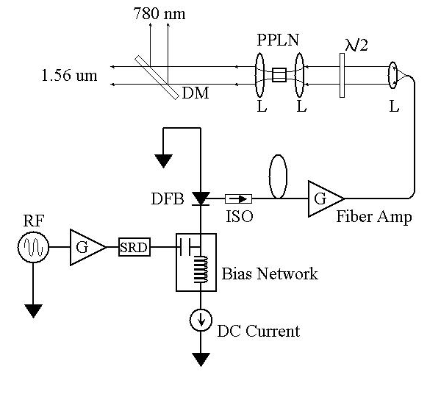
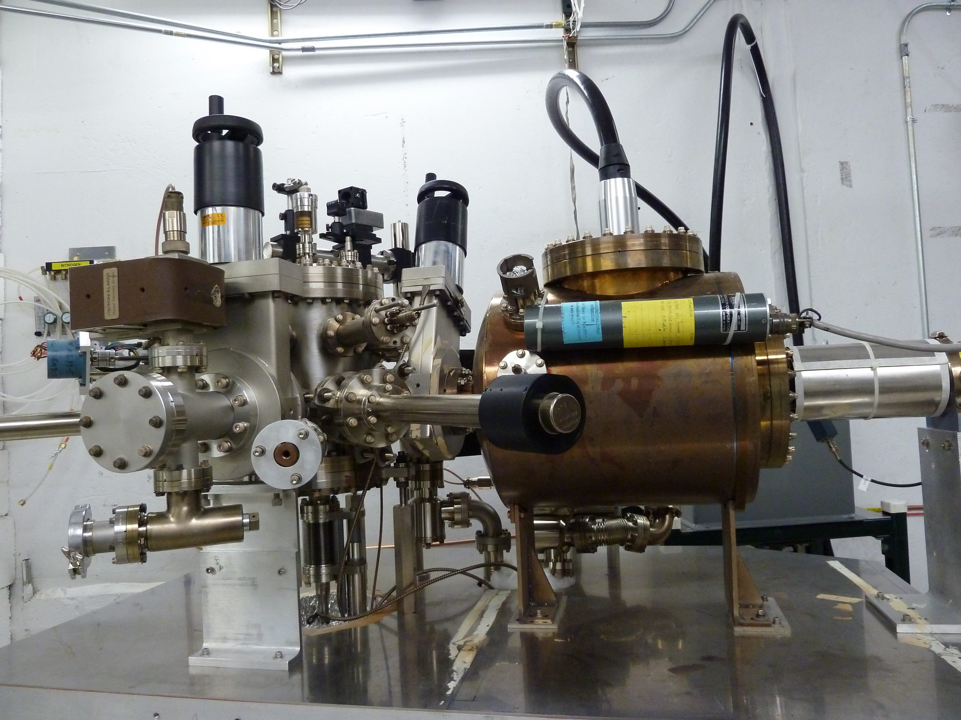
Polarized e-Source Requirements
All three halls get polarized e-beam from the same gun and photocathode
~ 35 Wks continuous operation at high average current, high polarization
Good Photocathode
Good Laser
Good gun
Superlattice GaAs
Fiber-based Laser
Inverted Guns
chekc
QE ~ 1%
Pol ~ 85%
@ 780 nm
Good Vacuum
No Field Emission
Long Lifetime

Slide 11
Photoemission from GaAs
Dipole layers of
Cesium + NF₃
Reduces Work Function
Negative Electron Affinity (NEA)
Bare GaAs surface
Large Work Function
Positive Electron Affinity (PEA)
NEA Surface Activation
PEA=4.07 eV
-
Conduction
Band
-
χ^{NEA} ~ 0.2 eV
E_{gap}
Valence
Band
+
Light
GaAs
Vacuum
GaAs
Vacuum

Slide 12
NEA Activation of GaAs
QE
“Activate” GaAs photocathode by applying about one mono-layer of Cesium and NF₃ to very clean surface
NF₃
Cs
0
Time
R | GaAs Light Reflection Coefficient (~ 0.3)
d | GaAs layer thickness (~ 0.1 μm)
α(Һω) | Photo-absorption Coefficient (~ 5x10³ cm⁻¹)
B(χ) | Surface Tunneling Probability(~ 0.2)

Slide 13
Bulk GaAs
Laser excitation from P_{3/2} to S_{1/2} : E_{gap} < E_{γ} < E_{gap}+Δ
Electron Polarization:
E
E
J
S_{1/2}
-1/2
+1/2
S_{1/2}
E_{gap}=1.42 eV
σ+
3
3
σ-
1
P_{3/2}
E_{F}
P_{3/2}
Δ=0.34 eV
-3/2
-1/2
+1/2
+3/2
P_{1/2}
-1/2
+1/2
P_{1/2}
k
m_{j}
σ+: Right-handed circularly polarized light
σ- : Left-handed circularly polarized light
Reverse electron polarization by reversing light polarization

Slide 14
Higher P: Breaking GaAs Degeneracy
Split degeneracy of P_{3/2} : Introduce strain on GaAs crystal by growing it on substrate (GaAsP) with different lattice constant
High polarization by laser excitation from P_{3/2} to S_{1/2} :
E_{gap} < E_{γ} < E_{gap}+δ
m_{j} = -1/2
+1/2
S_{1/2}
σ+
σ-
E_{gap}
P_{3/2}
m_{j} = -3/2
+3/2
δ=20–50
meV
-1/2
+1/2
Higher QE: Alternating layers of GaAs and GaAsP – Superlattice GaAs

Slide 15
GaAs Photocathode Evolution
Bulk GaAs
Strained GaAs:
GaAs on GaAsP
Superlattice GaAs:
Layers of GaAs on GaAsP
100 nm
100 nm
625 μm
2 μm
14 Layers
350 μm
QE ~ 20%, 120 μA/mW
Unpolarized @ 532 nm
QE ~ 5%, 30 μA/mW
Pol ~ 40% @ 780 nm
QE ~ 0.2%, 1 μA/mW
Pol ~ 75% @ 850 nm
No strain relaxation
QE ~ 1%, 6 μA/mW
Pol ~ 85% @ 780 nm
λ (nm) | E_{γ} (eV) | Color
532 | 2.33 | Green
780 | 1.59 | NIR
850 | 1.46 | NIR
E_{γ} = hc/λ
hc = 1240 eV.nm

Slide 16
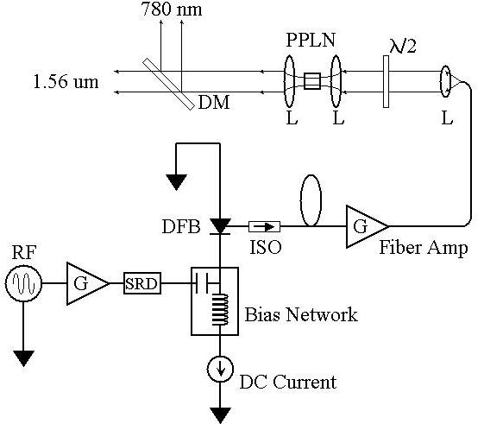
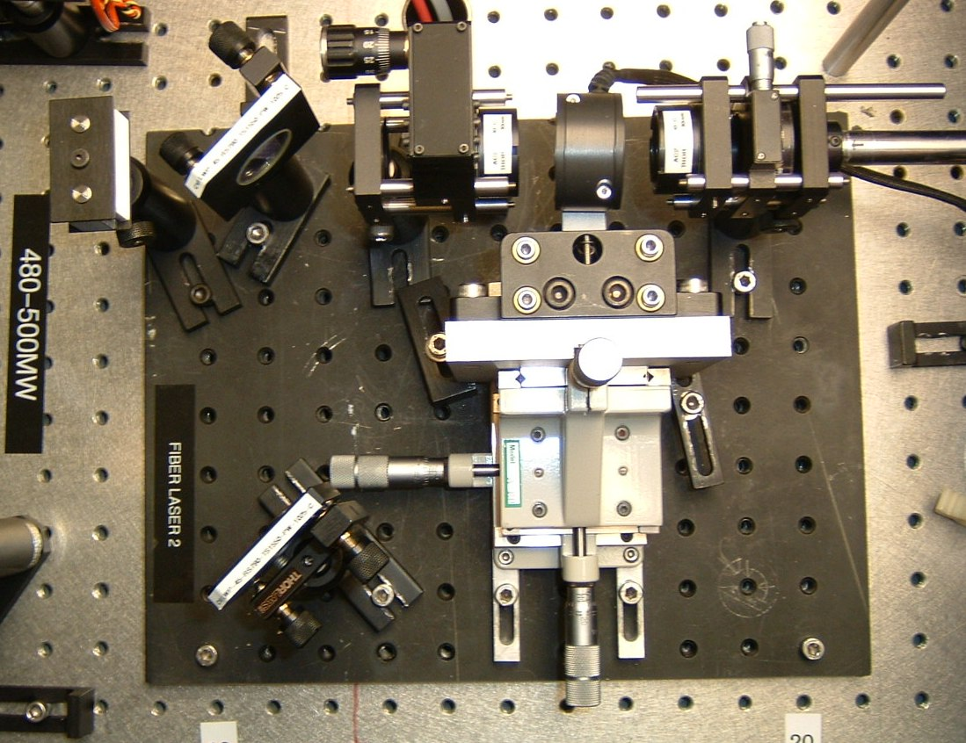
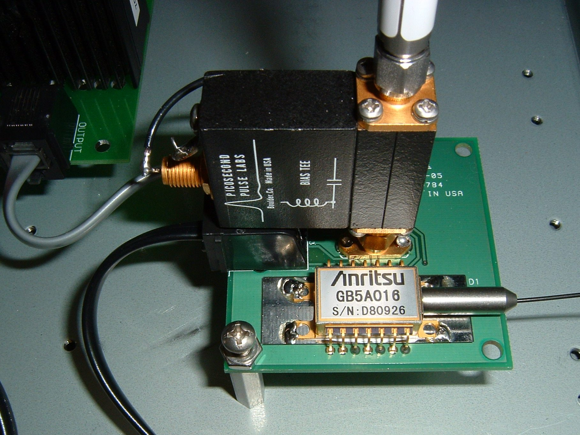
Fiber-based Drive Laser
780 nm
Frequency-doubler
1560 nm to 780 nm
30% Efficiency (2 W)
RF Locked Low-Power (1 mW)
1560 nm Fiber Diode
1560 nm
499 MHz
High Power (6 W) 1560 nm Fiber Amplifier

Slide 17
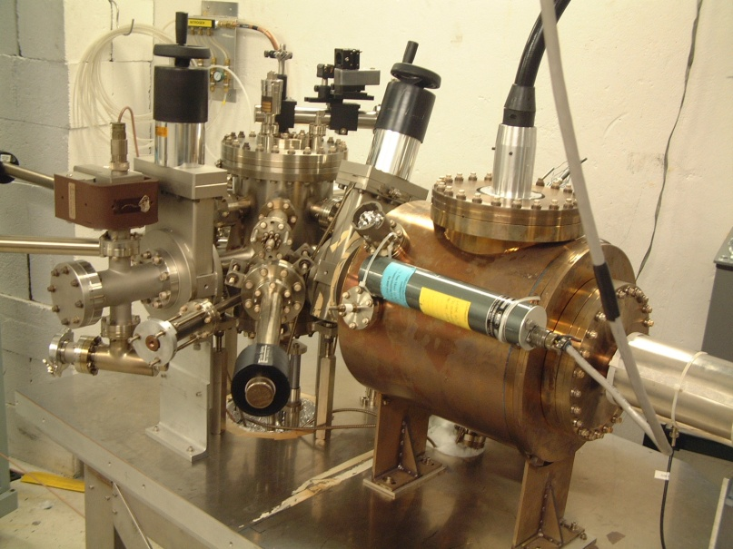
Load-lock Photogun
Best vacuum inside HV Chamber, which is never vented except to change electrodes
Photocathode Heat and Activation takes place inside Preparation Chamber
Use “Suitcase” to replace photocathodes through a Loading Chamber
Activation Laser
Preparation Chamber
Loading Chamber
HV Chamber
Storage
Manipulators

Slide 18
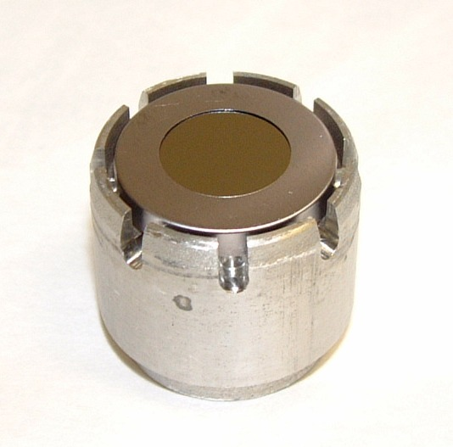
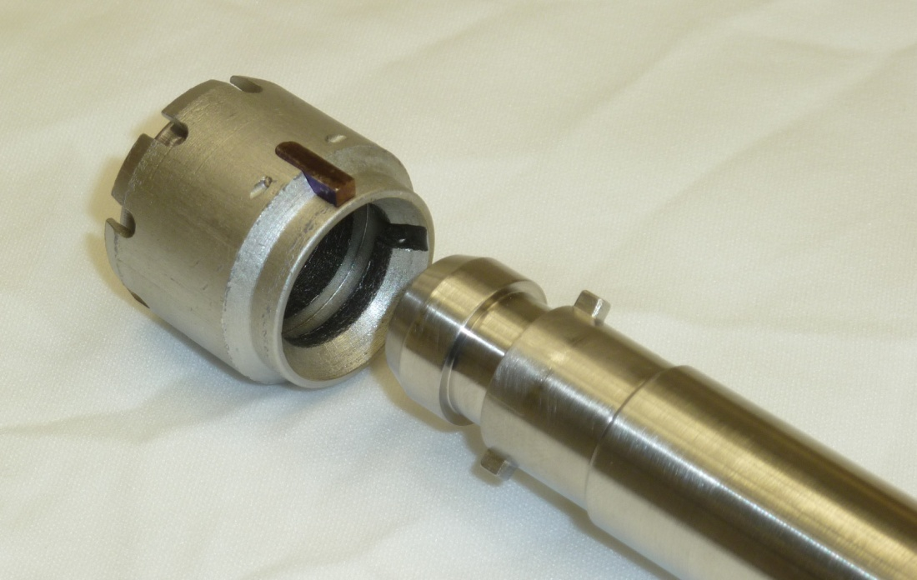
Key Features:
5 pucks can be stored in Storage Manipulators
8 hours to heat and activate new sample
Mask to limit active area
Suitcase for installing new photocathodes (one day to replace all pucks)
Puck (Mo)
Ring (Ta)
Puck Stop (rolling)
GaAs
Manipulator Key (male)
Puck Key (female)

Slide 19
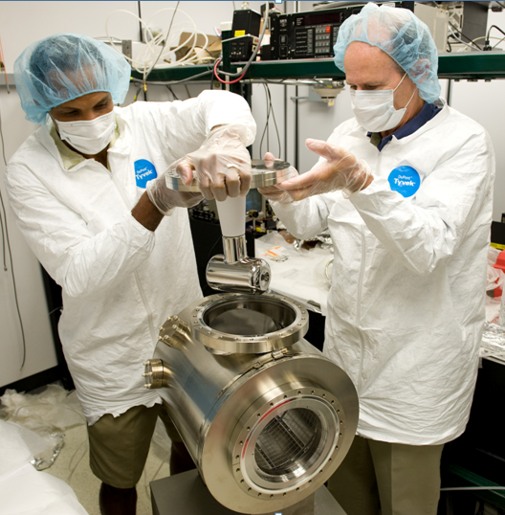
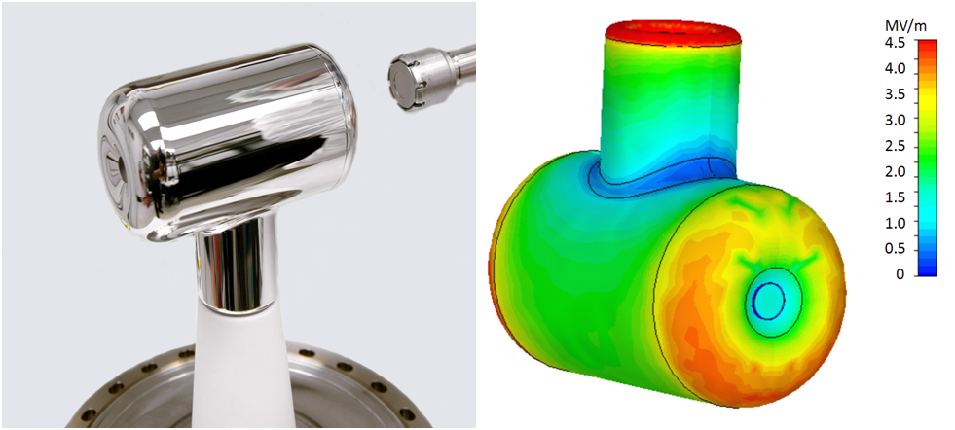

Slide 20
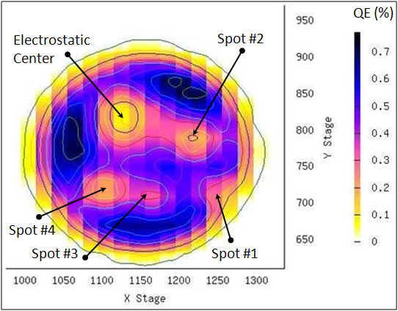
Imperfect Vacuum = Finite Lifetime
Ion back-bombardment – with characteristic QE “trench” from laser spot to electrostatic center of photocathode – damages the NEA of GaAs
High energy ions are focused to electrostatic center: create QE “hole”. We don’t run beam from electrostatic center
QE can be restored, but takes about 8 hours to heat and reactivate
Residual
Gas
Laser
Photocathode “QE scan”
Active area = 5 mm
Laser size = 0.4 mm
Can run beam from 6 locations (spots) before heating and reactivating

Slide 21
Ion Back-bombardment

Slide 22
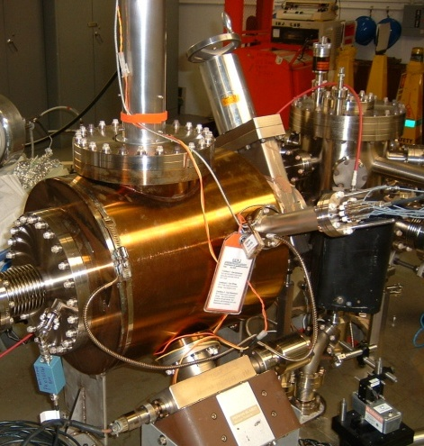
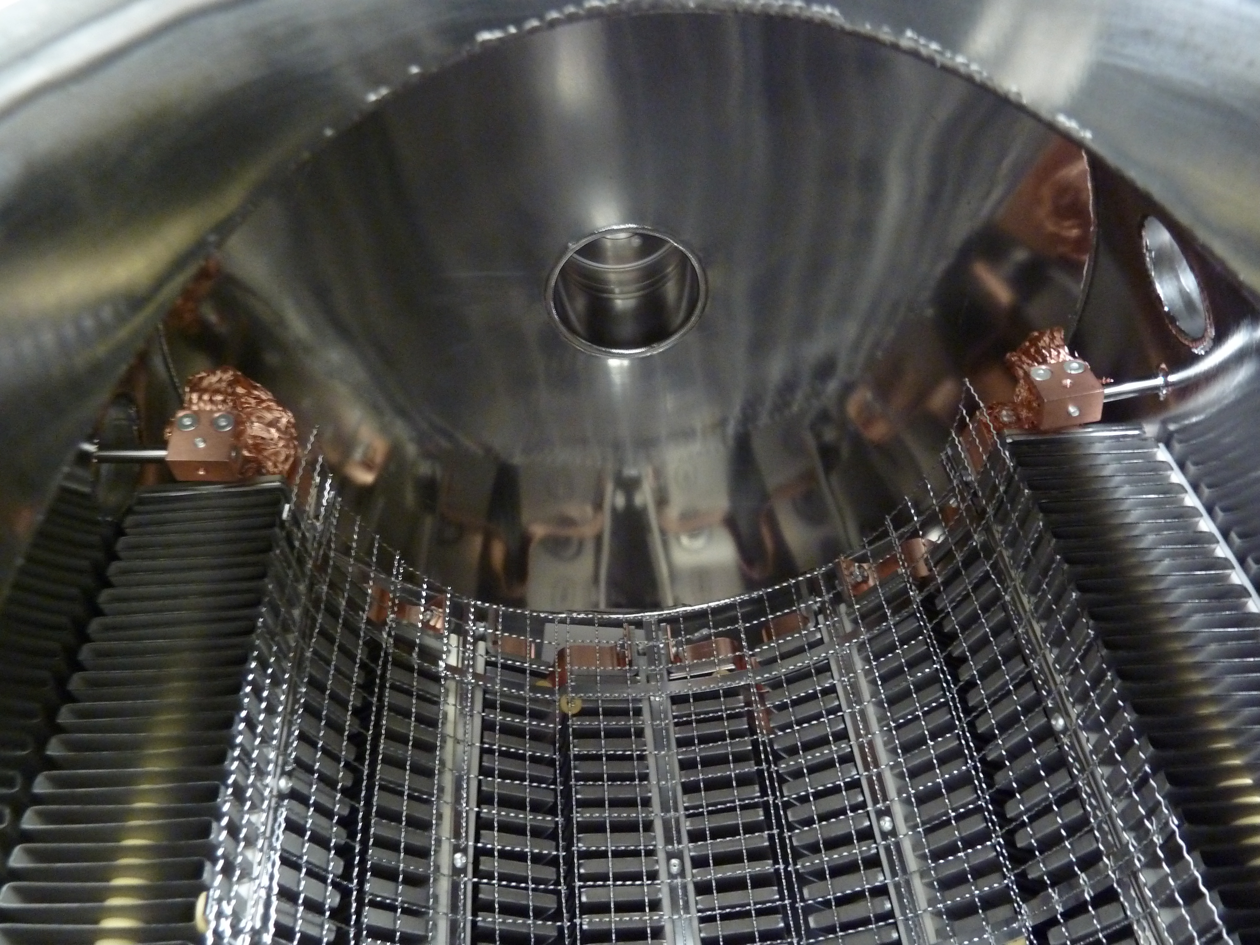
Reduce Outgassing & Improve Pumping
Primary source of gas in Polarized Gun: hydrogen outgassing
To reduce outgassing:
Reduce thick flange area
HV Chamber 400°C bake for 10 days
Pump system combines:
Non-Evaporable Getters (NEGs) (Zr-V-Fe)
Ion Pumps
Ion Pump
NEGs
Outgassing rate: 1.0×10⁻¹³ Torr.L/s.cm²
Extractor Gauge: 2.0×10⁻¹² Torr (raw value), our lowest value

Slide 23
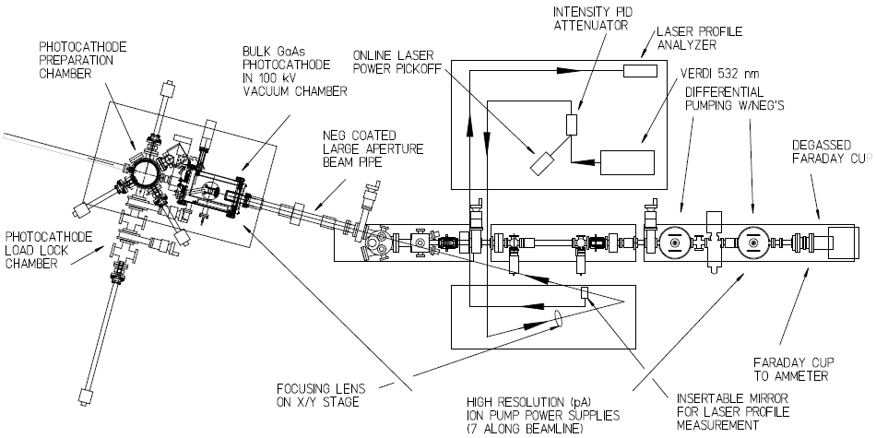
Injector Test Cave
SUITCASE

Slide 24
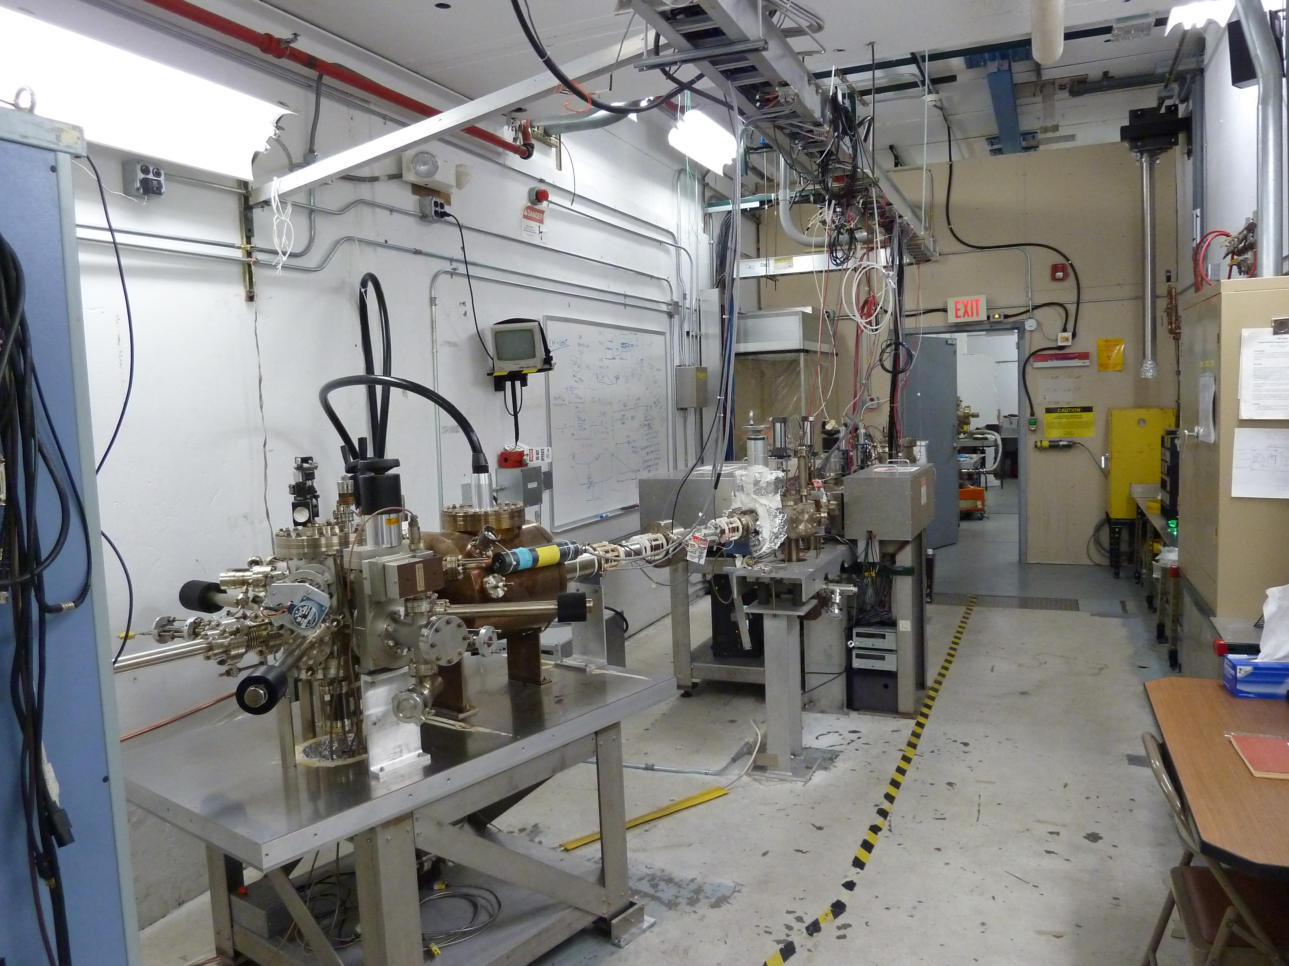

Slide 25
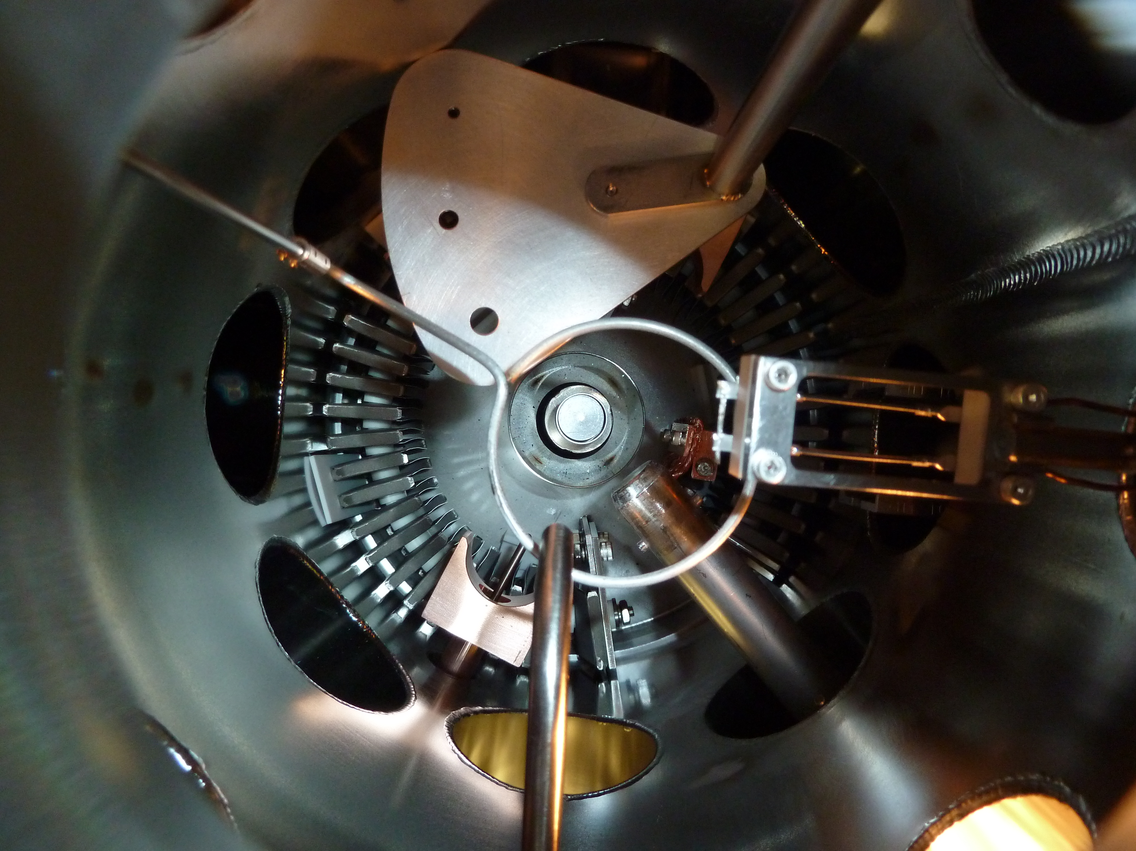
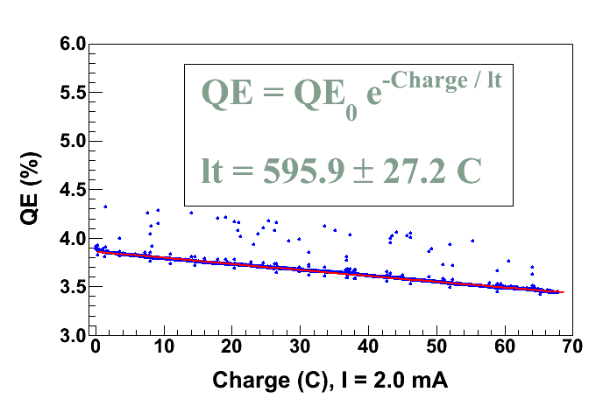
Measure Lifetime vs. Laser Position and
Active Area
Activate with different Masks: 5 mm, 7 mm, and No Mask (12.8 mm)
Measure Lifetime from different spots on Bulk GaAs with 532 nm green laser
Mask
Bias Ring
+200 V
Cs
Heater
Long Manipulator
NF₃
Leak Valve

Slide 26
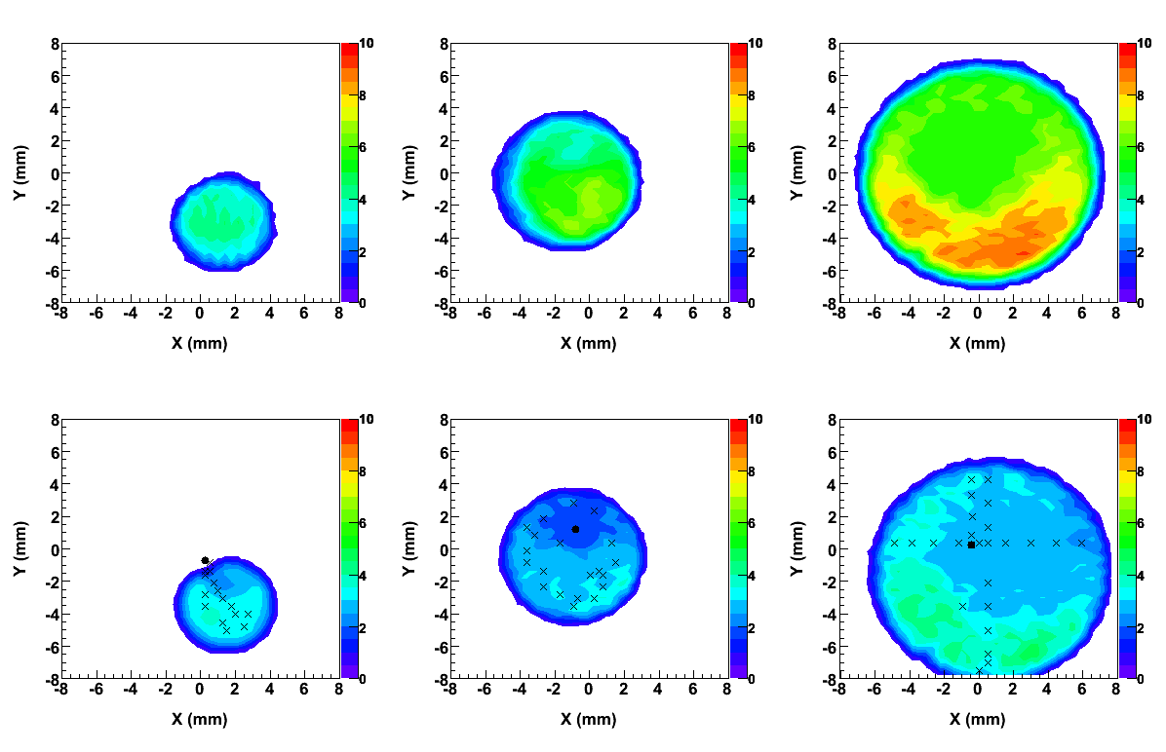
5 mm
7 mm
12.8 mm
After
Activation
After Lifetime Measurements
Spot
Electrostatic Center

Slide 27
 | I=0 (HV = 0, 100 kV) | I = 2 mA (Bulk GaAs, 532 nm, 350 μm Laser Spot) (HV = 100 kV)
 |  | 5 mm Active Area | 7 mm Active Area | 12.8 mm Active Area
Anode Current (pA) | 0.0 ± 0.3 | 0.0 ± 0.3 | 0.0 ± 0.3 | -100 – -1000
X-ray Detector (E-2 mR/h) | 0.6 ± 0.3 | 1.5 ± 0.5 | 1.8 ± 0.5 | 3 – 7
Gun Vacuum (pA) | 0 | 0 | 0 | 0 – 30
Y-Chamber Vacuum (nA) | 3.0 | 3.0 | 3.0 | 4 – 20
This is the range of values at the start of the lifetime measurements. The anode current is proportional to the laser power.

Slide 28
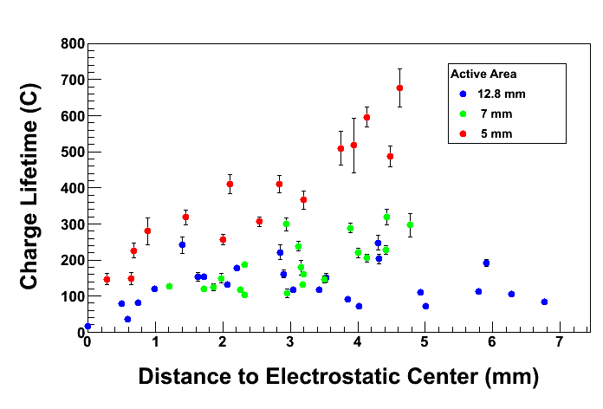
Finite lifetime due to ion back-bombardment
Lesson: it is extremely important to manage ALL of the extracted beam. Beam from outside 5 mm active area can hit beam-pipe walls, degrade vacuum, reduce lifetime

Slide 29
Benefits of Higher Gun Voltage
Reduce space-charge-induced emittance growth, maintain small transverse beam profile and short bunch-length. In other words, make a “stiff” beam right from the gun
Address current density limitation due to Child’s Law (Space Charge Limit)
Reduce problems associated with Surface Charge Limit (i.e., QE reduction at high laser power)
Prolong Charge Lifetime
Biggest Obstacle: Field Emission and HV Breakdown… which lead to bad vacuum and photocathode death

Slide 30
Emittance and Brightness
Normalized Emittance from GaAs:
q | Bunch Charge (= 0.4 pC, 200 μA and 499 MHz)
E_{s} | Electric Field at GaAs surface
T_{eff} | Effective Temperature of GaAs (= 300 – 400 K, 780 nm)
k_{B}T_{eff} | Thermal Energy (= 34 meV)
Gun HV (kV) | E_{s} (MV/m) | ε_{n} (μm)
100 | 2.0 | 0.011
140 | 2.8 | 0.009
200 | 4.0 | 0.008
Normalized Brightness:
Brightness is proportional to Gun HV

Slide 31
Bunchlength and Transmission
At higher gun HV, bunchlength is shorter – when Chopper Slit is fully open, it passes 111 ps - and space charge emittance blow-up is suppressed
Transmission through Injector, improves at higher gun voltage
Better transmission prolongs lifetime:
Less beam loss that degrades vacuum
Lower current from gun creates less ions and thus slows NEA damage
Better transmission reduces current fluctuations and thus improves Hall measurement of helicity-correlated charge asymmetry

Slide 32
Space Charge Limit at CEBAF
Maximum current density that can be transported across cathode-anode
gap is (for an infinite charge plane):
Child’s Law (1D):
[A/cm²]
For electron emission from a finite circular spot on the cathode:
Child’s Law (2D) (PRL 87, 278301) :
For CEBAF electron beam (499 MHz):
Short Pulse (PRL 98, 164802):

Slide 33
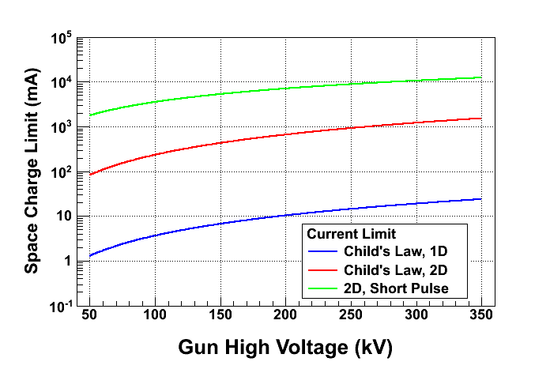
V | Gun Voltage
D | Cathode-anode Gap (6.3 cm)
R | Laser Spot Size (0.5 mm = 2r)
T_{b} | Bunchlength (50 ps)
τ_{CL} | Gap Transit Time (0.96 ns at 100 kV)

Slide 34
Surface Charge Limit
NEA of GaAs depends on Gun HV. QE increases with external Electric Field at GaAs surface, E_{s},
Where χ (~200 meV) is the zero-field NEA value (Physics Letters A 282, 309) and potential barrier lowering due to Electric Field is
χ
Where ε_{s} (= 13.1) is GaAs relative permittivity.
E_{gap}
δU(E_{s})
Gun HV (kV) | E_{s} (MV/m) | δU(E_{s}) (meV)
100 | 2.0 | 50
140 | 2.8 | 59
200 | 4.0 | 70

Slide 35
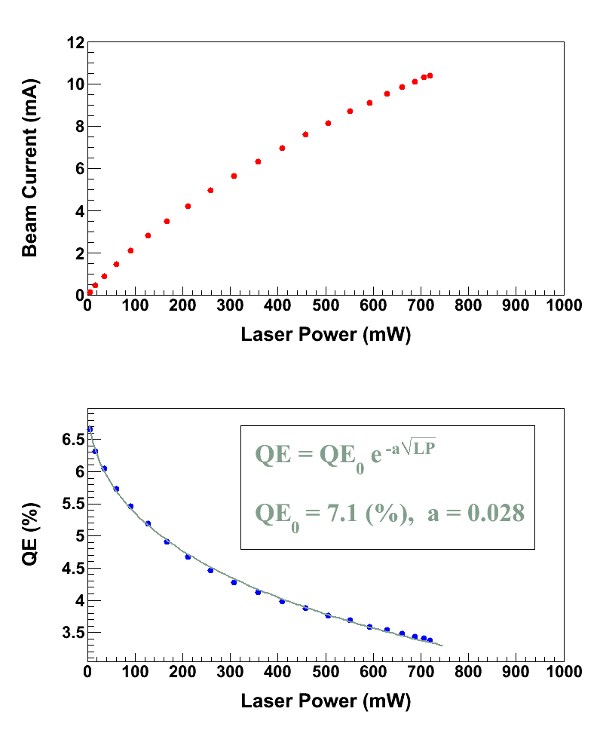
Surface Charge Limit, also known as Surface Photovoltage Effect, reduces NEA of GaAs: Photoelectrons trapped near GaAs surface produce opposing field that reduces NEA resulting in QE reduction at high laser power (LP),
U(LP)
χ
E_{gap}
Where U(LP) is up-shifting of potential barrier due to photovoltage.
δU(E_{s})
For heavily Zn doped GaAs surface, U(LP) → 0
Higher Gun HV suppresses photovoltage

Slide 36
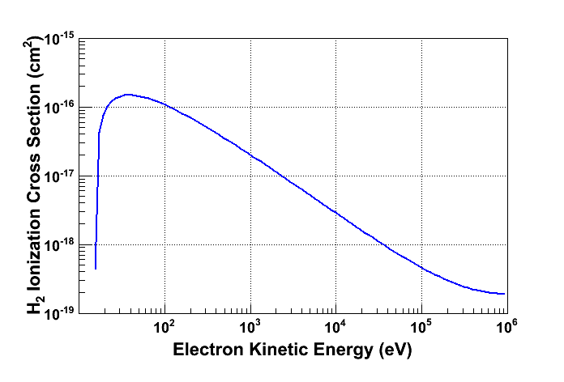
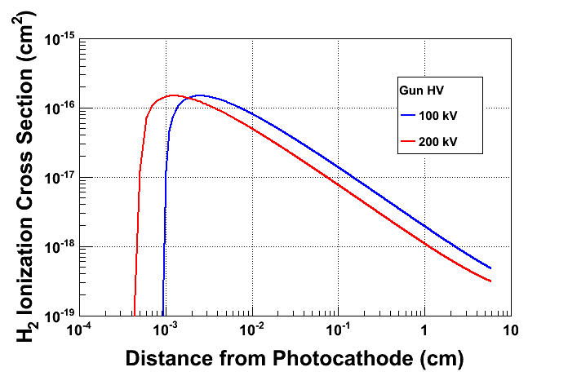
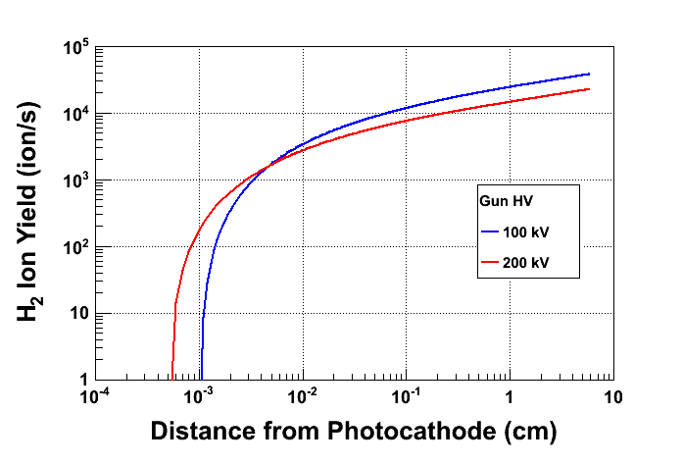
Prolong Photocathode Charge Lifetime
Most ions created at low energy
Most ions created close to GaAs surface
Beam Current: 2.0 mA
Vacuum: 8.0 × 10⁻¹² Torr

Slide 37
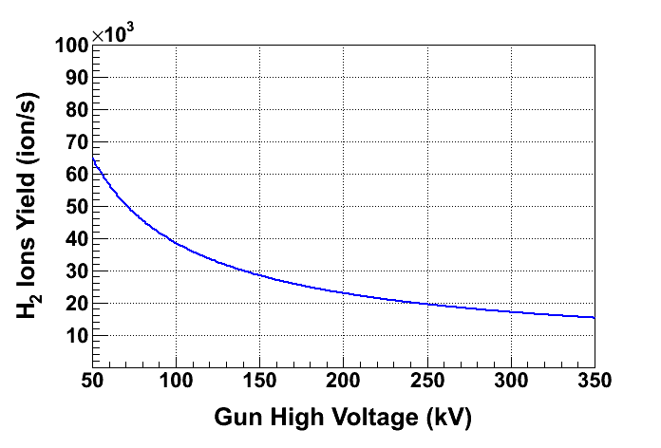
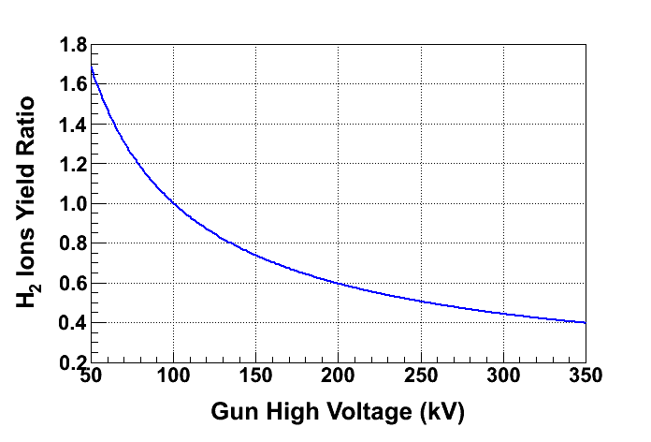
Ion energy
Low energy ion column for 100 kV gun
Low energy ion column for 200 kV gun
At 200 kV, only 60% of ions are created compared to 100 kV, longer lifetime

Slide 38
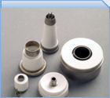
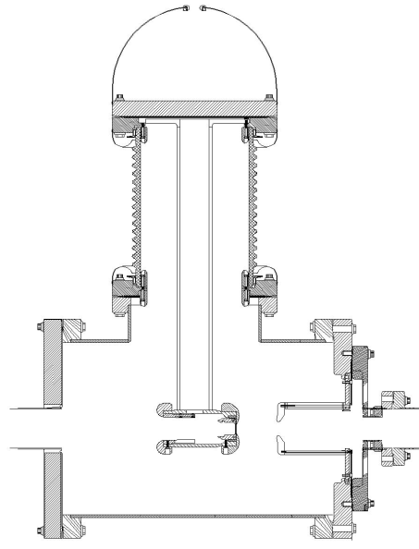
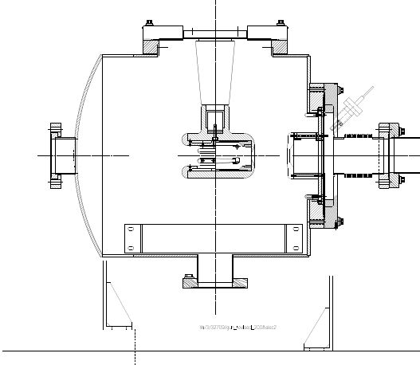
New Inverted Gun
Road to Higher Gun Voltage
Old Gun
Old Ceramic
Exposed to field emission
Large area
Expensive ($50k)
Lots of metal at HV
Medical x-ray technology
e⁻
New Ceramic
Compact
$5k
Less metal at HV
No SF₆ of N₂
Moved away from “conventional” insulator used on most GaAs Photoguns today – expensive, months to build, prone to damage from field emission.
High gradient locations not related to beam optics, lots of metal to polish.
Less flanges material, less outgassing, better vacuum.

Slide 39
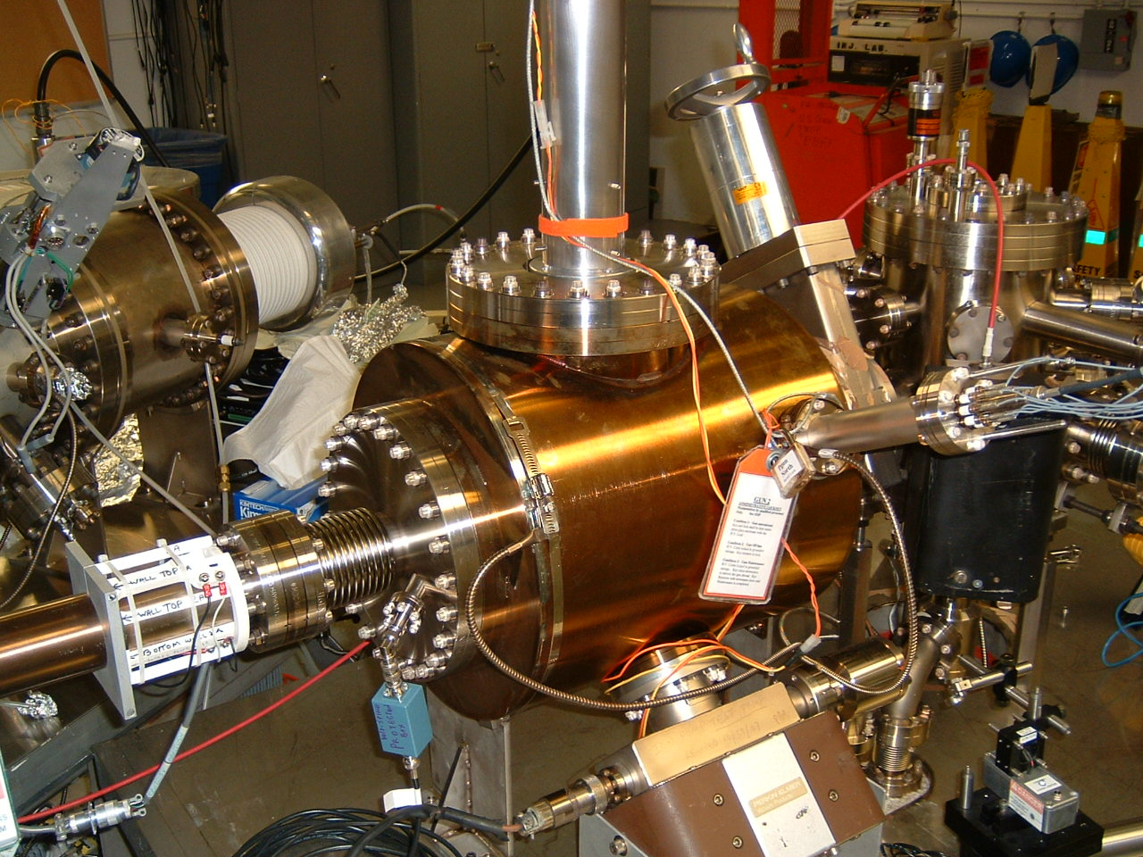
Inverted Gun #2 at Test Cave
HV Conditioned to 225 kV, with large grain Niobium (Nb) Electrode
Performs well at 140 kV
Problematic at 200 kV. Field emission (~ nA) and vacuum bursts that ruin QE
Preparing for “Plan B”
Inverted Gun #1 at CEBAF
HV Conditioned to 150 kV with Stainless Steel Electrode
100 kV Lifetime ~ 100 C at 180 μA with transmission of 85%
Now at 130 kV for QWeak. Lifetime ~ 100 C at 180 μA with transmission of 95%

Slide 40
Field Emission (FE)
Electron tunneling through the Electrode surface barrier due to the presence of Electric Field is described by Fowler – Nordheim formula:
φ
-eEx
E_{F}
φ | Work Function of Electrode
E | Electric Field at Electrode surface
β | Field Enhancement Factor at the emission site (= 30 – 60)
ζ | Constant determined by Electrode surface properties
γ | Constant determined by Electrode surface properties

Slide 41
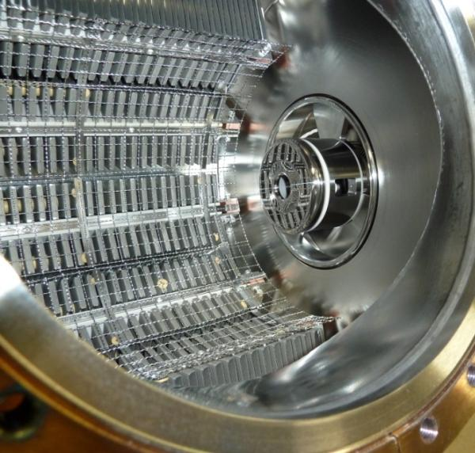
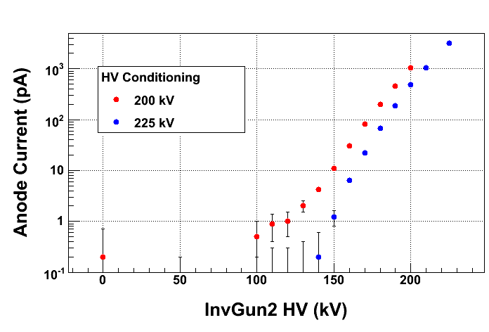
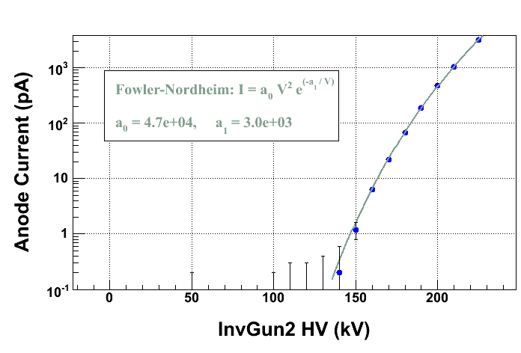
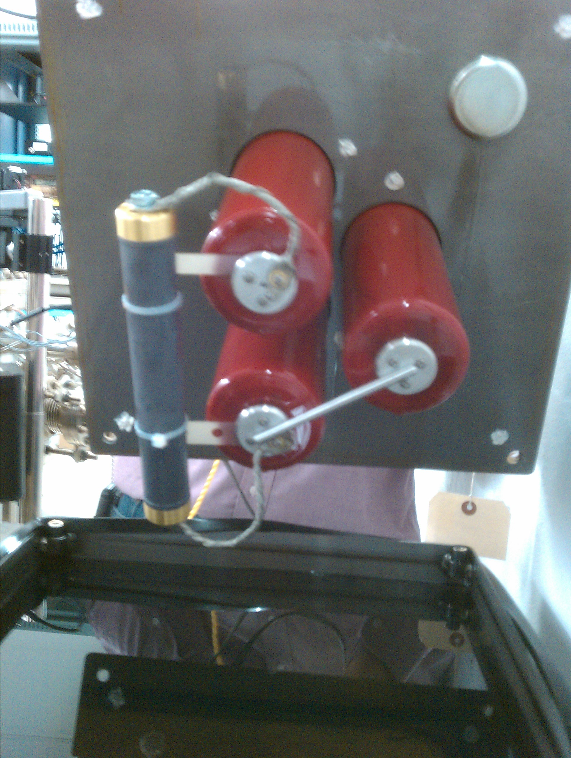
HV Conditioning and Field Emission
Floating Anode
connected to
Pico-ammeter
Macor glass-ceramic
spacer
100 MΩ
Conditioning
Resistor
(NICROM
100 kV, 75 W)
UNIVOLT
Transformer
Oil Tank
A Short for Beam
Delivery

Slide 42
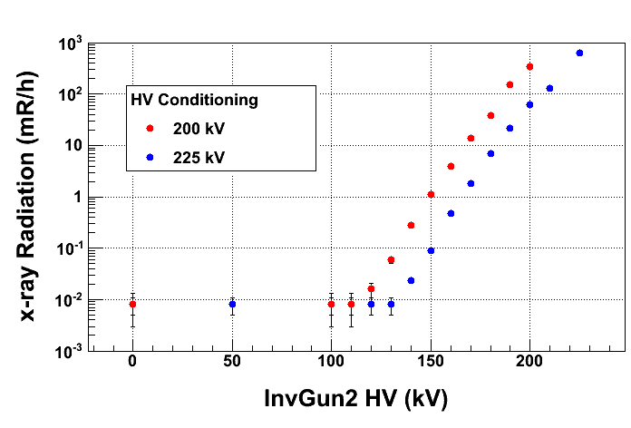
Anode won’t capture all FE, better to look for x-rays …
Ion Chamber Detector: Model IP 100
Energy threshold of 50 keV
Readout: CANBERRA ADM 616

Slide 43
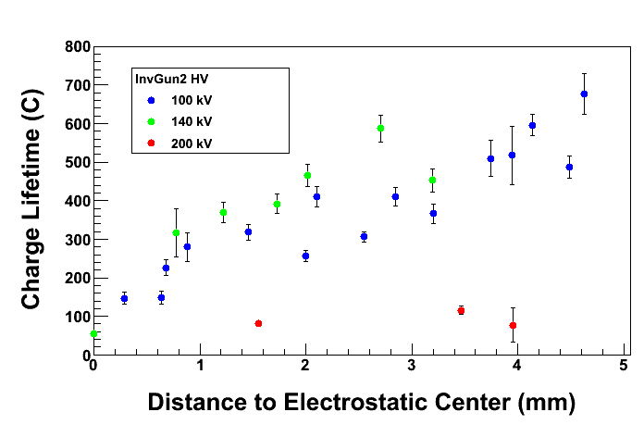
Charge Lifetime vs. Gun High Voltage
Poor lifetime at 200 kV due to field emission
And vacuum bursts often killed QE completely
 | I = 2 mA, Bulk GaAs (5 mm Active Area, 350 μm Laser Spot)
Gun HV | 100 kV | 140 kV | 200 kV
Anode Current (pA) | 0.0 ± 0.3 | -8 ± 1 | -520 ± 20
X-ray Detector (E-2 mR/h) | 1.5 ± 0.5 | 105 ± 5 | 5700 ± 300
Gun Vacuum (pA) | 0 | 0 | 400
Y-Chamber Vacuum (nA) | 3.0 | 3.0 – 3.2 | 3 – 4

Slide 44
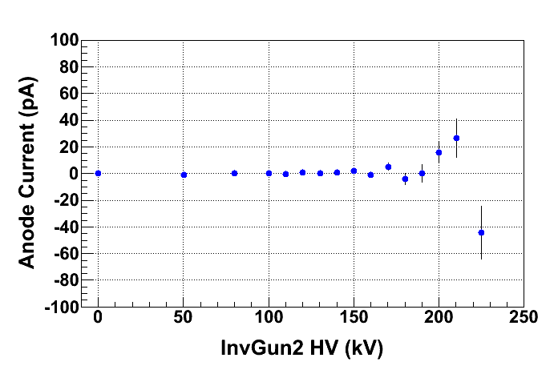
What’s Next? Plan B
Re-polished large grain Nb Electrode
HV conditioned to 225 kV; it looks very promising
x-ray stayed at background level (8 E-3 mR/h)
Added a leak valve to HV Chamber in case we need to Krypton-process the electrode to eliminate FE
Ready to run beam at 200 kV in January 2011

Slide 45
Summary and Outlook
Jefferson Lab is a world-class polarized electron beam research facility
Group Research:
Build 200 kV Electron Gun
Produce 5 mA polarized beam. We hold the world record of 1 mA from Superlattice GaAs
Electrode Research using HV Test Stand: SS and Nb electrodes with different surface treatments and coatings. FE Elimination by Krypton-processing
Cryo-pumping to improve vacuum
New Photocathode Materials:
5% Polarized QE
K₂CsSb: less vacuum requirement
Polarized Positron Source

