Slide 1
Experiment | Energy (GeV) | Pol (%) | I (µA) | Target | A_{pv} (ppb) | Maximum Charge Asym (ppb) | Maximum Position Diff (nm) | Maximum Angle Diff (nrad) | Maximum Size Diff (δσ/σ)
HAPPEx-I (Achieved) | 3.3 | 38.8 | 40 | ¹H (15 cm) | 15,050 | 200 | 12 | 12
G0-Forward (Achieved) | 3.0 | 73.7 | 40 | ¹H (20 cm) | 3,000-40,000 | 300±300 | 7±4 | 3±1
HAPPEx-II (Achieved) | 3.0 | 87.1 | 55 | ¹H (20 cm) | 1400 | 400 | 1 | 0.2
HAPPEx-III (Achieved) | 3.484 | 89.4 | 100 | ¹H (25 cm) | 16900 | 200±100 | 3±3 | 0.5±0.1 | 10⁻³
PREx-I (Achieved) | 1.056 | 89.2 | 100 | ²⁰⁸Pb (0.5 mm) | 657±60 | 100±130 | 2±3 | 1 | 10⁻⁴
QWeak-I (Achieved) | 1.155 | 89.0 | 180 | ¹H (35 cm) | 281±46 | 8±15 | 5±1 | 0.1±0.02 | 10⁻⁴
QWeak | 1.162 | 90 | 180 | ¹H (35 cm) | 234±5 | 100±10 | 2±1 | 30±3 | 10⁻⁴
PREx-II | 1.0 | 90 | 70 | ²⁰⁸Pb (0.5mm) | 500±15 | 100±10 | 1±1 | 0.3±0.1 | 10⁻⁴
Møller | 11.0 | 90 | 85 | ¹H (150 cm) | 35.6±0.74 | 10±10 | 0.5±0.5 | 0.05±0.05 | 10⁻⁴

Slide 2
Experiment | Energy (GeV) | Pol (%) | I (µA) | Target | A_{pv} (ppb) | Maximum Charge Asym (ppb) | Maximum Position Diff (nm) | Maximum Angle Diff (nrad) | Maximum Size Diff (δσ/σ)
HAPPEx-I (Achieved) | 3.3 | 38.8 | 40 | ¹H (15 cm) | 15,050 | 200 | 12 | 12
G0-Forward (Achieved) | 3.0 | 73.7 | 40 | ¹H (20 cm) | 3,000-40,000 | 300±300 | 7±4 | 3±1
HAPPEx-II (Achieved) | 3.0 | 87.1 | 55 | ¹H (20 cm) | 1400 | 400 | 1 | 0.2
HAPPEx-III (Achieved) | 3.484 | 89.4 | 100 | ¹H (25 cm) | 16900 | 200±100 | 3±3 | 0.5±0.1 | 10⁻³
PREx-I (Achieved) | 1.056 | 89.2 | 100 | ²⁰⁸Pb (0.5 mm) | 657±60 | 100±130 | 2±3 | 1 | 10⁻⁴
QWeak-I (Achieved) | 1.155 | 89.0 | 180 | ¹H (35 cm) | 281±46 | 8±15 | 5±1 | 0.1±0.02 | 10⁻⁴
QWeak | 1.162 | 90 | 180 | ¹H (35 cm) | 234±5 | 100±10 | 2±1 | 30±3 | 10⁻⁴
PREx-II | 1.0 | 90 | 70 | ²⁰⁸Pb (0.5mm) | 500±15 | 100±10 | 1±1 | 0.3±0.1 | 10⁻⁴
Møller | 11.0 | 90 | 85 | ¹H (150 cm) | 35.6±0.74 | 10±10 | 0.5±0.5 | 0.05±0.05 | 10⁻⁴

Slide 3
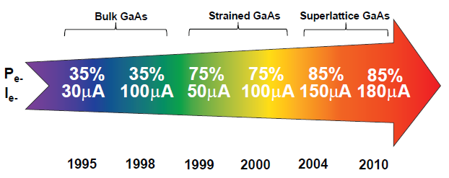
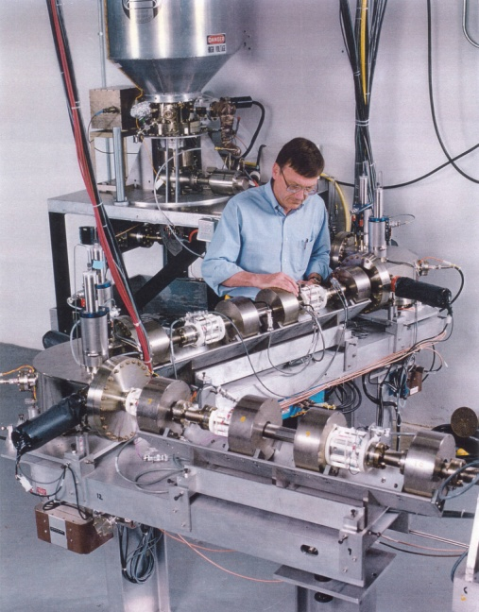
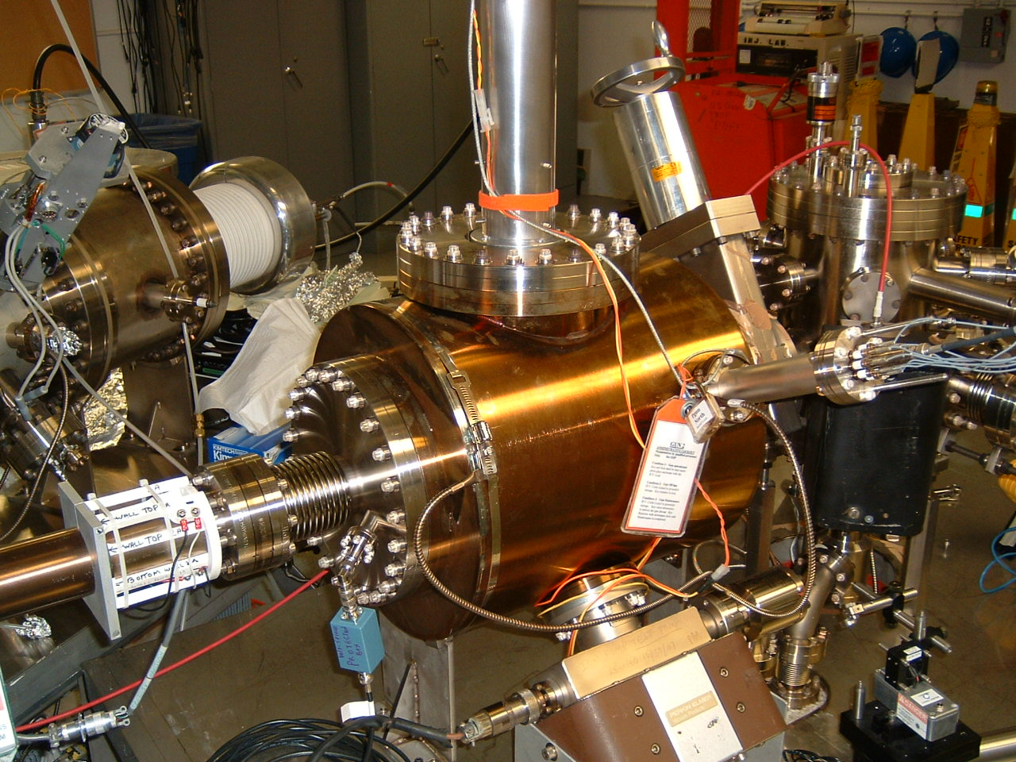
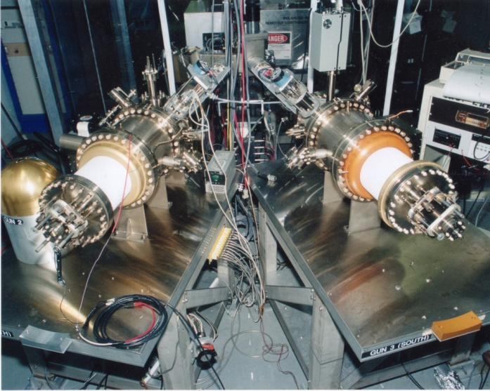
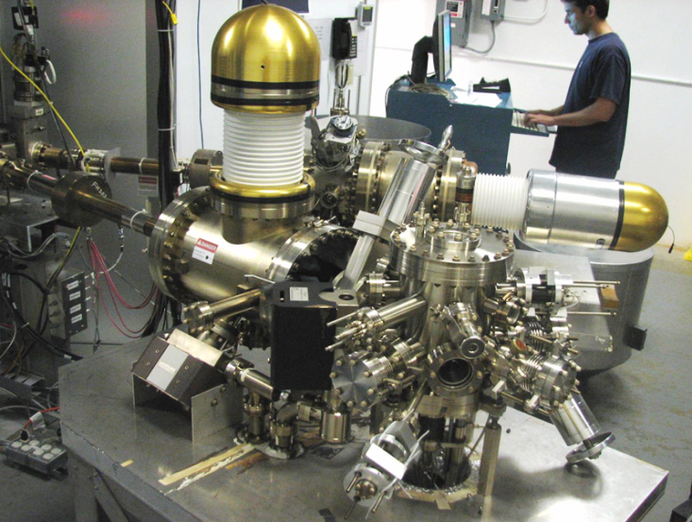
Always Tweaking the Design
1
4
Endless (?) quest for perfection
The photogun works well,
No anticipated near-term changes
2
3

Slide 4
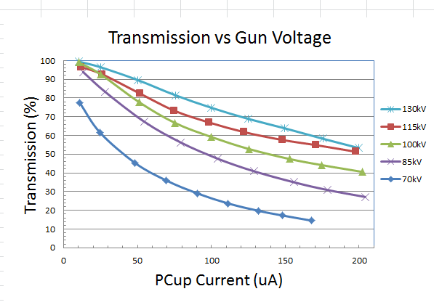
130 kV Inverted Gun
Higher Voltage = Better Transmission = Better Beam Quality
(and maybe longer lifetime)
Prebuncher operating at modest power takes care of the rest

Slide 5
Improve Lifetime with Large Laser Spot?
(Best Solution – Improve Vacuum, but not easy)
Bigger laser spot, same # electrons, same # ions
Ionized residual gas
strikes photocathode
Ion damage distributed
over larger area

Slide 6
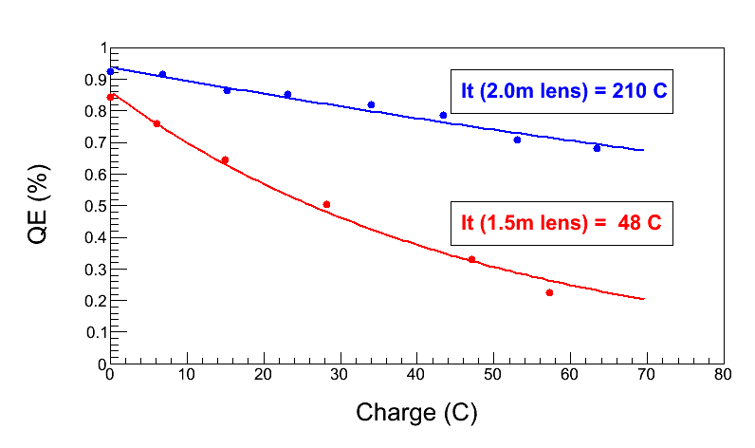
Enhanced lifetime for Qweak
Increase size of laser beam from ~ 0.35 mm to ~ 0.7 mm dia.
Can we use ~ cm size laser beams? Not in today’s CEBAF photogun.
How far can we extrapolate? Need a better cathode/anode optic
“Charge and fluence lifetime measurements of a DC high voltage GaAs photogun at high average current.,” J. Grames, R. Suleiman, et al., Phys. Rev. ST Accel. Beams 14, 043501 (2011)

Slide 7
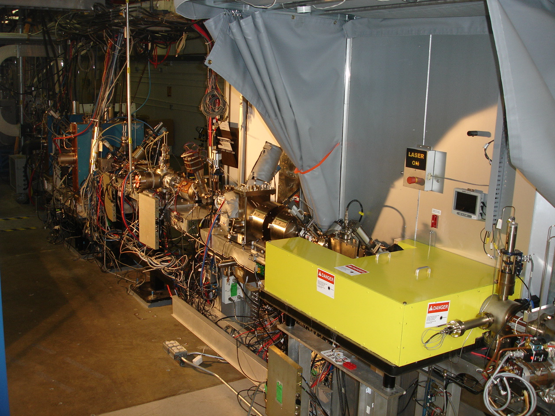
4π Electron Spin Manipulation
Horizontal Wien Filter
Two Solenoids
Vertical Wien Filter
Harder to flip spin than we imagined, more “things” change than just spin direction
Beam orbit downstream of HWien sensitive to laser/prebuncher (mis-)phasing
Don’t know what to do about this….

Slide 8
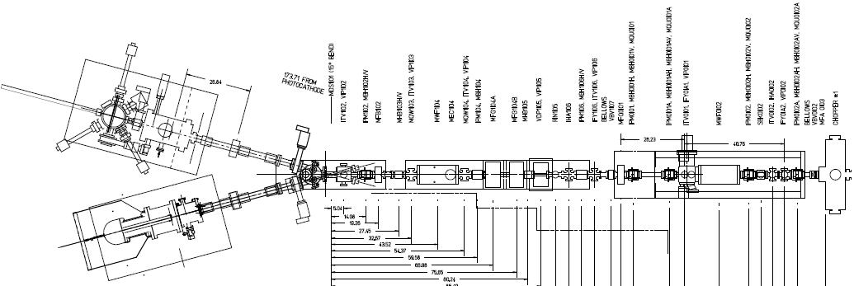
Electron Spin Reversal for PV
From Gun
“Spin Reversal”
Vertical Wien = 90 deg
Two Solenoids = ±90 deg
“Longitudinal Polarization”
Horizontal Wien = {-90…+90}
LEFT
RIGHT
Pondering a new beamline, but will it behave differently? Reluctant to move prebuncher. Modification would provide an opportunity to improve beamline vacuum….

Slide 9
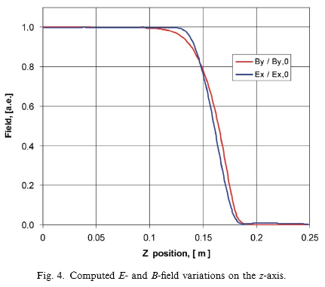
Two Wien Improvements
Do a better job characterizing optics, and compensate asymmetric focusing using quads, to achieve “perfect” spin flip
Mis-matched E and B fields create mini-chicane, with e-beam displaced from zero potential, which introduces a time delay…

Slide 10
All of the same knobs exist today….
Attenuator
IA
Rotatable GaAs
Photocathode
Gain-switched Diode Laser and Fiber Amplifier
LP HWP LP
PC WP LP
Shutter
Helicity Generator
Helicity Fiber
HV Supply
(0 – 90 V)
15° Dipole
nHelicity
Fiber
Vacuum
Window
Delayed
Helicity Fiber
T-Settle
Fiber
Hall
RHWP
Charge Feedback (IA)
V-Wien Filter
Target
Parity
DAQ
Spin Solenoids
BCM
Charge Feedback (PITA)
H-Wien Filter
BPMs
Position
Feedback
Pockels
Cell
HV Supply
(0 – 4 kV)
CEBAF
5 MeV
Helicity Magnets
PZT
Mirror
IHWP
Electron
Beam

Slide 11
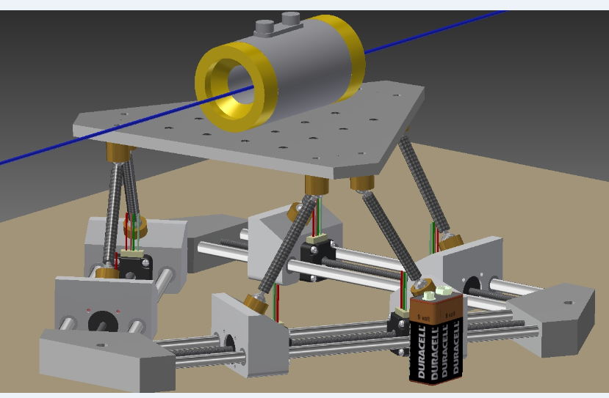
Stewart Platform: complete RC of PC alignment
LINUX-based software/freeware from hobbyists who build flight simulators
X, Y, pitch, roll and yaw

Slide 12
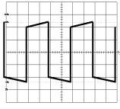
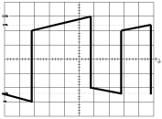
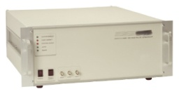
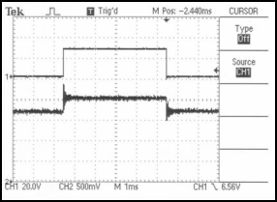
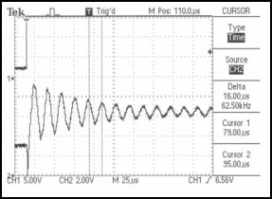
Initial attempts and problems encountered
This approach needed big capacitors…. lots of current
Two commercial high-speed / high-voltage transistor (~$8000)
Exaggeration of voltage droop on cell and subsequent re-charge after a helicity flip. Droop causes a serious problem when helicity flip rate was changed from a toggle to a pseudo-random pattern: pockels cell “memory”
high-voltage switch (~$10,000) All-in-one commercial bipolar
Charge droop was greatly improved, but high speed ringing of the cell was a problem for the settling time. In addition, the large high-speed switching currents created a noise induced helicity pickup on sensitive helicity DAQ components.
Work of John Hansknecht

Slide 13
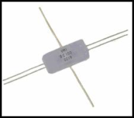
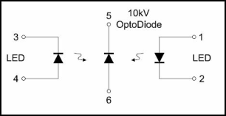
Solution: Opto-diode
Encapsulated Opto-diode $67 each
I = CΔV/ Charge time
+/- quarter wave voltage = 5120V
Cell capacitance = 6pf
Desired charge time = 100us
Calculated current is only 307uA !!
Work of John Hansknecht

Slide 14
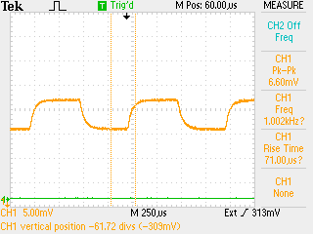
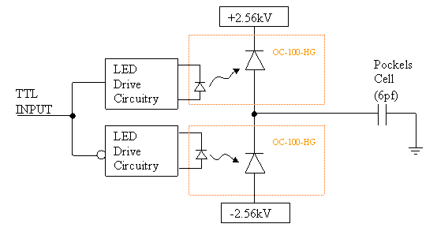
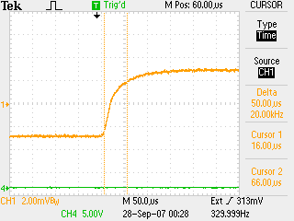
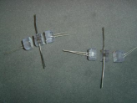
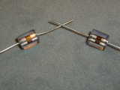
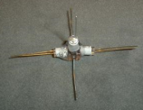
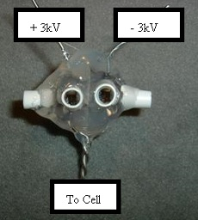
New Opto Diode Pockels Cell Switch
Pockels cell λ/2 flipping at 1kHz.
Perfect symmetry and no voltage droop over time.
Push-Pull Circuit
Pockels cell λ/2 transition optical result. ~70us with no ringing.
1
2
3
The old switch was limited to 30 Hz helicity flip rates due to power handling limitations. Now we flip at 1kHz for ~ 400$.
Pockels cell “memory” not an issue anymore….
4
Work of John Hansknecht

Slide 15
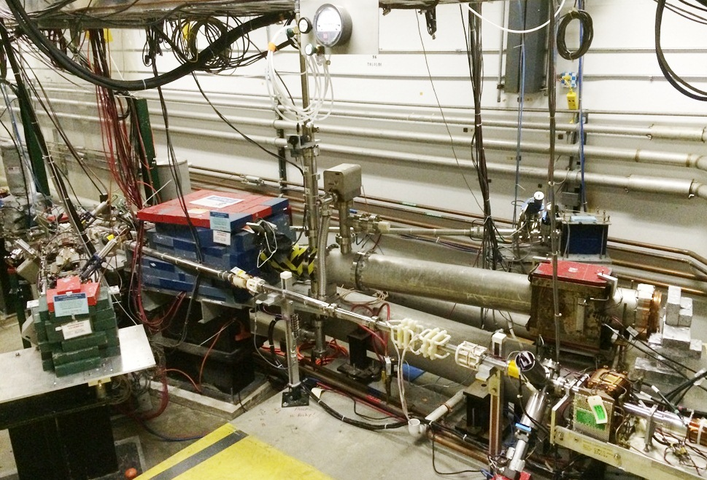
Mott Polarimeter at CEBAF

Slide 16
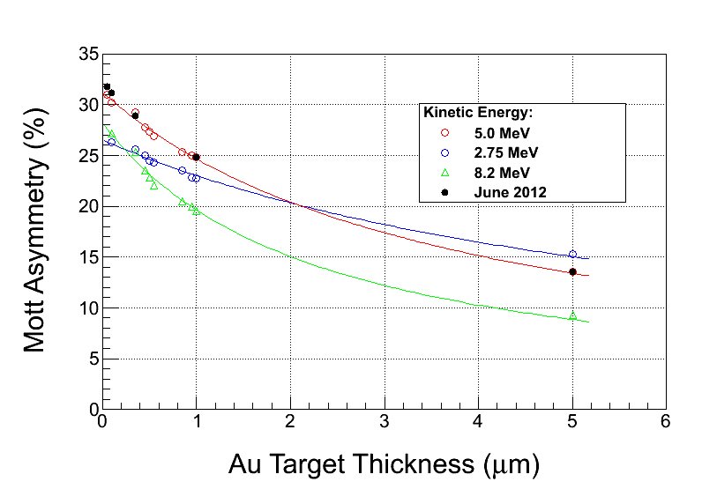
M. Steigerwald first reported MeV Mott Polarimeter at SPIN 2000, with accuracy 1.1%
Still that accurate? Can it be more accurate ??? => motivates a new “campaign” to study 5 MeV Mott

Slide 17
Accurate Mott Polarimetry
List of improvements and tasks:
Reduce background using time of flight analysis, laser at 31 MHz
Reduce background using Be dump plate
Upgrade DAQ to operate at higher data rates, higher beam currents (i.e., measure polarization at your current)
Exhaustive studies of systematic errors
GEANT modeling and assistance from theorists to help pin down the Sherman function at zero foil thickness
Different Zs, different energies
Planned Summer 2014 tests using 1/4CM at 4K…..
M. McHugh, Joe Grames, Riad Suleiman

Slide 18
Role of Beam Dump Background
12 ns round trip time
499 MHz (2ns)
Gold
0.1 um
Gold
1.0 um
Gold
10 um
M. McHugh
Joe Grames
Riad Suleiman

Slide 19
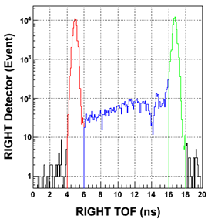
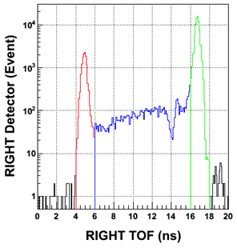
Dipole Suppression
Dipole deflects primary and secondary electrons
OFF
+5 A

Slide 20
Time Of Flight Separation
f_{beam} = 31.1875MHz
16 ns repetition rate > 12 ns “clearing time”
TARGET
STRAGGLERS
DUMP
TARGET
STRAGGLERS
DUMP

Slide 21
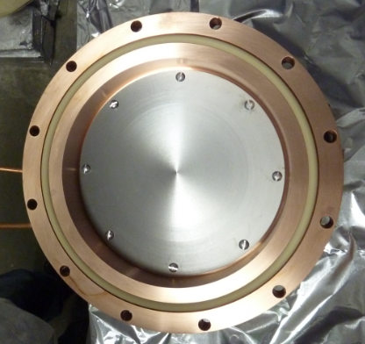
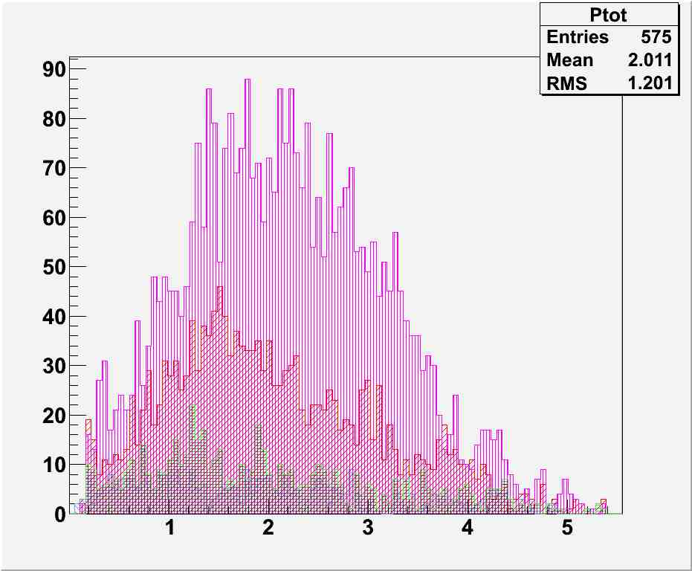
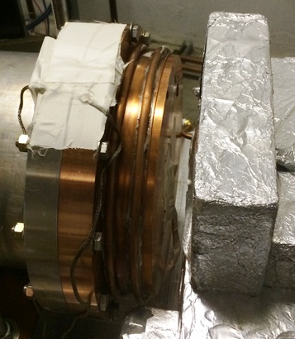
Be Dump Design
Kalrez™ high temp (240C) o-ring
Cu
Number of Electrons
Al
C
Dump should work fine to 1 kW (200uA @ 5MeV) so limitation will be deadtime.
Be
Total Momentum [MeV/c]
M. McHugh, Joe Grames, Riad Suleiman

Slide 22
TMONO Harmonic Resonant Cavity
Bunched electron beam can be described as Fourier series….
I(t) = a₀ + a₁ cos (ω_{o}t + θ₁) + a₂ cos (2ω_{o}t + θ₂) + a₃ cos(3ω_{o}t + θ₃) + …
…..a cavity sensitive to each mode = bunchlength monitor (Brock Roberts)

Slide 23
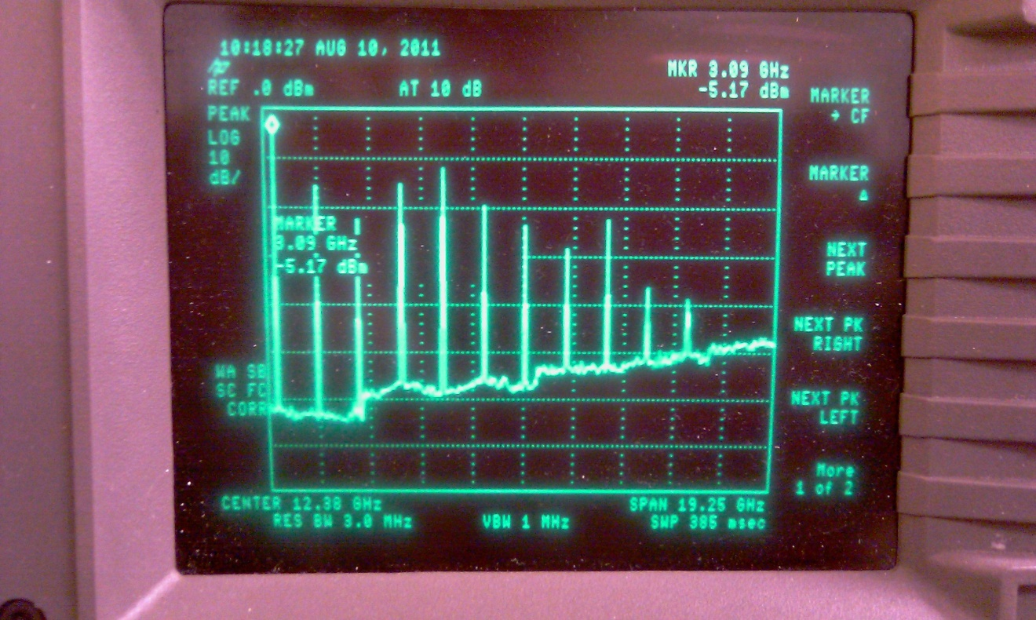
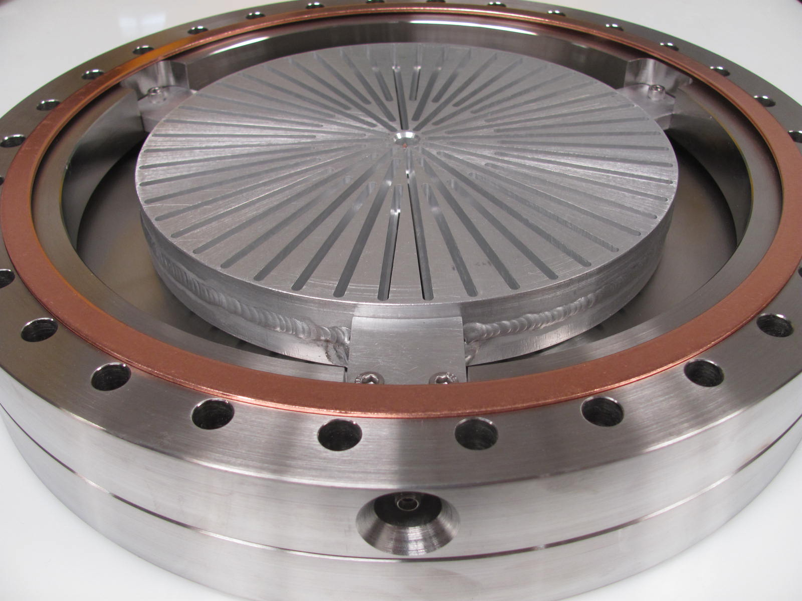
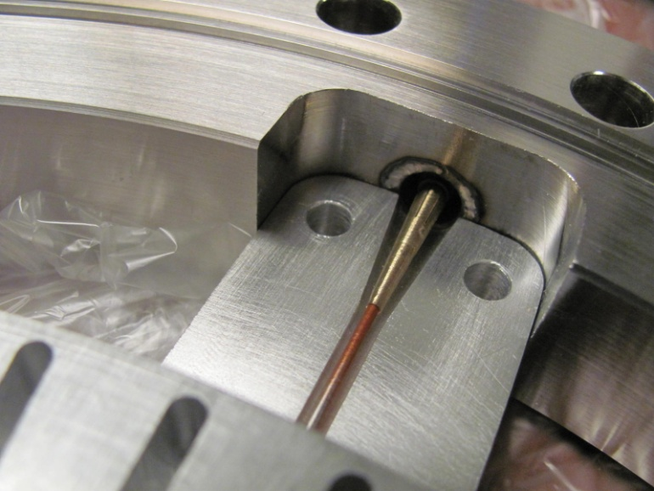
On the bench
“antenna/radiator” placed where the e-beam would travel. The antenna was driven with a 20 dBm,1556 MHz signal through a step recovery diode. Yes, cavity resonates at many harmonic modes.

Slide 24
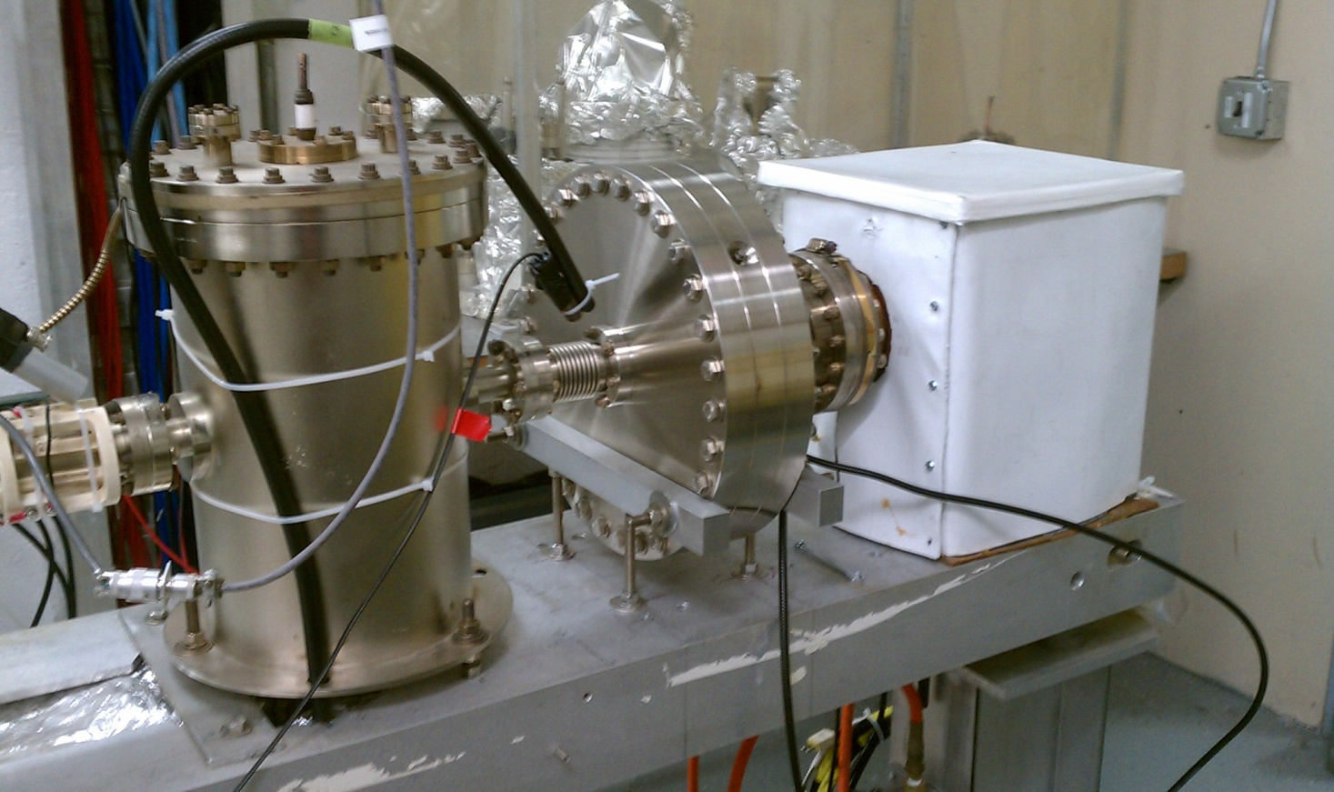
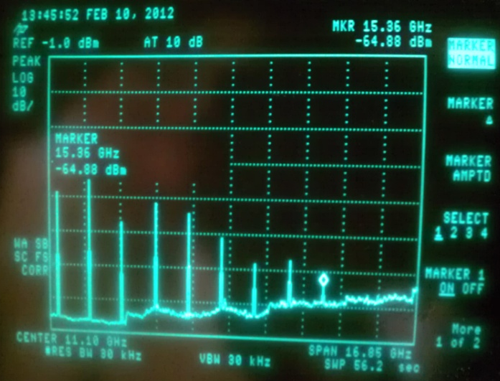
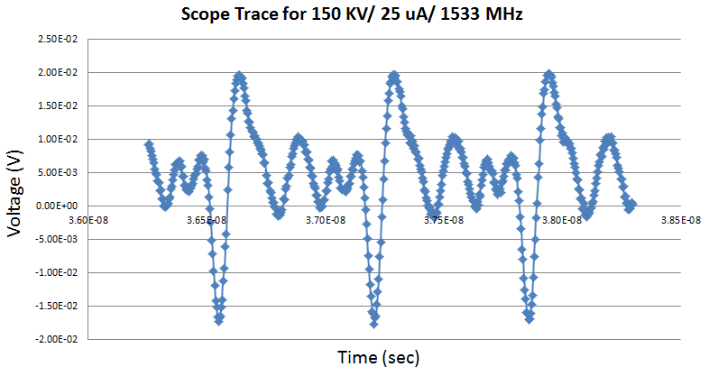
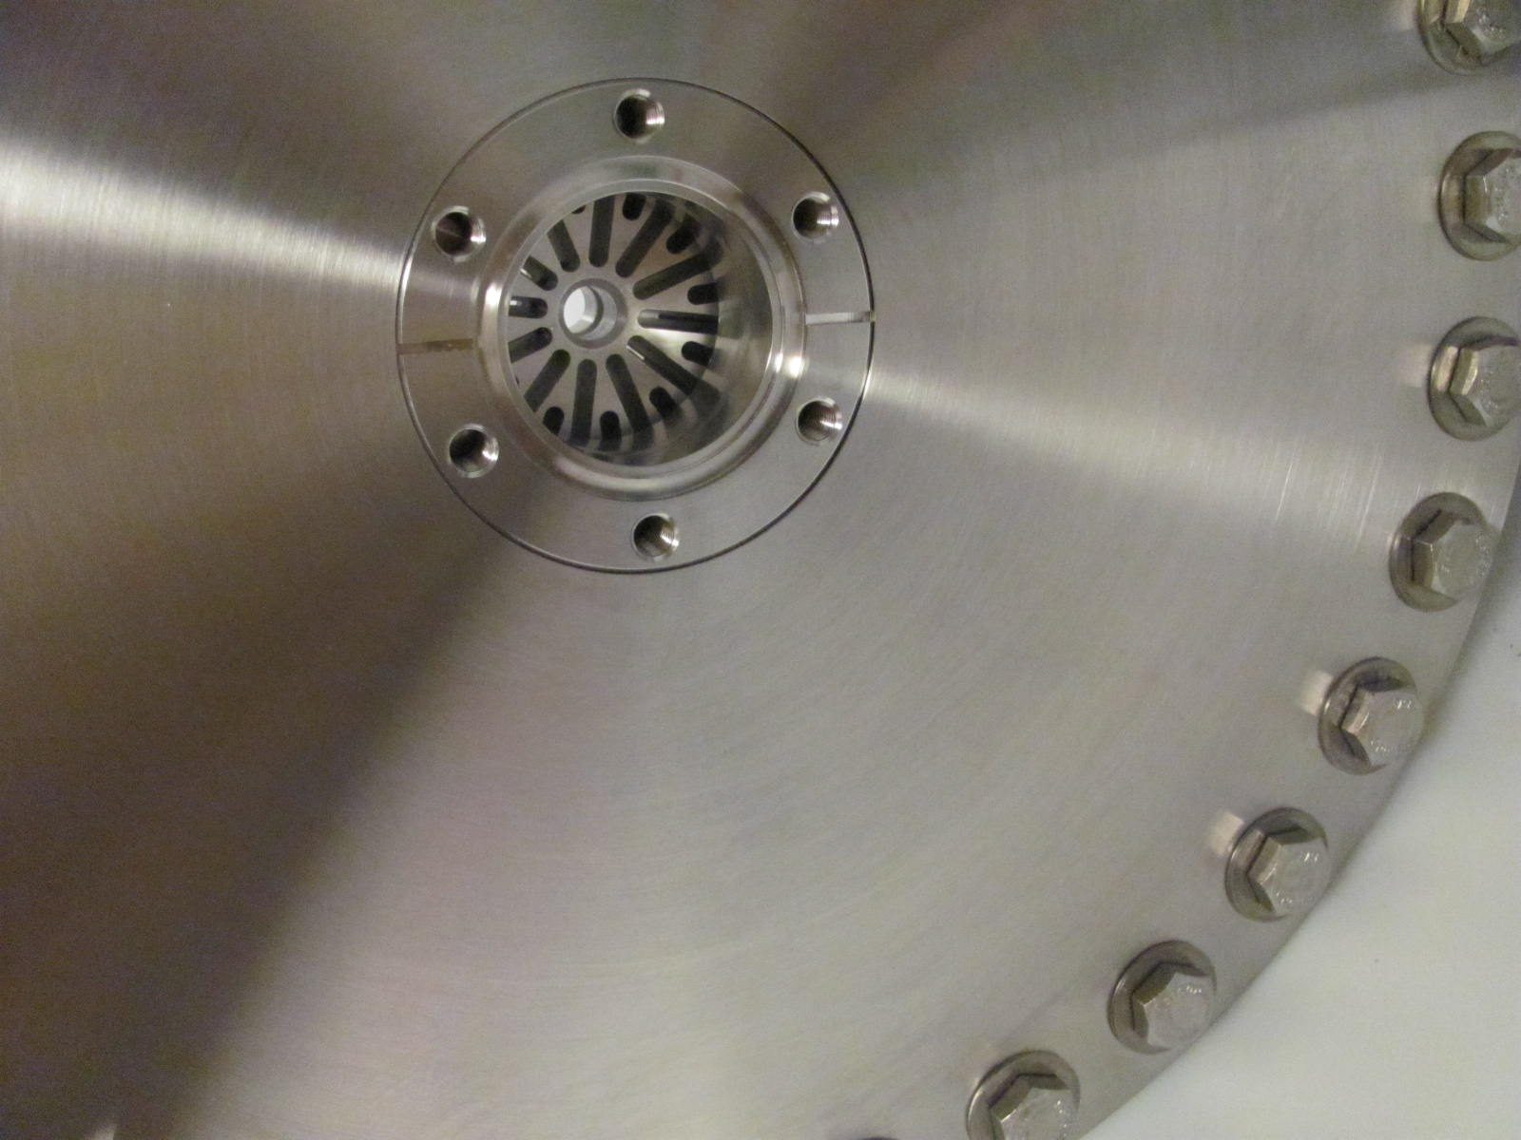
Installed at ITS
With beam delivered to dump, spectrum analysis shows harmonics visible to 18.396GHz, the 12th harmonic of 1533MHz (measurement made at 150kV, 25uA, superlattice cathode)

Slide 25
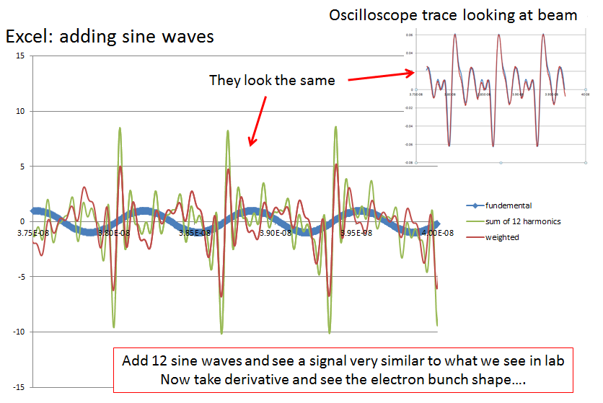
Bandwidth determines Resolution

Slide 26
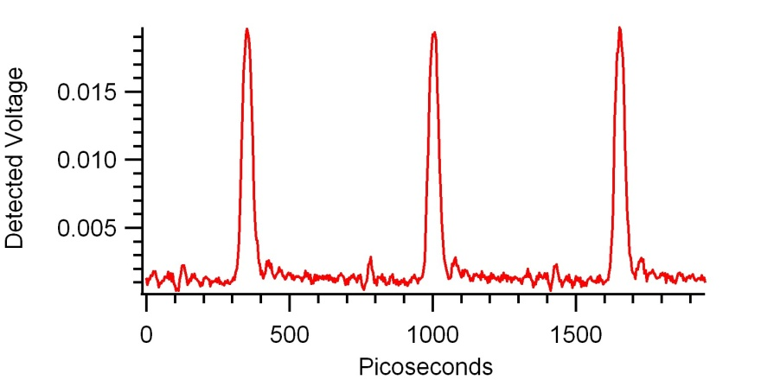
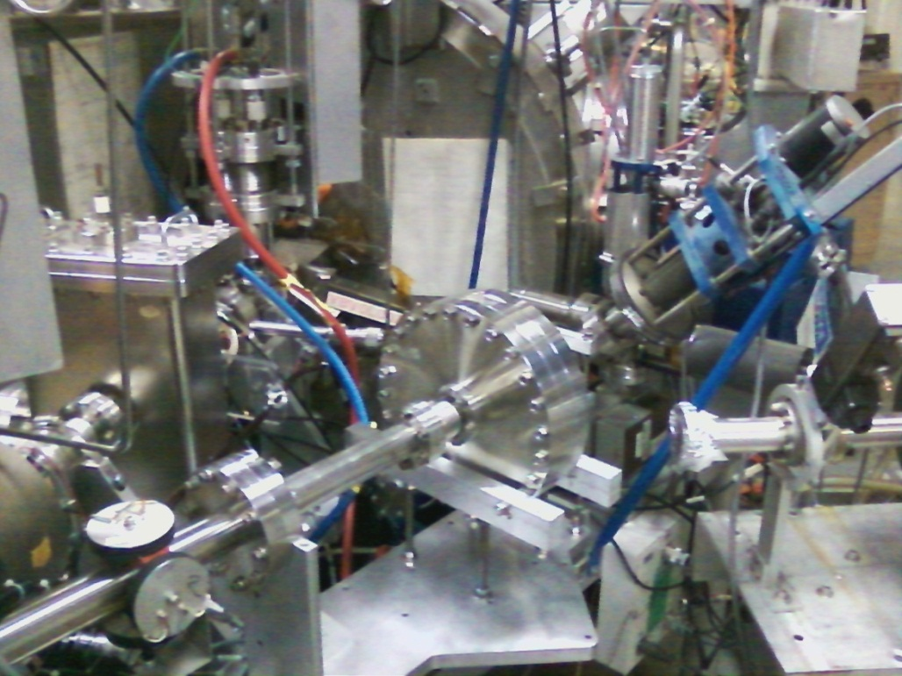
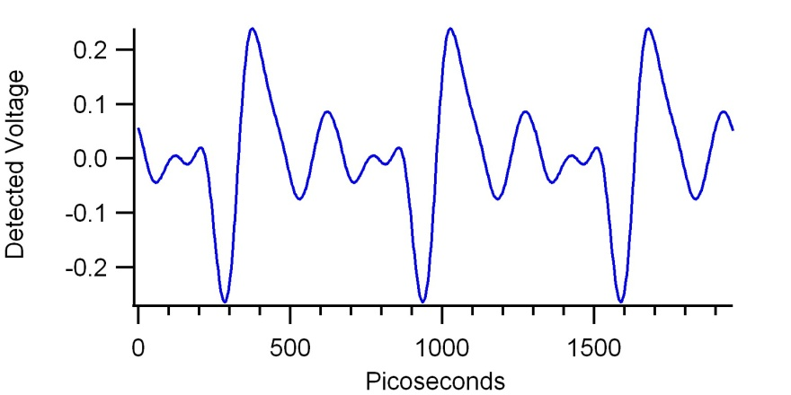
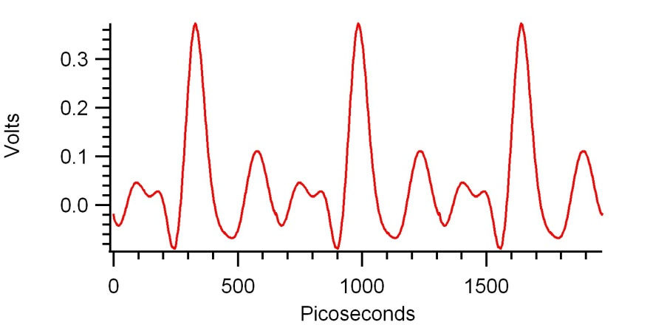
Laser optical pulse
At CEBAF 500 kV spectrometer line
(a)
O-scope Brock cavity
(b)
(c)
Brock Roberts will use RF model of cavity to see if it is sensitive to transverse beam motion and beam size variation…. helicity correlated beam size monitor? Lower noise floor for current monitoring?
Electron bunch
500 kV spectrometer line

Slide 27
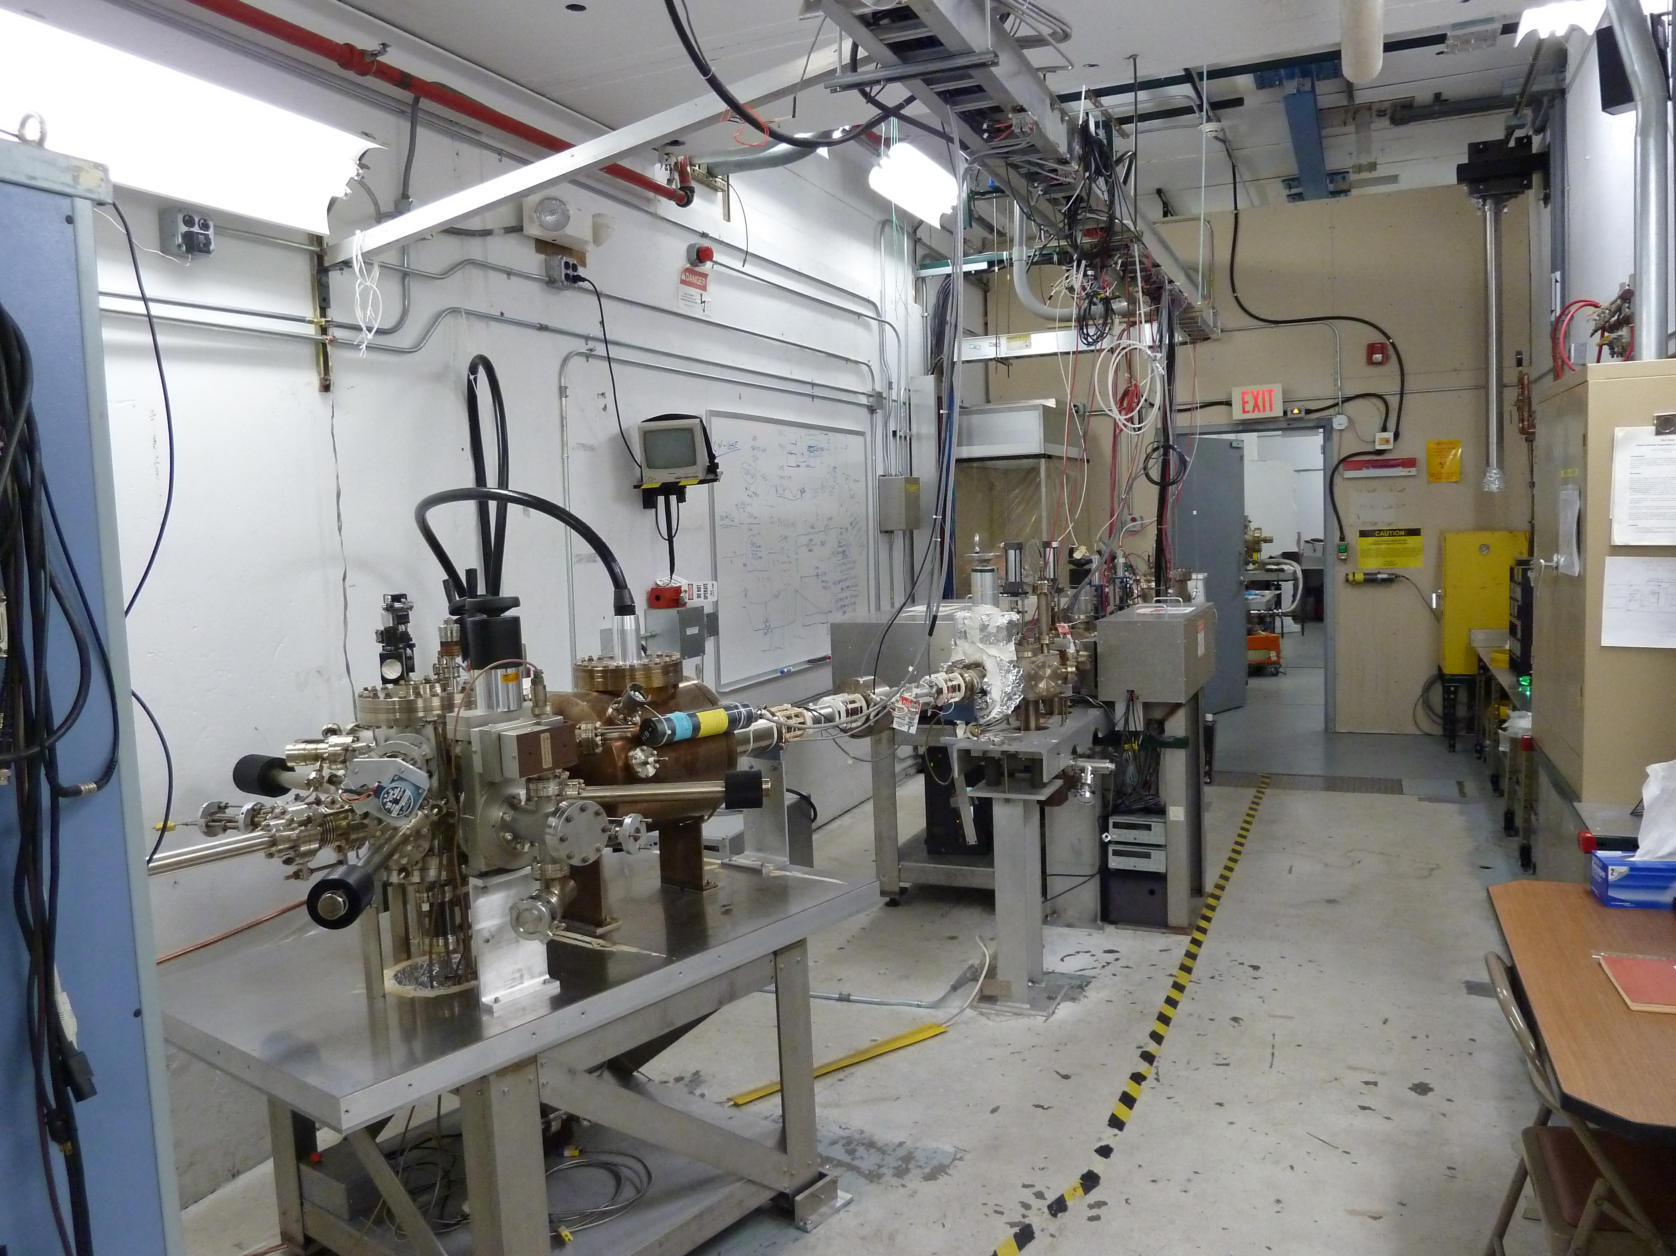
Load-locked photogun
and baked beamline:
Pressure ~ 4 e-12Torr

Slide 28
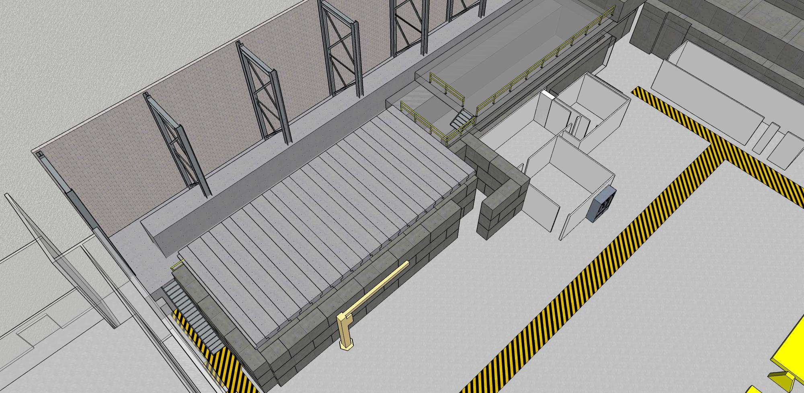

Slide 29
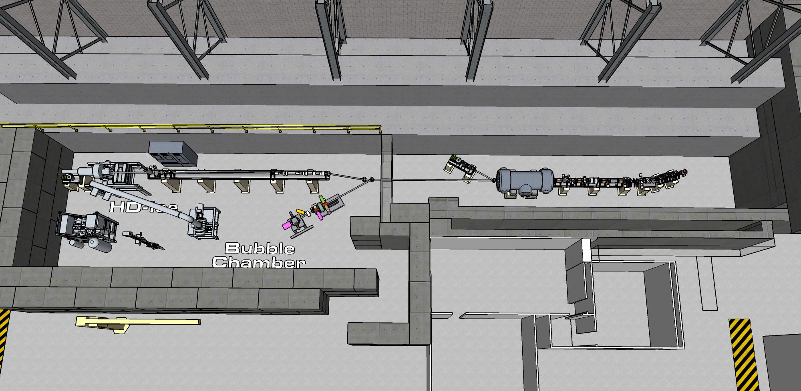

Slide 30
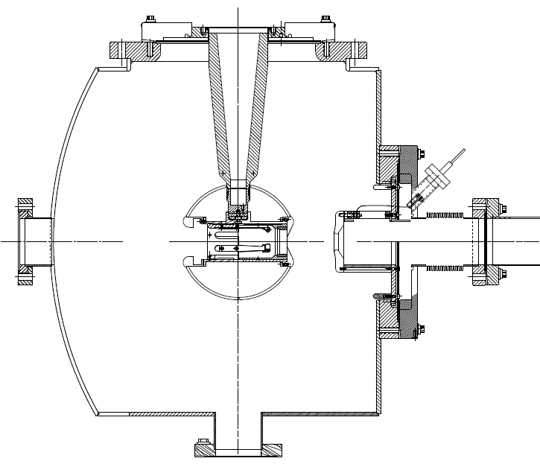
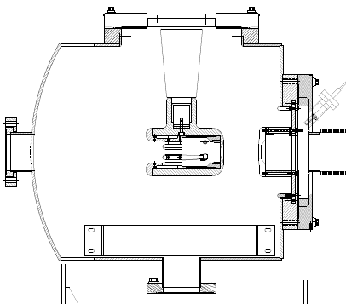
350kV Inverted Gun
200kV Inverted Gun
Longer insulator
Spherical electrode
Thin NEG sheet to move ground plane further away

Slide 31
To do list
Stewart Platform for Pockels cell: complete remote control of all alignment parameters
2 kHz Pockels cell switch, stable voltage and minimum transition time between helicity states
Improve 2-Wien Spin Flipper optics
Beam envelope matching to maximize adiabatic damping
Accurate Mott measurements at Injector
Re-wire 5MeV helicity magnets to provide HC focusing, and evaluate experimental sensitivity to HC spot size variation
Use POISSON and genetic algorithm to improve the field uniformity of pockel cell
Helicity correlated beam size monitor?
Beam current monitor with low noise floor?

Slide 32
Benchmarking PARMELA Simulation Results Against Beam-Based Measurements at CEBAF/Jefferson Lab – work of Ashwini Jayaprakash, JLab
Measurements at CEBAF/JLab
PARMELA Simulation Results
Similar Trends
Message: Beam quality, including transmission, improves at higher gun voltage

