Slide 1
New solenoid model
C. Valerio

Slide 2
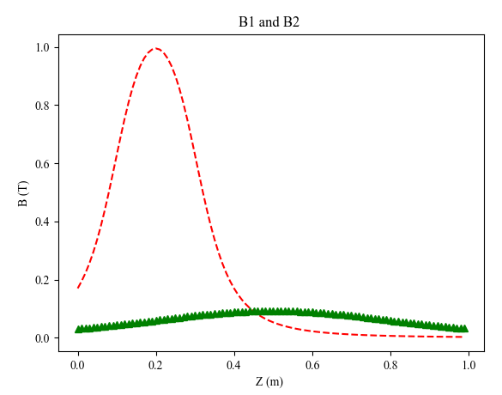
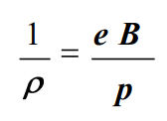
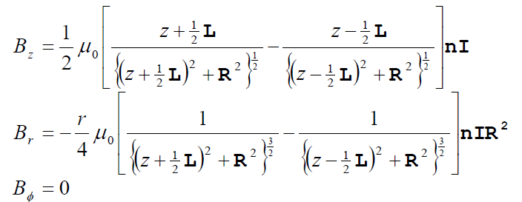
New Field approach based on the QWT
GPT include a solenoid model
Two Solenoids are used to model the field
Also, to improve the model the shape has been improved based
On [1]
Sol1 L= 0.1 m
Sol2 L= 0.6 m
For both the solenoid radius is set to 0.1 m
B1/B2=20
[1]ILC Undulator-Based Positron Source with Quarter Wave Transformer at 250 GeV CM Energy Andriy Ushakov

Slide 3
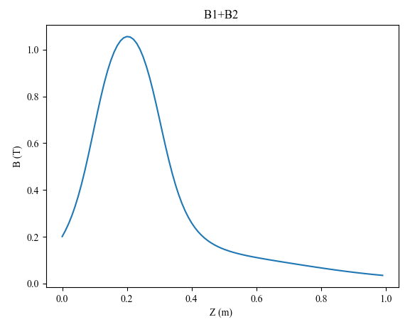
GPT include a solenoid model
Two Solenoids are used to model the previously used QWT
Also, to improve the model the shape has been improved based
On [1]
Sol1 L= 0.1 m
Sol2 L= 0.6 m
For both the solenoid radius is set to 0.1 m
B1/B2=20

Slide 4
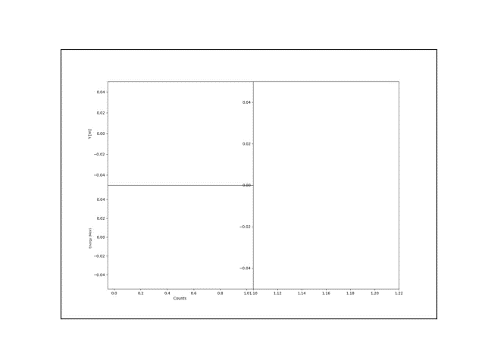
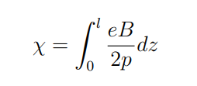
Capture of efficiency volume acceptance
Magnet strength scan from 0 to 8 Tesla
Input beam
Beam longitudinal uniform energy spread from 5 to 120 MeV
The transversal energy spread is 20 MeV
2 cm aperture beam line
The capture efficiency by energy depends on the magnet strength
Energy histogram at the end of the line
Z vs X (m)

Slide 5
Ratio between B1 and B2 effect
B1/B2=20
B1/B2=10
Pz (MeV )
Pz (MeV )

Slide 6
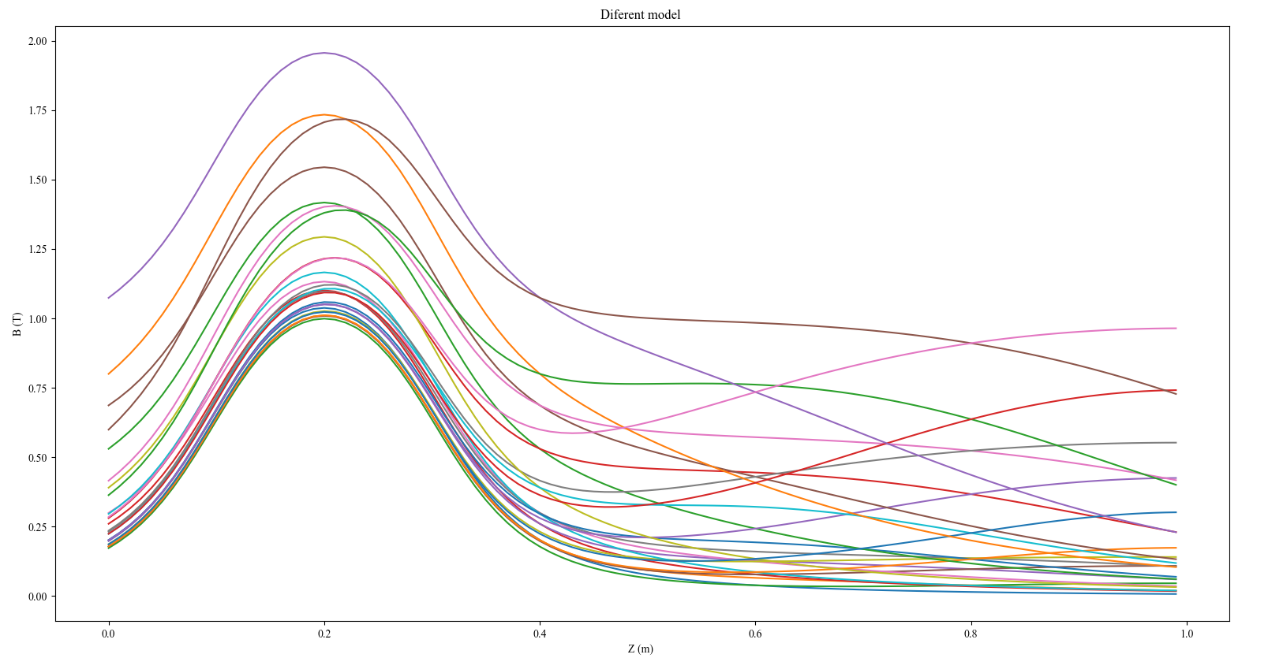
Set of combinations
We change
The aperture, length and field magnitude of the second solenoid

Slide 7
Next steps
Use the genetic algorithm to select one energy range and improve the capture efficiency in that region.
3 solenoids will be used to have more freedom in the shape of the field.

