Slide 1
MCC
ISB

Slide 2
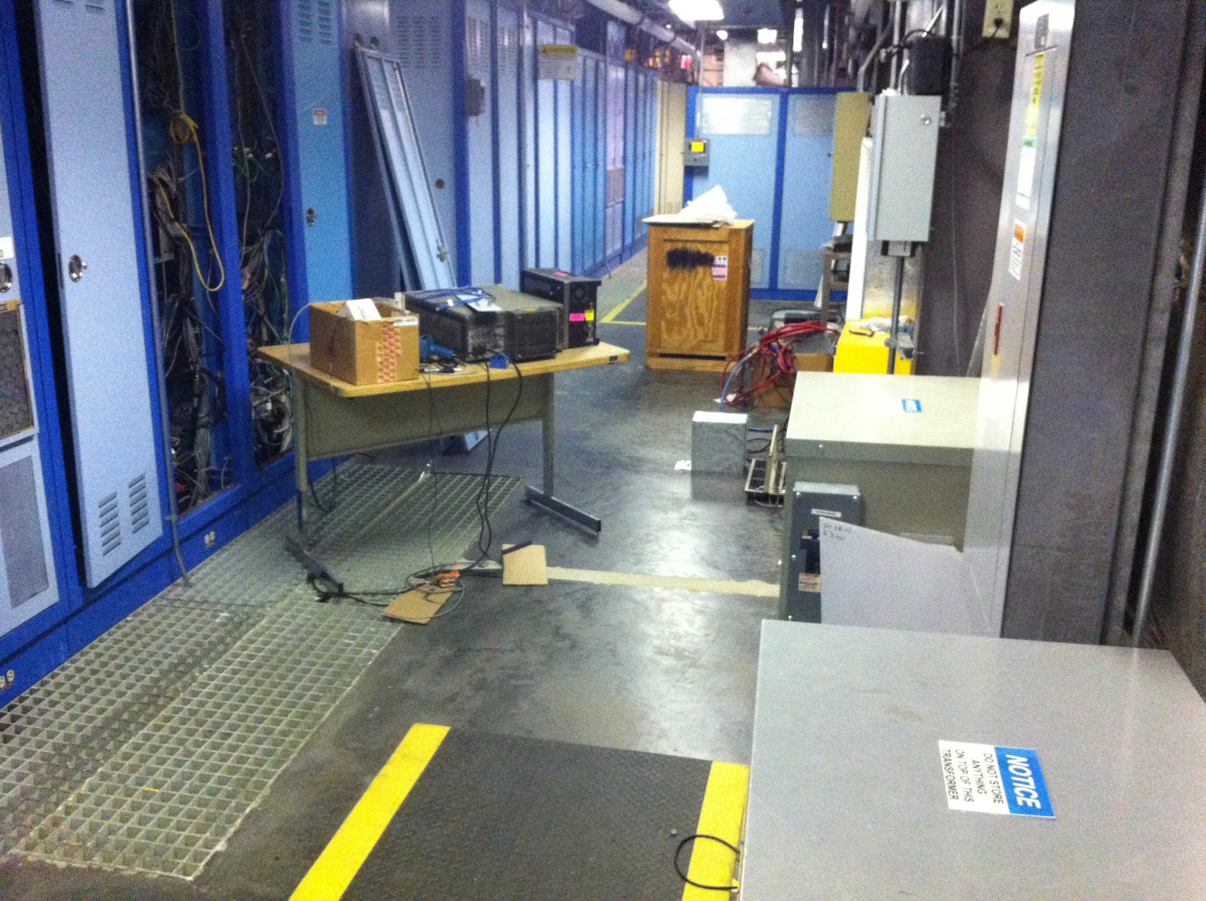
We can sit here in ISB
Cables from downstairs
(~30 ft)

Slide 3
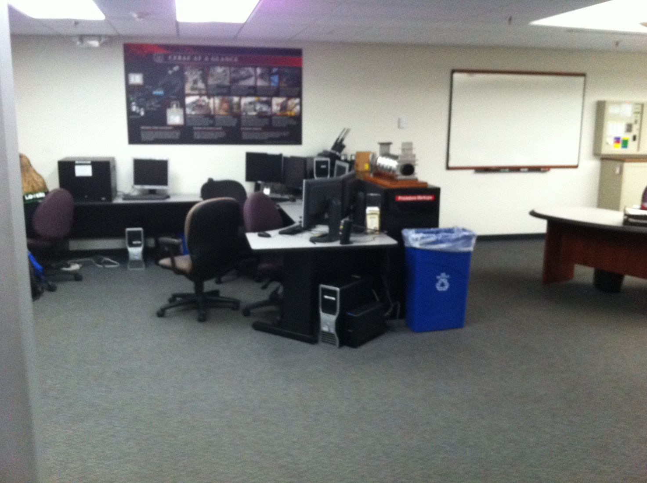
We can sit here
in MCC

