Slide 1
A concept for 3.4 GeV positron beam B.Wojtsekhowski, JLab
Can use of return flux. Need new/add. magnets for arc1 and arc 2
Arc1-neg - 1 GeV electron
Arc1-pos - 2 GeV positron
Arc2-neg - 2 GeV electron
Arc2-pos - 1 GeV positron
Resulting positron beam of 3.4 GeV
Injector from FEL building with energy ~ 100 MeV positrons acceleration
Is parallel to the electron beam!
1.2 GeV beam could be obtained even before the new Arc magnets are installed.

Slide 2
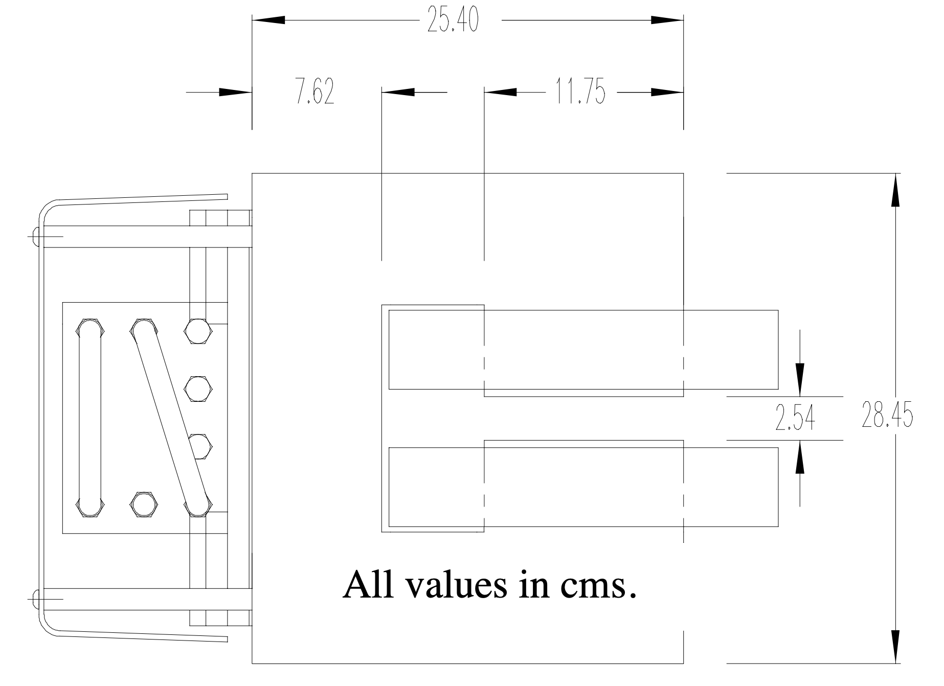

Slide 3
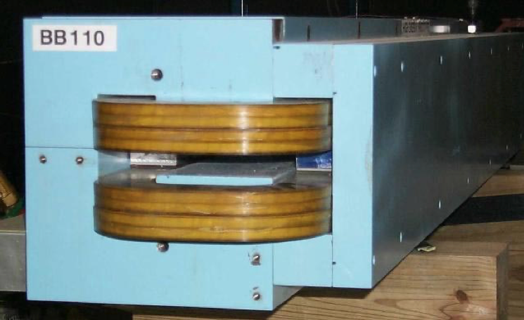

Slide 4
Typical Arc Magnet
Return flux in a yoke
Electron
beam
Proposed Arc, two magnets
shifted along the orbit
Proposed Arc (if the orbit is busy),
one combined magnet
16 dipoles in Arc 2

Slide 5
Positron
Linac - 1.1 GeV
Arc1
Arc2
Electron
Magnet Arc2
Proposed Arc option
Electron

Slide 6
Blue is an electron arc
Green is a positron arc
Free space for
a positron arc
16 dipoles in Arc 2

Slide 7
Significant R&D is needed for full scale positron project
Staging could be a solution for positron progress
Proposed 3.4 GeV will open window for a number of experiments
Cost for the CEBAF part is 16 x 2 dipoles put pipe + correctors; Cost of the injector ??
From Robin Wines:
For a new 2 meter long dipole, I would scale the 4 meter dipole down to $41,800 for 2021.
Full scale for this stage (P3) is below $10M

