Slide 1

Measurement of ¹⁶O(γ,α)¹²C with Bubble Chamber and Bremsstrahlung Beam at Jefferson Lab Injector
Riad Suleiman
June 04, 2014
Notes:
Title Page

Slide 2






B. DiGiovine
D. Henderson
R. J. Holt
K. E. Rehm
J. Benesch
P. Degtiarenko
A. Freyberger
J. Grames
G. Kharashvili
D. Meekins
M. Poelker
Y. Roblin
R. Suleiman
C. Tennant
V. Vylet
A. Robinson
C. Ugalde
W. Deconinck
D. Getts
https://wiki.jlab.org/ciswiki/index.php/Bubble_Chamber
A. Sonnenschein
Notes:
Interior Page Design 2

Slide 3
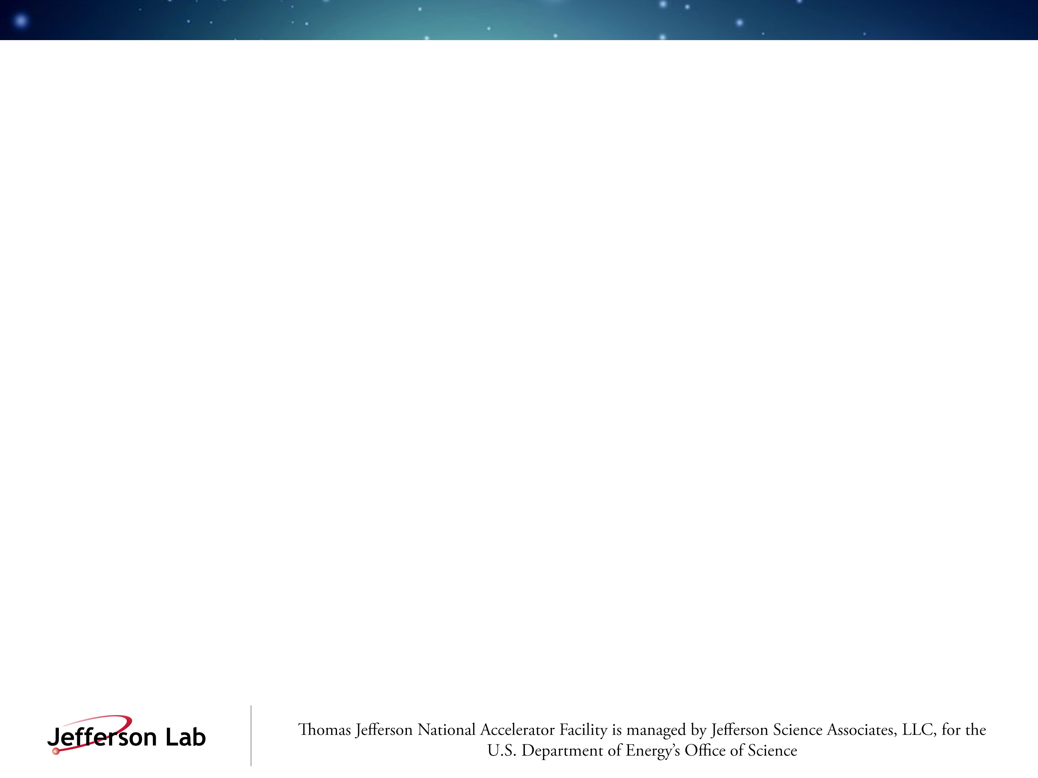
Outline
Nucleosynthesis and the ¹²C(α,γ)¹⁶O Reaction
Time Reversal Reaction: ¹⁶O(γ,α)¹²C
The Bubble Chamber
Bubble Chamber at HIGS
Experimental Setup at Jefferson Lab Injector
Bremsstrahlung Beam and Penfold-Leiss Unfolding
Statistical and Systematic Errors
Backgrounds and Ion Energy Distributions
Summary and Outlook

Slide 4

Relative Abundance of Elements by Weight
This region is bypassed by 3α process
Notes:
http://en.wikipedia.org/wiki/Nucleosynthesis

Slide 5
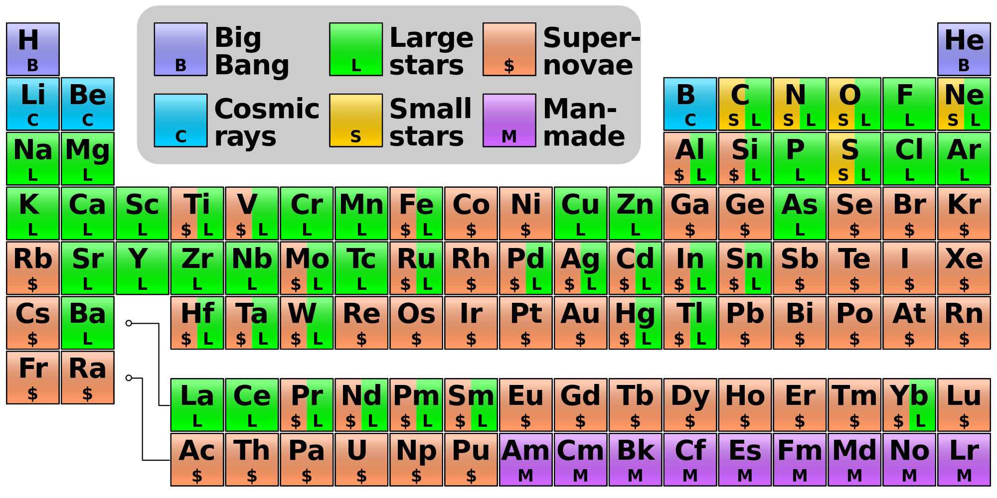
Nucleosynthesis
Big Bang Nucleosynthesis: quark ̶ gluon plasma → p, n, He
Stellar Nucleosynthesis: H burning, He burning, NCO cycle
Supernovae Nucleosynthesis: Si burning
Cosmic Ray Spallation
Notes:
http://en.wikipedia.org/wiki/Nucleosynthesis

Slide 6
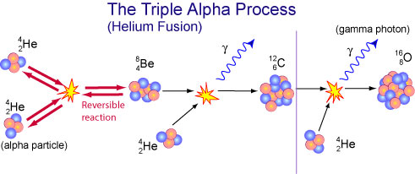
Stellar Helium Burning
Helium Reactions:
  α + α ↔ ⁸Be
  (Q = -0.092 MeV, T_{½} ≈ 10⁻¹⁶ s)
  α + ⁸Be → ¹²C + γ (Q = +7.367 MeV, Hoyle State = 7.654 MeV)
  α + ¹²C → ¹⁶O + γ (Q = +7.162 MeV)
  (slow, otherwise no ¹²C remains)
  α + ¹⁶O → ²⁰Ne + γ (very slow – due to parity conservation)
α + ¹²C burns at very small cross section σ ≈ 10⁻¹⁷ barn (10⁻⁴¹ cm²)
Currently, reaction rate error is large (±35%)
Thermonuclear reaction rate involving two nuclei is:
Goal <±10%
Only narrow energy range is relevant (Gamow Peak)
Notes:
Notes:
1- Simultaneous fusion of 3-alpha particles has very small probability, the process has to go through 8Be.

Slide 7

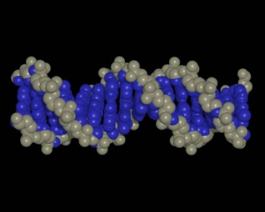

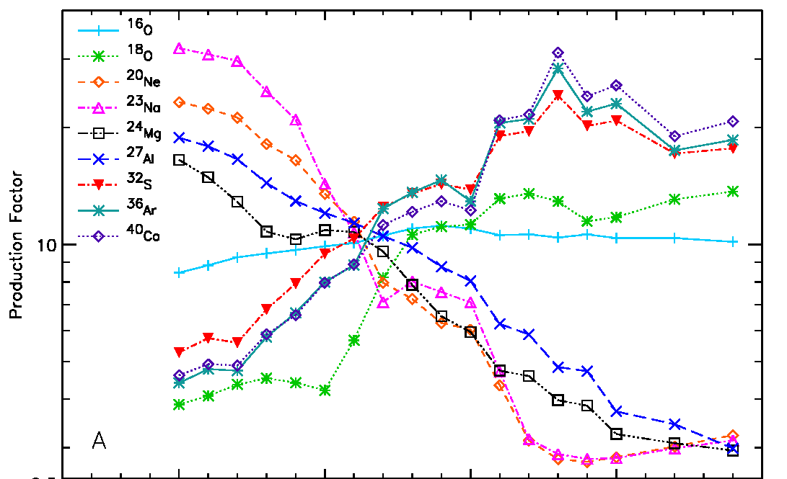
The ¹²C(α,γ)¹⁶O Reaction
The holy grail of nuclear astrophysics
Affects the synthesis of most of the elements of the periodic table
Sets the N(¹²C)/N(¹⁶O) (≈0.4) ratio in the universe
Determines the minimum mass a star requires to become a supernova
S. Woosley, A. Heger, Phys. Rep. 442 (2007) 269
Notes:
Interior Page Design 2

Slide 8
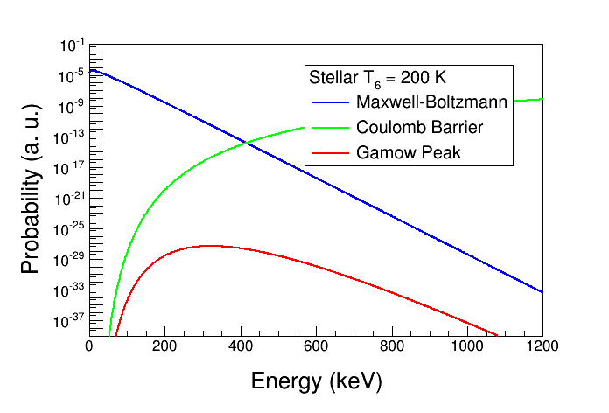
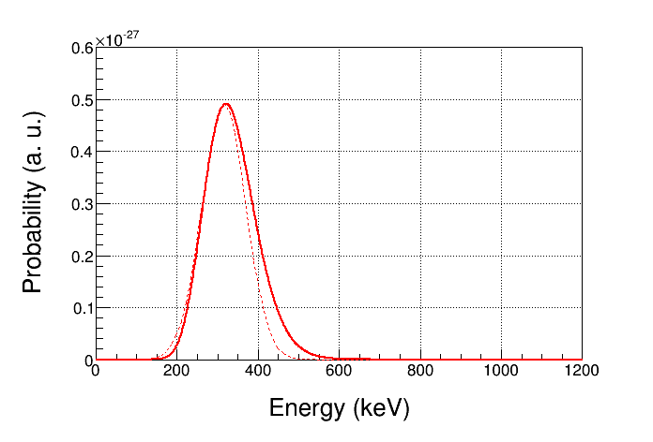
The Gamow Peak (Window)
Narrow energy range where thermonuclear reactions is most likely to occur in stellar plasma is a product of two distributions:
  Maxwell-Boltzmann energy distribution with e^{-E/kBT}
  Penetration through Coulomb barrier with e^{-b/E½}
For α + ¹²C, and stellar T=200 10⁶ K:
  Gamow Peak, E₀ ≈ 300 keV, Width ≈ 50 keV
  (in Center-of-Mass (CM) of α + ¹²C system)
  Maximum of Maxwell–Boltzmann
  energy distribution, k_{B}T = 17 keV

Slide 9
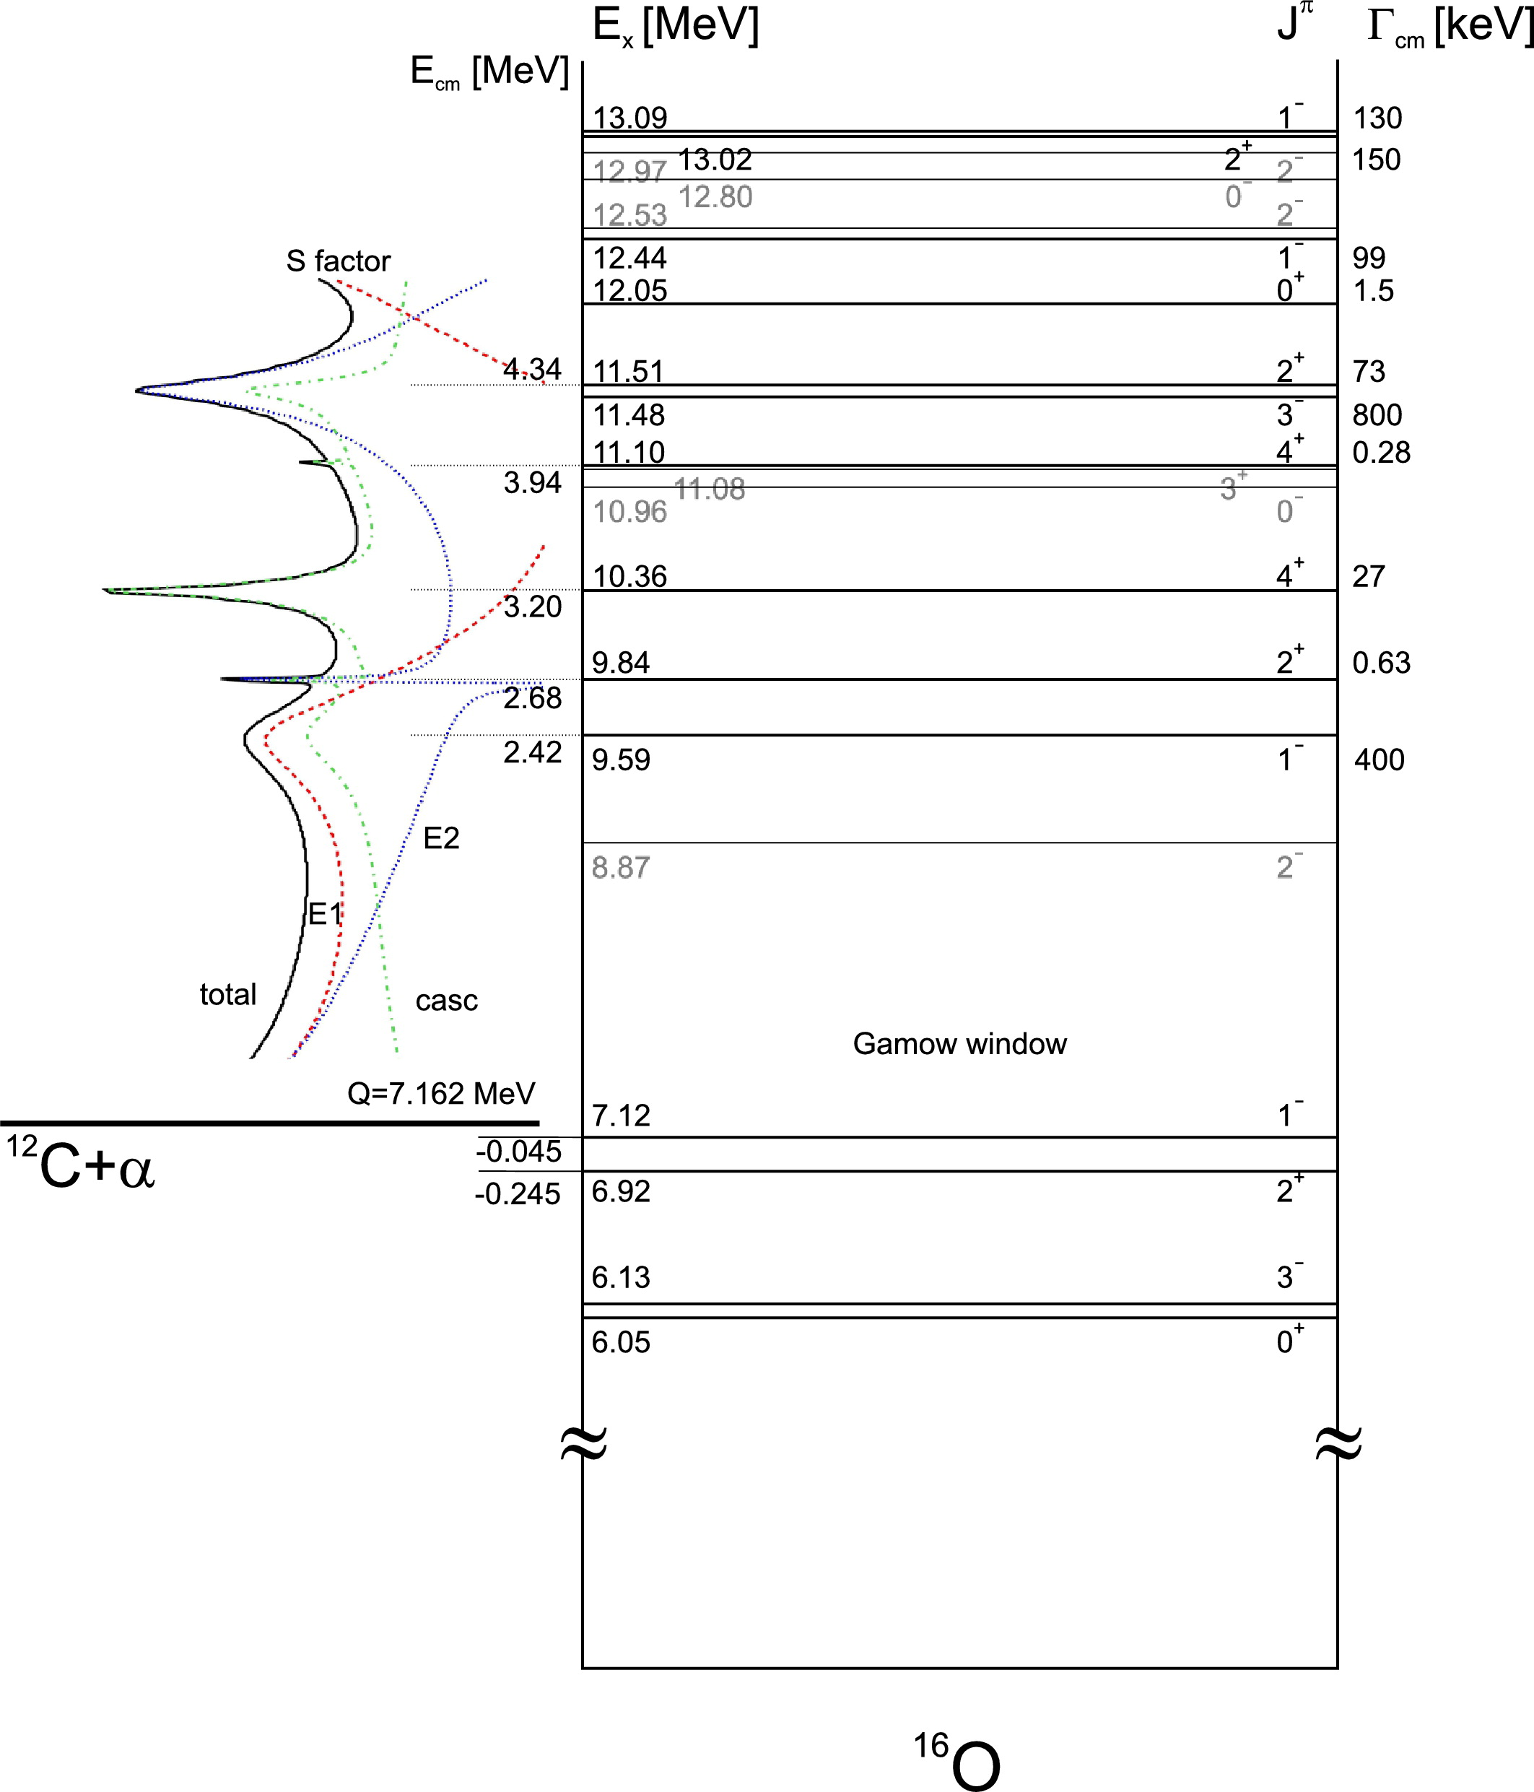
α+¹²C Reaction
    α (J^{π}=0⁺) + ¹²C (J^{π}=0⁺) cross section, σ(E₀), is dominated by p–wave (E1) and d–wave (E2) radiative capture to ¹⁶O ground state (J^{π}=0⁺)
Two bound states, at 6.92 MeV (J^{π}=2⁺) and 7.12 MeV (J^{π}=1–), with sub–threshold resonances at E_{R}=-0.245 and -0.045 MeV, provide most of σ(E₀) through their finite widths
Distinguish E1 and E2 by measuring γ–angular distributions
Notes:
Gammas from E1 and E2 transitions have the same energy (7.162+0.3 MeV).

Slide 10
Heroic efforts in search of ¹²C(α,γ)¹⁶O
Previous Experiments:
  Direct Measurements:
    Helium ions on carbon target: ¹²C(α,γ)¹⁶O
    Carbon ions on helium gas: ⁴He(¹²C, γ)¹⁶O or ⁴He(¹²C,¹⁶O)γ (Schürmann)
  Indirect Measurements:
    β–delayed α decay of ¹⁶N (J^{π}=2–, T_{½}=7.13 s, BR=0.12%)
    ¹⁶N → β– + ¹⁶O* (J^{π}=1–) → α + ¹²C
Experiment | Beam Current (mA) | Target (nuclei/cm²) | Time (h)
Redder | 0.7 | ¹²C, 3 10¹⁸ | 900
Ouellet | 0.03 | ¹²C, 5 10¹⁸ | 1950
Roters | 0.02 | ⁴He, 1 10¹⁹ | 5000
Kunz | 0.5 | ¹²C, 3 10¹⁸ | 700
EUROGAM | 0.34 | ¹²C, 1 10¹⁹ | 2100
GANDI | 0.6 (?) | ¹²C, 2 10¹⁸ | ?
Schürmann | 0.01 | ⁴He, 4 10¹⁷ | ?
Plag | 0.005 | ¹²C, 6 10¹⁸ | 278
Notes:
GANDI is written in German, the reference is on the wiki. Also I put the references to all previous experiments on the wiki.

Slide 11
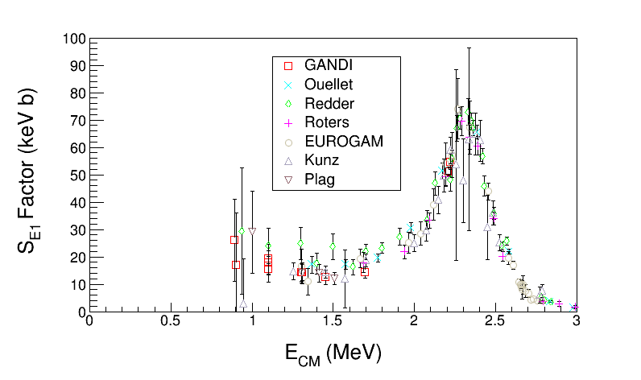
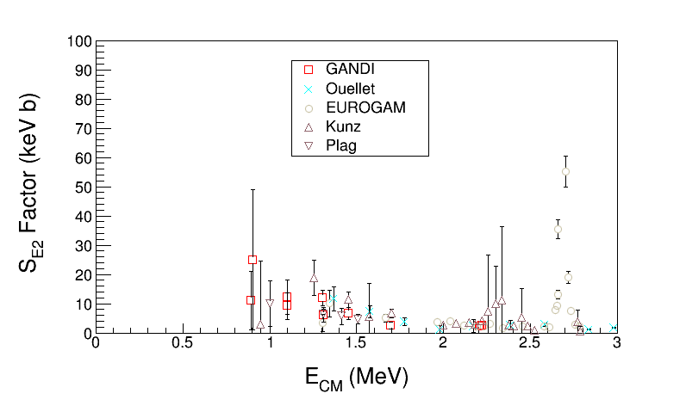
Astrophysical S-Factor ¹²C(α,γ)¹⁶O
Define S-Factor to remove both 1/E dependence of nuclear cross sections and Coulomb barrier transmission probability:
Author | S_{tot}(300) (keV b)
Hammer (2005) | 162±39
Kunz (2001) | 165±50
R-matrix Extrapolation to stellar helium burning at E = 300 keV
Notes:
What do you think about the table shown in this slide? See Schurmann data on slide 44. How did he come up with this small error?

Slide 12
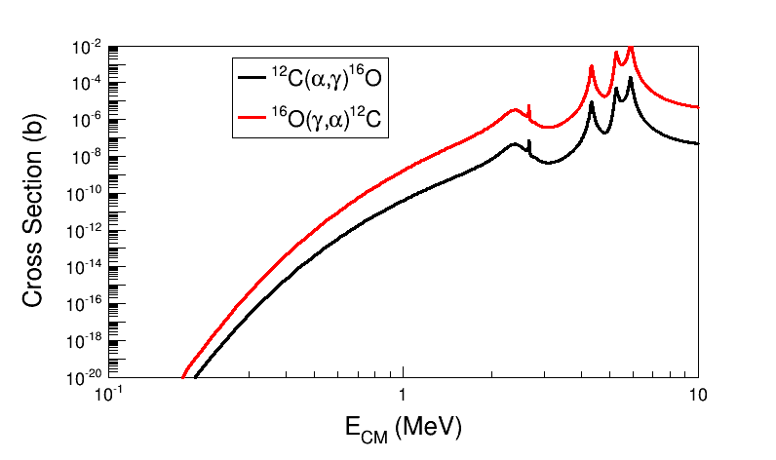
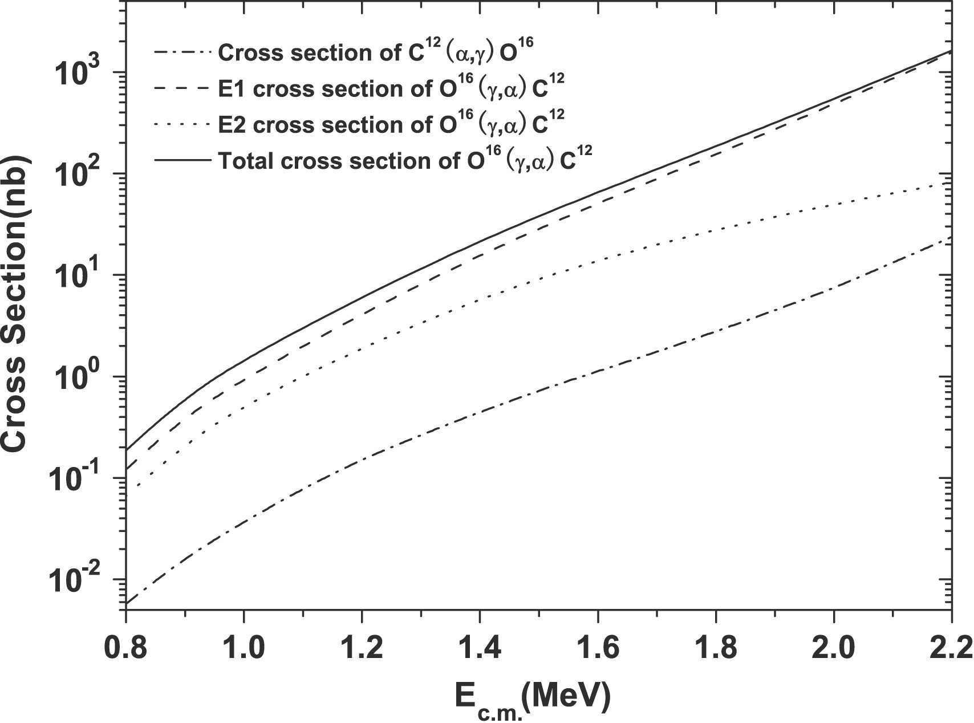
Time Reversal Reaction
¹²C
¹⁶O
α
γ
Stellar helium burning at E = 300 keV
Notes:
If we use linearly polarized gammas, we need also to measure the alpha-carbon angular distributions to separate E1 and E2 contributes.
What about right-handed or left-handed circularly polarized gammas? Circularly polarized light is a linear combination of linearly polarized light with a phase phi=90 deg. This is to say we cannot separate E1 and E2 with circularly polarized gammas.
At JLab Injector we can produce left-handed or right-handed gammas (our electron beam in linearly polarized).
To produce linear polarized gammas, we need to use a crystal radiator.
See paper: Y. Xu et al. on the wiki.

Slide 13
Reciprocity Relation: (γ,α) and (α,γ)
A(α, γ)B:
σ(γ,α) is over two orders of magnitude larger than σ(α, γ)
MeV
MeV
Notes:
Interior Page Design 2

Slide 14
New Approach: Reversal Reaction + Bubble Chamber
beam
target
signal
Extra gain (factor of 100) by measuring time reversal reaction
Target density up to 10⁴ higher than conventional targets. Number of ¹⁶O nuclei = 3.5 10²² /cm² (3.0 cm cell)
Measures total cross section σ_{tot} (or S_{tot})
Solid Angle and Detector Efficiency = 100%
Electromagnetic debris (electrons and gammas, or positrons) do NOT trigger nucleation (detector is insensitive to γ-rays by at least 1 part in 10¹¹).
γ + ¹⁶O → ¹²C + α
Monochromatic γ beam at HIGS ≈ 10^{7–8} γ/s
Bremsstrahlung at JLab ≈ 10⁹ γ/s (top 250 keV)
Notes:
Looking at the number of gammas we will have (slide 37), we will need to be insensitive to gamma-rays by at least 1 part in 10^15. I will keep using the factor of 10^11?

Slide 15
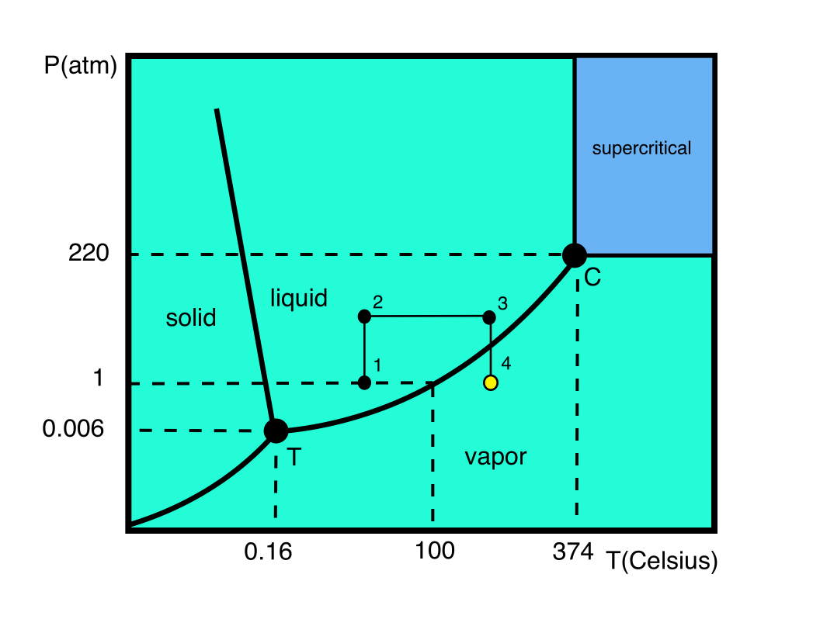
The Bubble Chamber
Donald Glaser won Nobel Prize for inventing chamber to detect particles (1960)
Now being used in Dark Matter Search Experiments: COUPP, PICASSO, SIMPLE
Superheat Preparation:
  Liquid is pressurized at ambient temperature (1 to 2)
  Then pressure is kept constant while temperature is
  increased to above boiling point (2 to 3)
  Finally pressure is slowly released while keeping
  temperature constant (3 to 4)
  At this point (4), still liquid but now superheated
Bubble Formation:
  Particle energy loss will induce vaporization
  Resultant vapor bubble is observable either visibly or audibly
  Bubble growth is captured by a digital camera
  Pressure is increased (4 to 3) to quench bubble. It takes
  about a second for liquid to return to a stable state
  Superheat is restored by releasing pressure again (3 to 4), and cycle is repeated for each bubble event
Superheat
Notes:
Do we have a similar figure for N2O?
The superheat is changed by changing the pressure not the temperature.

Slide 16
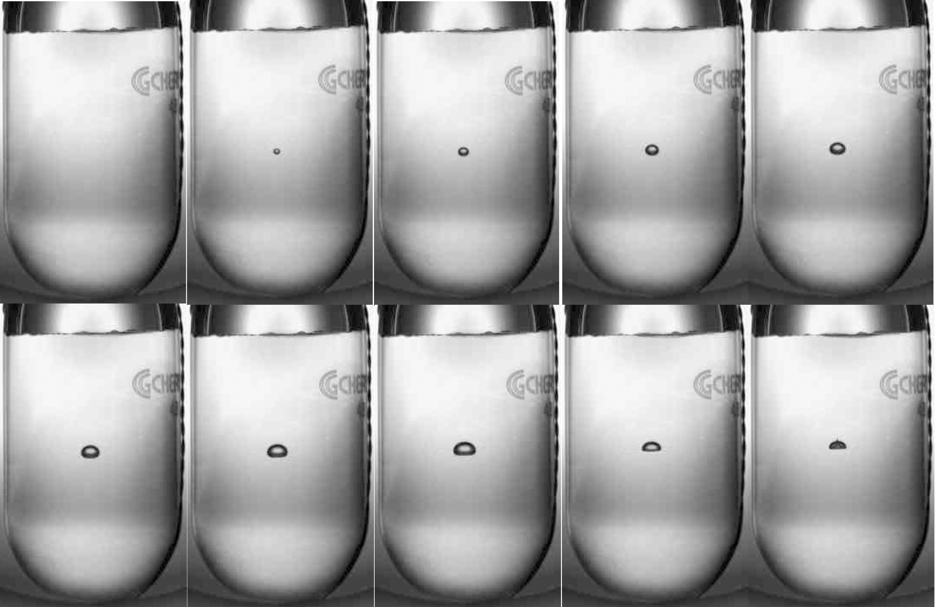
Bubble Growth and Quenching
¹⁹F(γ,α)¹⁵N event in C₄F₁₀ at HIGS
3.0 cm
100 Hz Digital Camera: Δt = 10 ms
Notes:
That is writing on the glass.

Slide 17

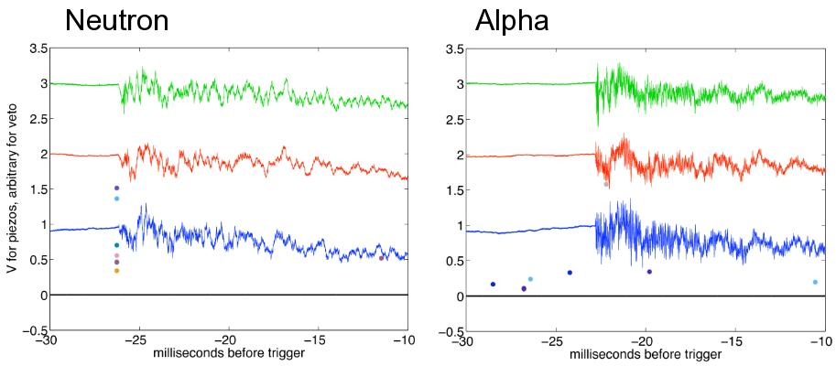
Acoustic Signal Discrimination
Bubble growth produces an audible click which is recorded by piezo-electric transducers
Neutron Events:
  ¹⁷O(γ,n)¹⁶O
  Neutron–nucleus elastic scattering: ¹⁶O(n,n), ¹⁴N(n,n)
  Ions ¹⁶O or ¹⁴N will generate a single bubble
Alpha Events:
  ¹⁶O(γ,α)¹²C
  ¹⁷O(γ,α)¹³C
  ¹⁸O(γ,α)¹⁴C
  Ions ¹²C+α or ¹³C+α or ¹⁴C+α will generate a combined multi-bubble
Higher Pitch
COUPP, FNAL, courtesy of A. Sonnenschein
Suppress neutron events by 100 using acoustic signal
Notes:
The audio files are from http://www-coupp.fnal.gov/public/publications/publication.html
Proton events, i.e, (g,p), should be similar to alphas because it is about the energy loss per length in the target.
When we talk about neutrons, we only worry about elastic scattering. What about inelastic scattering or neutron absorption?
Neutron inelastic or capture radiative capture reactions are usually smaller than elastic scattering by orders of magnitude.
These neutrons are fast, i.e., energy range of few MeV.

Slide 18
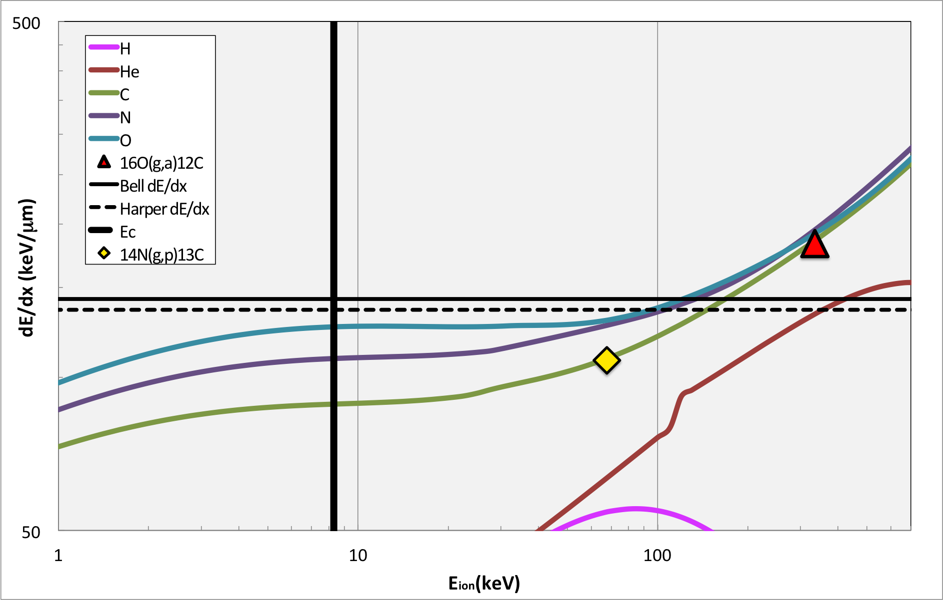
Bubble Chamber Principle
For bubble formation, particle must be over thresholds in both E and dE/dx
Only bubbles with r > R_{c} grow to be macroscopic
  s: Surface tension
Bubble requires minimum deposited energy (E_{c}) within minimum distance L_{c} (=aR_{c} , 10s of nm to a few µm)
  a: free parameter (to determined experimentally)

Slide 19
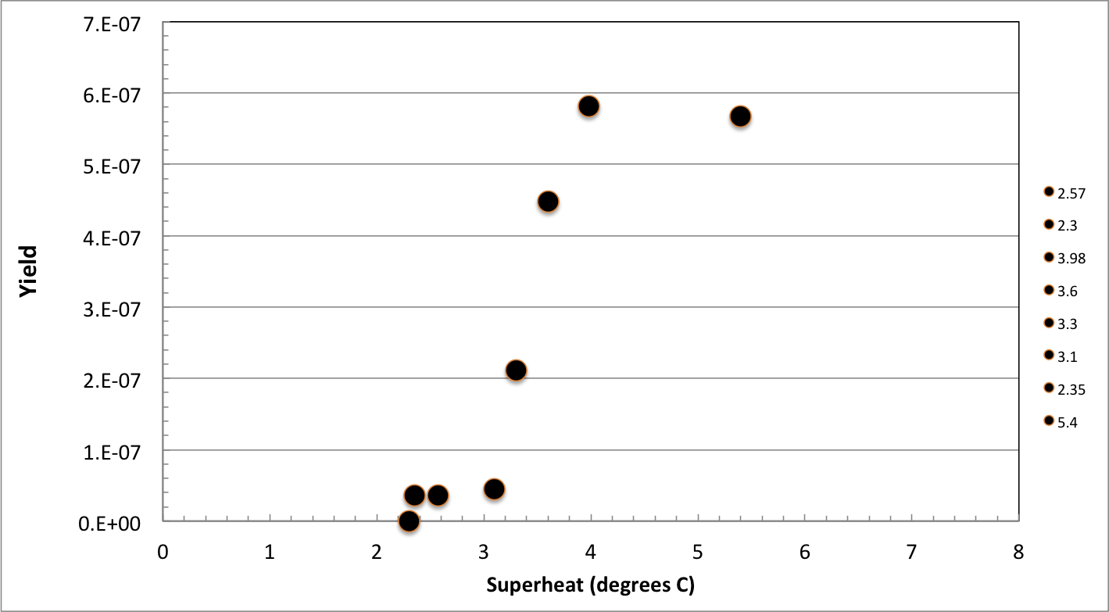
Efficiency Curve
N₂O thresholds
Superheat = 3.3˚C
N₂O efficiency curve,
HIGS April 2013,
E_{γ} = 9.7 MeV
γ+¹⁶O
γ+¹⁴N and γ+¹⁶O

Slide 20
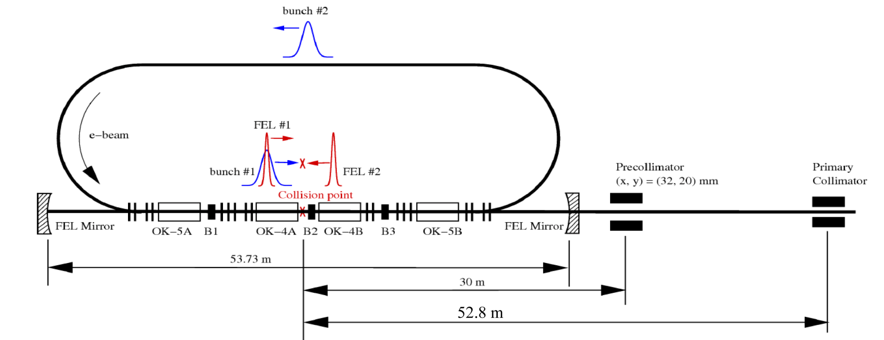
Bubble Chamber at HIGS
High Intensity Gamma Source (HIGS) at Duke University
γ-rays generated by Compton backscattering of free-electron-laser (FEL) light from high-energy electron beam bunches
Chamber location

Slide 21
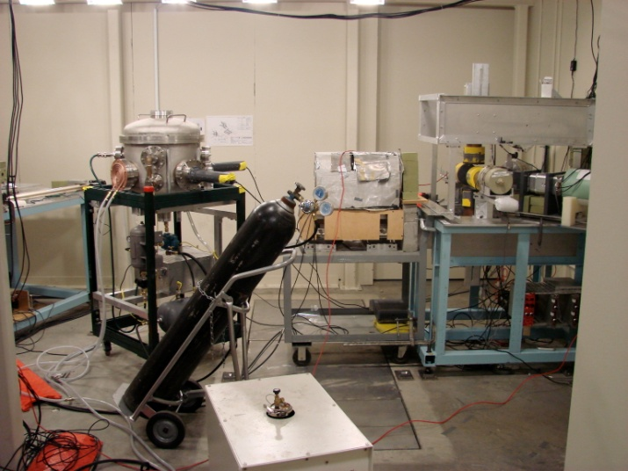
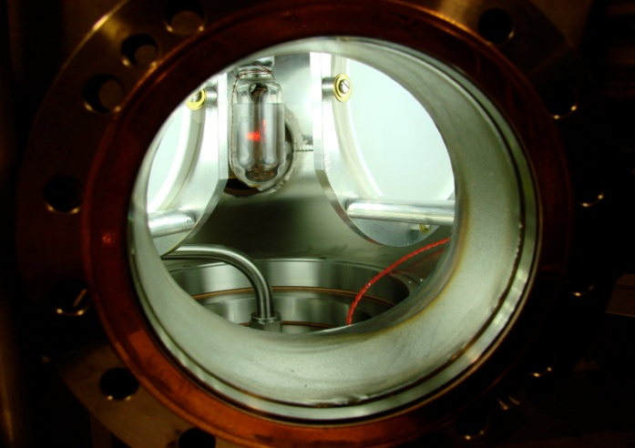
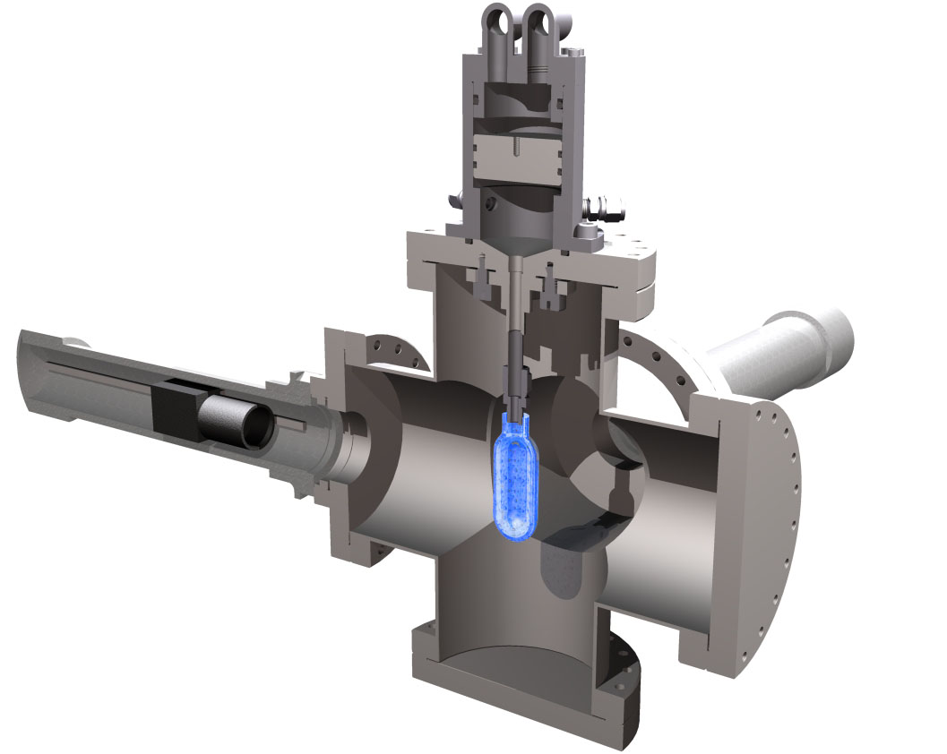
Measuring ¹⁹F(γ,α)¹⁵N at HIGS
2 Fast Digital Cameras
C₄F₁₀ Bubble Chamber
  T = 30˚C
  P = 3 atm
Notes:
Interior Page Design 2

Slide 22
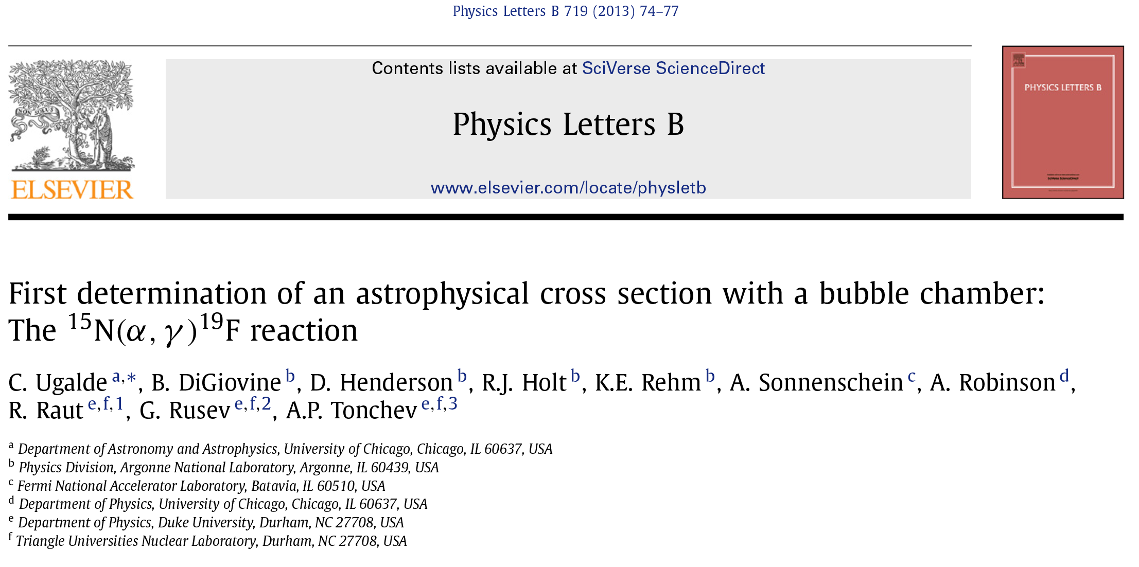
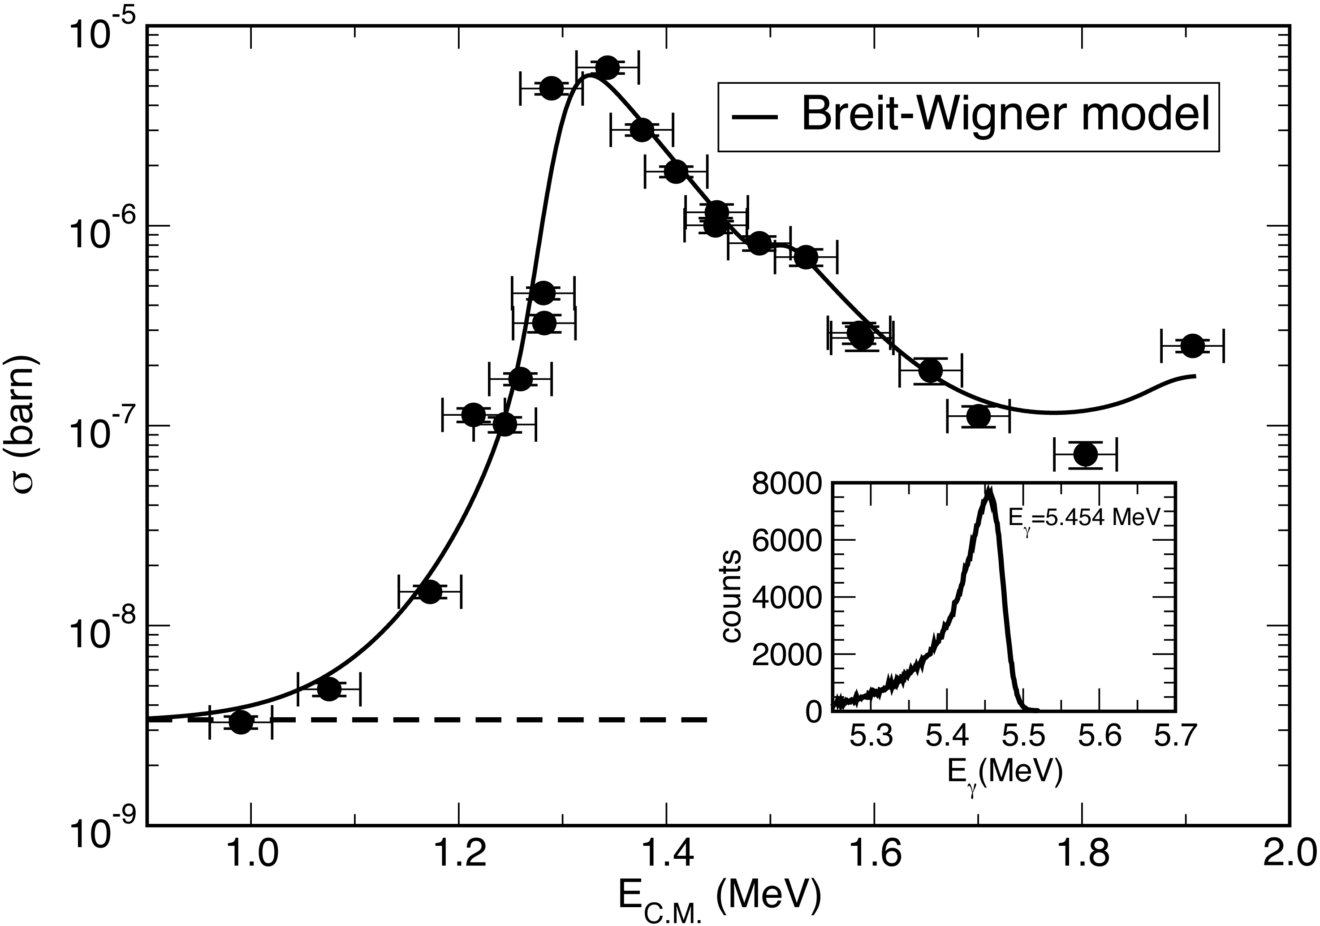
Notes:
That is a wire in the background of the bubble photo on the left. It was a wire attached to a piezoelectric on
the bottom of the glass for the acoustic signal. If not this, it was just a thermocouple wire.

Slide 23
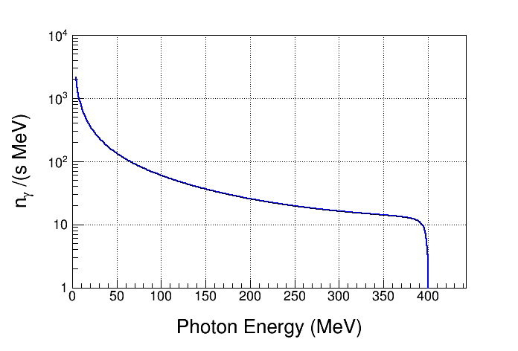
Bremsstrahlung Background at HIGS
Electron Beam Energy: 400 MeV
Electron Beam Current: 41 mA
Interaction Length: 35 m
Vacuum: 2x10⁻¹⁰ Torr
Residual Gas: Z = 10
Strong Bremsstrahlung
Background
(when coupled with large
cross sections at high energies)
Notes:
If it is neutron background that we worry about at HIGS then we can the acoustic signal. At HIGS, we can get more than (g,n) produced by the bremsstrahlung. All photo breakup reactions are possible because of the high energy bremsstrahlung.

Slide 24

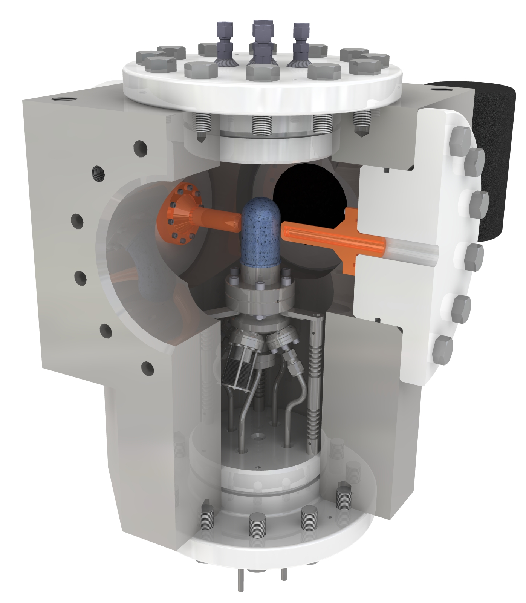
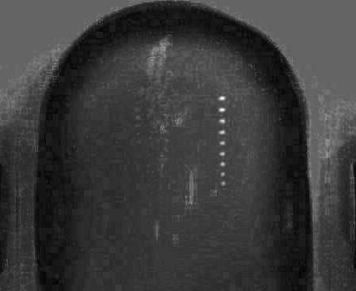
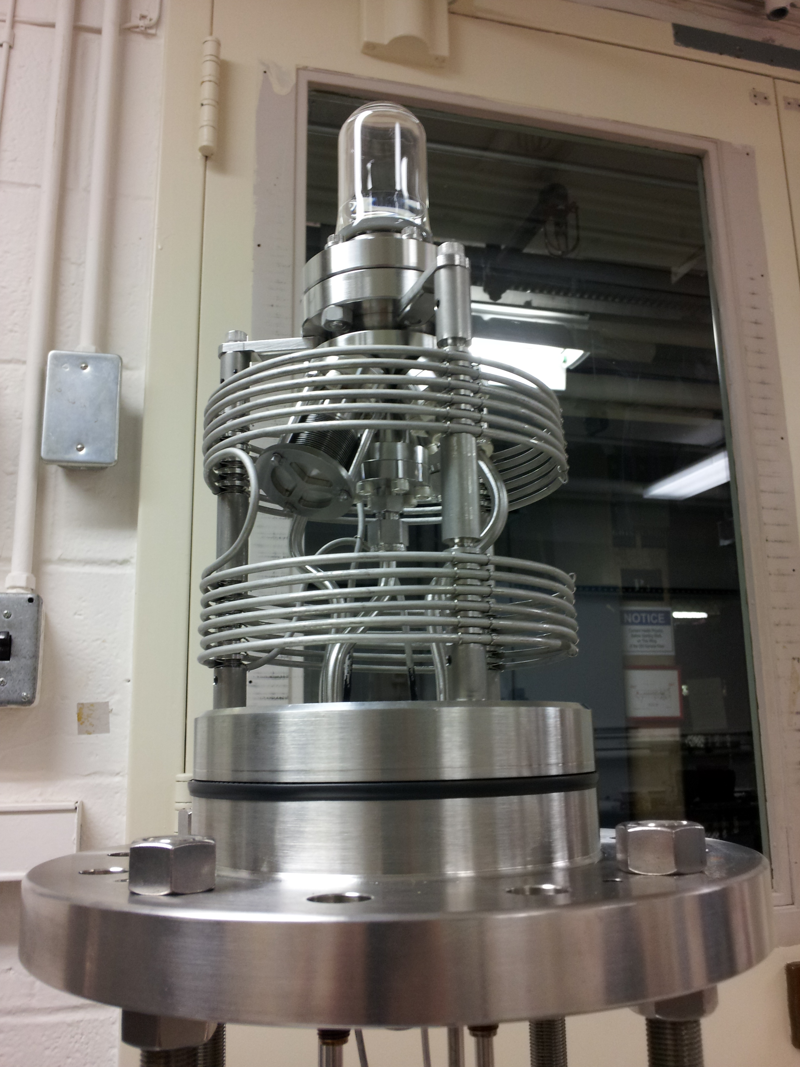
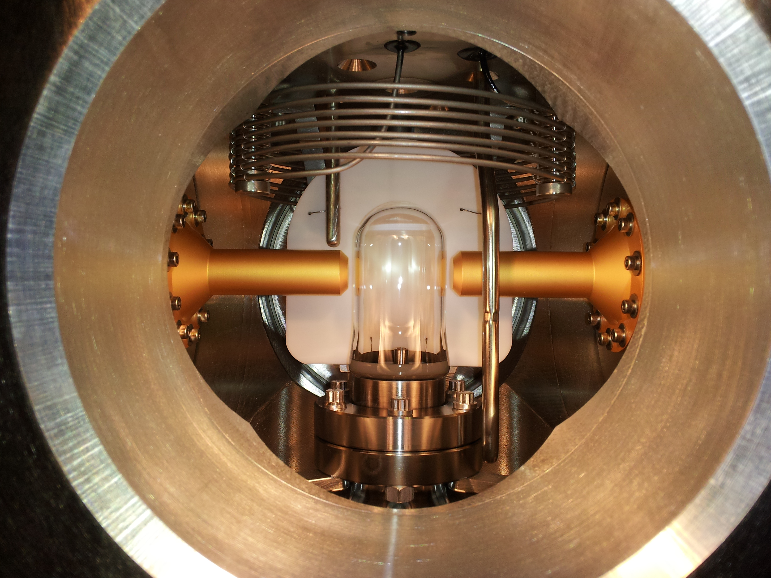
N₂O (Laughing Gas) Bubble Chamber
  T = -5˚C
  P = 60 atm
First γ+O→α+C bubble
HIGS, April 2013
Notes:
Why the bubble in N2O rises? But not in C4F10. And why the liquid is cloudy for N2O? What was the buffer liquid?
The bubble is far more buoyant in N2O than C4F10 and rises faster. The buffer liquid is water and we had water absorbed in the N2O, but not in C4F10.

Slide 25
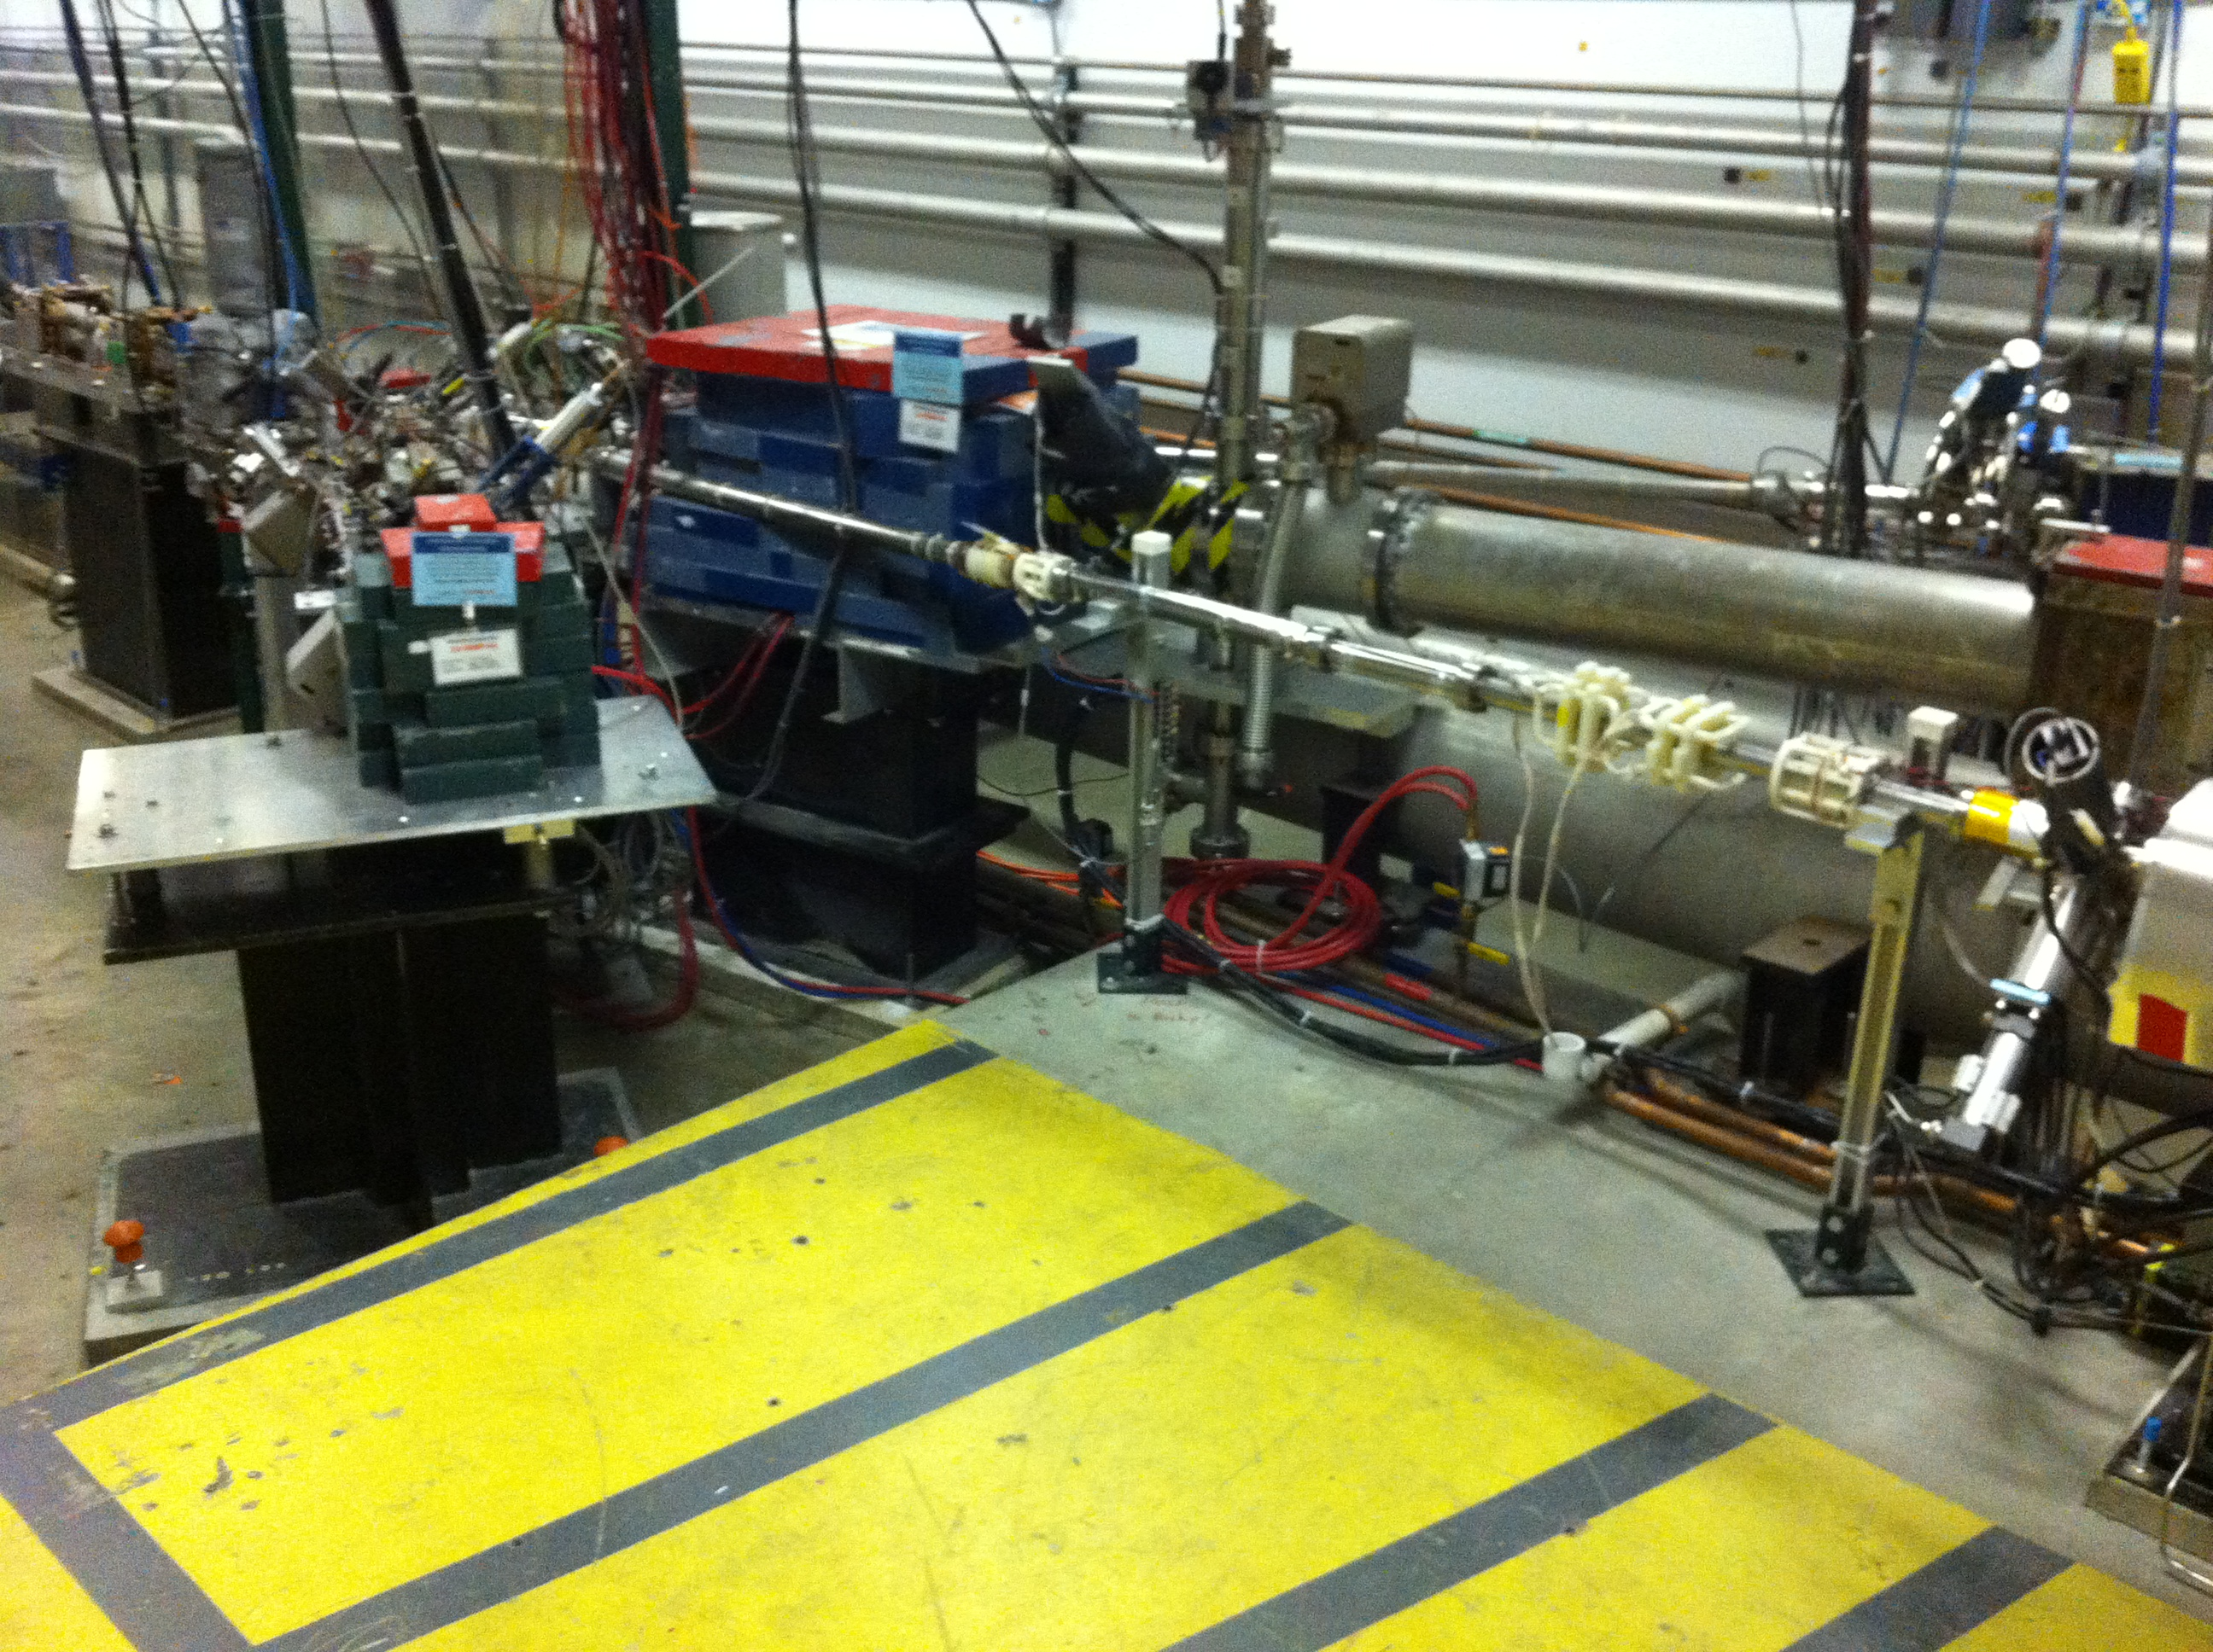
Experimental Setup at JLab Injector
BCM
2D
Spectrometer
Mott Polarimeter
5 MeV
Dipole
5D Spectrometer
Bubble
Chamber
location
Notes:
Interior Page Design 2

Slide 26
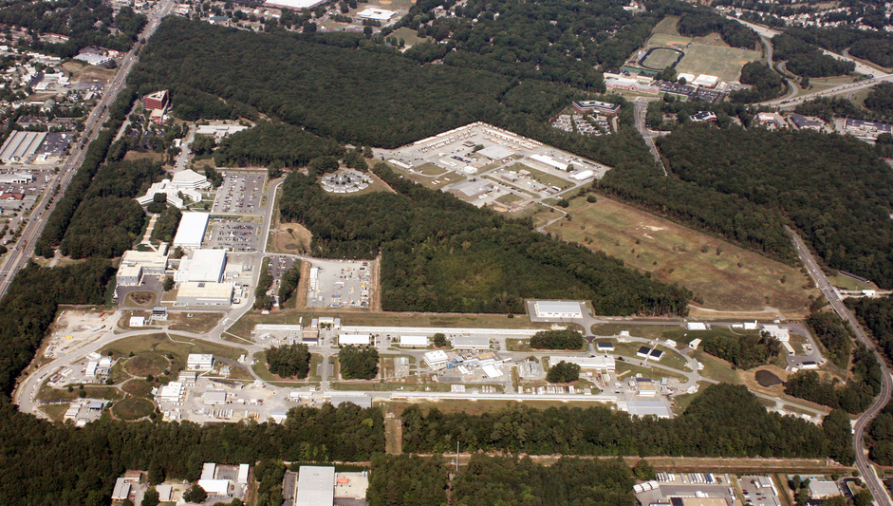

Slide 27
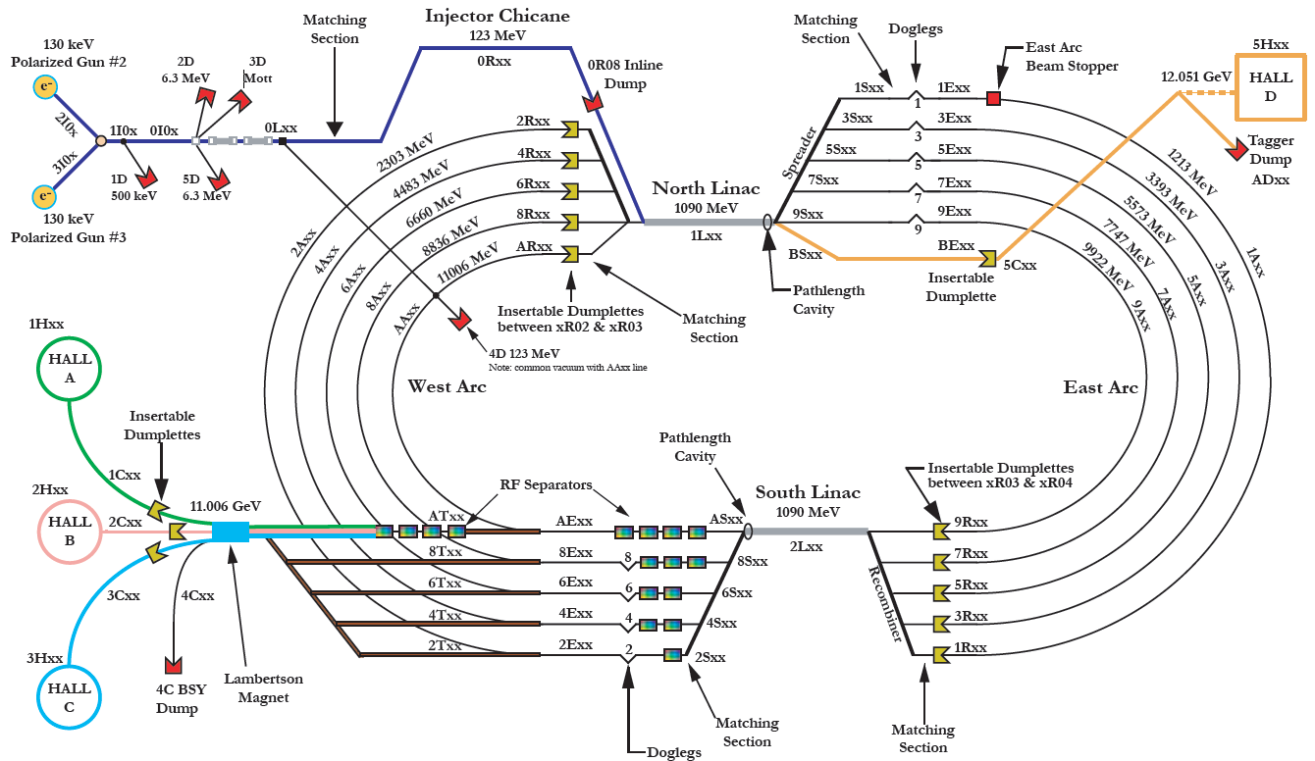

Slide 28
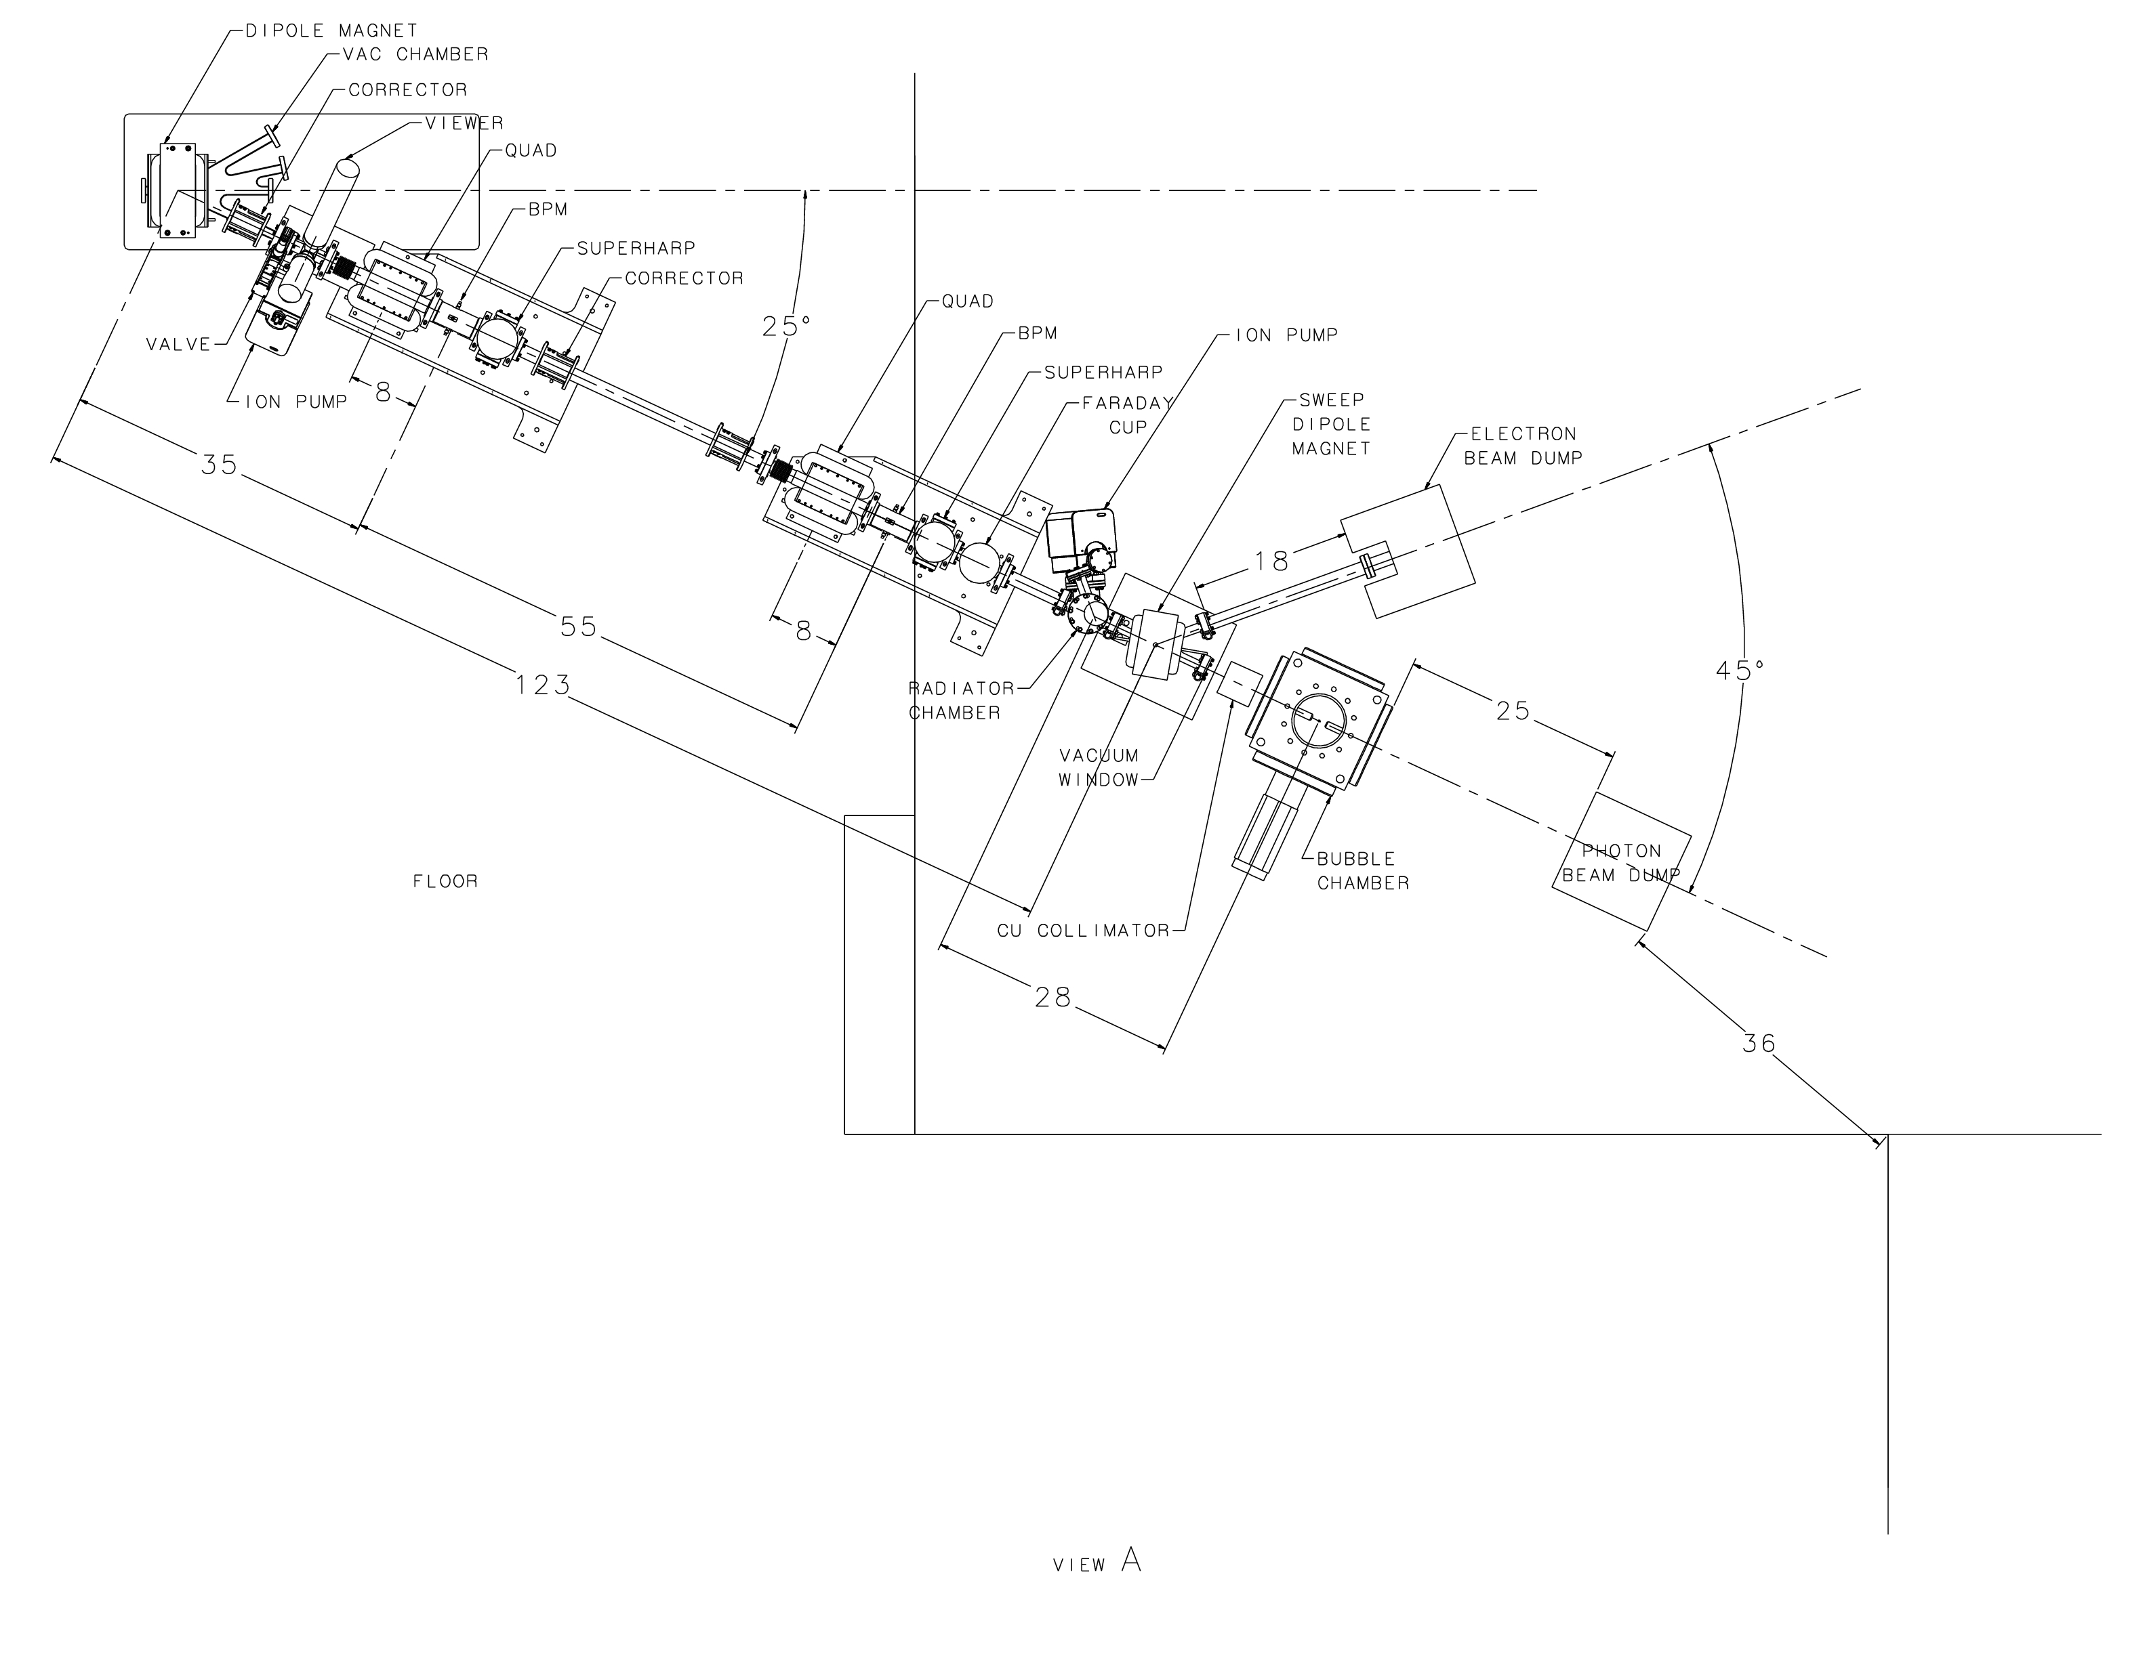
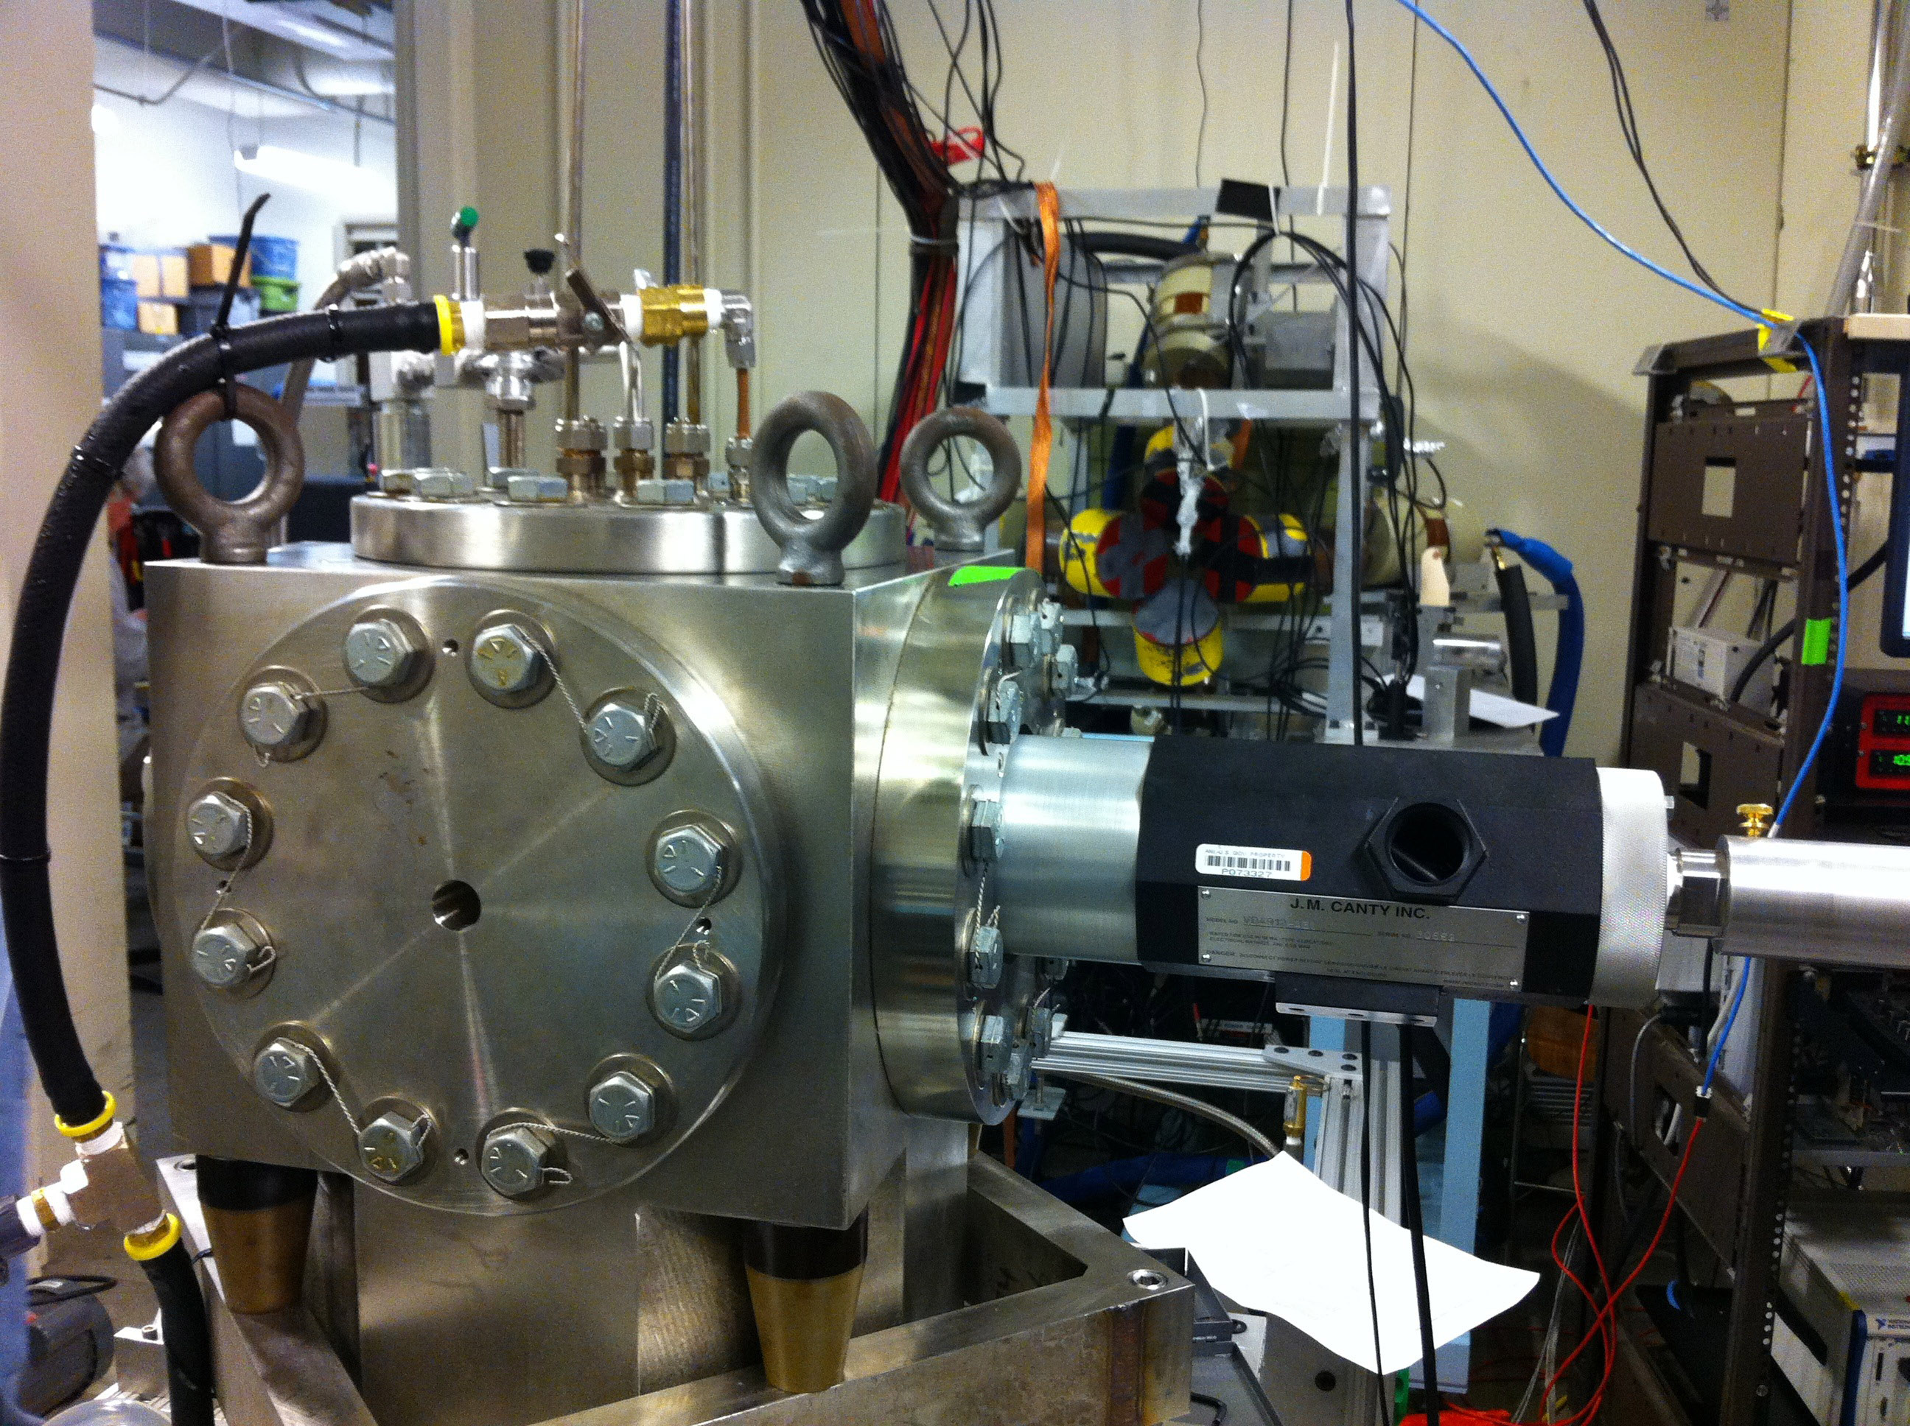
Beamline
Bubble Chamber at
HIGS April 2013
Beam Kinetic Energy, (MeV) | 7.9–8.5
Beam Current (µA) | 0.01–100
Absolute Beam Energy Uncertainty | <0.1%
Relative Beam Energy Uncertainty | <0.02%
Energy Resolution (Spread), σ_{T} /T | <0.06%
Beam Size, σ_{x,y} (mm) | 1–2
Polarization | None
Photon Beam
Entrance
Electron Beam Requirements at Radiator
Notes:
Interior Page Design 2

Slide 29
Schematics
Power deposited in radiator (100 µA and 8.5 MeV) :
  0.02 mm: Energy loss = 21 keV, P = 2.1 W
Pure Copper and Aluminum (high neutron threshold):
  ⁶³C(γ,n) threshold = 10.86 MeV
  ²⁷Al(γ,n) threshold = 13.06 MeV
Electron K.E.
3.0 – 8.5 MeV
0.01 – 100 µA
Sweep Magnet
Cu Vacuum Window 10 mil
Cu Radiator
0.02 mm
Al Beam Pipe
Cu Photon
Collimator
Cu Inner
Pipe
Use GEANT4 to design this region
Al Photon Dump
10 cm long
20 cm diameter
Bubble Chamber
Superheated N₂O
3 cm long
-5°C, 60 atm
Cu Electron Dump
2 kW (200 µA and 10 MeV)
Notes:
Interior Page Design 2

Slide 30
Measuring Absolute Beam Energy
5 MeV
Dipole
BPM
Electron Beam
Momentum
Notes:
Interior Page Design 2

Slide 31
Parameter | Term | Now | Goal
Dipole – linearity | δB/B | 0.25% | 0.02%
Dipole – spatial | δBL/BL | 0.10% | 0.02%
Dipole – reproduce | δB/B | 0.10% | 0.02%
Dipole – power supply | δI/I | 0.20% | 0.02%
Position – surveys | δθ/θ | 0.01% | 0.01%
Position – BPM calibration | δθ/θ | 0.05% | 0.05%
Stray magnetic field | δθ/θ | 0.05% | 0.05%
Total | δP/P | 0.36% | <0.10%
  Jay Benesch designed and is now working with Engineering to fabricate a more uniform and higher field dipole
  New Hall Probe: 0.01% accuracy, resolution to 2 ppm, and a temperature stability of 10 ppm/°C
  Better shielding of Earth’s and other stray magnetic fields
  Additional goal: Relative beam energy uncertainty <0.02%
Notes:
Interior Page Design 2

Slide 32
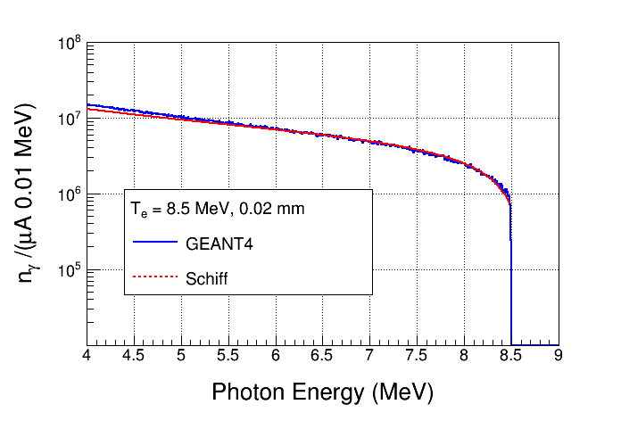
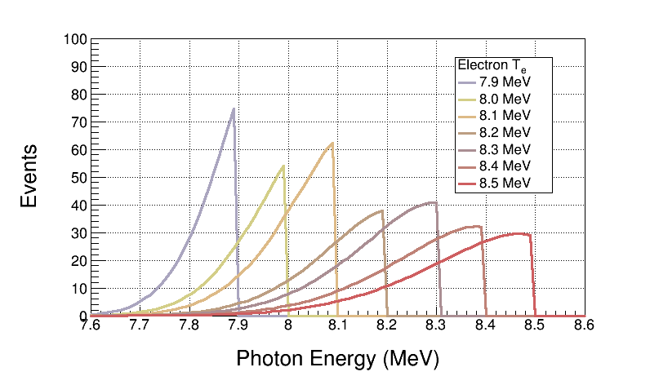
Bremsstrahlung Beam
Use both GEANT4 and FLUKA to calculate Bremsstrahlung spectra (we will not measure Bremsstrahlung spectra)
Monte Carlo simulation of Bremsstrahlung at radiotherapy energies is well studied, accuracy: ±5%
Bremsstrahlung Peaks
¹⁶O(γ,α)¹²C is ideal case for Bremsstrahlung beam and Penfold–Leiss Unfolding :
  Very steep; only photons near endpoint contribute to yield
  No-structure (resonances)

Slide 33
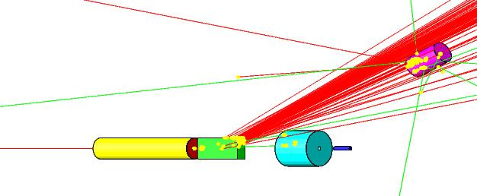
GEANT4 Simulation
Both GEANT4 and FLUKA use models that calculate wrong photo–nuclear cross sections. Both do not allow for user’s cross sections. What to do?
  Use GEANT4 and FLUKA to produce the photon spectra impinging on the superheated liquid.
  Fold the above photon spectra with our cross sections in stand-alone codes.
Use GEANT4 to design radiator, collimator, and dumps
Geometry in GEANT4:

Slide 34
Penfold-Leiss Cross Section Unfolding
Measure yields at: where,
The solution can be written in two forms:
Or, Matrix form:
Volterra Integral Equation of First Kind
Method of Quadratures: numerical solution of integral equation based on replacement of integral by finite sum

Slide 35
Statistical Error Propagation
Note:
In case of background Subtraction
With:
Then:

Slide 36
Where:
Although,
For mono-chromatic photon beam

Slide 37
Results
Radiator thickness = 0.02 mm
Bubble Chamber thickness = 3.0 cm, number of ¹⁶O nuclei = 3.474 10²² /cm²
Background subtraction of ¹⁸O(γ,α)¹⁴C
Electron Beam K. E. | Beam Current (µA) | Time (hour) | y_{i} | dy_{i} (no bg) | dy_{i}/y_{i} (no bg, %) | dy_{i} (with bg) | dy_{i}/y_{i} (with bg, %)
7.9 | 100 | 100 | 545 | 23 | 4.2 | 134 | 24.6
8.0 | 100 | 20 | 581 | 24 | 4.1 | 77 | 13.3
8.1 | 80 | 10 | 852 | 29 | 3.4 | 60 | 7.0
8.2 | 20 | 10 | 634 | 25 | 3.9 | 40 | 6.3
8.3 | 10 | 10 | 812 | 28 | 3.4 | 39 | 4.8
8.4 | 4 | 10 | 746 | 27 | 3.6 | 36 | 4.8
8.5 | 2 | 10 | 763 | 28 | 3.7 | 32 | 4.2
Notes:
Interior Page Design 2

Slide 38
Systematic Error Propagation
For absolute beam energy uncertainty of δE (= 0.1%) and zero relative beam energy uncertainty:
E_{i} (MeV) | dy_{i}/y_{i} (%) | dσ_{i}/σ_{i} (%)
7.9 | 12.5 | 12.6
8.0 | 10.8 | 10.5
8.1 | 9.3 | 9.1
8.2 | 8.0 | 7.1
8.3 | 7.0 | 6.3
8.4 | 6.3 | 5.8
8.5 | 5.6 | 5.2
This is the cross section dependence on energy
Accounted for dN_{ij} due to energy error when calculating dy_{i}

Slide 39
With:
Then:

Slide 40
Where:
Note: Correlation Coefficient (ρ_{ij}) =1
No energy-to-energy change in systematic error

Slide 41
Systematic Error Propagation
No energy-to-energy change in systematic error

Slide 42
Other Systematic Errors
Beam Current, δI/I | 3%
Photon Flux, δφ/φ | 5%
Radiator Thickness, δR/R | 3%
Bubble Chamber Thickness, δT/T | 3%
Bubble Chamber Efficiency, ε | 5%
Simulation
Then:

Slide 43
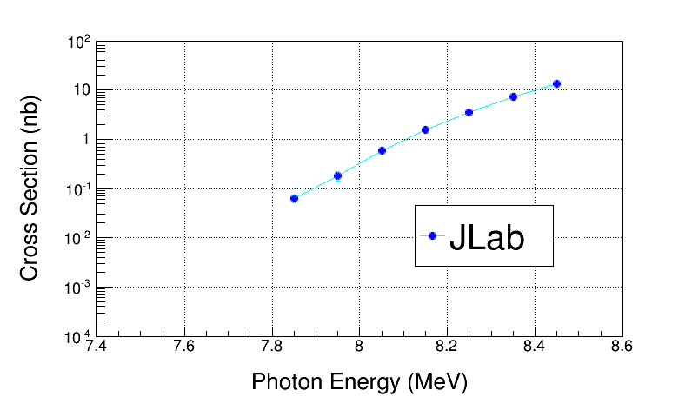
Electron Beam K. E. | Cross Section (nb) | Stat Error (no bg, %) | Stat Error (with bg, %)
7.9 | 0.046 | 4.4 | 24.5
8.0 | 0.185 | 6.0 | 20.7
8.1 | 0.58 | 6.3 | 14.7
8.2 | 1.53 | 8.2 | 13.8
8.3 | 3.49 | 9.1 | 13.3
8.4 | 7.2 | 10.6 | 13.8
8.5 | 13.6 | 12.2 | 14.8
Electron Beam K. E. | Cross Section (nb) | Sys Error (Energy, %) | Sys Error (Total, %)
7.9 | 0.046 | 12.5 | 15.3
8.0 | 0.185 | 10.2 | 13.5
8.1 | 0.58 | 8.3 | 12.2
8.2 | 1.53 | 7.0 | 11.4
8.3 | 3.49 | 6.0 | 10.7
8.4 | 7.2 | 5.3 | 10.5
8.5 | 13.6 | 4.7 | 10.1
Note: Absolute systematic errors do not get magnified in PL Unfolding

Slide 44
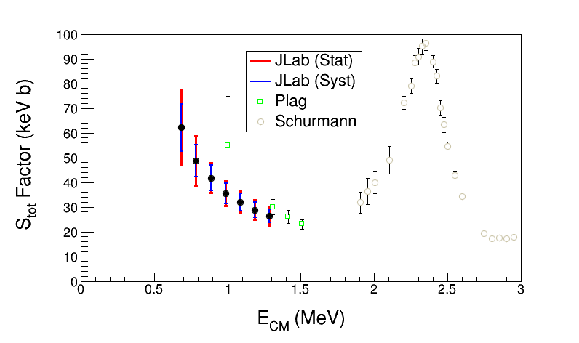
JLab Projected ¹²C(α,γ)¹⁶O S-Factor
Statistical Error: dominated by background subtraction from ¹⁸O(γ,α)¹⁴C (depletion = 5,000)
Electron Beam K. E. | Gamma Energy (MeV) | E_{CM} (MeV) | Cross Section (nb) | S_{tot} Factor (keV b) | Stat Error (%) | Sys Error (Total, %)
7.9 | 7.85 | 0.69 | 0.046 | 62.2 | 24.5 | 15.3
8.0 | 7.95 | 0.79 | 0.185 | 48.7 | 20.7 | 13.5
8.1 | 8.05 | 0.89 | 0.58 | 41.8 | 14.7 | 12.2
8.2 | 8.15 | 0.99 | 1.53 | 35.5 | 13.8 | 11.4
8.3 | 8.25 | 1.09 | 3.49 | 32.0 | 13.3 | 10.7
8.4 | 8.35 | 1.19 | 7.2 | 28.8 | 13.8 | 10.5
8.5 | 8.45 | 1.29 | 13.6 | 26.3 | 14.8 | 10.1
Bubble Chamber experiment measures total S-Factor, S_{E1} + S_{E2}
Notes:
Notes:
1- Schurmann at low energy is limited by 16O contamination of 12C ion beam.

Slide 45
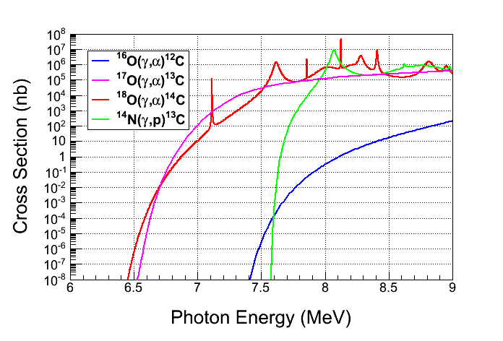
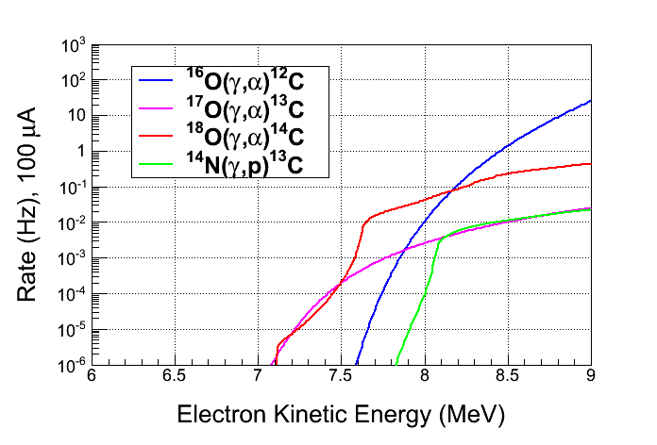
Backgrounds
Background from oxygen
isotopes and nitrogen in N₂O:
  ¹⁸O(γ,α)¹⁴C
  ¹⁷O(γ,α)¹³C
  ¹⁴N(γ,p)¹³C
Natural Abundance:
    ¹⁷O: 0.038%
    ¹⁸O: 0.205%
Expected Rates:
  ¹⁷O(γ,α)¹³C, depletion=5,000
  ¹⁸O(γ,α)¹⁴C, depletion=5,000
  ¹⁴N(γ,p)¹³C, Chamber eff.= 10⁻⁸
Notes:
Interior Page Design 2

Slide 46
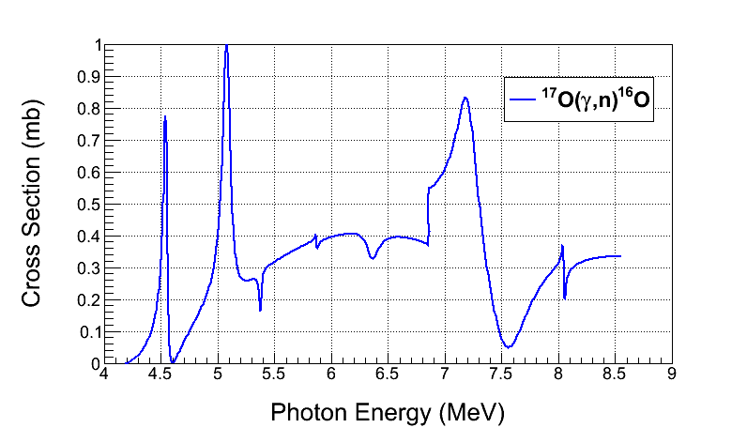
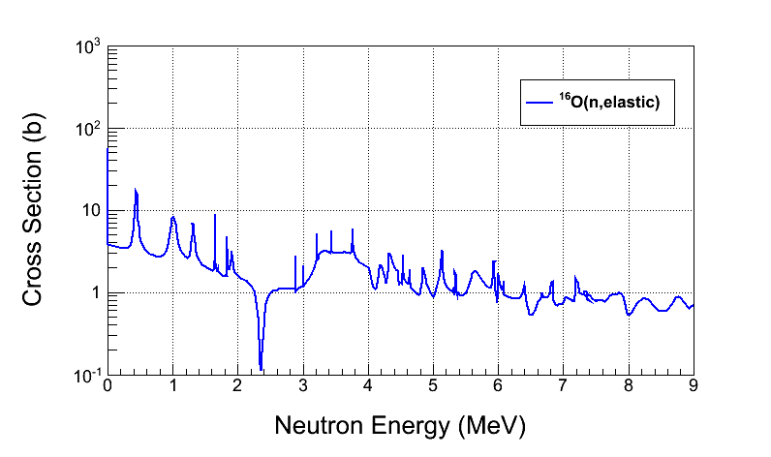
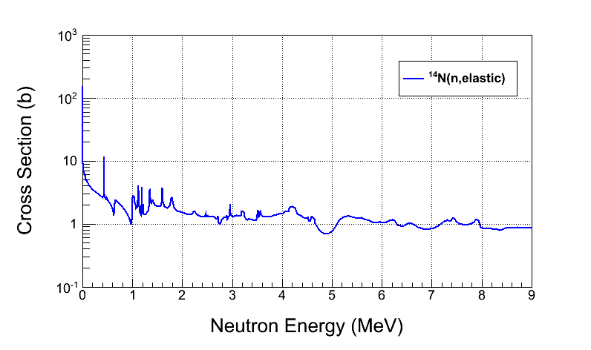
Background from:
  ¹⁷O(γ,n)¹⁶O and secondary (n,n)
  neutron–nucleus elastic scattering
Background from Chamber glass:
  Neutron–nucleus elastic scattering from
  ²⁹Si(γ,n)²⁸Si
Cosmic–ray background:
  µ±–nuclear
  neutron–nuclear elastic scattering
Reject neutron events using
acoustic signal (100 suppression factor)
Notes:
Interior Page Design 2

Slide 47
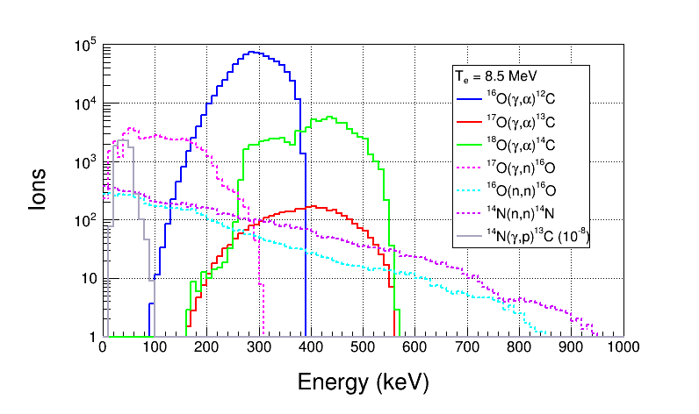
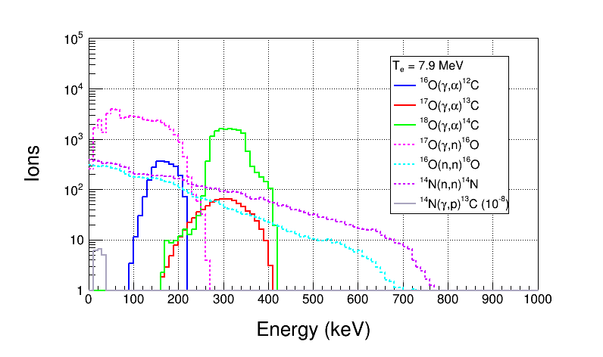
Ion Energy Distributions
Use depleted N₂O:
  ¹⁷O depletion = 5,000
  ¹⁸O depletion = 5,000
Suppress background with
Bubble Chamber thresholds
Threshold Efficiency (function
of superheat):
No acoustic cut
Particle | Efficiency
e± | <10⁻¹¹
γ | <10⁻¹¹
¹⁴N(γ,p)¹³C | <10⁻⁸
Notes:
Interior Page Design 2

Slide 48
Superheated Targets
List of superheated liquids to be used in experiment:
Readout:
  Fast Digital Camera
  Acoustic Signal to discriminate between neutron and alpha events
N₂O Targets | ¹⁶O | ¹⁷O | ¹⁸O
Natural Target | 99.757% | 0.038% | 0.205%
¹⁶O Target |  | Depleted > 5,000 | Depleted > 5,000
¹⁷O Target |  | Enriched > 80% | <1.0%
¹⁸O Target |  | <1.0% | Enriched > 80%
Physics
Measure
Backgrounds
Notes:
(g,p) events have acoustic signal similar to (g,a).

Slide 49
Summary and Outlook
Test N₂O Bubble Chamber at HIGS (Summer 2014)
Measure cross sections of ¹⁸O(γ,α)¹⁴C and ¹⁷O(γ,α)¹³C at HIGS (Fall 2014)
Test Bubble Chamber at JLab (October 2014, January 2015)
Run depleted N₂O bubble chamber at JLab to measure ¹⁶O(γ,α)¹²C
Beam issues:
  Design radiator, collimator, and dumps with GEANT4
  Simulate photon spectra with GEANT4 and FLUKA
  Deliver 8.5 MeV K.E. beam to 5D Spectrometer with <0.1% absolute energy uncertainty
Bubble Chamber issues:
  Study acoustic signal and measure neutron events suppression factor
  Deadtime measurements: use laser shutter to stop beam while chamber is not ready
  Measure O-isotopes depletion
Background tests:
  Measure cosmic–ray background
  Study chamber thresholds efficiency vs. superheat and measure γ-rays suppression factor

Slide 50
Backup Slides
Notes:
Interior Page Design 1

Slide 51
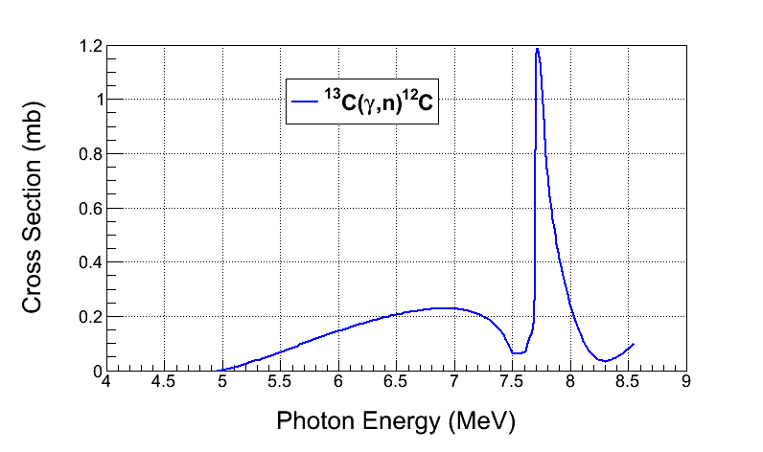
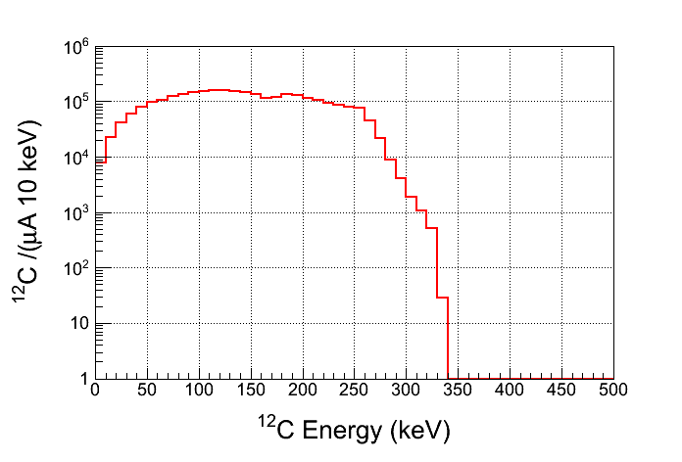
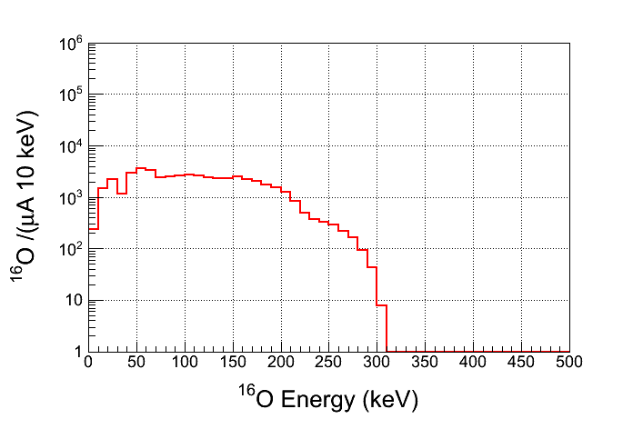
CO₂ Superheated Liquid?
Similar Bubble Chamber operational
parameters as N₂O
Natural Abundance: ¹³C: 1.07%
Depletion: ¹³C depletion=1,000
¹³C(γ,n)¹²C Background
For comparison, ¹⁷O(γ,n)¹⁶O
¹²C(γ,2α)α Background
Notes:
What is the expected background from 3-alpha?

Slide 52
Water Superheated Liquid?
Etching of glass vessel by superheated H₂O
  T = 250˚C
  P = 75 atm
Background from secondary neutron–nucleus elastic scattering by neutrons from d(γ,n)p

Slide 53
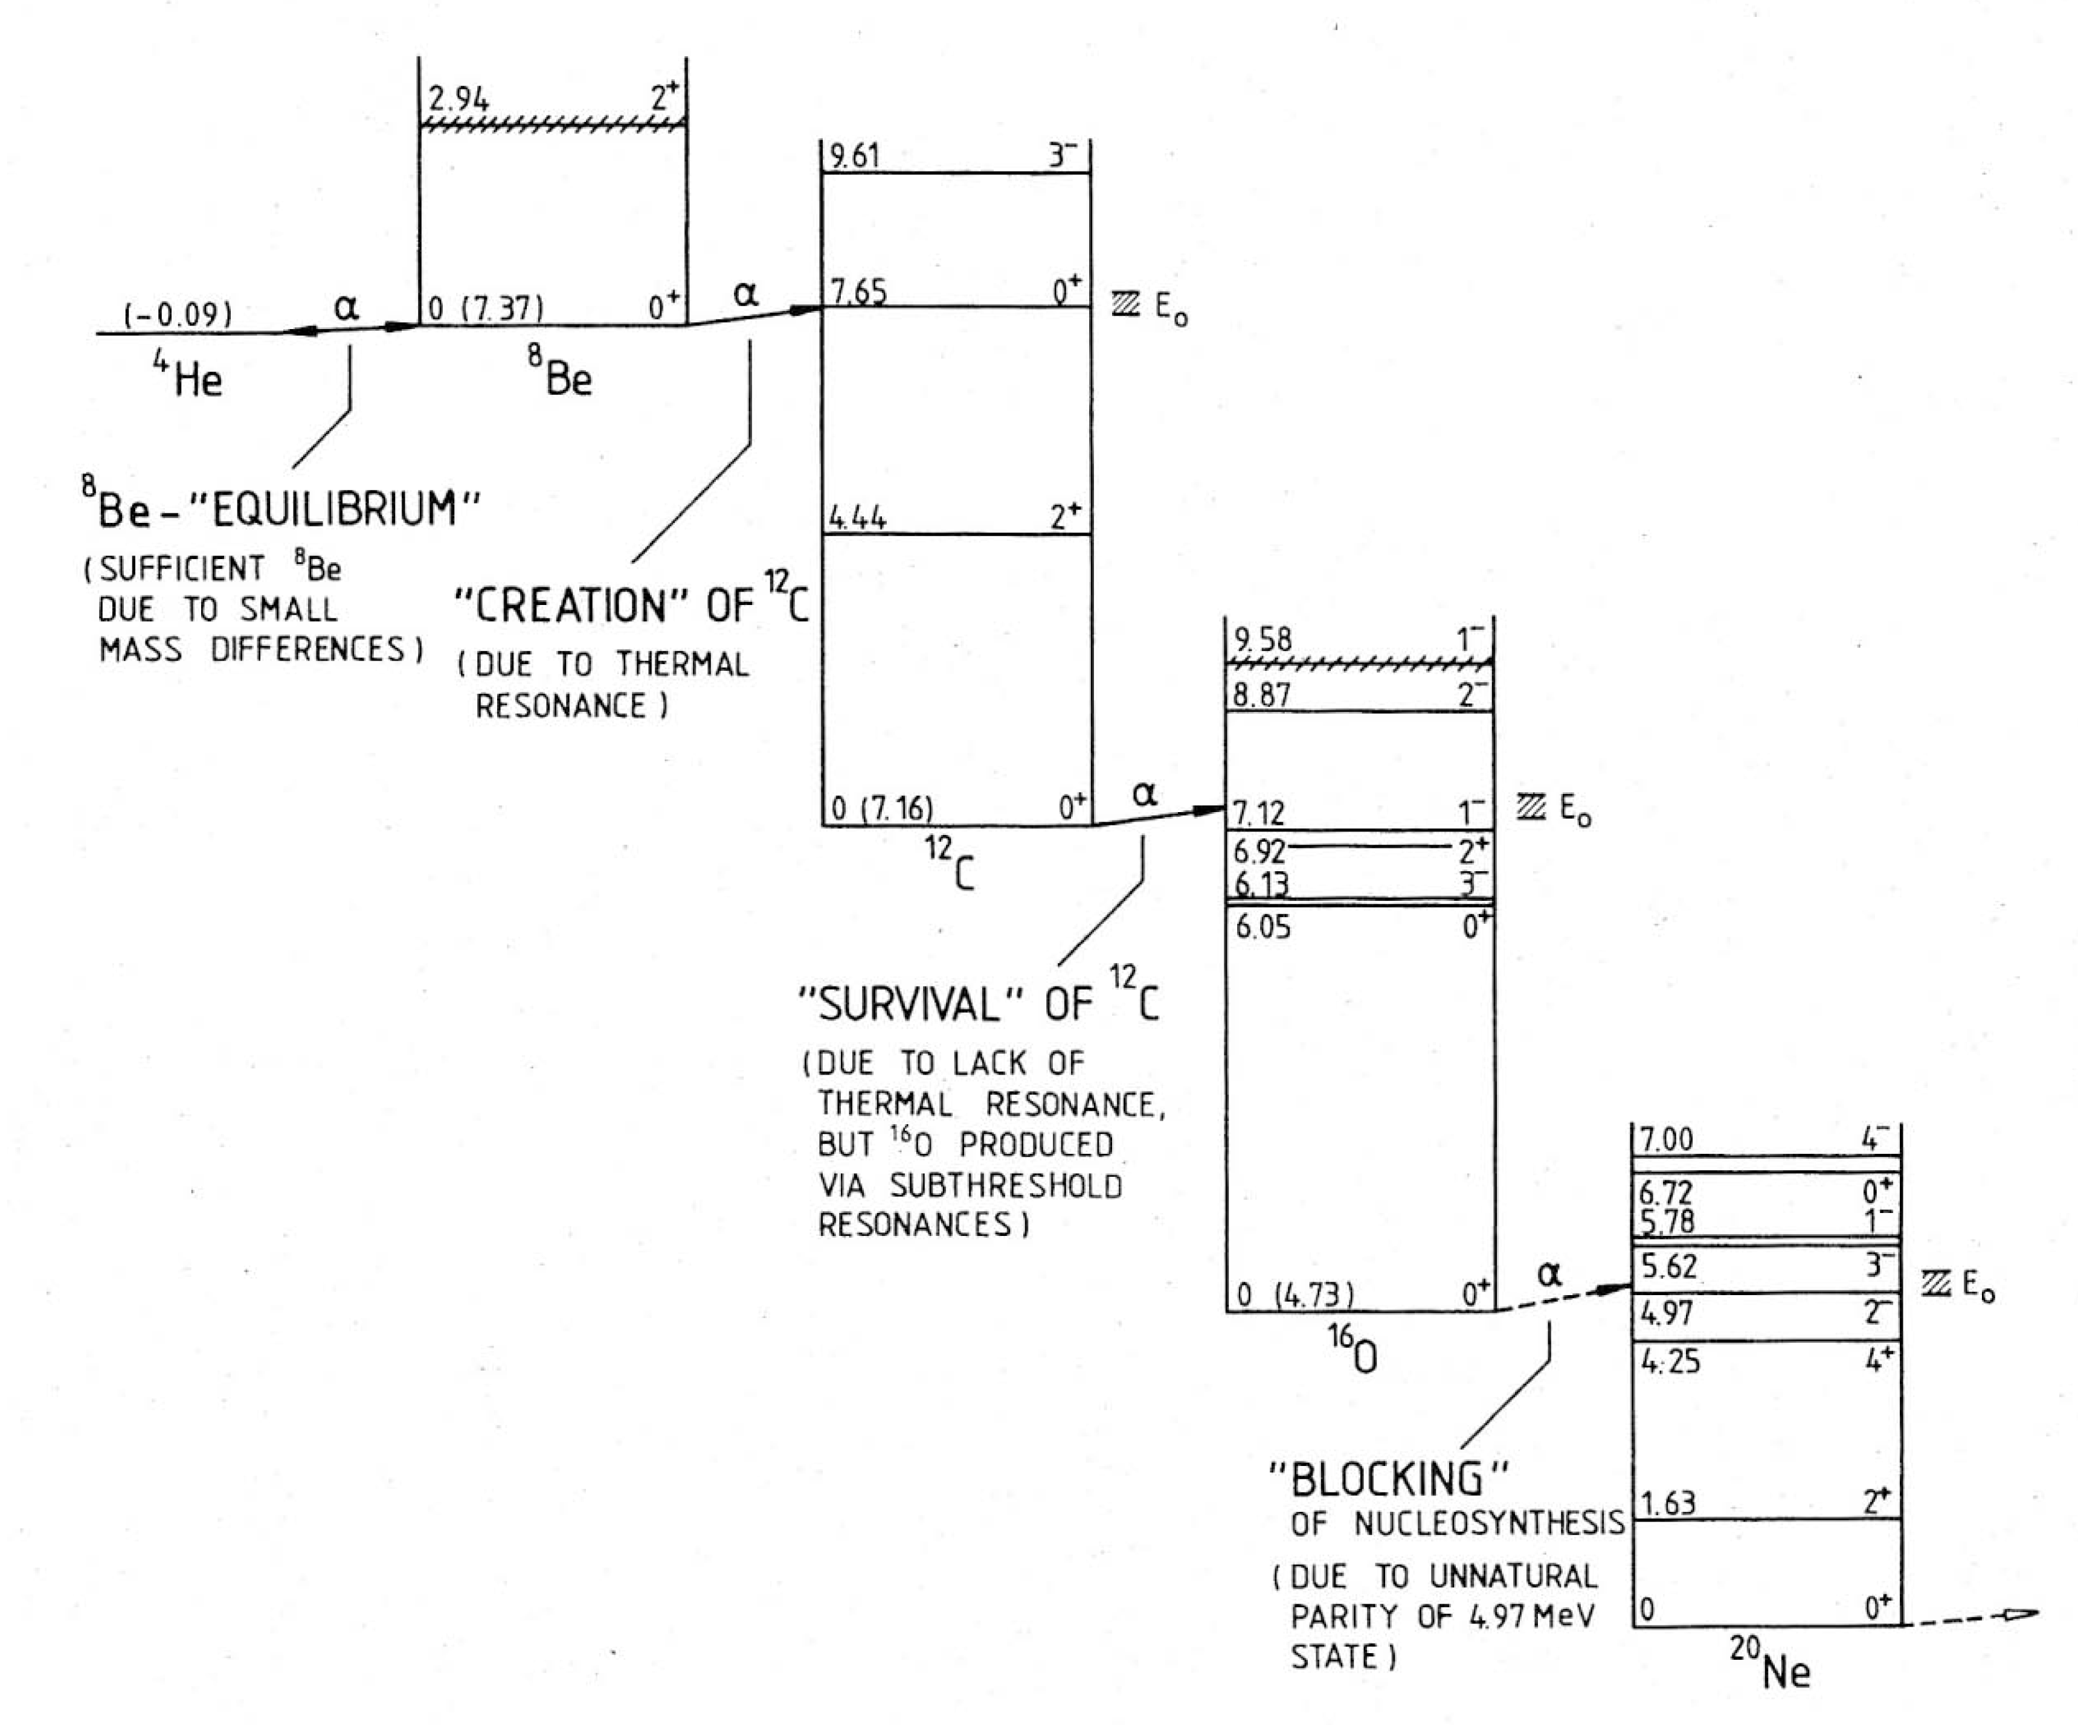
Rolfs and Rodney, 1988

