Slide 1
Evaluation of Bright Beams from a DC High Voltage Photogun with alkali-antimonide photocathode at high average current and high bunch charge
Yan Wang
Sept. 8, 2014

Slide 2
Outline
The high voltage gun
  Design of the gun
  Field emission & HV conditioning
  CsK2Sb photocathode
  Preliminary HV tests
The beamline
  Design and Components
Evaluation of the beam
  Emittance, bunch length and energy spread
  Fast kick
  Low and high bunch charge beams
Study of the CsK2Sb photocathode
  Charge lifetime
  How different preparation of the photo cathode affects the QE and beam quality.
Simulations
  TOSCA, Poisson, Elegant and GPT

Slide 3
High Voltage Gun
Design and build a DC high voltage photogun with the following characteristics:
Providing high brightness electron beams with high average current and high bunch charge.
Reliable operation at 350 – 500 kV
Minimal field emission
Inverted insulator design
Load - locked

Slide 4
The Gun Design - Why high voltage?
Many nuclear physics experiments require electron beams with high average current (1 - 100mA), high bunch charge (~1nC) and high brightness.
High brightness beams mean low emittance.
The beam emittance degrades in the first few centimeters of acceleration due to space charge forces within the electron bunch.
The space charge effect decreases when the beam energy increases.
The higher the gun voltage the higher the initial beam energy.

Slide 5
The Gun Design - Field Emission
Field emission is emission of electrons induced by an electrostatic field.
Occurs in high electric fields: MV/m
Originates from sharp tips and contamination of the cathode surface.
Is a primary source of vacuum breakdown and electrical discharge.
Limits the maximum achievable bias voltage

Slide 6
The Gun Design - How to Reduce Field Emission
Proper design of the cathode and anode.
High voltage conditioning:
  Gas conditioning - apply voltage to the cathode in small increments with Krypton gas present.

Slide 7
The Gun Design - Why Inverted Insulator
The inverted geometry does not use a large metal structure supporting the cathode electrode, i.e., less metal to generate field emission.
The inverted geometry makes the gun simpler and compact, and inexpensive to build.

Slide 8
The Gun Design - Why Inverted Insulator
(a) Conventional cylindrical design (b) Inverted insulator design

Slide 9
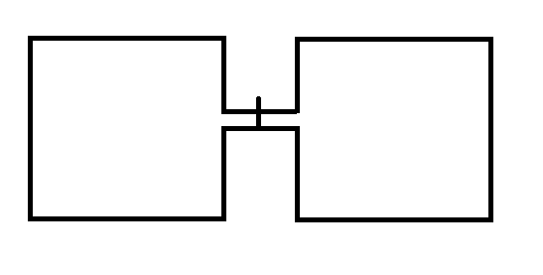
The Gun Design - Why Load-Lock
The load-lock design has been proved to be a better design:
No contamination of the gun components
Convenient and time saving
Preparation
Chamber
Gun Chamber
Valve

Slide 10
The Gun Design - Photocathode
There are two popular photocathodes: GaAs and CsK2Sb. A CsK2Sb photocathode will be used.
CsK2Sb photocathodes have a better lifetime under the similar conditions.
GaAs photocathodes are prone to rapid QE loss due to poor vacuum, low field emission, etc.

Slide 11
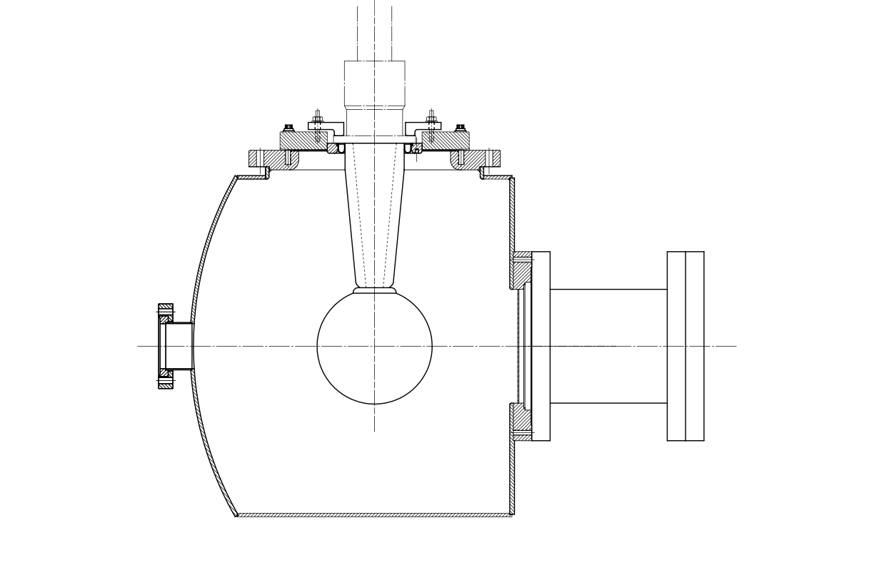
The Gun Design - Initial Design
HV cable
Inverted insulator
18”
6”
Anode
Cathode
Vacuum chamber
18”
Schematic of the Gun

Slide 12
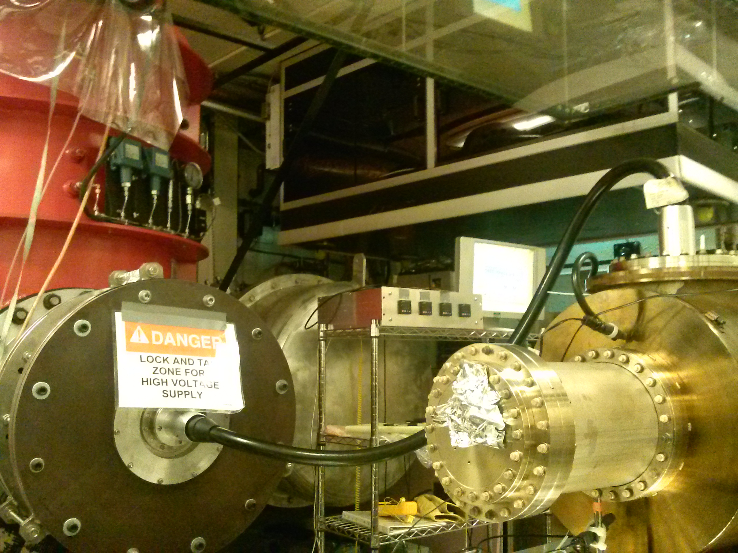
High Voltage Gun - Initial Tests

Slide 13
High Voltage Gun - Initial Tests
Apparatus:
A gas-insulated Cockcroft-Walton 580kV, 5mA HVPS by Glassman. The HVPS sits inside a steel tank filled with SF6 at 10 psi.
Two industrial X-ray cables (gauges R28 and R30) with molded rubber plug by Essex X-ray.
A gun vacuum chamber with a dummy cathode.
A leak valve for Krypton.
A NEG pump, an ion pump, a Turbo pump, a RGA and a Pirani cold cathode gauge

Slide 14
High Voltage Gun - Initial Tests
Two types of the insulators:
Type I: 19 cm 97% alumina.
Type II: 11.4 cm 94.4% alumina with lower bulk resistivity.
Cathode:
6-inch 304 stainless steel spherical ball.
Polished to mirror-like finish with silicon grit paper
Degreased and degassed

Slide 15
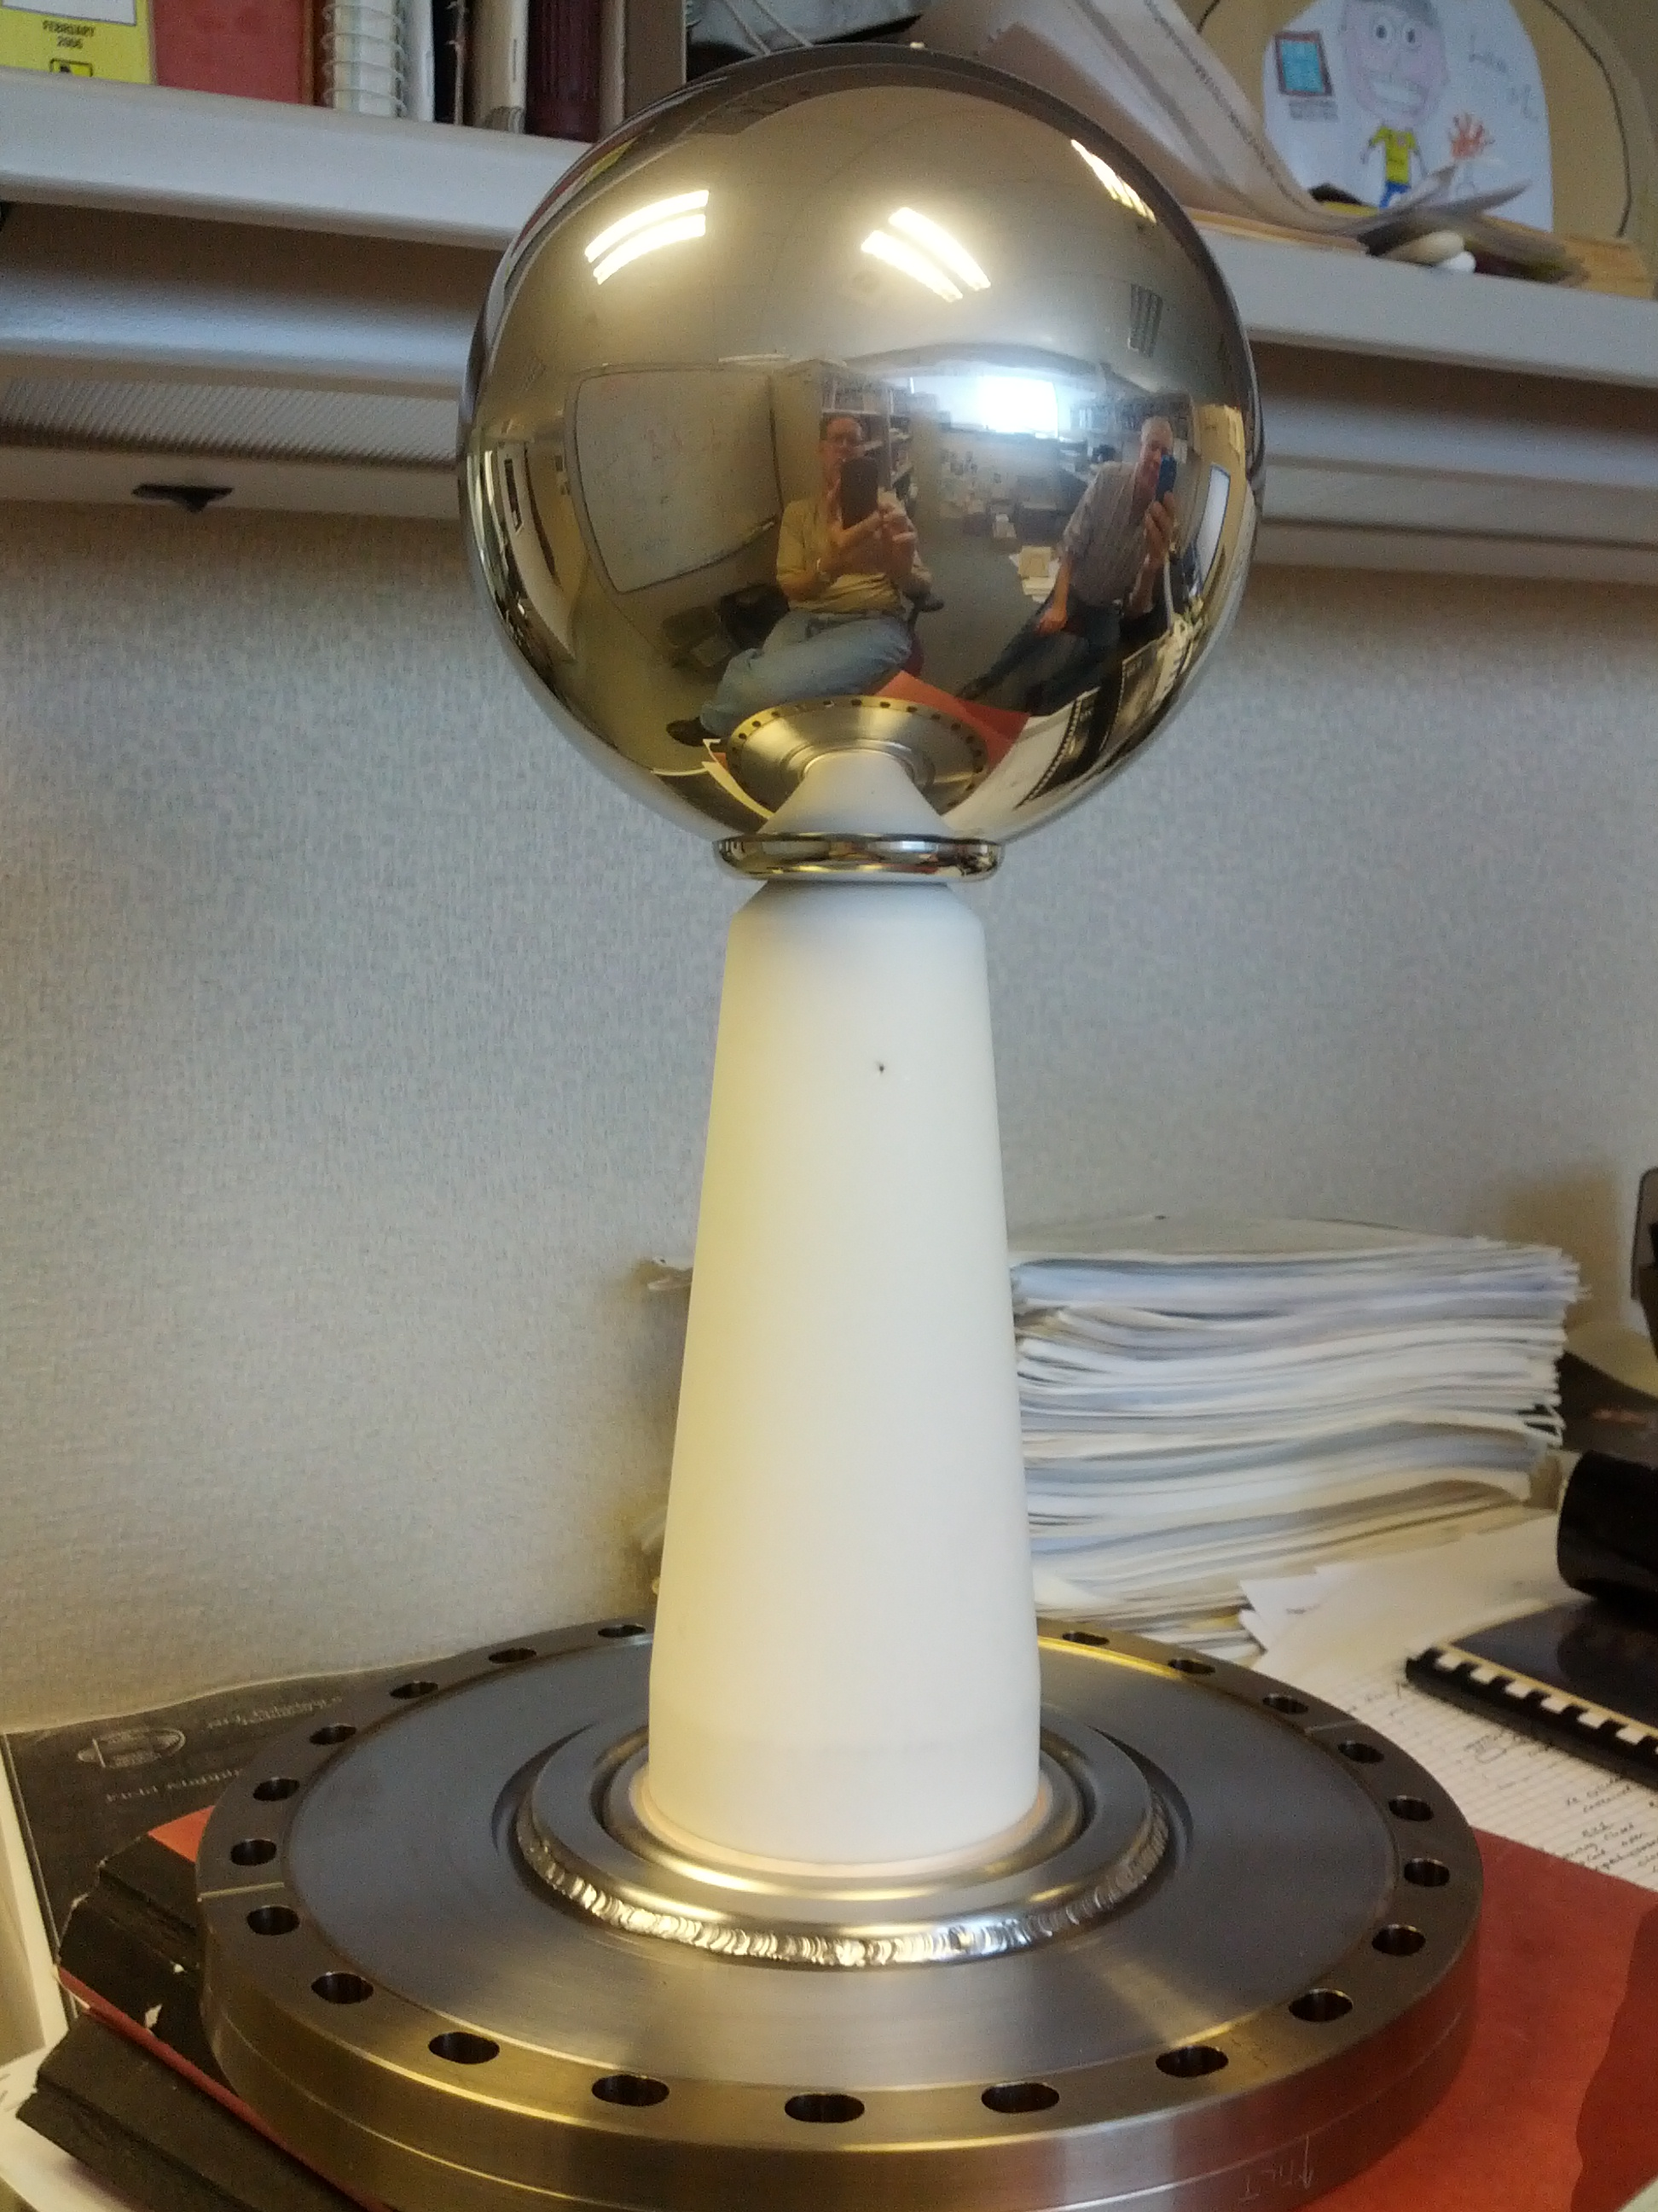
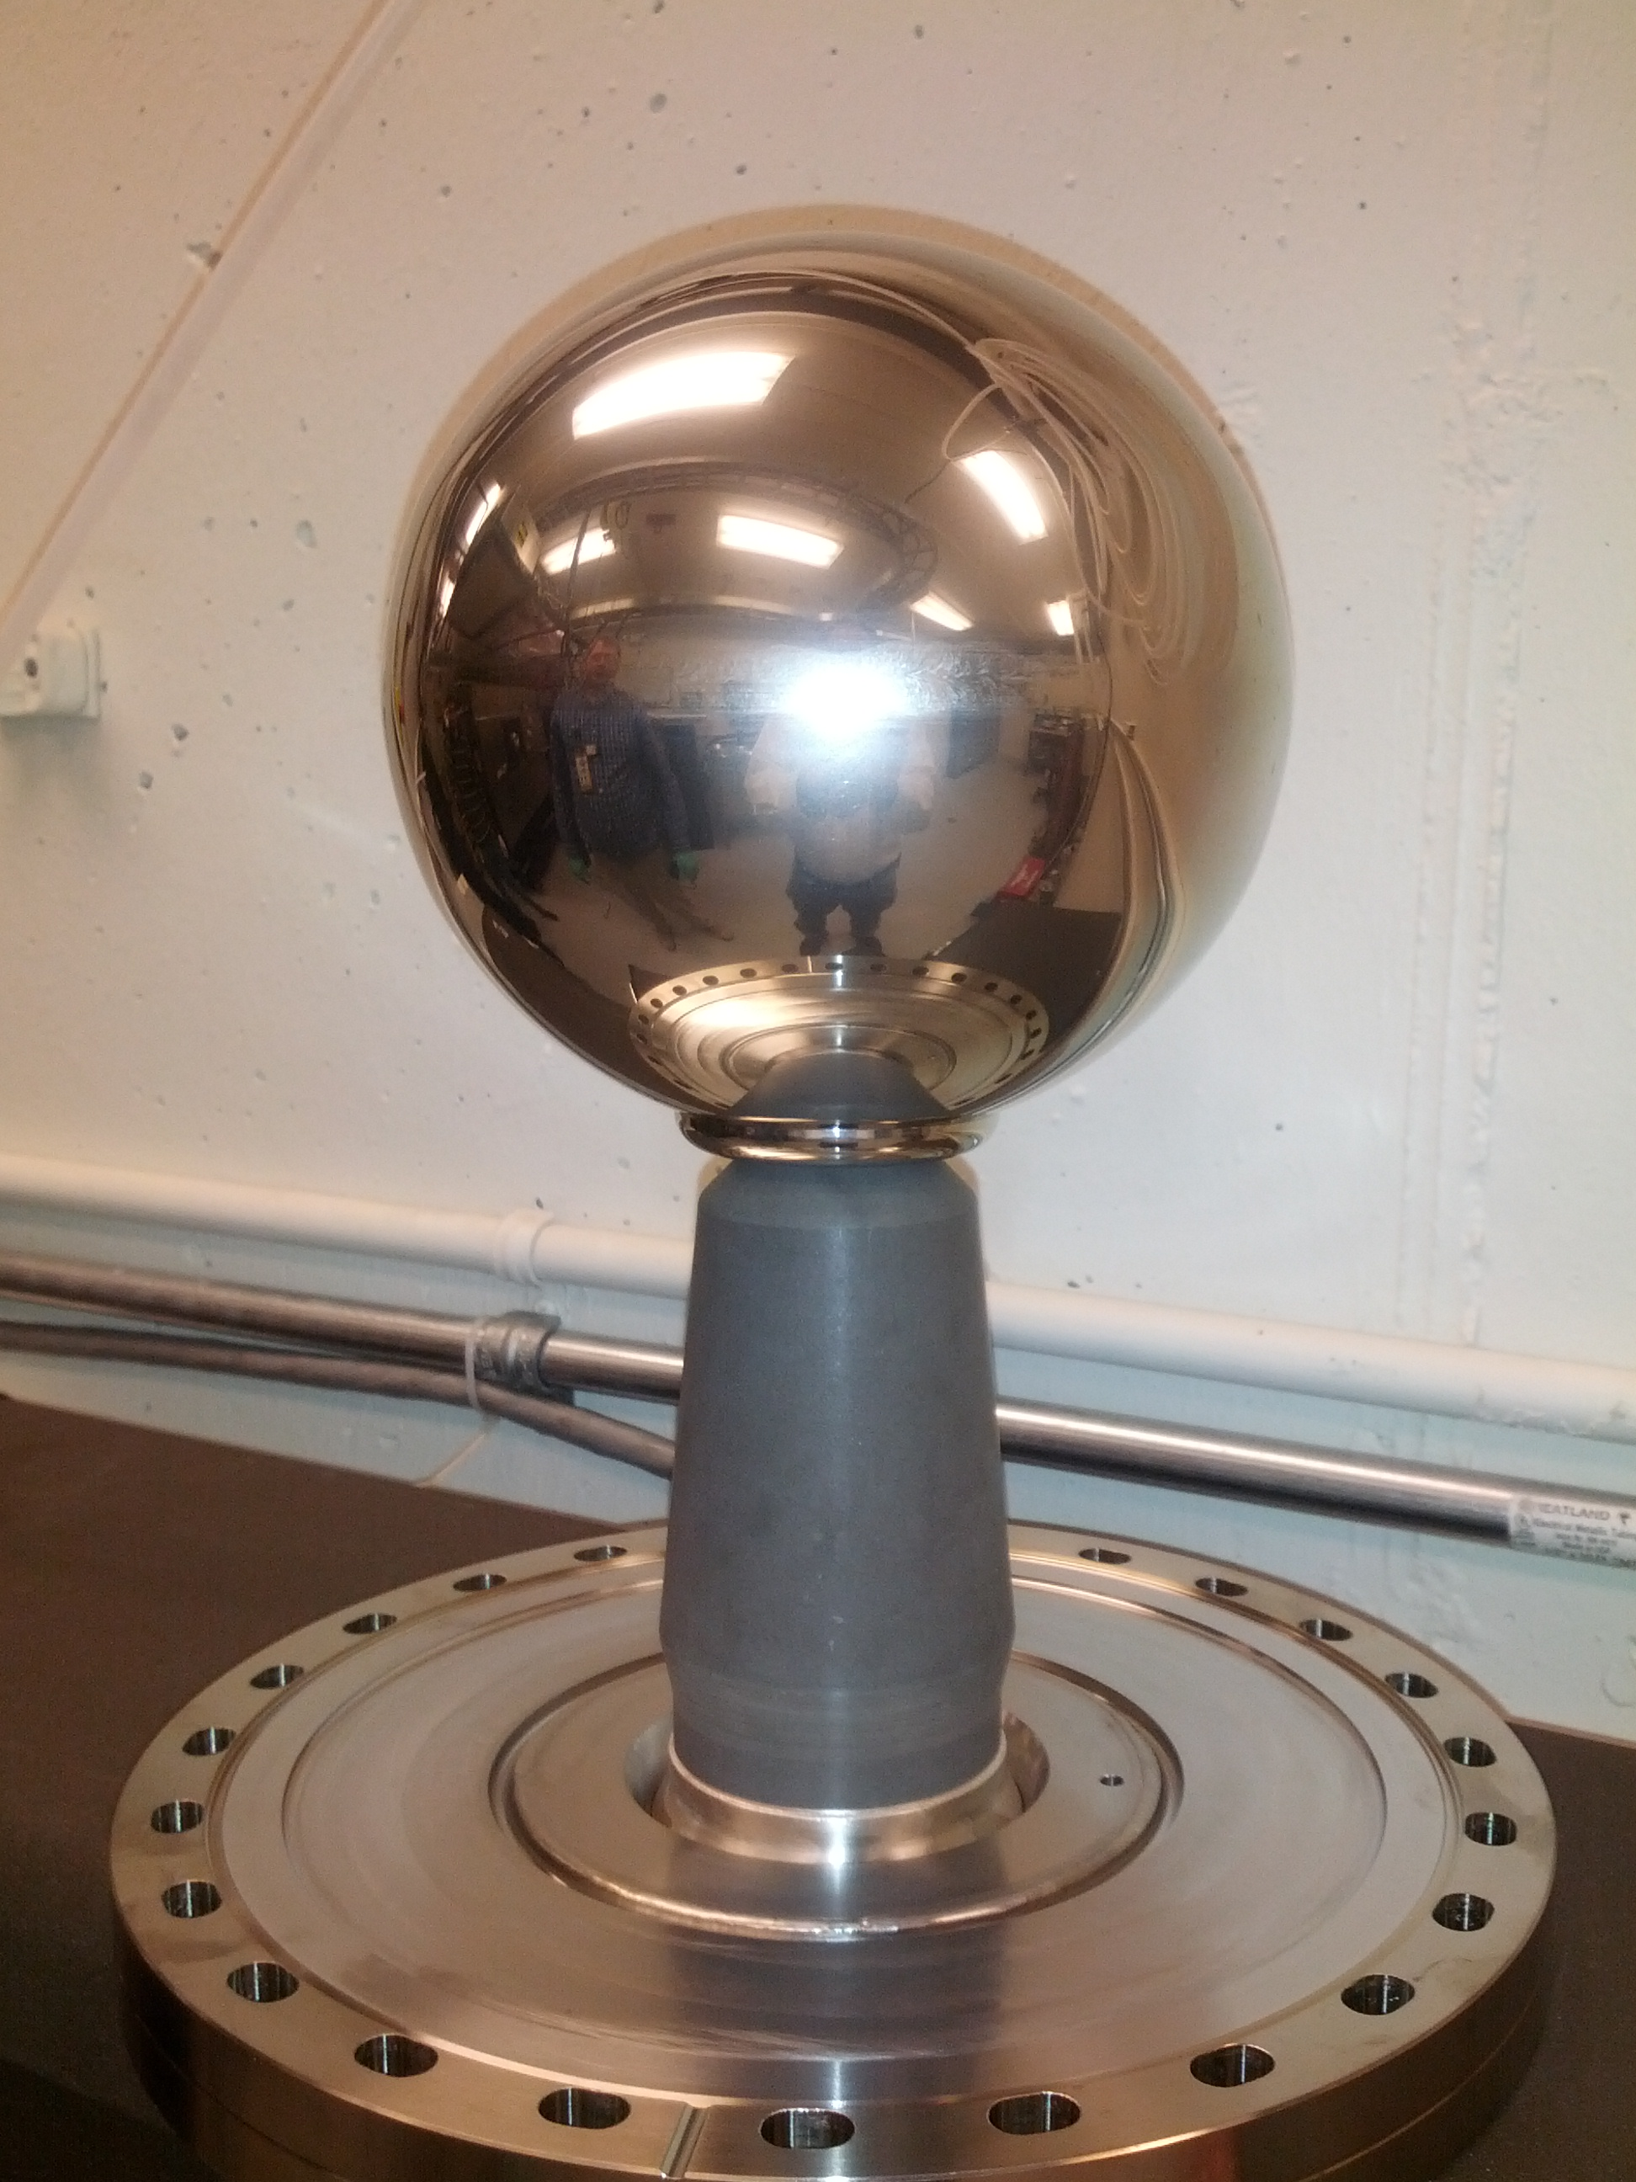
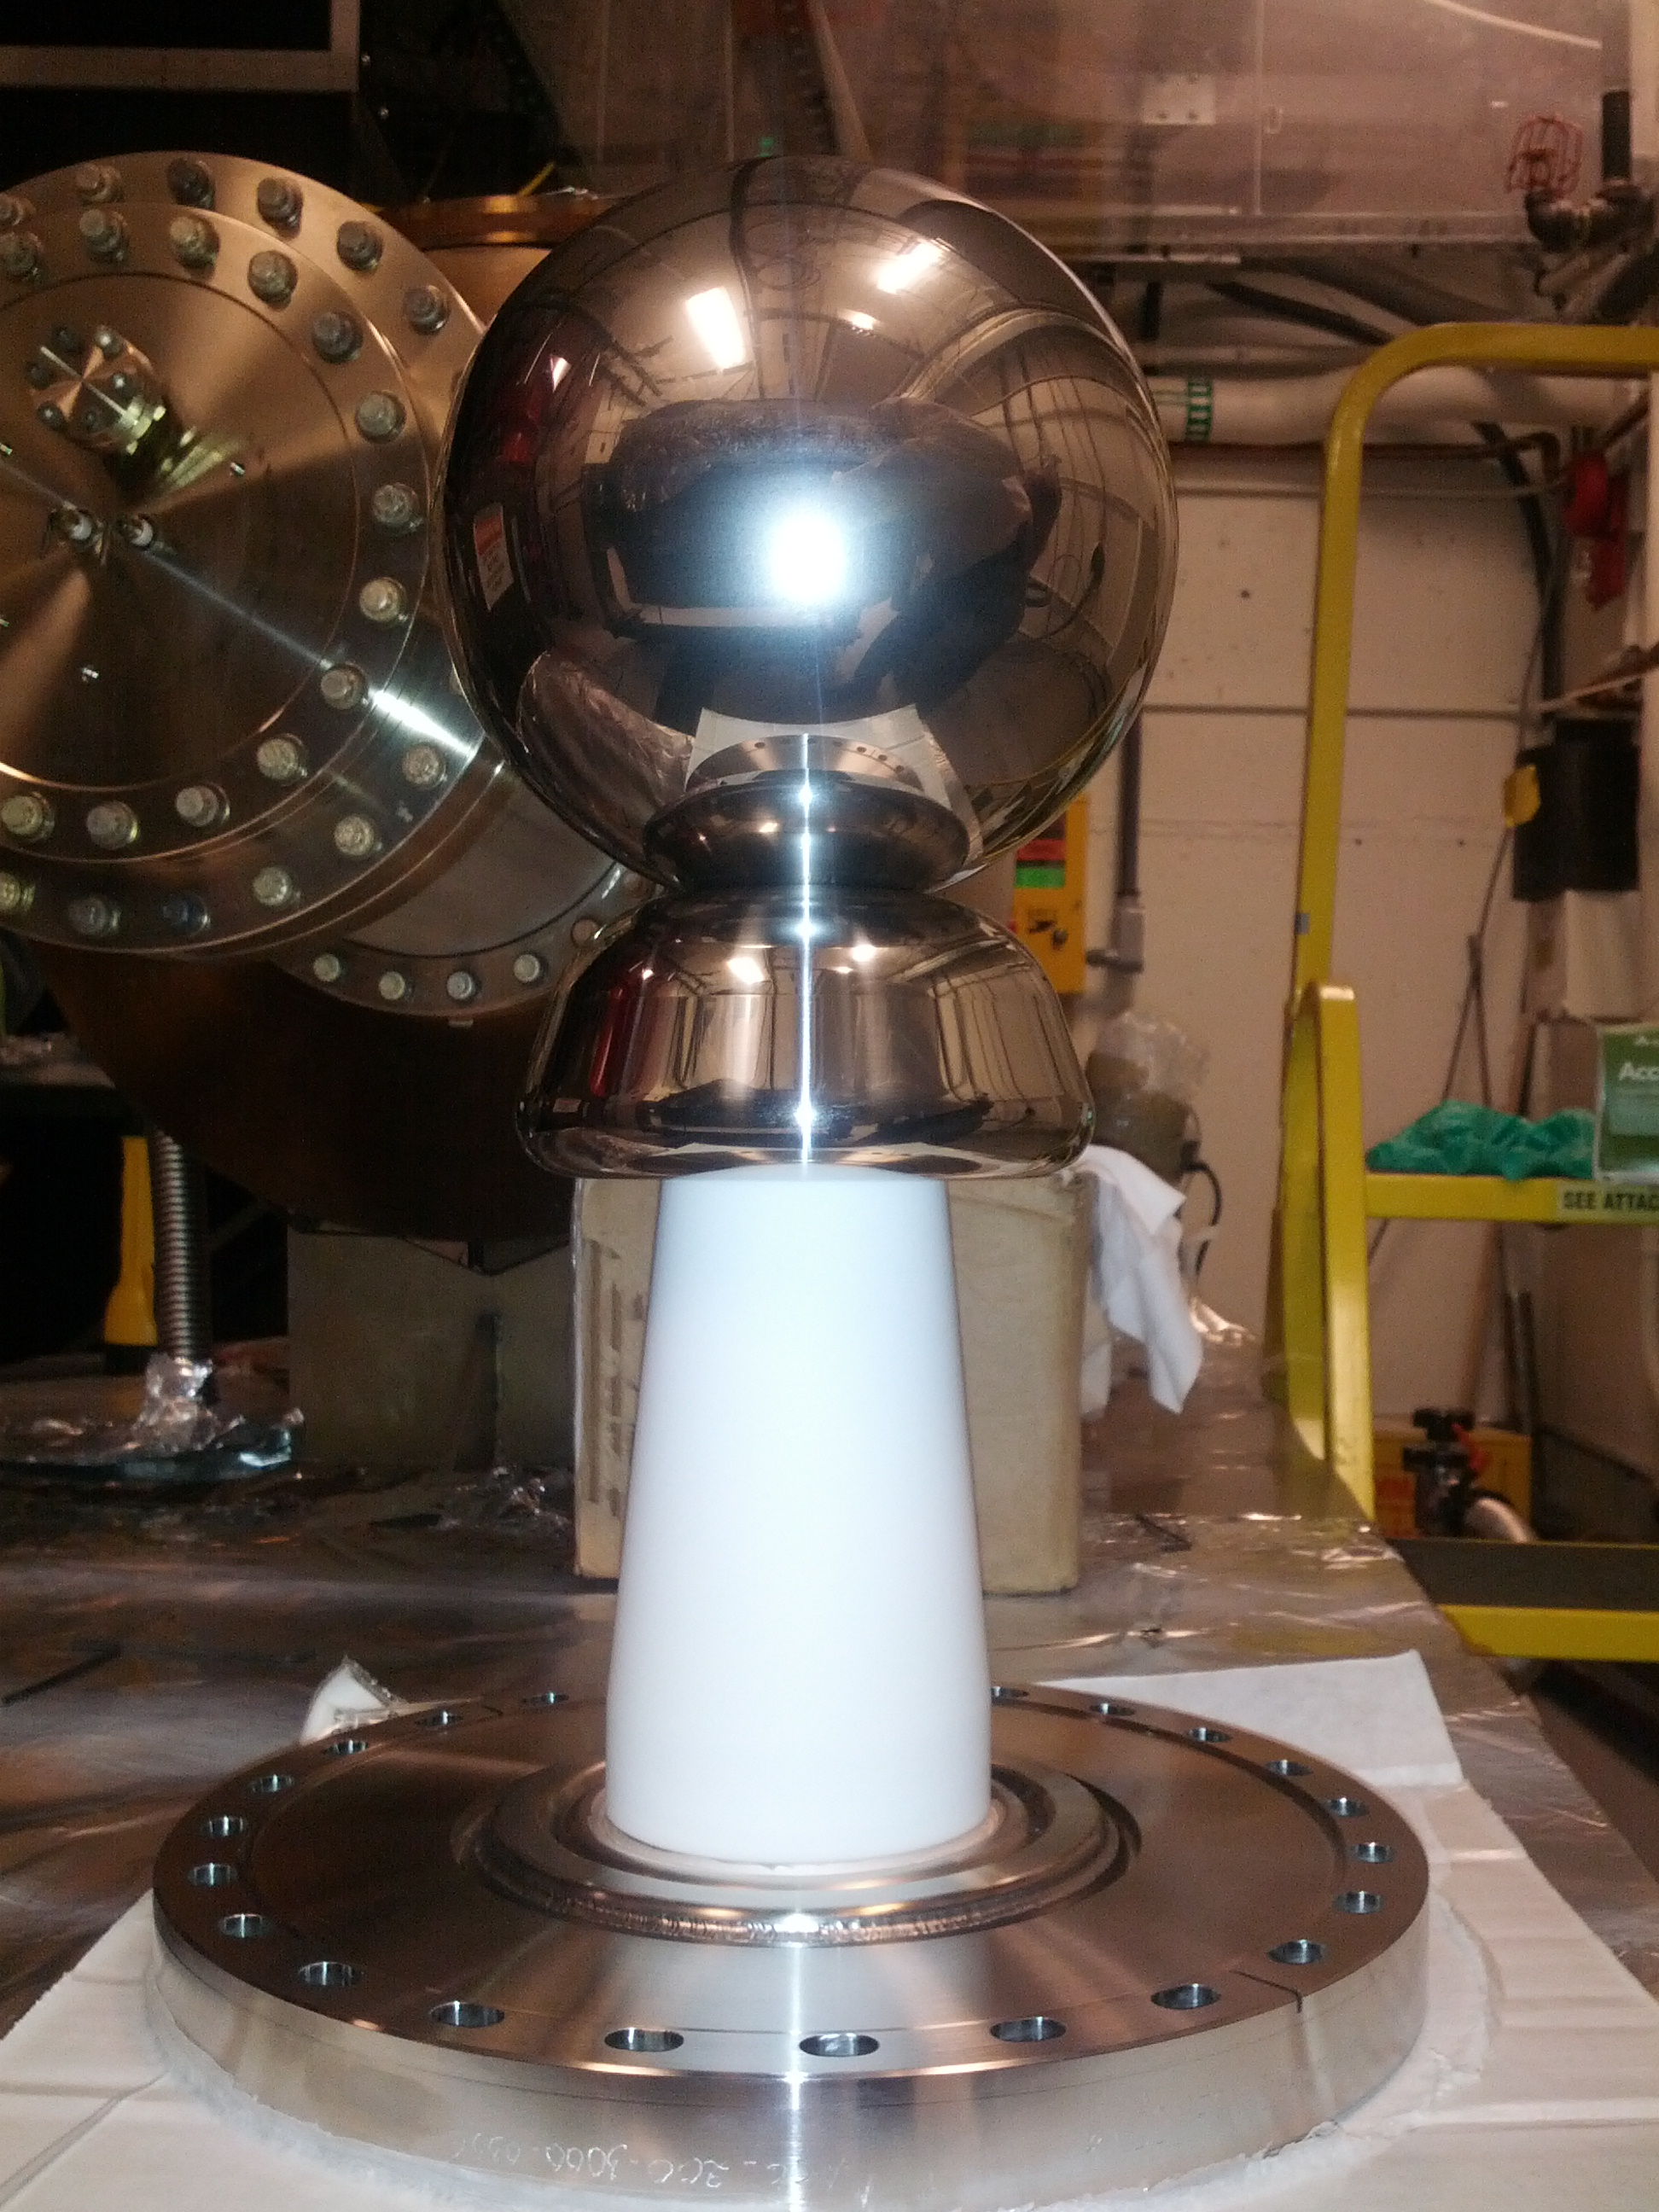
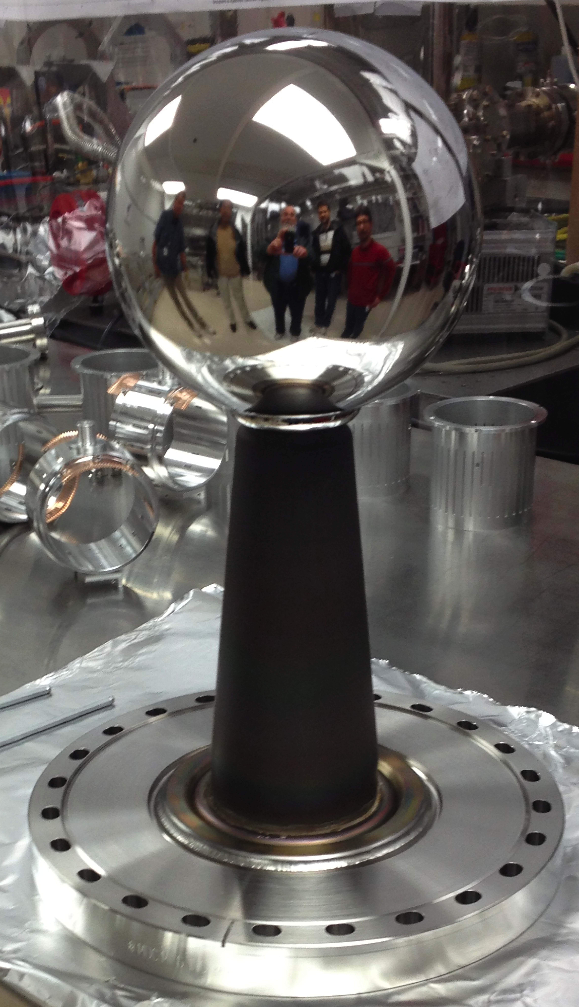
High Voltage Gun - Insulators and Cathode
R30 alumina
R28 alumina with
lower bulk resistivity
R30 alumina
with shed
R30 alumina
with ZrO coating

Slide 16
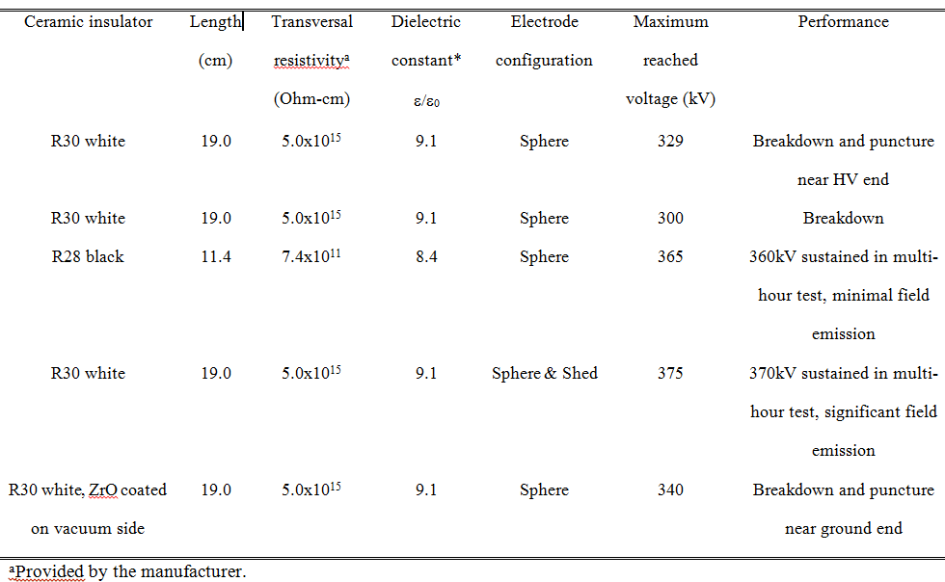
High Voltage Gun - Test Results

Slide 17
The Beamline
No acceleration of beam after the gun
Is going to be a diagnostic beamline:
  Measure the emittance, bunch length, energy spread.
  Study the beams with low & high bunch charges.
  Test the fast kicking.
  Study the CsK2Sb photocathode:
    Charge lifetime
    Photocathode preparations vs. QE and beam quality
    Laser sizes vs. beam quality

Slide 18












The Beamline – Basic design
Dump
CsK2Sb depo
chamber
Laser
Dump
Gun chamber
Solenoid
Valve
Brock cavity
Slit
BPM
corrector
Viewer
Dif pump
Dipole
Harp

Slide 19
The Beamline Components
CsK2Sb deposit chamber – photocathode preparation chamber
Gun chamber – generation of electrons
Brock cavity – bunch length monitor and fast kicker
Slit – beam emittance measurement
Solenoid – beam focusing
Corrector – beam steering
Dipole – energy measurement
Harp – beam profile measurement
BPM – beam position monitor
Viewer – beam profile checking
Differential pump – maintaining vacuum
Dump – beam termination point

Slide 20
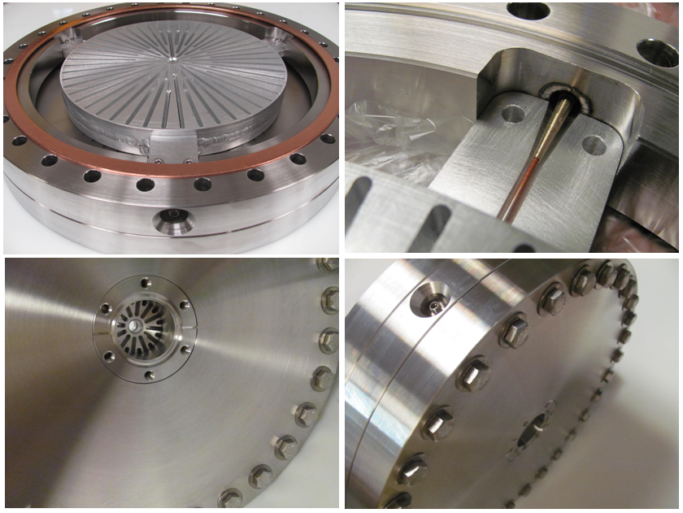
Beamline components - Brock Cavity
Developed by Electrodynamic
Used as a bunch length monitor and a beam kicker
Brock cavity

Slide 21
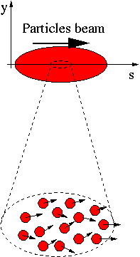
Evaluation of the beam - emittance
Beam bunch - many particles
Particles – moving with given
velocities
V = V_{x}i + V_{y}j + V_{z}k,
V_{x} ≠ 0, V_{y} ≠ 0

Slide 22
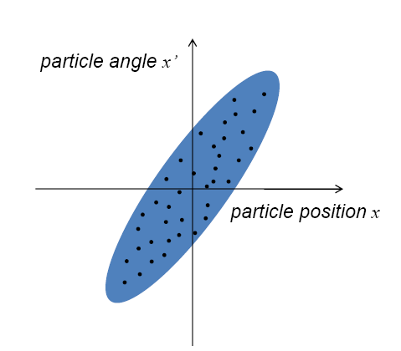
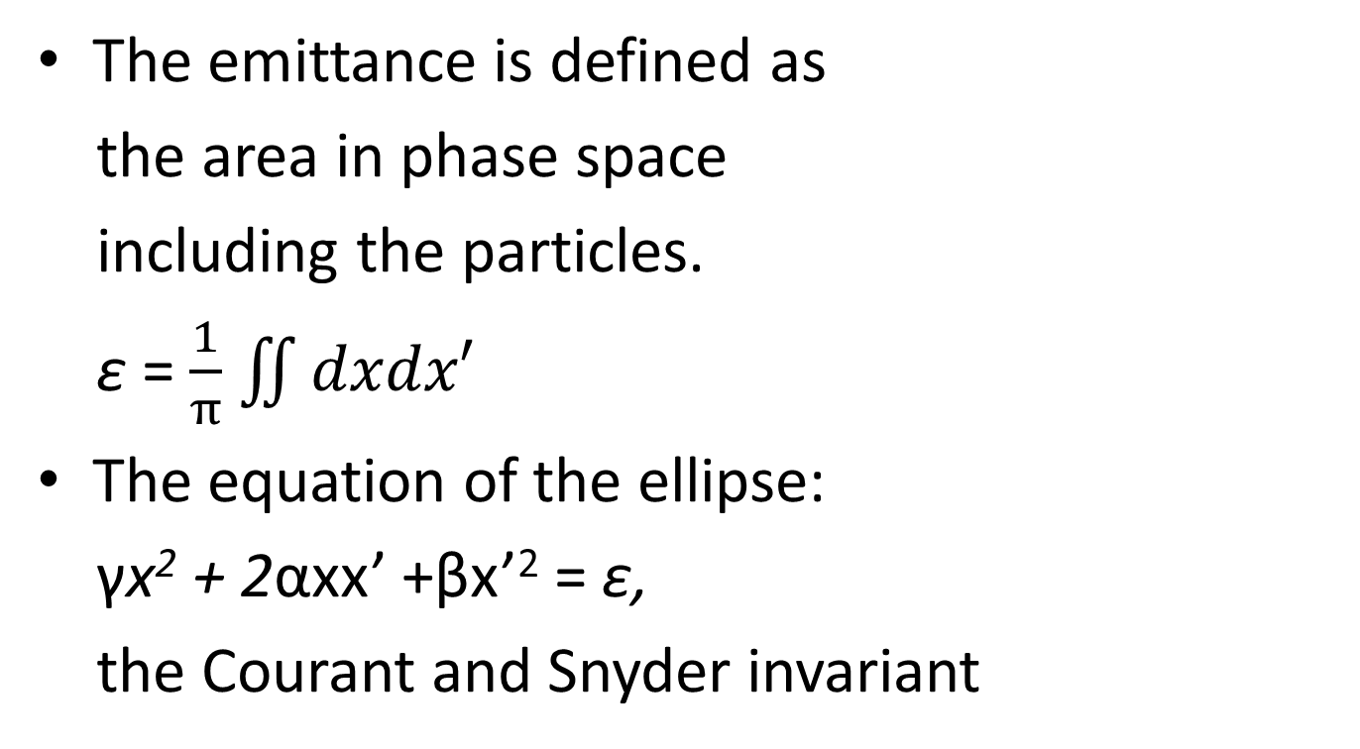
Evaluation of the Beam - Emittance
The emittance is defined as
the area in phase space
including the particles.
ɛ = $\frac{1}{π}$ $\iint{dxdx′}$
The equation of the ellipse:
γx² + 2αxx’ +βx’² = ɛ,
the Courant and Snyder invariant

Slide 23
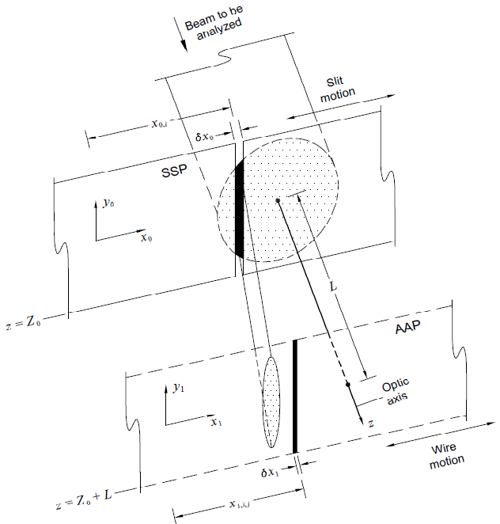
Evaluation of the Beam – Emittance
Use a slit and a harp to
measure emittance:
The slit is a rectangular
opening on a metal plate
which samples the beam and
makes a beamlet which is
emittance dominated.
The harp measures beam
profile and current.

Slide 24
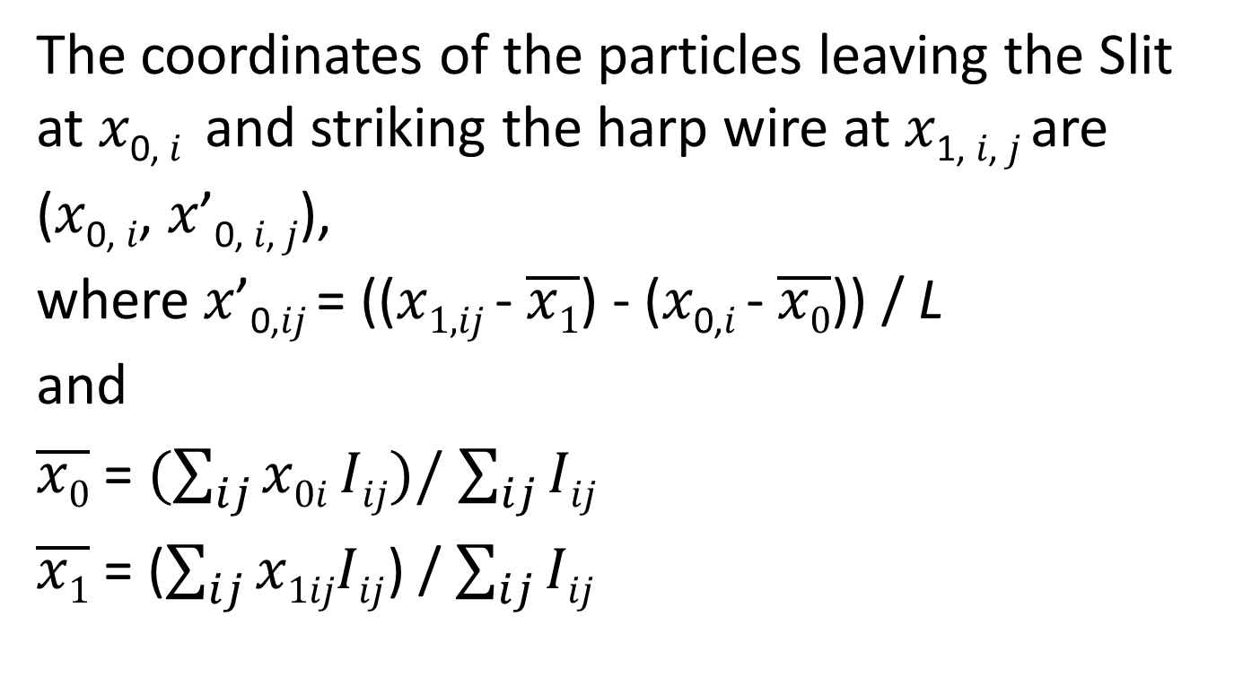
Evaluation of the Beam – Emittance
The coordinates of the particles leaving the Slit at 𝑥_{0, 𝑖} and striking the harp wire at 𝑥_{1, 𝑖, 𝑗} are
(𝑥_{0, 𝑖}, 𝑥’_{0, 𝑖, 𝑗}),
where 𝑥’_{0,𝑖𝑗} = ((𝑥_{1,𝑖𝑗} - $\overline{x1}$) - (𝑥_{0,𝑖} - $\overline{x0}$)) / L
and
$\overline{x0}$ = $(\sum_{ij}{x0i Iij)/}$ $\sum_{ij}{Iij}$
$\overline{x1}$ = ($\sum_{ij}{x1ijIij}$) / $\sum_{ij}{Iij}$

Slide 25
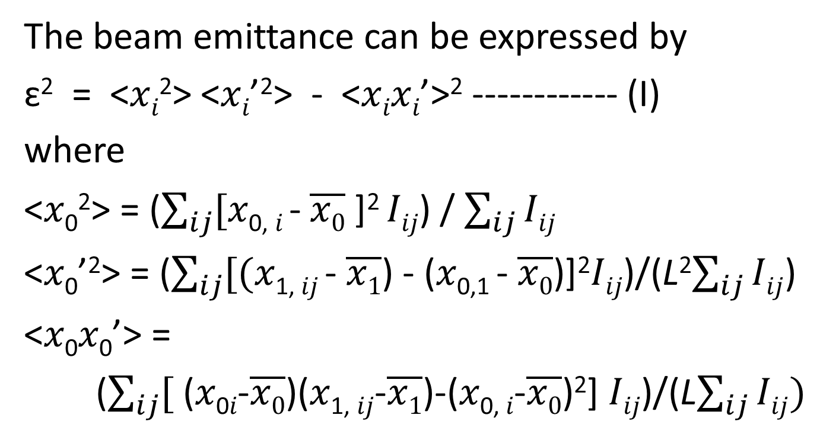
Evaluation of the Beam – Emittance
The beam emittance can be expressed by
ɛ² = ˂𝑥_{𝑖}²˃ ˂𝑥_{𝑖}’²˃ - ˂𝑥_{𝑖}𝑥_{𝑖}’˃² ------------ (I)
where
<𝑥₀²> = ($\sum_{ij}{[}$𝑥_{0, 𝑖} - $\overline{x0}$ ]² 𝐼_{𝑖𝑗}) / $\sum_{ij}{Iij}$
<𝑥₀’²> = ($\sum_{ij}{[(}$𝑥_{1, 𝑖𝑗} - $\overline{x1}$) - (𝑥_{0,1} - $\overline{x0}$)]²𝐼_{𝑖𝑗})/(L²$\sum_{ij}{Iij}$)
<𝑥₀𝑥₀’> =
($\sum_{ij}{[}$ (𝑥_{0𝑖}-$\overline{x0}$)(𝑥_{1, 𝑖𝑗}-$\overline{x1}$)-(𝑥_{0, 𝑖}-$\overline{x0}$)²] 𝐼_{𝑖𝑗})/(L$\sum_{ij}{Iij)}$

Slide 26
Evaluation of the Beam – Emittance
Measurement of the beam emittance using the Slit:
Scan the Slit across the beam, stopping in at least 10 regularly spaced locations across the beam diameter. This yields 𝑥_{0, 𝑖}.
For each Slit location, scan the harp across the beamlet, histogramming its current distribution. This yields the 𝑥_{1, 𝑖𝑗} and 𝐼_{𝑖𝑗}.
Calculate ˂𝑥₀²˃, ˂𝑥’₀²˃ and ˂𝑥₀𝑥’₀²˃
Use formula (I) to calculate ɛ.

Slide 27
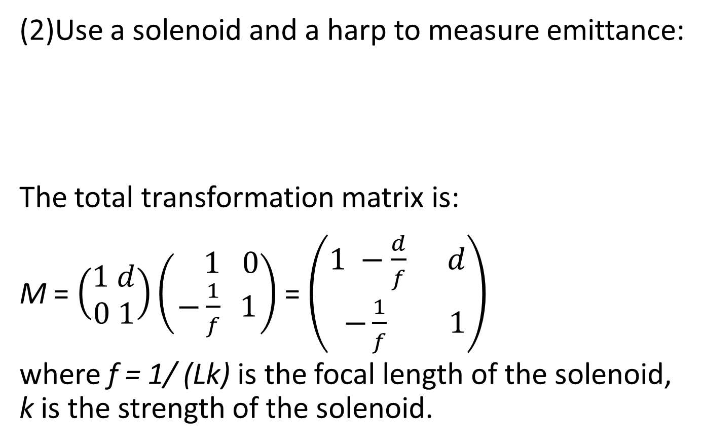
Evaluation of the Beam – Emittance
(2)Use a solenoid and a harp to measure emittance:
The total transformation matrix is:
M = $\left(\begin{aligned}1 d \\ 0 1\end{aligned}\right)\left(\begin{aligned} 1 0 \\ −\frac{1}{f} 1\end{aligned}\right)$ = $\left(\begin{aligned}1 −\frac{d}{f} d \\ −\frac{1}{f} 1\end{aligned}\right)$
where f = 1/ (Lk) is the focal length of the solenoid, k is the strength of the solenoid.
L
d

Slide 28
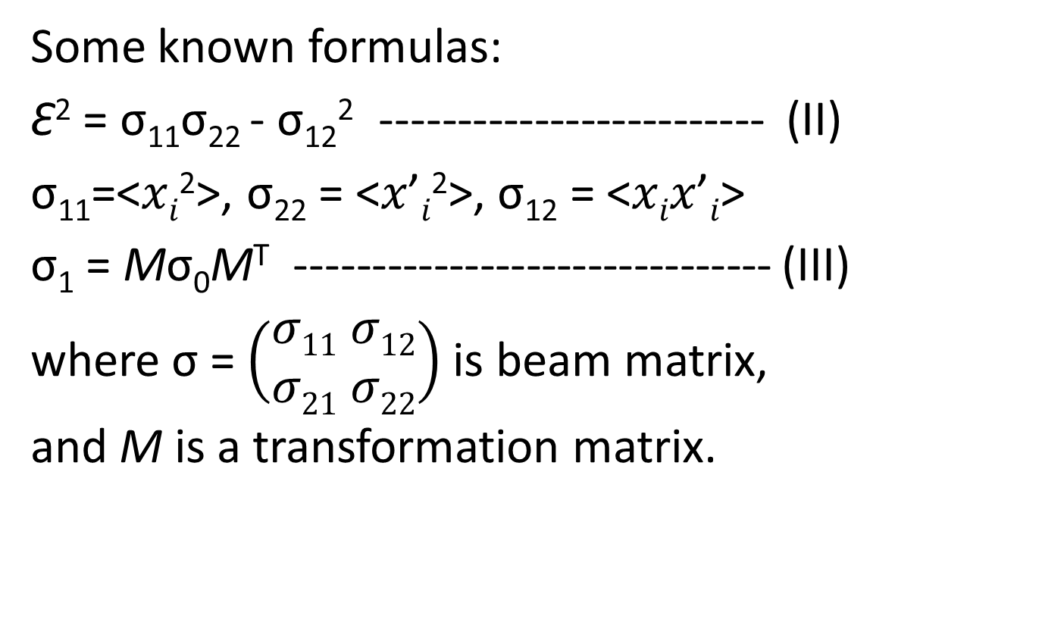
Evaluation of the Beam – Emittance
Some known formulas:
Ɛ² = σ₁₁σ₂₂ - σ₁₂² ------------------------- (II)
σ₁₁=<𝑥_{𝑖}²>, σ₂₂ = <𝑥’_{𝑖}²>, σ₁₂ = <𝑥_{𝑖}𝑥’_{𝑖}>
σ₁ = Mσ₀M^{T} ------------------------------- (III)
where σ = $\left(\begin{aligned}σ11 σ12 \\ σ21 σ22\end{aligned}\right)$ is beam matrix,
and M is a transformation matrix.

Slide 29
Evaluation of the Beam – Emittance
Apply formula (III) to the beam from the solenoid to the harp:
σ_{1,11}= (1+dLk)² σ_{0,11} + 2(1+dLk) dσ_{0,12} + d² σ_{0,22}
=(d²Lσ_{0,11})k²+2(dLσ_{0,11}+d²L_{s}σ_{0,12})k+(σ_{0,11}+2dσ_{0,12}+d²σ_{0,22})
Fitting σ_{1,11} with a parabola (ak² + bk + c)
will determine the whole beam matrix σ₀ by
σ_{0,11} = a/(d²L²),
σ_{0,12} = (b − 2dLσ_{0,11})/(2d²L),
σ_{0,22} = (c − σ_{0,11} − 2dσ_{0,12)}/d² .
Then we can calculate Ɛ using formula (II).

Slide 30
Evaluation of the Beam – Bunch Length
The Brock cavity is a non-invasive bunch length monitor:
The cavity resonates many harmonic TM0N0 modes simultaneously.
Beam current I(t) = A₀ + A₁ cos (ω₀t + θ₁) + A₂ cos (2ω₀t + θ₂) + A₃ cos (3ω₀t + θ₃) … Each (A_{n} ) term is amplitude, each frequency term is harmonic, an integer multiple of the bunch frequency, (A₀ ) is the average current.
When an electron bunch passes through a harmonic cavity, the harmonic modes are excited with amplitudes and relative phases proportional to the beam’s Fourier series.
The superposition of the harmonic modes on-axis, has a voltage vs. time waveform that ideally mirrors the current vs. time of the beam that induced it.

Slide 31
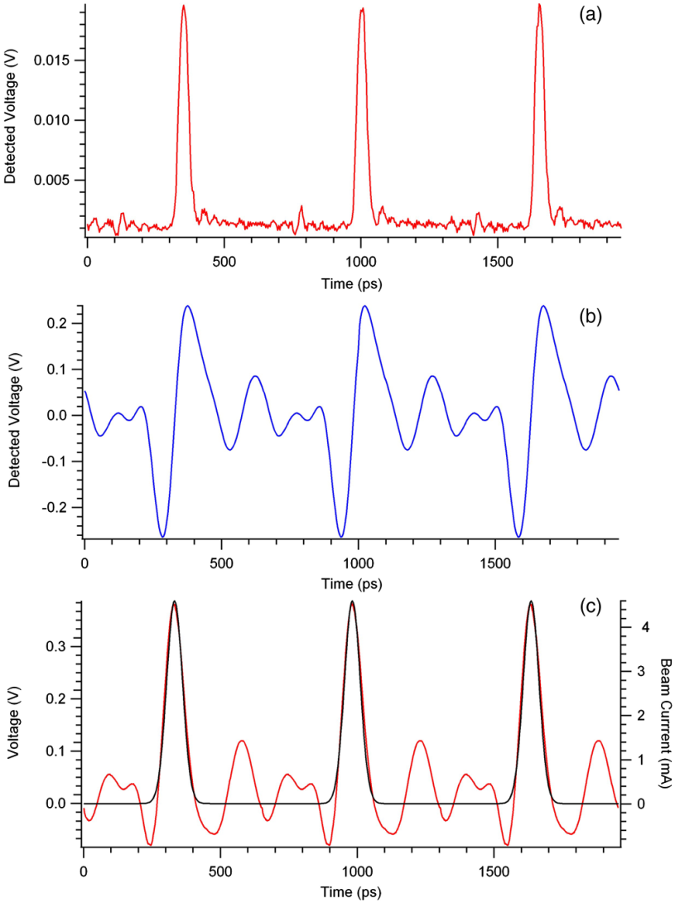
Evaluation of the Beam – Bunch Length
Bunch length measurement:
Drive laser pulse.
The signal detected
by the Brock cavity.
(c) The FFT of the signal
with overlaid Gaussian fit.
Bunch length = FWHM

Slide 32
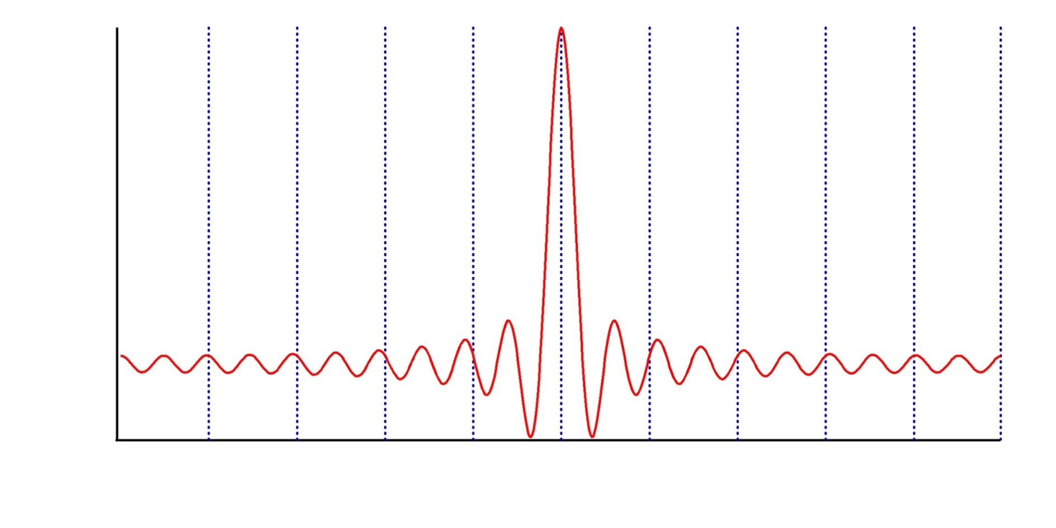
Evaluation of the Beam – Fast Kicker
The brock cavity is a beam kicker when powered.
A pulse (f = f₀/10) kicks one out of ten beam bunches

Slide 33
Evaluation of the Beam – Momentum Spread
Frequently it is desirable to determine experimentally the particle momentum and momentum spread.
Basically a quad, a bending magnet and a harp are needed to measure them.

Slide 34
Evaluation of the Beam – Momentum Spread
Individual particles in an intense beam are under the influence of strong repelling electrostatic forces creating the possibility of severe stability problems. This is the space charge effect.
Beam quality will be studied with low bunch change and high bunch charge.

Slide 35
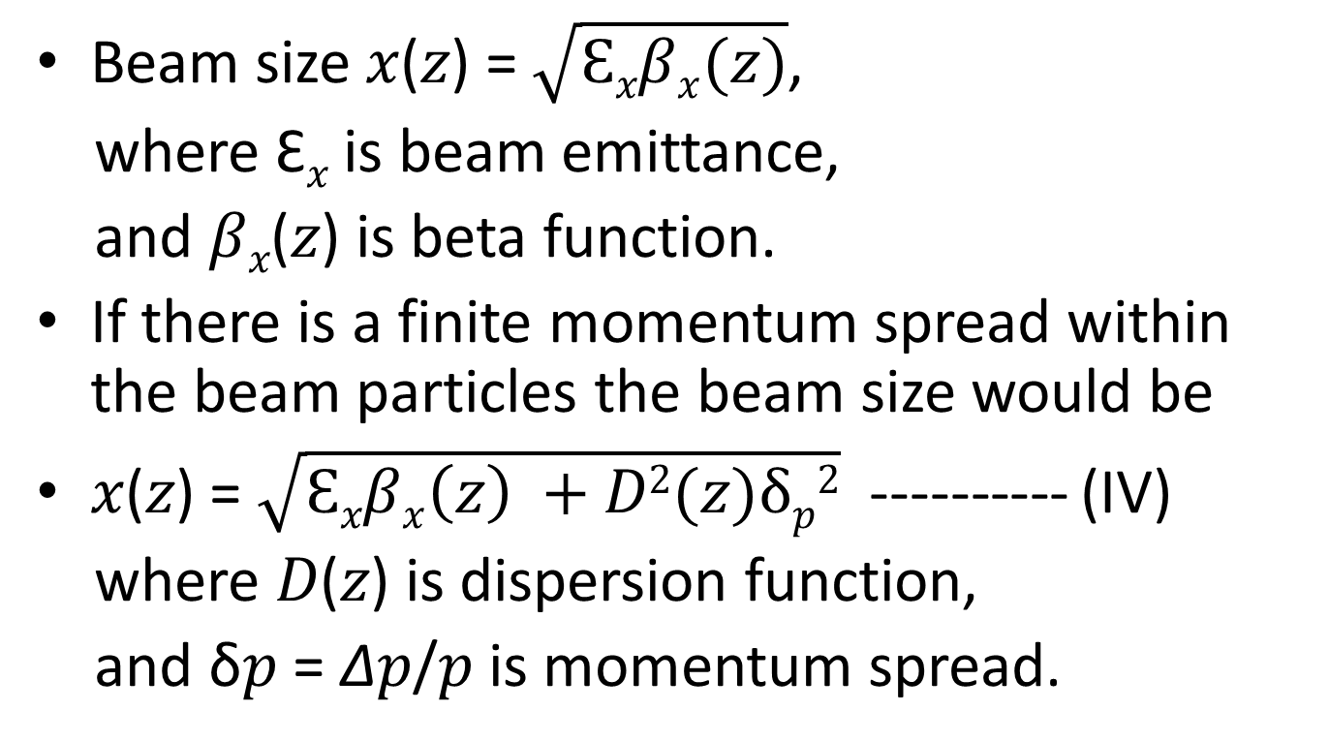
Evaluation of the Beam – Momentum Spread
Beam size 𝑥(𝑧) = $\sqrt{Ɛxβx(z)}$,
where Ɛ_{𝑥} is beam emittance,
and 𝛽_{𝑥}(𝑧) is beta function.
If there is a finite momentum spread within the beam particles the beam size would be
𝑥(𝑧) = $\sqrt{Ɛxβx\left(z\right) +D2(z)δp2}$ ---------- (IV)
where 𝐷(𝑧) is dispersion function,
and δ𝑝 = ∆𝑝/𝑝 is momentum spread.

Slide 36


Evaluation of the Beam – Momentum Spread
Solenoid
𝑥₂(𝐿)
Adjust the solenoid strength to get minimal
𝑥₁(𝐿) so 𝑥₂(𝐿) would be dispersion dominated at the same
solenoid setting when turning on the bending magnet.
From formula (IV) δ_{𝑝} = ∆𝑝/𝑝 = $\sqrt{x22\left(L\right)−x12(L)}$/𝐷(𝐿).
𝑝 = (3E-4) $(\int{Bdl }$)/θ.
Bending magnet
𝐷(𝐿)
𝐿
θ
𝑥$1(L)= \sqrt{Ɛxβx(L)}$
𝐿

Slide 37
CsK2Sb photocathode
The CsK2Sb photocathode has not been fully understood yet.
The charge lifetime, QE and beam emittance will be studied with different thickness of Sb, different laser spot sizes, low and high currents.

Slide 38
CsK2Sb photocathode– Charge Lifetime
Charge lifetime, defined as the amount of charge that can be extracted before the QE falls to 1/e of its initial value, was measured by monitoring the QE evolution as a function of accumulated charge.
Measurements are made at a particular constant beam current.
Beam current, laser power and laser spot sizes are some of the factors affecting the charge lifetime.

Slide 39
Simulations
Tosca and Poisson will be used to design the gun. These tools will help design better cathode geometry which affects the maximum achievable bias voltage.
Elegant and GPT will be used for the beamline design and beam transport. The simulated beam emittance and bunch length will be compared with the measured results.

Slide 40
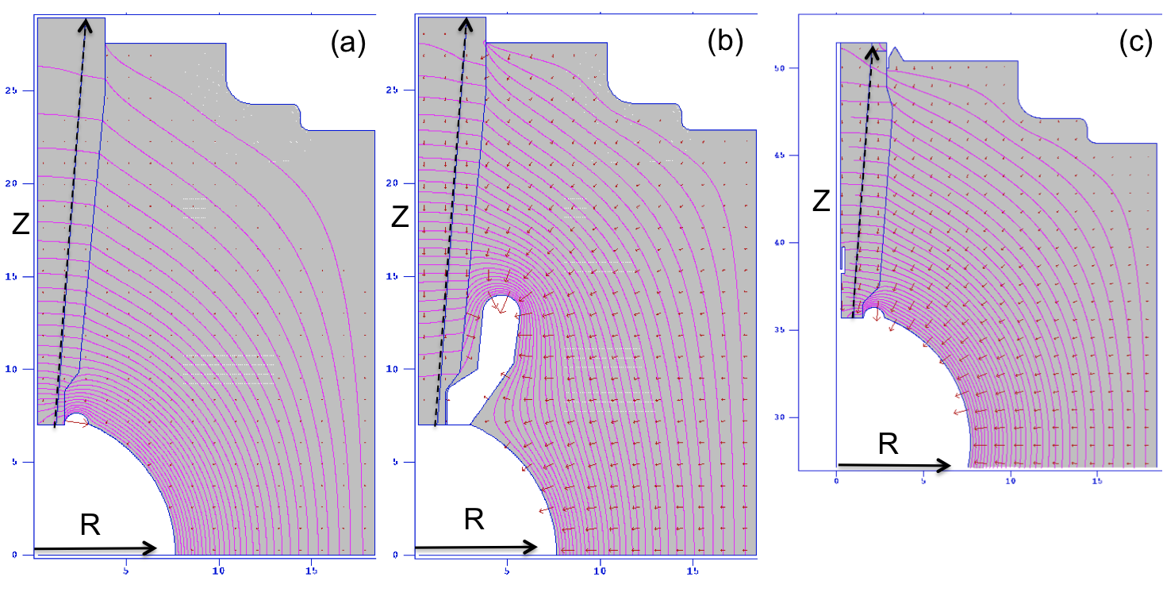
Simulations - Poisson
Electrostatic modeling results at350kV for (a) R30 pure alumina insulator, (b) R30 pure alumina insulator with shed electrode and (c) R28 lower bulk resistivity insulator.

Slide 41
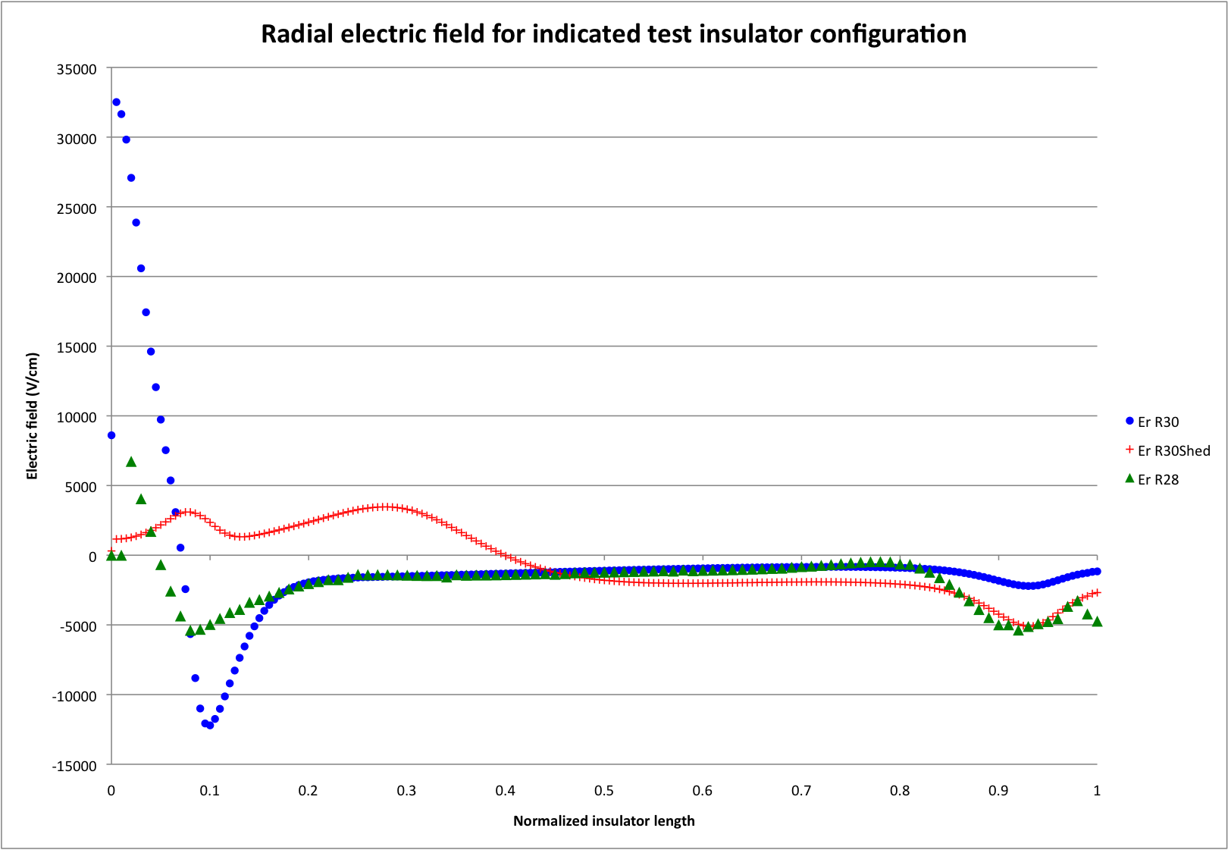
Simulations - Poisson
Radial electric field along the line between the plug and the insulator:

Slide 42
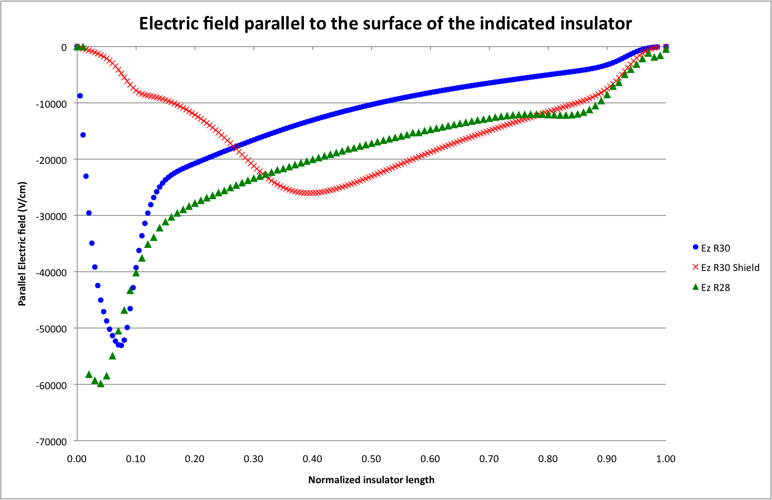
Simulations - Poisson
Parallel electric field along the line between the plug and the insulator:

Slide 43
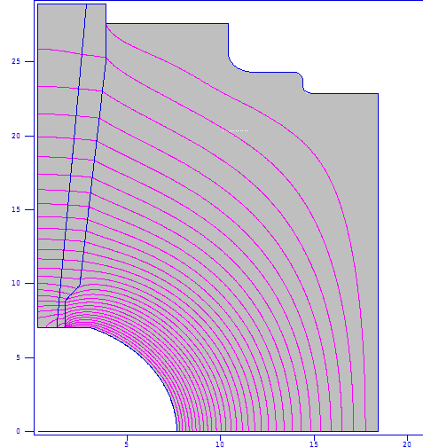
Simulations - Poisson
Potentials along
the line between
the plug and the
Insulator is non-linear.

Slide 44
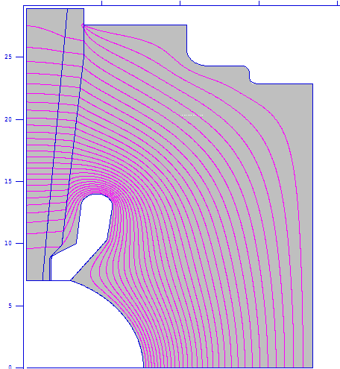
Simulations - Poisson
The potential
Linearity is
Improved
with a shed
Shield

Slide 45
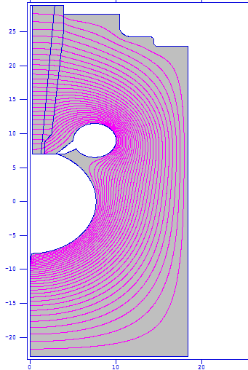
Simulations - Poisson
The potential linearity is much better with a
different shed design.
Bad symmetry

Slide 46
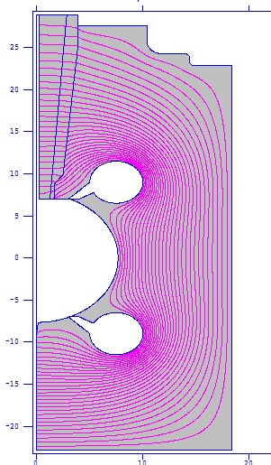
Simulations - Poisson
Good linearity
E field < 10 MV/m
Good symmetry

Slide 47
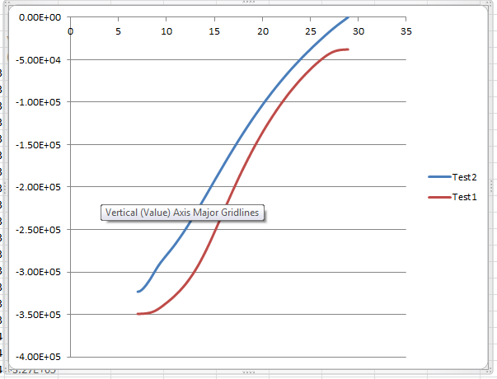
Simulations - Poisson
The potential linearity: the lower trace is from the first shed design;
the top trace is from the second shed design, which is better.

Slide 48
Simulations - GPT
Simulation results with I = 100uA, Q = 0.2pC

Slide 49
Simulations - GPT
Simulation results with I = 100mA, Q = 1nC

