Slide 1
Ions Production

Slide 2
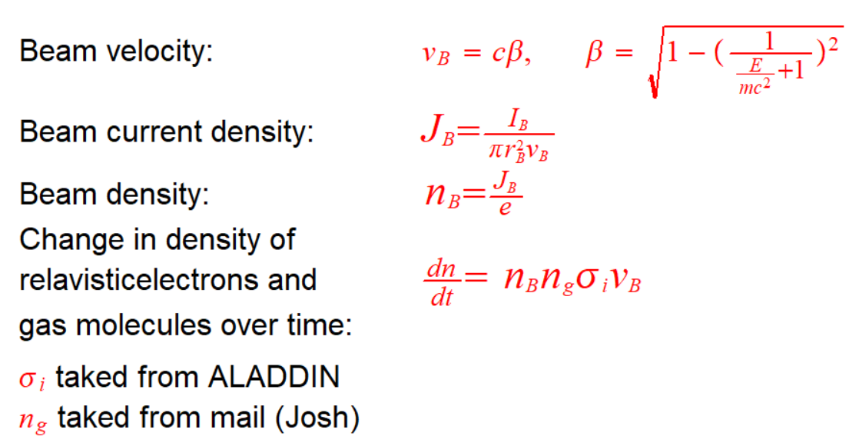
Used relations

Slide 3
Results for: e, H₂ [G] --> e, H₂⁺ [v], e

