Slide 1

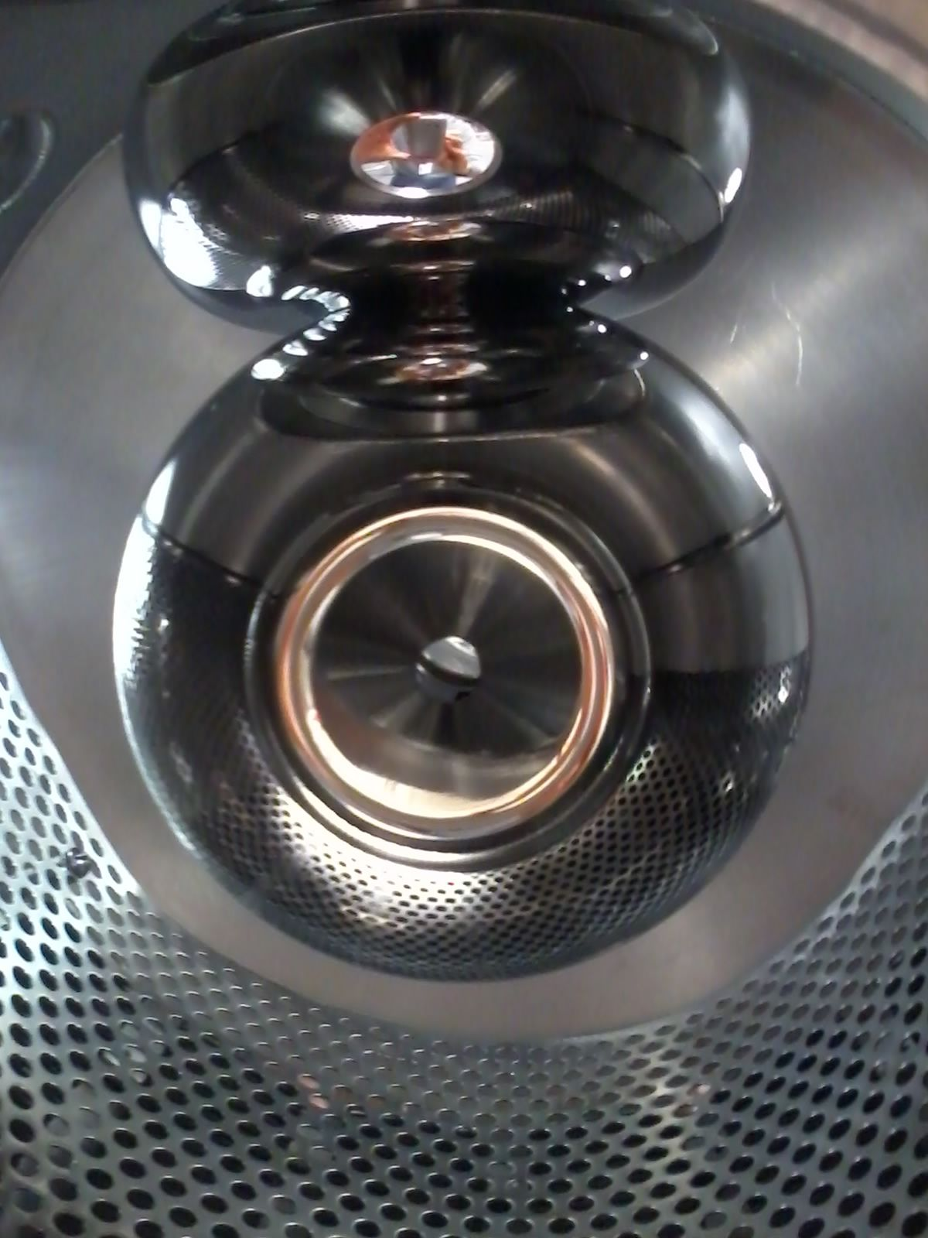
Inverted insulator photoelectron guns at Jefferson Lab
P. Adderley, J. Benesch, B. Bullard, J. Grames, F. Hannon, J. Hansknecht, C. Hernandez-Garcia, R. Kazimi, G. Krafft, M. A. Mamun, M. Poelker, R. Suleiman, M. Tiefenback and S. Zhang
Graduate Students: G. Palacios, Y. Wang, S. Wijiethunga, J. Yoskovitz
Accelerator Seminar, TRIUMF, Vancouver, BC, 21 November 2017

Slide 2
Outline
The past and present: Polarized electron beam sources at JLab for the high energy nuclear physics program
The future: Magnetized electron beam generation R&D for high energy electron coolers
The dream: Inverted Insulator electron guns:
  The concept
  The never ending bumpy road to the Super (reliable) Ultra (high vacuum and low emittance) Mega (volts/meter) electron gun
Reality:
  High voltage performance
  Beam production at mA level
  …and ions!

Slide 3
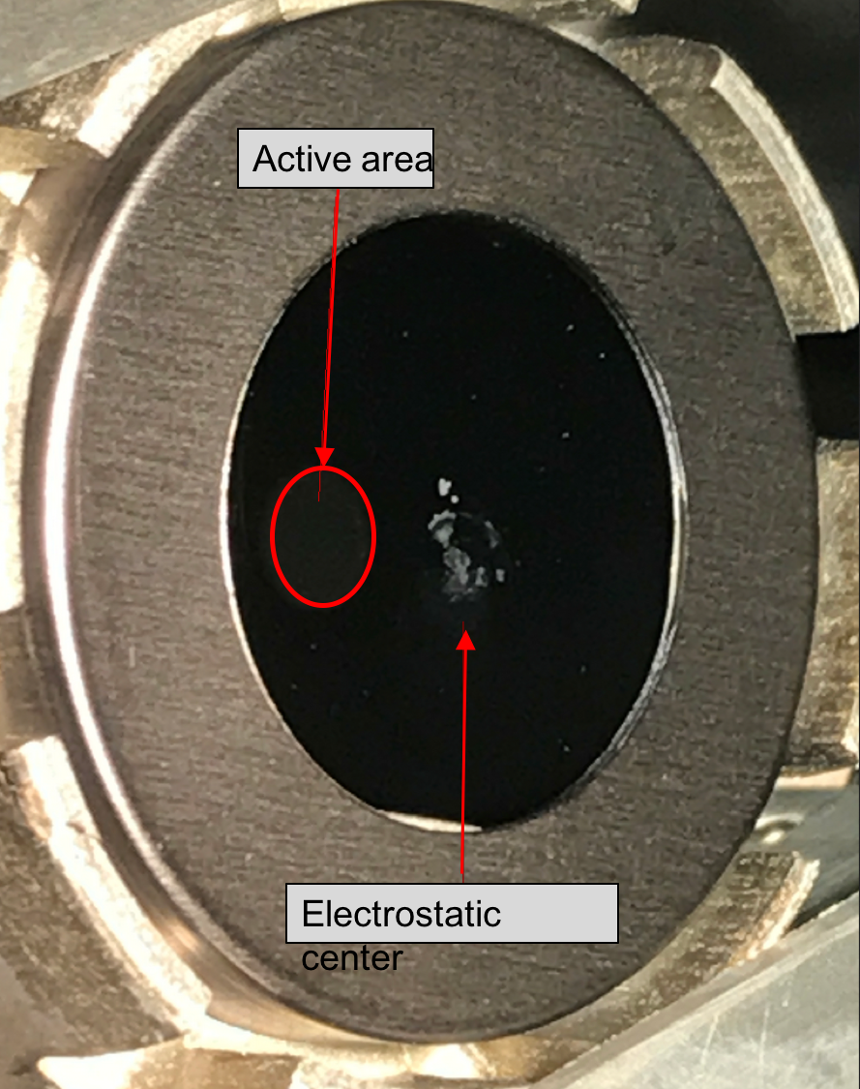
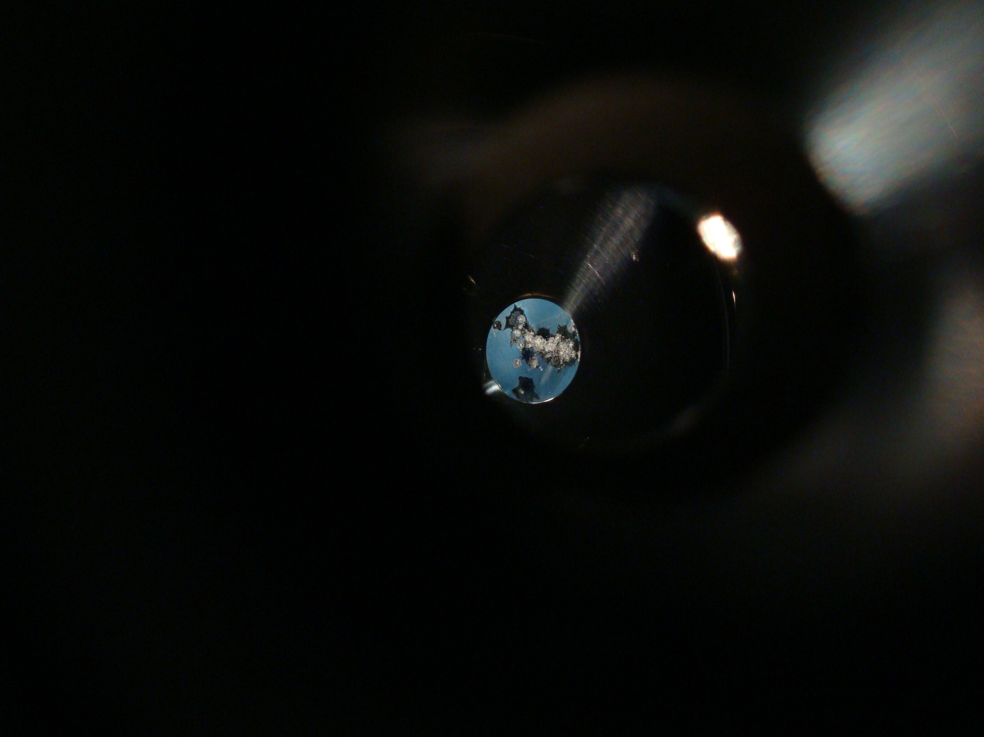
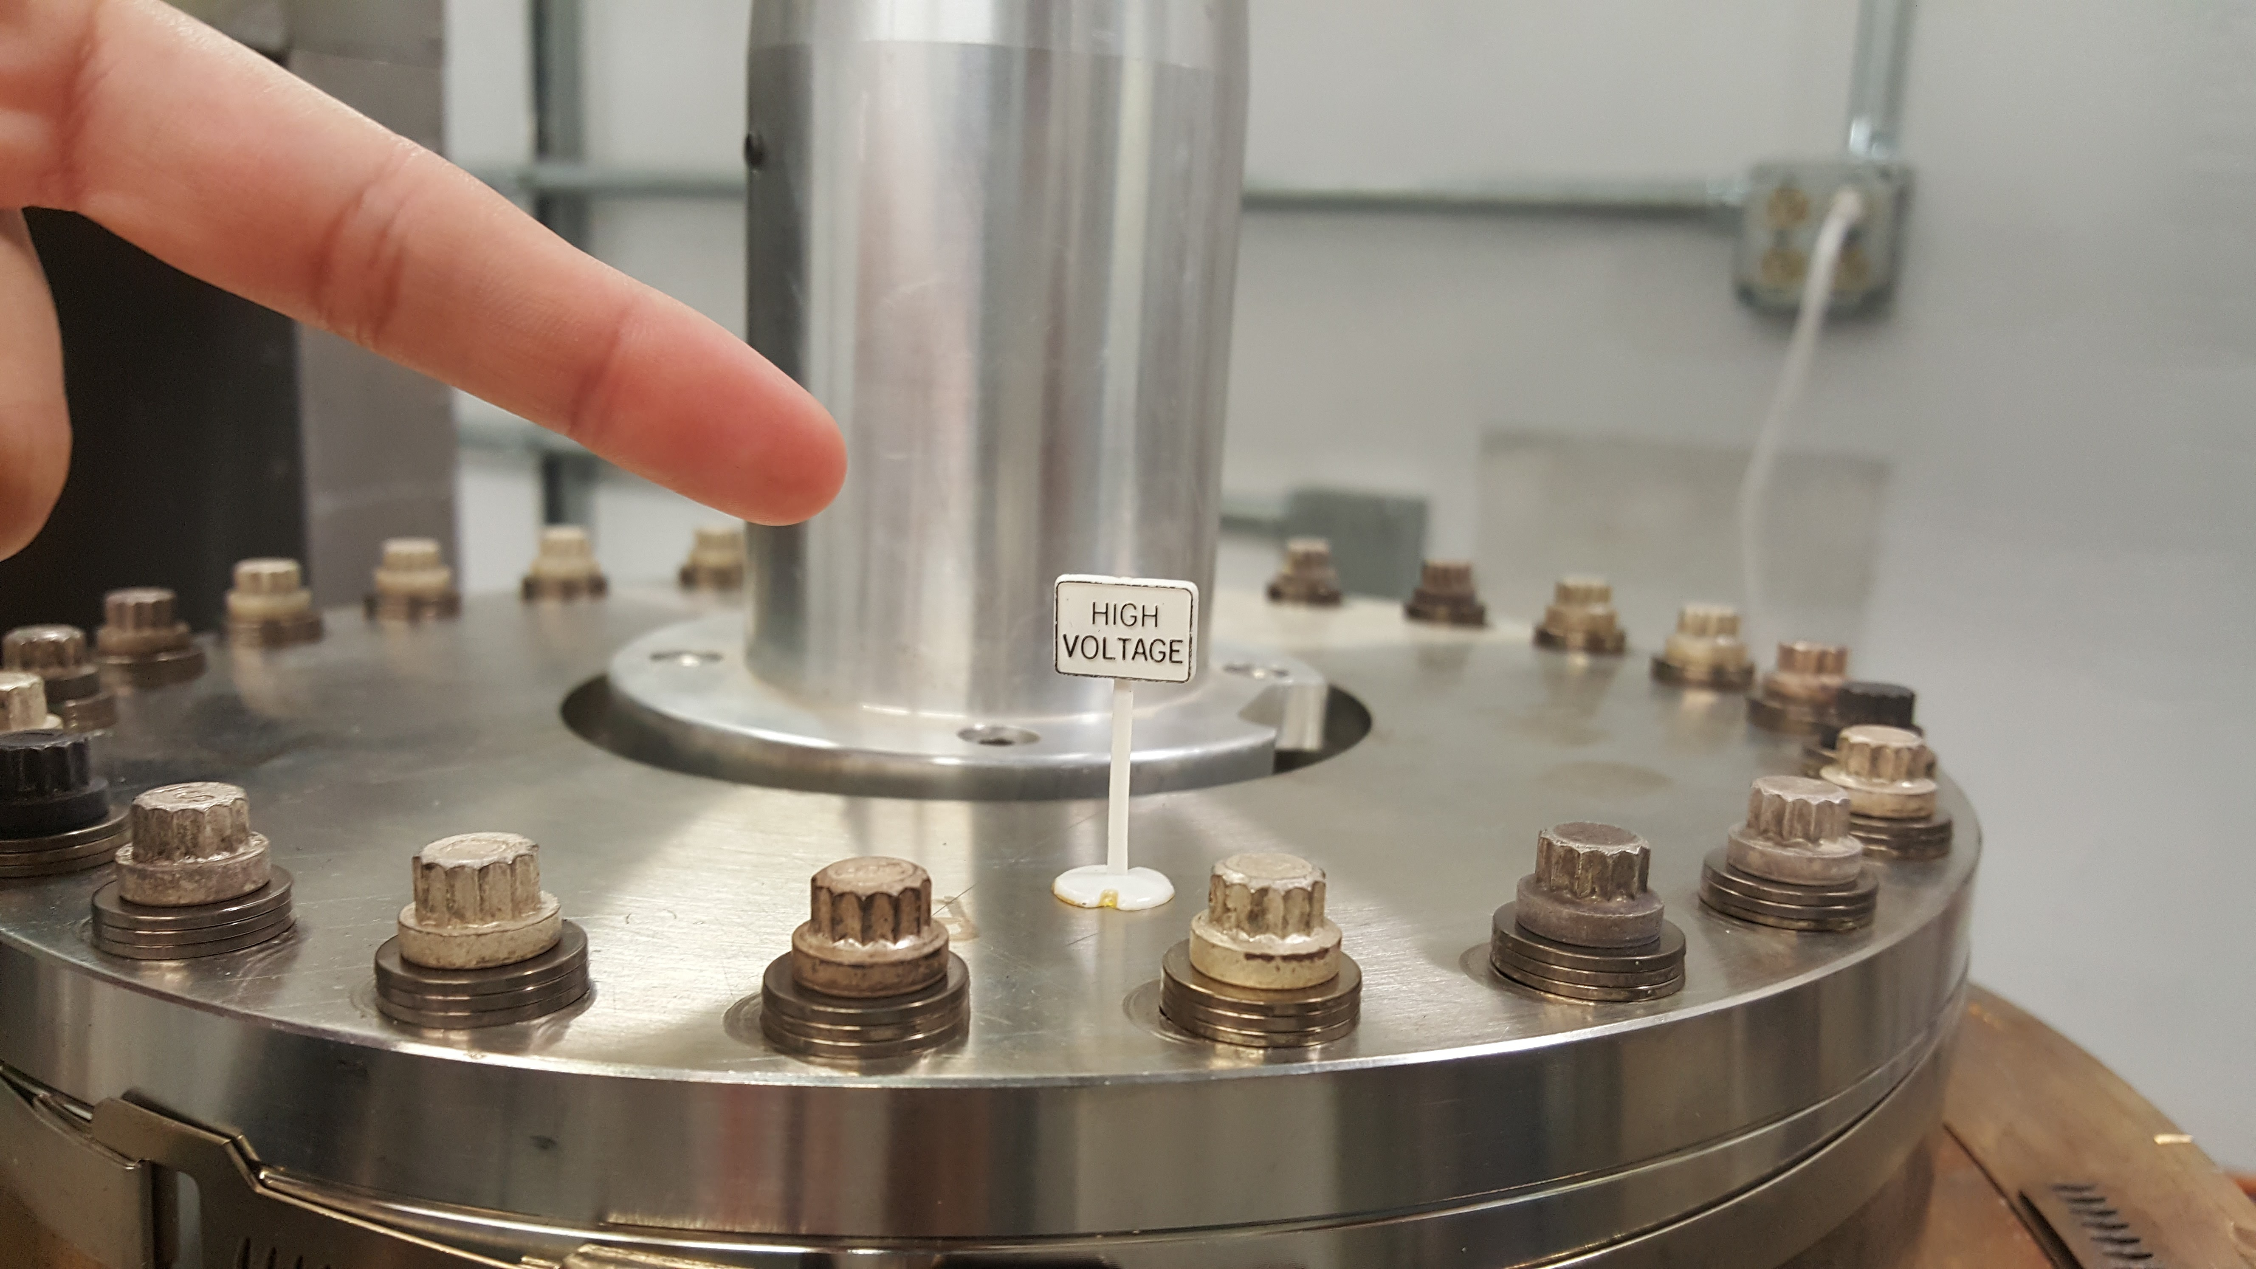
Key Features of a Polarized Photogun
Photocathode
  High Polarization
  High QE (photoemission yield)
  Long Lifetime at mA level
High Voltage
  No field emission
  Reliable, NO ARCING allowed!
Vacuum
Drive Laser
Notes:
Interior Page Design 2

Slide 4
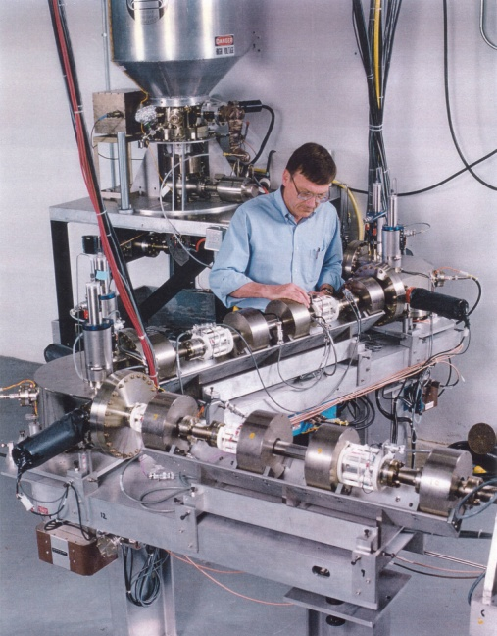
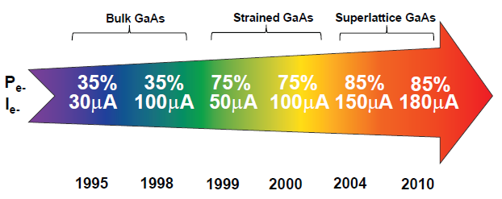
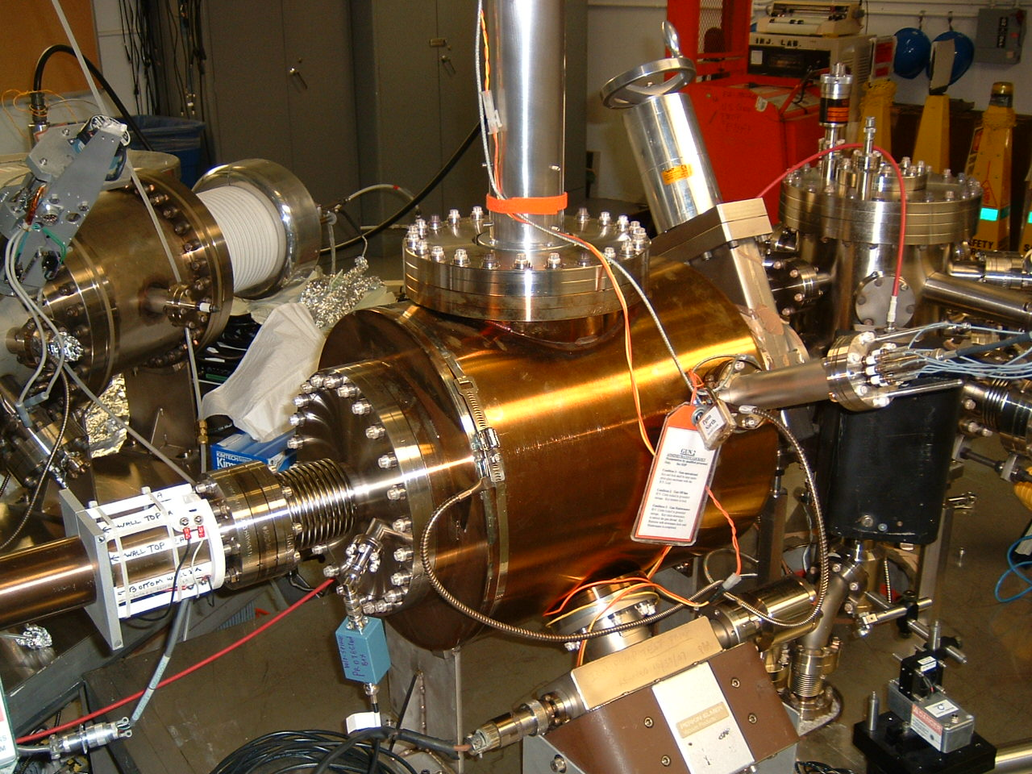
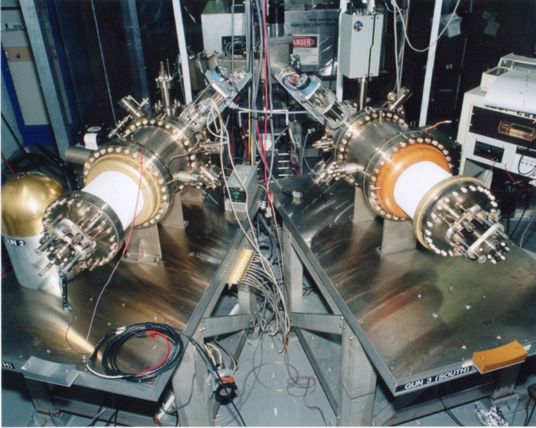
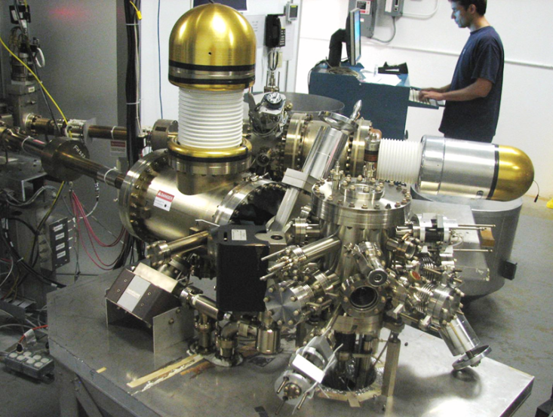
Polarized electron beam at CEBAF
1
4
Lifetime increased from 10s to 100s of Coulombs
The endless (?) quest for perfection
2
3
Notes:
Interior Page Design 1

Slide 5

CEBAF Injector Inverted insulator Gun 130 kV DC
Present configuration
Load Lock & Cathode Prep chamber
> electron beam to accelerator
130kV Gun

Slide 6
Polarized Source Operation Highlights
Photocathode
  Strained Superlattice GaAs/GaAsP #5756-4
  Good Polarization 85-87% (measured at Mott)
  Good QE > 1% after activation
Last Spring 2017
  Delivered 20-40 uA to 3 halls at a time (249.5 & 499 MHz)
  Hall A (Physics), Hall B (KPP), Hall C (KPP), Hall D (Physics)
This Fall 2017 – Winter 2018
  CEBAF restoration starts late November
  12 weeks of running scheduled
  Start simultaneous 4-Hall Operation
6

Slide 7

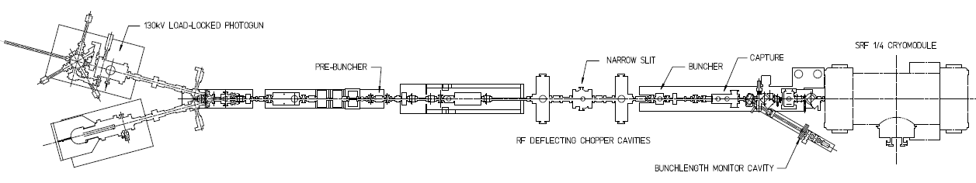
Lifetime Studies at mA Beam Current
CEBAF 130kV polarized “inverted gun” with load lock
Note:
1 mA 86 C/day
5 mA 432 C/day
10 mA 860 C/day
50 mA 4320 C/day
Polarized positrons for CEBAF, and on-going discussions with BNL related to high current eRHIC EIC, prompted experiments at CEBAF to characterize lifetime vs. laser spot size using high-polarization photocathodes
Required laser power, slope proportional to QE decay
Make beam here
Increasing laser size reduces QE decay proportionally
Deliver it here
Monitor vacuum and radiation
1mA
Vary the laser beam size

Slide 8


Improving Lifetime with Larger Laser Size
J. Grames, et al, Phys. Rev. ST Accel. Beams 14 043501 (2011)
GaAs @ 532nm

Slide 9

First Results: GaAs/GaAsP at mA Current
We operate left of this line
  CEBAF charge lifetime improves with spot size, as expected, but eventually beam size becomes “too large”
  Laser diameters greater than ~4 mm (4 sigma) will require properly designed cathode/anode electrodes, to ensure 100% transmission, to maintain excellent vacuum, to minimize ion bombardment
Although PREX/CREX doesn’t need milliAmp’s, by performing these studies we aim to improve Lifetime and QE Uniformity

Slide 10
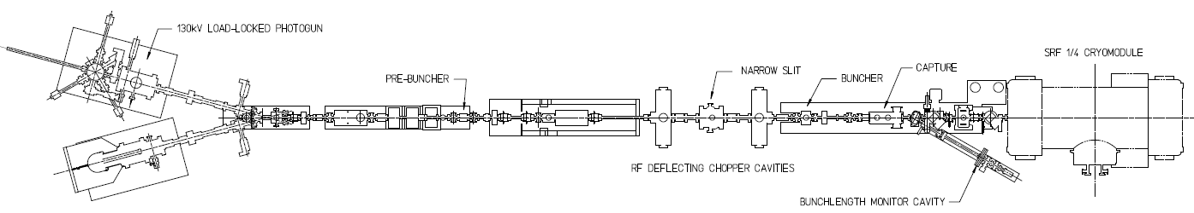
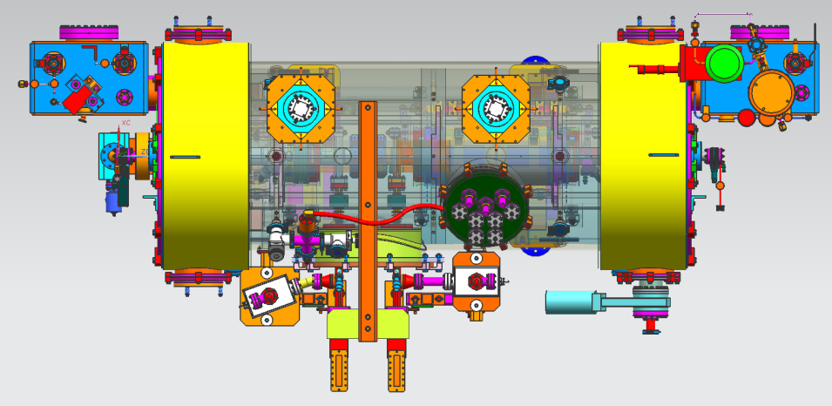
Injector Upgrade with improved design booster
200 kV
New SRF booster eliminates warm capture, RF deflection and x/y coupling!
Needs 200kV gun voltage and Wien filters: booster accepts 200keV beam!
Improve baked beam line vacuum so gun does not pump on beam line
Locate Wien filters (energy filter) upstream of pre-buncher cavity
Our new booster:
2 cell capture section + 7 cell cavity,
should provide 10 MeV beam and introduce no x/y coupling, allow better matching, more adiabatic damping

Slide 11
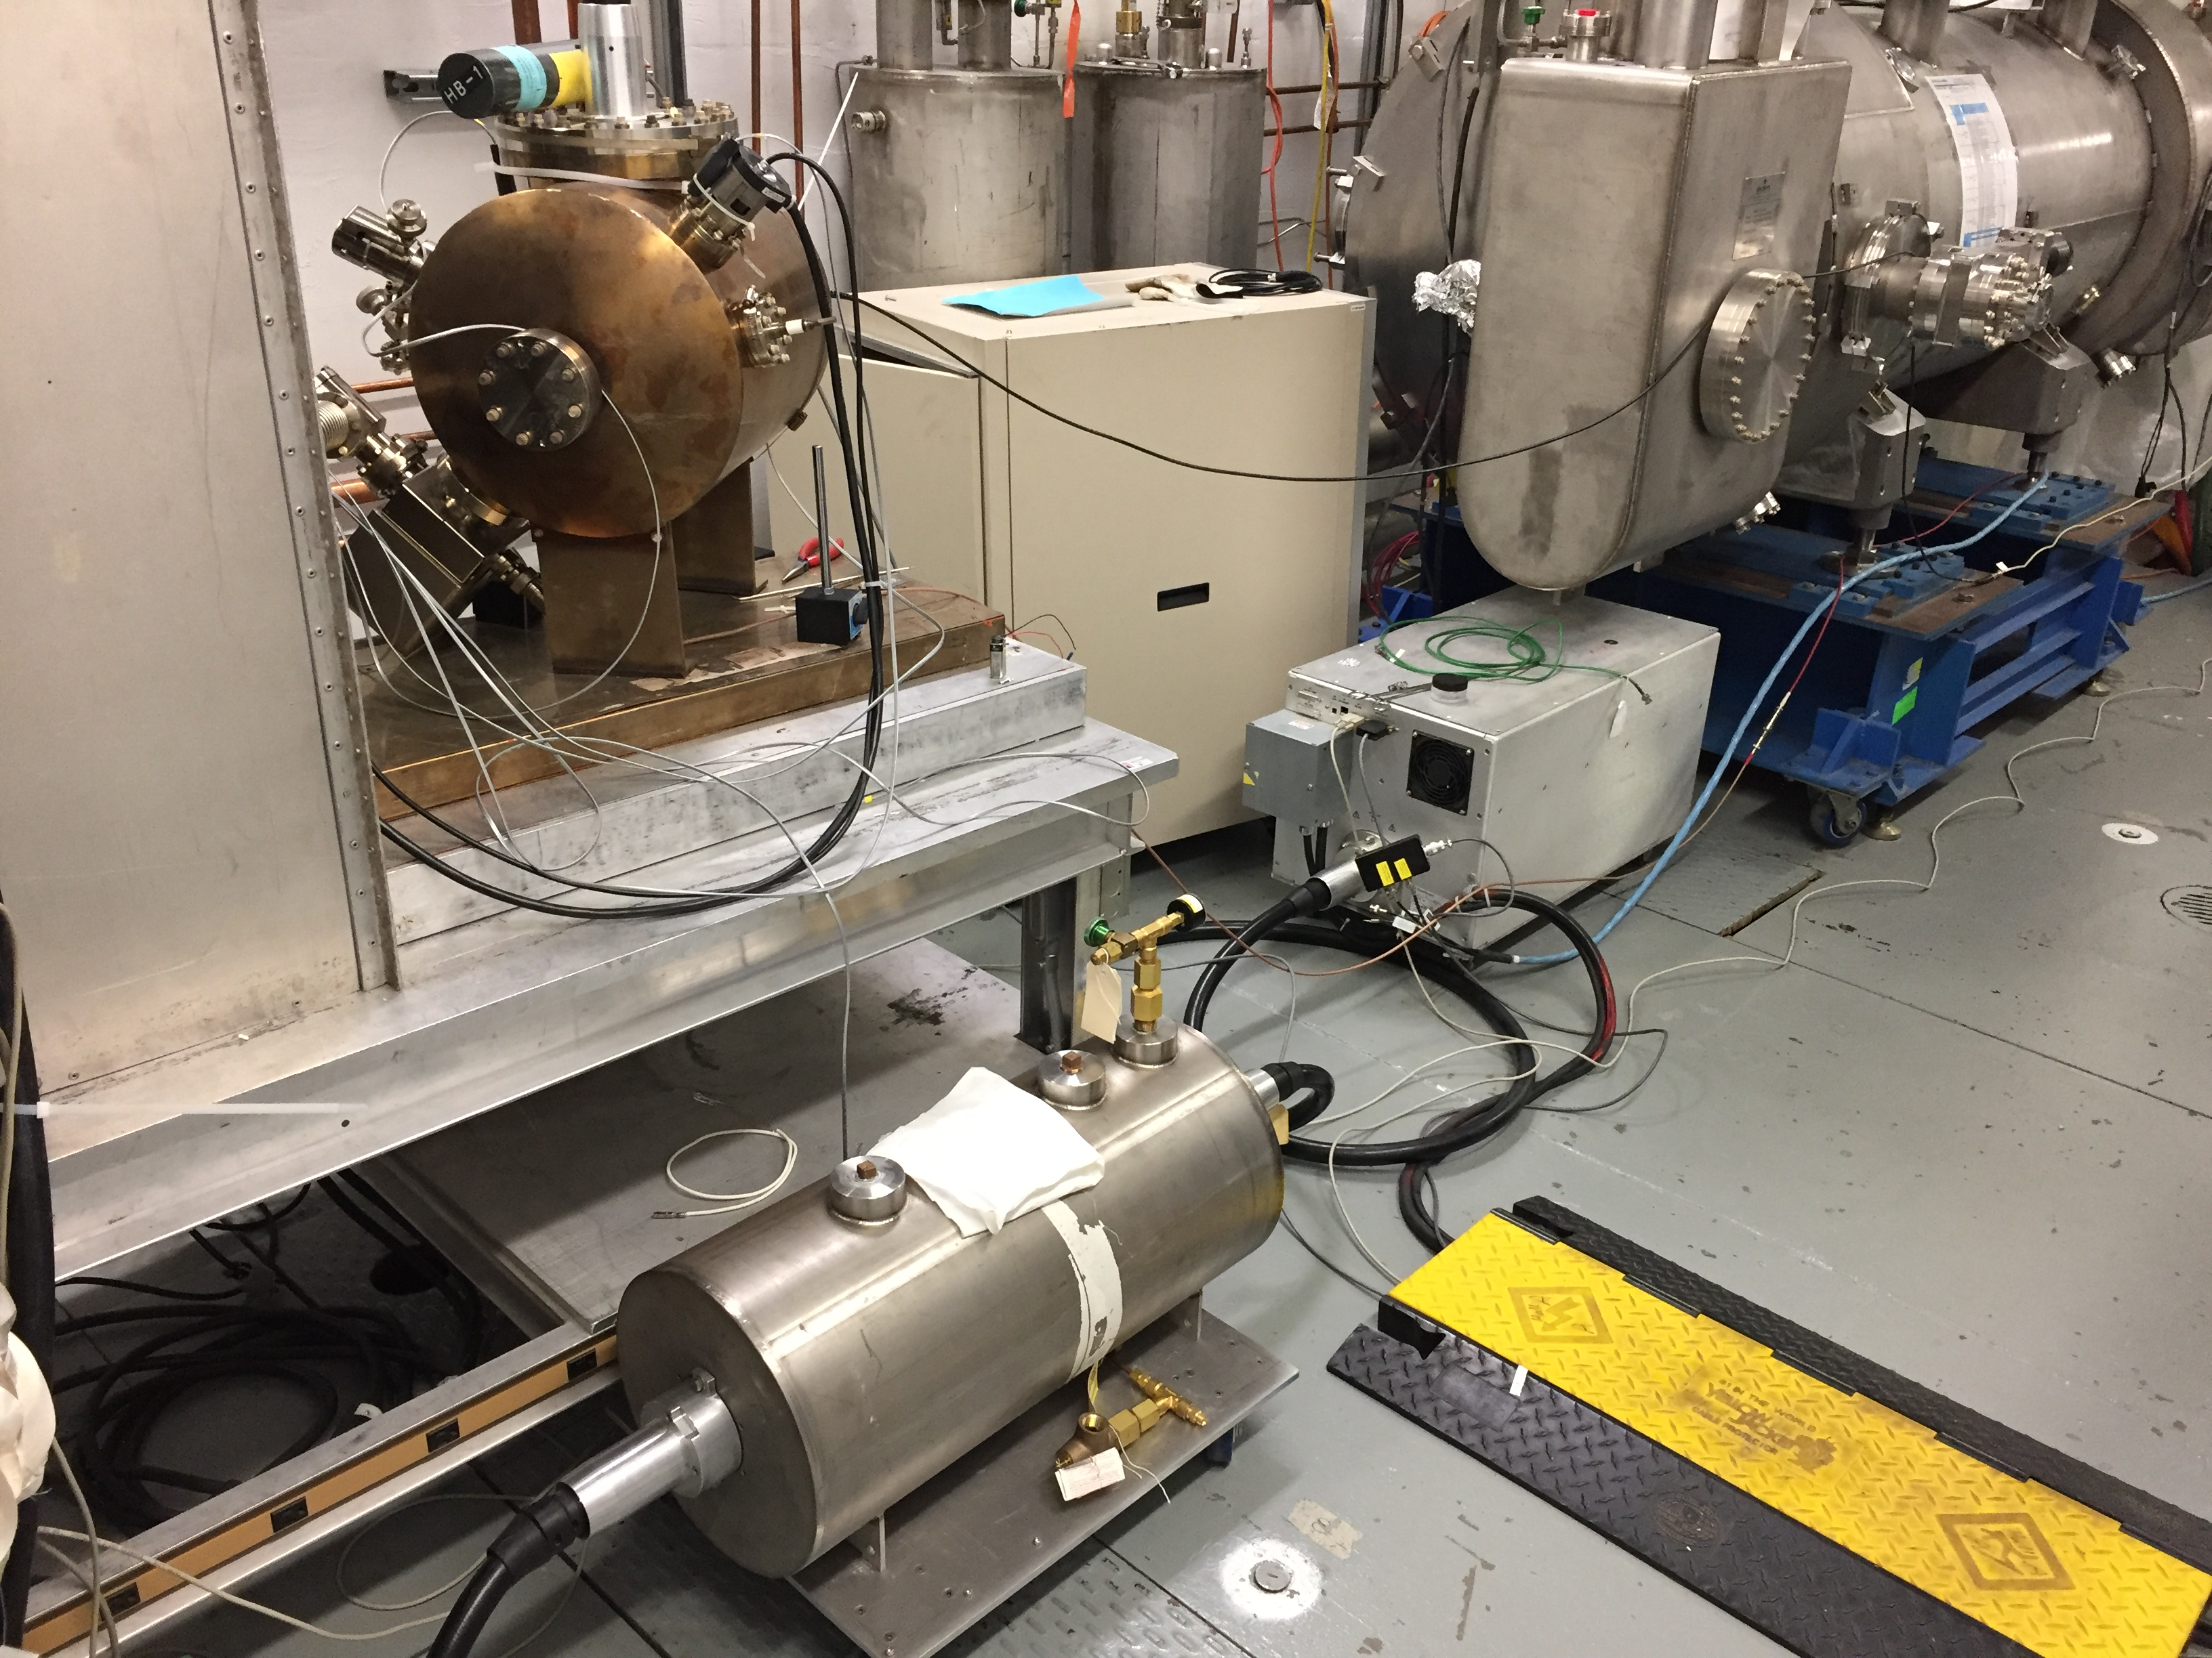
Conditioning the 200 kV gun at UITF (June 2017)
Gun assembled and baked successfully.
HV conditioned at the UITF using available with 225kV HVPS (Spellman) and SF6
Small, yet measurable on-set of field emission above 200kV – requires conditioning > 225kV to process

Slide 12
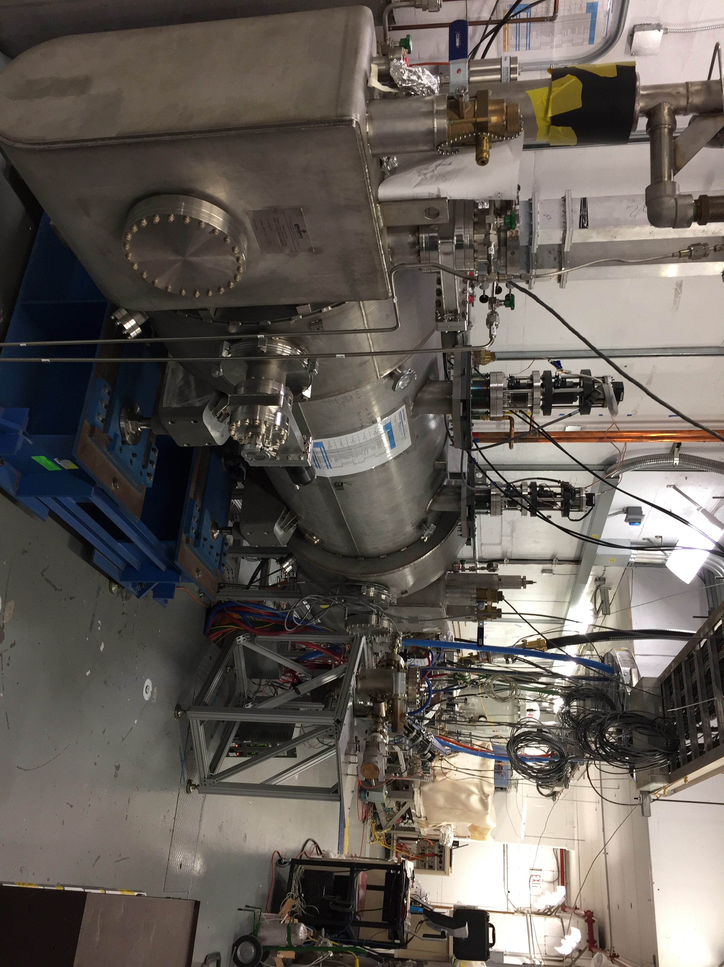
Testing CEBAF Upgrade new booster at UITF
Upgrade Cryounit Commissioning at Test Lab
  Spring 2017 – cryostat positioned at UITF
  Summer 2017 – keV vacuum beam line connected
  Winter 2018 – application of klystron power

Slide 13

Making magnetized e-beam for JLEIC High Energy Electron Cooler R&D
High Energy Electron Cooler
ion beam
Magnetization flip
ion beam
cooling solenoid (B<0)
cooling solenoid (B>0)
beam dump
linac
injector
fast extraction kicker
circulating bunches
fast injection kicker
Circulator Cooler Ring
ERL Ring
injected bunches
exchange
septum
extracted bunches
dechirper
vertical
bend
to CCR
vertical
bend
into ERL
rechirper

Slide 14
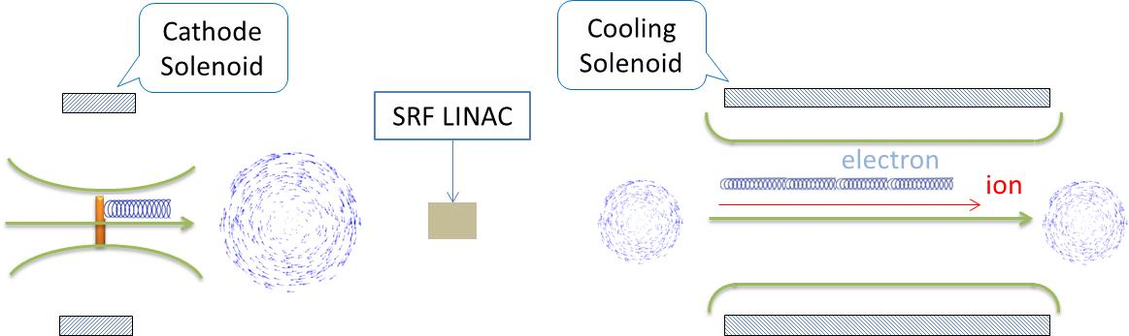
Magnetized Bunched-Beam Electron Cooling
Ion beam cooling in presence of magnetic field is much more efficient than cooling in a drift (no magnetic field):
Long cooling solenoid provides desired cooling effect:
V
B
V
B
B
V
B
V
Electrons born in strong uniform B_{z}
Upon exit of Cathode Solenoid
Upon entering Cooling Solenoid

Slide 15
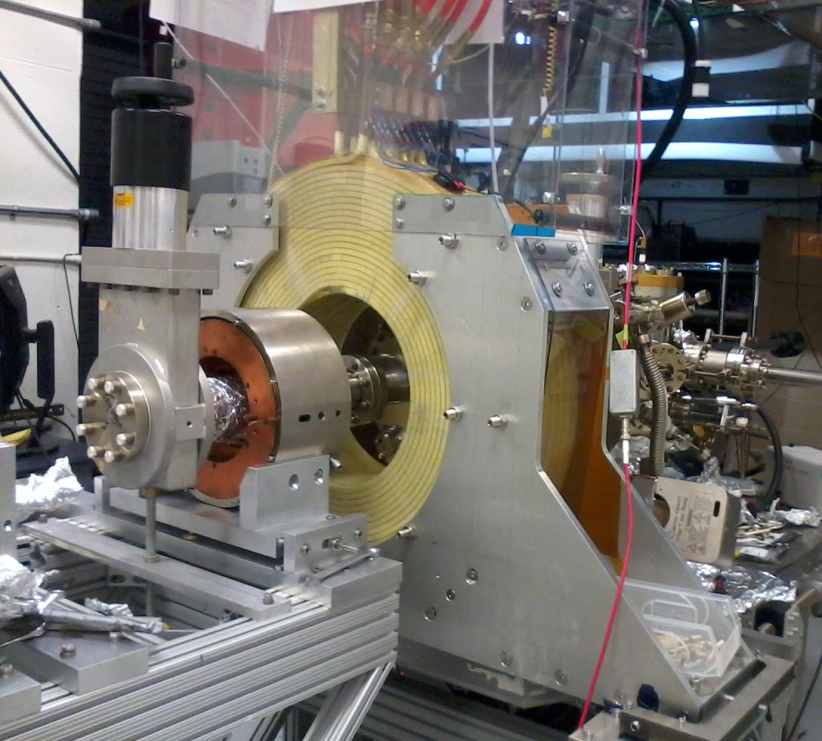
Electron beam suffers an azimuthal kick at entrance of cooling solenoid.
But this kick can be cancelled by an earlier kick at exit of photogun.
That is the purpose of cathode solenoid
Learned that gun solenoid can influence field emission
First trials with gun at high voltage and solenoid ON resulted in new field emission and vacuum activity
But we developed a procedure to energize solenoid without exciting new field emitters

Slide 16
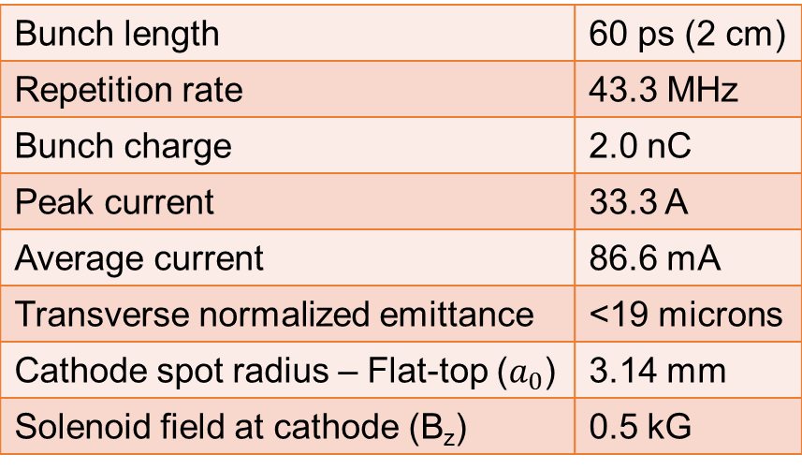
  But putting the electron beam into the cooling solenoid represents a challenge!
Bunch length | 60 ps (2 cm)
Repetition rate | 43.3 MHz
Bunch charge | 2.0 nC
Peak current | 33.3 A
Average current | 86.6 mA
Transverse normalized emittance | <19 microns
Cathode spot radius – Flat-top ($a_{0}$) | 3.14 mm
Solenoid field at cathode (B_{z}) | 0.5 kG
Cornell University demonstrated 65 mA and 2 nC, but not at same time, and non-magnetized
Fermilab Magnetized Photoinjector Laboratory:
Pulsed NCRF gun with Cs₂Te photocathode and UV laser (λ=263 nm)
Bunch charge: 0.5 nC and bunch length: 3 ps
0.5% duty factor (average current: 7.5 μA)
  Bunch frequency: 3 MHz
  Macropulse duration: 1 ms
  Number of bunches per macropulse: 3000
  Macropulse frequency: 5 Hz

Slide 17
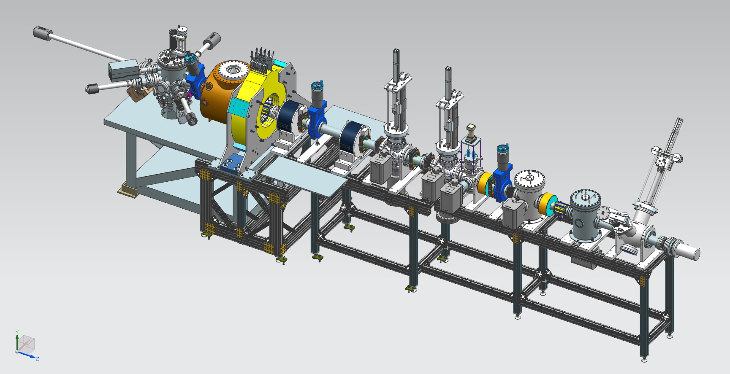
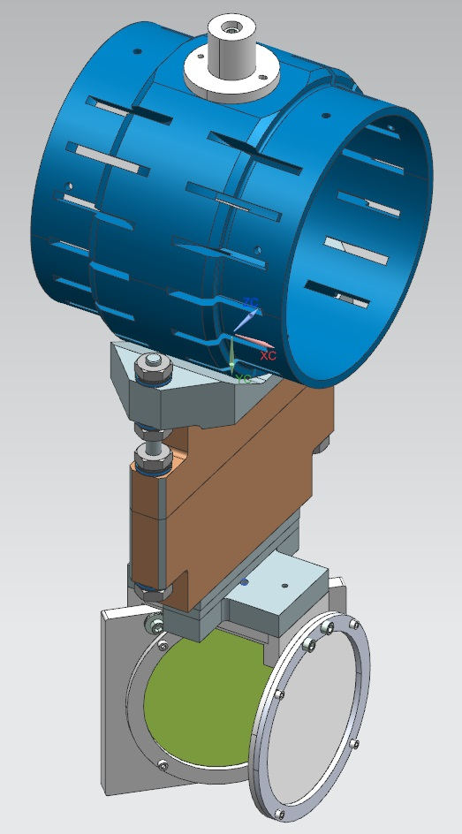
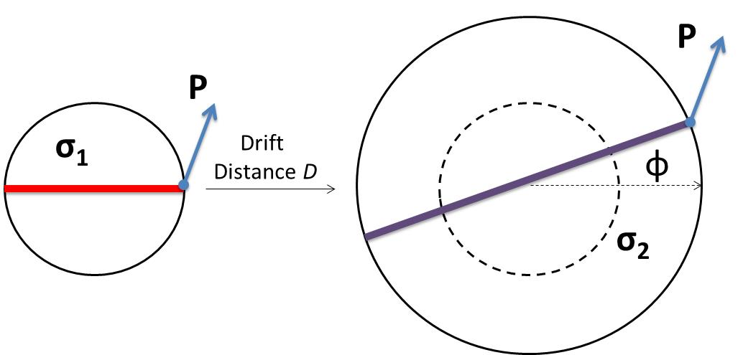
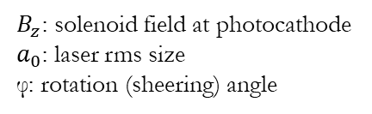
Taking on the challenge: magnetized Beam in JLab’s Gun Test Stand
Gun HV Chamber
Photocathode
Preparation
Chamber
Beamline
Gun Solenoid
Shield Tube
Viewer 3 Screen
Beam Dump
Use slit and viewscreens to measure mechanical angular momentum:
Slit
$B_{z}$: solenoid field at photocathode
$a_{0}$: laser rms size
φ: rotation (sheering) angle
Viewer Screen

Slide 18
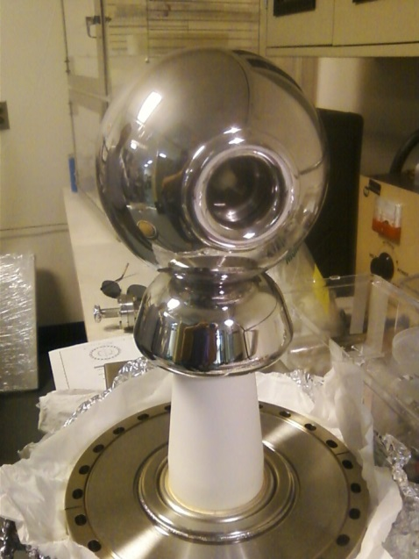
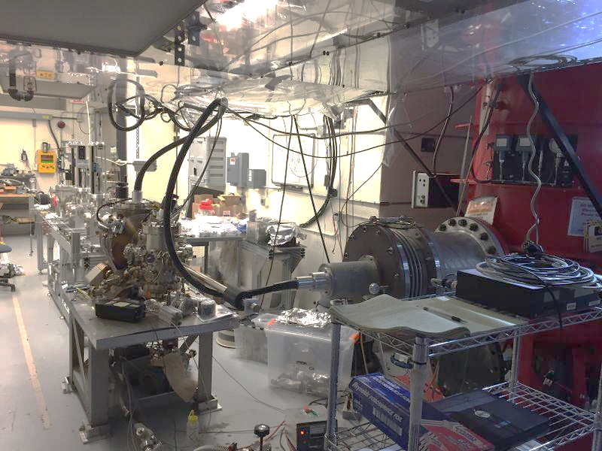
The Gun Test Stand with 300 kV Inverted Gun and CsK₂Sb Photocathode
Learning how to use the new photocathode
18
Slide 18

Slide 19
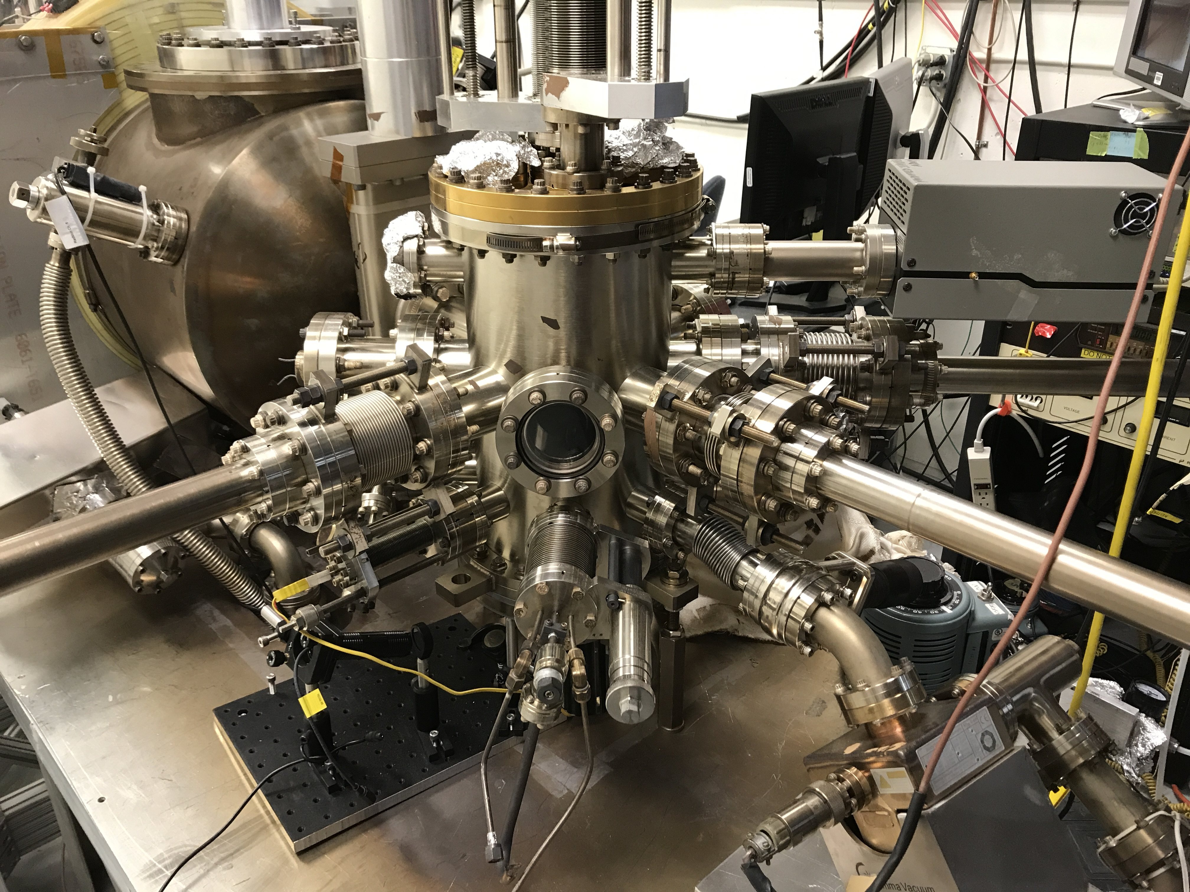
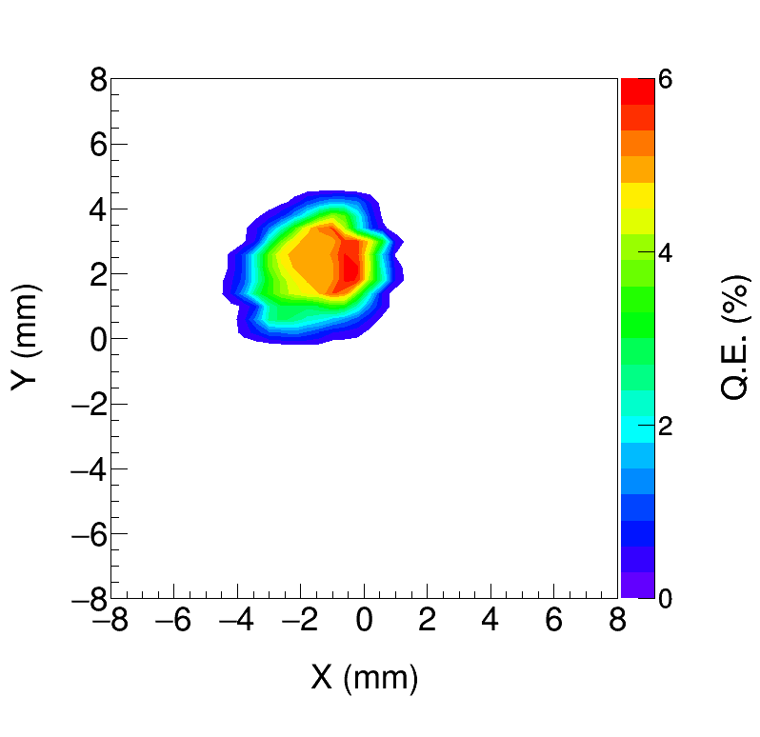
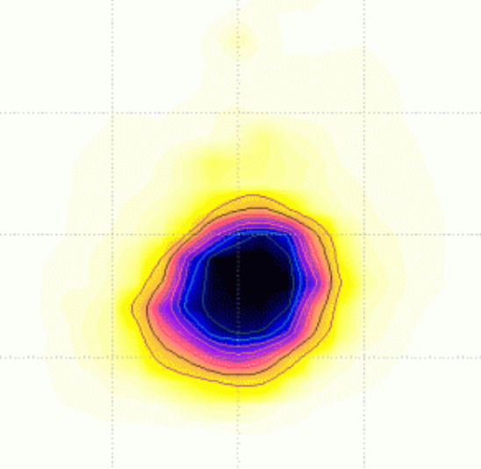
Photocathode Preparation Chamber
K₂CsSb grown with a mask – limit photocathode active area (3 mm diameter) to reduce beam halo, minimize vacuum excursions and high voltage arcing, prolong photogun operating lifetime
Active area can be offset from electrostatic center
5 mm active area available, Entire photocathode can be activated too
Consistently growing photocathodes with 5-7% QE

Slide 20
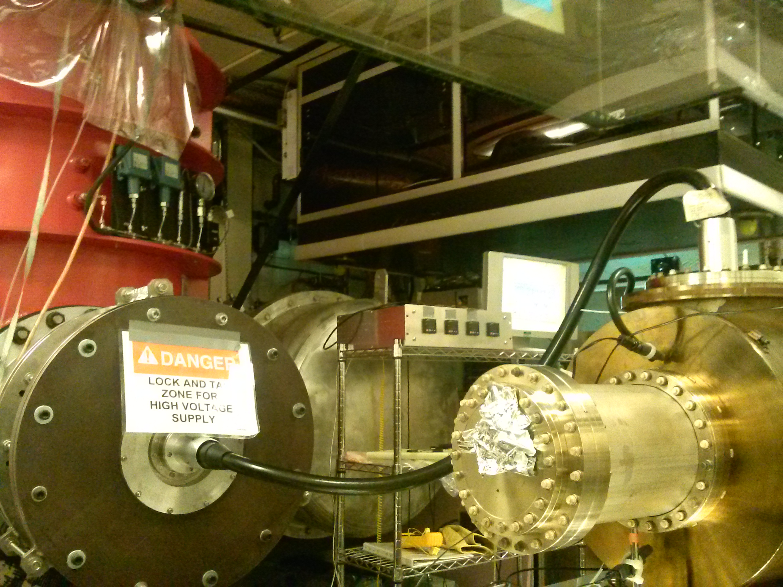
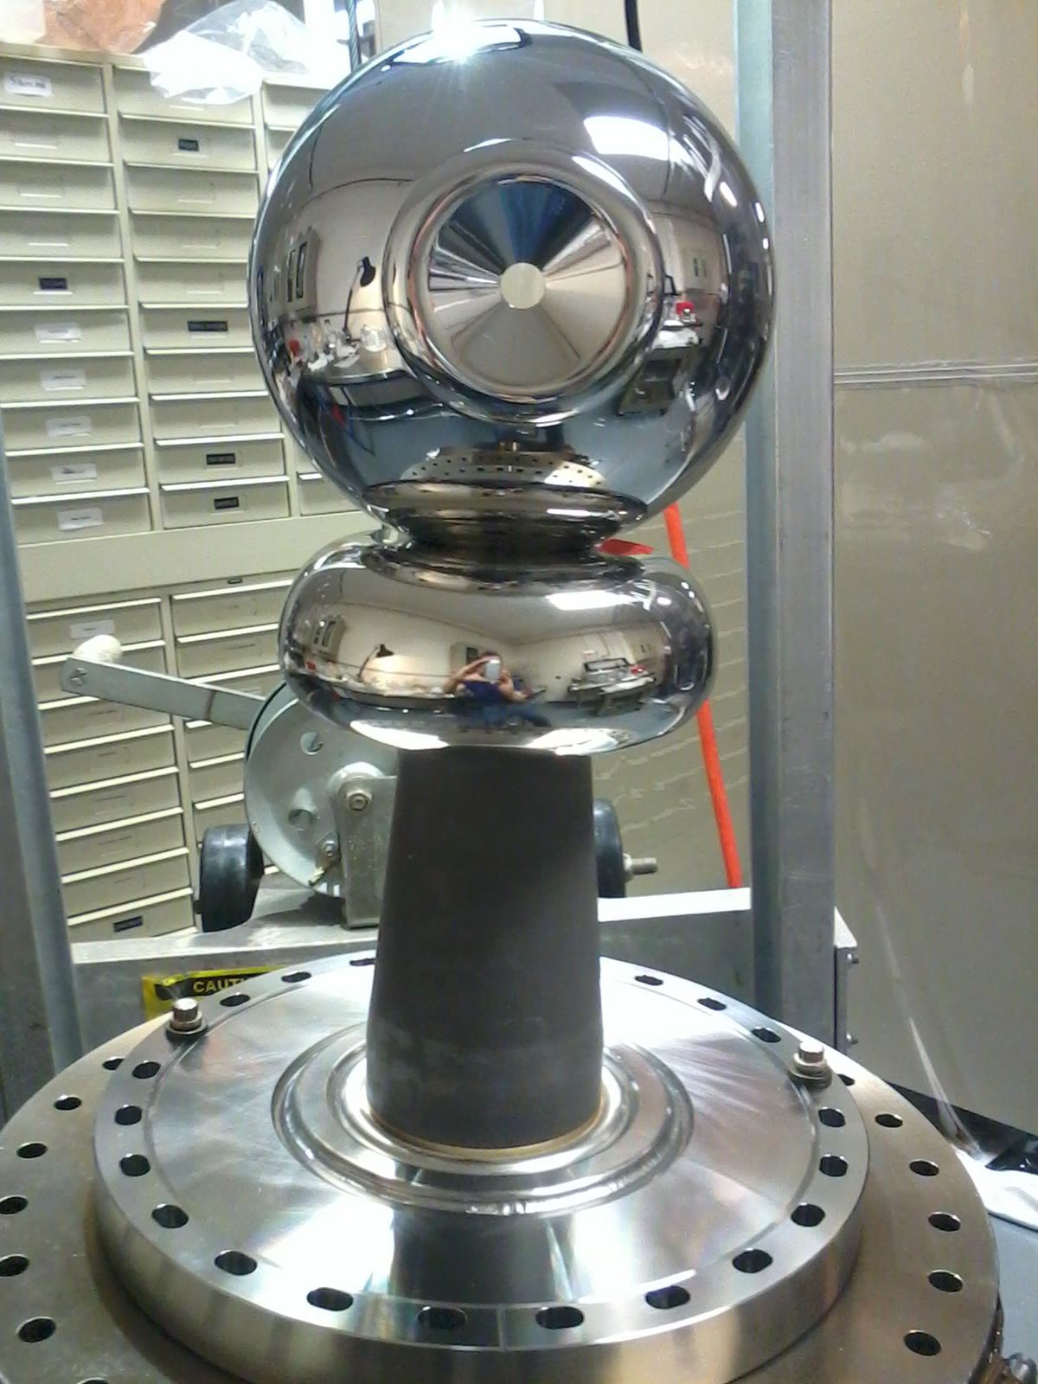
Glassman gas insulated HVPS connected to the inverted insulator gun using epoxy receptacles and 350kV to R30 cable plugs
R30 inverted ceramic & electrode
500kV 5 mA DC HVPS, SF6 at 10 psi
350kV plug, epoxy receptacle in SF6
R30 plug into gun ceramic
Notes:
Interior Page Design 2

Slide 21
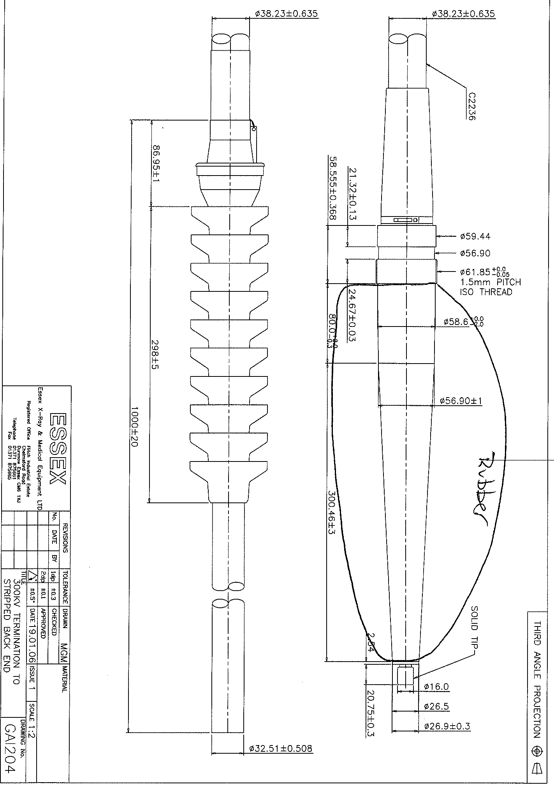
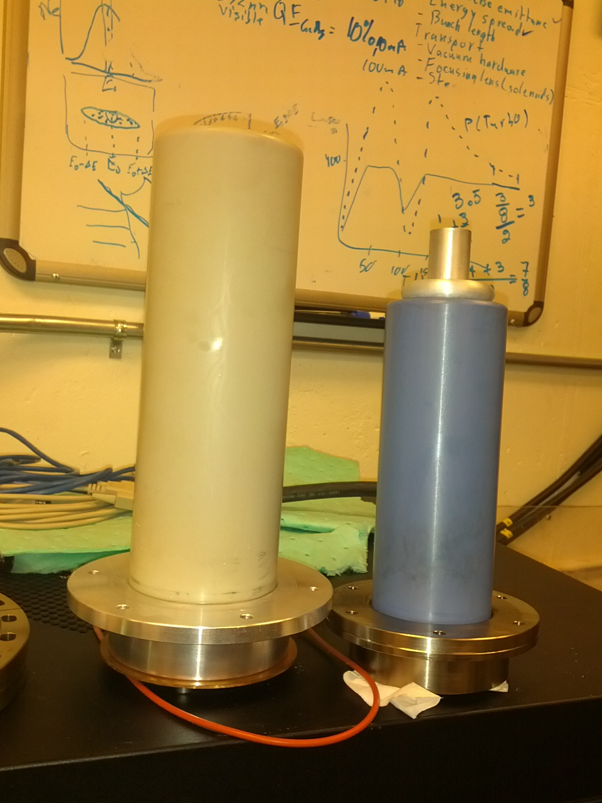
Thanks to Naimat Khan at TRIUMF: 350kV plug and epoxy receptacle from Dielectric Sciences
R30
R28

Slide 22
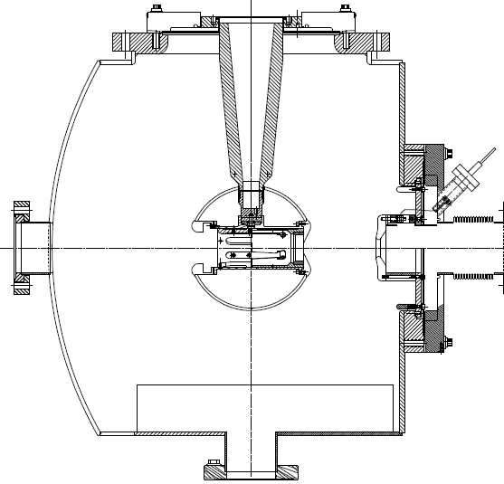
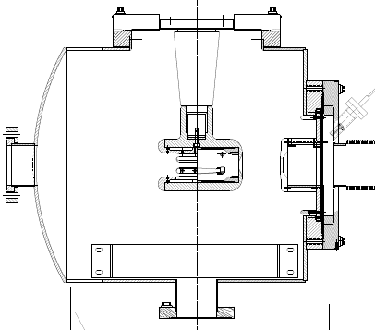
Inverted Insulator Photoguns
R30
R28
CEBAF 130 kV, used since 2010
350 kV gun for GTS and UITF
Longer “R30” insulator
Spherical electrode

Slide 23
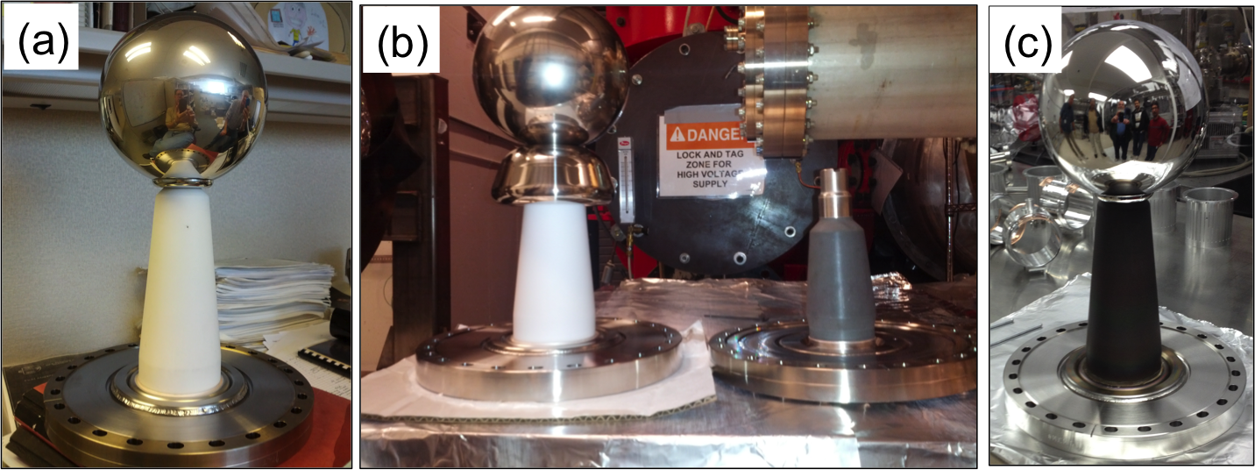
Building the 350 kV Gun
Start with “dummy” electrode (no photocathode) and test different insulators and cathode screening electrodes
R30
R28
C. Hernandez-Garcia, M. Poelker, and J. Hansknecht, “High Voltage Studies of Inverted-geometry Ceramic Insulators for a 350kV dc Polarized Electron Gun,” IEEE Transactions on Dielectrics and Electrical Insulation, Vol. 23, No. 1; February 2016

Slide 24
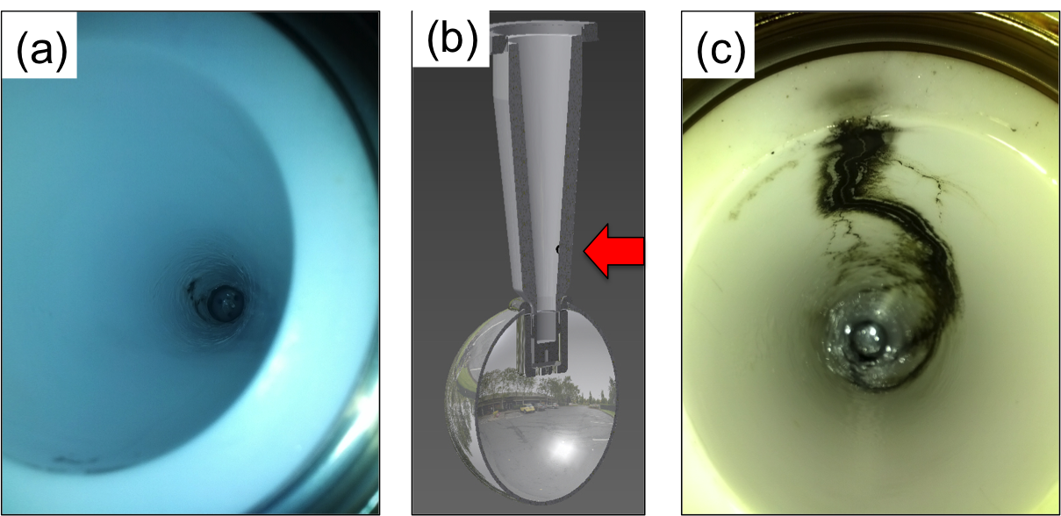
The Reality of HV Breakdown
The first test with R30 pure alumina ceramic suffered breakdown at ~315kV with subsequent puncture at 330kV.
A second test with a new R30 pure alumina suffered breakdown at ~315 kV.
Field emission managed via krypton-processing*, i.e., voltage was applied with ~10⁻⁵ Torr krypton added to gun chamber
* M. BastaniNejad, A. A. Elmustafa, E. Forman, J. Clark, S. Covert, J. Grames, J. Hansknecht, C. Hernandez-Garcia, M. Poelker and R. Suleiman, “Improving the performance of stainless-steel DC high voltage photoelectron gun cathode electrodes via gas conditioning with helium or krypton,” Nucl. Instr. and Meth. in Phys. Res. A, Vol. 762, pp. 135–141, 2014

Slide 25
Careful design of triple-junction-shield
Gradients shown for 350 kV
HV plug
Ceramic
Design overall shape for low gradient here !!
Simulationsby Y. Wang

Slide 26
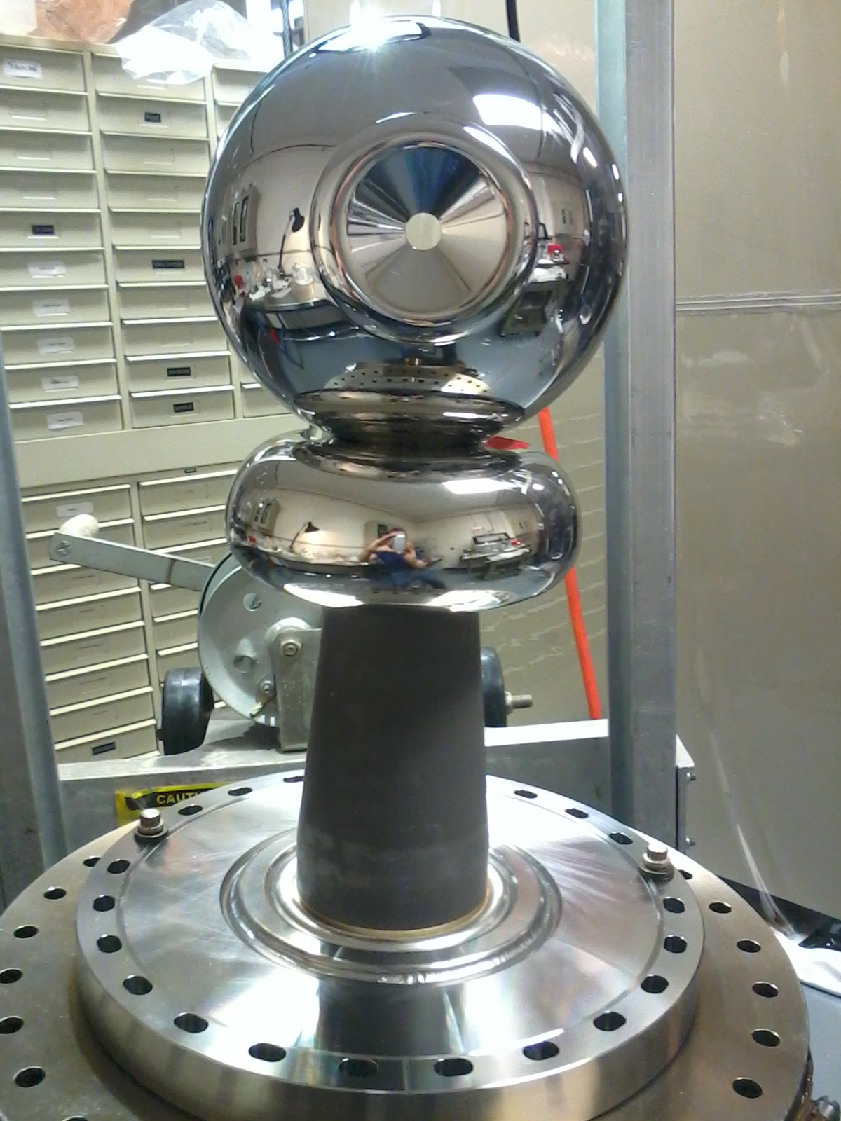
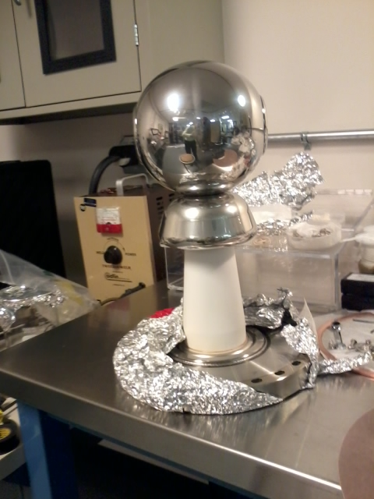
Optimizing the Electrode Design
Pure alumina insulator replaced with doped alumina (charge drainage) for higher voltage stand-off and robust operations
Electrode ‘shed’ (triple junction shield) re-designed to lower gradient from 12 MV/m to 10 MV/m at 350kV
Pure alumina insulator
Doped alumina insulator

Slide 27
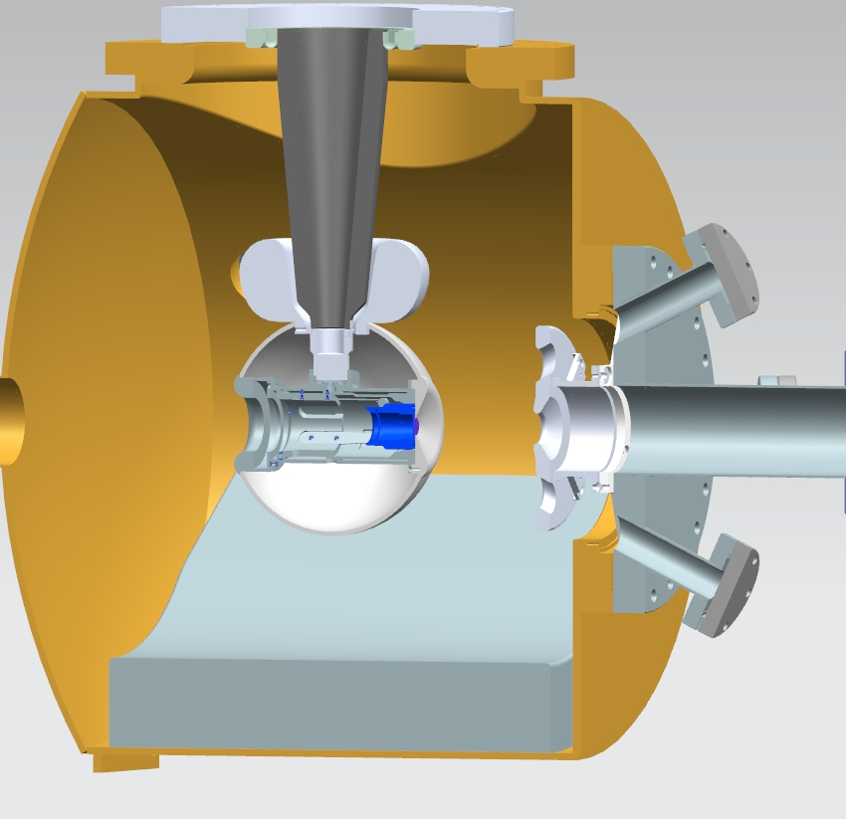
Inverted-Insulator Photoguns
with optimized triple point shields and mildly conductive insulators
MV/m
at 350kV
Insulator
Electron beam
NEG array
36 cm
COMSOL simulation done at 350kV by student G. Palacios
Both designs, maximum field strength < 10 MV/m
Notes:
Interior Page Design 2

Slide 28
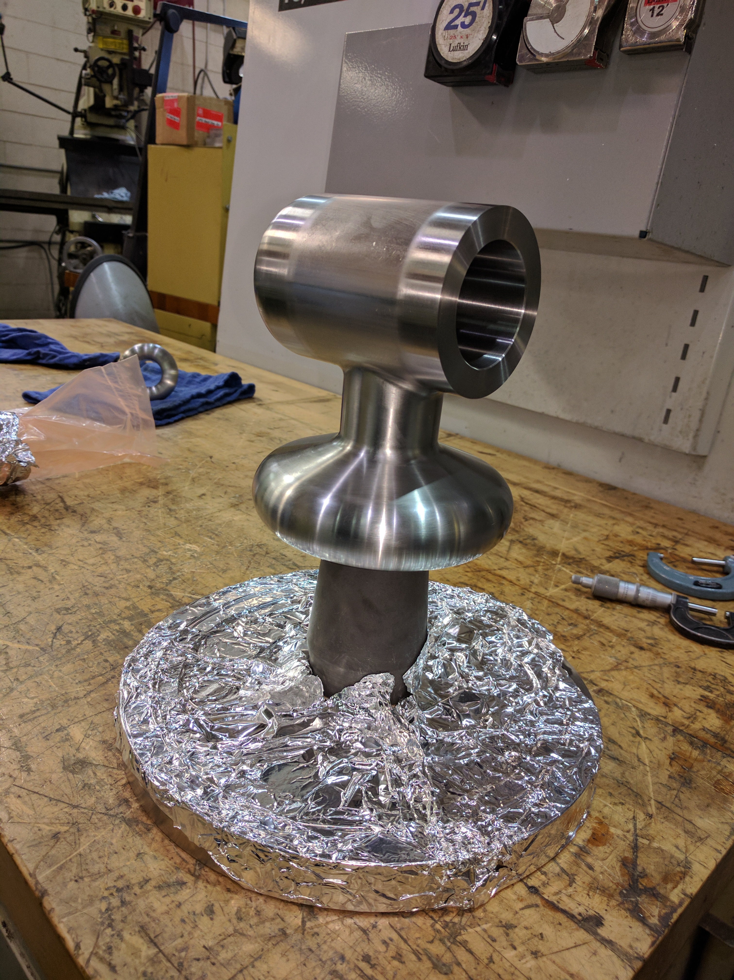

Ideal electrode geometries become Hand-Polishing Nightmare!
New CEBAF 200 kV Gun

Slide 29
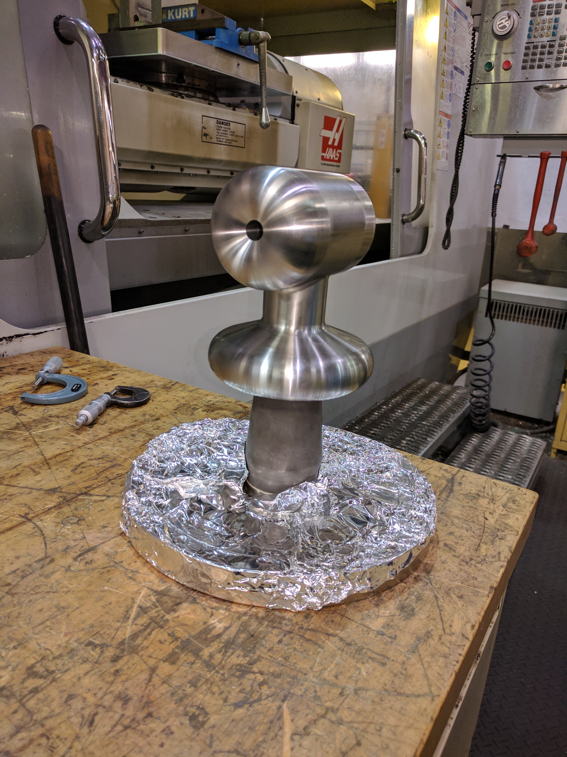
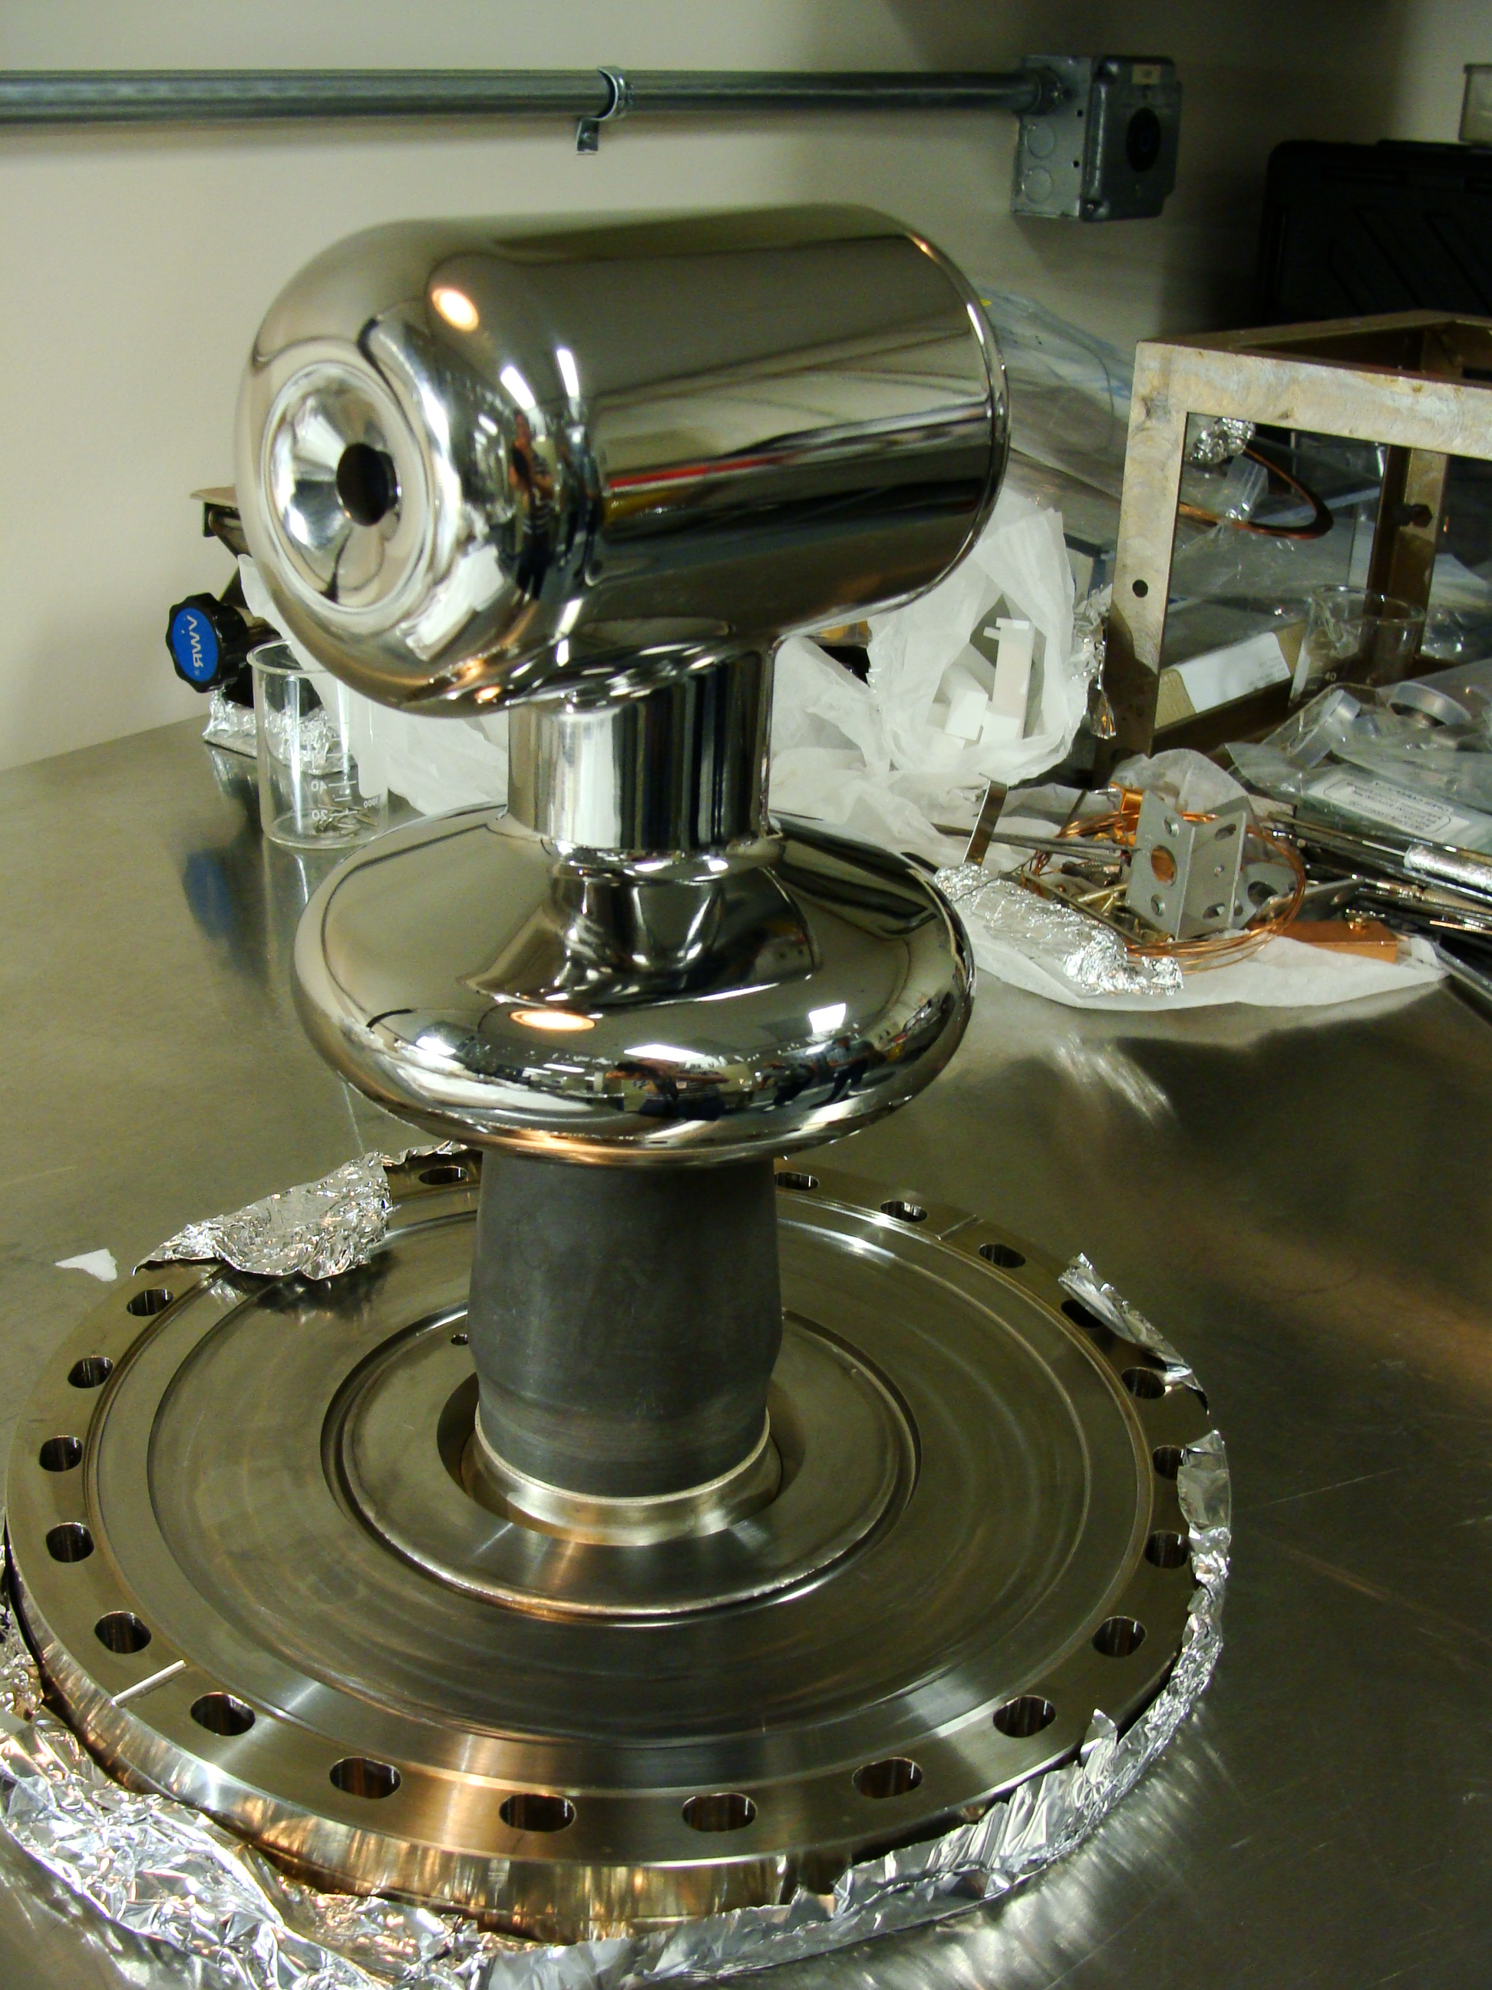
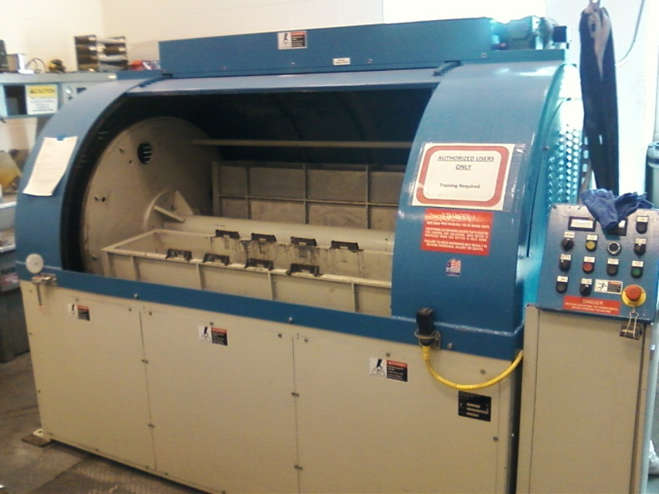
Centrifugal Barrel Polishing to Rescue
Months to hours !!!
30 min. plastic cones
30 min. crushed corncob
  From machine shop
  Barrel polishing machine at JLab SRF

Slide 30
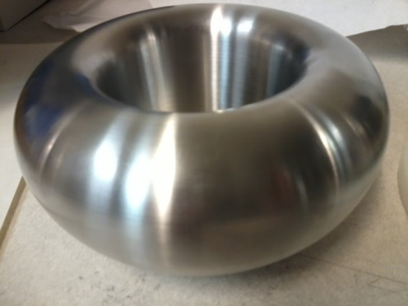
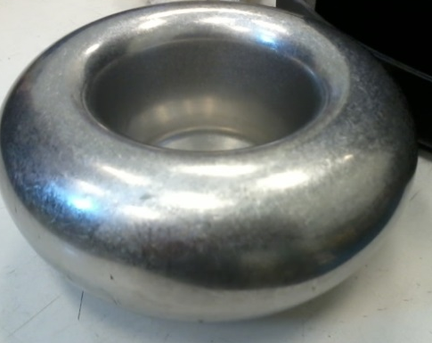
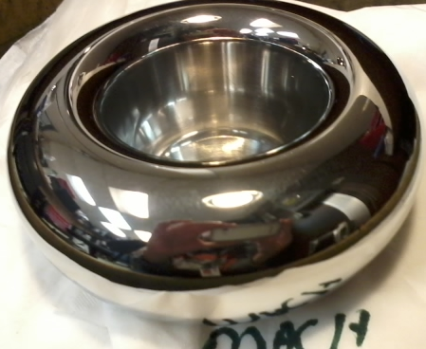
Barrel polished electrodes…
Gun electrodes traditionally polished using sand paper and diamond paste
Tedious process, takes about 30 days to complete
Now performed in 1 day using SRF barrel polishing machine
  From machine shop
30 minutes in plastic cones
30 minutes with corncob
C. Hernandez-Garcia, D. Bullard, F. Hannon, Y. Wang, and M. Poelker, “High voltage performance of a dc photoemission electron gun with centrifugal barrel-polished electrodes,” Rev. Sci. Instrum, 88, 093303 (2017)

Slide 31
Excellent Surface Finish
similar to traditional hand polishing with sand paper and diamond grit
Diamond paste polishing Ra 30 nm*
* M. BastaniNejad, A. A. Elmustafa, E. Forman, S. Covert, J. Hansknecht, C. Hernandez-Garcia, M. Poelker, L. Das, M. Kelley, P. Williams, “Evaluation of electropolished stainless steel electrodes for use in DC high voltage photoelectron guns,” J. Vac. Sci. Technol. A, Vol. 33, No. 4, Jul/Aug 2015

Slide 32
The ultimate metric of success: High Voltage!
Reached
360 kV in 70 hours
10 MV/m at 350 kV
Vacuum and radiation levels indistinguishable from bkgd at 350kV

Slide 33
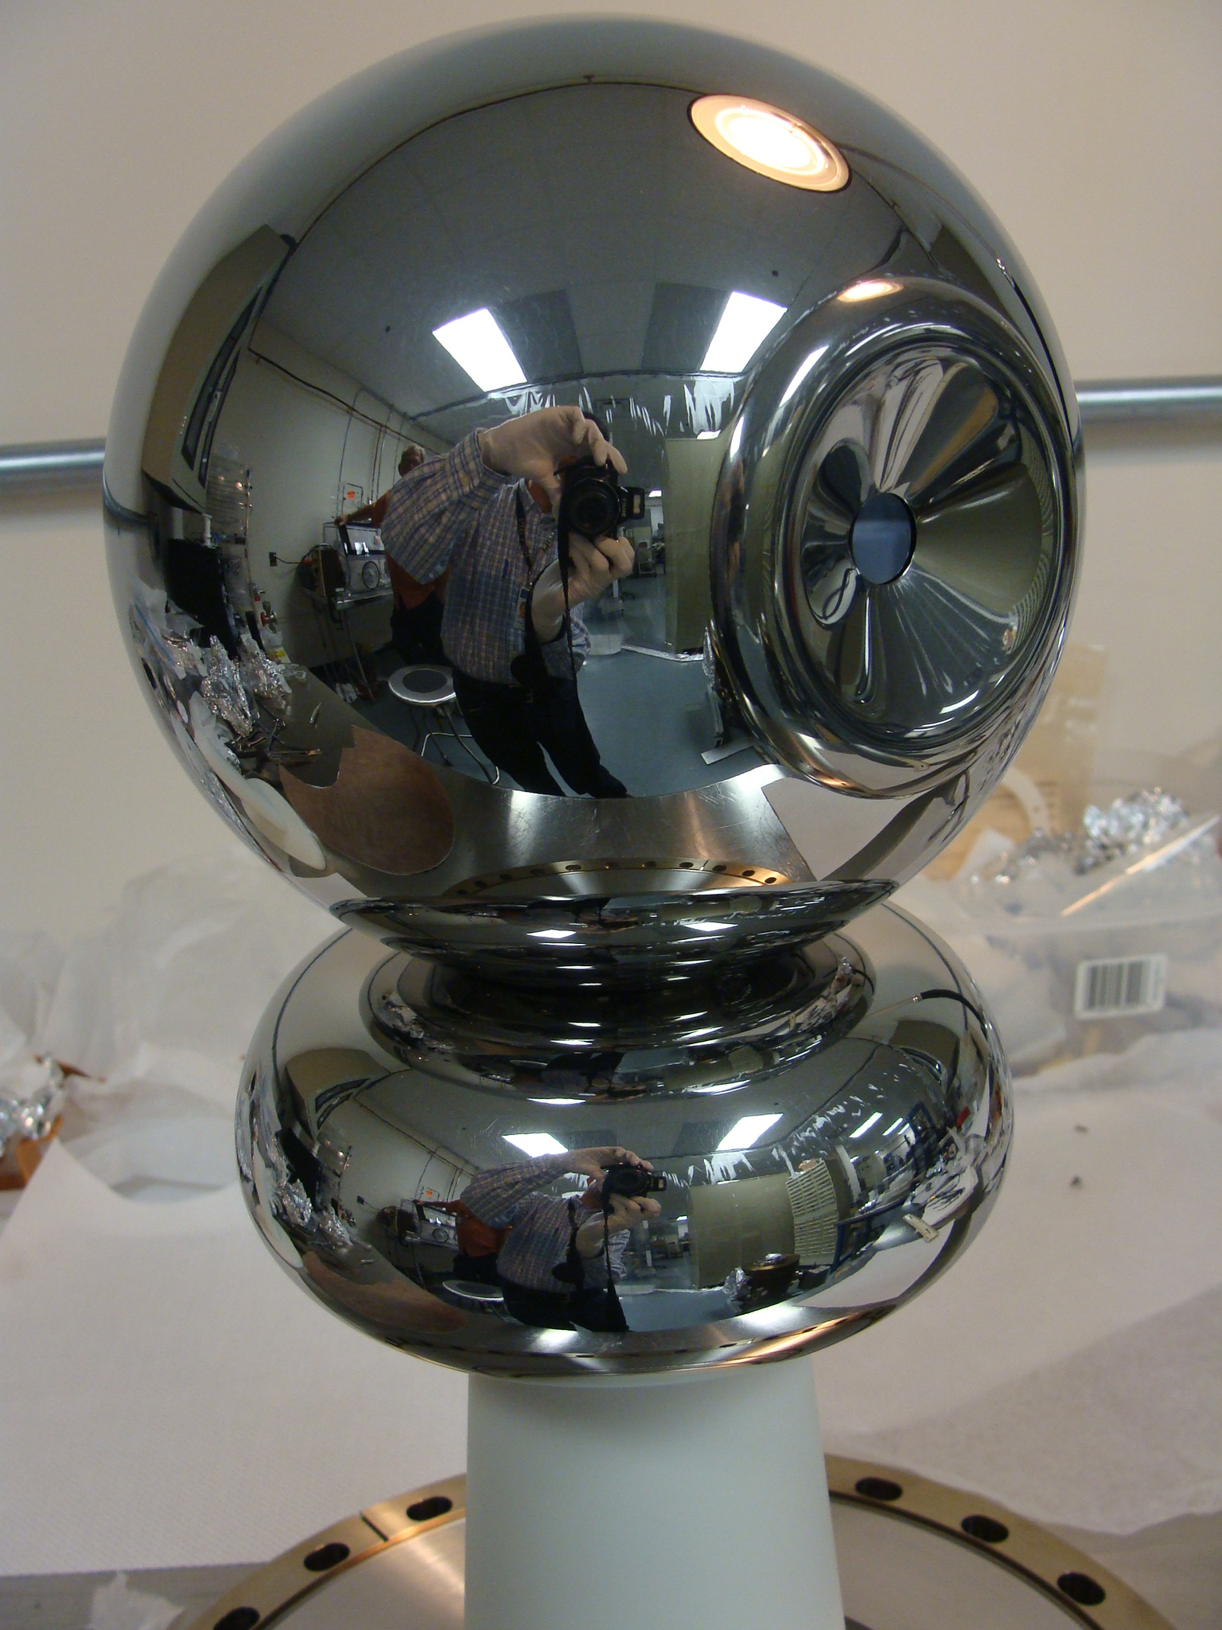
We have now 3 photoguns with barrel polished electrodes
CEBAF 200 kV
Conditioned to 216 kV,
No FE at 200kV, ready for installation
UITF 350 kV
Under assembly
GTS 350 kV
In operation since Nov. 2016 with CsK₂Sb photocathode:
4.5 mA beam! Magnetized AND non-magnetized

Slide 34
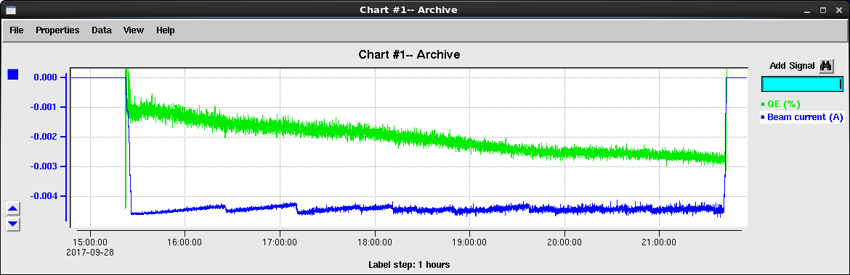
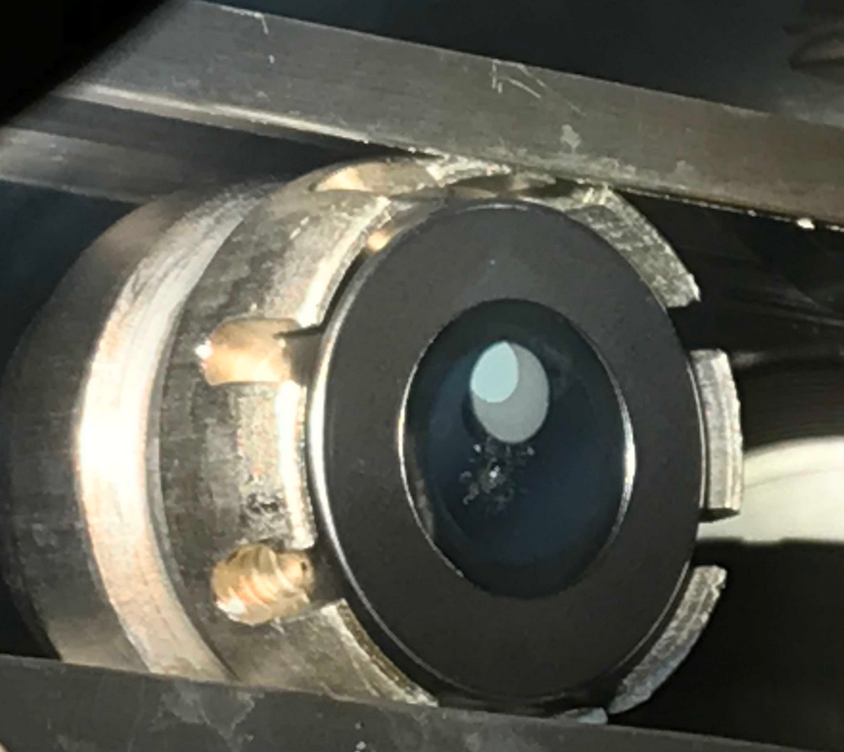
7 hour run at 4.5 mA Magnetized Beam
8% QE
Only 165 Coulomb 1/e QE lifetime
1.5 KGauss @ cathode
Delivered 4.5 mA DC magnetized beam for ~7 h, low QE lifetime.
Investigating charge lifetime factors from twenty two 1-hour long runs of 3-4.5 mA beams at 200-300 kV gun HV, and 0-400 A gun solenoid current conditions
Investigating the efficacy and necessity of installed dc ion-clearing electrodes to stop ions in beamline from reaching gun and causing HV arcs

Slide 35
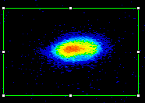
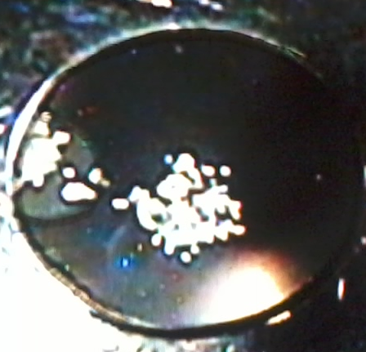
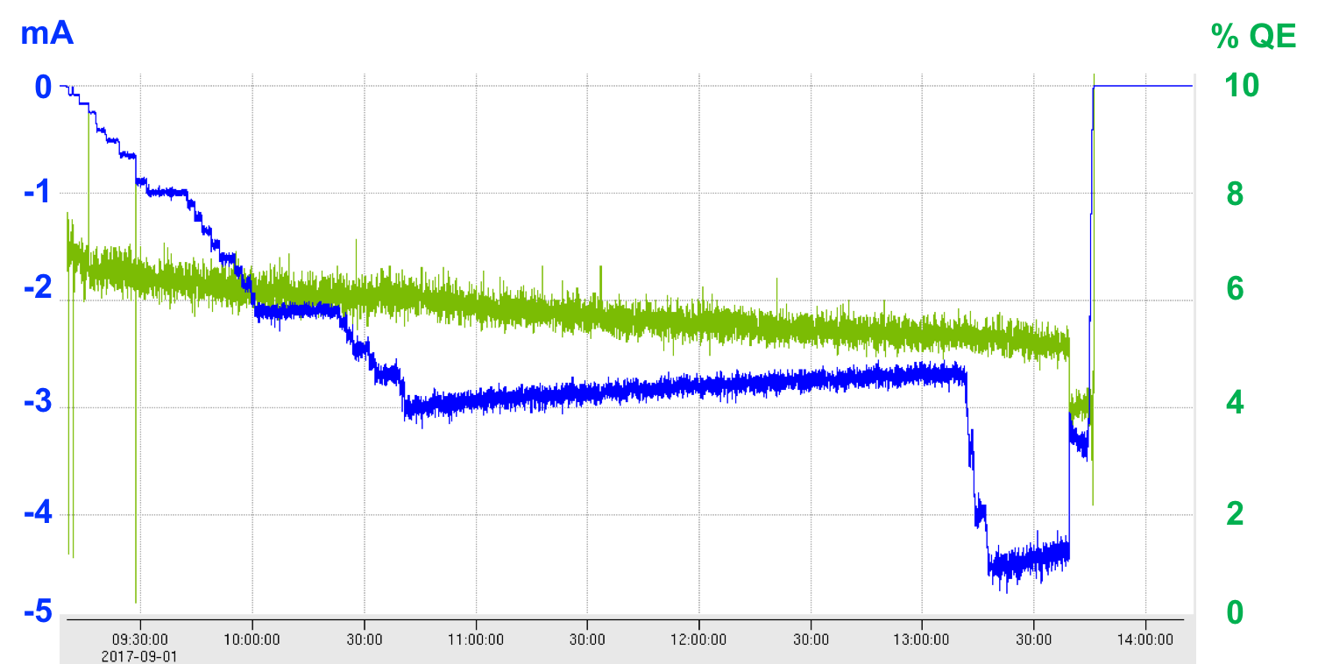
With cathode solenoid off, we observe cathode arcing!
Active area, CsKSb
Sb
Damaged
Active area
mA BEAM!
Cathode damage
Mo
puck
GaAs
Ta
Damaged
Electrostatic center
Non-magnetized beam current
Sudden QE drop
4.5mA

Slide 36

No cathode arcing with gun solenoid energized
3 mA
4% QE
Cathode solenoid current
300 A
400 A
250 A
200 A
150 A
Anode current
Anode current and ‘noise’ amplitude decrease as gun solenoid strength is increased

Slide 37
PRELIMINARY secondary ion mobility study
Work by:
Cristhian Valerio
Universidad Autonoma de Sinaloa, Mexico
Check the ion mobility
See if the ions generated outside the extraction can comeback even with solenoids running
Generate H2 ions at least 1 m away from the cathode

Slide 38




Secondary electrons in the cathode strike the anode
Ions strike the cathode with high density when solenoid is off
Yellow line: secondary electrons emitted from cathode.
RED LINE: Secondary ions returning to cathode
0 A
But magnetic field from solenoid focuses secondary electrons, allowing them to go through the anode.
Ion density at the cathode decreases when solenoid is energized
400 A
SimIon simulations by Cristhian Valerio

Slide 39
Summary
Demonstrated 4.5 mA magtentized and un-magnetized DC beam for extended periods of time, but cathode arcing needs to be resolved.
K₂CsSb Photocathode Preparation Chamber, Gun, Solenoid and Beamline are all operational
Photogun operates reliably at 300 kV with cathode solenoid
Cathode solenoid can trigger field emission but we have learned how to prevent this
Have successfully magnetized electron beam and measured rotation angle, reasonable agreement between measured and predicted but refining the simulation with GPT (3d)
Preparing to install a gain-switched drive laser, to generate mA magnetized beam with RF structure
Then switch to 32 mA 225 kV HV power supply….

Slide 40
Thanks to all those whom have done all the work
P. Adderley, J. Benesch, B. Bullard, J. Grames, F. Hannon, J. Hansknecht, M. Poelker, M. A. Mamun, R. Suleiman, M. Stutzman, G. Palacios, Y. Wang, S. Wijiethunga, J. Yoskovitz, S. Zhang, C. Valerio*
ODU Graduate Students, Postdoc
*Collaborator at U. of Sinaloa, Mexico

Slide 41
Backup Slides

Slide 42
High Polarization Photocathodes
Strained Superlattice GaAs/GaAsP
Bulk GaAs
Strained GaAs
with DBR
100 nm
100 nm
14 Layers
30 mA/W
1 mA/W
6 mA/W
30 mA/W
Testing at
CEBAF now
P_{e-} 35% 35% 75% 75% 85% 89%
I_{e-} 30μA 100μA 50μA 100μA 150μA 200μA
1995 1998 1999 2000 2004 2017
Photocathode capability (polarization and QE) has grown significantly.

Slide 43

Benefits of Distributed Bragg Reflector
non-DBR Photocathode : absorption in the GaAs/GaAsP superlattice < 5%
DBR photocathode : absorption in the GaAs/GaAsP superlattice > 20%
Enhanced absorption occurs only at specific laser wavelengths
Non-DBR photocathode
DBR photocathode

Slide 44


World Record QE from High Polarization Photocathode
Others have tried…but very difficult to obtain QE enhancement at the laser wavelength that also provides high polarization, CEBAF lasers operate at ~ 776 nm (doubled-telecom lasers)
Standard strained-superlattice
  QE = 0.89%
  Polarization = 92%
DBR
  QE = 6.4%
  Polarization = 84%
The highest reported QE of any high polarization photocathode
Excellent candidate for mA operations, will test at CEBAF this shutdown
SBIR partnership
W. Liu, S. Zhang, M. Stutzman, M. Poelker, Y. Chen, W. Lu, and A. Moy, Appl. Phys. Lett. 109, 252104 (2016)

Slide 45
Charge Lifetime of High Current Beam
Same laser spot size (0.38 mm rms)
  better lifetime at lower beam current
  Increased lifetime with lower incident laser power
With HV OFF: No QE drop from 22 h illumination at 0.8 W (required for 4.5 mA runs), even at 2 W for 2 h.
Laser spot size↑ and QE↑ ═ LT↑

Slide 46
Charge Lifetime of High Current Beam
No apparent Lifetime dependency on gun HV, magnetization effect, or run sequence
Only 3 incidents of QE drop due to arcing, and this happened only with non-magnetized beam
Strong focusing of gun solenoid might help keep ions away from e-beam

Slide 47

Measuring Electron Beam Magnetization
Use slit and viewscreens to measure mechanical angular momentum:
$B_{z}$: solenoid field at photocathode
$a_{0}$: laser rms size
φ: rotation (sheering) angle

Slide 48






Slit and Viewscreen Measurement
0 G at photocathode
Beamlet observed on downstream viewer
1511 G at photocathode

Slide 49
Gun Solenoid
Size | 11.811" ID, 27.559" OD, 6.242" Z
Conductor | L=500 m, A=0.53 cm² 16 layers by 20 turns
Coil Weight | 254 kg (560 lbs)
Resistance | 0.198 Ω
Field at Photocathode | 1.5 kG
Voltage | 79 V
Current | 400 A
Using spare CEBAF Dogleg magnet power supply (500 A, 80 V)
Learned that gun solenoid can influence field emission
First trials with gun at high voltage and solenoid ON resulted in new field emission and vacuum activity
Procedure to energize solenoid without exciting new field emitters

Slide 50



New Steel Photocathode Holders
Molybdenum
Steel
New steel holders (pucks) to enhance field to 2.0 kG at photocathode. Two types:
  Molybdenum and carbon steel hybrid puck
  Carbon steel puck
Steel

Slide 51

Classic voltage induced gas desorption
With every 1 kV increase, gas (mainly Hydrogen) is released from the chamber walls and accelerated by the potential towards the electrode. Upon impact, secondary electrons are released and accelerated to the chamber walls, releasing more gas. The process acts as a plasma, inducing pressure rise and x-rays detected by Geiger-Muller tubes. Since pumping is provided by NEG modules, the cascade process decays in a few minutes.

Slide 52

The # of secondary electrons striking the anode decreases with solenoid strength
200 A
The anode register a negative current during operation
It decrease as the big solenoid increase its strength
400 A

Slide 53

Secondary electrons in the cathode
Shifting the beam from the center helps to spread the ion back bombardment in the cathode

Slide 54

Cathode ion Back bombardment
Beam shift 2mm
Solenoid on
Beam center

Slide 55
Anode current in the anode
The current intensity need to be set correctly but the trends will be the same

Slide 56
Photocathode Preparation
Co-deposition of alkalis (K and Cs) on Sb layer using an effusion alkali source to grow bialkali photocathode
Deposition chamber was initially baked at 200 °C for >180 h
Vacuum with NEG pumps and an ion pump, Vacuum ~ 10⁻¹¹ Torr
Sb (99.9999%) , K (99.95%), and Cs (99.9+%)
Working distance: 2 cm, -280 V bias, low power (4 mW) laser (532 nm) and wavelength tunable light source
Substrate temperatures: 120 °C (for Sb), dropping from 120 °C to 80 °C (for alkalis)
Sb heater current supply from 25 A
Temperature kept stable at effusion source and adjusted to control alkali evaporation rate: hot air inlet tube (381-462 ° C), dispensing tube (232 -294 ° C), and reservoir tube (153 -281 ° C)
Chamber pressure: during bialkali deposition, > 1x10⁻⁸ Torr and post-deposition to ~10⁻⁹-10⁻¹⁰ Torr quickly
H₂O partial pressure < 2x10⁻¹¹ Torr

Slide 57
New Photoguns for…
CEBAF Injector Full-Energy Upgrade
  Replace 130 kV gun with 200 kV gun
Upgraded Injector Test Facility
  Commission new hardware destined for CEBAF: 200kV gun, HDIce, new quarter cryomodule, etc.,
  R&D: polarized positron source, Bubble Chamber astrophysics experiment, produce polarized targets for physics, etc.,
JLab Electron Ion Collider
  Higher voltage polarized gun for higher bunch charge
  Very high average current un-polarized beams for cooling ions – magnetized cooling
LERF/FEL
  Replace vent/bake gun with load locked gun
  Use alkali-antimonide photocathode instead of GaAs
Notes:
Interior Page Design 2

Slide 58


Upgraded Injector Test Facility - UITF
TEST HDIce
TEST NEW PHOTOGUNS
TEST 200 kV WIEN FILTER
COMMISSION NEW QUARTER CRYOMODULE
UITF beamline has BPMs, pockels cell tests can happen here…..
58

