Slide 1
Spin Precession in GPT
Spin precession equation in GPT with SI units
Joe Grames and Riad Suleiman

Slide 2
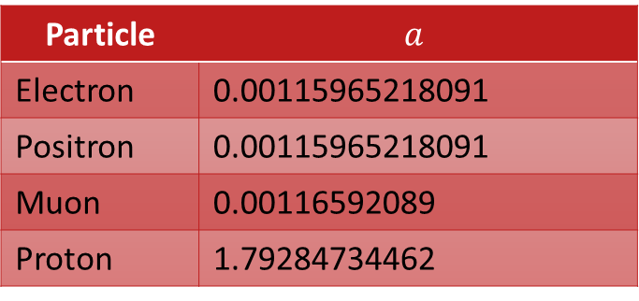
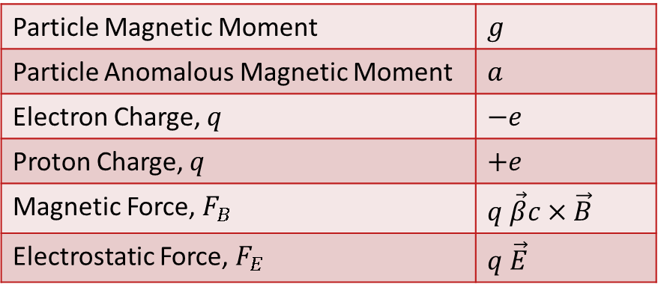
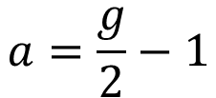
Constants and Units – International System of Units (SI)
$$a=\frac{g}{2}−1$$
Particle Magnetic Moment | $$g$$
Particle Anomalous Magnetic Moment | $$a$$
Electron Charge, $q$ | $$−e$$
Proton Charge, $q$ | $$+e$$
Magnetic Force, $F_{B}$ | $$q \vec{β}c×\vec{B}$$
Electrostatic Force, $F_{E}$ | $$q \vec{E}$$
Particle | $$a$$
Electron | 0.00115965218091
Positron | 0.00115965218091
Muon | 0.00116592089
Proton | 1.79284734462
c = 299792458.0 Speed of Light (m/s)
e = 1.602176e-19 Unit Charge (C)
mec2 = 510998.950 Electron Mass (eV)
e/me = 1.758820088e+11 Electron Cyclotron Frequency/Field ( rad/(s T)
E Electric Field Strength (V/m or N/C)
B Magnetic Field (T or N⋅s/(C m))

Slide 3

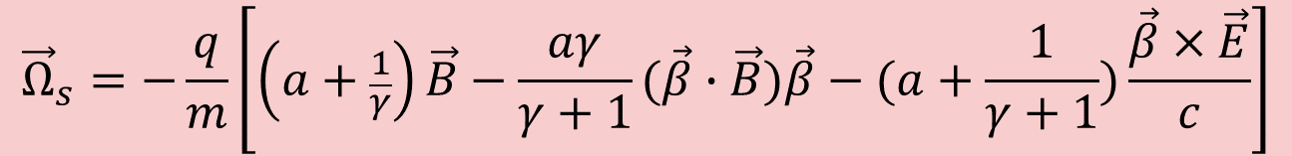
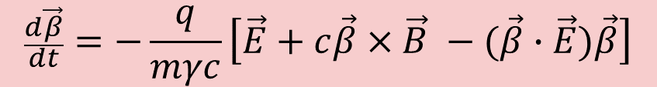
T-BMT Spin Equation in Lab Frame
Generalized Thomas-BMT equation in Lab Frame:
$$\frac{d\vec{S}}{dt}={\vec{Ω}}_{s}×\vec{S}$$
Same as Jackson’s Equation 11.170, p. 559
(Note: Jackson’s is in cgs units)
$${\vec{Ω}}_{s}=−\frac{q}{m}\left[\left(a+\frac{1}{γ}\right)\vec{B}−\frac{aγ}{γ+1}(\vec{β}∙\vec{B})\vec{β}−(a+\frac{1}{γ+1})\frac{\vec{β}×\vec{E}}{c}\right]$$
$$\frac{d\vec{β}}{dt}=−\frac{q}{mγc}\left[\vec{E}+c\vec{β}×\vec{B} −(\vec{β}∙\vec{E})\vec{β}\right]$$
Comparison of Spin Dynamics in the Cylindrical and Frenet–Serret Coordinate Systems
A. J. Silenko
https://link.springer.com/article/10.1134/S1547477115010197

Slide 4
Lab Frame BMT Spin Equation in GPT
const double g = 2.00231930436256 ;
const double go2m1 = g/2.0-1.0 ;
const double GoGp1 = G / (G+1.0) ;
double fB = go2 m1 + 1.0/G ;
double fBr = -go2m1 * GoGp1 * gptVECINP(Br,B) ;
double fxE = -(go2m1+GoGp1)/gpt_c ;
double t[3] ;
t[0] = fB*B[0] + fBr*Br[0] + fxE*(Br[1]*E[2] - Br[2]*E[1]) ;
t[1] = fB*B[1] + fBr*Br[1] + fxE*(Br[2]*E[0] - Br[0]*E[2]) ;
t[2] = fB*B[2] + fBr*Br[2] + fxE*(Br[0]*E[1] - Br[1]*E[0]) ;
const double *s = &x[par->odeoff+6] ;
const double fac = par->q / par->m ;
p[par->odeoff+6] = fac * (s[1]*t[2]-s[2]*t[1]) ;
p[par->odeoff+7] = fac * (s[2]*t[0]-s[0]*t[2]) ;
p[par->odeoff+8] = fac * (s[0]*t[1]-s[1]*t[0]) ;

