Slide 1
Simultaneous Beam Delivery with Parity Quality Beam
KLF Phase I ERR
Accelerator Parity-Quality-Beam Liaison: Riad Suleiman
Riad Suleiman
August 02, 2023

Slide 2
Outline
MOLLER Experiment
Co-operation of KLF with MOLLER:
Photocathode Effects
Injector Optimization
Sub-harmonic Beam Loading in Cavities
KLF Laser Status
Schedule and Summary

Slide 3
Parity-Violating Experiments at CEBAF
PV Experiment | Energy (GeV) | Pol (%) | I (µA) | Target | A_{pv} (ppb) | Charge Asym (ppb) | Position Diff (nm) | Angle Diff (nrad) | Size Asym(δσ/σ)
HAPPEx-I 1998 – 1999 | 3.3 | 38.8 68.8 | 100 40 | ¹H (15 cm) | 15,050 | 200 | 12 | 3 | <10⁻³
G0-Forward 2003 – 2004 | 3.0 | 73.7 | 40 | ¹H (20 cm) | 3,000-40,000 | 300±300 | 7±4 | 3±1 | <10⁻³
HAPPEx-II 2004 – 2005 | 3.03 | 87.1 | 55 | ¹H, ⁴He (20 cm) | 1,580 | 400 | 2 | 0.25 | <10⁻³
G0-Backward 2006 – 2007 | 0.359, 0.688 | 85.8 | 60 | ¹H, ²H (20 cm) | 9,700-37,400 | -30±300 | 47±9 | 1.2±0.5 | <10⁻³
HAPPEx-III 2009 | 3.484 | 89.4 | 100 | ¹H (25 cm) | 23,800 | 200±10 | 3 | 0.5±0.1 | <10⁻³
PVDIS 2009 | 6.067 | 89.0 | 105 | ²H (20 cm) | 60,000-160,000 | 100 | 100 | 40 | <10⁻³
PREx-I 2010 | 1.056 | 89.2 | 70 | ²⁰⁸Pb (0.5 mm) | 657±60 | 85±1 | 4 | 1 | <10⁻⁴
QWeak 2010 – 2012 | 1.162 | 88.7 | 180 | ¹H (34 cm) | 226.5±9.3 | 20.5±1.7 | -4.6±0.2 | -0.07±0.01 | <10⁻⁴
PREx-II 2019 | 0.953 | 89.7 | 70 | ²⁰⁸Pb (0.5 mm) | 550±18 | 20.7±0.2 | 2.2±4 | 0.3±0.3 | <6x10⁻⁵
CREx 2019-2020 | 2.18 | 87.1 | 150 | ⁴⁸Ca (5 mm) | 2668±113 | -88±26 | -5.2±3.6 | -0.13±0.08 | <6x10⁻⁵
MOLLER 2026-2028 | 10.8 | 90 | 65 | ¹H (125 cm) | 35.6±0.74 | <10 | <0.6 | <0.12 | <10⁻⁵
https://doi.org/10.1016/j.nima.2022.167710

Slide 4
MOLLER Experiment
MOLLER Apparatus is designed for nominal beam energy: $10.8±0.2$ GeV with low RF trip rate (<6/h)
65 µA with 90% polarization (max 70 µA for target studies)
Fast helicity reversal:
1920 Hz, 10 µsec settle time, 64-window pattern, 128-window delay
Slow helicity reversals:
Insertable half-wave plate (IHWP)
Wien Filters (using new 200 keV injector)
g_{e}-2 ($∆E\sim 0.10$ GeV)
Feedbacks on:
Helicity-correlated beam charge
Helicity-correlated position and angle
Polarization orientation
Small helicity-correlated beam asymmetries
Adequate adiabatic damping of transverse phase-space (for both $xx^{′}$ and $yy^{′}$) – a factor of 100 is desired, a factor of 10 is required. Ideally, $\sqrt{{P_{f}}/{P_{gun}}}=\sqrt{{10800}/{0.494}}=148$
Acceptable beam halo (MOLLER Halo Monitor: to be specified, Compton Polarimeter: <100 Hz/µA)

Slide 5
Running 4-Halls during KLF and MOLLER
Hall A (MOLLER):
0.26 pC @ 249.5 MHz (4 ns, 65 µA average beam current) at 11 GeV
Hall B:
0.002 pC @ 249.5 MHz (4 ns, 50 nA average beam current)
Hall C:
0.12 pC @ 249.5 MHz (4 ns, 35 µA average beam current)
KLF:
0.32 pC @ 15.6 MHz (64 ns, 5 µA average beam current)

Slide 6
Co-operation of KLF with MOLLER
Issues:
How would photocathode respond to such peak current variations?
Injector optimization for parity-quality-beam (Transmission and Beam Noise, Wien Flip) vs KLF?
How would RF system respond to such current variations? Sub-harmonic Beam loading in bunchers and SRF cavities in Linacs?
What else?
Experience: G0 Forward in Hall C (2003 – 2004)
1.28 pC @ 32 MHz (32 ns, 40 µA), 3rd pass (3.0 GeV)
Note that this was the parity-violation experiment

Slide 7
Photocathode Effects
Photocathode effects, e.g., Surface Charge Limit, will affect both charge in each bunch and charge asymmetry of each bunch, especially those close to KLF bunch, and overall average over whole beam
Helicity correlated charge asymmetry on one beam affects other beams at CEBAF especially high current beams
Parity-violation experiments in either Hall A or Hall C had to perform charge asymmetry feedback on other hall’s beam – therefore, Hall D must wok with MOLLER collaboration to implement a proper charge feedback system:
Intensity Attenuator (IA) system on laser table
BCM in Hall D
Parity data acquisition system to measure charge asymmetry

Slide 8
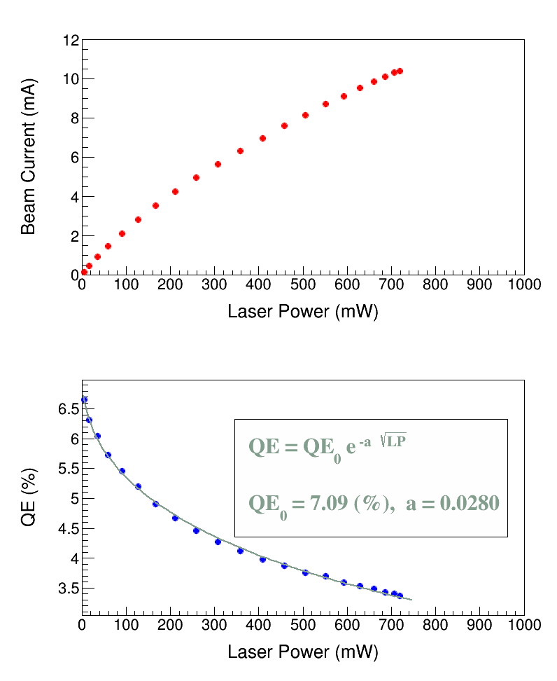
Surface Charge Limit
Also known as Surface Photovoltage Effect, reduces NEA (χ) of GaAs: Photoelectrons trapped near GaAs surface produce opposing field that reduces NEA resulting in QE reduction at high laser power (LP),
Bulk GaAs, 532 nm, 100 kV
U(LP)
χ
E_{gap}
δU(E_{s})
Where U(LP) is up-shifting of potential barrier due to photovoltage.
For heavily Zn doped GaAs surface, U(LP) → 0 (doping introduces high internal electric field to facilitate charge transport, increase diffusion length, and reduce chance of depolarization in active layer)
Higher Gun HV suppresses photovoltage

Slide 9
MOLLER Injector Optimization
Significant clipping of electron beam between photocathode and Hall can create excessive charge jitter or helicity correlated systematics on the beam. MOLLER requires very clean electron transmission from source to target with minimal beam interception. As a general rule, changes in mean value of charge asymmetry should be kept to less than 20 ppm, and width change less than 50 ppm, through injector and into hall (transmission of 95% can achieve this).
MOLLER will use two Wien filters and Spin Solenoids to apply a spin rotation with a period of about 5-7 days. These are referred to as Flip-Right or Flip-Left settings. Preservation of beam properties under polarization reversal is key to utility of this flip.

Slide 10
MOLLER Transmission and Beam Noise
D_{x}
A_{q}
= noise + HCBA intercoupling
noise
HCBA intercoupling
Aq distribution
Aq RMS
<Aq>
BPM name
BPM name
Poor beam transport can mess things up badly

Slide 11
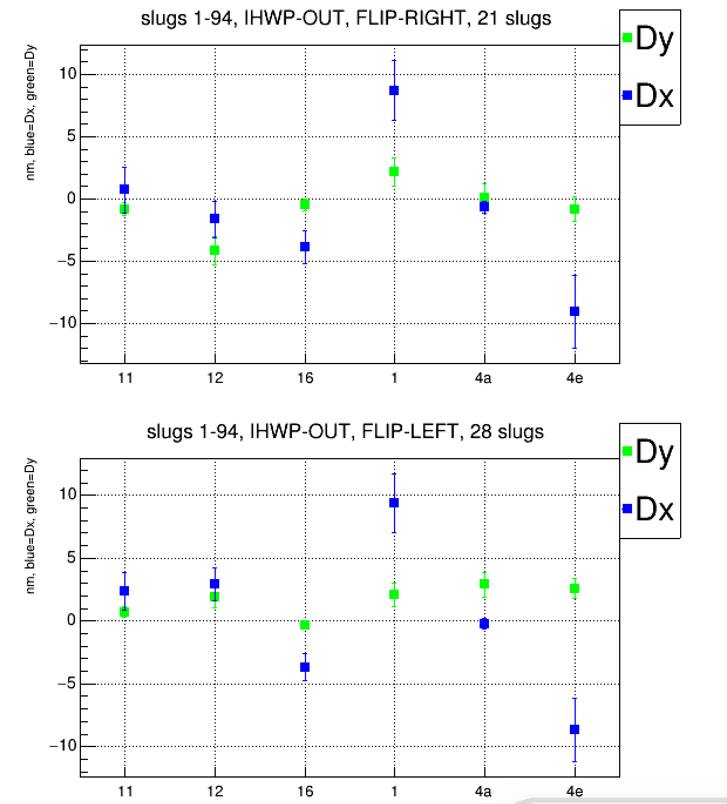
MOLLER Wein Flip
Symmetry is required for position difference and beam size asymmetry cancellations
Injector
Hall A
Flip Right:
Flip Left:
BPM name
BPM name

Slide 12
Beam Loading
Sub-harmonic Beam loading in Buncher and SRF cavities in Linacs?
Any changes to beam properties (e.g., energy spread)? Expected to be at 10⁻⁶ level in SRF cavities. Must be modeled and tested with beam.
Injector buncher cavities will be modeled and tested with beam

Slide 13
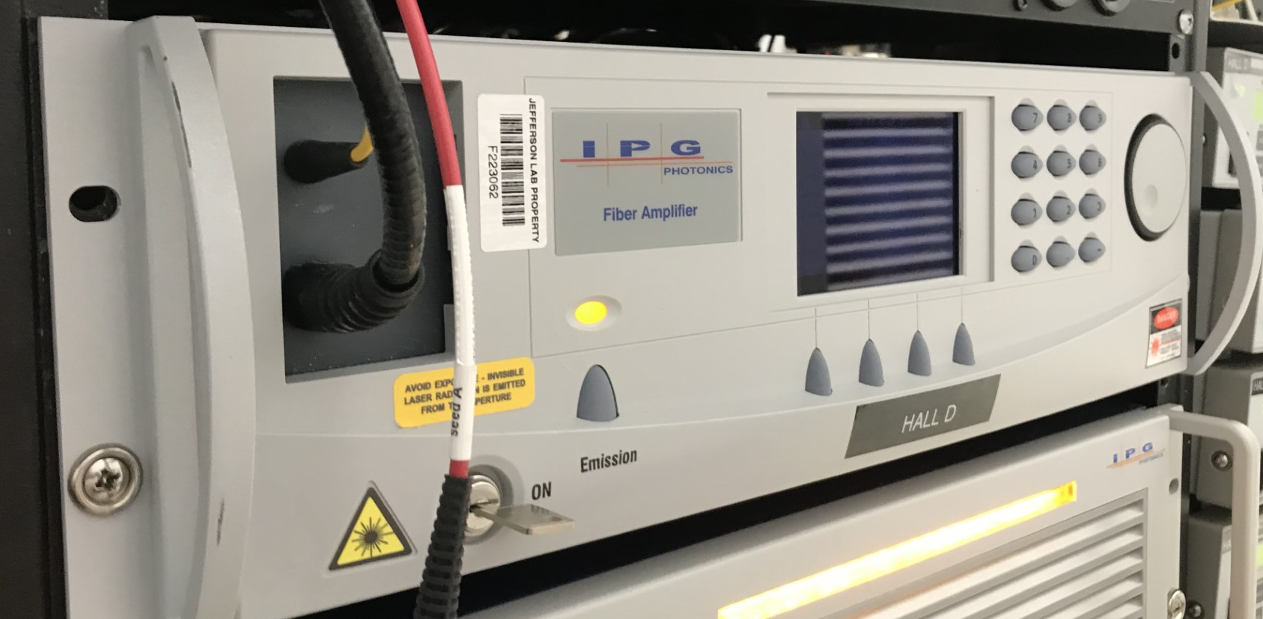
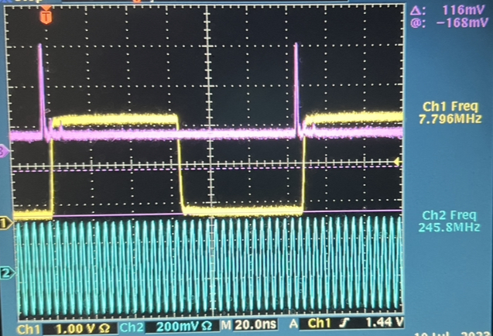
KLF Low-rep Laser (S. Zhang)
LLRFF
Seed Laser
High Power (6 W) 1560 nm Fiber Amplifier
Technical Scheme and Key Components:
New 15.6/7.8 MHz LLRF system
A new high energy laser pulse fiber amplifier
Use Existing SHG (PPLN crystal) for 780 nm and rest of hardware downstream in D laser path
New Intensity Attenuator (IA) for charge feedback
Fiber
Amp
PPLN
TMG
Atten
Laser
pulses
Low rep signal
IA
249.5 MHz RF

Slide 14
KLF Laser Status and Plans
Present status:
A temporary RF sync system is assembled and tested (15.6/7.8 MHz RF signal by dividing 249.5 MHz by 16/32) providing stable phase at 15.6 and 7.8 MHz
A new laser amplifier is tested at both 15.6 and 7.8 MHz with enough power (factor of 10 than required)
EPICS control is ready
Schedule:
Installation in Fall 2023

Slide 15
Laser Low-Level RF (LLRF)
15.6/7.8 MHz oscillation phase must be locked to accelerator 1497 MHz
Existing LLRF system can provide two frequencies: 499 MHz and 249.5 MHz. It utilizes heterodyning concept, using two local oscillator signals locked to the accelerator's 499 MHz reference. This ensures that drive signals are always locked to variable frequency of CEBAF accelerator.
To add a low-frequency drive signal of 15.6/7.8 MHz, we are designing a direct drive channel, which would provide full amplitude and phase control. To be ready by next Accelerator Shutdown.

Slide 16
Schedule
Task | Date
Install laser Amp with temporary RF system | Fall 2023
Photocathode studies | Spring 2024
KLF charge feedback | Spring 2024
Injector optimization studies | Spring 2024
Beam loading in Injector bunchers | Spring 2024
Beam loading in SRF Linacs (model) | Fall 2023
Install complete LLRF system | Spring 2024
Beam loading in SRF Linacs (beam) | Spring 2024

Slide 17
Summary
0.32 pC @ 15.6 MHz (64 ns) likely to be OK
Co-operation of KLF with MOLLER:
Photocathode effects
Requires charge asymmetry feedback on KLF beam
Injector will be optimized for MOLLER (not KLF)
Beam loading
Must perform beam studies to explore all potential issues – must be completed by June 2024

