Slide 1
Continuing Vision for e+ and energy upgrade
Last updated 8/31/22
Joe Grames

Slide 2
Director’s Council Vision (Plan A)
Positrons
Energy upgrade 1st FFA arc (no e+)
Energy upgrade 2nd FFA arc (no e+)
Configuration
Use LERF for both e+ and FFA injectors
Build connector line LERF to CEBAF East Arc
Build transport line East Arc to NL
CEBAF Injection Energies
Positrons
  Plan A – LERF to NL is 123 MeV
  Plan B1 (4-pass EM) – LERF to NL 650 MeV
Energy Upgrade
  Plan A – LERF to NL 650 MeV
CEBAF Top Off Energies
Positrons
  Plan A – ABC 11 GeV, D 12 GeV
  Plan B1 (4-pass EM) – ABC 9.45 GeV, D 10.55 GeV
Energy Upgrade
  Plan A – Phase 1 (17 GeV), Phase 2 (22 GeV)
A
B
1100
C
123
650
D
1100
116
7

Slide 3
Ideas resulting from meeting (Alex, Reza, Yves, Matt, Joe)
Phase 1 : positrons (1-pass LERF)
e+ @ 123
e+ source/collection
e-
e+
e-
e-
10
90-110
90-110
Phases 2 & 3 : energy upgrade (2-pass LERF)
e- @ 550-650
e-
10
90-110
90-110
90-110

Slide 4
Joe/Alex follow-up
Phase 1 : positrons (1-pass LERF)
e+ @ 123
e+ source/collection
e-
e+
e-
e-
10
90-110
90-110
Phases 2 & 3 : energy upgrade (2-pass LERF)
e- @ 550-650
e+ source/collection
e-
e+
e-
10
90-110
90-110
90-110

Slide 5
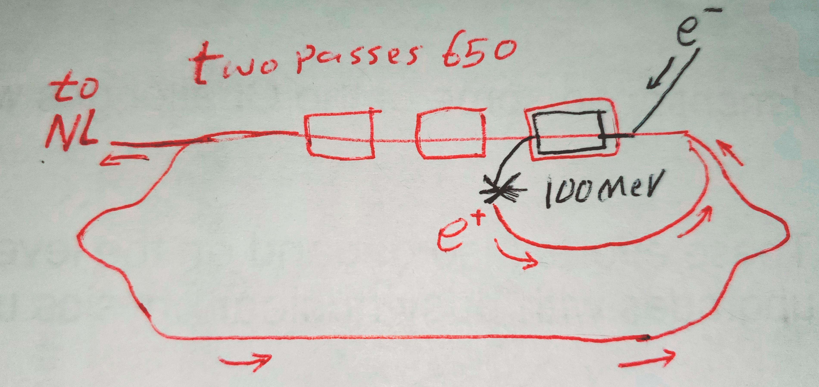
Reza follow-up

Slide 6
Joe follow-up with Alex on HE spin rotators
High energy spin rotators during FFA era
Major modification to transport lines … but happening for FFA, yes?
Plan A – Benefits to e- beams in FFA era
Plan B – Benefits to e+ beams in FFA era (up to 4 pass EM)
modest spin angle (+/- small deg), e.g. as the energy increases the sensitivity of spin stability to energy goes up, we could evaluate this but maybe +/- 10 deg is enough
b) larger spin angle (+/- larger degrees) to provide longitudinal polarization to more halls simultaneously, we need I think only one hall to have a rotator so we then have three degrees of freedom (energy, Wien, hall) for ABC
c) a fixed +/- 180 deg configuration that moves spin flipping to the halls, independent of the front end and only needed for PV experiments that might be planned in AC
d) finally there is the most developed "universal spin rotator" which in any hall would provide unique capabilities.
Fanglei has been our lead in this work, having a small discussion together with her could be valuable to gauge which might be worth thinking about.

Slide 7
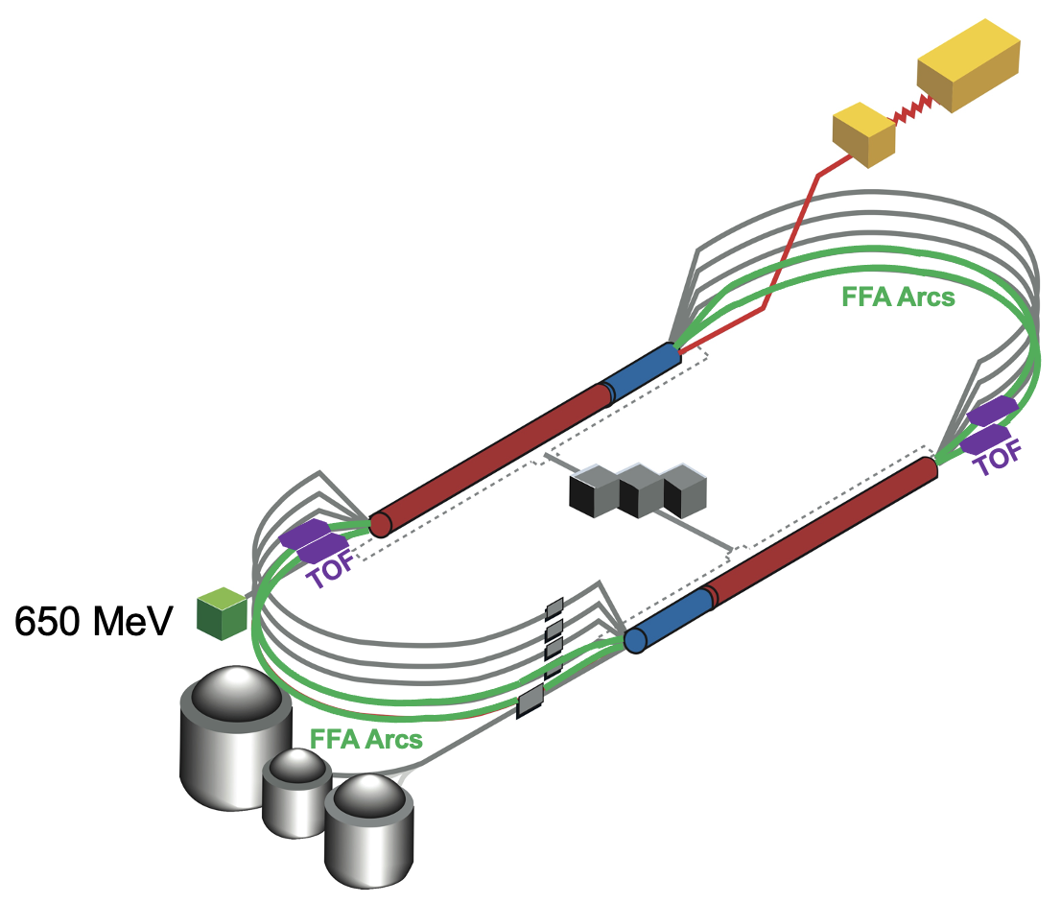
CEBAF Upgrade(s) beyond 12 GeV e-
Polarized positrons capability
  Near term, ~5 years, 12 GeV, multi-hall
  Imagine 100 – 300 MeV e- injector
Energy upgrade experimental program
  22 GeV, a decade from now, multi-hall
    Can have an intermediate stage of 17 GeV
  Replace two arcs per side with new FFA permanent magnet arcs
    (Single pair of arcs is considered too)
  Requires ~600 MeV e- injector
    This mean a shielded vault of ~70x10m

Slide 8
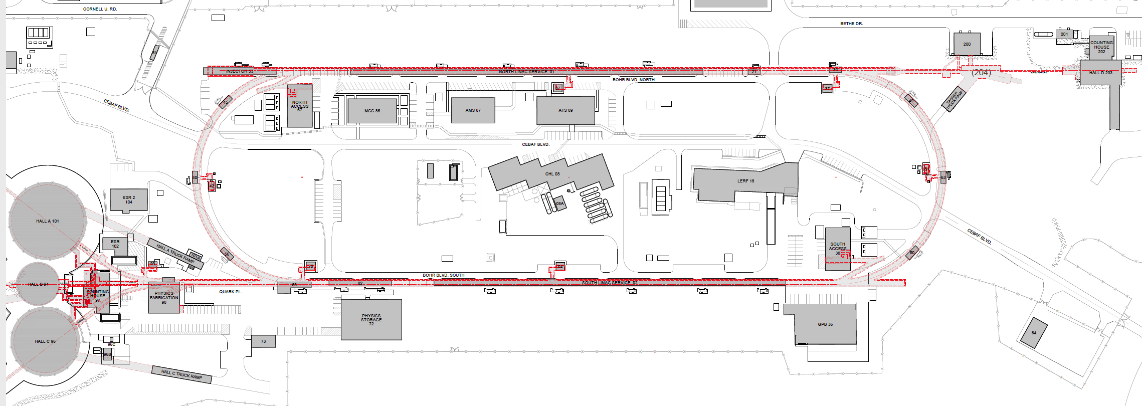
An electron/positron injector vault is required for both upgrades
New underground vault + short beam line
Existing FEL + long beam line
123 MeV e+ for 12 GeV CEBAF
650 MeV e- for Energy Upgrade
Green option is presently more cost effective and provides options for staging positron and energy upgrade

Slide 9
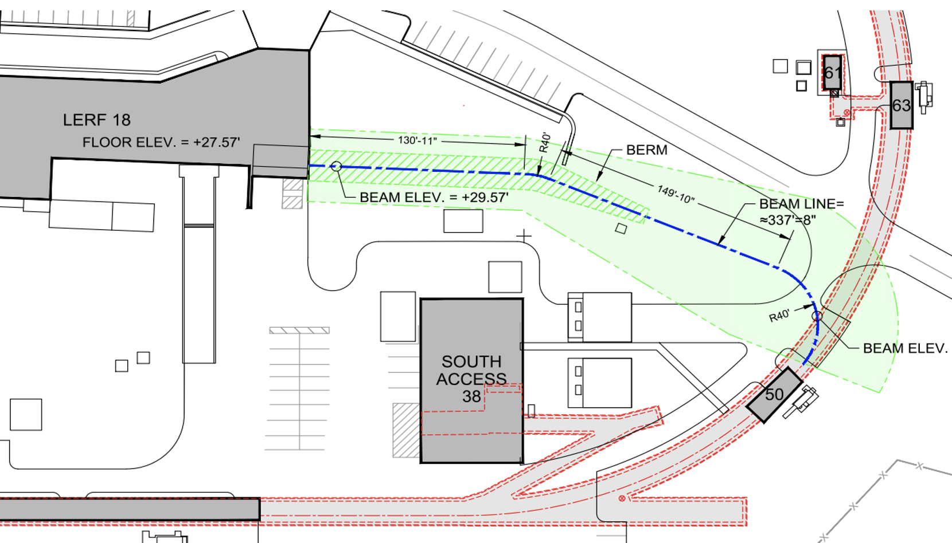
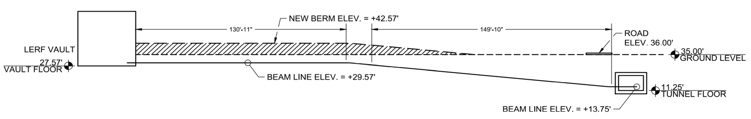
Tunnel to East Arc
Conventional Facilities construction experts assessment and design optimization
  Options 2a and 2b assessed
  Option 2c suggested and evaluated
  Feasibility confirmed
Rough cost estimates for hardware are in the process
Drawings courtesy Joel Dolbeck

Slide 10
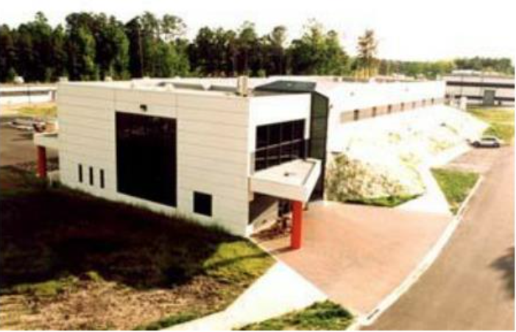
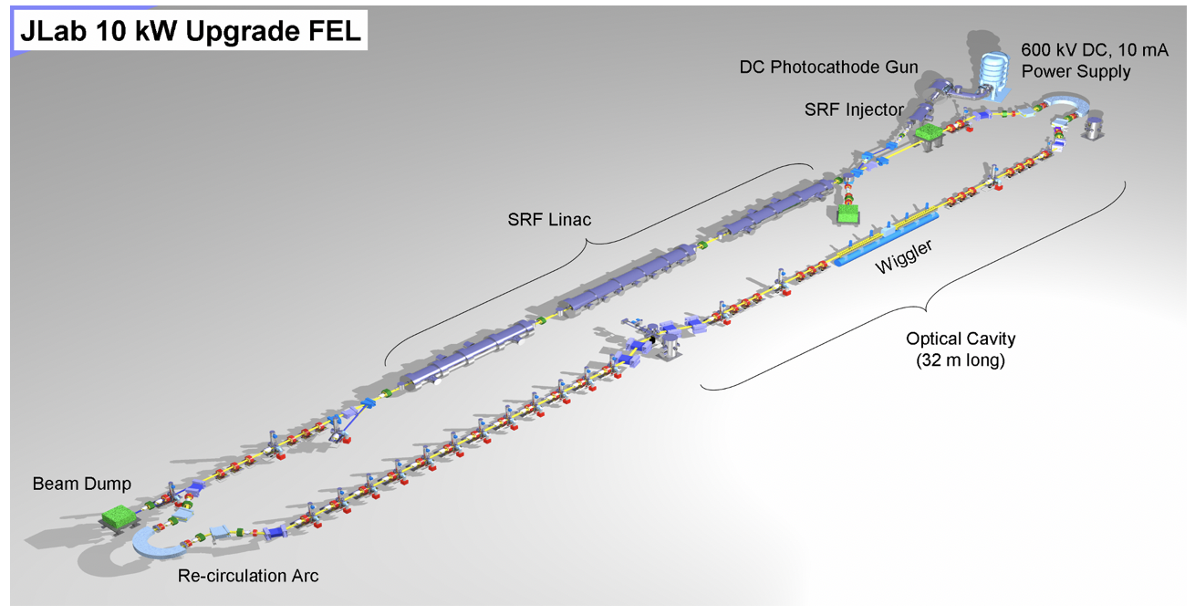
Staging electron/positron injector at the FEL

Slide 11
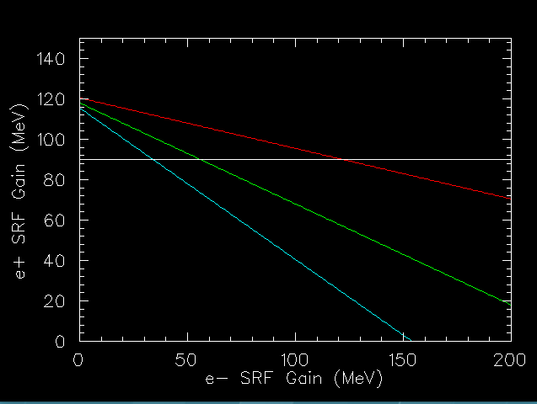
e+ @ 123
e+ source/collection
e-
e+
e-
e-
10
75
90
e-
e-
10
75
50
90
85 (10+75) MeV e- => e+ 33(123-90) MeV ~ 39%
135 (10+50+75) MeV e- => e+ 33 (123-90) MeV ~ 24%
Lower Pol
IP2
Higher Pol

Slide 12
How Tony, Steve, Matt, Joe ended the 7/13/22 meeting…
e+ @ 123
e+ source/collection
e-
e+
e-
e-
QCM
Refurb CM, max E @ 1 mA
CM, low cur. (80-110)
SRF priorities for positrons at LERF…
Repair QCM to make ~10 MeV, as soon as possible, so we can learn how to produce and capture positrons…
When possible, add 1 refurbished CM than can support ~1 mA with max energy possible, maybe as high as 75 MeV?
In ~5 years, need 1 CM than can boost positrons <10 uA to 123 MeV (can use the plot to the right, where RED and GREEN are “Must” and the CYAN is “Should”, might need to be 80-100 MeV CM for CEBAF injection
Lower Pol
IP2
Higher Pol

Slide 13
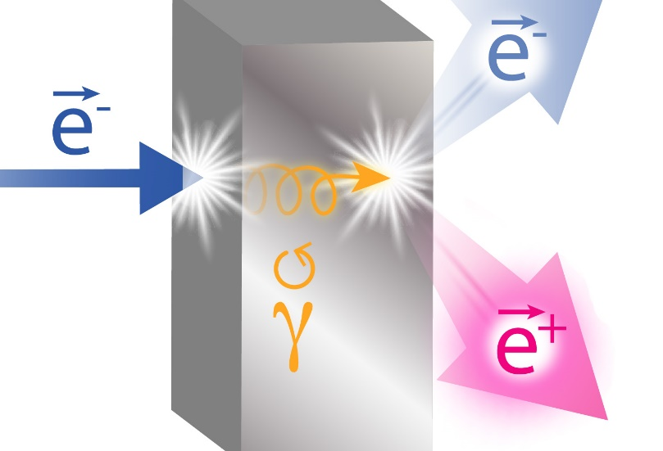
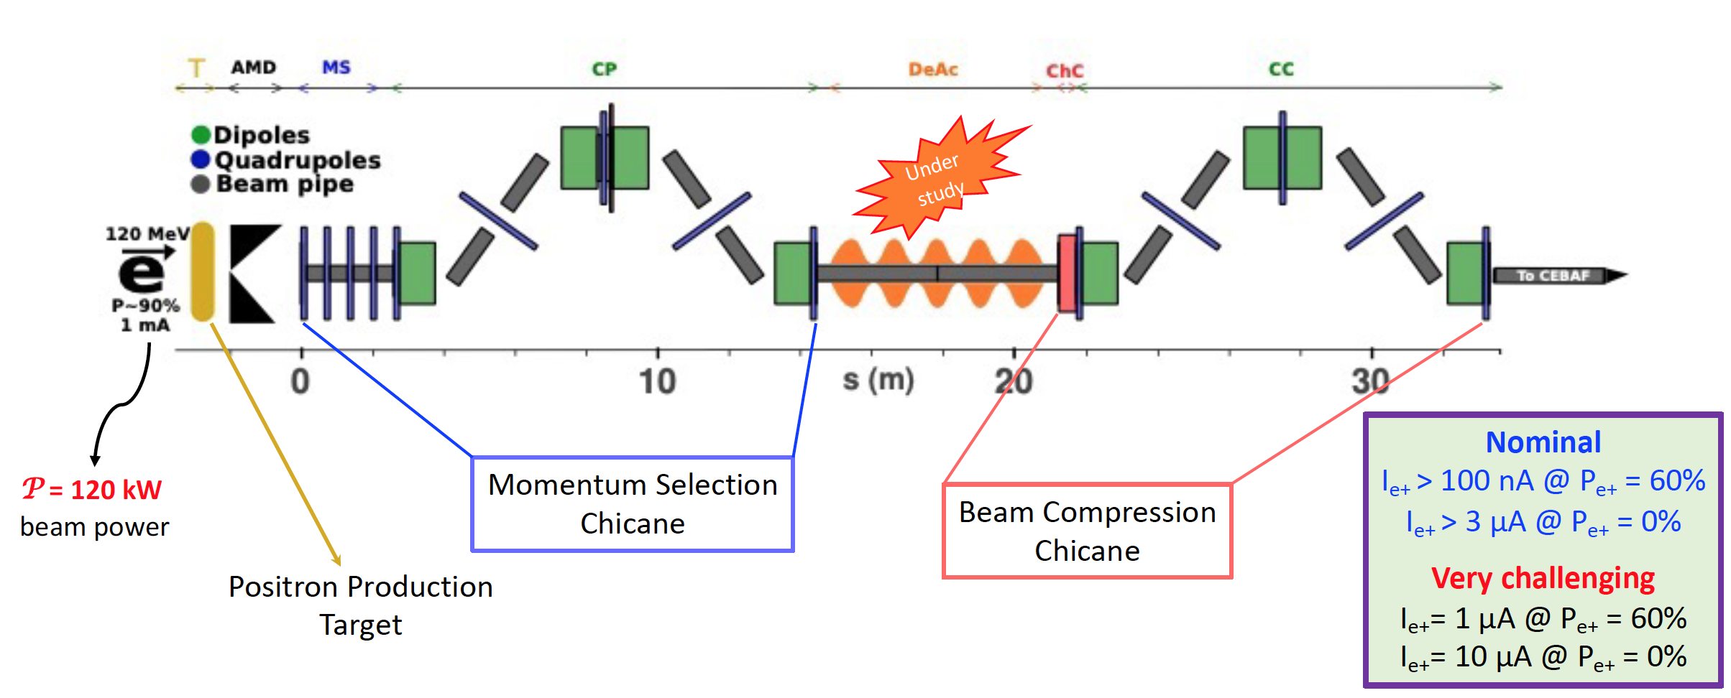
Polarized e+, big picture
Hardware needed:
  High current polarized e- source
  A cryomodule to accelerate e-
  An e+ target-source and collection system
  A cryomodule to accelerate e+
e+ @ 123
e+ source/collection
e-
e+
e-
e-
Collect e+ > 20 MeV
~10 MeV
~75 MeV
~100 MeV
Repaired QCM (1 mA)
Refurbished C75 (1 mA)
Cryomodule C100
Polarized positrons generation
Would like to organize a workshop at Jlab in the Late 2022 or Early 2023 to discuss technical collaboration.

Slide 14
e+ @ 123
e-
e-
e-
QCM (1mA)
C75 (1mA)
C50 (1mA)
e-
e+
C50 or C75

Slide 15
More thoughts on energy upgrade & positron injectors at LERF
Joe Grames
Aug 3, 2022

Slide 16
How to build one LERF with two injectors? a) using the same existing vault/floorspace, b) retaining same/similar SRF footprint (three CM), c) making use of recirculation (for the energy upgrade, e+?).
Finally, an overarching goal is compatibility between the positron and energy injectors, to be cost and time effective transitioning from one to another.

Slide 17
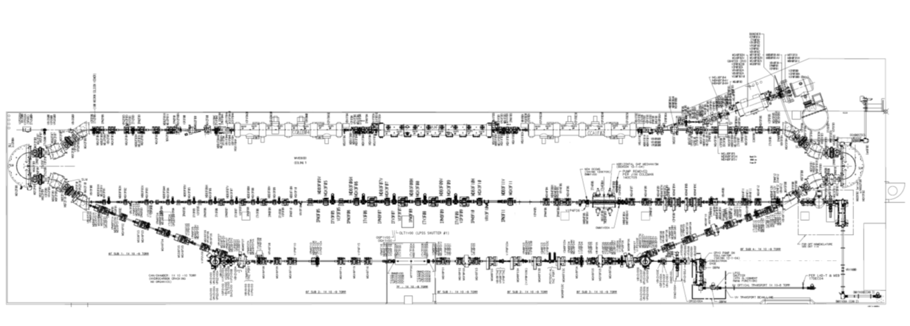
FEL/LERF
Alex Bogacz
Options for Recirculating Injector at 650 MeV

Slide 18
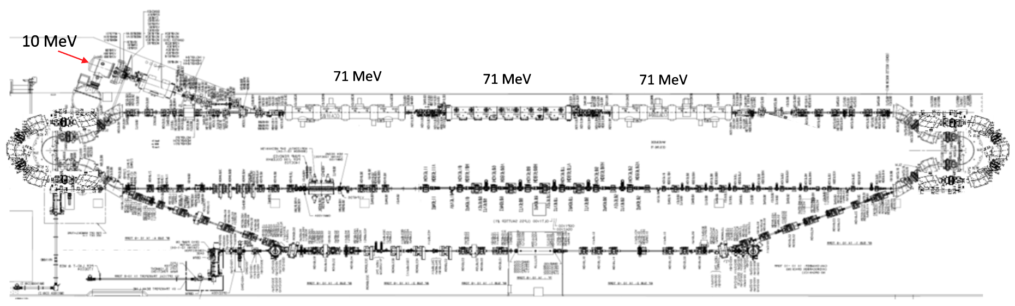
Recirculating Injector – Option 2 (3-pass)
650 MeV
Alex Bogacz
Options for Recirculating Injector at 650 MeV

Slide 19
Overlaying 650 MeV 3-pass into vault

Slide 20
Overlaying 650 MeV 3-pass into vault
Exiting “north” difficult
Exiting here still looks easier

Slide 21
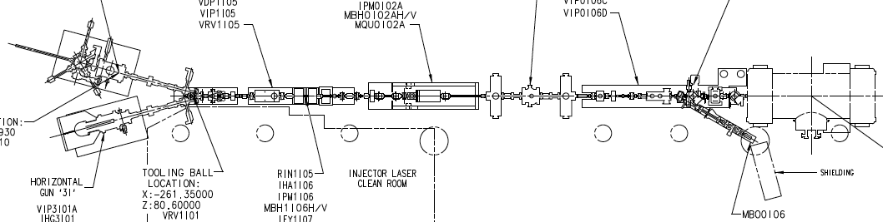
Trying counter-clockwise again…
CEBAF injector too big here
CEBAF injector too big here
Exiting here still looks easier

Slide 22
650 MeV e- injector for FFA >22 GeV
#4 – Extract 650 MeV from linac
#3 – 3-pass SRF acceleration to 650 MeV
Vertically stacked return lines to save floor space
#2 – Inject 10 MeV e- to linac
#1 – CEBAF style polarized e- injector 10 MeV
#5 – Transport e- at 650 MeV to exit LERF

Slide 23
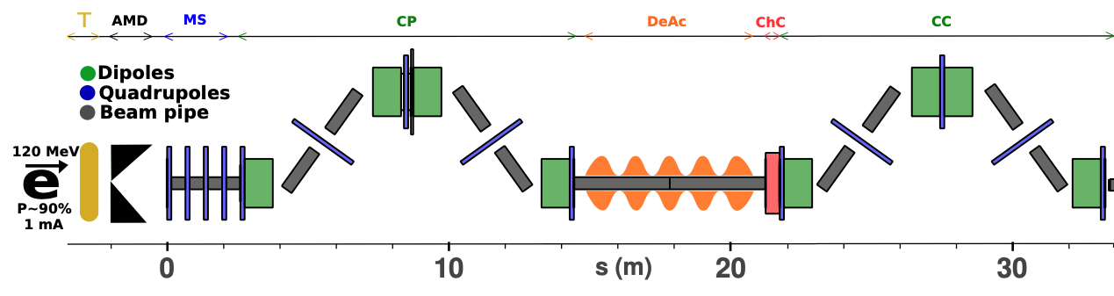
123 MeV e+ injector for 12 GeV positrons
#1A – FEL style compact e- injector 10 MeV
#6 – SRF accelerate e+ to 123 MeV
#2 - SRF accelerate >100 MeV
#5 – Injector e+ to linac
#3 – Extract e- to target
#4 - Produce e+ accelerate to 50-70 MeV
#1B – CEBAF style polarized e- injector 10 MeV
#7 – Transport e+ at 123 MeV to exit LERF

Slide 24
Still wondering about e+ @ 650 for 3-pass later…
Run e- near crest
Run e+ near zero-cross
Final e+ accel 123 MeV
?
Exiting here looks easier

Slide 25
More thoughts on energy upgrade & positron injectors at LERF
Joe Grames
Aug 10, 2022

Slide 26
Gun
-20 deg
QCM
0-140
20 deg
0 deg
Gun
-20 deg
QCM
0-140
20 deg
180 deg
Wien

Slide 27
CM3
4
1
CM2
2
3
DIAG
# | Configuration | Dipole #1 | Dipole #2 | Dipole #3 | Dipole #4
Dash Blue | Tune up e- beam “straight ahead” to CM3 | 0 | 0 | n/a | n/a
Dots Blue | Tune up e- through e+ injector to DIAG | LEFT | RIGHT | 0 | n/a
Dots Blue | Tune up e- through e+ injector to CM3 | LEFT | RIGHT | RIGHT | LEFT
Dash Red | Make e+ and send to DIAG | LEFT | RIGHT | 0 | n/a
Solid Red | Make e+ and send to CM3 | LEFT | RIGHT | RIGHT | LEFT

Slide 28
What are the current plans for producing a target for PPB (will it become a DOE project or will it stay an internal jlab project?), what are the timelines for PPB
  Positrons would be funded through NP-OPS.
  We have talked about funding the injector through an Early Career Award
  FY23 – moving to LERF recent development, finalize a design
  FY24 – design and simulations
  FY25 – engineering and fabrication
  FY26 – installation and testing
  FY27 – commissioning
  FY28 – positron injector ready (still requires new tunnel and CEBAF transport lines, TBD)

Slide 29
More thoughts … on (prototype) layout
Joe Grames
Aug 17, 2022

Slide 30
Electron spin polarization – Reza brings up very important point
 | GAIN | ENERGY | Bend | Precession | Total | Pz = Cos(Total)
 | MeV | MeV | deg | deg | deg | #
QCM | 10 | 10 | 20 | 0.45 | 0.45 | 1.000
CM | 0 | 10 | -180 | -4.08 | -3.63 | 0.998
 | 10 | 20 | -180 | -8.17 | -7.71 | 0.991
 | 20 | 30 | -180 | -12.25 | -11.79 | 0.979
 | 30 | 40 | -180 | -16.33 | -15.88 | 0.962
 | 40 | 50 | -180 | -20.41 | -19.96 | 0.940
 | 50 | 60 | -180 | -24.50 | -24.04 | 0.913
 | 60 | 70 | -180 | -28.58 | -28.12 | 0.882
 | 70 | 80 | -180 | -32.66 | -32.21 | 0.846
 | 80 | 90 | -180 | -36.74 | -36.29 | 0.806
 | 90 | 100 | -180 | -40.83 | -40.37 | 0.762
 | 100 | 110 | -180 | -44.91 | -44.45 | 0.714
 | 110 | 120 | -180 | -48.99 | -48.54 | 0.662
 | 120 | 130 | -180 | -53.07 | -52.62 | 0.607
 | 130 | 140 | -180 | -57.16 | -56.70 | 0.549
 | 140 | 150 | -180 | -61.24 | -60.79 | 0.488
Electron Injector Precession
Precession [deg] = (g-2)/2 * (E/m) * Bend [deg]
Pz = P0 * cosine(Precession)
Example
10 MeV section [deg] = 1.159e-3 * (10/0.511) * 20 = +0.45
Pz = 1 * 0.99997

Slide 31
Add a Wien filter (0-60 deg vs. energy)
”Transparent layout” (0.45 deg or gun might be straight)
Wien
Maybe we want a Wien anyway?
Not being “forced” to use a Wien is nice.
180 bend
Does it better “center” around in/out?
Could it be the dispersive P selector?

Slide 32
Prototype and segue to full injector – exploring straight design for a moment…
  folding in guesses at SRF options
    QCM repair by Spring 2024
    CM#1 refurbishment TBD (optimizing for prototype time frame)
  combining comments from Yves and Reza about footprint
Prototype Experiment
Full injector Mated to CEBAF
?

Slide 33
This is approximate layout we discuss now…

Slide 34
300 kV polarized gun
300 kV Wien filter
FEL QCM leak repair (>10)
Refurbish FEL CM (>20)
Transport lines
What about the prototype…
High power fixed W target
QWT/AMD
NC multi-cell (4MV/m) cavities
Low field guiding solenoid
SRF QCM (2 5-cell cavities)
180 dispersive bunch compressor
Transport lines
Diagnostics
Emittance filter
Matching section
Chicane dp/p filter

Slide 35
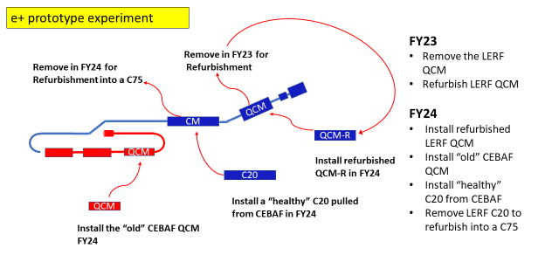
Suggestion from Tony Reilly
Also considering path for upgrading ”healthy” C20 to C50 or C75

Slide 36
Prototype (means LERF testing 3-5 years)
Electron energy in range of 33-71 MeV
Positron collection energy 8-18 (lo-pol) and 17-36 (IP2) and 25-54 (hi-pol)
123 MeV injector fully satisfied with three C75 or marginal with one C75 + one C100
Phase 1 (means 12 GeV e+ >5 years)
Electron energy in range of 76-134 MeV
Positron collection energy 19-34 (lo-pol) and 38-67 (IP2) and 57-101 (hi-pol)
123 MeV injector fully satisfied with two C75 + one C100 or marginal with three C75
SUMMARY
Two cases fully satisfied (C75-C75-C75 or C75-C75-C100)
Two cases marginally satisfied (C75+C100 or C75-C75-C75)
Interestingly with three C75 the best scenario is Prototype Experiment + later addition of two C75

