Slide 1

Milliampere beam studies using high polarization photocathodes at the CEBAF Photoinjector
Joe Grames, Phil Adderley, B. Bullard, John Hansknecht,
C. Hernandez-Garcia, G. Palacios, Matt Poelker,
Daniel Moser, Marcy Stutzman, Shukui Zhang
LHeC, FCC-eh and PERLE Workshop
LAL Orsay
June 27-29, 2018

Slide 2
Outline
PEPPo – an application requiring milliampere polarized electron beams
Ion bombardment, the dominant lifetime limiting mechanism of polarized photocathodes
To operate at mA current without interruption, requires kC charge lifetime
R&D to extend the charge lifetime of polarized electron sources

Slide 3


Polarized Electrons for Polarized Positrons
electron beam polarization
85.2 ± 0.6 ± 0.7 %
PEPPo demonstrated efficient transfer of polarization from electrons to positrons by bremsstrahlung + pair creation at low energy (<10 MeV).
In the range of 10-100 MeV conversion efficiency 10⁻⁴ to 10⁻³ suggests useful polarized positron current benefits from milliamperes of polarized electrons
D. Abbott et al, "Production of Highly Polarized Positrons Using Polarized Electrons at MeV Energies", Phys. Rev. Lett, 116, 214801 (2016)

Slide 4

Polarization Studies at mA Beam Current
First measurement of beam polarization at JLab from superlattice (GaAs/GaAsP photocathode at milli-Ampere current
CEBAF 5 MeV Mott polarimeter: on-going effort to ascribe sub-percent accuracy (collaborators D. Moser, X. Roca-Maza, Charles Sinclair, M.J. McHugh, and Tim Gay)
CEBAF 5 MeV Mott Polarimeter

Slide 5

  CEBAF Load Lock Photogun (-130kV)
CEBAF Polarized Inverted Load Lock Gun (Spring 2017)
1 mA 86 C/day
5 mA 432 C/day
10 mA 860 C/day
50 mA 4320 C/day

Slide 6
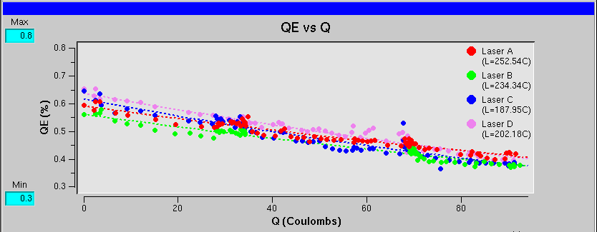
Recent CEBAF Polarized Source Performance
Gun2 Photocathode (Fall 2016 – Spring 2017)
  Strained Superlattice GaAs/GaAsP #5756-4
  Good Polarization 85-87% (measured at Mott)
  Good QE > 1% after activation
  Lifetime about 200C (σ_{4D} ~ 1mm) with intensity < 200μA

Slide 7

Ion Bombardment

Slide 8


Improving Lifetime with Larger Laser Size
J. Grames, et al., Phys. Rev. ST Accel. Beams 14 043501 (2011)
GaAs @ 532nm

Slide 9

Improving charge lifetime with GaAs/GaAsP
Indeed, we enhanced the Charge Lifetime for QWeak by a factor of four when doubling the laser spot size from 0.5 mm to 1.0 mm (diameter)
but milliampere applications require kiloCoulomb charge lifetime to provide uninterrupted operation of reasonable duration

Slide 10
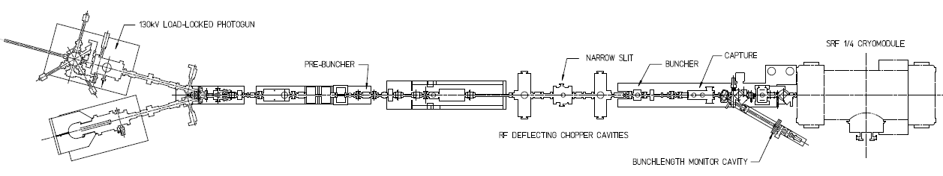
Lifetime Studies at mA Beam Current
CEBAF 130kV polarized “inverted gun” with load lock
Polarized positrons for CEBAF, and on-going discussions with BNL related to high current eRHIC EIC, prompted experiments at CEBAF to characterize lifetime vs. laser spot size using high-polarization photocathodes
Make beam here
(-130kV, 0-1.5mA, 0-3pC)
Monitor vacuum and radiation levels along beam line
Deliver it here
(Faraday cup)
Vary the laser beam size
(f=499 MHz, σ_{t} ~ 50 ps)

Slide 11
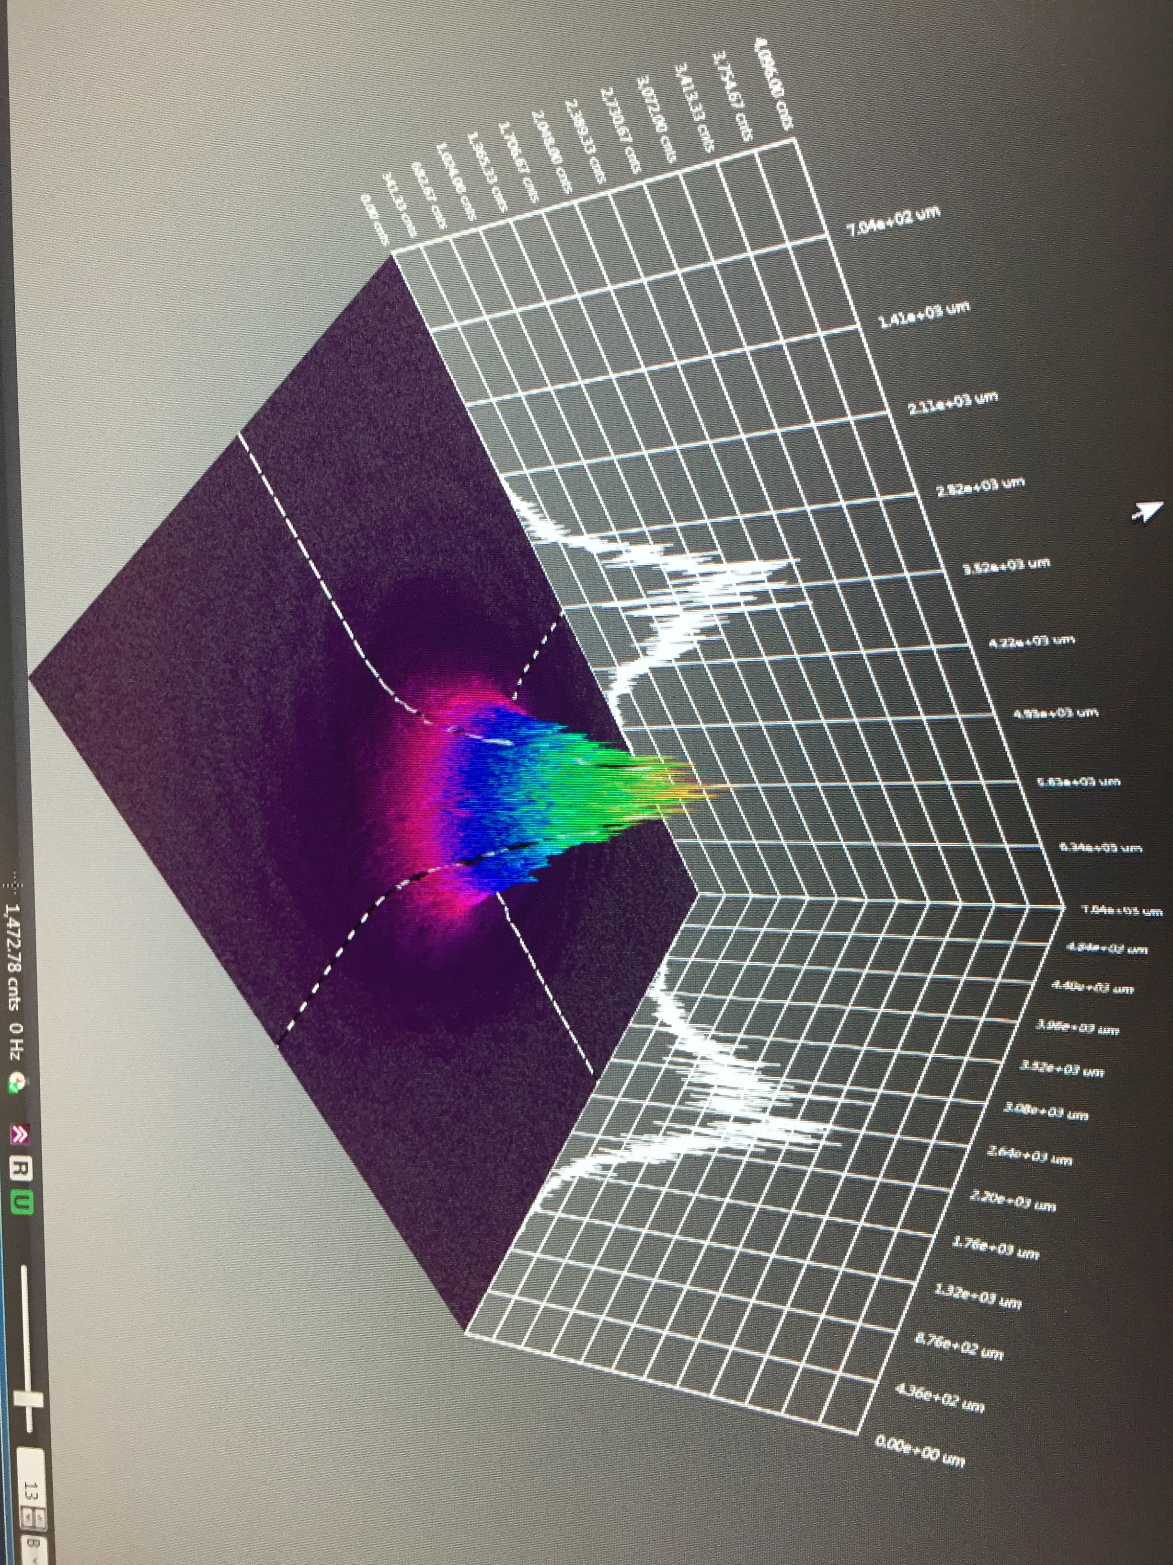

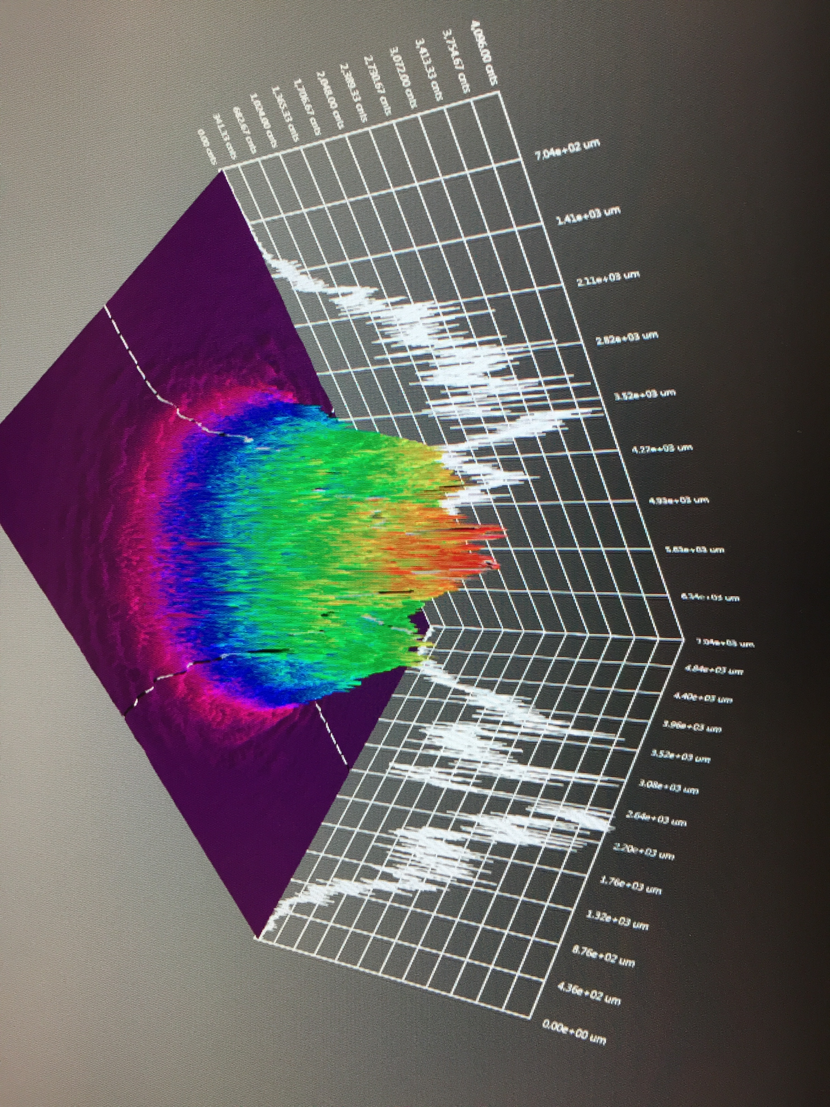
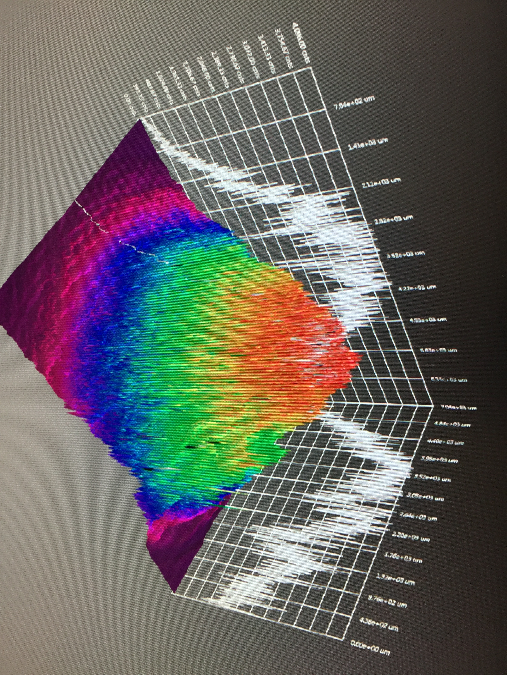
Variation of Laser Spot Size
Photocathode diameter 5 mm (defined by a mask during activation)
Varied laser diameter σ_{4D} ~1-5 mm (area 3-20 mm²)
Laser profile defined at photocathode plane

Slide 12
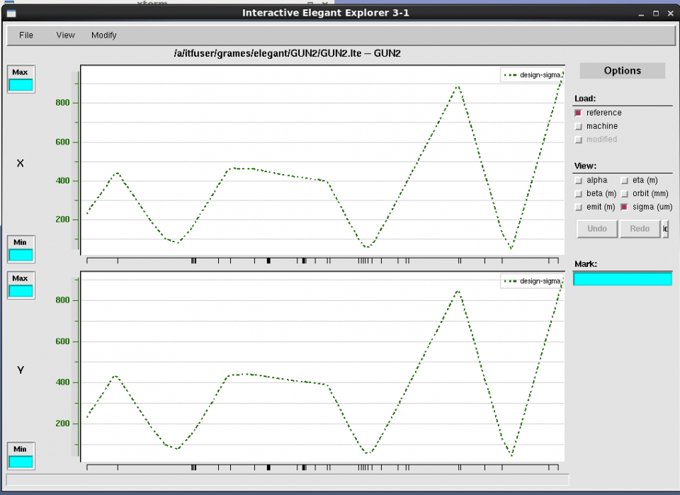
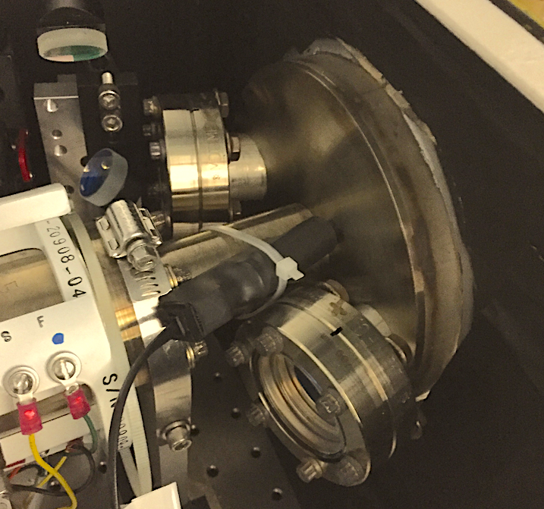
Lifetime Studies at mA Beam Current
X-ray detectors were distributed along beam line at locations of likely beam loss, e.g. apertures (where beam pipe size changes or intentional apertures).
Beam Size

Slide 13
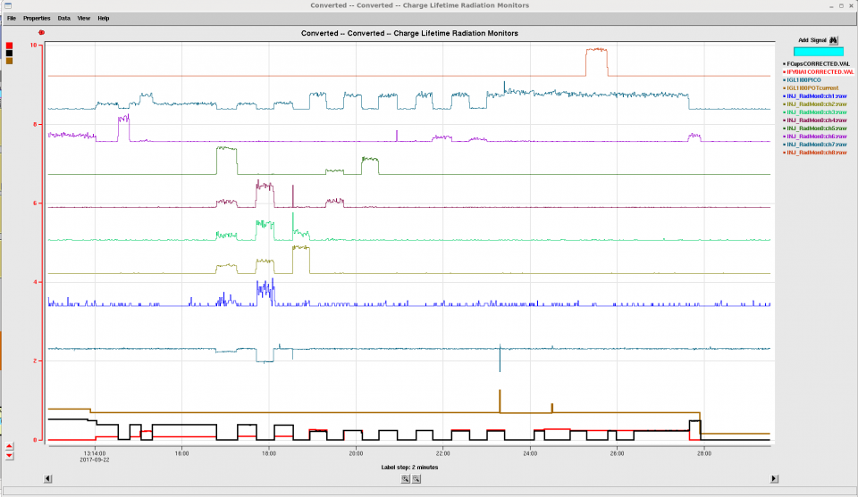
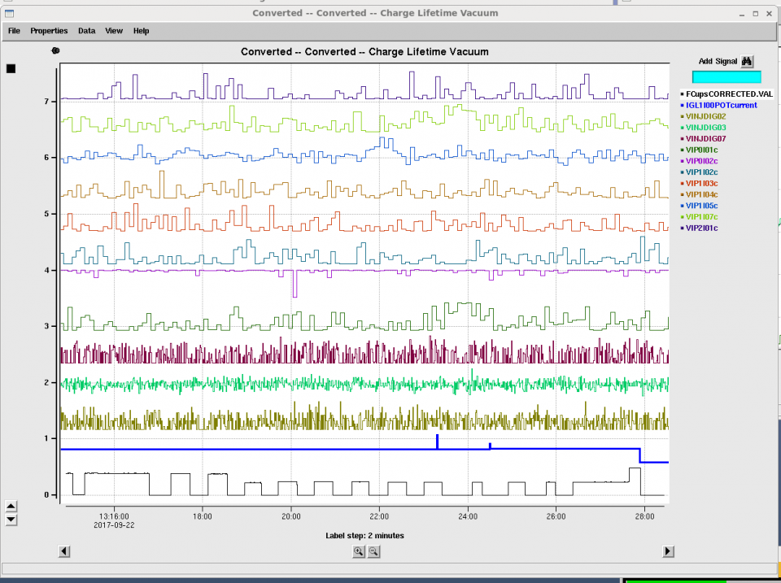
Sensitivity of x-ray detectors for beam loss
X-ray monitors demonstrate high sensitivity and localization for beam intentionally lost. Sensitivity as good as 60 pA (typ. 1-5 nA)
x-ray
loss
While increased vacuum levels are a good indicator of decreased photocathode lifetime, in this study we observe little indication of beam loss.
vacuum
loss

Slide 14
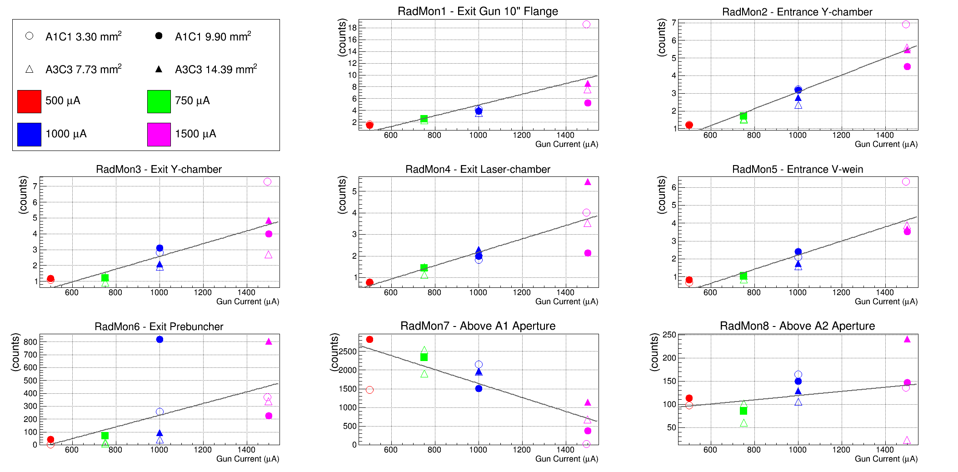
Radiation Level vs. Intensity
Low x-ray levels (<10 Hz) along beam pipe (35mm) suggest ~nA loss.
High x-ray levels (>100’s Hz) are in close proximity to smallest aperture (3mm)

Slide 15
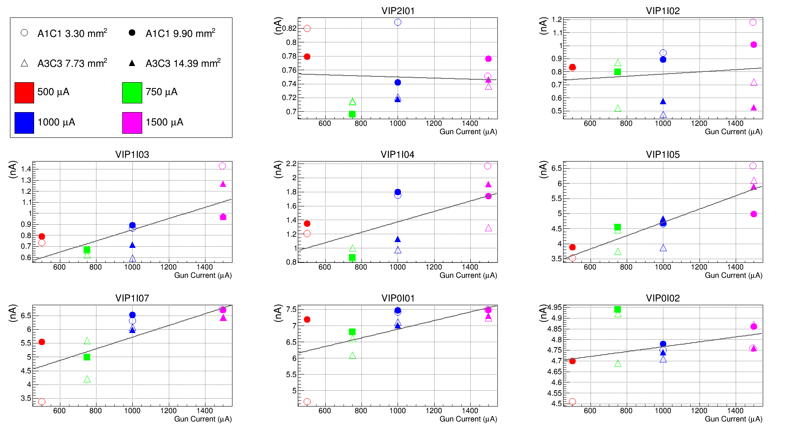
Vacuum Level vs. Intensity
Vacuum levels similarly increase with beam current, but “scatter” in vacuum level downstream of the gun larger than with the x-ray monitors.

Slide 16

Lifetime Studies at mA Beam Current
Required laser power, slope proportional to QE decay
Increasing laser size reduces QE decay proportionally
1mA
Adjust beam size to decrease x-ray level

Slide 17
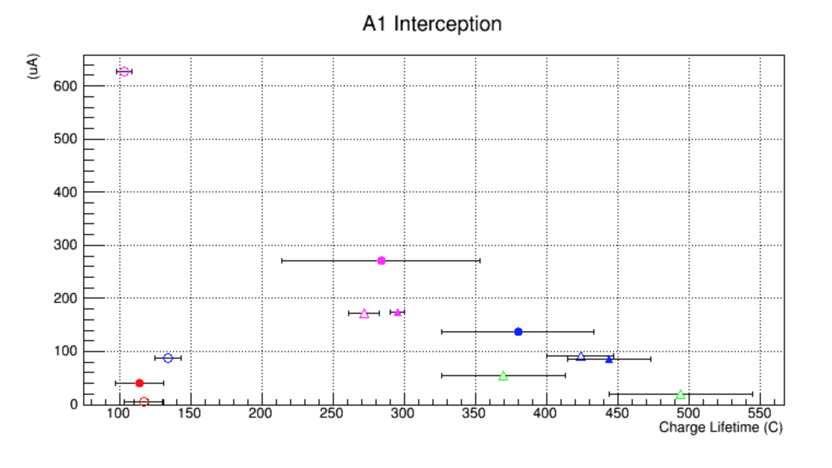
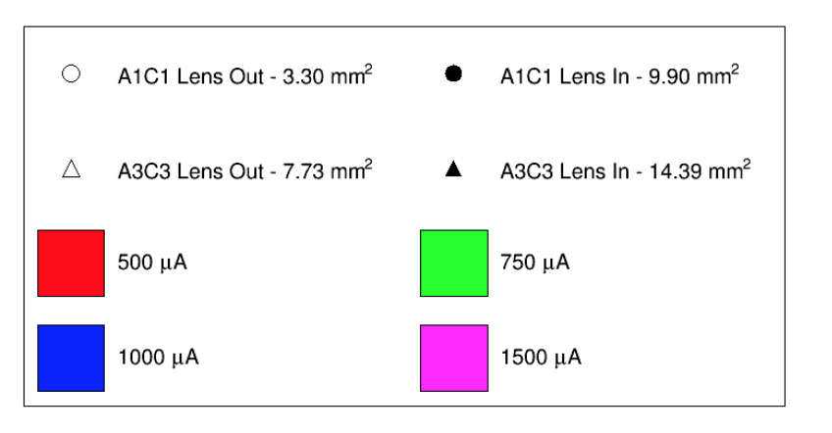
Emittance Aperture Interception vs. Lifetime
Interception on a 4mm aperture measures beam size
Largest interception (circles) occur with smallest laser size (space charge)

Slide 18
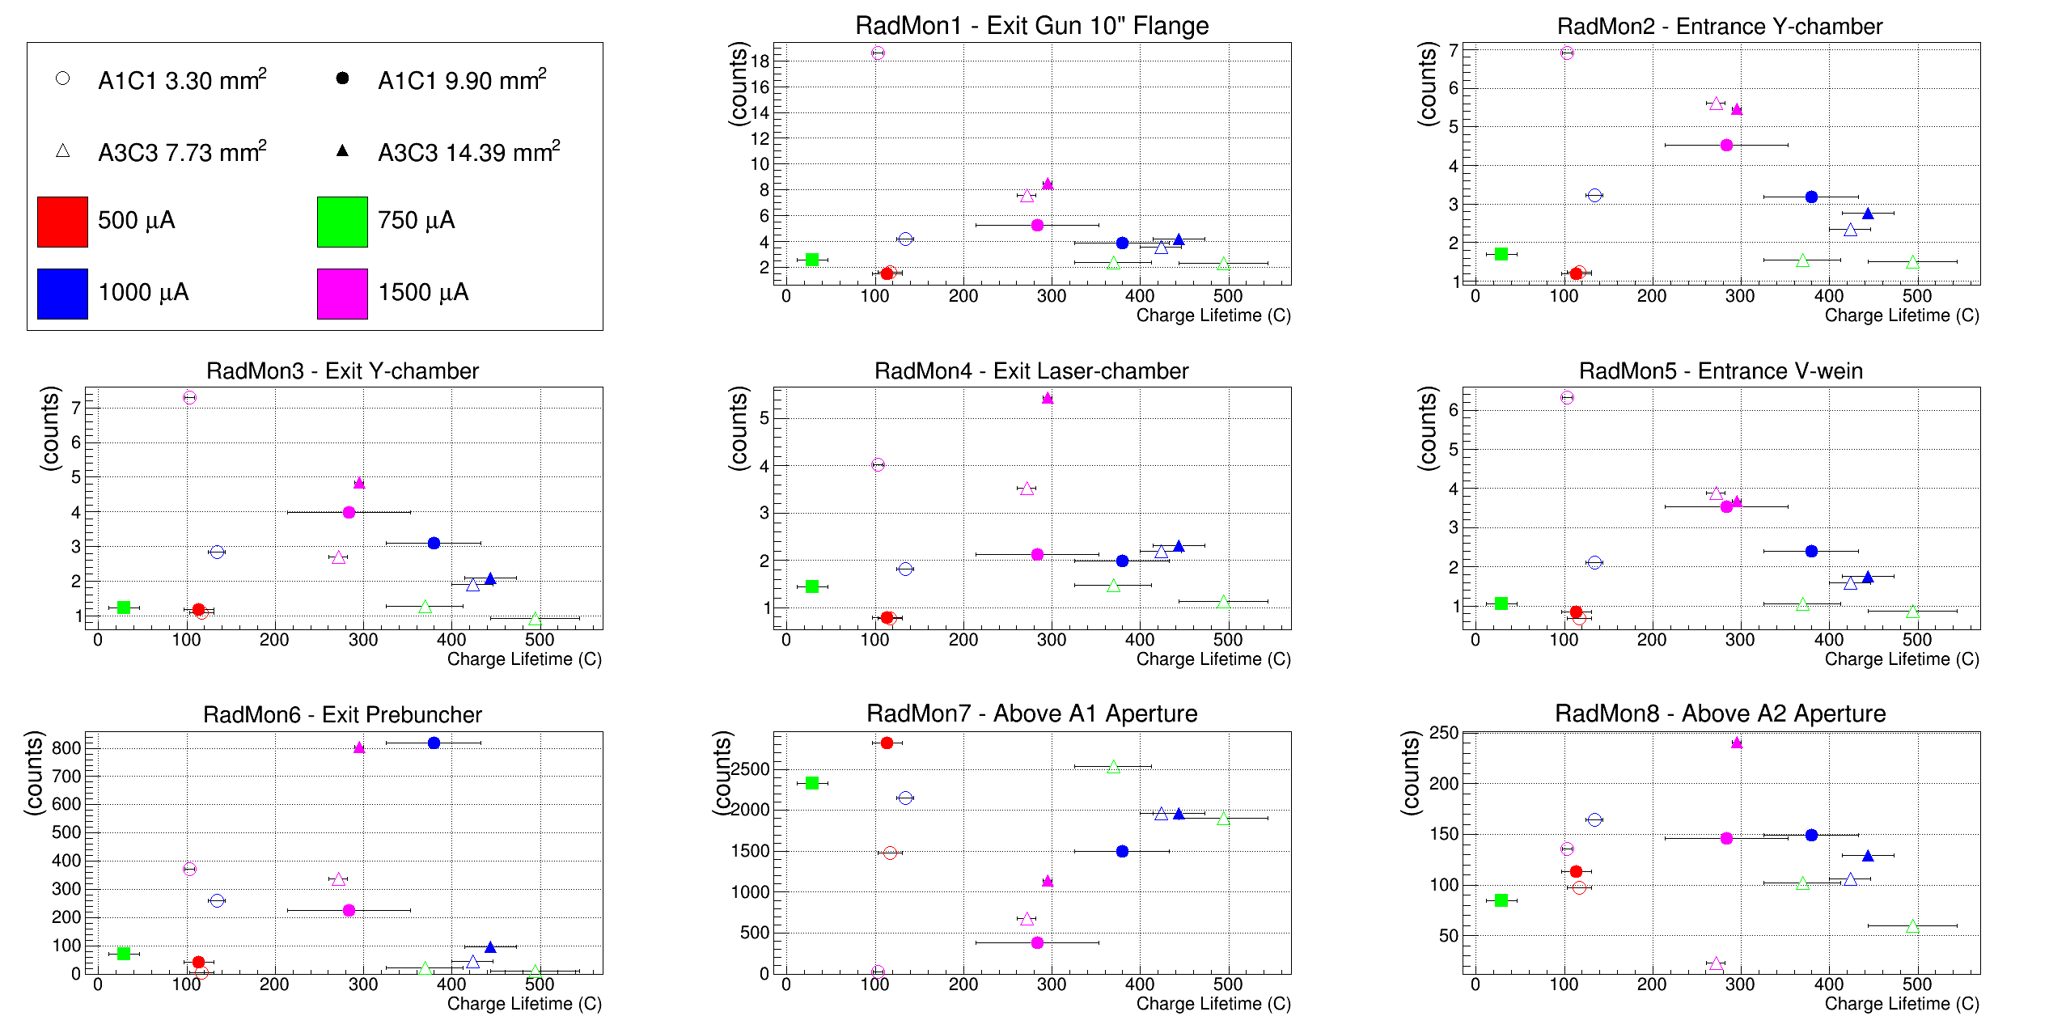
Radiation Level vs. Lifetime
The best charge lifetime is achieved when x-ray levels are smallest.

Slide 19
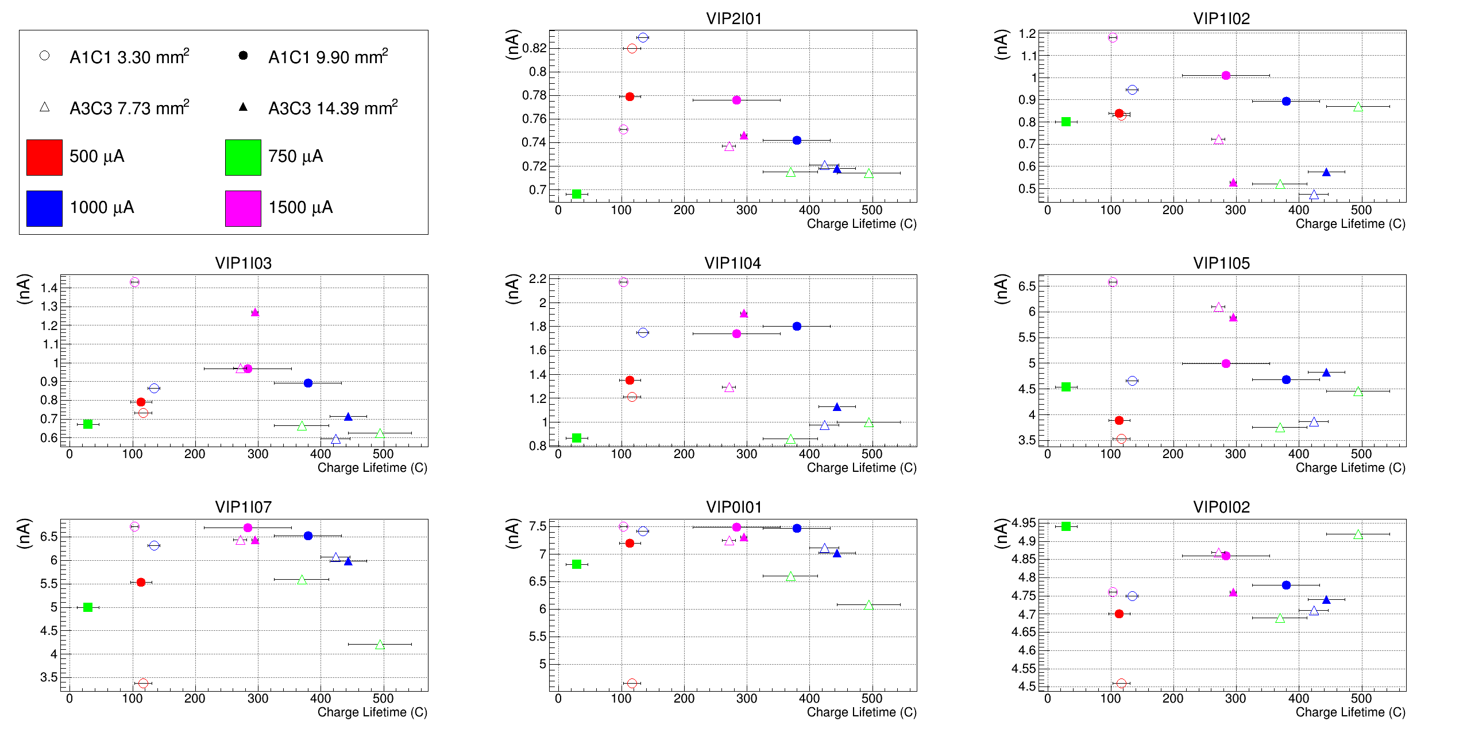
Vacuum vs. Lifetime
Correlation of vacuum with charge lifetime most evident near the Gun
Vacuum levels generally not as sensitive as x-ray levels

Slide 20

First Results: GaAs/GaAsP at mA Current
1 mA for 7 days is 600 C
1mA(2007)
CEBAF
4mA(2011)
  CEBAF charge lifetime improves with spot size, as expected, but eventually beam size becomes “too large”
  Laser diameters greater than ~4 mm (4 sigma) will require properly designed cathode/anode electrodes, to ensure 100% transmission, to maintain excellent vacuum, to minimize ion bombardment

Slide 21
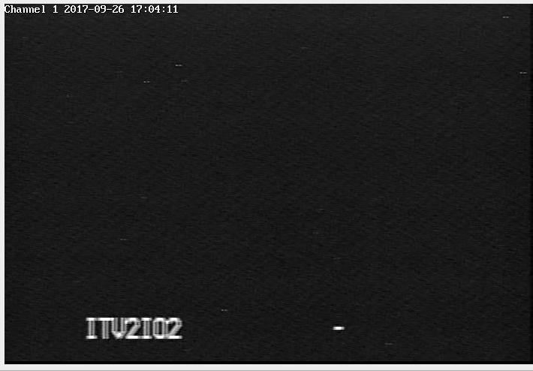
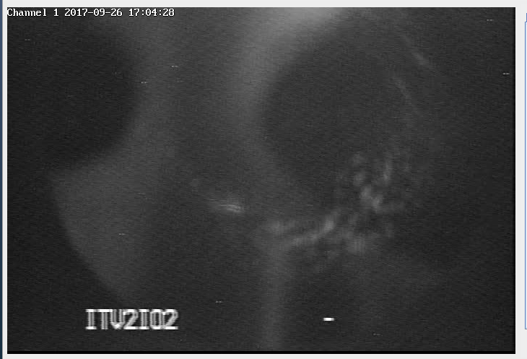
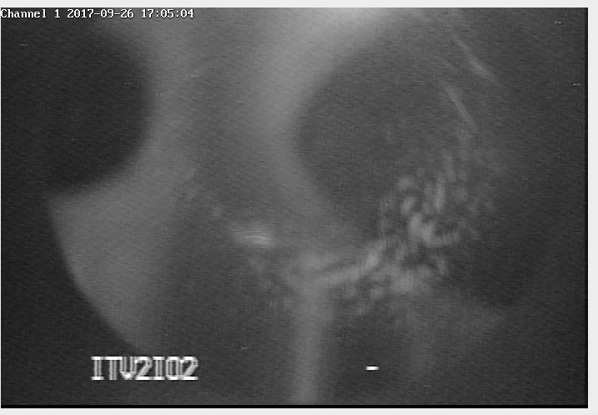
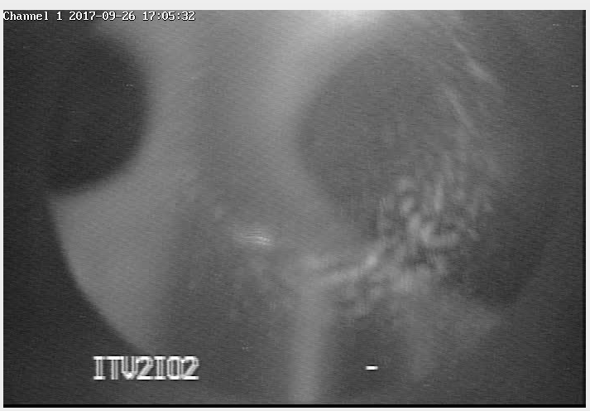
Managing Laser Power to Improve Charge Lifetime
A large fraction of laser light (33%) is reflected from GaAs leading to the possibility of “stray” electrons, a bad thing…
The remaining light is mainly absorbed in GaAs substrate, leading to heating, also a bad thing…
Laser OFF
100 mW
(6mA/%/W)
I = 1 mA
&
QE < 1%
=> P > ~100’s mW
200 mW
300 mW

Slide 22
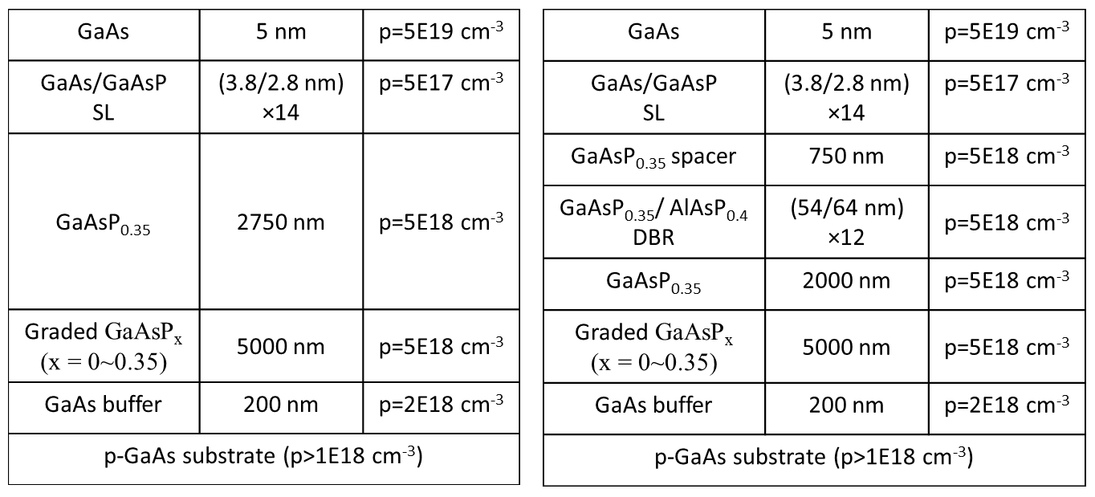
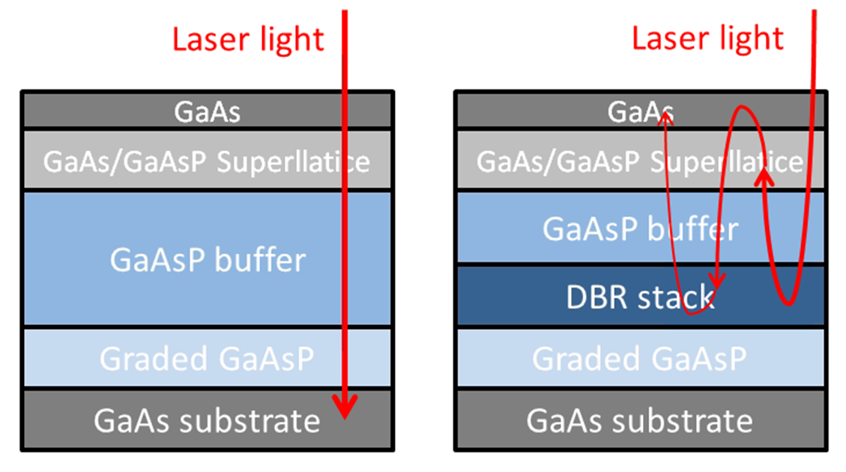
Benefits of Distrubted Bragg Reflector (DBR)
non-DBR Photocathode : absorption in the GaAs/GaAsP superlattice < 5%
  Most light passes into the substrate leading to unwanted heating
DBR photocathode : absorption in the GaAs/GaAsP superlattice > 20%
  Less light required to make required beam, less light means less heat
Promising for high current initiatives like polarized positrons at CEBAF and EIC
Enhanced absorption occurs only at specific laser wavelengths
Photocathode without DBR
Photocathode with DBR
(57 layers!)
Non-DBR photocathode
DBR photocathode

Slide 23
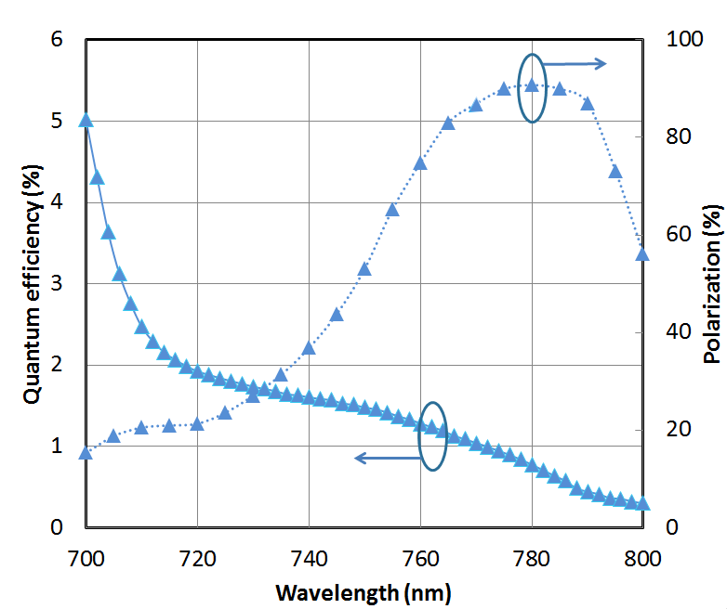
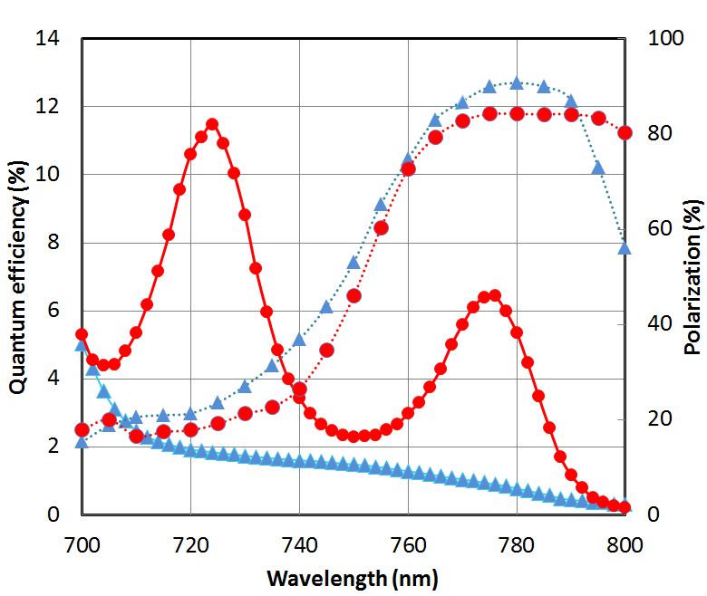
World Record QE from High Polarization Photocathode
Others have tried…but very difficult to obtain QE enhancement at the laser wavelength that also provides high polarization, CEBAF lasers operate at ~ 776 nm (doubled-telecom lasers)
Standard strained-superlattice
  QE = 0.89%
  Polarization = 92%
DBR
  QE = 6.4%
  Polarization = 84%
The highest reported QE of any high polarization photocathode
Excellent candidate for mA operations, will test at CEBAF this shutdown
SBIR partnership
W. Liu, S. Zhang, M. Stutzman, M. Poelker, Y. Chen, W. Lu, and A. Moy, Appl. Phys. Lett. 109, 252104 (2016)

Slide 24
GaAs Photocathode Polarization vs. Time
Strained Superlattice GaAs/GaAsP
Bulk GaAs
Strained GaAs
SLSP-DBR
100 nm
100 nm
14 Layers
30 mA/W
1 mA/W
6 mA/W
30 mA/W
?
P_{e-} 35% 35% 75% 75% 85% 89%
I_{e-} 30μA 100μA 50μA 100μA 150μA 200μA
1995 1998 1999 2000 2004 2017
Photocathode capability (polarization and QE) has grown significantly.

Slide 25
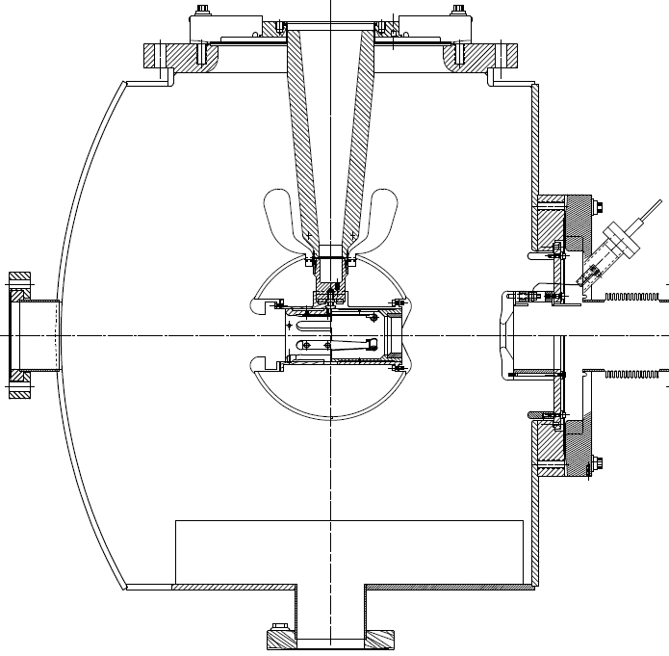

Inverted-Insulator Photoguns
with optimized triple point shields and mildly conductive insulators
CEBAF 200 kV Gun
350 kV gun for GTS and UITF
Both designs, maximum field strength < 10 MV/m
Notes:
Interior Page Design 2

Slide 26
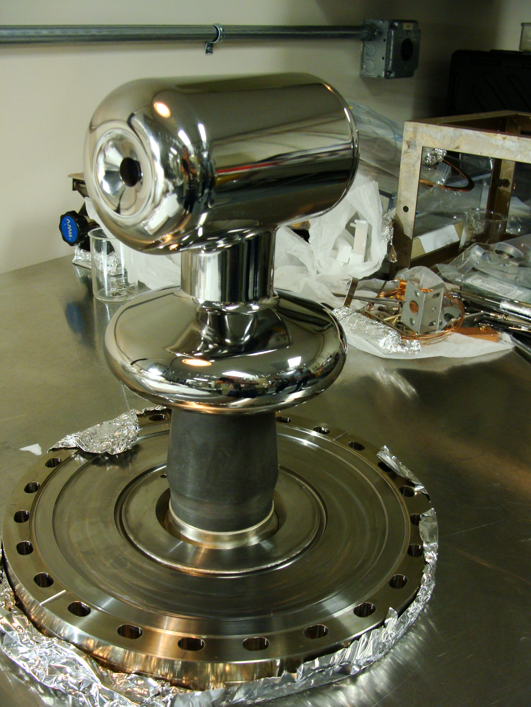
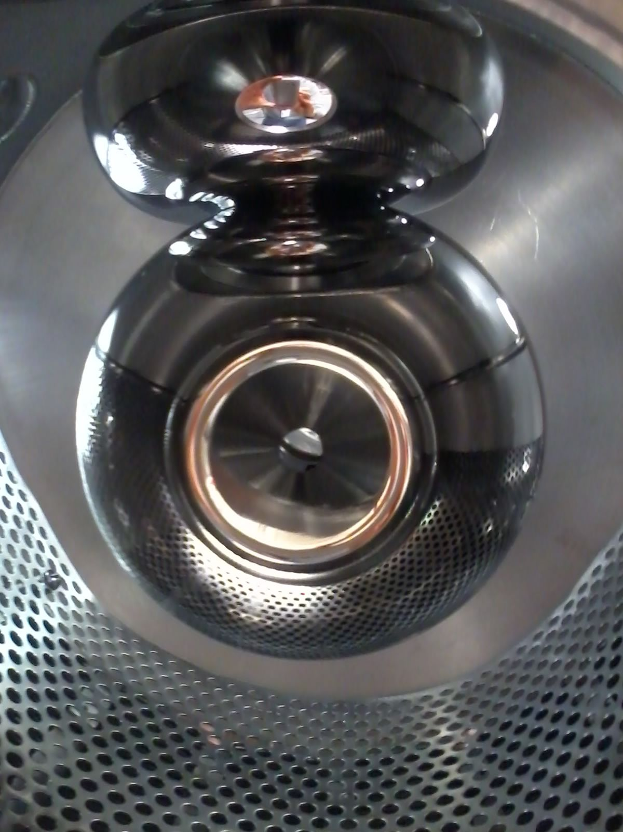
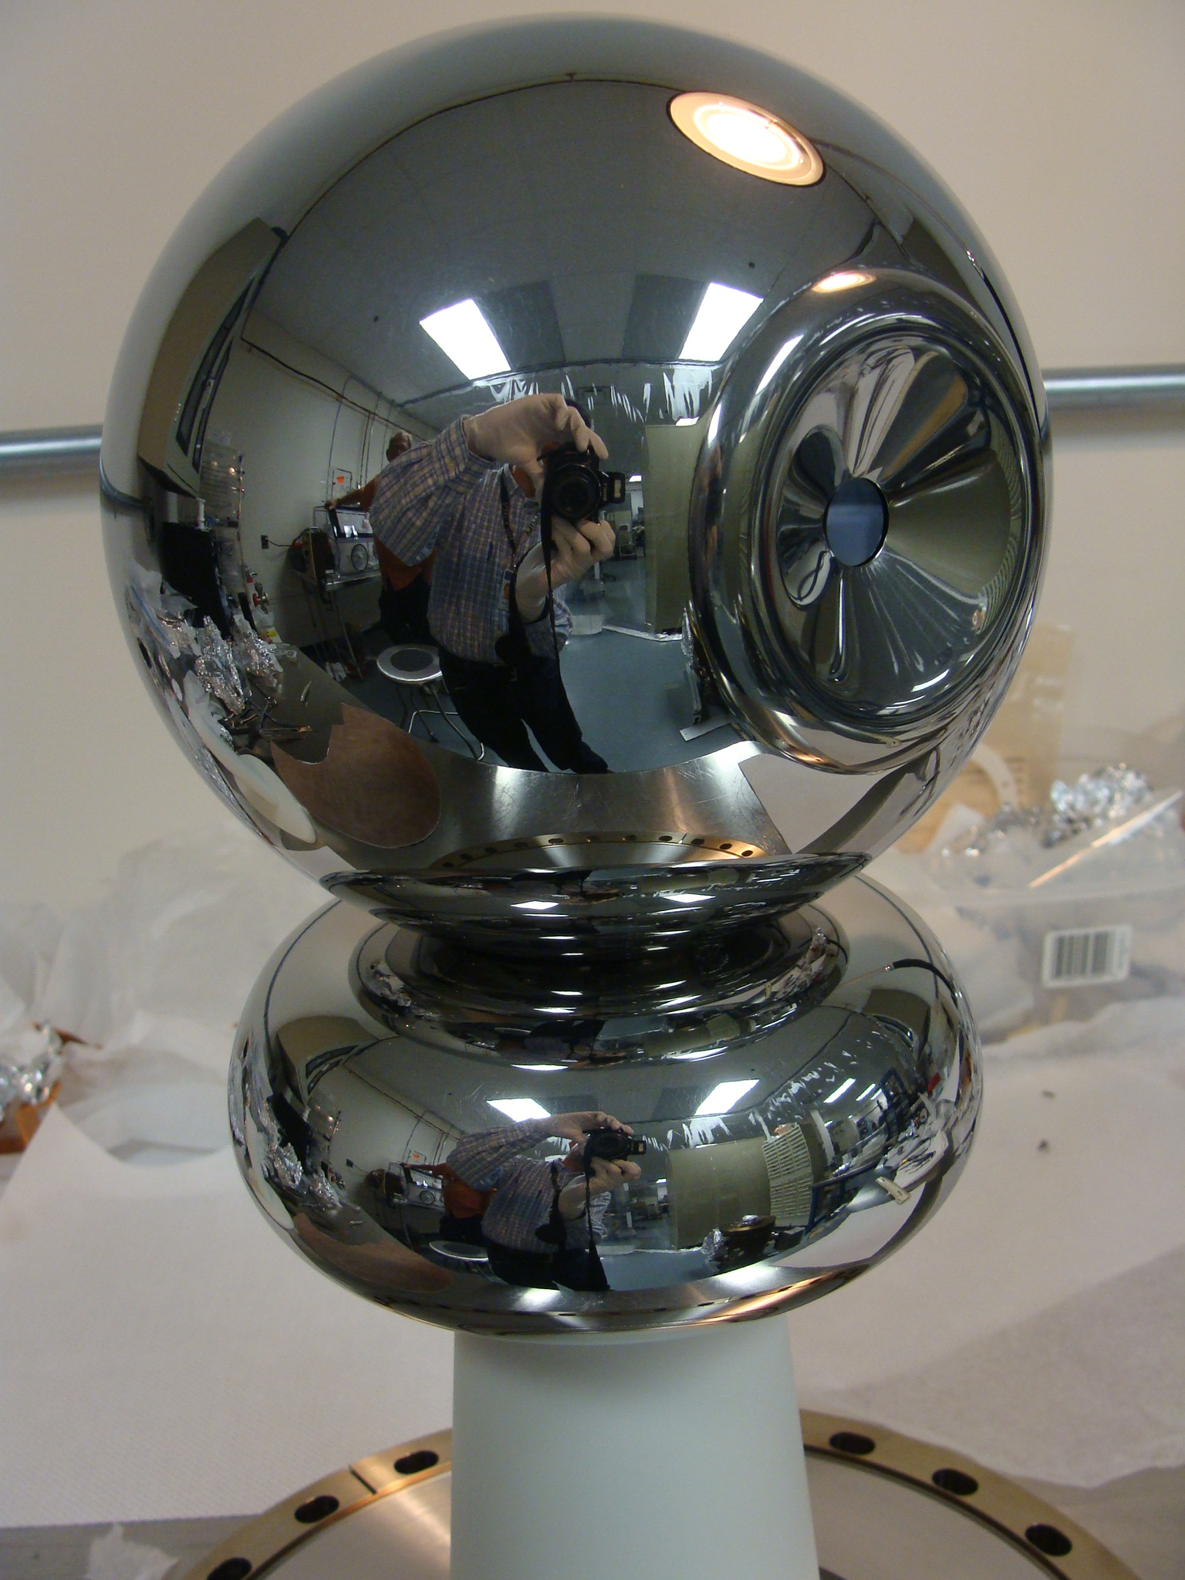
3 photoguns with barrel polished electrodes
CEBAF 200 kV
Installed June 2018
Commissioning now.
GTS 350 kV
In operation since Nov. 2016 with CsK₂Sb photocathode:
500 uA magnetized beam
4.5 mA non-magnetized
UITF 350 kV
Polarized Gun
Under assembly

Slide 27
Summary
Extending the charge lifetime of today’s spin polarized GaAs photoguns from tens to thousands of Coulombs is a requirement for extended uninterrupted operation at milliampere beam current
These new results demonstrate highest charge lifetime from high polarization GaAs/GaAsP photocathodes by increasing laser spot sizes using at mA current but…
Managing ALL of the beam remains essential. These results suggest CEBAF gun requires larger electrodes for sustainable milliampere operation
New DBR photocathode is an excellent candidate for high current (mA) polarized electron beam initiatives. Lifetime tests at CEBAF to happen soon, during this shutdown
Managing application of high voltage to the cathode and eliminating field emission are essential for achieving long charge lifetime
Importantly, realistic dynamic lifetime models are critically needed to to separate and understand the dependencies of operational gun conditions.

Slide 28
Backup Slides

Slide 29
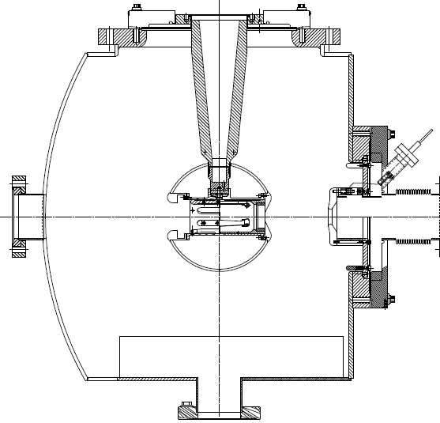
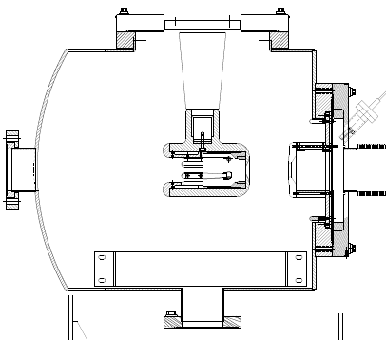
Inverted Insulator Photoguns
CEBAF 130 kV, used since 2010
350 kV gun for GTS and UITF
Longer “R30” insulator
Spherical electrode

Slide 30
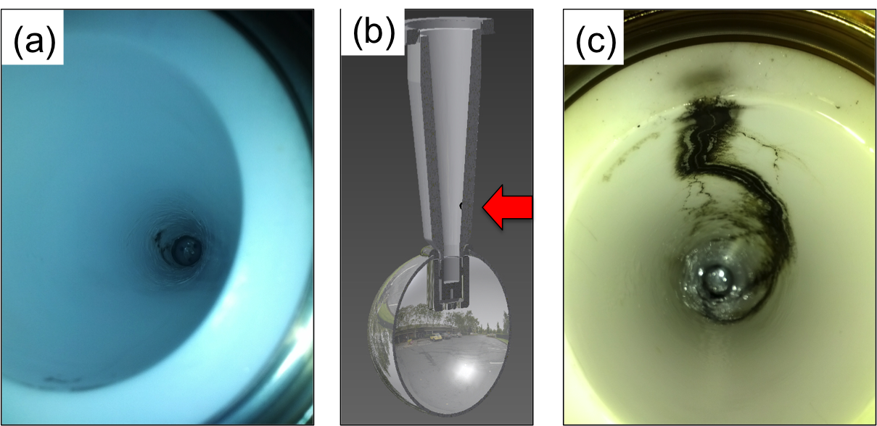
The Reality of HV Breakdown
The first test with R30 pure alumina ceramic suffered breakdown at ~315kV with subsequent puncture at 330kV.
A second test with a new R30 pure alumina suffered breakdown at ~315 kV.
Field emission managed via krypton-processing*, i.e., voltage was applied with ~10⁻⁵ Torr krypton added to gun chamber
* M. BastaniNejad, A. A. Elmustafa, E. Forman, J. Clark, S. Covert, J. Grames, J. Hansknecht, C. Hernandez-Garcia, M. Poelker and R. Suleiman, “Improving the performance of stainless-steel DC high voltage photoelectron gun cathode electrodes via gas conditioning with helium or krypton,” Nucl. Instr. and Meth. in Phys. Res. A, Vol. 762, pp. 135–141, 2014

Slide 31
Careful design of triple-junction-shield
Gradients shown for 350 kV
HV plug
Ceramic
Design overall shape for low gradient here !!
Simulationsby Y. Wang

Slide 32
The ultimate metric of success: High Voltage
Reached
360 kV in 70 hours
10 MV/m at 350 kV
Vacuum and radiation levels indistinguishable from bkgd at 350kV

Slide 33
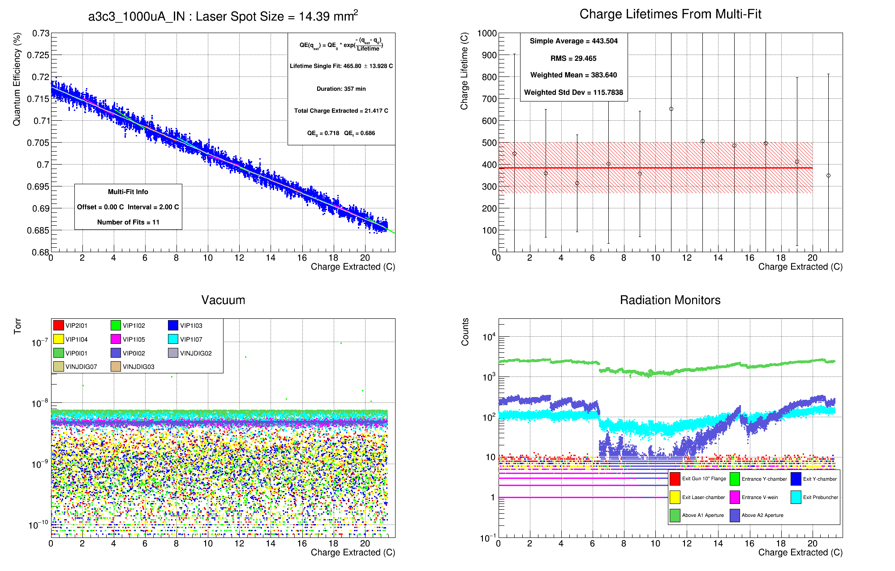
Example Lifetime Run (1 mA ,14mm²)

Slide 34
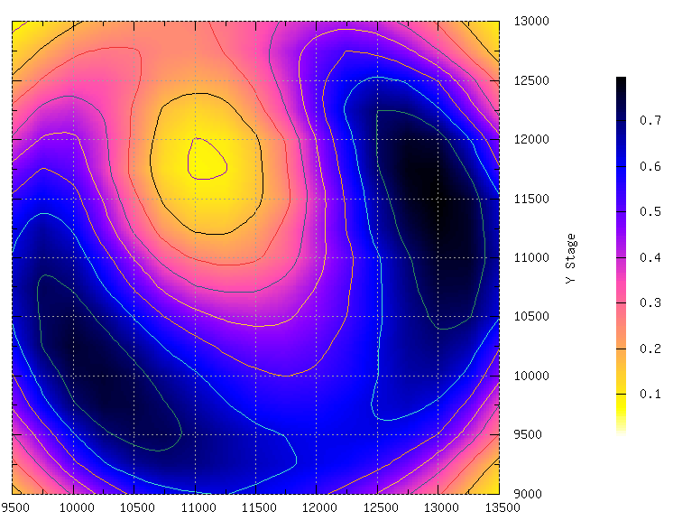
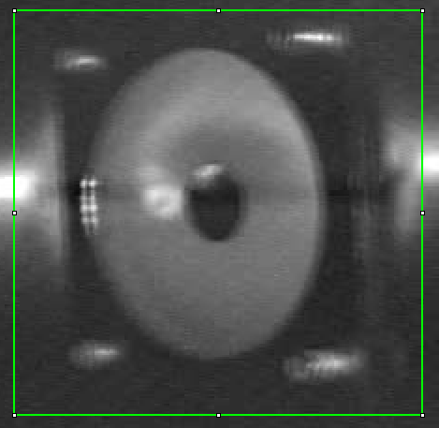
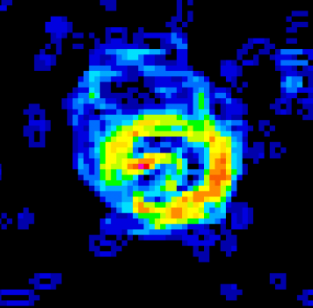
Photocurrent Dependence of Laser Profile
The scaling of photocathode lifetime, however, depends on the convolution of the laser profile and the changing photocathode QE.
The QE hole at the electro-static center (left) is imaged on a view screen (right) when using a laser with a diameter than a very “deep” QE hole.

Slide 35
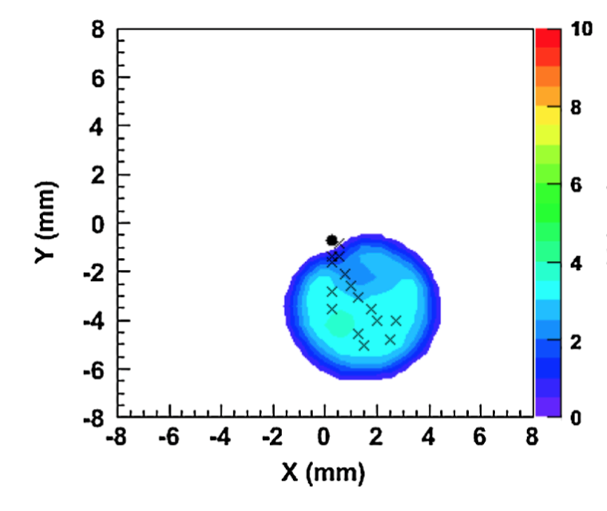
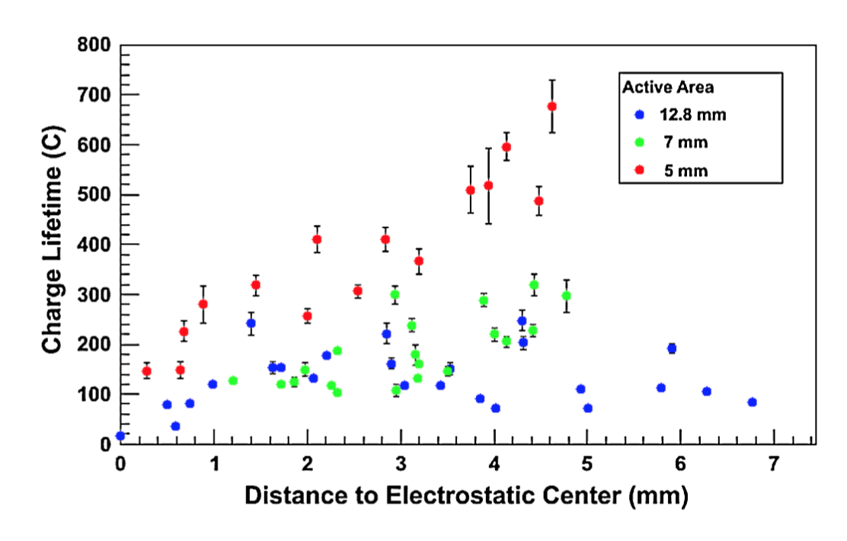
Lifetime Dependence of Laser Position/Profile
Dependence on proximity to the electro-static center has been thoroughly measured with bulk GaAs.
We have begun a similar study...when CEBAF operations permit.
size
Bulk GaAs, 532nm
5mm active area
positon
PHYSICAL REVIEW SPECIAL TOPICS - ACCELERATORS AND BEAMS 14, 043501 (2011)

Slide 36
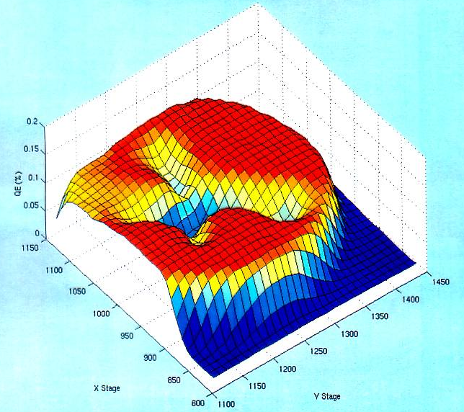
Pragmatically Avoiding the “EC”
We don’t run beam from the electrostatic center of the cathode/anode
Laser spot diameter <1 mm can be moved to different locations on the photocathode (5mm)
Electrons
OUT
Laser
IN
Gas
Ions create QE trough to electrostatic center
Here, QE ion damage forms QE trough from four spots to EC.

