Slide 1
CEBAF New Wien Control
How to Wien Voltage and Magnetic Field
Riad Suleiman

Slide 2





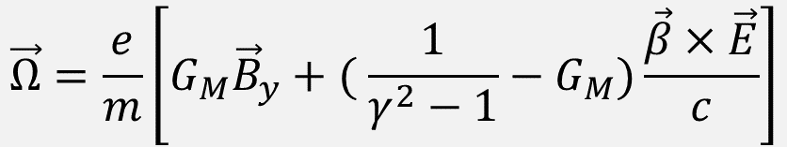

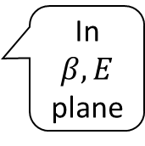




BMT Spin Equation
In a Wien Filter with electric and magnetic fields transverse to electron beam velocity, spin precession relative to momentum in lab frame is given by following form of generalized Thomas-BMT equation:
$$\vec{Ω}=\frac{e}{m}\left[G_{M}{\vec{B}}_{y}+( {\frac{1}{γ^{2}−1}−G}_{M})\frac{\vec{β}×\vec{E}}{c}\right]$$
$$\vec{Ω}={\vec{Ω}}_{B}+{\vec{Ω}}_{E}$$
Left
Spin Precession Angle:
Time-of-Flight of electron beam in Wien determined by E-Field:
$$θ=\vec{Ω} T$$
$$F_{E}$$
$$F_{B}$$
$$\vec{β}$$
$$\vec{E}$$
$${\vec{Ω}}_{B}+{\vec{Ω}}_{E}$$
In $β,E$ plane
$$\vec{S}$$
$$T=L_{E}/(βc)$$
Right
$$\vec{B}(+I)$$
Down

Slide 3

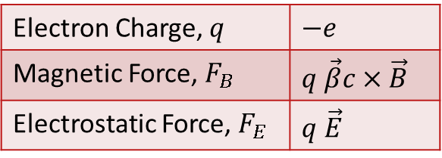

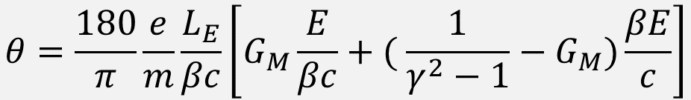
Electromagnetic Forces
Electron Charge, $q$ | $$−e$$
Magnetic Force, $F_{B}$ | $$q \vec{β}c×\vec{B}$$
Electrostatic Force, $F_{E}$ | $$q \vec{E}$$
$$B=E/(βc)$$
$$V=Eg/2$$
c = 299792458.0 Speed of Light (m/s)
e = 1.602176e-19 Electron Charge (C)
mc² = 510998.950 Electron Mass (eV)
G_{M} = 0.00115965218091 Electron Anomalous Magnetic Moment
e/m = 1.758820088e+11 Electron Cyclotron Frequency/Field (rad/(s T))
L_{E} = 3.120e-01 Electric Field Effective Length (m)
L_{B} = 3.105e-01 Magnetic Field Effective Length (m)
g = 1.5e-02 Wien Gap (m)
E Electric Field Strength (V/m or N/C)
B Magnetic Field (T or N⋅s/(C m))
V Plate Voltage on Beam Left
$$θ=\frac{180}{π}\frac{e}{m}\frac{L_{E}}{βc}\left[G_{M}\frac{E}{βc}+( {\frac{1}{γ^{2}−1}−G}_{M})\frac{βE}{c}\right]$$

Slide 4
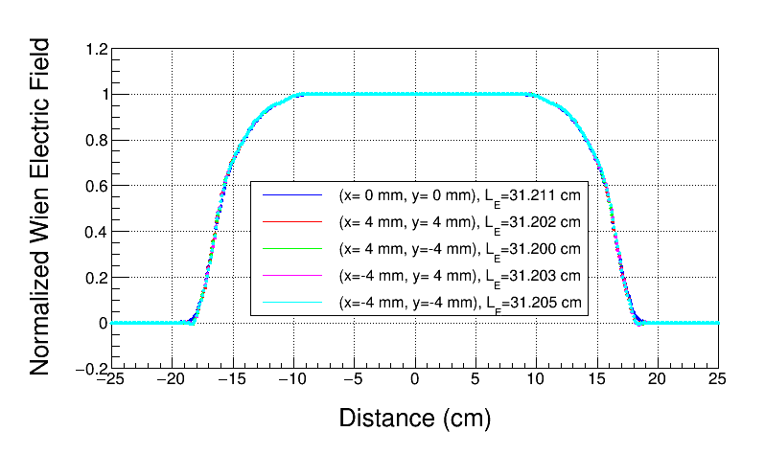
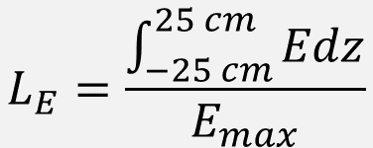
Electric Field Effective Length
$$L_{E}=\frac{\int_{−25 cm}^{25 cm}{Edz}}{E_{max}}$$
CST model based on actual CEBAF drawings (faceted)

Slide 5
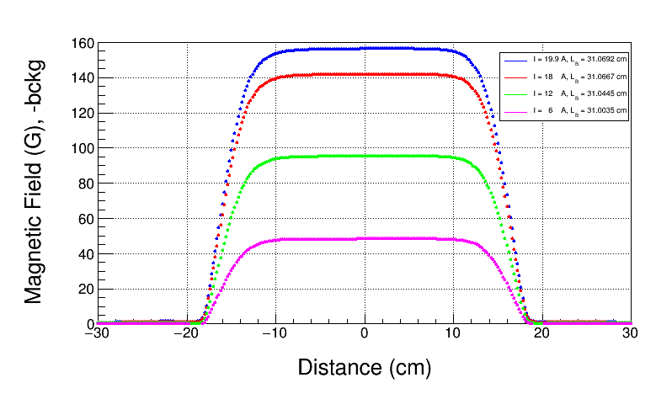
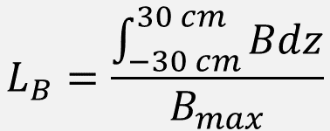
Magnetic Field Effective Length
$$L_{B}=\frac{\int_{−30 cm}^{30 cm}{Bdz}}{B_{max}}$$

Slide 6


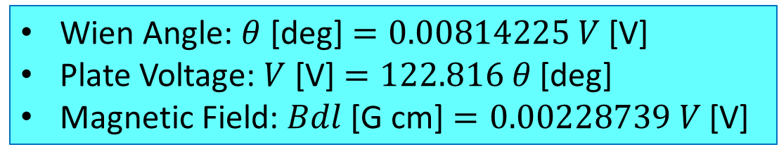
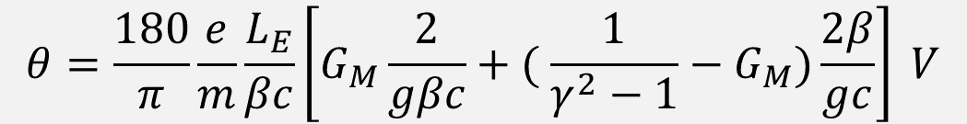
Wien Equations (Gun HV = 130 kV)
$$B=E/(βc)$$
$$V=Eg/2$$
$$θ=\frac{180}{π}\frac{e}{m}\frac{L_{E}}{βc}\left[G_{M}\frac{2}{gβc}+( {\frac{1}{γ^{2}−1}−G}_{M})\frac{2β}{gc}\right] V$$
Wien Angle: $θ$ [deg] $=0.00814225 V$ [V]
Plate Voltage: $V$ [V] $=122.816 θ$ [deg]
Magnetic Field: $Bdl$ [G cm] $=0.00228739 V$ [V]

Slide 7
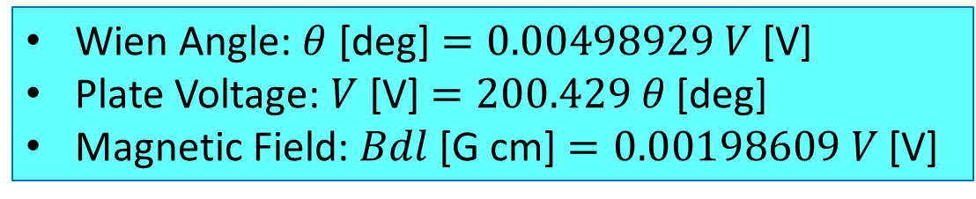
Wien Equations (Gun HV = 200 kV)
$$B=E/(βc)$$
$$V=Eg/2$$
$$θ=\frac{180}{π}\frac{e}{m}\frac{L_{E}}{βc}\left[G_{M}\frac{2}{gβc}+( {\frac{1}{γ^{2}−1}−G}_{M})\frac{2β}{gc}\right] V$$
Wien Angle: $θ$ [deg] $=0.00498929 V$ [V]
Plate Voltage: $V$ [V] $=200.429 θ$ [deg]
Magnetic Field: $Bdl$ [G cm] $=0.00198609 V$ [V]

Slide 8
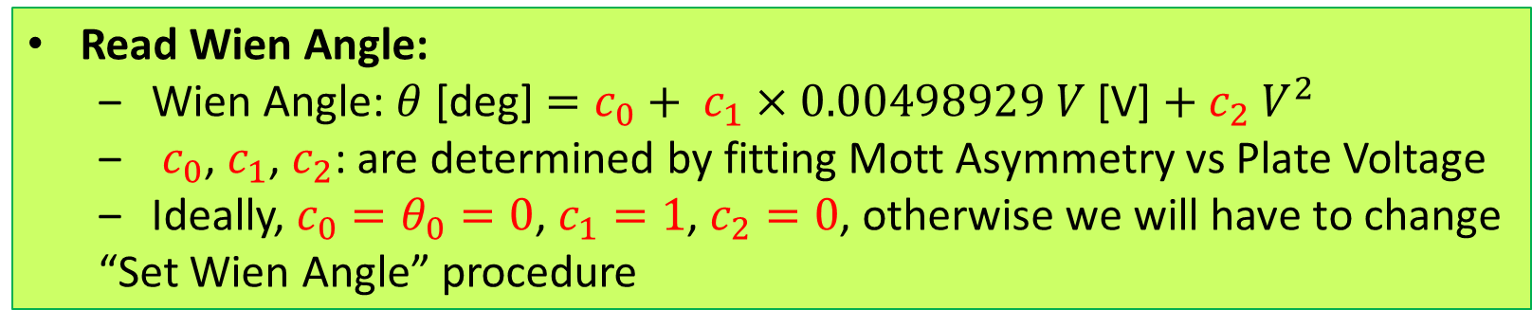
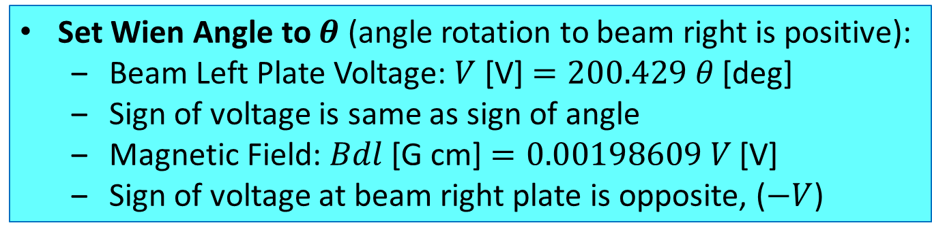
Wien Angle: Set and Readback (given here at 200 kV, as an example)
Set Wien Angle to $θ$ (angle rotation to beam right is positive):
  Beam Left Plate Voltage: $V$ [V] $=200.429 θ$ [deg]
  Sign of voltage is same as sign of angle
  Magnetic Field: $Bdl$ [G cm] $=0.00198609 V$ [V]
  Sign of voltage at beam right plate is opposite, ($−V$)
Read Wien Angle:
  Wien Angle: $θ$ [deg] $=c_{0}+ c_{1}×0.00498929 V$ [V] $+ c_{2} V^{2}$
  $c_{0}$, $c_{1}$, $c_{2}$: are determined by fitting Mott Asymmetry vs Plate Voltage
  Ideally, $c_{0}=θ_{0}=0$, $c_{1}=1$, $c_{2}=0$, otherwise we will have to change
  “Set Wien Angle” procedure

